Slide 1
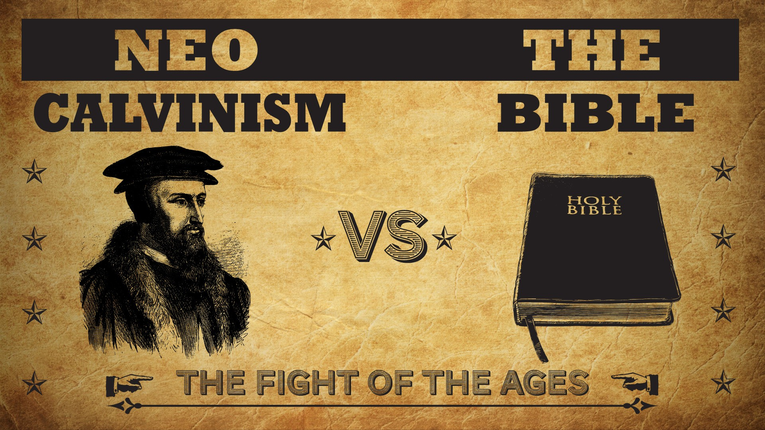
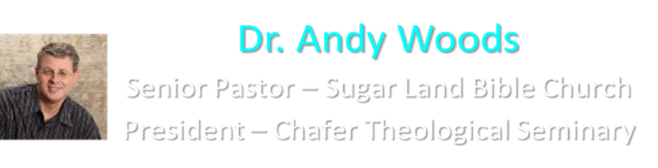

Slide 2
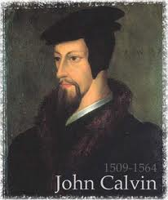
Neo-Calvinism vs. The Bible
Calvinism’s Mixed Blessing
Why Critique Calvinism?
The Source of Calvin’s Theology
Calvin’s Manner of Life
TULIP Through the Grid of Scripture
Conclusion

Slide 3
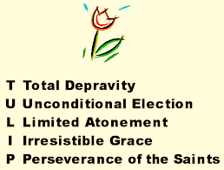
V. Running TULIP Through the Grid of Scripture
Total Depravity
Unconditional Election
Limited Atonement
Irresistible Grace
Perseverance of the Saints

Slide 4
Perseverance of the Saints
Calvinistic definition
Examples
Problems with the Calvinistic understanding

Slide 5
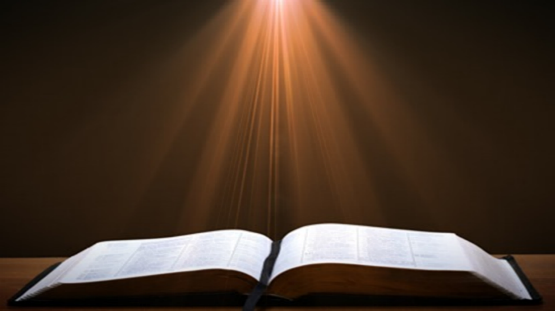
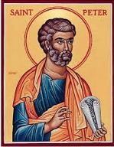
1 Peter 1:4-5
“⁴ to obtain an inheritance which is imperishable and undefiled and will not fade away, reserved in heaven for you, ⁵ who are protected by the power of God through faith for a salvation ready to be revealed in the last time.”

Slide 6
Perseverance of the Saints = Perseverance in Good Works to the End of One’s Life to Prove that He is One of the Elect
“P” stands for “Perseverance of the Saints.” This is what Calvinists say gives them the assurance of eternal security, but in actuality “the emphasis is upon the believer’s faithfulness in persevering—not upon God’s keeping power … uncertainty as to one’s ultimate salvation is, in fact, built into the very fabric of Calvinism itself.”
Bob Kirkland, Calvinism: None Dare Call It Heresy; Spotlight on the Life and Teachings of John Calvin (Eureka, MT: Lighthouse Trails, 2018), 34.

Slide 7
Perseverance of the Saints
Calvinistic definition
Examples
Problems with the Calvinistic understanding

Slide 8


John Calvin
John Calvin, Calvin’s Calvinism: God’s Eternal Predestination and Secret Providence (Reformed Free Publishing Association, Kindle edition from the 2009 2nd edition), Kindle location 532.
Calvin said: “[T]hose who do not persevere unto the end belong not to the calling of God. The Fall of Adam was not by accident, nor by chance, but was ordained by the secret counsel of God.”

Slide 9
Perseverance of the Saints
Calvinistic definition
Examples
Problems with the Calvinistic understanding

Slide 10
Problems with the Calvinistic Perseverance Definition
Final salvation is unbiblical
Scriptural examples of non-persevering saints
Support only found in out of context verses
Subtle form of works salvation
Preferability of immediate death following conversion?
Lessens the importance of practical sanctification
Lessens the importance of the Bema Seat warnings
Destroys the assurance of salvation

Slide 11
Destroys the Assurance of Salvation
The Biblical View of the Assurance of Salvation
Examples of How the “Perseverance of the Saints” Destroys the Assurance of Salvation
Calvinism’s “Two Kinds of Faith” Doctrine damages the Assurance of Salvation

Slide 12
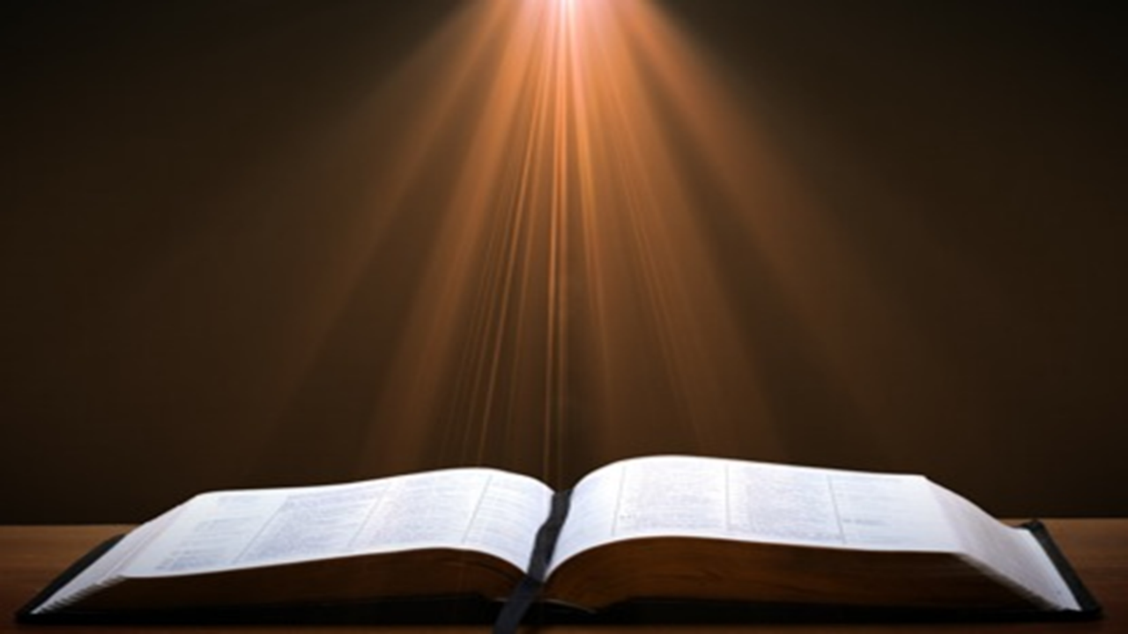

1 John 5:13
“These things I have written to you who believe in the name of the Son of God, so that you may know that you have eternal life.”

Slide 13

Lewis Sperry Chafer, Salvation: A Clear Doctrinal Analysis (Grand Rapids: Zondervan, 1977), 60. Italics added
Lewis Sperry Chafer
“There is a normal Christian experience. There are new and blessed emotions and desires. Old things do pass away; and behold all things do become new; but all such experiences are but secondary evidences, as to the fact of salvation, in that they grow out of that positive repose of faith which is the primary evidence.”

Slide 14
Destroys the Assurance of Salvation
The Biblical View of the Assurance of Salvation
Examples of How the “Perseverance of the Saints” Destroys the Assurance of Salvation
Calvinism’s “Two Kinds of Faith” Doctrine damages the Assurance of Salvation

Slide 15
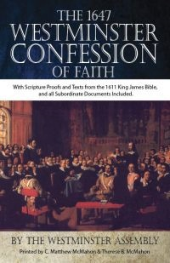
Westminster Confession Chapter XVIII, Article III – Of the Assurance of Grace and Salvation
“This infallible assurance doth not so belong to the essence of faith, but that a true believer will wait long, and conflict with many difficulties before he be a partaker of it.”

Slide 16
Destroys the Assurance of Salvation
The Biblical View of the Assurance of Salvation
Examples of How the “Perseverance of the Saints” Destroys the Assurance of Salvation
Calvinism’s “Two Kinds of Faith” Doctrine damages the Assurance of Salvation

Slide 17
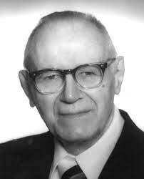
William Hendriksen
William Hendriksen, A Commentary on the Gospel of John, 3d ed. (London: Banner of Truth Trust, 1964), p. 127. (1978). Bibliotheca Sacra, 135. (1978). Bibliotheca Sacra, 135.
“Many trusted in his name; i.e., because of the manner in which his power was displayed they accepted him as a great prophet and perhaps even as the Messiah. This, however, is not the same as saying that they surrendered their hearts to him. Not all faith is saving faith...”

Slide 18
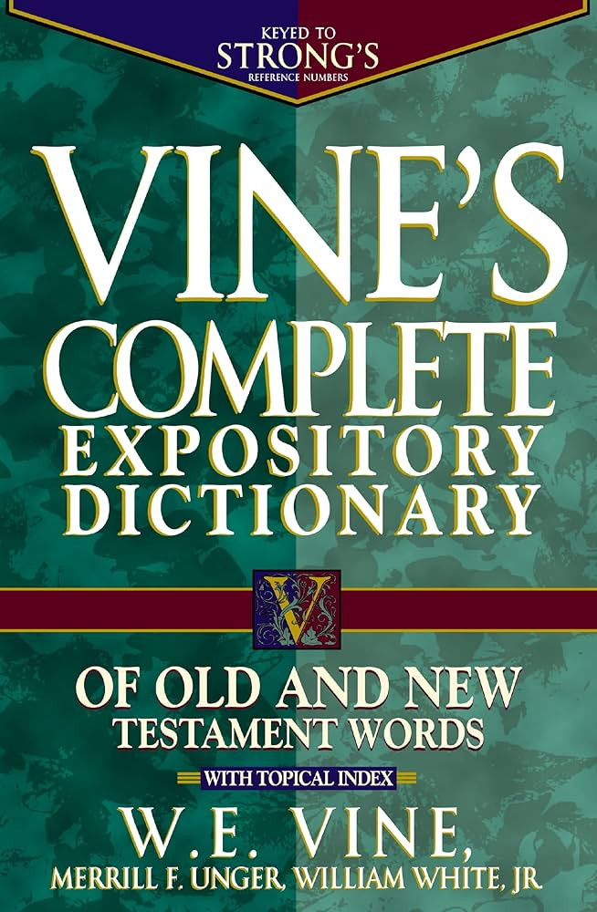
“Believe” Defined
“pisteuō…’to believe,’ also ‘to be persuaded of,’ and hence, ‘to place confidence in, to trust,’ signifies, in this sense of the word, reliance upon, not mere credence. It is most frequent in the writings of the apostle John, especially the Gospel. He does not use the noun…Of the writers of the Gospels…uses of the verb…John ninety-nine.”
W. E. Vine, Merrill F. Unger, and William White, Vine's Complete Expository Dictionary of the Old and New Testament Words (Nashville: Nelson, 1996), 61.

Slide 19
Romans 4:5
“But to the one who does not work, but believes in Him who justifies the ungodly, his faith is credited as righteousness.”

Slide 20

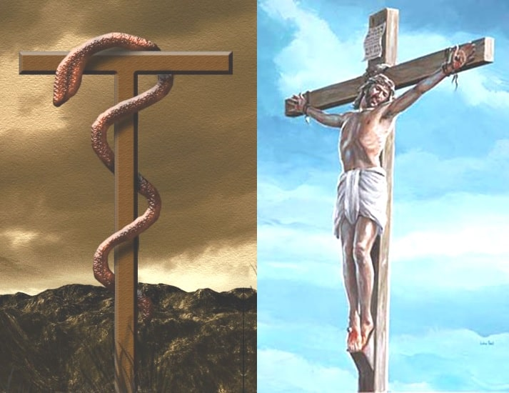
John 3:14-15
“¹⁴ As Moses lifted up the serpent in the wilderness, even so must the Son of Man be lifted up; ¹⁵ so that whoever believes will in Him have eternal life.”

Slide 21
Numbers 21:8-9
“⁸ Then the Lord said to Moses, ‘Make a fiery serpent, and set it on a standard; and it shall come about, that everyone who is bitten, when he looks at it, he will live.’ ⁹ And Moses made a bronze serpent and set it on the standard; and it came about, that if a serpent bit any man, when he looked to the bronze serpent, he lived.”

Slide 22
Robert Gromacki
Salvation is Forever, p. 88
“How many times did the people have to look at the serpent to be healed? Just once. One look prompted by faith was enough. So it is with Calvary. How many times must one look at Christ in faith to be saved? Just once. The faith that heals or saves is an act, a completed event, not an attitude.”
Robert Gromacki, Salvation Is Forever (Schaumburg, IL: Regular Baptist Press, 1989), 88.

Slide 23

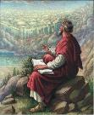
John 20:30-31
“Therefore many other signs Jesus also performed in the presence of the disciples, which are not written in this book; but these have been written so that you may believe that Jesus is the Christ, the Son of God; and that believing you may have life in His name.”

Slide 24
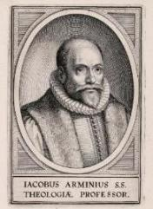
John 20:30-31?
Present tense participle “believing” – John 3:16, 18; 5:24
Abuse of the present tense
Present tense does not always require continual behavior
Mark 6:14
John the “the one continually baptizing?”
John already dead!
Not describing continual baptizing
Just describing him
How many times do you have to MURDER before you are a MURDERER? Once! Same with a FISHERMAN & BELIEVER

Slide 25
John 20:30-31?
Does not preclude ongoing faith but does not require it
Other verb forms also used to describe belief (John 8:30-31)
It is possible for a Christian to struggle with faith
2 Tim. 2:13 – “faithless” = unbelieving
Jas. 1:5-8
Peter’s sinking and three-fold denial
Luke 22:31-32
Is unbelief the unpardonable sin?

Slide 26
John 20:30-31?
Present tense participle “believing” – John 3:16, 18; 5:24
Abuse of the present tense
Present tense does not always require continual behavior
Mark 6:14
John the “the one continually baptizing?”
John already dead!
Not describing continual baptizing
Just describing him
How many times do you have to MURDER before you are a MURDERER? Once! Same with a FISHERMAN & BELIEVER

Slide 27
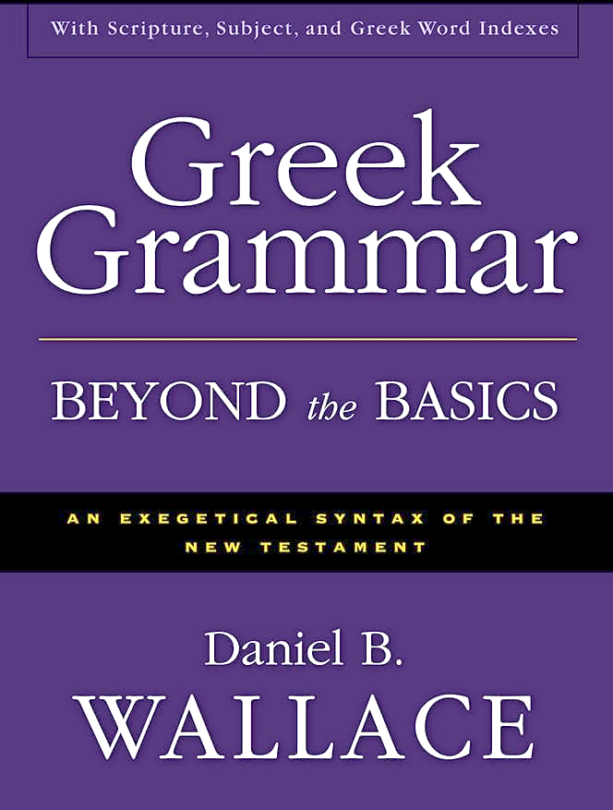
Believing Forever? – No! Take Off Your Theological Lenses!
“The aspectual force of the present ho pisteuōn seems to be in contrast with ho pisteusas…The present was the tense of choice most likely because the NT writers by and large saw continual belief as a necessary condition of salvation. Along these lines, it seems significant that the promise of salvation is almost always given to ho pisteuōn, almost never to ho pisteusas…”
Daniel B. Wallace, Greek Grammar Beyond the Basics: An Exegetical Syntax of the New Testament with Scripture, Subject, and Greek Word Indexes (Grand Rapids: Zondervan, 1996), 621, n. 22.

Slide 28
John 20:30-31?
Present tense participle “believing” – John 3:16, 18; 5:24
Abuse of the present tense
Present tense does not always require continual behavior
Mark 6:14
John the “the one continually baptizing?”
John already dead!
Not describing continual baptizing
Just describing him
How many times do you have to MURDER before you are a MURDERER? Once! Same with a FISHERMAN & BELIEVER

Slide 29
John 20:30-31?
Present tense participle “believing” – John 3:16, 18; 5:24
Abuse of the present tense
Present tense does not always require continual behavior
Mark 6:14
John the “the one continually baptizing?”
John already dead!
Not describing continual baptizing
Just describing him
How many times do you have to MURDER before you are a MURDERER? Once! Same with a FISHERMAN & BELIEVER

Slide 30

Present Tense Participle Does Not Always Mean Forever
John 4:13 John 4:26 John 4:36 John 5:3 John 5:24 John 6:14 |  | John 11:26-27 Mark 6:14 Mark 14:20 Luke 16:18 Gal. 3:13
Bob Wilkin, “The One Who Believes: Is Continuous Faith Required to be Born Again?,” online: http://www.faithalone.org/magazine/y2006/06jf1.html, accessed 06 May 2015.

Slide 31

John 5:24
“Truly, truly, I say to you, he who hears My word, and believes Him who sent Me, has eternal life, and does not come into judgment, but has passed out of death into life.”

Slide 32
John 20:30-31?
Present tense participle “believing” – John 3:16, 18; 5:24
Abuse of the present tense
Present tense does not always require continual behavior
Mark 6:14
John the “the one continually baptizing?”
John already dead!
Not describing continual baptizing
Just describing him
How many times do you have to MURDER before you are a MURDERER? Once! Same with a FISHERMAN & BELIEVER

Slide 33
Mark 6:14
“And King Herod heard of it, for His name had become well known; and people were saying, ‘John the Baptist (baptizō) has risen from the dead, and that is why these miraculous powers are at work in Him.’”

Slide 34
John 20:30-31?
Present tense participle “believing” – John 3:16, 18; 5:24
Abuse of the present tense
Present tense does not always require continual behavior
Mark 6:14
John the “the one continually baptizing?”
John already dead!
Not describing continual baptizing
Just describing him
How many times do you have to MURDER before you are a MURDERER? Once! Same with a FISHERMAN & BELIEVER

Slide 35
John 20:30-31?
Does not preclude ongoing faith but does not require it
Other verb forms also used to describe belief (John 8:30-31)
It is possible for a Christian to struggle with faith
2 Tim. 2:13 – “faithless” = unbelieving
Jas. 1:5-8
Peter’s sinking and three-fold denial
Luke 22:31-32
Is unbelief the unpardonable sin?

Slide 36
John 20:30-31?
Does not preclude ongoing faith but does not require it
Other verb forms also used to describe belief (John 8:30-31)
It is possible for a Christian to struggle with faith
2 Tim. 2:13 – “faithless” = unbelieving
Jas. 1:5-8
Peter’s sinking and three-fold denial
Luke 22:31-32
Is unbelief the unpardonable sin?

Slide 37
John 8:30-31
“As He spoke these things, many came to *believe in Him. So Jesus was saying to those Jews who had ⁺believed Him, “If you continue in My word, then you are truly disciples of Mine.”
* aorist active indicative
⁺ perfect active participle

Slide 38
John 20:30-31?
Does not preclude ongoing faith but does not require it
Other verb forms also used to describe belief (John 8:30-31)
It is possible for a Christian to struggle with faith
2 Tim. 2:13 – “faithless” = unbelieving
Jas. 1:5-8
Peter’s sinking and three-fold denial
Luke 22:31-32
Is unbelief the unpardonable sin?

Slide 39
John 20:30-31?
Does not preclude ongoing faith but does not require it
Other verb forms also used to describe belief (John 8:30-31)
It is possible for a Christian to struggle with faith
2 Tim. 2:13 – “faithless” = unbelieving
Jas. 1:5-8
Peter’s sinking and three-fold denial
Luke 22:31-32
Is unbelief the unpardonable sin?

Slide 40

2 Timothy 2:13
“If we are faithless [without faith], He remains faithful, for He cannot deny Himself.”

Slide 41
John 20:30-31?
Does not preclude ongoing faith but does not require it
Other verb forms also used to describe belief (John 8:30-31)
It is possible for a Christian to struggle with faith
2 Tim. 2:13 – “faithless” = unbelieving
Jas. 1:5-8
Peter’s sinking and three-fold denial
Luke 22:31-32
Is unbelief the unpardonable sin?

Slide 42
James 1:5-8
“But if any of you lacks wisdom, let him ask of God, who gives to all generously and without reproach, and it will be given to him. ⁶ But he must ask in faith without any doubting, for the one who doubts is like the surf of the sea, driven and tossed by the wind. ⁷ For that man ought not to expect that he will receive anything from the Lord, ⁸ being a double-minded man, unstable in all his ways.”

Slide 43
John 20:30-31?
Does not preclude ongoing faith but does not require it
Other verb forms also used to describe belief (John 8:30-31)
It is possible for a Christian to struggle with faith
2 Tim. 2:13 – “faithless” = unbelieving
Jas. 1:5-8
Peter’s sinking and three-fold denial
Luke 22:31-32
Is unbelief the unpardonable sin?

Slide 44
John 20:30-31?
Does not preclude ongoing faith but does not require it
Other verb forms also used to describe belief (John 8:30-31)
It is possible for a Christian to struggle with faith
2 Tim. 2:13 – “faithless” = unbelieving
Jas. 1:5-8
Peter’s sinking and three-fold denial
Luke 22:31-32
Is unbelief the unpardonable sin?

Slide 45
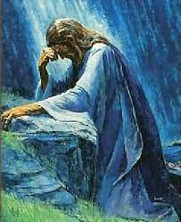
Luke 22:32
“but I have prayed for you, that your faith may not fail; and you, when once you have turned again, strengthen your brothers.”

Slide 46
John 20:30-31?
Does not preclude ongoing faith but does not require it
Other verb forms also used to describe belief (John 8:30-31)
It is possible for a Christian to struggle with faith
2 Tim. 2:13 – “faithless” = unbelieving
Jas. 1:5-8
Peter’s sinking and three-fold denial
Luke 22:31-32
Is unbelief the unpardonable sin?

Slide 47
Titus 2:14
“who gave Himself for us to redeem us from every lawless deed, and to purify for Himself a people for His own possession, zealous for good deeds.”

Slide 48
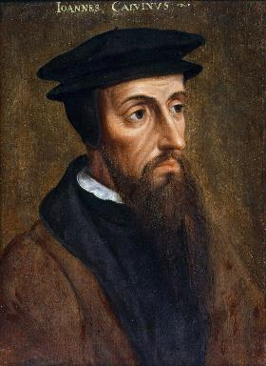
Neo-Calvinism vs. The Bible
Why Critique Calvinism?
The Source of Calvin’s Theology
Calvin’s Manner of Life
TULIP Through the Grid of Scripture
Conclusion

Slide 49
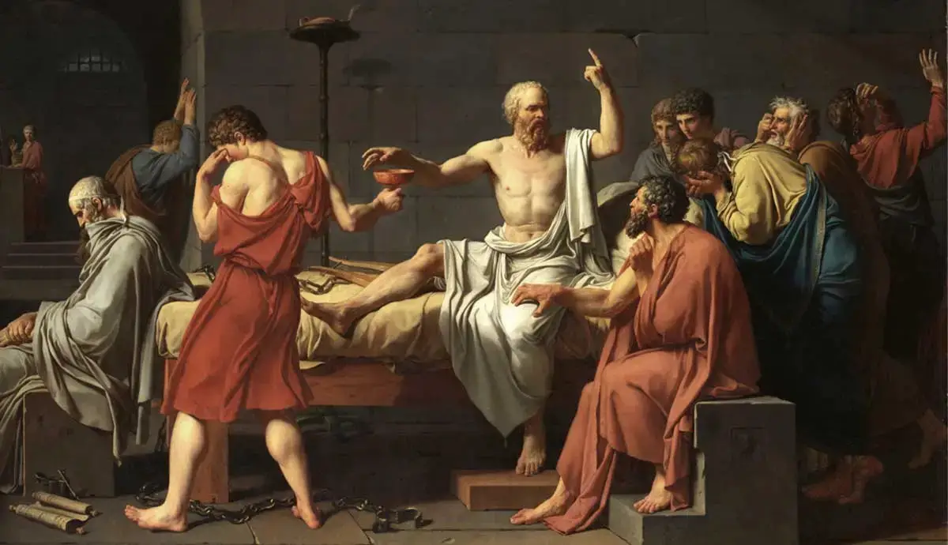
Colossians 2:8
⁸“See to it that no one takes you captive through philosophy and empty deception, according to the tradition of men, according to the elementary principles of the world, rather than according to Christ.”

Slide 50
Calvinism is an Imposed Philosophy Upon Scripture
“Likewise, John Calvin…latched onto little more than a single word (predestinate) and ran with it. Then, rather than carefully looking to the whole of Scripture to verify his precepts and conclusions, he looked to the writings of Augustine to verify his thinking. The result is that, as with Catholicism, we now have ‘another gospel’ that is not solely based on Scripture but on the confused thinking and misconstrued assumptions of a mere man. With Calvin, rather than changing his views to fit Scripture, he changed the meaning of words in Scripture to fit his now distorted view of God and salvation.”
Bob Kirkland, Calvinism: None Dare Call It Heresy; Spotlight on the Life and Teachings of John Calvin (Eureka, MT: Lighthouse Trails, 2018), 97.

