Slide 1
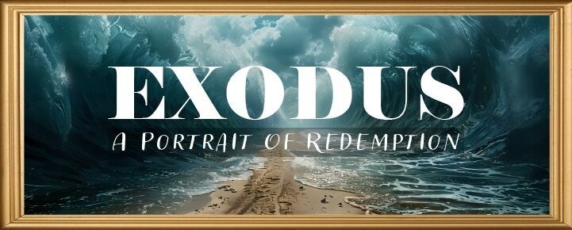


Slide 2
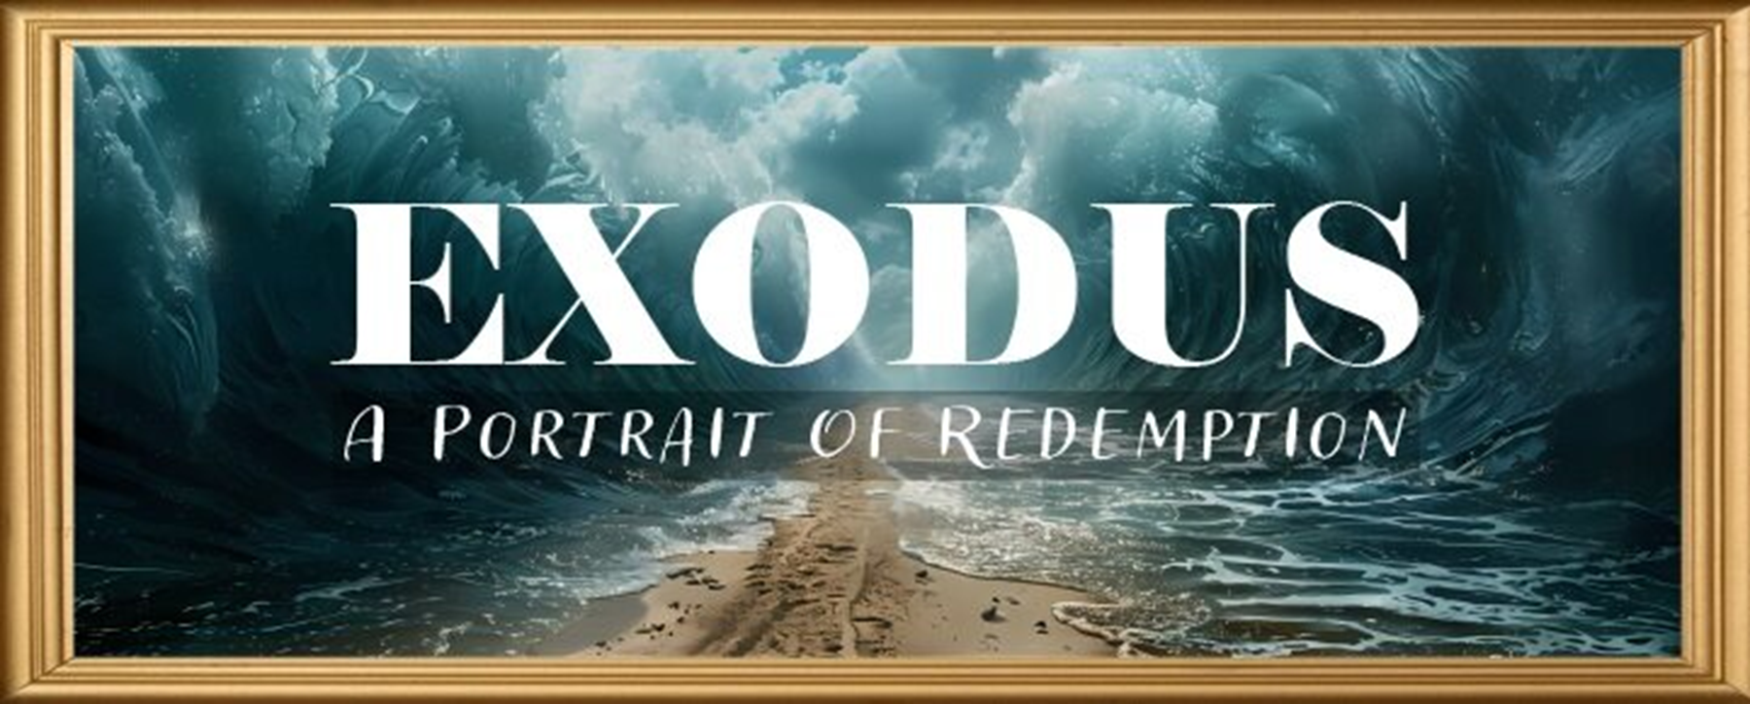
EXODUS STRUCTURE/OUTLINE
Redemption (1–18)
Redemption (1:1–12:30)
Liberation (12:31–15:21)
Preservation (15:22–18:27)
Mosaic Covenant (19–40)
Law (19–24)
Tabernacle instructions (25–31)
Apostasy (32–34)
Tabernacle building (35–40)

Slide 3
REDEMPTION (1:1–12:30)
Why redemption is necessary (Exod 1)
Development of the deliverer (Exod 2–4)
First confrontation with Pharaoh (Exod 5)
God reassures Moses (Exod 6:1–7:7)
Second confrontation with Pharaoh (Exod 7:8-13)
Plagues (Exod 7:14–12:30)

Slide 4
TEN PLAGUES REDEMPTION (7:14–12:30)
Nile to blood
Frogs
Gnats
Flies
Death of livestock
Boils
Hail
Locusts
Darkness
Death of 1st born

Slide 5
The Plagues of Egypt
NO. | DESCRIPTION | SCRIPTURE | Egyptian Deity
1. | Water to Blood | Exod. 7:14-25 | Hapi, Khnum
2. | Frogs | Exod. 8:1-15 | Heqt
3. | Gnats | Exod. 8:16-19 | Set
4. | Flies | Exod. 8:20-32 | Uatchit
5. | Disease on Cattle | Exod. 9:1-7 | Hathor, Apis
6. | Boils | Exod. 9:8-12 | Sekhmet, Serapis
7. | Hail | Exod. 9:13-35 | Seth, Nut
8. | Locusts | Exod. 10:1-20 | Seth, Nut, Osiris
9. | Darkness | Exod. 10:21-29 | Re, Horus, Atum
10. | Death of the First Born | Exod. 12:29-36 | Min, Osiris, Heqt, Isis

Slide 6
FROGS Exodus 8:1-15
God’s Instructions to Moses (1-5)
Aaron’s Obedience (6)
Pharaoh’s Miracle (7)
Pharaoh’s Condition (8-11)
Fulfillment of Prophecy (12-14)
Pharaoh’s Condition (15)

Slide 7
IV. Exodus 8:8-11 Pharaoh’s Condition
Pharaoh’s Request (8)
Question of Timing (9)
Pharaoh’s Answer (10a)
Moses’ Promise (10b-11)

Slide 8
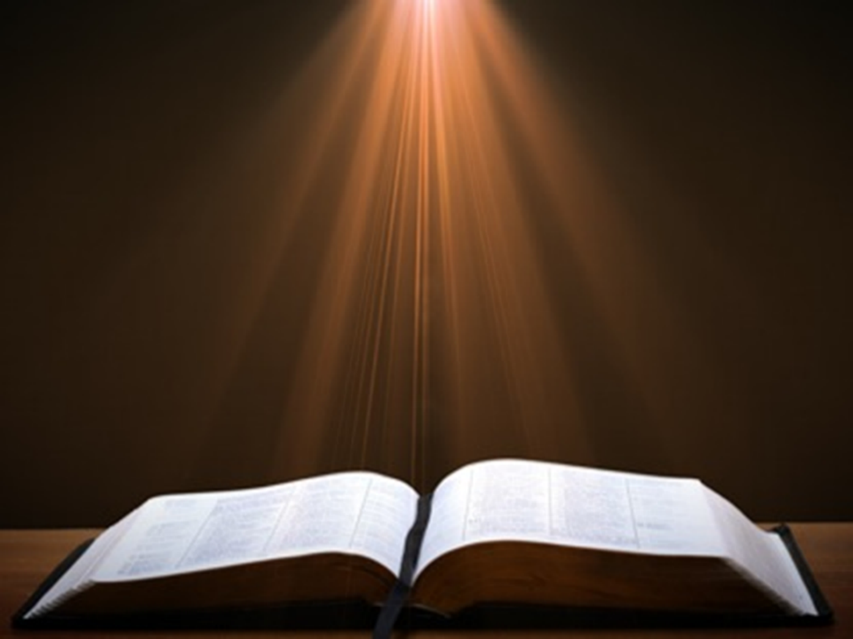
Romans 13:3-5
“For rulers are not a cause of fear for good behavior, but for evil. Do you want to have no fear of authority? Do what is good and you will have praise from the same; for it [government] is a minister of God to you for good. But if you do what is evil, be afraid; for it [government] does not bear the sword for nothing; for it [government] is a minister of God, an avenger who brings wrath on the one who practices evil.”

Slide 9

Principles of Civil Disobedience
“Crystal” clear conflict between the laws of man and God
Exhaustion of all creative legal remedies
A willingness to “pay the consequences”
Maintaining of respect for civil authorities

Slide 10
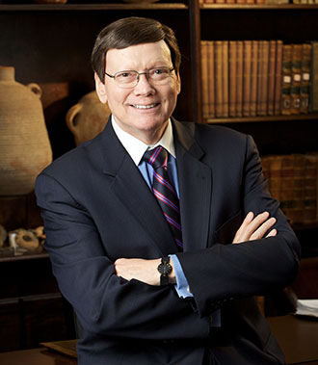
Dr. Ed Hindson
Hindson, E. E., & Mitchell, D. R., eds. (2010). King James Version Bible Commentary for Today: The Most Up-to-Date Commentary on the Time-Honored Text of the King James Version (p. 91). Thomas Nelson.
“Those who hold to the miraculous intensification of natural events theory of the plagues suggest that the red sediment, algae, or fungus, coupled with the dead fish, had so polluted the Nile that the frogs abandoned the river and swarmed over the land and into the houses to seek moisture. This explanation, however, does not sufficiently address the text’s presentation of the abundance of frogs or their swarming at Moses’ precise signal.”

Slide 11
IV. Exodus 8:8-11 Pharaoh’s Condition
Pharaoh’s Request (8)
Question of Timing (9)
Pharaoh’s Answer (10a)
Moses’ Promise (10b-11)

Slide 12
Dr. Ed Hindson
Hindson, E. E., & Mitchell, D. R., eds. (2010). King James Version Bible Commentary for Today: The Most Up-to-Date Commentary on the Time-Honored Text of the King James Version (p. 92). Thomas Nelson.
“8:10. That thou mayest know (v. 10). To demonstrate that it was done by the power of the Lord, Moses granted Pharaoh the honor of choosing the specific time for the frogs’ removal. By this point, apparently, Pharaoh is so troubled by the plague that he is not thinking clearly. Instead of choosing to terminate the plague immediately, he chose for it to end on the following day.”

Slide 13
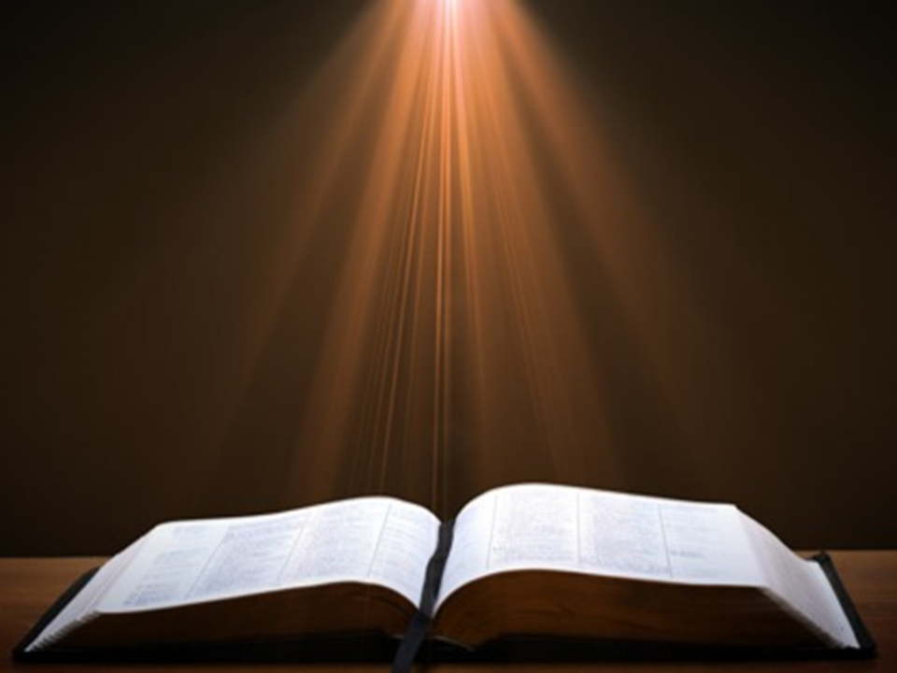
Romans 1:18–20
¹⁸ For the wrath of God is revealed from heaven against all ungodliness and unrighteousness of men who suppress the truth in unrighteousness, ¹⁹ because that which is known about God is evident within them; for God made it evident to them. ²⁰ For since the creation of the world His invisible attributes, His eternal power and divine nature, have been clearly seen, being understood through what has been made, so that they are without excuse.

Slide 14
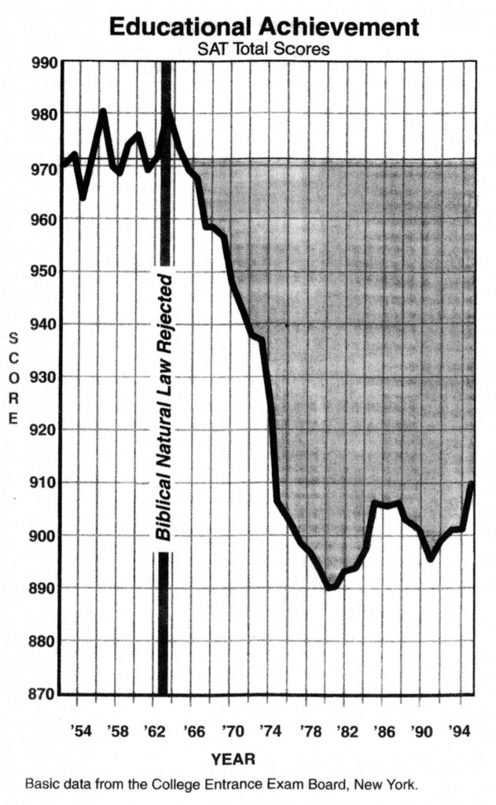
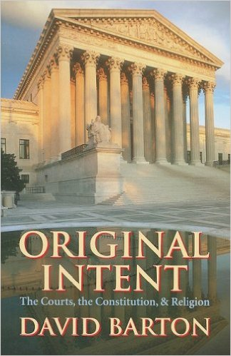
David Barton, Original Intent, p. 245

Slide 15
IV. Exodus 8:8-11 Pharaoh’s Condition
Pharaoh’s Request (8)
Question of Timing (9)
Pharaoh’s Answer (10a)
Moses’ Promise (10b-11)

Slide 16


John 1:14
“And the Word became flesh, and dwelt among us, and we saw His glory, glory as of the only begotten [monogenēs] from the Father, full of grace and truth.”

Slide 17
FROGS Exodus 8:1-15
God’s Instructions to Moses (1-5)
Aaron’s Obedience (6)
Pharaoh’s Miracle (7)
Pharaoh’s Condition (8-11)
Fulfillment of Prophecy (12-14)
Pharaoh’s Condition (15)

Slide 18
V. Exodus 8:12-14 Fulfillment of Prophecy
Moses’ & Aaron’s Intercession (12)
God’s Answer (13-14)

Slide 19
V. Exodus 8:12-14 Fulfillment of Prophecy
Moses’ & Aaron’s Intercession (12)
God’s Answer (13-14)

Slide 20
V. Exodus 8:12-14 Fulfillment of Prophecy
Moses’ & Aaron’s Intercession (12)
God’s Answer (13-14)

Slide 21
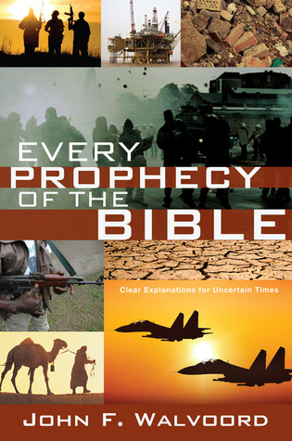

Slide 22

John 13:19; 14:29
“¹⁹ From now on I am telling you before it comes to pass, so that when it does occur, you may believe that I am He… ^{14:29} Now I have told you before it happens, so that when it happens, you may believe.”

Slide 23
What Happened to Christ’s Disciples?
Disciple | Place | Martyrdom
James the Son of Alpheus | Jerusalem | Clubbed to death
Simon the Zealot | Jerusalem | Martyred
James the Son of Zebedee | Judea (Acts 12:2) | Executed
Thaddeus | Mesopotamia | Beaten to death
Peter | Babylon, Rome | Crucified upside down
Matthew | Parthia (Tehran) | Beheaded
Notes:
109 prophecies…
Peter Stoner – SCIENCE SPEAKS, An Evaluation of Certain Christian Evidences
To fulfill just 8 prophecies =1 X 10 to the twenty-eighth power!
Can we visualize this with an illustration? Suppose we took an atheistic professor, blindfolded him and covered the state of Texas two feet deep with silver dollars. Then we put a check on one of those silver dollars and mixed them up. The odds of one person fulfilling just these eight prophecies would be the same as this atheistic professor selecting the silver dollar upon which we have placed a check, in his first try.
https://www.bereanpublishers.com/the-odds-of-eight-messianic-prophecies-coming-true/

Slide 24
What Happened to Christ’s Disciples?
Disciple | Place | Martyrdom
John | Asia Minor, Patmos, Ephesus | Fried in boiling oil
Philip | E. Turkey | Tortured & crucified
Thomas | India | Speared
Bartholomew | India | Flayed & crucified
Andrew | Ukraine, Russia, Greece | Hanged
Notes:
109 prophecies…
Peter Stoner – SCIENCE SPEAKS, An Evaluation of Certain Christian Evidences
To fulfill just 8 prophecies =1 X 10 to the twenty-eighth power!
Can we visualize this with an illustration? Suppose we took an atheistic professor, blindfolded him and covered the state of Texas two feet deep with silver dollars. Then we put a check on one of those silver dollars and mixed them up. The odds of one person fulfilling just these eight prophecies would be the same as this atheistic professor selecting the silver dollar upon which we have placed a check, in his first try.
https://www.bereanpublishers.com/the-odds-of-eight-messianic-prophecies-coming-true/

Slide 25
FROGS Exodus 8:1-15
God’s Instructions to Moses (1-5)
Aaron’s Obedience (6)
Pharaoh’s Miracle (7)
Pharaoh’s Condition (8-11)
Fulfillment of Prophecy (12-14)
Pharaoh’s Condition (15)

Slide 26
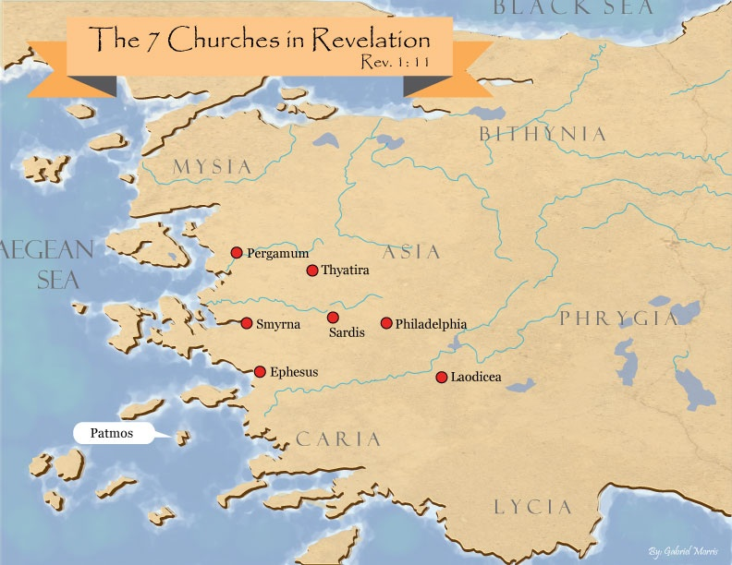
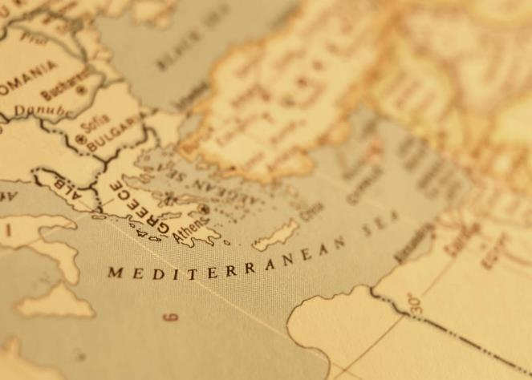

Slide 27
Dr. Ed Hindson
Hindson, E. E., & Mitchell, D. R., eds. (2010). King James Version Bible Commentary for Today: The Most Up-to-Date Commentary on the Time-Honored Text of the King James Version (p. 86). Thomas Nelson.
“4:21. I will harden his heart. An expression meaning ‘to strengthen his will.’ The text identifies the heart as the location of the volition, man’s decision-making ability. On seven occasions in the narrative, God hardens Pharaoh’s heart (9:12; 10:1, 20, 27; 11:10; 14:4, 8) or foretells that He will harden Pharaoh’s heart (4:21; 7:3), and nine times in the text, Pharaoh hardens his own heart (7:13, 14, 22; 8:15, 19, 32; 9:7, 34–35). For the initial five plagues, the text registers Pharaoh as the agent of hardening. Not until the sixth plague does God participate in the confirmation of Pharaoh’s own volitional choices.”

Slide 28

Charles Ryrie Ryrie Study Bible, page 96
Exodus 4:21 - “harden his heart. Ten times it is said that Pharaoh hardened his own heart (7:13, 14, 22; 8:15, 19, 32; 9:7, 34, 35; 13:15), and 10 times that God hardened Pharaoh’s heart (4:21; 7:3; 9:12; 10:1, 20, 27; 11:10; 14:4, 8, 17). Paul uses this as an example of the inscrutable will of God and of His mercy toward men (Rom. 9:14–18). Seven times Pharaoh hardened his own heart before God first hardened it, though the prediction that God would do it preceded all.”

Slide 29
GOD HARDENING PHARAOH'S HEART
The prediction of God hardening of Pharaoh (4:21)
Pharaoh repeatedly hardening his own heart (7:13, 22; 8:15, 19, 32; 9:7)
Not until the sixth plague did God harden Pharaoh’s heart (Exod 9:12)

Slide 31
John 13:19; 14:29
“¹⁹ From now on I am telling you before it comes to pass, so that when it does occur, you may believe that I am He… ^{14:29} Now I have told you before it happens, so that when it happens, you may believe.”

Slide 32
What Happened to Christ’s Disciples?
Disciple | Place | Martyrdom
James the Son of Alpheus | Jerusalem | Clubbed to death
Simon the Zealot | Jerusalem | Martyred
James the Son of Zebedee | Judea (Acts 12:2) | Executed
Thaddeus | Mesopotamia | Beaten to death
Peter | Babylon, Rome | Crucified upside down
Matthew | Parthia (Tehran) | Beheaded
Notes:
109 prophecies…
Peter Stoner – SCIENCE SPEAKS, An Evaluation of Certain Christian Evidences
To fulfill just 8 prophecies =1 X 10 to the twenty-eighth power!
Can we visualize this with an illustration? Suppose we took an atheistic professor, blindfolded him and covered the state of Texas two feet deep with silver dollars. Then we put a check on one of those silver dollars and mixed them up. The odds of one person fulfilling just these eight prophecies would be the same as this atheistic professor selecting the silver dollar upon which we have placed a check, in his first try.
https://www.bereanpublishers.com/the-odds-of-eight-messianic-prophecies-coming-true/

Slide 33
What Happened to Christ’s Disciples?
Disciple | Place | Martyrdom
John | Asia Minor, Patmos, Ephesus | Fried in boiling oil
Philip | E. Turkey | Tortured & crucified
Thomas | India | Speared
Bartholomew | India | Flayed & crucified
Andrew | Ukraine, Russia, Greece | Hanged
Notes:
109 prophecies…
Peter Stoner – SCIENCE SPEAKS, An Evaluation of Certain Christian Evidences
To fulfill just 8 prophecies =1 X 10 to the twenty-eighth power!
Can we visualize this with an illustration? Suppose we took an atheistic professor, blindfolded him and covered the state of Texas two feet deep with silver dollars. Then we put a check on one of those silver dollars and mixed them up. The odds of one person fulfilling just these eight prophecies would be the same as this atheistic professor selecting the silver dollar upon which we have placed a check, in his first try.
https://www.bereanpublishers.com/the-odds-of-eight-messianic-prophecies-coming-true/

Slide 34
Conclusion

Slide 35
FROGS Exodus 8:1-15
God’s Instructions to Moses (1-5)
Aaron’s Obedience (6)
Pharaoh’s Miracle (7)
Pharaoh’s Condition (8-11)
Fulfillment of Prophecy (12-14)
Pharaoh’s Condition (15)

Slide 36
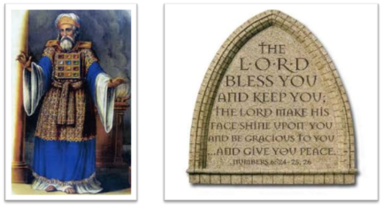
²⁴ The Lord bless you, and keep you; ²⁵ The Lord make His face shine on you, And be gracious to you; ²⁶ The Lord lift up His countenance on you, And give you peace.
Numbers 6:24–26 (NASB95)

