Slide 1
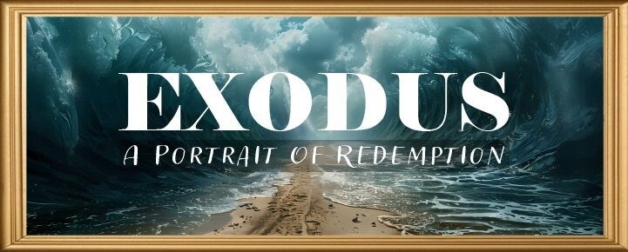


Slide 2
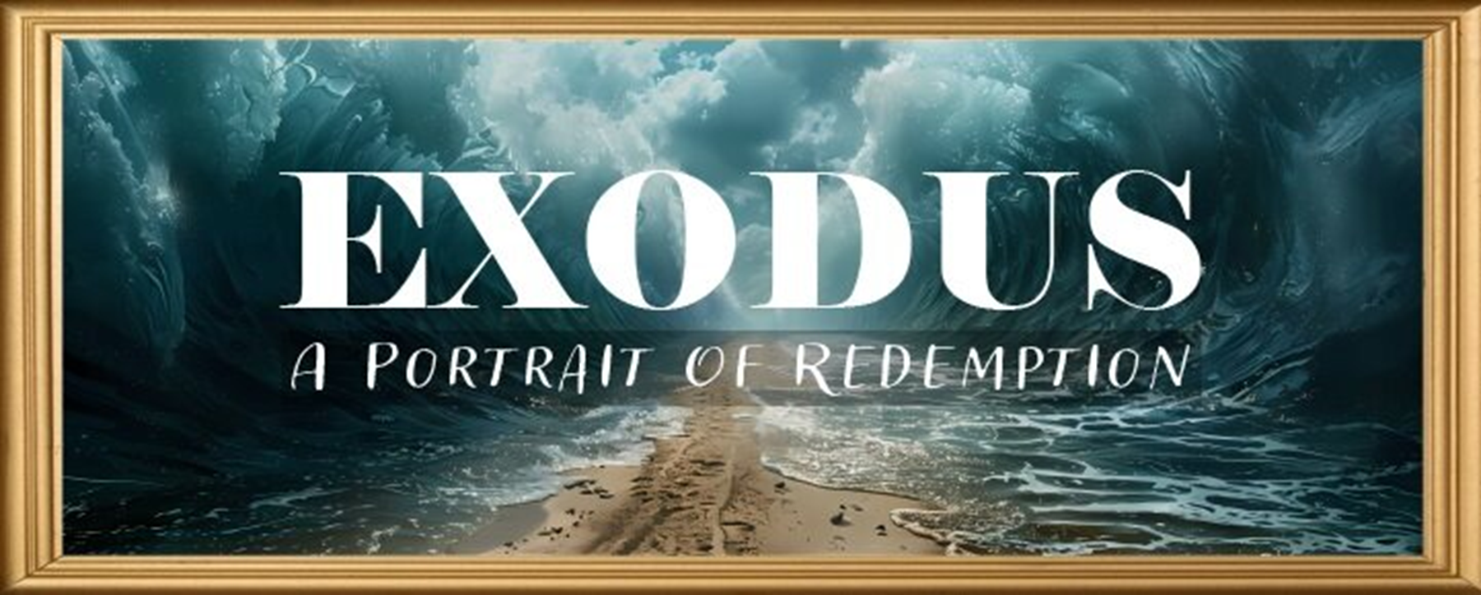
EXODUS STRUCTURE/OUTLINE
Redemption (1–18)
  Redemption (1:1–12:30)
  Liberation (12:31–15:21)
  Preservation (15:22–18:27)
Mosaic Covenant (19–40)
  Law (19–24)
  Tabernacle instructions (25–31)
  Apostasy (32–34)
  Tabernacle building (35–40)

Slide 3
REDEMPTION
(1:1–12:30)
Why redemption is necessary (Exod 1)
Development of the deliverer (Exod 2–4)
First confrontation with Pharaoh (Exod 5)
God reassures Moses (Exod 6:1–7:7)
Second confrontation with Pharaoh (Exod 7:8-13)
Plagues (Exod 7:14–12:30)

Slide 4
TEN PLAGUES REDEMPTION (7:14–12:30)
Nile to blood
Frogs
Gnats
Flies
Death of livestock
Boils
Hail
Locusts
Darkness
Death of 1st born

Slide 5
The Plagues of Egypt
NO. | DESCRIPTION | SCRIPTURE | Egyptian Deity
1. | Water to Blood | Exod. 7:14-25 | Hapi, Khnum
2. | Frogs | Exod. 8:1-15 | Heqt
3. | Gnats | Exod. 8:16-19 | Set
4. | Flies | Exod. 8:20-32 | Uatchit
5. | Disease on Cattle | Exod. 9:1-7 | Hathor, Apis
6. | Boils | Exod. 9:8-12 | Sekhmet, Serapis
7. | Hail | Exod. 9:13-35 | Seth, Nut
8. | Locusts | Exod. 10:1-20 | Seth, Nut, Osiris
9. | Darkness | Exod. 10:21-29 | Re, Horus, Atum
10. | Death of the First Born | Exod. 12:29-36 | Min, Osiris, Heqt, Isis

Slide 6
FROGS
Exodus 8:1-15
  God’s Instructions to Moses (1-5)
  Aaron’s Obedience (6)
  Pharaoh’s Miracle (7)
  Pharaoh’s Condition (8-11)
  Fulfillment of Prophecy (12-14)
  Pharaoh’s Condition (15)

Slide 7
FROGS
Exodus 8:1-15
  God’s Instructions to Moses (1-5)
  Aaron’s Obedience (6)
  Pharaoh’s Miracle (7)
  Pharaoh’s Condition (8-11)
  Fulfillment of Prophecy (12-14)
  Pharaoh’s Condition (15)

Slide 8
I. Exodus 8:1-5
God’s Instructions to Moses
    For Pharaoh (1-4)
    For Aaron (5)

Slide 9
I. Exodus 8:1-5
God’s Instructions to Moses
    For Pharaoh (1-4)
    For Aaron (5)

Slide 10
Exodus 8:1-4
For Pharaoh
      Command (1)
      Consequence (2-4)

Slide 11
Exodus 8:1-4
For Pharaoh
      Command (1)
      Consequence (2-4)

Slide 12
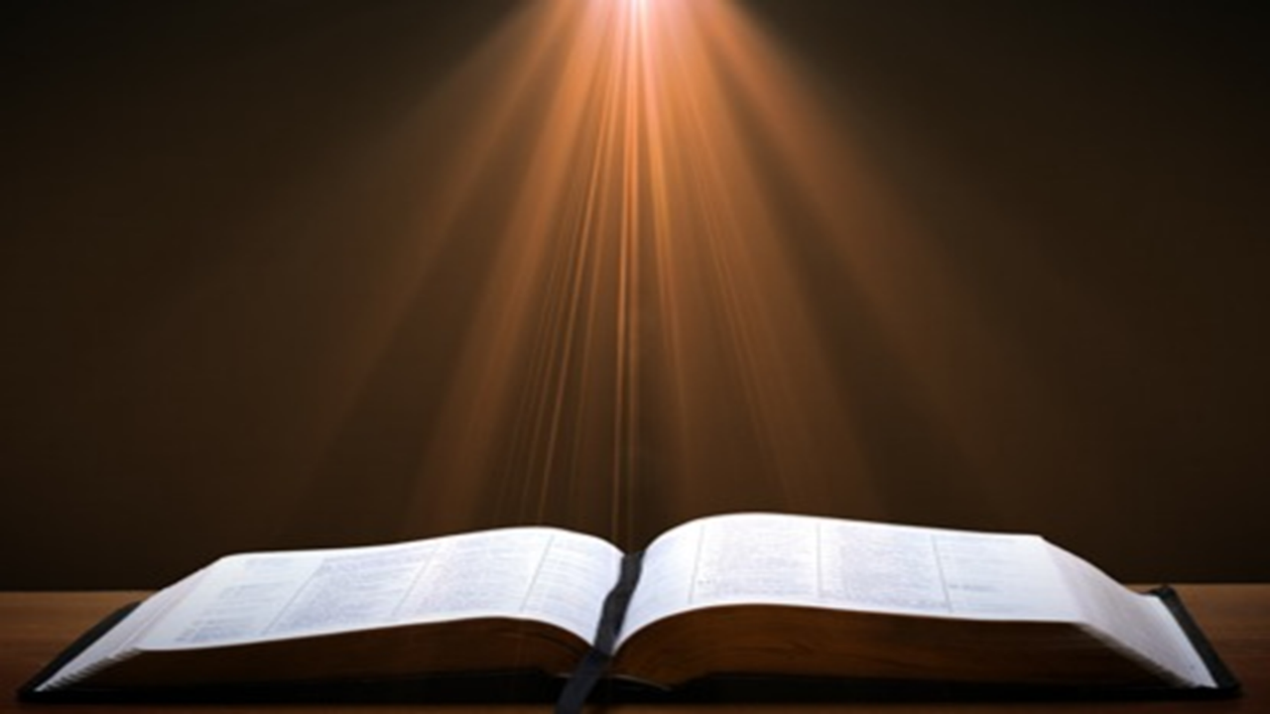
Ephesians 2:8-10
“⁸ For by grace you have been saved through faith; and that not of yourselves, it is the gift of God; ⁹ not as a result of works, so that no one may boast. ¹⁰ For we are His workmanship, created in Christ Jesus for good works, which God prepared beforehand so that we would walk [peripateō, subjunctive mood] in them.”

Slide 13
Three Tenses of Salvation
Phase | Justification (Punctiliar) | Sanctification (Process) | Glorification
Tense | Past | Present | Future
Saved from sin’s: | Penalty | Power | Presence
Scripture | Eph 2:8-9; Titus 3:5 | Philip 2:12 | Rom 5:10

Slide 14
Exodus 8:1-4
For Pharaoh
      Command (1)
      Consequence (2-4)

Slide 15
The Plagues of Egypt
NO. | DESCRIPTION | SCRIPTURE | Egyptian Deity
1. | Water to Blood | Exod. 7:14-25 | Hapi, Khnum
2. | Frogs | Exod. 8:1-15 | Heqt
3. | Gnats | Exod. 8:16-19 | Set
4. | Flies | Exod. 8:20-32 | Uatchit
5. | Disease on Cattle | Exod. 9:1-7 | Hathor, Apis
6. | Boils | Exod. 9:8-12 | Sekhmet, Serapis
7. | Hail | Exod. 9:13-35 | Seth, Nut
8. | Locusts | Exod. 10:1-20 | Seth, Nut, Osiris
9. | Darkness | Exod. 10:21-29 | Re, Horus, Atum
10. | Death of the First Born | Exod. 12:29-36 | Min, Osiris, Heqt, Isis

Slide 16
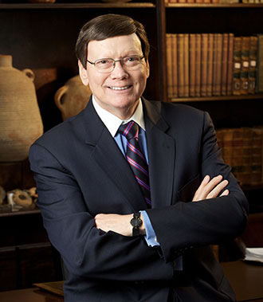
Dr. Ed Hindson
Hindson, E. E., & Mitchell, D. R., eds. (2010). King James Version Bible Commentary for Today: The Most Up-to-Date Commentary on the Time-Honored Text of the King James Version (p. 91). Thomas Nelson.
“Egyptian deities challenged by this particular plague were Hapi, the spirit of the Nile, and Heqet, the frog-headed goddess of childbirth assistance, who also had the distinction of being the wife of Khnum, the guardian of the Nile.”

Slide 17
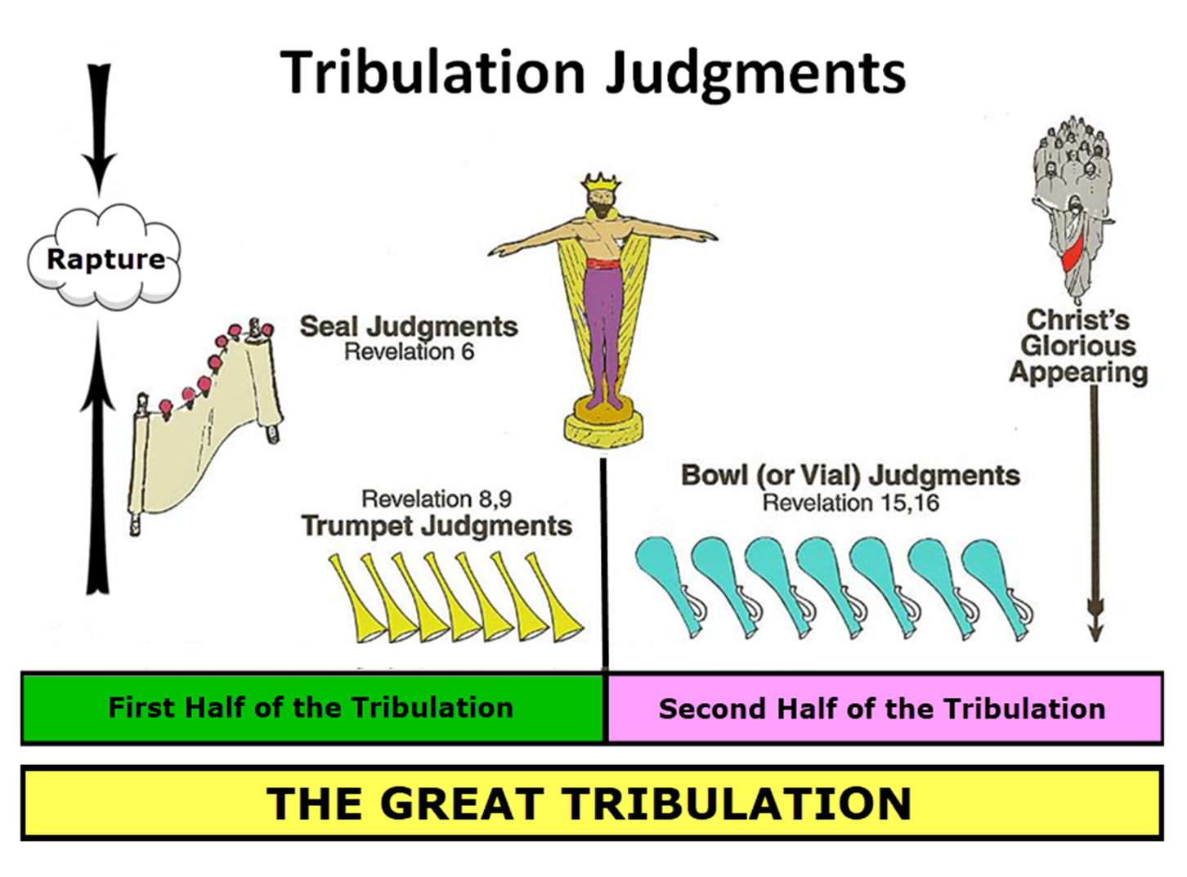

Slide 18
I. Exodus 8:1-5
God’s Instructions to Moses
    For Pharaoh (1-4)
    For Aaron (5)

Slide 19
FROGS
Exodus 8:1-15
  God’s Instructions to Moses (1-5)
  Aaron’s Obedience (6)
  Pharaoh’s Miracle (7)
  Pharaoh’s Condition (8-11)
  Fulfillment of Prophecy (12-14)
  Pharaoh’s Condition (15)

Slide 20
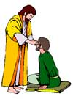
“SEVEN SIGNS” in Gospel of John
1. Changing Water into Wine | 2:11
2. Healing official’s son | 4:46-54
3. Healing an invalid at the Pool of Bethesda | 5:1-18
4. Feeding the 5,000 | 6:5-14
5. Walking on water | 6:16-21
6. Healing a blind man | 9:1-7
7. Raising dead Lazarus | 11:1-45

Slide 21
Dr. Ed Hindson
Hindson, E. E., & Mitchell, D. R., eds. (2010). King James Version Bible Commentary for Today: The Most Up-to-Date Commentary on the Time-Honored Text of the King James Version (p. 91). Thomas Nelson.
“Those who hold to the miraculous intensification of natural events theory of the plagues suggest that the red sediment, algae, or fungus, coupled with the dead fish, had so polluted the Nile that the frogs abandoned the river and swarmed over the land and into the houses to seek moisture. This explanation, however, does not sufficiently address the text’s presentation of the abundance of frogs or their swarming at Moses’ precise signal.”

Slide 22
FROGS
Exodus 8:1-15
  God’s Instructions to Moses (1-5)
  Aaron’s Obedience (6)
  Pharaoh’s Miracle (7)
  Pharaoh’s Condition (8-11)
  Fulfillment of Prophecy (12-14)
  Pharaoh’s Condition (15)

Slide 23

Satanic/Demonic Miracles
Exod. 7–8
Deut. 13:1-3
Job 1:12-19; 2:7-8
1 Sam. 28?
Matt. 7:21-23; 24:24
Luke 4:5
Acts 8:9; 16:16
Gal. 1:6-9
2 Thess. 2:9
2 Cor. 11:14
Rev. 13:3, 13, 15; 16:13-14

Slide 24
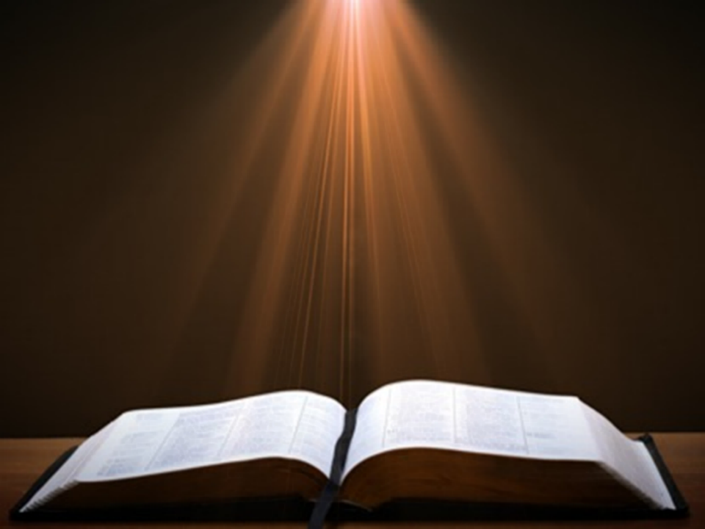
Galatians 1:6–9
⁶ I am amazed that you are so quickly deserting Him who called you by the grace of Christ, for a different gospel; ⁷ which is really not another; only there are some who are disturbing you and want to distort the gospel of Christ. ⁸ But even if we, or an angel from heaven, should preach to you a gospel contrary to what we have preached to you, he is to be accursed! ⁹ As we have said before, so I say again now, if any man is preaching to you a gospel contrary to what you received, he is to be accursed!

Slide 25

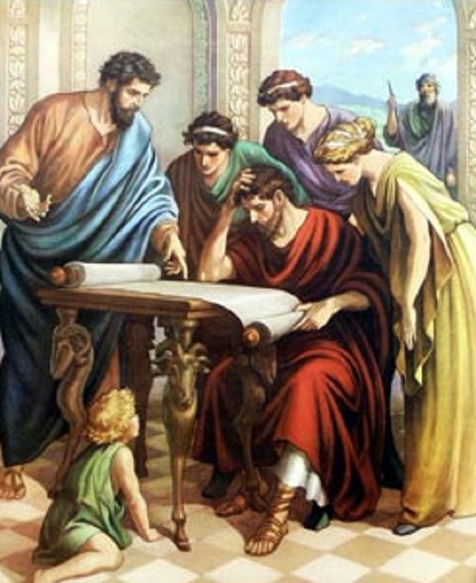
Acts 17:11
“Now these were more noble-minded than those in Thessalonica, for they received the word with great eagerness, examining the Scriptures daily to see whether these things were so.”

Slide 26
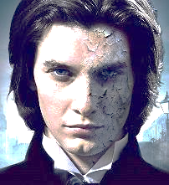
1 John 4:1
“Beloved, do not believe every spirit, but test the spirits to see whether they are from God, because many false prophets have gone out into the world.”

Slide 27
Dr. Ed Hindson
Hindson, E. E., & Mitchell, D. R., eds. (2010). King James Version Bible Commentary for Today: The Most Up-to-Date Commentary on the Time-Honored Text of the King James Version (p. 91-92). Thomas Nelson.
“Again, the text records the Egyptian magicians (v. 7) supernaturally duplicating the miracle. As with their duplication of the first plague, the question must be raised as to why they would enact such a counterproductive measure. As the land teemed with a deluge of frogs, Pharaoh’s priests increased the number of frogs. As noted with the previous plague, a demonstration of true supernatural power would have been to undo the plague of frogs. This power, however, the magicians did not possess.”

Slide 28

Ezekiel 28:13, 15
¹³ “You were in Eden, the garden of God; Every precious stone was your covering: The ruby, the topaz and the diamond; The beryl, the onyx and the jasper; The lapis lazuli, the turquoise and the emerald; And the gold, the workmanship of your settings and sockets, Was in you. On the day that you were created They were prepared… ¹⁵ “You were blameless in your ways From the day you were created Until unrighteousness was found in you.

Slide 29
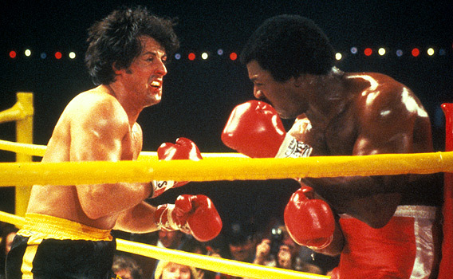

Slide 30
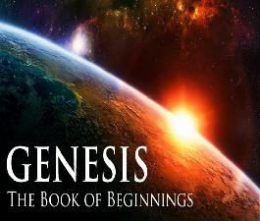
Refutation of Man’s Philosophies
(Gen 1:1)
Atheism – God created (Ps. 14:1)
Pantheism – God is transcendent over creation
Polytheism – One God created (Deut. 6:4; Isa 43:11; 44:6; 45:5)
Materialism – Matter began
Dualism – God alone created (Ezek. 28:13, 15)
Humanism – God rather than man created
Naturalism – God created
Morris, Genesis Record, 38

Slide 31
FROGS
Exodus 8:1-15
  God’s Instructions to Moses (1-5)
  Aaron’s Obedience (6)
  Pharaoh’s Miracle (7)
  Pharaoh’s Condition (8-11)
  Fulfillment of Prophecy (12-14)
  Pharaoh’s Condition (15)

Slide 32
IV. Exodus 8:8-11
Pharaoh’s Condition
    Pharaoh’s Request (8)
    Question of Timing (9)
    Pharaoh’s Answer (10a)
    Moses’ Promise (10b-11)

Slide 33
IV. Exodus 8:8-11
Pharaoh’s Condition
    Pharaoh’s Request (8)
    Question of Timing (9)
    Pharaoh’s Answer (10a)
    Moses’ Promise (10b-11)

Slide 34
Revelation 9:20-21
“²⁰ The rest of mankind, who were not killed by these plagues, did not repent of the works of their hands, so as not to worship demons, and the idols of gold and of silver and of brass and of stone and of wood, which can neither see nor hear nor walk; ²¹ and they did not repent of their murders nor of their sorceries nor of their immorality nor of their thefts.”

Slide 35

Romans 1:18–20
¹⁸ For the wrath of God is revealed from heaven against all ungodliness and unrighteousness of men who suppress the truth in unrighteousness, ¹⁹ because that which is known about God is evident within them; for God made it evident to them. ²⁰ For since the creation of the world His invisible attributes, His eternal power and divine nature, have been clearly seen, being understood through what has been made, so that they are without excuse.

Slide 36
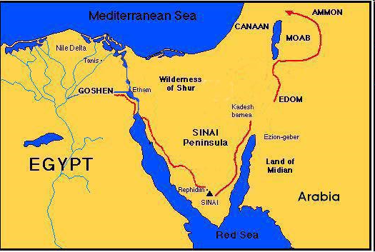

Slide 37
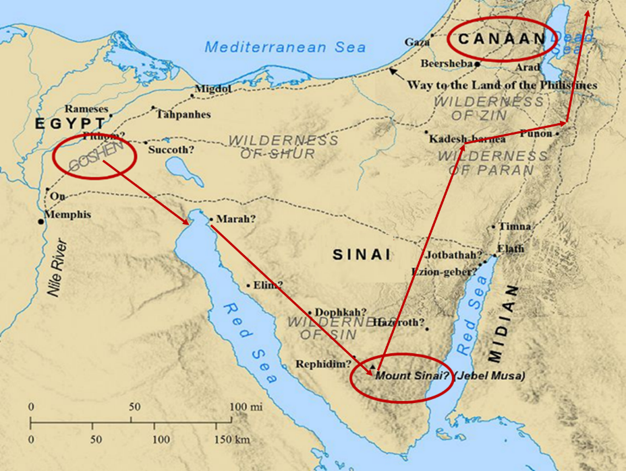

Slide 38
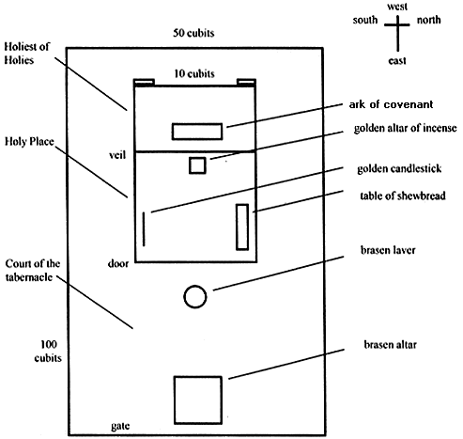
Tabernacle Diagram

Slide 39


Romans 12:1
¹ Therefore I urge you, brethren, by the mercies of God, to present your bodies a living and holy sacrifice, acceptable to God, which is your spiritual service of worship.

Slide 40
IV. Exodus 8:8-11
Pharaoh’s Condition
    Pharaoh’s Request (8)
    Question of Timing (9)
    Pharaoh’s Answer (10a)
    Moses’ Promise (10b-11)

Slide 41

Romans 13:3-5
“For rulers are not a cause of fear for good behavior, but for evil. Do you want to have no fear of authority? Do what is good and you will have praise from the same; for it [government] is a minister of God to you for good. But if you do what is evil, be afraid; for it [government] does not bear the sword for nothing; for it [government] is a minister of God, an avenger who brings wrath on the one who practices evil.”

Slide 42

Principles of Civil Disobedience
“Crystal” clear conflict between the laws of man and God
Exhaustion of all creative legal remedies
A willingness to “pay the consequences”
Maintaining of respect for civil authorities

Slide 43
Dr. Ed Hindson
Hindson, E. E., & Mitchell, D. R., eds. (2010). King James Version Bible Commentary for Today: The Most Up-to-Date Commentary on the Time-Honored Text of the King James Version (p. 91). Thomas Nelson.
“Those who hold to the miraculous intensification of natural events theory of the plagues suggest that the red sediment, algae, or fungus, coupled with the dead fish, had so polluted the Nile that the frogs abandoned the river and swarmed over the land and into the houses to seek moisture. This explanation, however, does not sufficiently address the text’s presentation of the abundance of frogs or their swarming at Moses’ precise signal.”

Slide 44
IV. Exodus 8:8-11
Pharaoh’s Condition
    Pharaoh’s Request (8)
    Question of Timing (9)
    Pharaoh’s Answer (10a)
    Moses’ Promise (10b-11)

Slide 45
Dr. Ed Hindson
Hindson, E. E., & Mitchell, D. R., eds. (2010). King James Version Bible Commentary for Today: The Most Up-to-Date Commentary on the Time-Honored Text of the King James Version (p. 92). Thomas Nelson.
“8:10. That thou mayest know (v. 10). To demonstrate that it was done by the power of the Lord, Moses granted Pharaoh the honor of choosing the specific time for the frogs’ removal. By this point, apparently, Pharaoh is so troubled by the plague that he is not thinking clearly. Instead of choosing to terminate the plague immediately, he chose for it to end on the following day.”

Slide 46
IV. Exodus 8:8-11
Pharaoh’s Condition
    Pharaoh’s Request (8)
    Question of Timing (9)
    Pharaoh’s Answer (10a)
    Moses’ Promise (10b-11)

Slide 47
FROGS
Exodus 8:1-15
  God’s Instructions to Moses (1-5)
  Aaron’s Obedience (6)
  Pharaoh’s Miracle (7)
  Pharaoh’s Condition (8-11)
  Fulfillment of Prophecy (12-14)
  Pharaoh’s Condition (15)

Slide 48
V. Exodus 8:12-14
Fulfillment of Prophecy
    Moses’ & Aaron’s Intercession (12)
    God’s Answer (13-14)

Slide 49
V. Exodus 8:12-14
Fulfillment of Prophecy
    Moses’ & Aaron’s Intercession (12)
    God’s Answer (13-14)

Slide 50
V. Exodus 8:12-14
Fulfillment of Prophecy
    Moses’ & Aaron’s Intercession (12)
    God’s Answer (13-14)

Slide 51
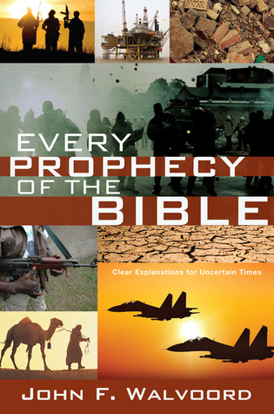

Slide 52


John 13:19; 14:29
“¹⁹ From now on I am telling you before it comes to pass, so that when it does occur, you may believe that I am He… ^{14:29} Now I have told you before it happens, so that when it happens, you may believe.”

Slide 53
What Happened to Christ’s Disciples?
Disciple | Place | Martyrdom
James the Son of Alpheus | Jerusalem | Clubbed to death
Simon the Zealot | Jerusalem | Martyred
James the Son of Zebedee | Judea (Acts 12:2) | Executed
Thaddeus | Mesopotamia | Beaten to death
Peter | Babylon, Rome | Crucified upside down
Matthew | Parthia (Tehran) | Beheaded
Notes:
109 prophecies…
Peter Stoner – SCIENCE SPEAKS, An Evaluation of Certain Christian Evidences
To fulfill just 8 prophecies =1 X 10 to the twenty-eighth power!
Can we visualize this with an illustration? Suppose we took an atheistic professor, blindfolded him and covered the state of Texas two feet deep with silver dollars. Then we put a check on one of those silver dollars and mixed them up. The odds of one person fulfilling just these eight prophecies would be the same as this atheistic professor selecting the silver dollar upon which we have placed a check, in his first try.
https://www.bereanpublishers.com/the-odds-of-eight-messianic-prophecies-coming-true/

Slide 54
What Happened to Christ’s Disciples?
Disciple | Place | Martyrdom
John | Asia Minor, Patmos, Ephesus | Fried in boiling oil
Philip | E. Turkey | Tortured & crucified
Thomas | India | Speared
Bartholomew | India | Flayed & crucified
Andrew | Ukraine, Russia, Greece | Hanged
Notes:
109 prophecies…
Peter Stoner – SCIENCE SPEAKS, An Evaluation of Certain Christian Evidences
To fulfill just 8 prophecies =1 X 10 to the twenty-eighth power!
Can we visualize this with an illustration? Suppose we took an atheistic professor, blindfolded him and covered the state of Texas two feet deep with silver dollars. Then we put a check on one of those silver dollars and mixed them up. The odds of one person fulfilling just these eight prophecies would be the same as this atheistic professor selecting the silver dollar upon which we have placed a check, in his first try.
https://www.bereanpublishers.com/the-odds-of-eight-messianic-prophecies-coming-true/

Slide 55
FROGS
Exodus 8:1-15
  God’s Instructions to Moses (1-5)
  Aaron’s Obedience (6)
  Pharaoh’s Miracle (7)
  Pharaoh’s Condition (8-11)
  Fulfillment of Prophecy (12-14)
  Pharaoh’s Condition (15)

Slide 56
Dr. Ed Hindson
Hindson, E. E., & Mitchell, D. R., eds. (2010). King James Version Bible Commentary for Today: The Most Up-to-Date Commentary on the Time-Honored Text of the King James Version (p. 86). Thomas Nelson.
“4:21. I will harden his heart. An expression meaning ‘to strengthen his will.’ The text identifies the heart as the location of the volition, man’s decision-making ability. On seven occasions in the narrative, God hardens Pharaoh’s heart (9:12; 10:1, 20, 27; 11:10; 14:4, 8) or foretells that He will harden Pharaoh’s heart (4:21; 7:3), and nine times in the text, Pharaoh hardens his own heart (7:13, 14, 22; 8:15, 19, 32; 9:7, 34–35). For the initial five plagues, the text registers Pharaoh as the agent of hardening. Not until the sixth plague does God participate in the confirmation of Pharaoh’s own volitional choices.”

Slide 57

Charles Ryrie
Ryrie Study Bible, page 96
Exodus 4:21 - “harden his heart. Ten times it is said that Pharaoh hardened his own heart (7:13, 14, 22; 8:15, 19, 32; 9:7, 34, 35; 13:15), and 10 times that God hardened Pharaoh’s heart (4:21; 7:3; 9:12; 10:1, 20, 27; 11:10; 14:4, 8, 17). Paul uses this as an example of the inscrutable will of God and of His mercy toward men (Rom. 9:14–18). Seven times Pharaoh hardened his own heart before God first hardened it, though the prediction that God would do it preceded all.”

Slide 58
GOD HARDENING PHARAOH'S HEART
The prediction of God hardening of Pharaoh (4:21)
Pharaoh repeatedly hardening his own heart (7:13, 22; 8:15, 19, 32; 9:7)
Not until the sixth plague did God harden Pharaoh’s heart (Exod 9:12)

Slide 60
John 13:19; 14:29
“¹⁹ From now on I am telling you before it comes to pass, so that when it does occur, you may believe that I am He… ^{14:29} Now I have told you before it happens, so that when it happens, you may believe.”

Slide 61
What Happened to Christ’s Disciples?
Disciple | Place | Martyrdom
James the Son of Alpheus | Jerusalem | Clubbed to death
Simon the Zealot | Jerusalem | Martyred
James the Son of Zebedee | Judea (Acts 12:2) | Executed
Thaddeus | Mesopotamia | Beaten to death
Peter | Babylon, Rome | Crucified upside down
Matthew | Parthia (Tehran) | Beheaded
Notes:
109 prophecies…
Peter Stoner – SCIENCE SPEAKS, An Evaluation of Certain Christian Evidences
To fulfill just 8 prophecies =1 X 10 to the twenty-eighth power!
Can we visualize this with an illustration? Suppose we took an atheistic professor, blindfolded him and covered the state of Texas two feet deep with silver dollars. Then we put a check on one of those silver dollars and mixed them up. The odds of one person fulfilling just these eight prophecies would be the same as this atheistic professor selecting the silver dollar upon which we have placed a check, in his first try.
https://www.bereanpublishers.com/the-odds-of-eight-messianic-prophecies-coming-true/

Slide 62
What Happened to Christ’s Disciples?
Disciple | Place | Martyrdom
John | Asia Minor, Patmos, Ephesus | Fried in boiling oil
Philip | E. Turkey | Tortured & crucified
Thomas | India | Speared
Bartholomew | India | Flayed & crucified
Andrew | Ukraine, Russia, Greece | Hanged
Notes:
109 prophecies…
Peter Stoner – SCIENCE SPEAKS, An Evaluation of Certain Christian Evidences
To fulfill just 8 prophecies =1 X 10 to the twenty-eighth power!
Can we visualize this with an illustration? Suppose we took an atheistic professor, blindfolded him and covered the state of Texas two feet deep with silver dollars. Then we put a check on one of those silver dollars and mixed them up. The odds of one person fulfilling just these eight prophecies would be the same as this atheistic professor selecting the silver dollar upon which we have placed a check, in his first try.
https://www.bereanpublishers.com/the-odds-of-eight-messianic-prophecies-coming-true/

Slide 63
Conclusion

Slide 64
FROGS
Exodus 8:1-15
  God’s Instructions to Moses (1-5)
  Aaron’s Obedience (6)
  Pharaoh’s Miracle (7)
  Pharaoh’s Condition (8-11)
  Fulfillment of Prophecy (12-14)
  Pharaoh’s Condition (15)

Slide 65
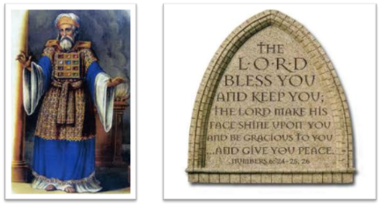
²⁴ The Lord bless you, and keep you; ²⁵ The Lord make His face shine on you, And be gracious to you; ²⁶ The Lord lift up His countenance on you, And give you peace.
Numbers 6:24–26 (NASB95)

