Slide 1


Slide 2
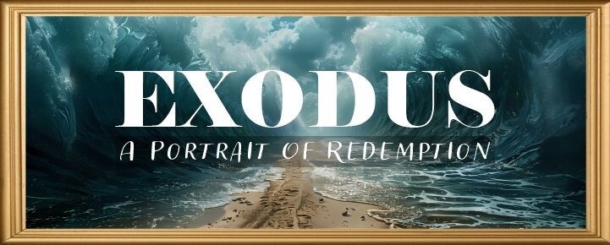


Slide 3
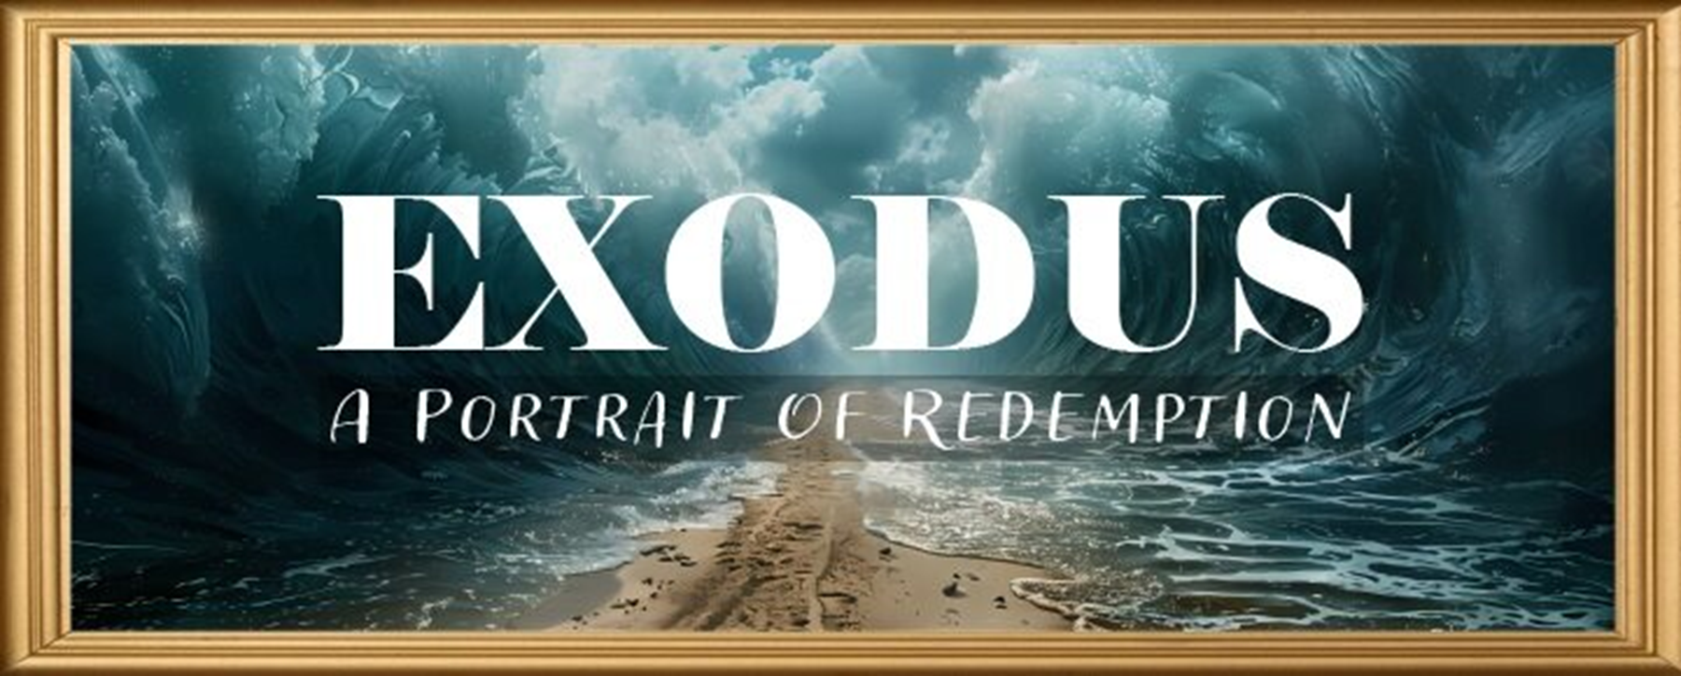
EXODUS STRUCTURE/OUTLINE
Redemption (1–18)
Redemption (1:1–12:30)
Liberation (12:31–15:21)
Preservation (15:22–18:27)
Mosaic Covenant (19–40)
Law (19–24)
Tabernacle instructions (25–31)
Apostasy (32–34)
Tabernacle building (35–40)

Slide 4
REDEMPTION (1:1–12:30)
Why redemption is necessary (Exod 1)
Development of the deliverer (Exod 2–4)
First confrontation with Pharaoh (Exod 5)
God reassures Moses (Exod 6:1–7:7)
Second confrontation with Pharaoh (Exod 7:8-13)
Plagues (Exod 7:14–12:30)

Slide 5
TEN PLAGUES REDEMPTION (7:14–12:30)
Nile to blood
Frogs
Gnats
Flies
Death of livestock
Boils
Hail
Locusts
Darkness
Death of 1st born

Slide 6
The Plagues of Egypt
NO. | DESCRIPTION | SCRIPTURE | Egyptian Deity
1. | Water to Blood | Exod. 7:14-25 | Hapi, Khnum
2. | Frogs | Exod. 8:1-15 | Heqt
3. | Gnats | Exod. 8:16-19 | Set
4. | Flies | Exod. 8:20-32 | Uatchit
5. | Disease on Cattle | Exod. 9:1-7 | Hathor, Apis
6. | Boils | Exod. 9:8-12 | Sekhmet, Serapis
7. | Hail | Exod. 9:13-35 | Seth, Nut
8. | Locusts | Exod. 10:1-20 | Seth, Nut, Osiris
9. | Darkness | Exod. 10:21-29 | Re, Horus, Atum
10. | Death of the First Born | Exod. 12:29-36 | Min, Osiris, Heqt, Isis

Slide 7
SECOND CONFRONTATION WITH PHARAOH Exodus 7:1-25
The Prophets (1-7)
The Power (8-13)
The Plagues (14-25)

Slide 8
III. Exodus 7:14-25 The Plagues
Pharaoh’s condition (14)
God’s instruction (15-19)
Moses’ obedience (20-25)

Slide 9
Exodus 7:20-25 Moses’ Obedience
Nile to blood (20-21)
Pharaoh’s miracle (22a)
Pharaoh’s hardness (22b-23)
Lasting results (24)
Duration (25)

Slide 10
Exodus 7:20-25 Moses’ Obedience
Nile to blood (20-21)
Pharaoh’s miracle (22a)
Pharaoh’s hardness (22b-23)
Lasting results (24)
Duration (25)

Slide 11
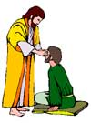
“SEVEN SIGNS” in Gospel of John
1. Changing Water into Wine | 2:11
2. Healing official’s son | 4:46-54
3. Healing an invalid at the Pool of Bethesda | 5:1-18
4. Feeding the 5,000 | 6:5-14
5. Walking on water | 6:16-21
6. Healing a blind man | 9:1-7
7. Raising dead Lazarus | 11:1-45

Slide 12
THREE PHASES OF MOSES’ 120 YEAR LIFE
LIFE PHASE | SCRIPTURE | YEARS | AGE | ACTIVITY
Natural Training | Acts 7:23 | 1526–1486 B.C. | 1-40 | Egyptian Education
Spiritual Training | Exod. 7:7 | 1486–1446 B.C. | 40-80 | Midian Shepherding
Ministry | Deut. 31:2; 34:7; Acts 7:36 | 1446–1406 B.C. | 80-120 | Exodus, Law, Wilderness Preservation, Pentateuch Authorship

Slide 13
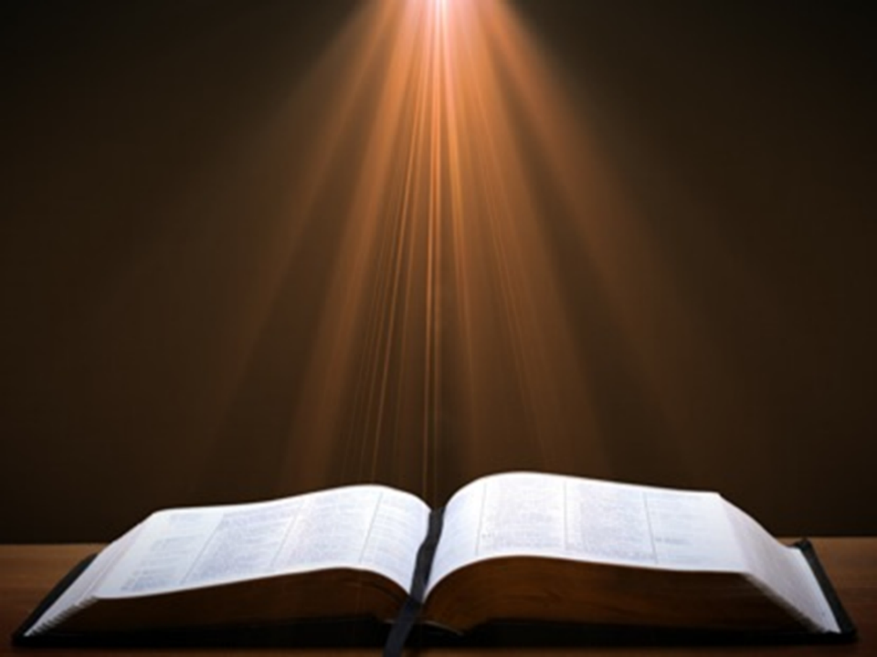

John 13:19; 14:29
“¹⁹ From now on I am telling you before it comes to pass, so that when it does occur, you may believe that I am He… ^{14:29} Now I have told you before it happens, so that when it happens, you may believe.”

Slide 14
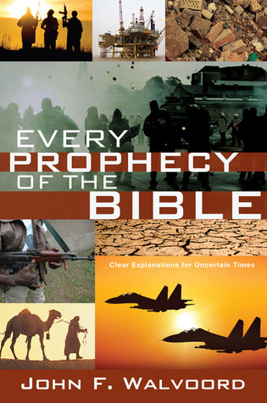

Slide 15
What Happened to Christ’s Disciples?
Disciple | Place | Martyrdom
James the Son of Alpheus | Jerusalem | Clubbed to death
Simon the Zealot | Jerusalem | Martyred
James the Son of Zebedee | Judea (Acts 12:2) | Executed
Thaddeus | Mesopotamia | Beaten to death
Peter | Babylon, Rome | Crucified upside down
Matthew | Parthia (Tehran) | Beheaded
Notes:
109 prophecies…
Peter Stoner – SCIENCE SPEAKS, An Evaluation of Certain Christian Evidences
To fulfill just 8 prophecies =1 X 10 to the twenty-eighth power!
Can we visualize this with an illustration? Suppose we took an atheistic professor, blindfolded him and covered the state of Texas two feet deep with silver dollars. Then we put a check on one of those silver dollars and mixed them up. The odds of one person fulfilling just these eight prophecies would be the same as this atheistic professor selecting the silver dollar upon which we have placed a check, in his first try.
https://www.bereanpublishers.com/the-odds-of-eight-messianic-prophecies-coming-true/

Slide 16
What Happened to Christ’s Disciples?
Disciple | Place | Martyrdom
John | Asia Minor, Patmos, Ephesus | Fried in boiling oil
Philip | E. Turkey | Tortured & crucified
Thomas | India | Speared
Bartholomew | India | Flayed & crucified
Andrew | Ukraine, Russia, Greece | Hanged
Notes:
109 prophecies…
Peter Stoner – SCIENCE SPEAKS, An Evaluation of Certain Christian Evidences
To fulfill just 8 prophecies =1 X 10 to the twenty-eighth power!
Can we visualize this with an illustration? Suppose we took an atheistic professor, blindfolded him and covered the state of Texas two feet deep with silver dollars. Then we put a check on one of those silver dollars and mixed them up. The odds of one person fulfilling just these eight prophecies would be the same as this atheistic professor selecting the silver dollar upon which we have placed a check, in his first try.
https://www.bereanpublishers.com/the-odds-of-eight-messianic-prophecies-coming-true/

Slide 17
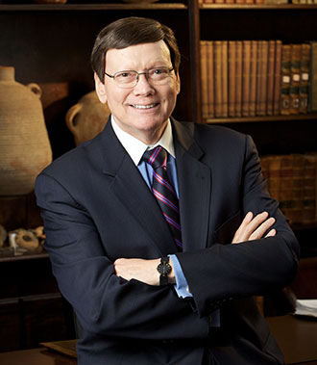
Dr. Ed Hindson
Hindson, E. E., & Mitchell, D. R., eds. (2010). King James Version Bible Commentary for Today: The Most Up-to-Date Commentary on the Time-Honored Text of the King James Version (p. 90). Thomas Nelson.
“The purpose was to demonstrate the Lord’s superiority over Egypt’s voluminous number of false gods (12:12; 18:11; Num. 33:4). There were some eighty ancient-Egyptian gods, each one the personification of an animal or object. In addition, Pharaoh himself was considered to be the incarnation of the god Horus, with the court magicians serving as his priests. Each of the ten plagues was designed to challenge a specific god or gods within the Egyptian pantheon and ultimately to topple the credibility of Pharaoh’s own divinity as well (see Davis, Moses, pp. 79–129).”

Slide 18
Dr. Ed Hindson
Hindson, E. E., & Mitchell, D. R., eds. (2010). King James Version Bible Commentary for Today: The Most Up-to-Date Commentary on the Time-Honored Text of the King James Version (p. 91). Thomas Nelson.
“This plague, as were they all, was meant to demonstrate the Lord’s superiority over Pharaoh and his gods. The Nile River was considered sacred, the very bloodstream of the god Osirus. Other deities challenged by this particular plague were Khnum, the guardian of the Nile; Hapi, the spirit of the Nile; and Sepek, the crocodile god.”

Slide 19

Charles Ryrie Ryrie Study Bible, page 100
Exodus 7:17 - “The reflection of the setting sun on the river might give the water a red appearance temporarily but would not cause the fish to die and the water to become unusable. Nor would red silting, not uncommon to the Nile, do this. This was a supernatural judgment. The water was turned to blood in terms of appearance (taste, smell, and texture).”

Slide 20
Exodus 7:20-25 Moses’ Obedience
Nile to blood (20-21)
Pharaoh’s miracle (22a)
Pharaoh’s hardness (22b-23)
Lasting results (24)
Duration (25)

Slide 21

Satanic/Demonic Miracles
Exod. 7–8
Deut. 13:1-3
Job 1:12-19; 2:7-8
1 Sam. 28?
Matt. 7:21-23; 24:24
Luke 4:5
Acts 8:9; 16:16
Gal. 1:6-9
2 Thess. 2:9
2 Cor. 11:14
Rev. 13:3, 13, 15; 16:13-14

Slide 22

Galatians 1:6–9
⁶ I am amazed that you are so quickly deserting Him who called you by the grace of Christ, for a different gospel; ⁷ which is really not another; only there are some who are disturbing you and want to distort the gospel of Christ. ⁸ But even if we, or an angel from heaven, should preach to you a gospel contrary to what we have preached to you, he is to be accursed! ⁹ As we have said before, so I say again now, if any man is preaching to you a gospel contrary to what you received, he is to be accursed!

Slide 23
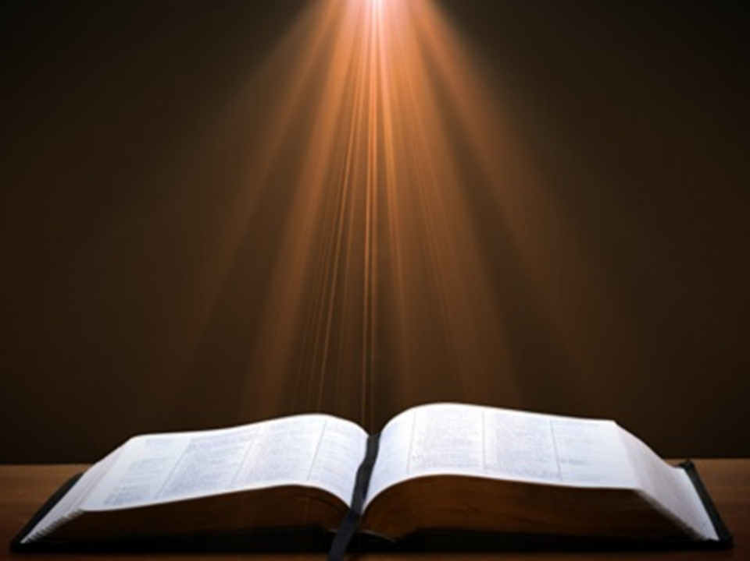
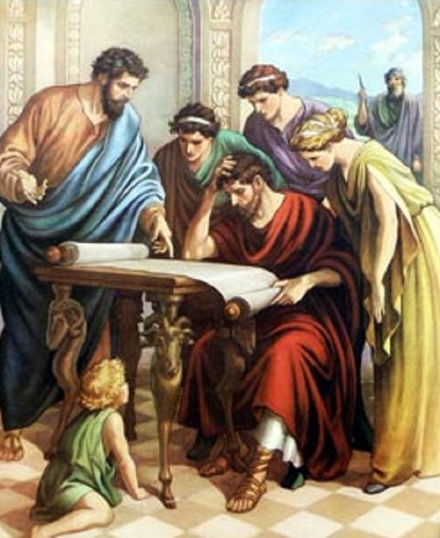
Acts 17:11
“Now these were more noble-minded than those in Thessalonica, for they received the word with great eagerness, examining the Scriptures daily to see whether these things were so.”

Slide 24
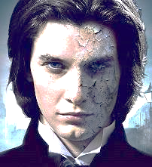
1 John 4:1
“Beloved, do not believe every spirit, but test the spirits to see whether they are from God, because many false prophets have gone out into the world.”

Slide 25
Exodus 7:20-25 Moses’ Obedience
Nile to blood (20-21)
Pharaoh’s miracle (22a)
Pharaoh’s hardness (22b-23)
Lasting results (24)
Duration (25)

Slide 26
Charles Ryrie Ryrie Study Bible, page 96
Exodus 4:21 - “harden his heart. Ten times it is said that Pharaoh hardened his own heart (7:13, 14, 22; 8:15, 19, 32; 9:7, 34, 35; 13:15), and 10 times that God hardened Pharaoh’s heart (4:21; 7:3; 9:12; 10:1, 20, 27; 11:10; 14:4, 8, 17). Paul uses this as an example of the inscrutable will of God and of His mercy toward men (Rom. 9:14–18). Seven times Pharaoh hardened his own heart before God first hardened it, though the prediction that God would do it preceded all.”

Slide 27
Dr. Ed Hindson
Hindson, E. E., & Mitchell, D. R., eds. (2010). King James Version Bible Commentary for Today: The Most Up-to-Date Commentary on the Time-Honored Text of the King James Version (p. 86). Thomas Nelson.
“4:21. I will harden his heart. An expression meaning ‘to strengthen his will.’ The text identifies the heart as the location of the volition, man’s decision-making ability. On seven occasions in the narrative, God hardens Pharaoh’s heart (9:12; 10:1, 20, 27; 11:10; 14:4, 8) or foretells that He will harden Pharaoh’s heart (4:21; 7:3), and nine times in the text, Pharaoh hardens his own heart (7:13, 14, 22; 8:15, 19, 32; 9:7, 34–35). For the initial five plagues, the text registers Pharaoh as the agent of hardening. Not until the sixth plague does God participate in the confirmation of Pharaoh’s own volitional choices.”

Slide 28
GOD HARDENING PHARAOH'S HEART
The prediction of God hardening of Pharaoh (4:21)
Pharaoh repeatedly hardening his own heart (7:13, 22; 8:15, 19, 32; 9:7)
Not until the sixth plague did God harden Pharaoh’s heart (Exod 9:12)

Slide 29
Exodus 7:20-25 Moses’ Obedience
Nile to blood (20-21)
Pharaoh’s miracle (22a)
Pharaoh’s hardness (22b-23)
Lasting results (24)
Duration (25)

Slide 30
Dr. Ed Hindson
Hindson, E. E., & Mitchell, D. R., eds. (2010). King James Version Bible Commentary for Today: The Most Up-to-Date Commentary on the Time-Honored Text of the King James Version (p. 91). Thomas Nelson.
“During this period, the sole source of fresh water throughout Egypt was the underground natural springs. The Egyptians now had to exert themselves. As the Hebrews had to gather their own straw, now the Egyptians were forced to dig round about the river (v. 24) for their own water.”

Slide 31
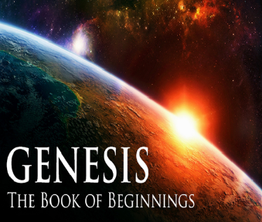
8 New Promises Genesis 12:1-3
Land (Gen. 12:1b)
Great nation (Gen. 12:2a)
Personal blessing (Gen. 12:2b)
Great name (Gen. 12:2c)
Blessing to others (Gen. 12:2d)
Blessing to blessers (Gen. 12:3a)
Cursing to cursers (Gen. 12:3b)
Blessing to the world (Gen. 12:3c)

Slide 32

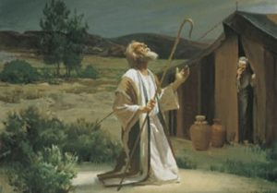
Genesis 12:3
“And I will bless those who bless you, And the one who curses you I will curse. And in you all the families of the earth will be blessed.”

Slide 33
Exodus 7:20-25 Moses’ Obedience
Nile to blood (20-21)
Pharaoh’s miracle (22a)
Pharaoh’s hardness (22b-23)
Lasting results (24)
Duration (25)

Slide 34
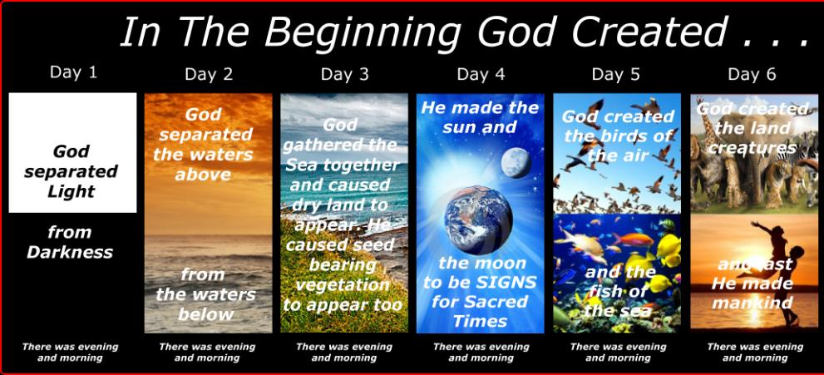
SHAPING AND POPULATING (GEN 1:1)
Day 1: | Light | Day 4: | Luminaries
Day 2: | Water, sky | Day 5: | Sea animals, birds
Day 3: | Land, vegetation | Day 6: | Land animals, man

Slide 35
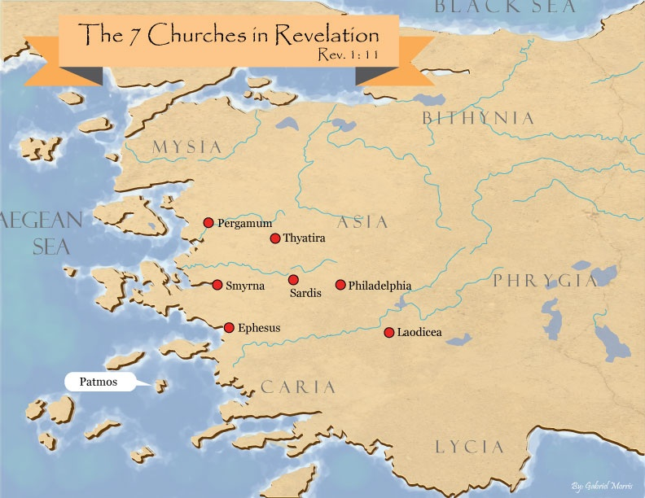
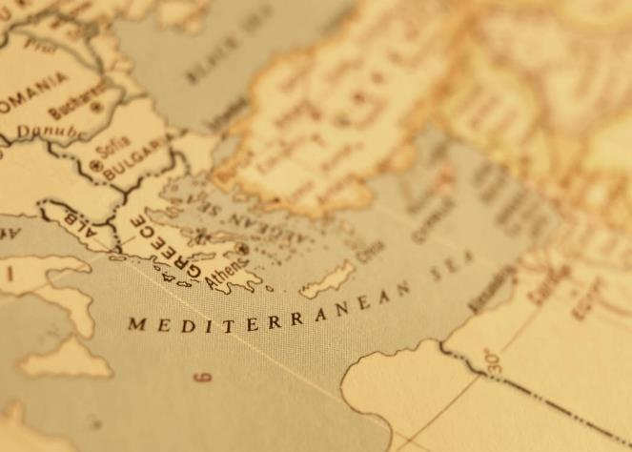

Slide 36

Genesis 6:1-3
“¹ Now it came about, when men began to multiply on the face of the land, and daughters were born to them, ² that the sons of God saw that the daughters of men were beautiful; and they took wives for themselves, whomever they chose. ³ Then the Lord said, “My Spirit shall not strive with man forever, because he also is flesh; nevertheless his days shall be one hundred and twenty years.”

Slide 37
Conclusion

Slide 38
III. Exodus 7:14-25 The Plagues
Pharaoh’s condition (14)
God’s instruction (15-19)
Moses’ obedience (20-25)

Slide 39
Exodus 7:20-25 Moses’ Obedience
Nile to blood (20-21)
Pharaoh’s miracle (22a)
Pharaoh’s hardness (22b-23)
Lasting results (24)
Duration (25)

Slide 40
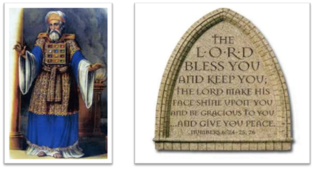
²⁴ The Lord bless you, and keep you; ²⁵ The Lord make His face shine on you, And be gracious to you; ²⁶ The Lord lift up His countenance on you, And give you peace.
Numbers 6:24–26 (NASB95)

