Slide 1
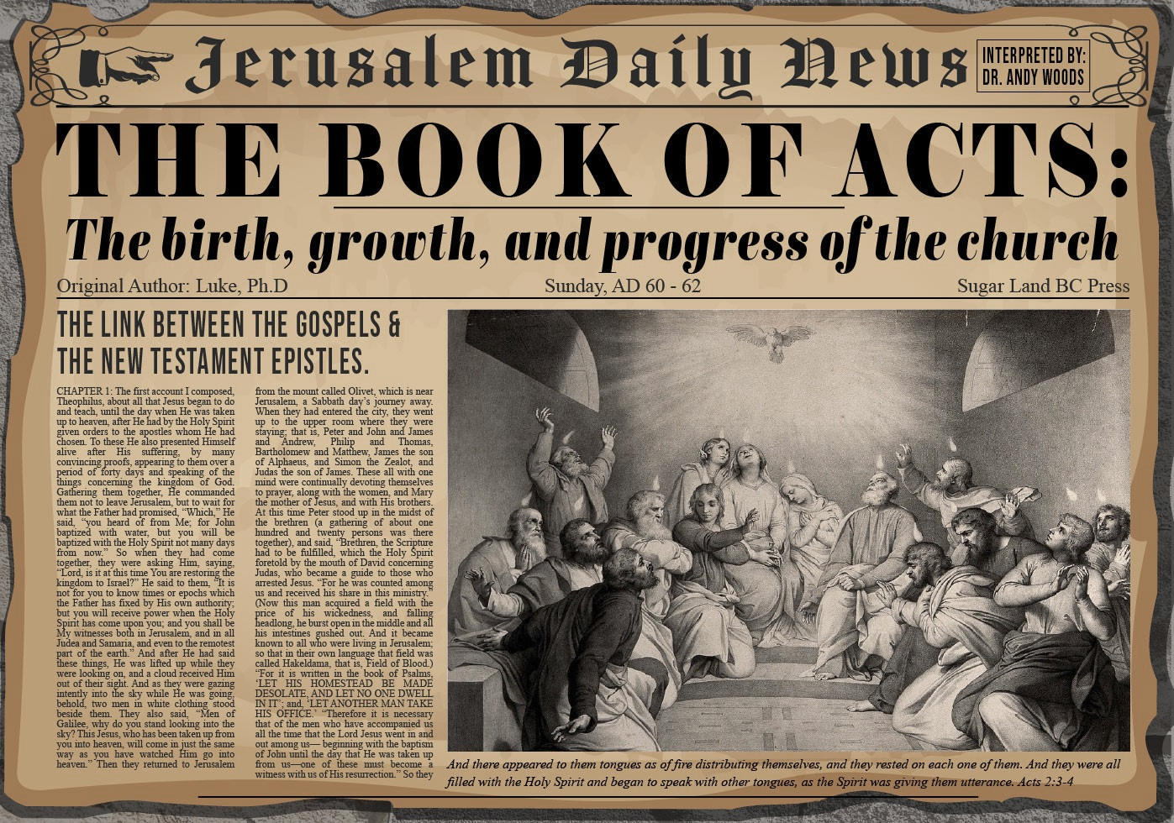


Slide 2
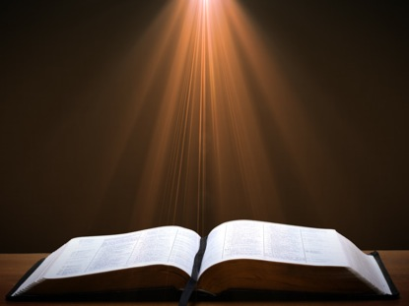
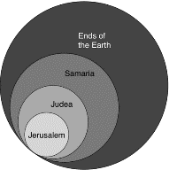
Acts 1:8
“but you will receive power when the Holy Spirit has come upon you; and you shall be My witnesses both in Jerusalem, and in all Judea and Samaria, and even to the remotest part of the earth.”

Slide 3
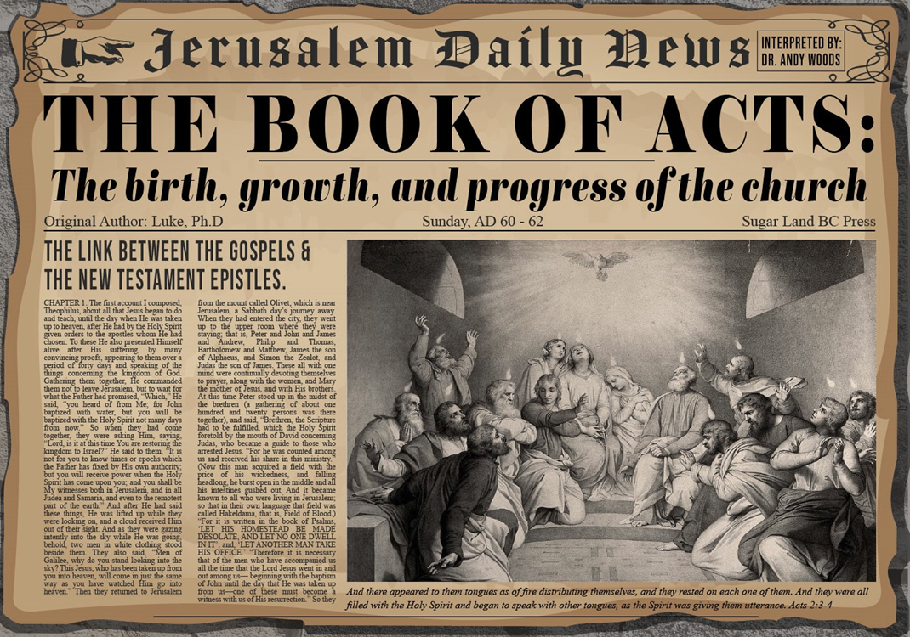
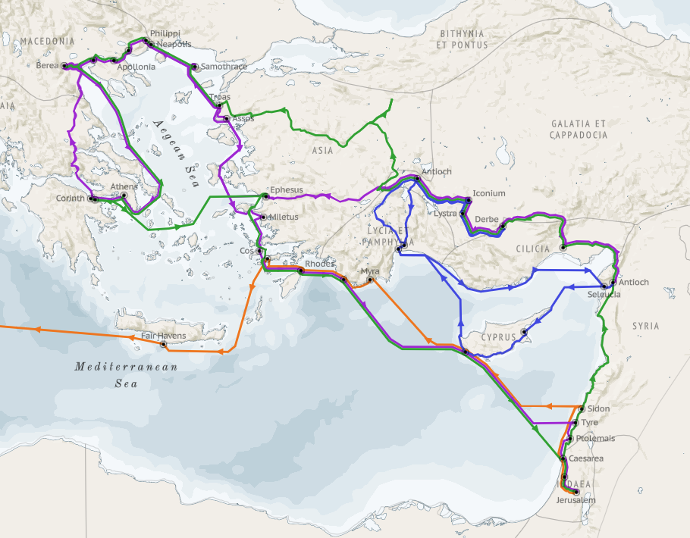
Structure (Acts 1:8)
Jerusalem (Acts 1–7)
Judea and Samaria (Acts 8–12)
Remotest part of the earth (Acts 13–28)
1st missionary journey (Acts 13–14)
Jerusalem council (Acts 15:1-35)
2nd missionary journey (Acts 15:36 –18:22)
3rd missionary journey (Acts 18:23–21:17)
Trip to Rome (Acts 21:18–28:31)

Slide 4
Acts 15:1-35 Jerusalem Council
Occasion (1-5)
Declarations (6-21)
Decision (22-29)
Delivery (30-35)

Slide 5
II. Declarations Acts 15:6-21
Meeting convened (6)
Peter’s address (7-11)
Barnabas’ & Paul’s testimony (12)
James’ address (13-21)

Slide 6
Acts 15:13-21 James’ Address
Introduction (13a)
Addressees (13b)
Peter’s address (14)
Old Testament citation (15-18)
Conclusions (19-21)

Slide 7
Acts 15:13-21 James’ Address
Introduction (13a)
Addressees (13b)
Peter’s address (14)
Old Testament citation (15-18)
Conclusions (19-21)

Slide 8

Acts 1:13-14
“ ¹³ When they had entered the city, they went up to the upper room where they were staying; that is, Peter and John and James and Andrew, Philip and Thomas, Bartholomew and Matthew, James the son of Alphaeus, and Simon the Zealot, and Judas the son of James. ¹⁴ These all with one mind were continually devoting themselves to prayer, along with the women, and Mary the mother of Jesus, and with His brothers.”

Slide 9
JAMES OF THE NEW TESTAMENT
Father of Judas (not Iscariot)
The son of Alphaeus
The son of Zebedee and brother of John
The half brother of Christ

Slide 10
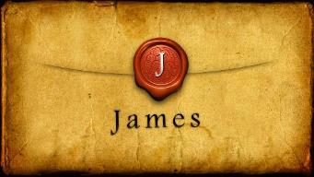
Which James?
Father of Judas (not Iscariot)
The son of Alphaeus
The son of Zebedee and brother of John
The half brother of Christ

Slide 11
SIMILARITIES WITH ACTS 15
 | James | Acts 15
Greetings | 1:1 | 15:23
Visit | 1:27 | 15:14
Listen | 2:5 | 15:13
Turn | 5:19-20 | 15:19
Being called by God’s name | 2:7 | 15:17

Slide 12
Acts 15:13-21 James’ Address
Introduction (13a)
Addressees (13b)
Peter’s address (14)
Old Testament citation (15-18)
Conclusions (19-21)

Slide 13
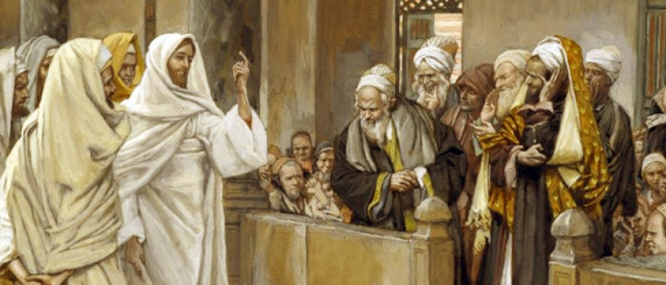
TYPES OF PHARISEES
TYPE | OVERTHROWN
Justification | Matthew 5:20
Sanctification | Galatians 3:3
Ecclesiology | Acts 15

Slide 14
Acts 15:13-21 James’ Address
Introduction (13a)
Addressees (13b)
Peter’s address (14)
Old Testament citation (15-18)
Conclusions (19-21)

Slide 15

Acts 15:14
“Simeon has related how God first concerned Himself about taking from among the Gentiles a people for His name.”

Slide 16

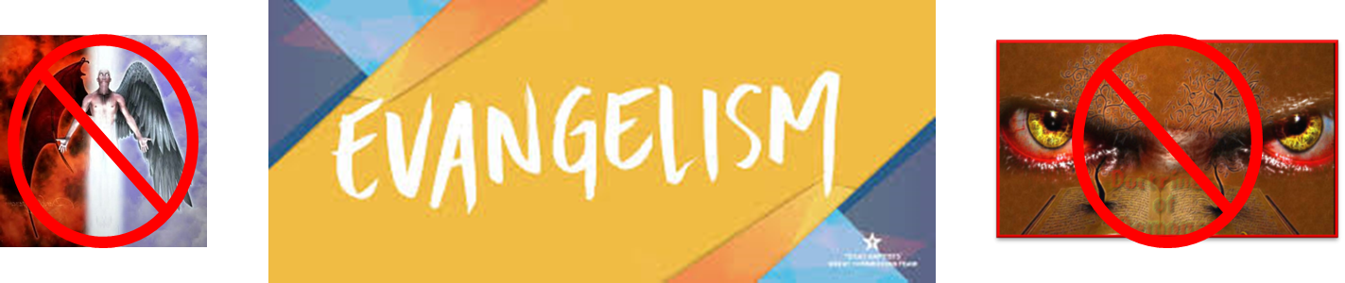
Matthew 16:18
“I also say to you that you are Peter (Petros), and upon this rock (petra) I will build [oikodomeō] My church; and the gates of Hades WILL NOT overpower it.”

Slide 17
Acts 15:14
“Simeon has related how God first concerned Himself about taking from among the Gentiles a people for His name.”

Slide 18
Romans 11:25-26
“²⁵ For I do not want you, brethren, to be uninformed of this mystery—so that you will not be wise in your own estimation—that a partial hardening has happened to Israel until the fullness of the Gentiles has come in; ²⁶ and so all Israel will be saved; just as it is written, ‘The Deliverer will come from Zion, He will remove ungodliness from Jacob.’”

Slide 19
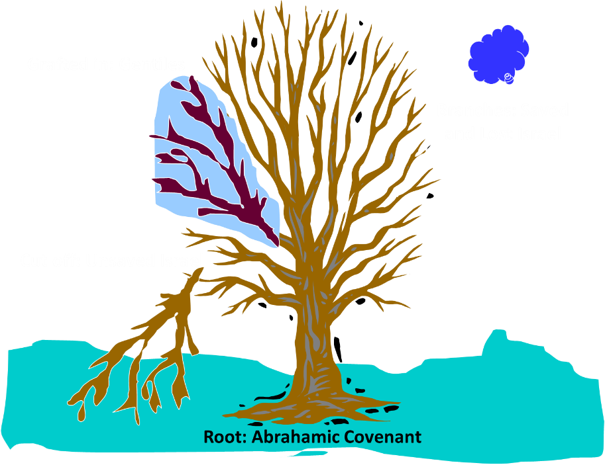
Notes:
19

Slide 20

Acts 15:14-21
¹⁴ “Simeon has related how God first concerned Himself about taking from among the Gentiles a people for His name. ¹⁵ With this the words of the Prophets agree, just as it is written, ¹⁶ ‘After these things I will return, And I will rebuild the tabernacle of David which has fallen, And I will rebuild its ruins, And I will restore it, ¹⁷ So that the rest of mankind may seek the Lord, And all the Gentiles who are called by My name,’ ¹⁸ Says the Lord, who makes these things known from long ago.”

Slide 21


Thomas Ice Tim LaHaye Prophecy Study Bible, p. 1304.
“James explains how the decision of the council at Jerusalem was an outworking of God‘s purpose for this age. God‘s plan for history relates to the past ages with Israel and to Israel‘s role in the coming age (the Millennium), but the current Church Age will center around the Gentiles. After the Church Age is concluded, the Lord will return, and ‘rebuild the tabernacle of David’ [verse 16], i.e., the nation of Israel. This Old Testament reference is from Amos 9:11–12. During the Tribulation the Lord will work to convert the nation of Israel to Himself, ending with the second coming and the millennial reign of Christ. God‘s plans for history will come to pass just as He ordained.”

Slide 22
Acts 15:13-21 James’ Address
Introduction (13a)
Addressees (13b)
Peter’s address (14)
Old Testament citation (15-18)
Conclusions (19-21)

Slide 23
Acts 15:15-18 Old Testament Citation
Introduction (15)
Amos 9:11-12 (16-18)

Slide 24
Acts 15:15-18 Old Testament Citation
Introduction (15)
Amos 9:11-12 (16-18)

Slide 25
Acts 15:14-21
¹⁴ “Simeon has related how God first concerned Himself about taking from among the Gentiles a people for His name. ¹⁵ With this the words of the Prophets agree [symphōneō], just as it is written, ¹⁶ ‘After these things I will return, And I will rebuild the tabernacle of David which has fallen, And I will rebuild its ruins, And I will restore it, ¹⁷ So that the rest of mankind may seek the Lord, And all the Gentiles who are called by My name,’ ¹⁸ Says the Lord, who makes these things known from long ago.”…

Slide 26

Acts 1:16
“Brethren, the Scripture had to be fulfilled (plēroō), which the Holy Spirit foretold by the mouth of David concerning Judas, who became a guide to those who arrested Jesus.”

Slide 27
Acts 15:15-18 Old Testament Citation
Introduction (15)
Amos 9:11-12 (16-18)

Slide 28
Acts 15:14-21
¹⁴ “Simeon has related how God first concerned Himself about taking from among the Gentiles a people for His name. ¹⁵ With this the words of the Prophets agree, just as it is written, ¹⁶ ‘After these things I will return, And I will rebuild the tabernacle of David which has fallen, And I will rebuild its ruins, And I will restore it, ¹⁷ So that the rest of mankind may seek the Lord, And all the Gentiles who are called by My name,’ ¹⁸ Says the Lord, who makes these things known from long ago.”…

Slide 29
ORDER OF PAUL’S LETTERS | ORDER OF PAUL’S LETTERS
1. | Galatians | A.D. 49
2. | 1‒2 Thessalonians | A.D. 51
3. | 1‒2 Corinthians | A.D. 56
4. | Romans | A.D. 57
5. | Ephesians, Colossians, Philemon, Philippians | A.D. 60‒62
6. | 1 Timothy, Titus | A.D. 62‒66
7. | 2 Timothy | A.D. 67

Slide 30
Luke 24:27, 44
“²⁷ Then beginning with Moses and with all the prophets, He explained to them the things concerning Himself in all the Scriptures…⁴⁴ Now He said to them, ‘These are My words which I spoke to you while I was still with you, that all things which are written about Me in the Law of Moses and the Prophets and the Psalms must be fulfilled.’”

Slide 31
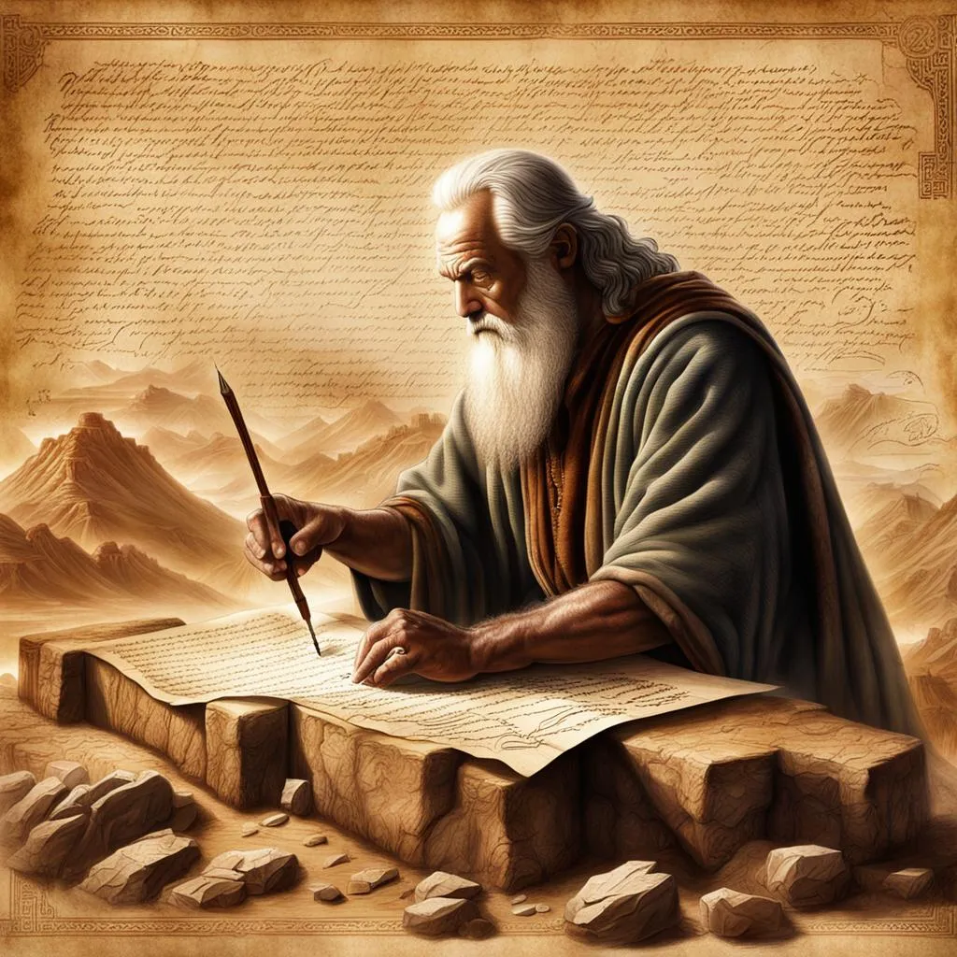
John 5:39, 46
“³⁹ You search the Scriptures because you think that in them you have eternal life; it is these that testify about Me…⁴⁶ For if you believed Moses, you would believe Me, for he wrote about Me.”

Slide 32
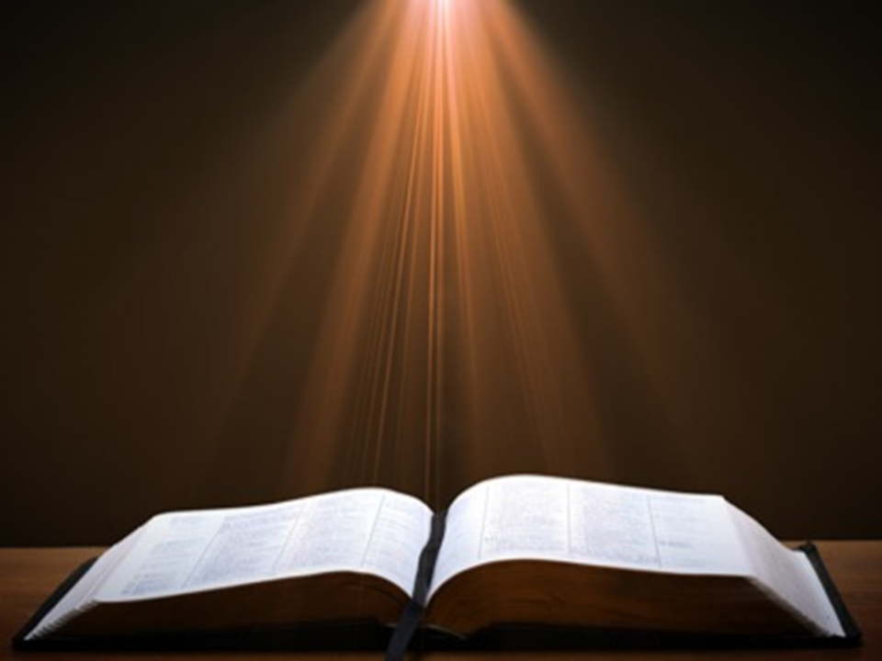
Acts 17:1-3
“¹ Now when they had traveled through Amphipolis and Apollonia, they came to Thessalonica, where there was a synagogue of the Jews. ² And according to Paul’s custom, he visited them, and for three Sabbaths reasoned with them from the Scriptures, ³ explaining and giving evidence that the Christ had to suffer and rise from the dead, and saying, “This Jesus whom I am proclaiming to you is the Christ.”

Slide 33

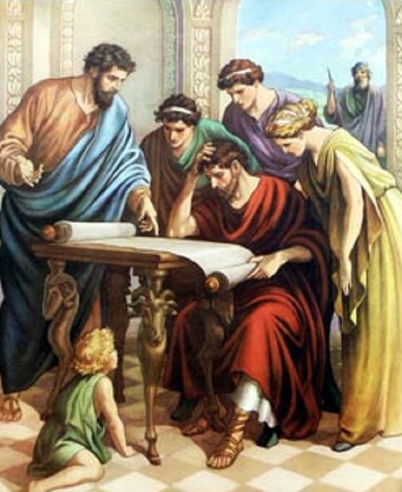
Acts 17:11
“Now these were more noble-minded than those in Thessalonica, for they received the word with great eagerness, examining the Scriptures daily to see whether these things were so.”

Slide 34

1 Corinthians 15:3-4
“³ For I handed down to you as of first importance what I also received, that Christ died for our sins according to the Scriptures, ⁴ and that He was buried, and that He was raised on the third day according to the Scriptures.”

Slide 35
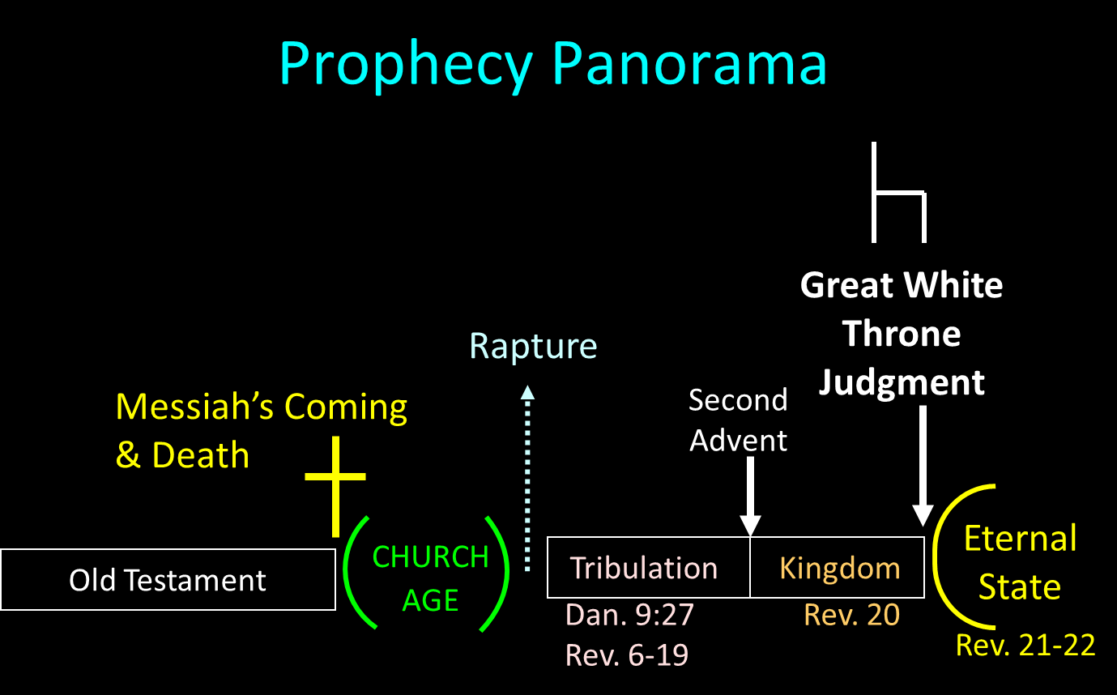

Slide 36
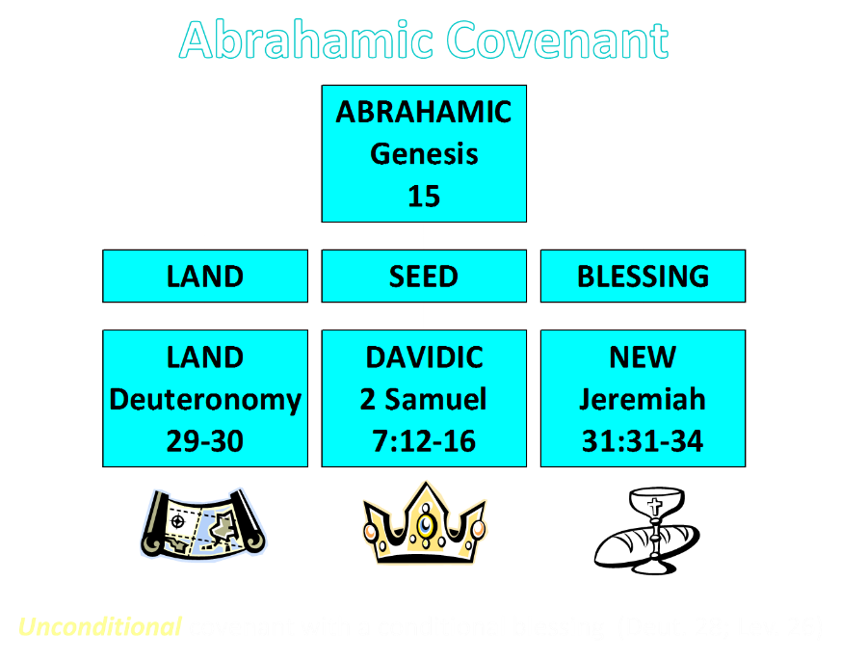

Slide 37
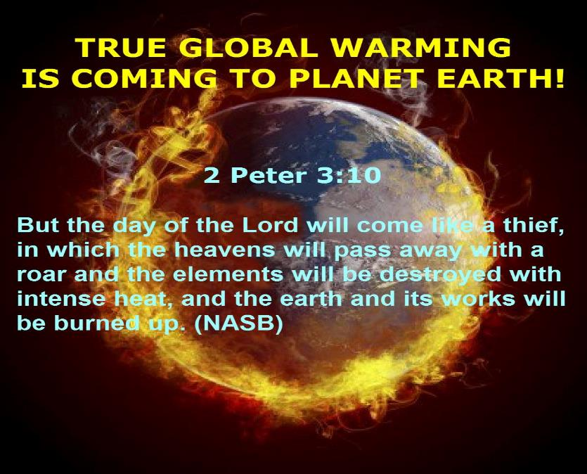

Slide 38
2 Peter 3:10-11
“¹⁰ But the day of the Lord will come like a thief, in which the heavens will pass away with a roar and the elements will be destroyed with intense heat, and the earth and its works will be burned up. ¹¹ Since all these things are to be destroyed in this way, what sort of people ought you to be in holy conduct and godliness.”

Slide 39
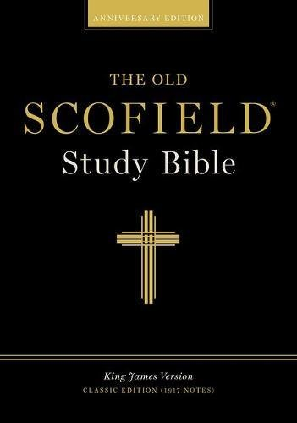
Scofield Reference Bible
Page 1520
“...begins with the words ‘on that day.’ James introduced this quotation in such a way as to show what day Amos was talking about, namely, the time after the present world witness (Acts 1:8), when Christ will return. James showed that there will be Gentile believers at that time, as well as Jewish believers; hence he concluded that Gentiles are not required to become Jewish proselytes by circumcision.”

Slide 40

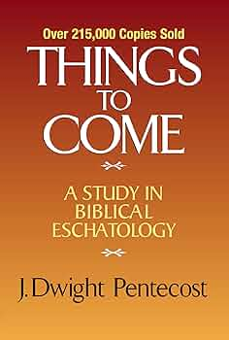
J. Dwight Pentecost
Thy Kingdom Come, Page 279-80
“Afterward a question was raised concerning whether it was necessary for the Gentiles who had believed and had been brought into the church to abide by the precepts of the Mosaic Law. Judaizers insisted that in order to please God as believers and members of the kingdom of God, it was necessary for all men to live under the precepts of the Mosaic Law. This question was submitted to the apostles in Jerusalem, and Peter testified to the salvation of the Gentiles by faith in Jesus Christ apart from the Law (15:7–11).”

Slide 41
J. Dwight Pentecost
Thy Kingdom Come, Page 279-80
“His testimony is further corroborated by Barnabas and Paul (v. 12), and James who presided at this council hearing rendered the decision of the council. It was evident that God for the first time in dealing with men was dealing with Gentiles as Gentiles ‘taking from the Gentiles a people for Himself (v. 14). James found this in keeping with the prophetic program. In Amos 9:11–12 it was prophesied that after the period in which Israel was disciplined because of disobedience (vv. 1–10) and the Davidic throne left empty for a time, the Davidic throne would be restored and the Davidic kingdom would be instituted.”

Slide 42
J. Dwight Pentecost
Thy Kingdom Come, Page 279-80
“When it is reinstituted, the kingdom will include not only the physical descendants of Abraham, but also a multitude of Gentiles as well. Therefore the restored Davidic kingdom under its rightful Davidic king would be composed of both Jews and Gentiles. In that kingdom Gentiles would not be made into Jews; instead they would be in the kingdom as Gentiles. This allowed James to conclude that if God had a program for Gentiles as Gentiles in the future Davidic kingdom established here on the earth, there was no reason to deny that God could include Gentiles as Gentiles in this present form of the theocracy.”

Slide 43
J. Dwight Pentecost
Thy Kingdom Come, Page 279-80
“Therefore the issue was settled—the Gentiles did not need to be circumcised and bring themselves under the Mosaic Law in order to participate in the present form of the kingdom. Rather, apart from the Mosaic Law, through faith in Jesus Christ they are equal participants with believing Jews in the present form of the kingdom of God”

Slide 44
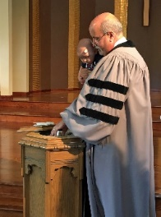
Kim Riddlebarger
Kim Riddlebarger, A Case for Amillennialism: Understanding the End Times (Grand Rapids: Baker, 2003), 39-40.
“In Acts 15, the church in Antioch appointed Paul and Barnabas to report to the Jerusalem council regarding the salvation of the Gentiles and to seek help in resolving the question that had been troubling the church as a result. Should Gentile converts be circumcised in order to be saved? Once in the city, Paul and Barnabas reported to the elders and apostles on all the things God was doing among the Gentiles (v. 4). When certain converted Pharisees declared that Gentiles must be circumcised and obey the law of Moses (v. 5), Peter refuted their arguments by pointing out that it was God who had given these Gentiles the Holy Spirit:”

Slide 45
Kim Riddlebarger
Kim Riddlebarger, A Case for Amillennialism: Understanding the End Times (Grand Rapids: Baker, 2003), 39-40.
“‘We believe it is through the grace of our Lord Jesus that we are saved, just as they are’ (v. 11). Then James, the leader of the church, spoke (vv. 13ff.): ‘God at first showed his concern by taking from the Gentiles a people for himself. The words of the prophets are in agreement with this, as it is written,’ and James cited a passage from Amos 9:11–12: ‘After this I will return and rebuild David’s fallen tent. Its ruins I will rebuild, and I will restore it, that the remnant of men may seek the Lord, and all the Gentiles who bear my name, says the Lord, who does these things’ that have been known for ages.’”

Slide 46
Kim Riddlebarger
Kim Riddlebarger, A Case for Amillennialism: Understanding the End Times (Grand Rapids: Baker, 2003), 39-40.
“James saw the prophecy as fulfilled in Christ’s resurrection and exaltation and in the reconstitution of his disciples as the new Israel. The presence of both Jew and Gentile in the church was proof that the prophecy of Amos had been fulfilled. David’s fallen tent had been rebuilt by Christ. In Amos’s prophecy, ‘after this’ indicated that the prophecy referred to what God would do for Israel after the exile. When James applied this prophecy to the church, was he spiritualizing an Old Testament text? Or was James reading the Old Testament through a Christ-centered lens typical of the greater light of the messianic age?”

Slide 47
Acts 15:14-21
¹⁴ “Simeon has related how God first concerned Himself about taking from among the Gentiles a people for His name. ¹⁵ With this the words of the Prophets agree [symphōneō], just as it is written, ¹⁶ ‘After these things I will return, And I will rebuild the tabernacle of David which has fallen, And I will rebuild its ruins, And I will restore it, ¹⁷ So that the rest of mankind may seek the Lord, And all the Gentiles who are called by My name,’ ¹⁸ Says the Lord, who makes these things known from long ago.”…

Slide 48
Acts 1:16
“Brethren, the Scripture had to be fulfilled (plēroō), which the Holy Spirit foretold by the mouth of David concerning Judas, who became a guide to those who arrested Jesus.”

Slide 49
Kim Riddlebarger
Kim Riddlebarger, A Case for Amillennialism: Understanding the End Times (Grand Rapids: Baker, 2003), 39-40.
“This question lies at the heart of the debate between amillenarians and dispensationalists. The famous notes of the Scofield Reference Bible (1909) say that from a dispensational perspective James’s speech is the most important in the New Testament. According to Scofield, James is describing what will happen after the church age concludes (‘after this’), i.e., in the millennium, when God will reestablish a Davidic rule over Israel. If this is true, when Paul and Barnabas sought guidance for a concern that was immediate to them (Should Gentile converts be circumcised?), James responded by pointing to a future millennium thousands of years distant.”

Slide 50
2 Peter 3:10-11
“¹⁰ But the day of the Lord will come like a thief, in which the heavens will pass away with a roar and the elements will be destroyed with intense heat, and the earth and its works will be burned up. ¹¹ Since all these things are to be destroyed in this way, what sort of people ought you to be in holy conduct and godliness.”

Slide 52
Kim Riddlebarger
Kim Riddlebarger, A Case for Amillennialism: Understanding the End Times (Grand Rapids: Baker, 2003), 39-40.
“Here is one instance in which dispensational presuppositions get in the way of the plain sense of the text. Scofield interprets the text literalistically, not literally. Dispensationalists are often forced to reinterpret any New Testament data that does not fit in their Old Testament–derived prophetic scheme. Dispensational presuppositions will not fit with much of the interpretation supplied to Old Testament data by New Testament authors. A thorough survey of both Old Testament and New Testament eschatological categories will demonstrate the dispensational hermeneutic to be untenable.”

Slide 53
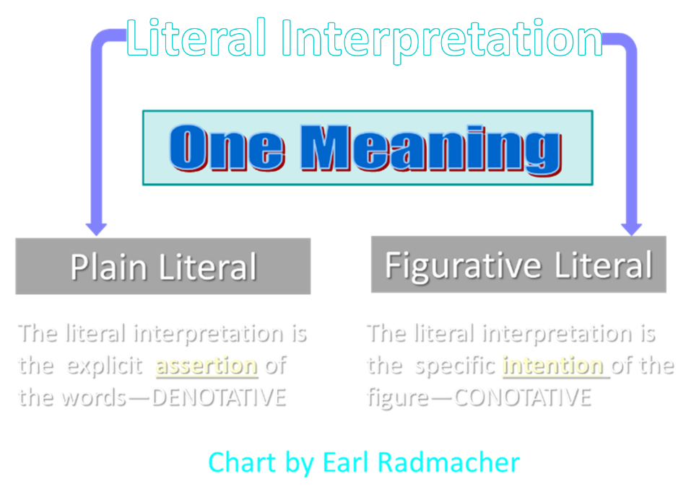

Slide 54
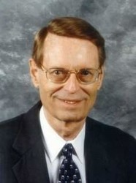
Charles Ryrie Dispensationalism (Chicago: Moody Press, 1965), 86.
Literal interpretation “…might also be called plain interpretation so that no one receives the mistaken notion that the literal principle rules out figures of speech.”

Slide 55
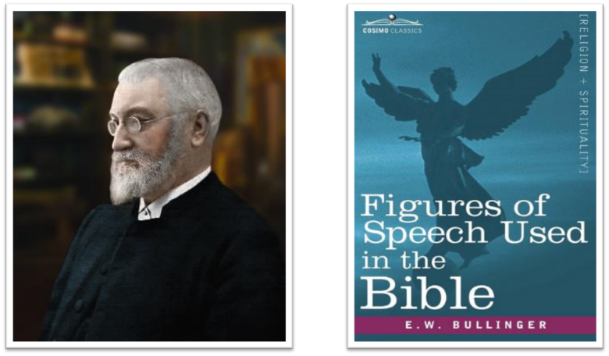
E.W. Bullinger (1837‒1913)

Slide 56
Kim Riddlebarger
Kim Riddlebarger, A Case for Amillennialism: Understanding the End Times (Grand Rapids: Baker, 2003), 39-40.
“More importantly, such a survey gives us the proper framework and external controls to interpret prophetic sections of Scripture correctly. The irony is that dispensationalists’ practice of interpreting all prophetic texts in a literalistic fashion amounts to a repudiation of the historic Protestant hermeneutic and the principle of the analogy of faith. If amillenarians adopt the New Testament writers’ interpretation of the Old Testament, are they not following the literal sense of Scripture, even if the New Testament writers universalize something that was limited to Israel in the Old Testament?”
Notes:
analogy of faith - Scripture is in agreement and will not contradict itself and we should interpret unclear passages in light of clear passages

Slide 57
Kim Riddlebarger
Kim Riddlebarger, A Case for Amillennialism: Understanding the End Times (Grand Rapids: Baker, 2003), 39-40.
“The dispensationalists’ literalistic reading of prophetic passages must not be confused with a literal reading. A literal reading—a reading that gets at the plain sense of the text—will allow the New Testament to interpret the Old. It is amillenarians, not dispensationalists, who interpret prophecy literally in that they follow the literal sense of how the writers of the New Testament interpret Old Testament prophecy.”

Slide 58
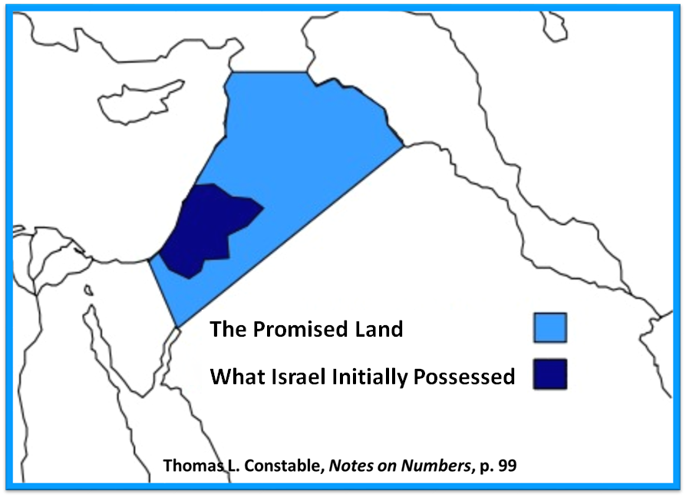

Slide 59
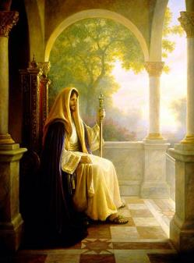
OT PROPHETS DESCRIBE THE KINGDOM
Kingdom Characteristics
Is. 2:1-4; 11:6-9; 65:17-25
Jerusalem = center of world spiritual and political authority
Perfect justice
World peace
Peace in the animal kingdom
Universal spiritual knowledge

Slide 60
OT PROPHETS DESCRIBE THE KINGDOM
Established by God (Dan. 2:44) Eternal (Dan. 7:27) Christ’s direct rule (Zech. 9:9-10) Earthly (Zech. 14:9) Land promises realized (Gen. 15:18-21) Israel’s preeminence (Isa. 49:22-23) Immediate answered prayers (Isa. 65:24) | Millennial Temple (Ezek. 40‒46) Millennial David (Jer. 30:9) Righteousness (Isa. 9:6-7) Curse curtailed (Isa. 65:20, 22) Peace (Isa. 2:4) Prosperity (Amos 9:13-14; Isa 65:22) Topographical changes (Ezek. 47:1-12)

Slide 61

“Here the Prophet describes the felicity which shall be under the reign of Christ: and we know that whenever the Prophets set forth promises of a happy and prosperous state to God’s people, they adopt metaphorical expressions, and say, that abundance of all good things shall flow, that there shall be the most fruitful produce, that provisions shall be bountifully supplied; for they accommodated their mode of speaking to the notions of that ancient people; it is therefore no wonder if they sometimes speak to them as to children. At the same time, the Spirit under these figurative expressions declares, that the kingdom of Christ shall in every way be happy and blessed, or that the Church of God, which means the same thing, shall be blessed, when Christ shall begin to reign.”
John Calvin
Commentary on Amos 9:13
Amos 9:13—“Behold the days come, saith the LORD, that the plowman shall overtake the reaper, and the treader of grapes him that soweth seed: and the mountains shall drop sweet wine, and all the hills shall melt.”

Slide 62


George Eldon Ladd
A Theology of the New Testament (Grand Rapids: Eerdmans, 1974), 336–37.
“[T]he new redemptive events in the course of Heilsgeschichte have compelled Peter to reinterpret the Old Testament. Because of the resurrection and ascension of Jesus, Peter transfers the messianic Davidic throne from Jerusalem to God’s right hand in heaven. Jesus has now been enthroned as the Davidic Messiah on the throne of David, and is awaiting the final consummation of his messianic reign.. .. This involves a rather radical reinterpretation of Old Testament prophecies, but no more so than the entire reinterpretation of God’s redemptive plan by the early church. In fact, it is an essential part of this reinterpretation demanded by the events of redemptive history.. ..Jesus is enthroned as the Messiah.... He must reign until all his enemies are made a stool for his feet.”

Slide 63


Darrell Bock
“Evidence from Acts,” in The Coming Millennial Kingdom, ed. Donald Campbell and Jeffrey Townsend (Chicago: Moody, 1992), 194.
“The Davidic throne and the heavenly throne of Jesus at the right hand of the Father are one and the same.”

Slide 64

2 Samuel 7:12-16
“When your days are complete and you lie down with your fathers, I will raise up your descendant after you, who will come forth from you, and I will establish his kingdom. ¹³ He shall build a house for My name, and I will establish the throne of his kingdom forever. ¹⁴ I will be a father to him and he will be a son to Me; when he commits iniquity, I will correct him with the rod of men and the strokes of the sons of men, ¹⁵ but My lovingkindness shall not depart from him, as I took it away from Saul, whom I removed from before you. ¹⁶ Your house and your kingdom shall endure before Me forever; your throne shall be established forever.” ¹⁷ In accordance with all these words and all this vision, so Nathan spoke to David.”

Slide 65

John F. Walvoord Israel in Prophecy (Grand Rapids: Zondervan, 1962), 84-85, 87.
“The covenant with David is not only given twice in its major content— namely, II Samuel 7 and I Chronicles 17—but it is also confirmed in Psalm 89. In this and other Old Testament references there is no allusion anywhere to the idea that these promises are to be understood in a spiritualized sense as referring to the church or to a reign of God in heaven. Rather, it is linked to the earth and to the seed of Israel, and to the land...There is no indication that this kingdom extended to a spiritual entity such as the church nor that the throne in view is the throne of God in heaven rather than the throne of David on earth...Such a situation does not prevail in this present age and is not related here or elsewhere to the reign of Christ from the throne of His Father in heaven.”

Slide 66
CHANGES | BIBLICAL DAVIDIC THRONE | DAVIDIC THRONE NOW?
Place: | Earth | Heaven
People: | Israel | Gentile Church
Israel: | Converted | Unconverted

Slide 67
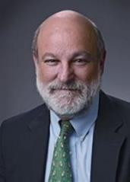
“Complementary Hermeneutics” in Progressive Dispensationalism
“…the New Testament does introduce change and advance; it does not merely repeat Old Testament revelation. In making complementary additions, however, it does not jettison Old Testament promises. The enhancement is not at the expense of the original promise.”
Craig Blaising and Darrell Bock, “Dispensationalism, Israel and the Church: Assessment and Dialogue,” in Dispensationalism, Israel and the Church, ed. Craig Blaising and Darrell Bock (Grand Rapids: Zondervan, 1992), 392–93.
Notes:
WRONG!!!

Slide 68
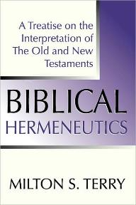
Milton Terry
Biblical Hermeneutics: A Treatise on the Interpretation of the Old and New Testaments (1885; reprint, Grand Rapids: Zondervan, 1947), 205.
Milton Terry explains: “A fundamental principle in grammatico-historical exposition is that the words and sentences can have but one significance in one and the same connection. The moment we neglect this principle we drift upon a sea of uncertainty and conjecture.”

Slide 69
Bernard Ramm
Protestant Biblical Interpretation, 3rd rev. ed. (Grand Rapids: Baker, 1970), 113.
“But here we must remember the old adage: ‘Interpretation is one, application is many.’ This means that there is only one meaning to a passage of Scripture which is determined by careful study. But a given text or a given passage may speak to a number of problems or issues. Five or six different kinds of sermons could be preached from the text, ‘You must be born again’ (John 3:7). What application the preacher makes of the text is determined by the purposes of the sermon. But the preacher must always distinguish the initial primary meaning of the text from the particular application he makes with it.”

Slide 70
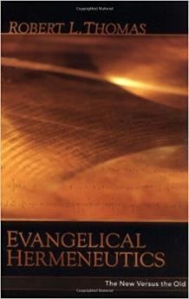
Robert Thomas
“Evangelical Hermeneutics,” .362.
“Blaising and Bock…interpret Babylon n Revelation 17‒18 as representing Rome and Rebuilt Babylon on the Euphrates, and in addition, in ‘the sweep of history’ it could represent any city since the world empire’s center is always shifting.”

Slide 71
Acts 17:11
“Now these were more noble-minded than those in Thessalonica, for they received the word with great eagerness, examining the Scriptures daily to see whether these things were so.”

Slide 72
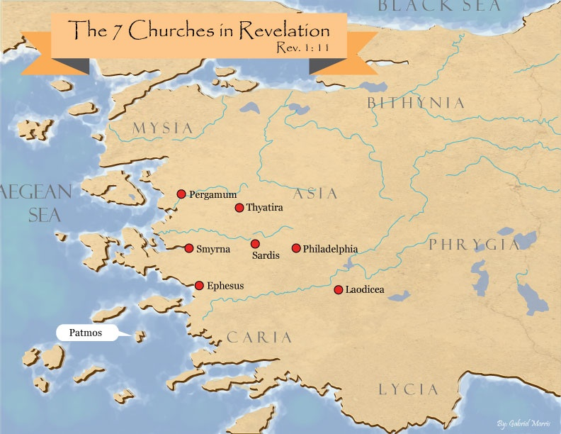
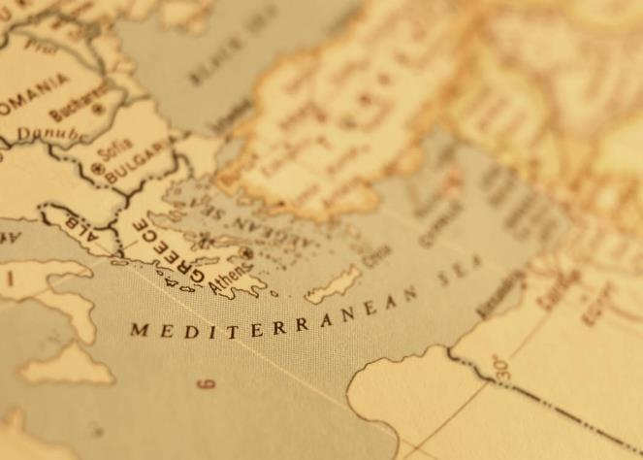

Slide 73
Acts 15:13-21 James’ Address
Introduction (13a)
Addressees (13b)
Peter’s address (14)
Old Testament citation (15-18)
Conclusions (19-21)

Slide 74
Acts 15:19-21 Conclusions
Concerning the Gentiles (19-20)
Concerning Moses (21)

Slide 75
Acts 15:19-21 Conclusions
Concerning the Gentiles (19-20)
Concerning Moses (21)

Slide 76
Acts 15:19-21 Concerning the Gentiles
Adherence to OT Law not required (19)
Abstentions to avoid offence (20)

Slide 77
Acts 15:19-21 Concerning the Gentiles
Adherence to OT Law not required (19)
Abstentions to avoid offence (20)

Slide 78
Acts 15:14-21
…“¹⁹ Therefore it is my judgment that we do not trouble those who are turning to God from among the Gentiles, ²⁰ but that we write to them that they abstain from things contaminated by idols and from fornication and from what is strangled and from blood. ²¹ For Moses from ancient generations has in every city those who preach him, since he is read in the synagogues every Sabbath.”

Slide 79
Acts 15:19-21 Concerning the Gentiles
Adherence to OT Law not required (19)
Abstentions to avoid offence (20)

Slide 80
Acts 15:14-21
…“¹⁹ Therefore it is my judgment that we do not trouble those who are turning to God from among the Gentiles, ²⁰ but that we write to them that they abstain from things contaminated by idols and from fornication and from what is strangled and from blood. ²¹ For Moses from ancient generations has in every city those who preach him, since he is read in the synagogues every Sabbath.”

Slide 81
Acts 15:20 Abstentions Reiterated
Food sacrificed to idols (20a)
Fornication (20b)
Things strangled (20c)
Blood (20d)

Slide 82
Acts 15:20 Abstentions Reiterated
Food sacrificed to idols (20a)
Fornication (20b)
Things strangled (20c)
Blood (20d)

Slide 83
Acts 15:20 Abstentions Reiterated
Food sacrificed to idols (20a)
Fornication (20b)
Things strangled (20c)
Blood (20d)

Slide 84
Acts 15:20 Abstentions Reiterated
Food sacrificed to idols (20a)
Fornication (20b)
Things strangled (20c)
Blood (20d)

Slide 85
Acts 15:20 Abstentions Reiterated
Food sacrificed to idols (20a)
Fornication (20b)
Things strangled (20c)
Blood (20d)

Slide 86
Acts 15:19-21 Conclusions
Concerning the Gentiles (19-20)
Concerning Moses (21)

Slide 87
Acts 15:14-21
…“¹⁹ Therefore it is my judgment that we do not trouble those who are turning to God from among the Gentiles, ²⁰ but that we write to them that they abstain from things contaminated by idols and from fornication and from what is strangled and from blood. ²¹ For Moses from ancient generations has in every city those who preach him, since he is read in the synagogues every Sabbath.”

Slide 88
Acts 15:1-35 Jerusalem Council
Occasion (1-5)
Declarations (6-21)
Decision (22-29)
Delivery (30-35)

