Slide 1
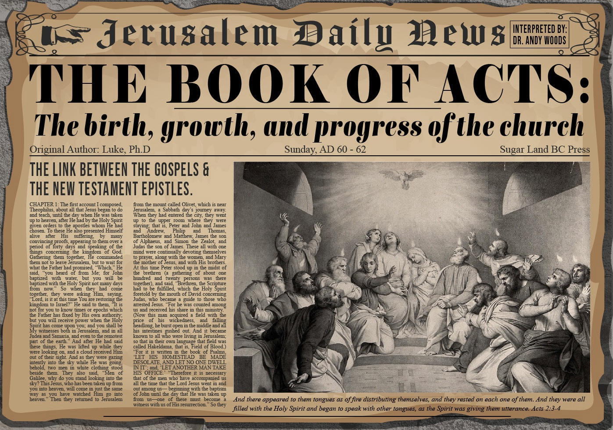


Slide 2
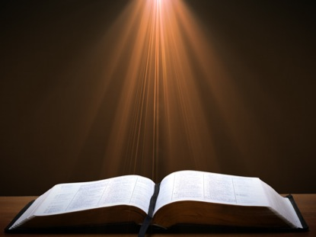
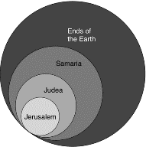
Acts 1:8
“but you will receive power when the Holy Spirit has come upon you; and you shall be My witnesses both in Jerusalem, and in all Judea and Samaria, and even to the remotest part of the earth.”

Slide 3
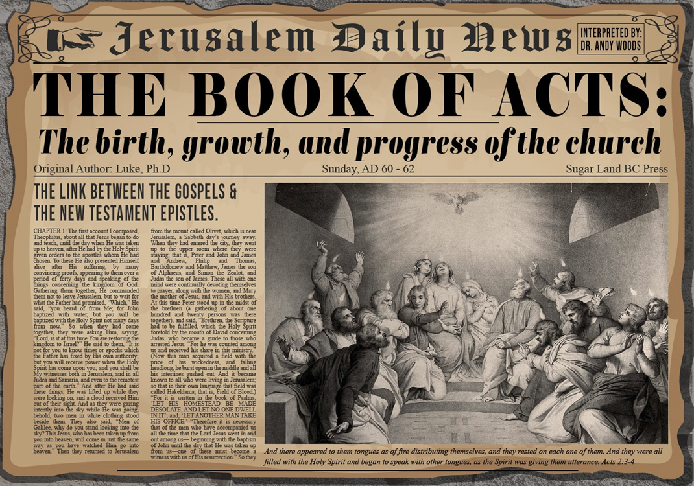
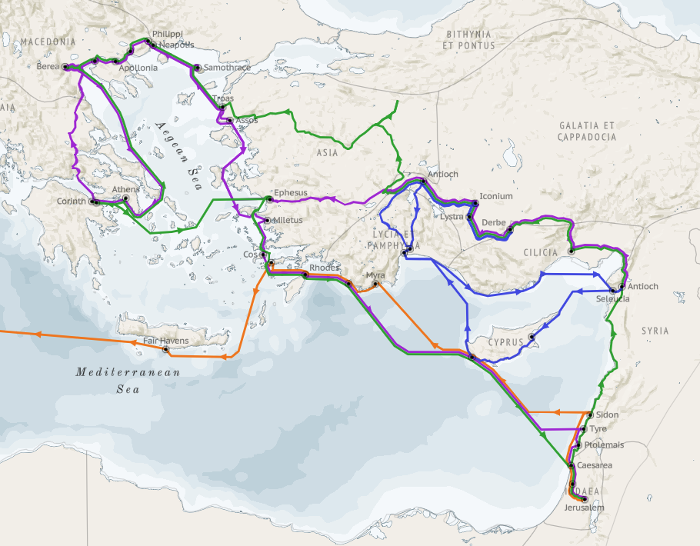
Structure (Acts 1:8)
  Jerusalem (Acts 1–7)
  Judea and Samaria (Acts 8–12)
  Remotest part of the earth (Acts 13–28)
  1st missionary journey (Acts 13–14)
  Jerusalem council (Acts 15:1-35)
  2nd missionary journey (Acts 15:36 –18:22)
  3rd missionary journey (Acts 18:23–21:17)
  Trip to Rome (Acts 21:18–28:31)

Slide 4
Acts 15:1-35
Jerusalem Council
  Occasion (1-5)
  Declarations (6-21)
  Decision (22-29)
  Delivery (30-35)

Slide 5
II. Declarations
Acts 15:6-21
  Meeting convened (6)
  Peter’s address (7-11)
  Barnabas’ & Paul’s testimony (12)
  James’ address (13-21)

Slide 6
Acts 15:7-11
Peter’s Address
      God chose Gentile salvation (7)
      Spirit authenticated Gentile salvation (8-9)
      Peter’s challenge (10)
      Peter’s conclusion (11)

Slide 7
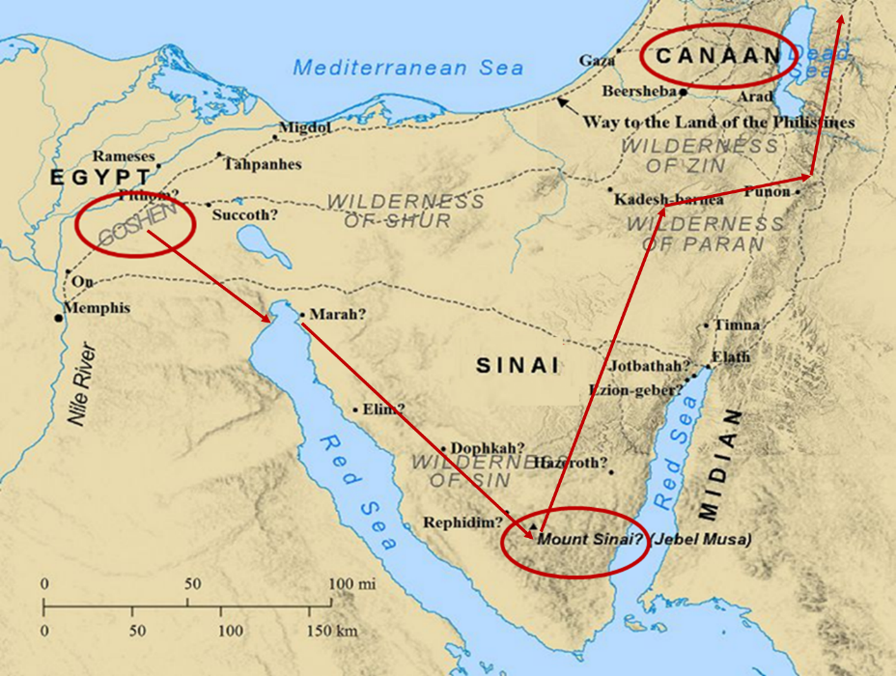

Slide 8
Six Parts of a Suzerain-Vassal Treaty in Deuteronomy
Preamble (1:1-5)
Prologue (1:6–4:40)
Covenant obligations (5–26)
Storage and reading instructions (27:2-3; 31:9, 24, 26)
Witnesses (32:1)
Blessings and curses (28)

Slide 9
ISRAEL'S JUDGMENTS
Division of the kingdom in 931 B.C. (1 Kgs. 12)
Assyrian judgment in 722 B.C. (2 Kgs. 17)
Babylonian captivity in 586 B.C. (2 Kgs. 25)
Rome Diaspora in A.D. 70 (Luke 19:41-44)

Slide 10
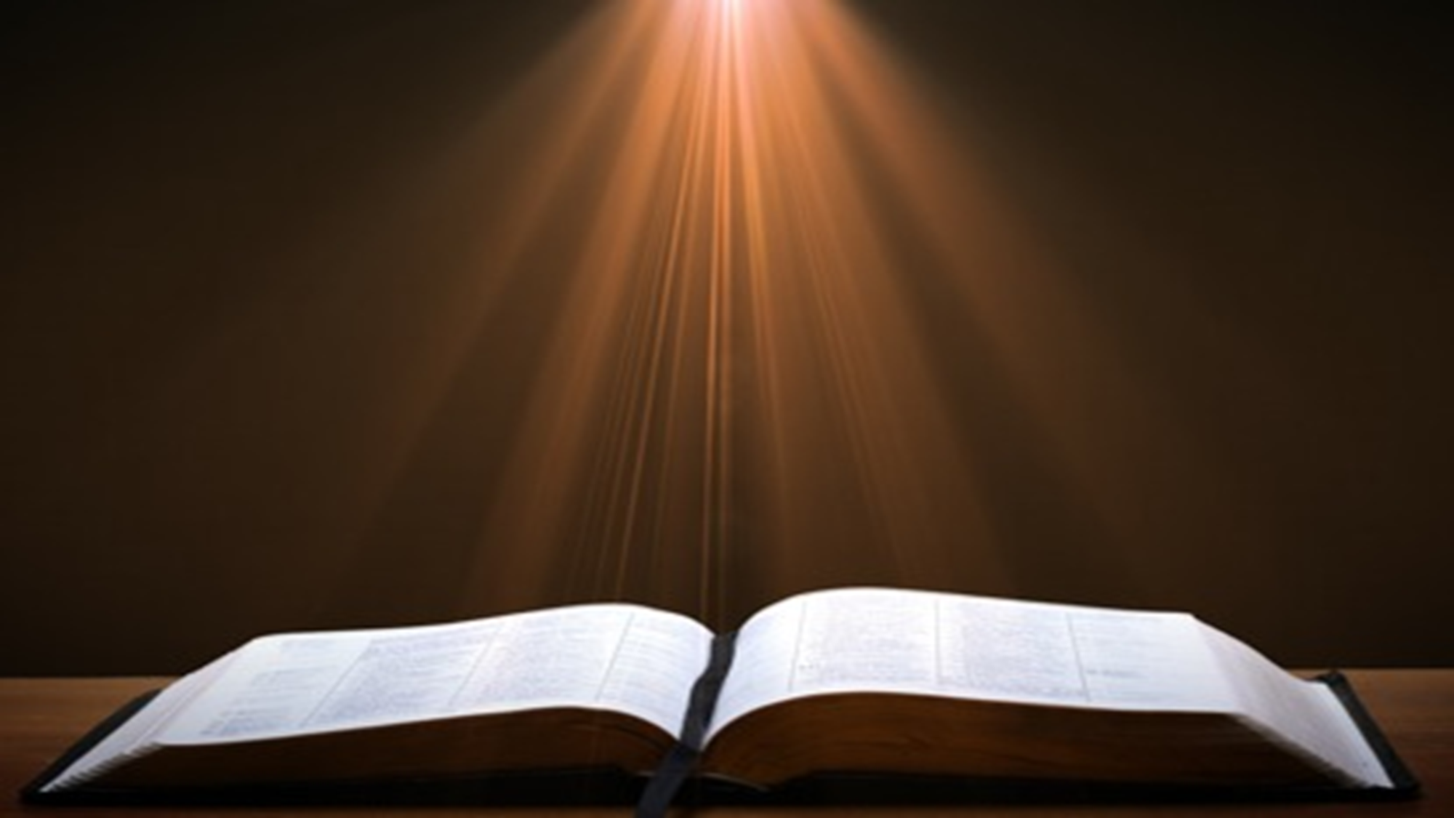

Psalm 147:19-20
“He declares His words to Jacob, His statutes and His ordinances to Israel. He has not dealt thus with any nation; And as for His ordinances, they have not known them. Praise the Lord!”

Slide 11
Acts 15:7-11
Peter’s Address
      God chose Gentile salvation (7)
      Spirit authenticated Gentile salvation (8-9)
      Peter’s challenge (10)
      Peter’s conclusion (11)

Slide 12

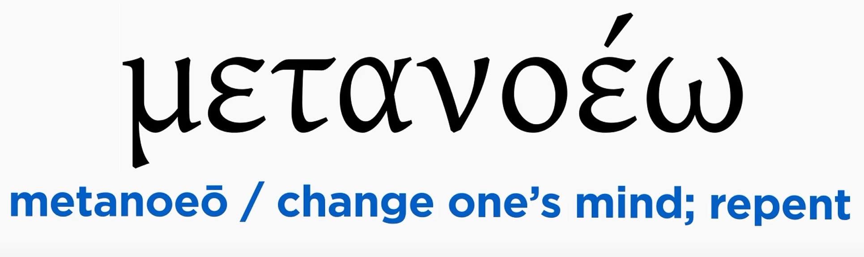
Acts 2:38
“Peter said to them, “Repent [metanoeō], and each of you be baptized in the name of Jesus Christ for (eis) the forgiveness of your sins; and you will receive the gift of the Holy Spirit.”

Slide 13


Acts 2:38
“Peter said to them, ‘Repent, and each of you be baptized in the name of Jesus Christ for (eis) the forgiveness of your sins; and you will receive the gift of the Holy Spirit.’”

Slide 14
Matthew 12:41
“The men of Nineveh will stand up with this generation at the judgment and will condemn it because they repented at [in the face of/because of] (eis) the preaching of Jonah; and behold, something greater than Jonah is here.”

Slide 15

Acts 11:15-16
“¹⁵ And as I began to speak, the Holy Spirit fell upon them just as He did upon us at the beginning. ¹⁶ And I remembered the word of the Lord, how He used to say, ‘John baptized with water, but you will be baptized with the Holy Spirit.’”

Slide 16
II. Declarations
Acts 15:6-21
  Meeting convened (6)
  Peter’s address (7-11)
  Barnabas’ & Paul’s testimony (12)
  James’ address (13-21)

Slide 17
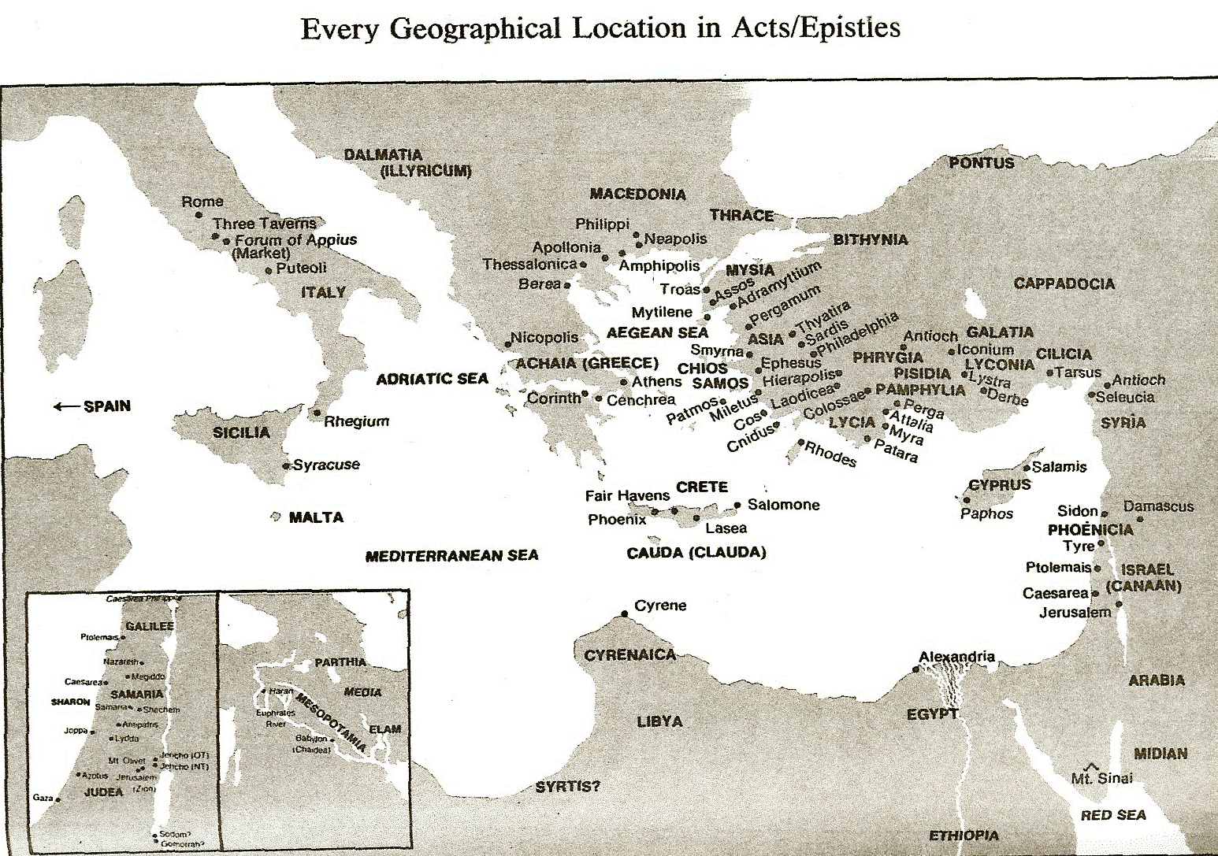

Slide 18
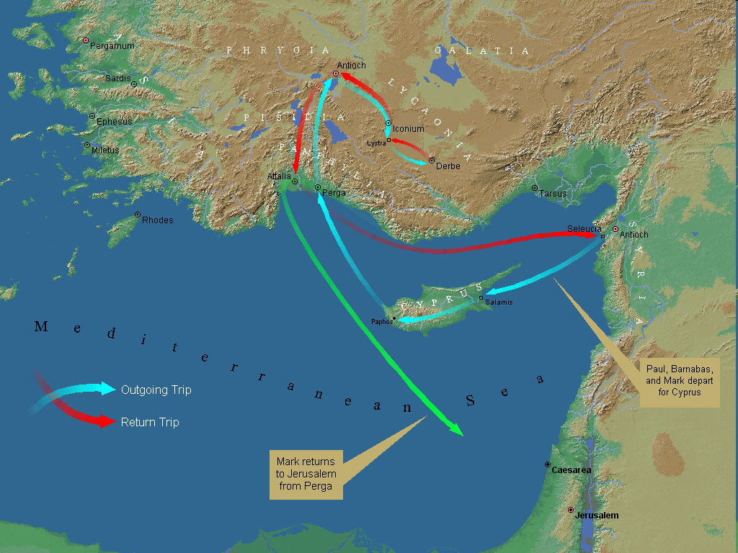
First Missionary Journey

Slide 19

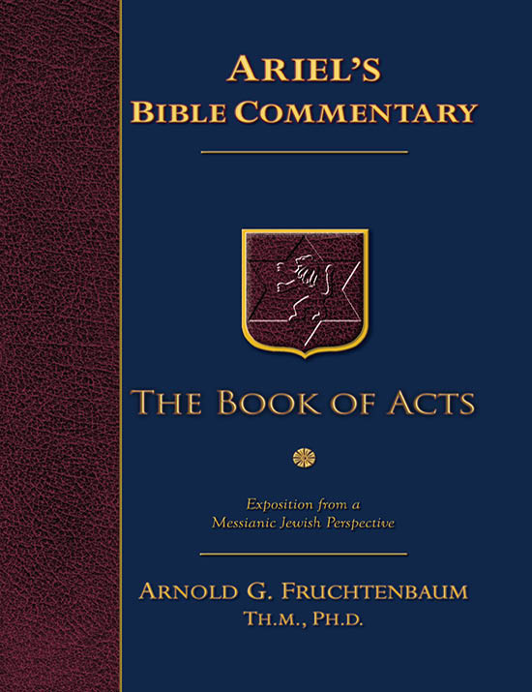
Dr. Arnold G. Fruchtenbaum
The Book of Acts, 83
“The apostles did many signs and wonders. In fact, the only ones who performed miracles in the book of Acts were the apostles or their delegates, such as Stephen (Acts 6:8). These apostolic delegates were appointed by the laying on of hands by the apostles. Signs and wonders were not performed by the believers at large.”

Slide 20

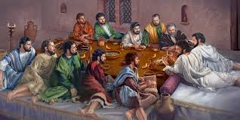
Ephesians 2:20
“having been built on the foundation of the apostles and prophets, Christ Jesus Himself being the corner stone.”

Slide 21
II. Declarations
Acts 15:6-21
  Meeting convened (6)
  Peter’s address (7-11)
  Barnabas’ & Paul’s testimony (12)
  James’ address (13-21)

Slide 22
Acts 15:13-21
James’ Address
      Introduction (13a)
      Addressees (13b)
      Peter’s address (14)
      Old Testament citation (15-18)
      Conclusions (19-21)

Slide 23
Acts 15:13-21
James’ Address
      Introduction (13a)
      Addressees (13b)
      Peter’s address (14)
      Old Testament citation (15-18)
      Conclusions (19-21)

Slide 24

Acts 1:13-14
“ ¹³ When they had entered the city, they went up to the upper room where they were staying; that is, Peter and John and James and Andrew, Philip and Thomas, Bartholomew and Matthew, James the son of Alphaeus, and Simon the Zealot, and Judas the son of James. ¹⁴ These all with one mind were continually devoting themselves to prayer, along with the women, and Mary the mother of Jesus, and with His brothers.”

Slide 25
JAMES OF THE NEW TESTAMENT
Father of Judas (not Iscariot)
The son of Alphaeus
The son of Zebedee and brother of John
The half brother of Christ

Slide 26
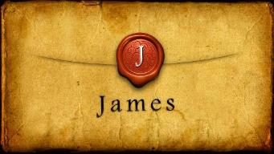
Which James?
Father of Judas (not Iscariot)
The son of Alphaeus
The son of Zebedee and brother of John
The half brother of Christ

Slide 27
SIMILARITIES WITH ACTS 15
 | James | Acts 15
Greetings | 1:1 | 15:23
Visit | 1:27 | 15:14
Listen | 2:5 | 15:13
Turn | 5:19-20 | 15:19
Being called by God’s name | 2:7 | 15:17

Slide 28
Acts 15:13-21
James’ Address
      Introduction (13a)
      Addressees (13b)
      Peter’s address (14)
      Old Testament citation (15-18)
      Conclusions (19-21)

Slide 29
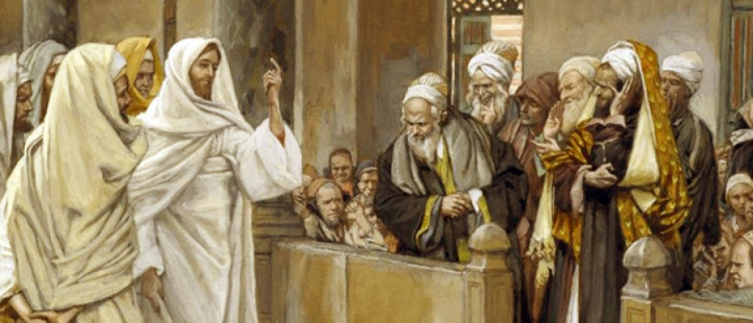
TYPES OF PHARISEES
TYPE | OVERTHROWN
Justification | Matthew 5:20
Sanctification | Galatians 3:3
Ecclesiology | Acts 15

Slide 30
Acts 15:13-21
James’ Address
      Introduction (13a)
      Addressees (13b)
      Peter’s address (14)
      Old Testament citation (15-18)
      Conclusions (19-21)

Slide 31

Acts 15:14
“Simeon has related how God first concerned Himself about taking from among the Gentiles a people for His name.”

Slide 32

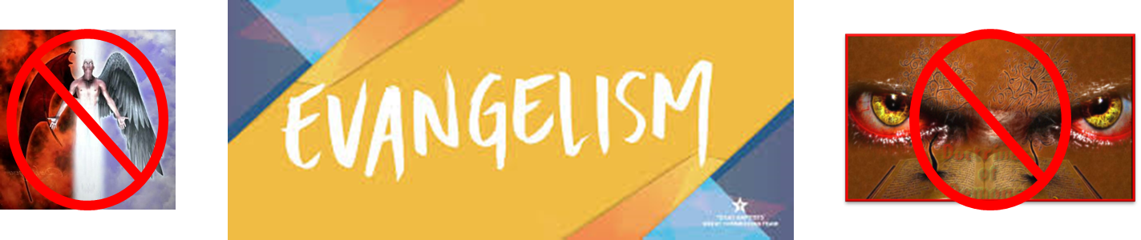
Matthew 16:18
“I also say to you that you are Peter (Petros), and upon this rock (petra) I will build [oikodomeō] My church; and the gates of Hades WILL NOT overpower it.”

Slide 33
Acts 15:14
“Simeon has related how God first concerned Himself about taking from among the Gentiles a people for His name.”

Slide 34
Romans 11:25-26
“²⁵ For I do not want you, brethren, to be uninformed of this mystery—so that you will not be wise in your own estimation—that a partial hardening has happened to Israel until the fullness of the Gentiles has come in; ²⁶ and so all Israel will be saved; just as it is written, ‘The Deliverer will come from Zion, He will remove ungodliness from Jacob.’”

Slide 35
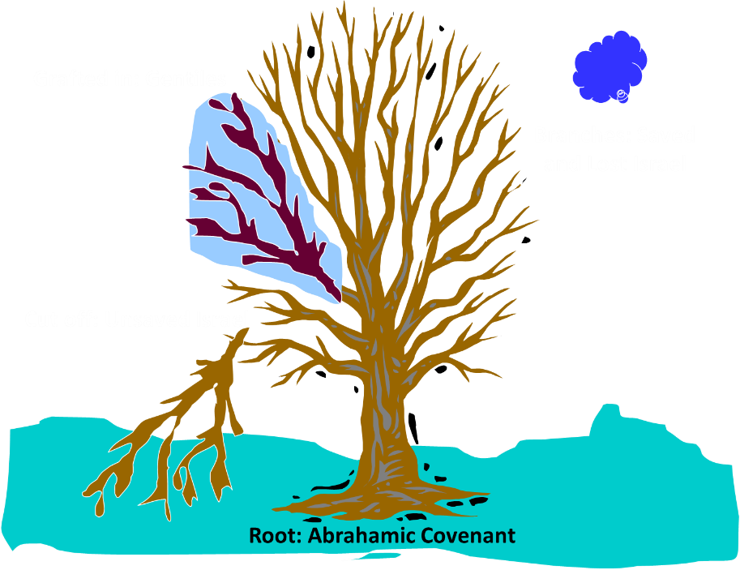
Notes:
35

Slide 36
Acts 15:14-21
¹⁴ “Simeon has related how God first concerned Himself about taking from among the Gentiles a people for His name. ¹⁵ With this the words of the Prophets agree, just as it is written, ¹⁶ ‘After these things I will return, And I will rebuild the tabernacle of David which has fallen, And I will rebuild its ruins, And I will restore it, ¹⁷ So that the rest of mankind may seek the Lord, And all the Gentiles who are called by My name,’ ¹⁸ Says the Lord, who makes these things known from long ago.”

Slide 37


Thomas Ice
Tim LaHaye Prophecy Study Bible, p. 1304.
“James explains how the decision of the council at Jerusalem was an outworking of God‘s purpose for this age. God‘s plan for history relates to the past ages with Israel and to Israel‘s role in the coming age (the Millennium), but the current Church Age will center around the Gentiles. After the Church Age is concluded, the Lord will return, and ‘rebuild the tabernacle of David’ [verse 16], i.e., the nation of Israel. This Old Testament reference is from Amos 9:11–12. During the Tribulation the Lord will work to convert the nation of Israel to Himself, ending with the second coming and the millennial reign of Christ. God‘s plans for history will come to pass just as He ordained.”

Slide 38
Acts 15:13-21
James’ Address
      Introduction (13a)
      Addressees (13b)
      Peter’s address (14)
      Old Testament citation (15-18)
      Conclusions (19-21)

Slide 39
Acts 15:15-18
Old Testament Citation
      Introduction (15)
      Amos 9:11-12 (16-18)

Slide 40
Acts 15:15-18
Old Testament Citation
      Introduction (15)
      Amos 9:11-12 (16-18)

Slide 41
Acts 15:14-21
¹⁴ “Simeon has related how God first concerned Himself about taking from among the Gentiles a people for His name. ¹⁵ With this the words of the Prophets agree, just as it is written, ¹⁶ ‘After these things I will return, And I will rebuild the tabernacle of David which has fallen, And I will rebuild its ruins, And I will restore it, ¹⁷ So that the rest of mankind may seek the Lord, And all the Gentiles who are called by My name,’ ¹⁸ Says the Lord, who makes these things known from long ago.”…

Slide 42

Acts 1:16
“Brethren, the Scripture had to be fulfilled (plēroō), which the Holy Spirit foretold by the mouth of David concerning Judas, who became a guide to those who arrested Jesus.”

Slide 43
Acts 15:15-18
Old Testament Citation
      Introduction (15)
      Amos 9:11-12 (16-18)

Slide 44
Acts 15:14-21
¹⁴ “Simeon has related how God first concerned Himself about taking from among the Gentiles a people for His name. ¹⁵ With this the words of the Prophets agree, just as it is written, ¹⁶ ‘After these things I will return, And I will rebuild the tabernacle of David which has fallen, And I will rebuild its ruins, And I will restore it, ¹⁷ So that the rest of mankind may seek the Lord, And all the Gentiles who are called by My name,’ ¹⁸ Says the Lord, who makes these things known from long ago.”…

Slide 45
Luke 24:27, 44
“²⁷ Then beginning with Moses and with all the prophets, He explained to them the things concerning Himself in all the Scriptures…⁴⁴ Now He said to them, ‘These are My words which I spoke to you while I was still with you, that all things which are written about Me in the Law of Moses and the Prophets and the Psalms must be fulfilled.’”

Slide 46
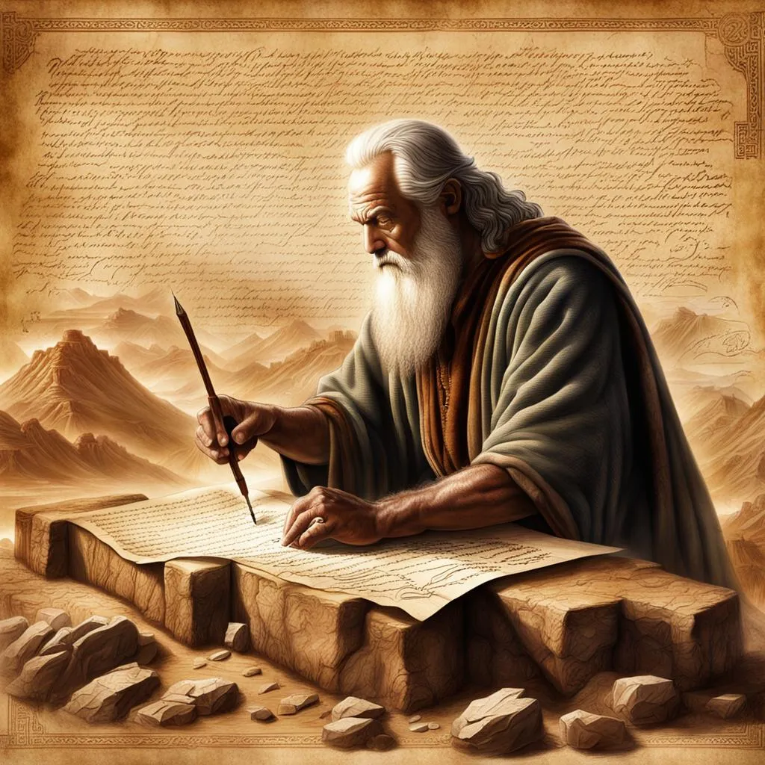
John 5:39, 46
“³⁹ You search the Scriptures because you think that in them you have eternal life; it is these that testify about Me…⁴⁶ For if you believed Moses, you would believe Me, for he wrote about Me.”

Slide 47

Acts 17:1-3
“¹ Now when they had traveled through Amphipolis and Apollonia, they came to Thessalonica, where there was a synagogue of the Jews. ² And according to Paul’s custom, he visited them, and for three Sabbaths reasoned with them from the Scriptures, ³ explaining and giving evidence that the Christ had to suffer and rise from the dead, and saying, “This Jesus whom I am proclaiming to you is the Christ.”

Slide 48

1 Corinthians 15:3-4
“³ For I handed down to you as of first importance what I also received, that Christ died for our sins according to the Scriptures, ⁴ and that He was buried, and that He was raised on the third day according to the Scriptures.”

Slide 49
ORDER OF PAUL’S LETTERS | ORDER OF PAUL’S LETTERS
1. | Galatians | A.D. 49
2. | 1‒2 Thessalonians | A.D. 51
3. | 1‒2 Corinthians | A.D. 56
4. | Romans | A.D. 57
5. | Ephesians, Colossians, Philemon, Philippians | A.D. 60‒62
6. | 1 Timothy, Titus | A.D. 62‒66
7. | 2 Timothy | A.D. 67

Slide 50
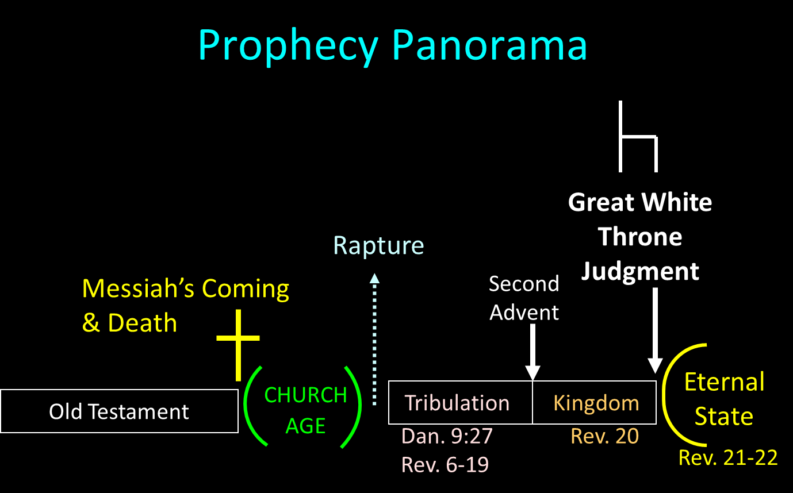

Slide 51
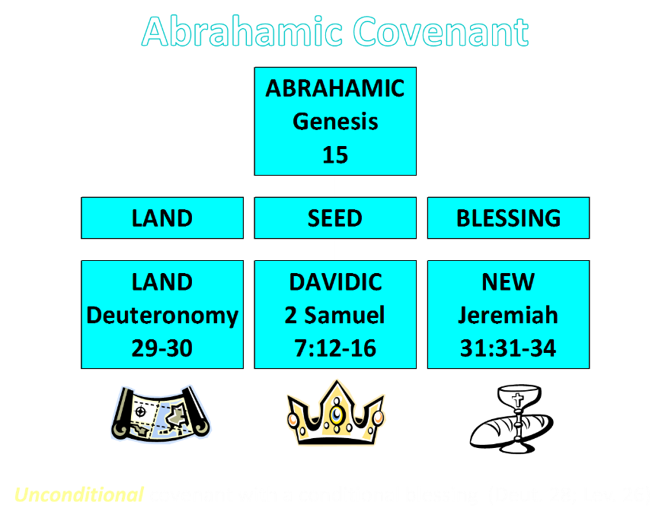

Slide 52
2 Peter 3:10-11
“¹⁰ But the day of the Lord will come like a thief, in which the heavens will pass away with a roar and the elements will be destroyed with intense heat, and the earth and its works will be burned up. ¹¹ Since all these things are to be destroyed in this way, what sort of people ought you to be in holy conduct and godliness.”

Slide 53
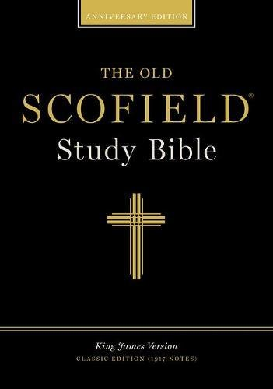
Scofield Reference Bible
Page 1520
“...begins with the words ‘on that day.’ James introduced this quotation in such a way as to show what day Amos was talking about, namely, the time after the present world witness (Acts 1:8), when Christ will return. James showed that there will be Gentile believers at that time, as well as Jewish believers; hence he concluded that Gentiles are not required to become Jewish proselytes by circumcision.”

Slide 54
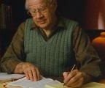
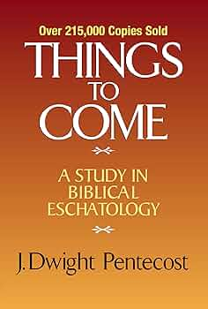
J. Dwight Pentecost
Thy Kingdom Come, Page 279-80
“Afterward a question was raised concerning whether it was necessary for the Gentiles who had believed and had been brought into the church to abide by the precepts of the Mosaic Law. Judaizers insisted that in order to please God as believers and members of the kingdom of God, it was necessary for all men to live under the precepts of the Mosaic Law. This question was submitted to the apostles in Jerusalem, and Peter testified to the salvation of the Gentiles by faith in Jesus Christ apart from the Law (15:7–11).”

Slide 55
J. Dwight Pentecost
Thy Kingdom Come, Page 279-80
“His testimony is further corroborated by Barnabas and Paul (v. 12), and James who presided at this council hearing rendered the decision of the council. It was evident that God for the first time in dealing with men was dealing with Gentiles as Gentiles ‘taking from the Gentiles a people for Himself (v. 14). James found this in keeping with the prophetic program. In Amos 9:11–12 it was prophesied that after the period in which Israel was disciplined because of disobedience (vv. 1–10) and the Davidic throne left empty for a time, the Davidic throne would be restored and the Davidic kingdom would be instituted.”

Slide 56
J. Dwight Pentecost
Thy Kingdom Come, Page 279-80
“When it is reinstituted, the kingdom will include not only the physical descendants of Abraham, but also a multitude of Gentiles as well. Therefore the restored Davidic kingdom under its rightful Davidic king would be composed of both Jews and Gentiles. In that kingdom Gentiles would not be made into Jews; instead they would be in the kingdom as Gentiles. This allowed James to conclude that if God had a program for Gentiles as Gentiles in the future Davidic kingdom established here on the earth, there was no reason to deny that God could include Gentiles as Gentiles in this present form of the theocracy.”

Slide 57
J. Dwight Pentecost
Thy Kingdom Come, Page 279-80
“Therefore the issue was settled—the Gentiles did not need to be circumcised and bring themselves under the Mosaic Law in order to participate in the present form of the kingdom. Rather, apart from the Mosaic Law, through faith in Jesus Christ they are equal participants with believing Jews in the present form of the kingdom of God”

Slide 58
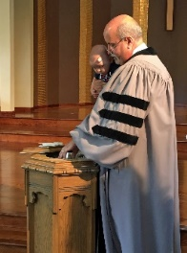
Kim Riddlebarger
Kim Riddlebarger, A Case for Amillennialism: Understanding the End Times (Grand Rapids: Baker, 2003), 39-40.
“In Acts 15, the church in Antioch appointed Paul and Barnabas to report to the Jerusalem council regarding the salvation of the Gentiles and to seek help in resolving the question that had been troubling the church as a result. Should Gentile converts be circumcised in order to be saved? Once in the city, Paul and Barnabas reported to the elders and apostles on all the things God was doing among the Gentiles (v. 4). When certain converted Pharisees declared that Gentiles must be circumcised and obey the law of Moses (v. 5), Peter refuted their arguments by pointing out that it was God who had given these Gentiles the Holy Spirit:”

Slide 59
Kim Riddlebarger
Kim Riddlebarger, A Case for Amillennialism: Understanding the End Times (Grand Rapids: Baker, 2003), 39-40.
“‘We believe it is through the grace of our Lord Jesus that we are saved, just as they are’ (v. 11). Then James, the leader of the church, spoke (vv. 13ff.): ‘God at first showed his concern by taking from the Gentiles a people for himself. The words of the prophets are in agreement with this, as it is written,’ and James cited a passage from Amos 9:11–12: ‘After this I will return and rebuild David’s fallen tent. Its ruins I will rebuild, and I will restore it, that the remnant of men may seek the Lord, and all the Gentiles who bear my name, says the Lord, who does these things’ that have been known for ages.’”

Slide 60
Kim Riddlebarger
Kim Riddlebarger, A Case for Amillennialism: Understanding the End Times (Grand Rapids: Baker, 2003), 39-40.
“James saw the prophecy as fulfilled in Christ’s resurrection and exaltation and in the reconstitution of his disciples as the new Israel. The presence of both Jew and Gentile in the church was proof that the prophecy of Amos had been fulfilled. David’s fallen tent had been rebuilt by Christ. In Amos’s prophecy, ‘after this’ indicated that the prophecy referred to what God would do for Israel after the exile. When James applied this prophecy to the church, was he spiritualizing an Old Testament text? Or was James reading the Old Testament through a Christ-centered lens typical of the greater light of the messianic age?”

Slide 61
Acts 15:14-21
¹⁴ “Simeon has related how God first concerned Himself about taking from among the Gentiles a people for His name. ¹⁵ With this the words of the Prophets agree, just as it is written, ¹⁶ ‘After these things I will return, And I will rebuild the tabernacle of David which has fallen, And I will rebuild its ruins, And I will restore it, ¹⁷ So that the rest of mankind may seek the Lord, And all the Gentiles who are called by My name,’ ¹⁸ Says the Lord, who makes these things known from long ago.”…

Slide 62
Acts 1:16
“Brethren, the Scripture had to be fulfilled (plēroō), which the Holy Spirit foretold by the mouth of David concerning Judas, who became a guide to those who arrested Jesus.”

Slide 63
Kim Riddlebarger
Kim Riddlebarger, A Case for Amillennialism: Understanding the End Times (Grand Rapids: Baker, 2003), 39-40.
“This question lies at the heart of the debate between amillenarians and dispensationalists. The famous notes of the Scofield Reference Bible (1909) say that from a dispensational perspective James’s speech is the most important in the New Testament. According to Scofield, James is describing what will happen after the church age concludes (‘after this’), i.e., in the millennium, when God will reestablish a Davidic rule over Israel. If this is true, when Paul and Barnabas sought guidance for a concern that was immediate to them (Should Gentile converts be circumcised?), James responded by pointing to a future millennium thousands of years distant.”

Slide 64
2 Peter 3:10-11
“¹⁰ But the day of the Lord will come like a thief, in which the heavens will pass away with a roar and the elements will be destroyed with intense heat, and the earth and its works will be burned up. ¹¹ Since all these things are to be destroyed in this way, what sort of people ought you to be in holy conduct and godliness.”

Slide 66
Kim Riddlebarger
Kim Riddlebarger, A Case for Amillennialism: Understanding the End Times (Grand Rapids: Baker, 2003), 39-40.
“Here is one instance in which dispensational presuppositions get in the way of the plain sense of the text. Scofield interprets the text literalistically, not literally. Dispensationalists are often forced to reinterpret any New Testament data that does not fit in their Old Testament–derived prophetic scheme. Dispensational presuppositions will not fit with much of the interpretation supplied to Old Testament data by New Testament authors. A thorough survey of both Old Testament and New Testament eschatological categories will demonstrate the dispensational hermeneutic to be untenable.”

Slide 67
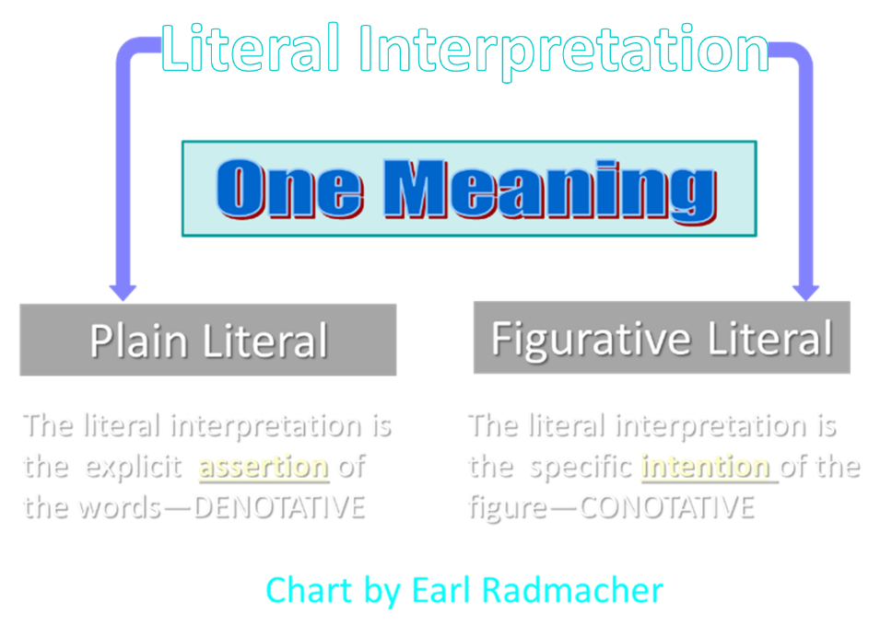

Slide 68
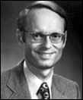
Charles Ryrie
Dispensationalism (Chicago: Moody Press, 1965), 86.
Literal interpretation “…might also be called plain interpretation so that no one receives the mistaken notion that the literal principle rules out figures of speech.”

Slide 69
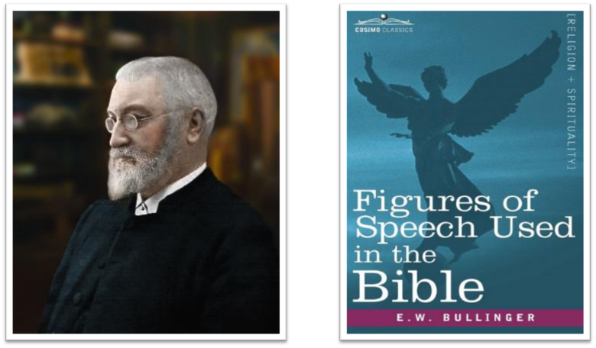
E.W. Bullinger (1837‒1913)

Slide 70
Kim Riddlebarger
Kim Riddlebarger, A Case for Amillennialism: Understanding the End Times (Grand Rapids: Baker, 2003), 39-40.
“More importantly, such a survey gives us the proper framework and external controls to interpret prophetic sections of Scripture correctly. The irony is that dispensationalists’ practice of interpreting all prophetic texts in a literalistic fashion amounts to a repudiation of the historic Protestant hermeneutic and the principle of the analogy of faith. If amillenarians adopt the New Testament writers’ interpretation of the Old Testament, are they not following the literal sense of Scripture, even if the New Testament writers universalize something that was limited to Israel in the Old Testament?”
Notes:
analogy of faith - Scripture is in agreement and will not contradict itself and we should interpret unclear passages in light of clear passages

Slide 71
Kim Riddlebarger
Kim Riddlebarger, A Case for Amillennialism: Understanding the End Times (Grand Rapids: Baker, 2003), 39-40.
“The dispensationalists’ literalistic reading of prophetic passages must not be confused with a literal reading. A literal reading—a reading that gets at the plain sense of the text—will allow the New Testament to interpret the Old. It is amillenarians, not dispensationalists, who interpret prophecy literally in that they follow the literal sense of how the writers of the New Testament interpret Old Testament prophecy.”

Slide 72
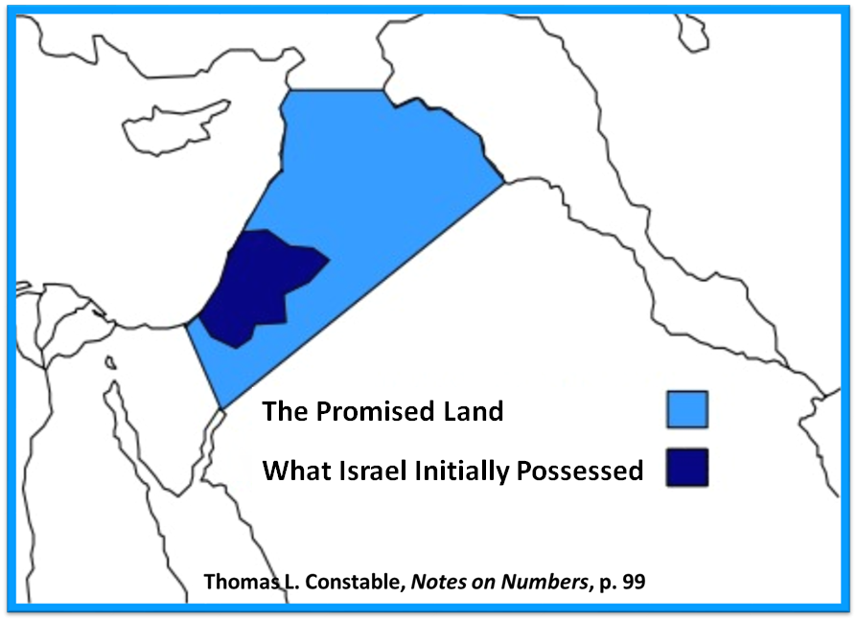

Slide 73
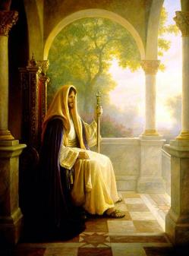
OT PROPHETS DESCRIBE THE KINGDOM
Kingdom Characteristics
Is. 2:1-4; 11:6-9; 65:17-25
  Jerusalem = center of world spiritual and political authority
  Perfect justice
  World peace
  Peace in the animal kingdom
  Universal spiritual knowledge

Slide 74
OT PROPHETS DESCRIBE THE KINGDOM
Established by God (Dan. 2:44) Eternal (Dan. 7:27) Christ’s direct rule (Zech. 9:9-10) Earthly (Zech. 14:9) Land promises realized (Gen. 15:18-21) Israel’s preeminence (Isa. 49:22-23) Immediate answered prayers (Isa. 65:24) | Millennial Temple (Ezek. 40‒46) Millennial David (Jer. 30:9) Righteousness (Isa. 9:6-7) Curse curtailed (Isa. 65:20, 22) Peace (Isa. 2:4) Prosperity (Amos 9:13-14; Isa 65:22) Topographical changes (Ezek. 47:1-12)

Slide 75

“Here the Prophet describes the felicity which shall be under the reign of Christ: and we know that whenever the Prophets set forth promises of a happy and prosperous state to God’s people, they adopt metaphorical expressions, and say, that abundance of all good things shall flow, that there shall be the most fruitful produce, that provisions shall be bountifully supplied; for they accommodated their mode of speaking to the notions of that ancient people; it is therefore no wonder if they sometimes speak to them as to children. At the same time, the Spirit under these figurative expressions declares, that the kingdom of Christ shall in every way be happy and blessed, or that the Church of God, which means the same thing, shall be blessed, when Christ shall begin to reign.”
John Calvin
Commentary on Amos 9:13
Amos 9:13—“Behold the days come, saith the LORD, that the plowman shall overtake the reaper, and the treader of grapes him that soweth seed: and the mountains shall drop sweet wine, and all the hills shall melt.”

Slide 76
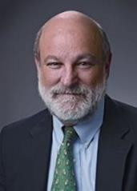
“Complementary Hermeneutics” in Progressive Dispensationalism
“…the New Testament does introduce change and advance; it does not merely repeat Old Testament revelation. In making complementary additions, however, it does not jettison Old Testament promises. The enhancement is not at the expense of the original promise.”
Craig Blaising and Darrell Bock, “Dispensationalism, Israel and the Church: Assessment and Dialogue,” in Dispensationalism, Israel and the Church, ed. Craig Blaising and Darrell Bock (Grand Rapids: Zondervan, 1992), 392–93.
Notes:
WRONG!!!

Slide 77
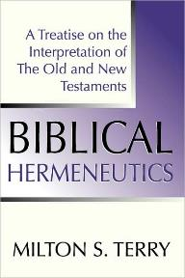
Milton Terry
Biblical Hermeneutics: A Treatise on the Interpretation of the Old and New Testaments (1885; reprint, Grand Rapids: Zondervan, 1947), 205.
Milton Terry explains: “A fundamental principle in grammatico-historical exposition is that the words and sentences can have but one significance in one and the same connection. The moment we neglect this principle we drift upon a sea of uncertainty and conjecture.”

Slide 78
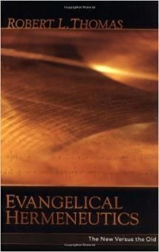
Robert Thomas
“Evangelical Hermeneutics,” .362.
“Blaising and Bock…interpret Babylon n Revelation 17‒18 as representing Rome and Rebuilt Babylon on the Euphrates, and in addition, in ‘the sweep of history’ it could represent any city since the world empire’s center is always shifting.”

Slide 79

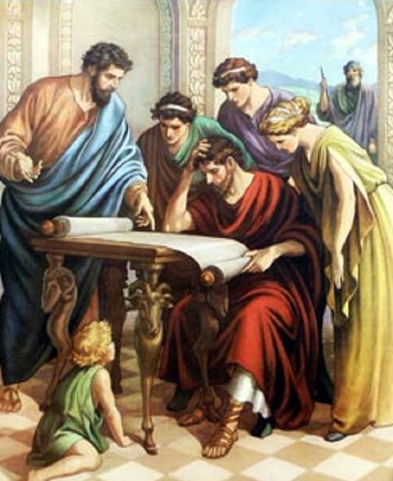
Acts 17:11
“Now these were more noble-minded than those in Thessalonica, for they received the word with great eagerness, examining the Scriptures daily to see whether these things were so.”

Slide 80
Acts 15:13-21
James’ Address
      Introduction (13a)
      Addressees (13b)
      Peter’s address (14)
      Old Testament citation (15-18)
      Conclusions (19-21)

Slide 81
Acts 15:19-21
Conclusions
      Concerning the Gentiles (19-20)
      Concerning Moses (21)

Slide 82
Acts 15:19-21
Conclusions
      Concerning the Gentiles (19-20)
      Concerning Moses (21)

Slide 83
Acts 15:19-21
Concerning the Gentiles
      Adherence to OT Law not required (19)
      Abstentions to avoid offence (20)

Slide 84
Acts 15:19-21
Concerning the Gentiles
      Adherence to OT Law not required (19)
      Abstentions to avoid offence (20)

Slide 85
Acts 15:14-21
…“¹⁹ Therefore it is my judgment that we do not trouble those who are turning to God from among the Gentiles, ²⁰ but that we write to them that they abstain from things contaminated by idols and from fornication and from what is strangled and from blood. ²¹ For Moses from ancient generations has in every city those who preach him, since he is read in the synagogues every Sabbath.”

Slide 86
Acts 15:19-21
Concerning the Gentiles
      Adherence to OT Law not required (19)
      Abstentions to avoid offence (20)

Slide 87
Acts 15:14-21
…“¹⁹ Therefore it is my judgment that we do not trouble those who are turning to God from among the Gentiles, ²⁰ but that we write to them that they abstain from things contaminated by idols and from fornication and from what is strangled and from blood. ²¹ For Moses from ancient generations has in every city those who preach him, since he is read in the synagogues every Sabbath.”

Slide 88
Acts 15:20
Abstentions Reiterated
      Food sacrificed to idols (20a)
      Fornication (20b)
      Things strangled (20c)
      Blood (20d)

Slide 89
Acts 15:20
Abstentions Reiterated
      Food sacrificed to idols (20a)
      Fornication (20b)
      Things strangled (20c)
      Blood (20d)

Slide 90
Acts 15:20
Abstentions Reiterated
      Food sacrificed to idols (20a)
      Fornication (20b)
      Things strangled (20c)
      Blood (20d)

Slide 91
Acts 15:20
Abstentions Reiterated
      Food sacrificed to idols (20a)
      Fornication (20b)
      Things strangled (20c)
      Blood (20d)

Slide 92
Acts 15:20
Abstentions Reiterated
      Food sacrificed to idols (20a)
      Fornication (20b)
      Things strangled (20c)
      Blood (20d)

Slide 93
Acts 15:19-21
Conclusions
      Concerning the Gentiles (19-20)
      Concerning Moses (21)

Slide 94
Acts 15:14-21
…“¹⁹ Therefore it is my judgment that we do not trouble those who are turning to God from among the Gentiles, ²⁰ but that we write to them that they abstain from things contaminated by idols and from fornication and from what is strangled and from blood. ²¹ For Moses from ancient generations has in every city those who preach him, since he is read in the synagogues every Sabbath.”

Slide 95
Acts 15:1-35
Jerusalem Council
  Occasion (1-5)
  Declarations (6-21)
  Decision (22-29)
  Delivery (30-35)

