Slide 1
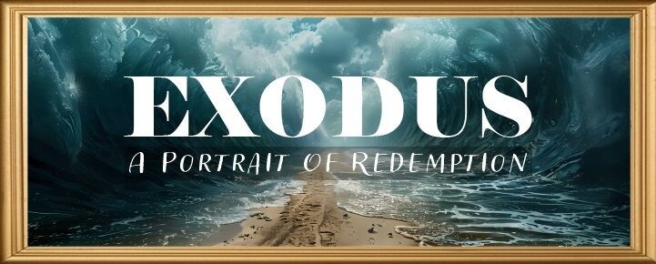


Slide 2
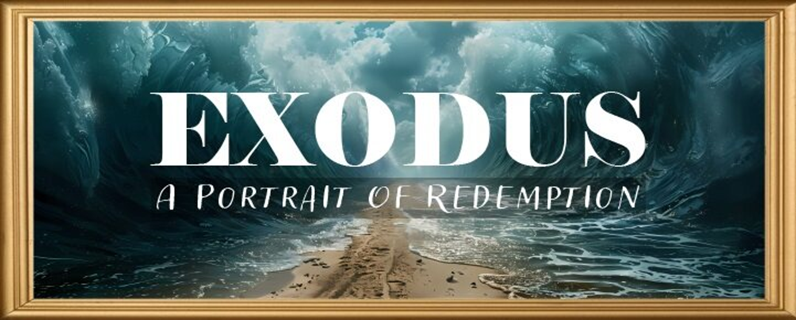
EXODUS STRUCTURE/OUTLINE
Redemption (1–18)
Redemption (1:1–12:30)
Liberation (12:31–15:21)
Preservation (15:22–18:27)
Mosaic Covenant (19–40)
Law (19–24)
Tabernacle instructions (25–31)
Apostasy (32–34)
Tabernacle building (35–40)

Slide 3
REDEMPTION (1:1–12:30)
Why redemption is necessary (Exod 1)
Development of the deliverer (Exod 2–4)
First confrontation with Pharaoh (Exod 5)
God reassures Moses (Exod 6:1–7:7)
Second confrontation with Pharaoh (Exod 7:8-13)
Plagues (Exod 7:14–12:30)

Slide 4
SECOND CONFRONTATION WITH PHARAOH Exodus 7:1-25
The Prophets (1-7)
The Power (8-13)
The Plagues (14-25)

Slide 5
II. Exodus 7:8-13 The Power
God’s miracle (8-10)
Pharaoh’s miracle (11-12a)
God’s supremacy (12b)
Pharaoh’s hardening (13)

Slide 6
II. Exodus 7:8-13 The Power
God’s miracle (8-10)
Pharaoh’s miracle (11-12a)
God’s supremacy (12b)
Pharaoh’s hardening (13)

Slide 7
Exodus 7:8-10 God’s Miracle
Instructions (8-9)
Obedience (10)

Slide 8
Exodus 7:8-10 God’s Miracle
Instructions (8-9)
Obedience (10)

Slide 9
THREE PHASES OF MOSES’ 120 YEAR LIFE
LIFE PHASE | SCRIPTURE | YEARS | AGE | ACTIVITY
Natural Training | Acts 7:23 | 1526–1486 B.C. | 1-40 | Egyptian Education
Spiritual Training | Exod. 7:7 | 1486–1446 B.C. | 40-80 | Midian Shepherding
Ministry | Deut. 31:2; 34:7; Acts 7:36 | 1446–1406 B.C. | 80-120 | Exodus, Law, Wilderness Preservation, Pentateuch Authorship

Slide 10
Exodus 7:8-10 God’s Miracle
Instructions (8-9)
Obedience (10)

Slide 11
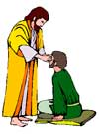
“SEVEN SIGNS” in Gospel of John
1. Changing Water into Wine | 2:11
2. Healing official’s son | 4:46-54
3. Healing an invalid at the Pool of Bethesda | 5:1-18
4. Feeding the 5,000 | 6:5-14
5. Walking on water | 6:16-21
6. Healing a blind man | 9:1-7
7. Raising dead Lazarus | 11:1-45

Slide 12
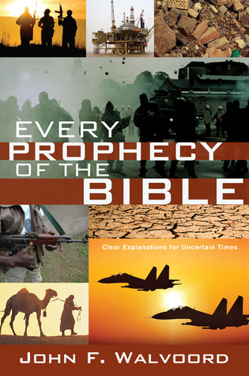

Slide 13
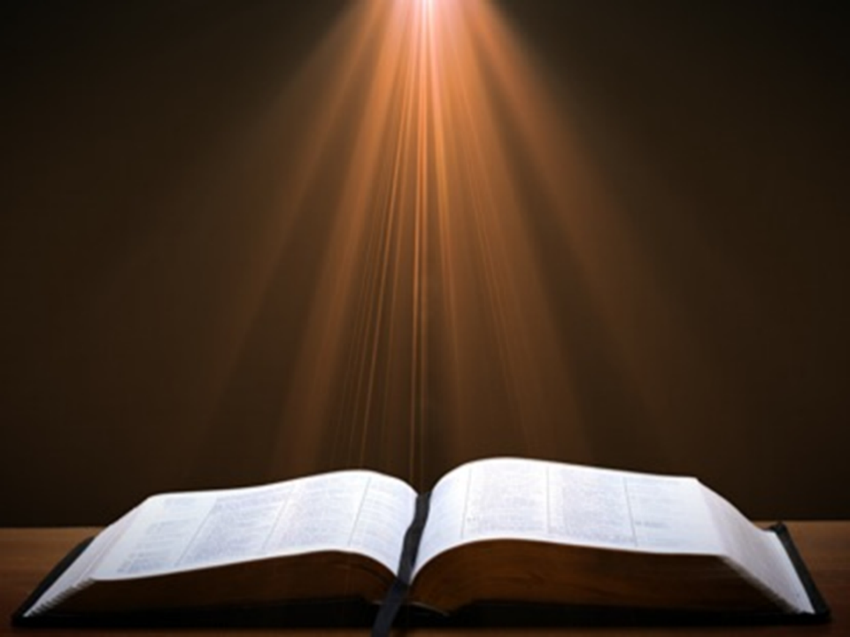

John 13:19; 14:29
“¹⁹ From now on I am telling you before it comes to pass, so that when it does occur, you may believe that I am He… ^{14:29} Now I have told you before it happens, so that when it happens, you may believe.”

Slide 14
What Happened to Christ’s Disciples?
Disciple | Place | Martyrdom
James the Son of Alpheus | Jerusalem | Clubbed to death
Simon the Zealot | Jerusalem | Martyred
James the Son of Zebedee | Judea (Acts 12:2) | Executed
Thaddeus | Mesopotamia | Beaten to death
Peter | Babylon, Rome | Crucified upside down
Matthew | Parthia (Tehran) | Beheaded
Notes:
109 prophecies…
Peter Stoner – SCIENCE SPEAKS, An Evaluation of Certain Christian Evidences
To fulfill just 8 prophecies =1 X 10 to the twenty-eighth power!
Can we visualize this with an illustration? Suppose we took an atheistic professor, blindfolded him and covered the state of Texas two feet deep with silver dollars. Then we put a check on one of those silver dollars and mixed them up. The odds of one person fulfilling just these eight prophecies would be the same as this atheistic professor selecting the silver dollar upon which we have placed a check, in his first try.
https://www.bereanpublishers.com/the-odds-of-eight-messianic-prophecies-coming-true/

Slide 15
What Happened to Christ’s Disciples?
Disciple | Place | Martyrdom
John | Asia Minor, Patmos, Ephesus | Fried in boiling oil
Philip | E. Turkey | Tortured & crucified
Thomas | India | Speared
Bartholomew | India | Flayed & crucified
Andrew | Ukraine, Russia, Greece | Hanged
Notes:
109 prophecies…
Peter Stoner – SCIENCE SPEAKS, An Evaluation of Certain Christian Evidences
To fulfill just 8 prophecies =1 X 10 to the twenty-eighth power!
Can we visualize this with an illustration? Suppose we took an atheistic professor, blindfolded him and covered the state of Texas two feet deep with silver dollars. Then we put a check on one of those silver dollars and mixed them up. The odds of one person fulfilling just these eight prophecies would be the same as this atheistic professor selecting the silver dollar upon which we have placed a check, in his first try.
https://www.bereanpublishers.com/the-odds-of-eight-messianic-prophecies-coming-true/

Slide 16
II. Exodus 7:8-13 The Power
God’s miracle (8-10)
Pharaoh’s miracle (11-12a)
God’s supremacy (12b)
Pharaoh’s hardening (13)

Slide 17
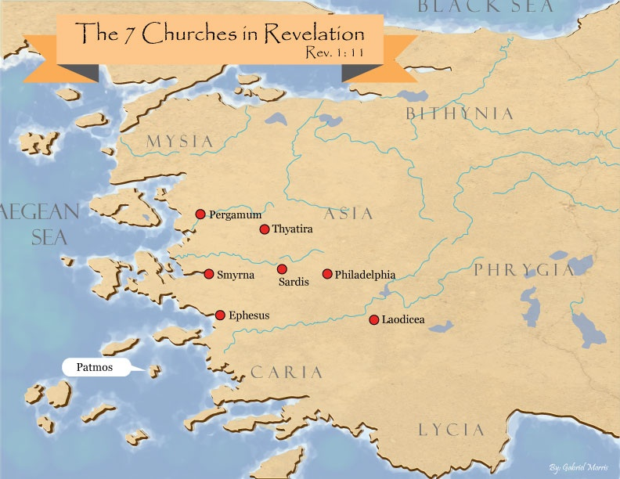
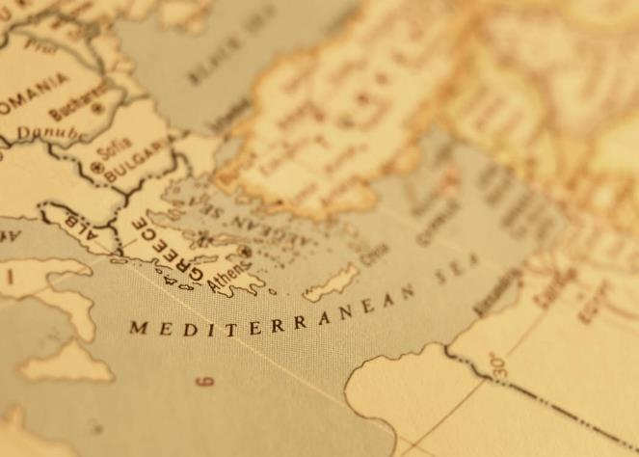

Slide 18

Satanic/Demonic Miracles
Exod. 7–8
Deut. 13:1-3
Job 1:12-19; 2:7-8
1 Sam. 28?
Matt. 7:21-23; 24:24
Luke 4:5
Acts 8:9; 16:16
Gal. 1:6-9
2 Thess. 2:9
2 Cor. 11:14
Rev. 13:3, 13, 15; 16:13-14

Slide 19

Galatians 1:6–9
⁶ I am amazed that you are so quickly deserting Him who called you by the grace of Christ, for a different gospel; ⁷ which is really not another; only there are some who are disturbing you and want to distort the gospel of Christ. ⁸ But even if we, or an angel from heaven, should preach to you a gospel contrary to what we have preached to you, he is to be accursed! ⁹ As we have said before, so I say again now, if any man is preaching to you a gospel contrary to what you received, he is to be accursed!

Slide 20
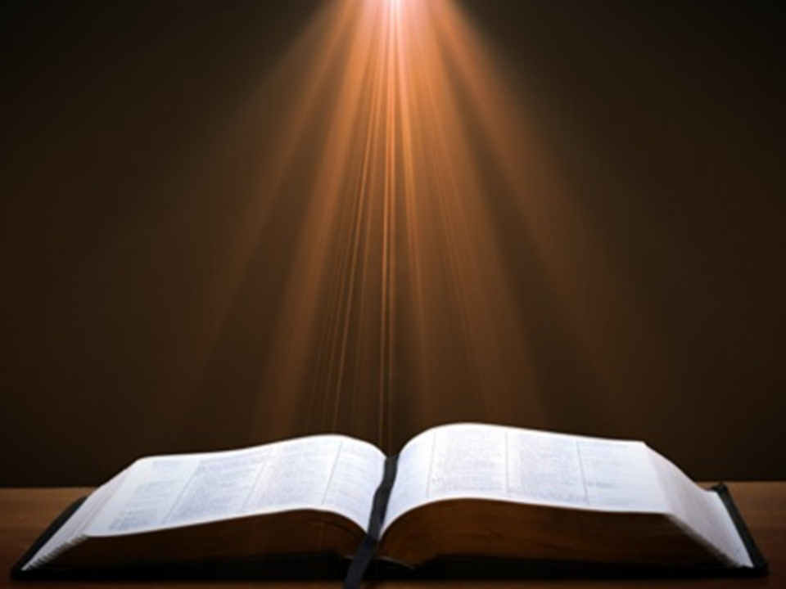
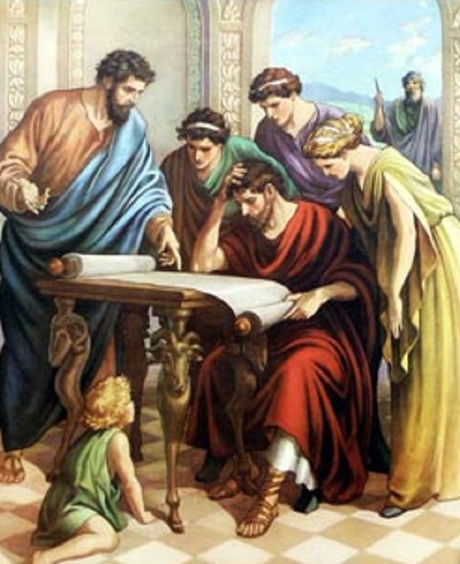
Acts 17:11
“Now these were more noble-minded than those in Thessalonica, for they received the word with great eagerness, examining the Scriptures daily to see whether these things were so.”

Slide 21

1 Corinthians 3:1-3 (NKJV)
^{“1} And I, BRETHREN, could not speak to you as to spiritual people but as to carnal, as to babes in Christ. ² I fed you with milk and not with solid food; for until now you were not able to receive it, and even now you are still not able; ³ for you are still carnal. For where there are envy, strife, and divisions among you, are you not carnal and behaving like mere men?”

Slide 22
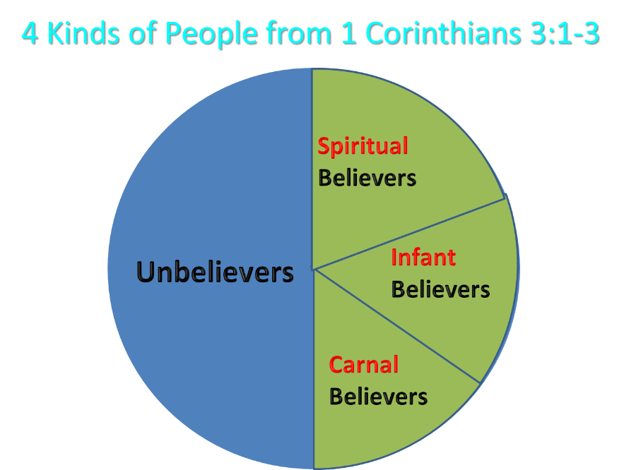
Notes:
Ray Steadman – “1st Californians”
Unbelievers vs Categories of Believers
Unbelievers – ψυχικός psuchikós; Natural, pertaining to the natural as distinguished from the spiritual
Spiritual Believers – πνευματικός pneumatikós; of persons who are spiritual, enlightened by the Holy Spirit
Infant Believers – σάρκινος sárkinos; with propensities of the flesh unto sin; νήπιος nḗpios; an infant, child, baby without any definite limitation of age. (This relates to immaturity and lack of instruction)
Carnal Believers – σαρκικός sarkikós; tendency to satisfy the flesh, implying sinfulness, sinful propensity, carnal (This relates to disobedience and open rebellion)

Slide 23
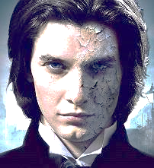
1 John 4:1
“Beloved, do not believe every spirit, but test the spirits to see whether they are from God, because many false prophets have gone out into the world.”

Slide 25
II. Exodus 7:8-13 The Power
God’s miracle (8-10)
Pharaoh’s miracle (11-12a)
God’s supremacy (12b)
Pharaoh’s hardening (13)

Slide 26
The Plagues of Egypt
NO. | DESCRIPTION | SCRIPTURE | Egyptian Deity
1. | Water to Blood | Exod. 7:14-25 | Hapi, Khnum
2. | Frogs | Exod. 8:1-15 | Heqt
3. | Gnats | Exod. 8:16-19 | Set
4. | Flies | Exod. 8:20-32 | Uatchit
5. | Disease on Cattle | Exod. 9:1-7 | Hathor, Apis
6. | Boils | Exod. 9:8-12 | Sekhmet, Serapis
7. | Hail | Exod. 9:13-35 | Seth, Nut
8. | Locusts | Exod. 10:1-20 | Seth, Nut, Osiris
9. | Darkness | Exod. 10:21-29 | Re, Horus, Atum
10. | Death of the First Born | Exod. 12:29-36 | Min, Osiris, Heqt, Isis

Slide 27

Ezekiel 28:13, 15
¹³ “You were in Eden, the garden of God; Every precious stone was your covering: The ruby, the topaz and the diamond; The beryl, the onyx and the jasper; The lapis lazuli, the turquoise and the emerald; And the gold, the workmanship of your settings and sockets, Was in you. On the day that you were created They were prepared… ¹⁵ “You were blameless in your ways From the day you were created Until unrighteousness was found in you.

Slide 28
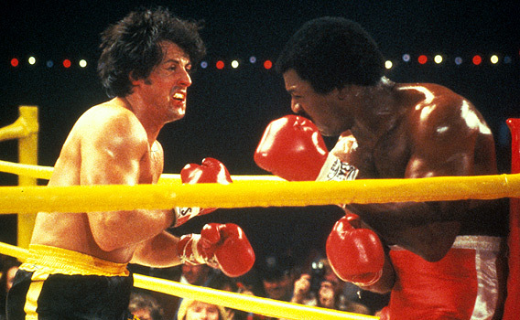

Slide 29
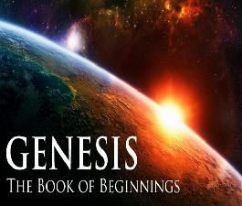
Refutation of Man’s Philosophies (Gen 1:1)
Atheism – God created (Ps. 14:1)
Pantheism – God is transcendent over creation
Polytheism – One God created (Deut. 6:4; Isa 43:11; 44:6; 45:5)
Materialism – Matter began
Dualism – God alone created (Ezek. 28:13, 15)
Humanism – God rather than man created
Naturalism – God created
Morris, Genesis Record, 38

Slide 30
II. Exodus 7:8-13 The Power
God’s miracle (8-10)
Pharaoh’s miracle (11-12a)
God’s supremacy (12b)
Pharaoh’s hardening (13)

Slide 31

Charles Ryrie Ryrie Study Bible, page 96
Exodus 4:21 - “harden his heart. Ten times it is said that Pharaoh hardened his own heart (7:13, 14, 22; 8:15, 19, 32; 9:7, 34, 35; 13:15), and 10 times that God hardened Pharaoh’s heart (4:21; 7:3; 9:12; 10:1, 20, 27; 11:10; 14:4, 8, 17). Paul uses this as an example of the inscrutable will of God and of His mercy toward men (Rom. 9:14–18). Seven times Pharaoh hardened his own heart before God first hardened it, though the prediction that God would do it preceded all.”

Slide 32
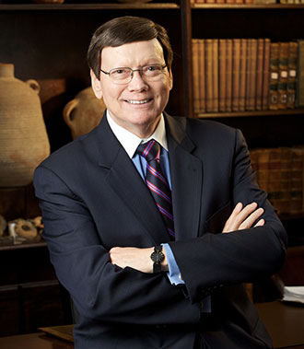
Dr. Ed Hindson
Hindson, E. E., & Mitchell, D. R., eds. (2010). King James Version Bible Commentary for Today: The Most Up-to-Date Commentary on the Time-Honored Text of the King James Version (p. 86). Thomas Nelson.
“4:21. I will harden his heart. An expression meaning ‘to strengthen his will.’ The text identifies the heart as the location of the volition, man’s decision-making ability. On seven occasions in the narrative, God hardens Pharaoh’s heart (9:12; 10:1, 20, 27; 11:10; 14:4, 8) or foretells that He will harden Pharaoh’s heart (4:21; 7:3), and nine times in the text, Pharaoh hardens his own heart (7:13, 14, 22; 8:15, 19, 32; 9:7, 34–35). For the initial five plagues, the text registers Pharaoh as the agent of hardening. Not until the sixth plague does God participate in the confirmation of Pharaoh’s own volitional choices.”

Slide 33
John 13:19; 14:29
“¹⁹ From now on I am telling you before it comes to pass, so that when it does occur, you may believe that I am He… ^{14:29} Now I have told you before it happens, so that when it happens, you may believe.”

Slide 35
What Happened to Christ’s Disciples?
Disciple | Place | Martyrdom
James the Son of Alpheus | Jerusalem | Clubbed to death
Simon the Zealot | Jerusalem | Martyred
James the Son of Zebedee | Judea (Acts 12:2) | Executed
Thaddeus | Mesopotamia | Beaten to death
Peter | Babylon, Rome | Crucified upside down
Matthew | Parthia (Tehran) | Beheaded
Notes:
109 prophecies…
Peter Stoner – SCIENCE SPEAKS, An Evaluation of Certain Christian Evidences
To fulfill just 8 prophecies =1 X 10 to the twenty-eighth power!
Can we visualize this with an illustration? Suppose we took an atheistic professor, blindfolded him and covered the state of Texas two feet deep with silver dollars. Then we put a check on one of those silver dollars and mixed them up. The odds of one person fulfilling just these eight prophecies would be the same as this atheistic professor selecting the silver dollar upon which we have placed a check, in his first try.
https://www.bereanpublishers.com/the-odds-of-eight-messianic-prophecies-coming-true/

Slide 36
What Happened to Christ’s Disciples?
Disciple | Place | Martyrdom
John | Asia Minor, Patmos, Ephesus | Fried in boiling oil
Philip | E. Turkey | Tortured & crucified
Thomas | India | Speared
Bartholomew | India | Flayed & crucified
Andrew | Ukraine, Russia, Greece | Hanged
Notes:
109 prophecies…
Peter Stoner – SCIENCE SPEAKS, An Evaluation of Certain Christian Evidences
To fulfill just 8 prophecies =1 X 10 to the twenty-eighth power!
Can we visualize this with an illustration? Suppose we took an atheistic professor, blindfolded him and covered the state of Texas two feet deep with silver dollars. Then we put a check on one of those silver dollars and mixed them up. The odds of one person fulfilling just these eight prophecies would be the same as this atheistic professor selecting the silver dollar upon which we have placed a check, in his first try.
https://www.bereanpublishers.com/the-odds-of-eight-messianic-prophecies-coming-true/

Slide 37
SECOND CONFRONTATION WITH PHARAOH Exodus 7:1-25
The Prophets (1-7)
The Power (8-13)
The Plagues (14-25)

Slide 38
III. Exodus 7:14-25 The Plagues
Pharaoh’s condition (14)
God’s instruction (15-19)
Moses’ obedience (20-25)

Slide 39
III. Exodus 7:14-25 The Plagues
Pharaoh’s condition (14)
God’s instruction (15-19)
Moses’ obedience (20-25)

Slide 40
III. Exodus 7:14-25 The Plagues
Pharaoh’s condition (14)
God’s instruction (15-19)
Moses’ obedience (20-25)

Slide 41
Exodus 7:15-19 God’s Instructions
Meet Pharaoh (15)
Command to Pharaoh (16)
Miracles for Pharaoh (17-19)

Slide 42
Exodus 7:15-19 God’s Instructions
Meet Pharaoh (15)
Command to Pharaoh (16)
Miracles for Pharaoh (17-19)

Slide 43
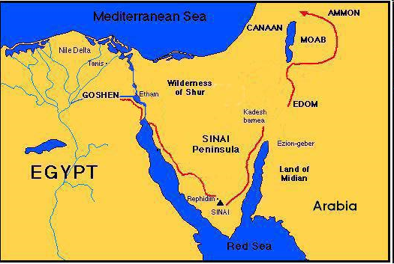

Slide 44
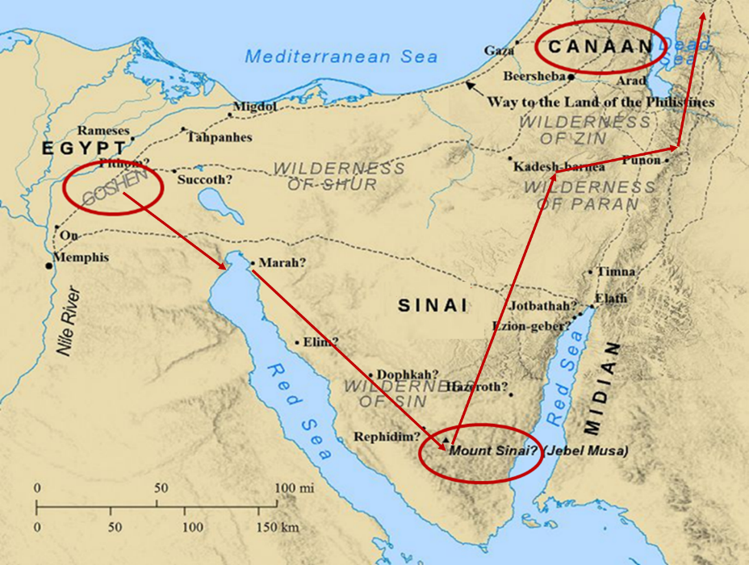

Slide 45
Exodus 7:15-19 God’s Instructions
Meet Pharaoh (15)
Command to Pharaoh (16)
Miracles for Pharaoh (17-19)

Slide 46
Ephesians 2:8-10
“⁸ For by grace you have been saved through faith; and that not of yourselves, it is the gift of God; ⁹ not as a result of works, so that no one may boast. ¹⁰ For we are His workmanship, created in Christ Jesus for good works, which God prepared beforehand so that we would walk [peripateō, subjunctive mood] in them.”

Slide 47
Charles Ryrie Ryrie Study Bible, page 96
Exodus 4:21 - “harden his heart. Ten times it is said that Pharaoh hardened his own heart (7:13, 14, 22; 8:15, 19, 32; 9:7, 34, 35; 13:15), and 10 times that God hardened Pharaoh’s heart (4:21; 7:3; 9:12; 10:1, 20, 27; 11:10; 14:4, 8, 17). Paul uses this as an example of the inscrutable will of God and of His mercy toward men (Rom. 9:14–18). Seven times Pharaoh hardened his own heart before God first hardened it, though the prediction that God would do it preceded all.”

Slide 48
Dr. Ed Hindson
Hindson, E. E., & Mitchell, D. R., eds. (2010). King James Version Bible Commentary for Today: The Most Up-to-Date Commentary on the Time-Honored Text of the King James Version (p. 86). Thomas Nelson.
“4:21. I will harden his heart. An expression meaning ‘to strengthen his will.’ The text identifies the heart as the location of the volition, man’s decision-making ability. On seven occasions in the narrative, God hardens Pharaoh’s heart (9:12; 10:1, 20, 27; 11:10; 14:4, 8) or foretells that He will harden Pharaoh’s heart (4:21; 7:3), and nine times in the text, Pharaoh hardens his own heart (7:13, 14, 22; 8:15, 19, 32; 9:7, 34–35). For the initial five plagues, the text registers Pharaoh as the agent of hardening. Not until the sixth plague does God participate in the confirmation of Pharaoh’s own volitional choices.”

Slide 49
Exodus 7:15-19 God’s Instructions
Meet Pharaoh (15)
Command to Pharaoh (16)
Miracles for Pharaoh (17-19)

Slide 50
Exodus 7:17-19 Miracles to Pharaoh
Nile (17-18)
Waters of Egypt (19)

Slide 51
Exodus 7:17-19 Miracles to Pharaoh
Nile (17-18)
Waters of Egypt (19)

Slide 52
The Plagues of Egypt
NO. | DESCRIPTION | SCRIPTURE | Egyptian Deity
1. | Water to Blood | Exod. 7:14-25 | Hapi, Khnum
2. | Frogs | Exod. 8:1-15 | Heqt
3. | Gnats | Exod. 8:16-19 | Set
4. | Flies | Exod. 8:20-32 | Uatchit
5. | Disease on Cattle | Exod. 9:1-7 | Hathor, Apis
6. | Boils | Exod. 9:8-12 | Sekhmet, Serapis
7. | Hail | Exod. 9:13-35 | Seth, Nut
8. | Locusts | Exod. 10:1-20 | Seth, Nut, Osiris
9. | Darkness | Exod. 10:21-29 | Re, Horus, Atum
10. | Death of the First Born | Exod. 12:29-36 | Min, Osiris, Heqt, Isis

Slide 53
Dr. Ed Hindson
Hindson, E. E., & Mitchell, D. R., eds. (2010). King James Version Bible Commentary for Today: The Most Up-to-Date Commentary on the Time-Honored Text of the King James Version (p. 90). Thomas Nelson.
“The fourth purpose was to demonstrate the Lord’s superiority over Egypt’s voluminous number of false gods (12:12; 18:11; Num. 33:4). There were some eighty ancient-Egyptian gods, each one the personification of an animal or object. In addition, Pharaoh himself was considered to be the incarnation of the god Horus, with the court magicians serving as his priests. Each of the ten plagues was designed to challenge a specific god or gods within the Egyptian pantheon and ultimately to topple the credibility of Pharaoh’s own divinity as well (see Davis, Moses, pp. 79–129).”

Slide 54
Dr. Ed Hindson
Hindson, E. E., & Mitchell, D. R., eds. (2010). King James Version Bible Commentary for Today: The Most Up-to-Date Commentary on the Time-Honored Text of the King James Version (p. 91). Thomas Nelson.
“This plague, as were they all, was meant to demonstrate the Lord’s superiority over Pharaoh and his gods. The Nile River was considered sacred, the very bloodstream of the god Osirus. Other deities challenged by this particular plague were Khnum, the guardian of the Nile; Hapi, the spirit of the Nile; and Sepek, the crocodile god.”

Slide 55
Charles Ryrie Ryrie Study Bible, page 100
Exodus 7:17 - “The reflection of the setting sun on the river might give the water a red appearance temporarily but would not cause the fish to die and the water to become unusable. Nor would red silting, not uncommon to the Nile, do this. This was a supernatural judgment. The water was turned to blood in terms of appearance (taste, smell, and texture).”

Slide 56
Exodus 7:17-19 Miracles to Pharaoh
Nile (17-18)
Waters of Egypt (19)

Slide 57
Dr. Ed Hindson
Hindson, E. E., & Mitchell, D. R., eds. (2010). King James Version Bible Commentary for Today: The Most Up-to-Date Commentary on the Time-Honored Text of the King James Version (p. 91). Thomas Nelson.
“Some hold that the first nine plagues may have been a series of miraculous intensifications of natural events. For example, they hold that this initial plague could have resulted from large quantities of red sediment, algae, or fungus that caused the water to take on the appearance of blood. While possible, this is unlikely, for this and other similar theories do not explain the text’s account of the immediate transformation of all water, including that which was previously stored in pools and containers.”

Slide 58
Dr. Ed Hindson
Hindson, E. E., & Mitchell, D. R., eds. (2010). King James Version Bible Commentary for Today: The Most Up-to-Date Commentary on the Time-Honored Text of the King James Version (p. 91). Thomas Nelson.
“Publicly, in front of Pharaoh and his servants, Aaron, at his brother’s command, took the rod, and smote the waters (v. 20). The now completely crimson water stank (v. 21) with an inundation of dead fish and proved undrinkable. The magnitude of the sign’s effect extended not merely to bodies of water but to every vessel that already contained drinking water.”

Slide 59
III. Exodus 7:14-25 The Plagues
Pharaoh’s condition (14)
God’s instruction (15-19)
Moses’ obedience (20-25)

Slide 60
Exodus 7:20-25 Moses’ Obedience
Nile to blood (20-21)
Pharaoh’s miracle (22a)
Pharaoh’s hardness (22b-23)
Lasting results (24)
Duration (25)

Slide 61
Exodus 7:20-25 Moses’ Obedience
Nile to blood (20-21)
Pharaoh’s miracle (22a)
Pharaoh’s hardness (22b-23)
Lasting results (24)
Duration (25)

Slide 62
“SEVEN SIGNS” in Gospel of John
1. Changing Water into Wine | 2:11
2. Healing official’s son | 4:46-54
3. Healing an invalid at the Pool of Bethesda | 5:1-18
4. Feeding the 5,000 | 6:5-14
5. Walking on water | 6:16-21
6. Healing a blind man | 9:1-7
7. Raising dead Lazarus | 11:1-45

Slide 63
John 13:19; 14:29
“¹⁹ From now on I am telling you before it comes to pass, so that when it does occur, you may believe that I am He… ^{14:29} Now I have told you before it happens, so that when it happens, you may believe.”

Slide 65
What Happened to Christ’s Disciples?
Disciple | Place | Martyrdom
James the Son of Alpheus | Jerusalem | Clubbed to death
Simon the Zealot | Jerusalem | Martyred
James the Son of Zebedee | Judea (Acts 12:2) | Executed
Thaddeus | Mesopotamia | Beaten to death
Peter | Babylon, Rome | Crucified upside down
Matthew | Parthia (Tehran) | Beheaded
Notes:
109 prophecies…
Peter Stoner – SCIENCE SPEAKS, An Evaluation of Certain Christian Evidences
To fulfill just 8 prophecies =1 X 10 to the twenty-eighth power!
Can we visualize this with an illustration? Suppose we took an atheistic professor, blindfolded him and covered the state of Texas two feet deep with silver dollars. Then we put a check on one of those silver dollars and mixed them up. The odds of one person fulfilling just these eight prophecies would be the same as this atheistic professor selecting the silver dollar upon which we have placed a check, in his first try.
https://www.bereanpublishers.com/the-odds-of-eight-messianic-prophecies-coming-true/

Slide 66
What Happened to Christ’s Disciples?
Disciple | Place | Martyrdom
John | Asia Minor, Patmos, Ephesus | Fried in boiling oil
Philip | E. Turkey | Tortured & crucified
Thomas | India | Speared
Bartholomew | India | Flayed & crucified
Andrew | Ukraine, Russia, Greece | Hanged
Notes:
109 prophecies…
Peter Stoner – SCIENCE SPEAKS, An Evaluation of Certain Christian Evidences
To fulfill just 8 prophecies =1 X 10 to the twenty-eighth power!
Can we visualize this with an illustration? Suppose we took an atheistic professor, blindfolded him and covered the state of Texas two feet deep with silver dollars. Then we put a check on one of those silver dollars and mixed them up. The odds of one person fulfilling just these eight prophecies would be the same as this atheistic professor selecting the silver dollar upon which we have placed a check, in his first try.
https://www.bereanpublishers.com/the-odds-of-eight-messianic-prophecies-coming-true/

Slide 67
Exodus 7:20-25 Moses’ Obedience
Nile to blood (20-21)
Pharaoh’s miracle (22a)
Pharaoh’s hardness (22b-23)
Lasting results (24)
Duration (25)

Slide 68
Satanic/Demonic Miracles
Exod. 7–8
Deut. 13:1-3
Job 1:12-19; 2:7-8
1 Sam. 28?
Matt. 7:21-23; 24:24
Acts 8:9; 16:16
Gal. 1:6-9
2 Thess. 2:9
Rev. 13:3, 13, 15; 16:13-14

Slide 69
Galatians 1:6–9
⁶ I am amazed that you are so quickly deserting Him who called you by the grace of Christ, for a different gospel; ⁷ which is really not another; only there are some who are disturbing you and want to distort the gospel of Christ. ⁸ But even if we, or an angel from heaven, should preach to you a gospel contrary to what we have preached to you, he is to be accursed! ⁹ As we have said before, so I say again now, if any man is preaching to you a gospel contrary to what you received, he is to be accursed!

Slide 70
Acts 17:11
“Now these were more noble-minded than those in Thessalonica, for they received the word with great eagerness, examining the Scriptures daily to see whether these things were so.”

Slide 71
1 John 4:1
“Beloved, do not believe every spirit, but test the spirits to see whether they are from God, because many false prophets have gone out into the world.”

Slide 72
Exodus 7:20-25 Moses’ Obedience
Nile to blood (20-21)
Pharaoh’s miracle (22a)
Pharaoh’s hardness (22b-23)
Lasting results (24)
Duration (25)

Slide 73
Charles Ryrie Ryrie Study Bible, page 96
Exodus 4:21 - “harden his heart. Ten times it is said that Pharaoh hardened his own heart (7:13, 14, 22; 8:15, 19, 32; 9:7, 34, 35; 13:15), and 10 times that God hardened Pharaoh’s heart (4:21; 7:3; 9:12; 10:1, 20, 27; 11:10; 14:4, 8, 17). Paul uses this as an example of the inscrutable will of God and of His mercy toward men (Rom. 9:14–18). Seven times Pharaoh hardened his own heart before God first hardened it, though the prediction that God would do it preceded all.”

Slide 74
Dr. Ed Hindson
Hindson, E. E., & Mitchell, D. R., eds. (2010). King James Version Bible Commentary for Today: The Most Up-to-Date Commentary on the Time-Honored Text of the King James Version (p. 86). Thomas Nelson.
“4:21. I will harden his heart. An expression meaning ‘to strengthen his will.’ The text identifies the heart as the location of the volition, man’s decision-making ability. On seven occasions in the narrative, God hardens Pharaoh’s heart (9:12; 10:1, 20, 27; 11:10; 14:4, 8) or foretells that He will harden Pharaoh’s heart (4:21; 7:3), and nine times in the text, Pharaoh hardens his own heart (7:13, 14, 22; 8:15, 19, 32; 9:7, 34–35). For the initial five plagues, the text registers Pharaoh as the agent of hardening. Not until the sixth plague does God participate in the confirmation of Pharaoh’s own volitional choices.”

Slide 75
Exodus 7:20-25 Moses’ Obedience
Nile to blood (20-21)
Pharaoh’s miracle (22a)
Pharaoh’s hardness (22b-23)
Lasting results (24)
Duration (25)

Slide 76
Dr. Ed Hindson
Hindson, E. E., & Mitchell, D. R., eds. (2010). King James Version Bible Commentary for Today: The Most Up-to-Date Commentary on the Time-Honored Text of the King James Version (p. 91). Thomas Nelson.
“During this period, the sole source of fresh water throughout Egypt was the underground natural springs. The Egyptians now had to exert themselves. As the Hebrews had to gather their own straw, now the Egyptians were forced to dig round about the river (v. 24) for their own water.”

Slide 77

8 New Promises Genesis 12:1-3
Land (Gen. 12:1b)
Great nation (Gen. 12:2a)
Personal blessing (Gen. 12:2b)
Great name (Gen. 12:2c)
Blessing to others (Gen. 12:2d)
Blessing to blessers (Gen. 12:3a)
Cursing to cursers (Gen. 12:3b)
Blessing to the world (Gen. 12:3c)

Slide 78

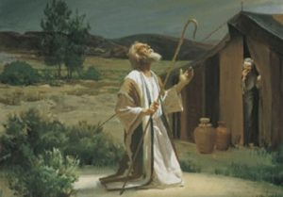
Genesis 12:3
“And I will bless those who bless you, And the one who curses you I will curse. And in you all the families of the earth will be blessed.”

Slide 79
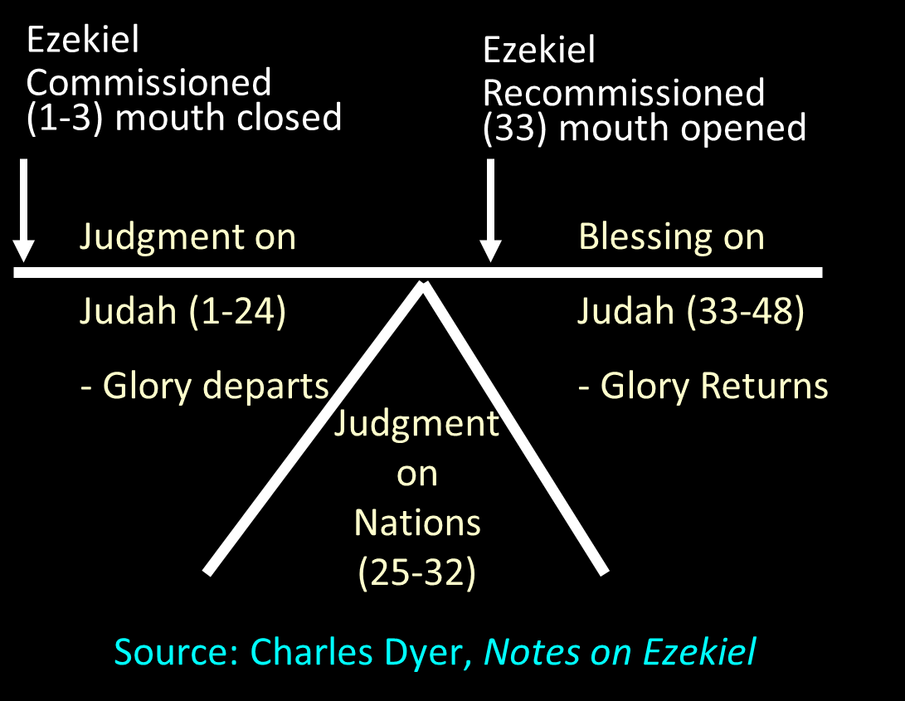

Slide 80
Exodus 7:20-25 Moses’ Obedience
Nile to blood (20-21)
Pharaoh’s miracle (22a)
Pharaoh’s hardness (22b-23)
Lasting results (24)
Duration (25)

Slide 81
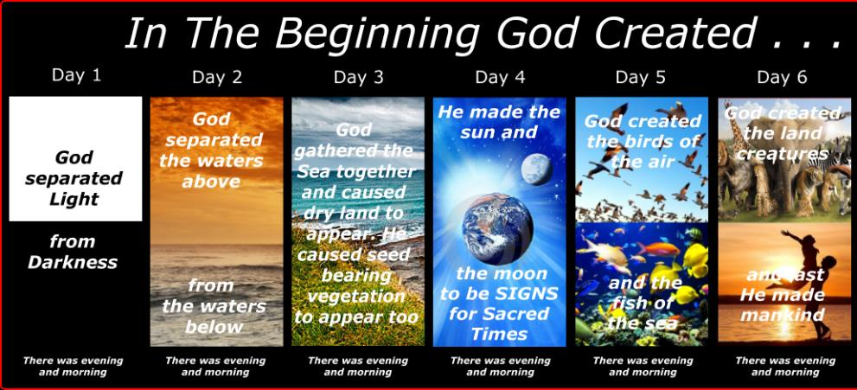
SHAPING AND POPULATING (GEN 1:1)
Day 1: | Light | Day 4: | Luminaries
Day 2: | Water, sky | Day 5: | Sea animals, birds
Day 3: | Land, vegetation | Day 6: | Land animals, man

Slide 82
Conclusion

Slide 83
SECOND CONFRONTATION WITH PHARAOH Exodus 7:1-25
The Prophets (1-7)
The Power (8-13)
The Plagues (14-25)

Slide 84
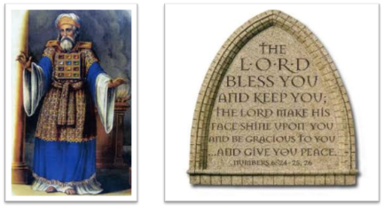
²⁴ The Lord bless you, and keep you; ²⁵ The Lord make His face shine on you, And be gracious to you; ²⁶ The Lord lift up His countenance on you, And give you peace.
Numbers 6:24–26 (NASB95)

