Slide 1
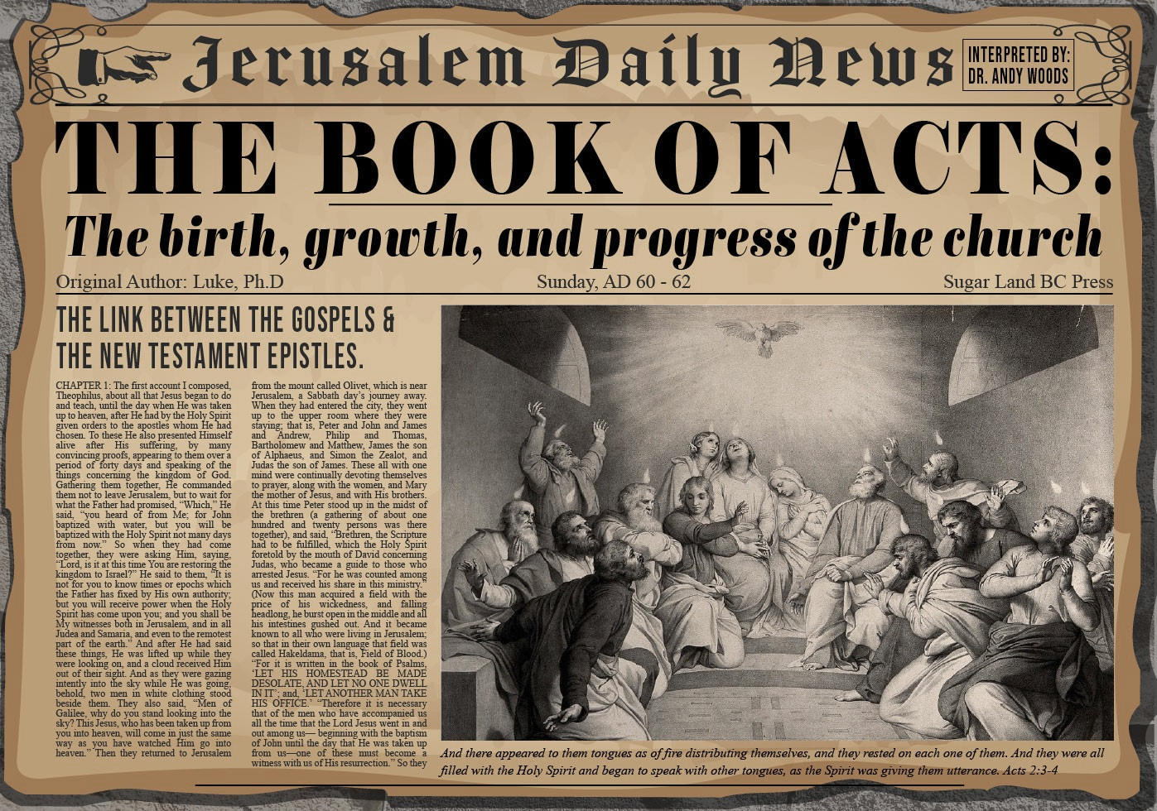


Slide 2
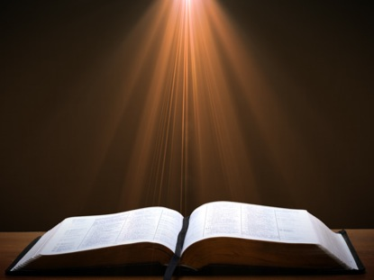
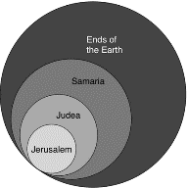
Acts 1:8
“but you will receive power when the Holy Spirit has come upon you; and you shall be My witnesses both in Jerusalem, and in all Judea and Samaria, and even to the remotest part of the earth.”

Slide 3
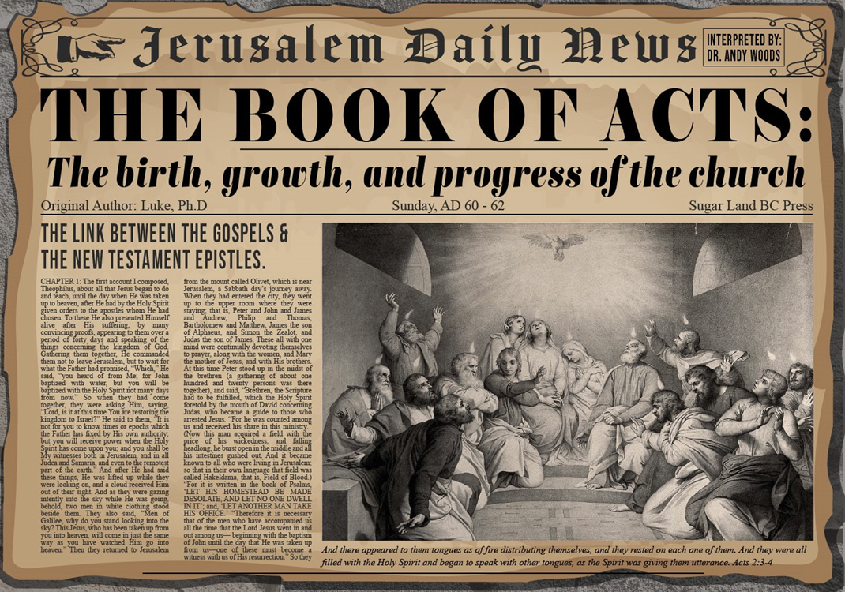
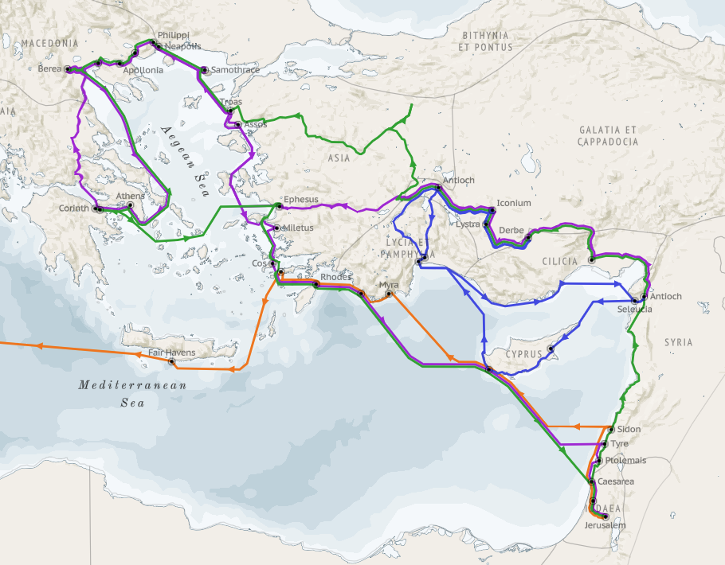
Structure (Acts 1:8)
Jerusalem (Acts 1–7)
Judea and Samaria (Acts 8–12)
Remotest part of the earth (Acts 13–28)
1st missionary journey (Acts 13–14)
Jerusalem council (Acts 15:1-35)
2nd missionary journey (Acts 15:36 –18:22)
3rd missionary journey (Acts 18:23–21:17)
Trip to Rome (Acts 21:18–28:31)

Slide 4
Acts 15:1-35 Jerusalem Council
Occasion (1-5)
Declarations (6-21)
Decision (22-29)
Delivery (30-35)

Slide 5
II. Declarations Acts 15:6-21
Meeting convened (6)
Peter’s address (7-11)
Barnabas’ & Paul’s testimony (12)
James’ address (13-21)

Slide 6
Acts 15:7-11 Peter’s Address
God chose Gentile salvation (7)
Spirit authenticated Gentile salvation (8-9)
Peter’s challenge (10)
Peter’s conclusion (11)

Slide 7
Acts 15:7-11 Peter’s Address
God chose Gentile salvation (7)
Spirit authenticated Gentile salvation (8-9)
Peter’s challenge (10)
Peter’s conclusion (11)

Slide 8
From Peter to Paul
Reference | Center | Person | Place | Outreach
Acts 1–12 | Jerusalem | Peter | Jerusalem, Judea, Samaria | Jewish
Acts 13–28 | Antioch | Paul | Uttermost parts | Gentiles

Slide 9
From Peter to Paul
Peter | Paul
Heals a man lame from birth (3:1-11) | Heals a man lame from birth (14:8-18)
Heals by shadow (5:15-16) | Heals by handkerchief (19:11-12)
Success is a cause of jealousy (5:17) | Success is a cause of jealousy (13:45)
Confronts a sorcerer (8:9-24) | Confronts a sorcerer (13:6-11)
Raises Dorcas (9:36-41) | Raises Eutychus (20:9-12)
Jailed and miraculously freed (12:3-19) | Jailed and miraculously freed (16:25-34)

Slide 10

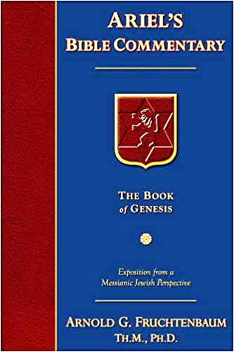
Dr. Arnold G. Fruchtenbaum
The Book of Acts, 276
“After having spoken to the disciples, Peter departed, and went to another place (v. 17b). He fled out of Jerusalem. Luke chose not to disclose where Peter went, but we do know something about Peter’s travels from other passages. According to I Corinthians 9:5, he had an itinerant ministry; according to I Corinthians 1:12, he spent some time in Corinth; according to Galatians 2:11, he was in Antioch of Pisidia; according to I Peter 1:1, he was in Asia Minor; and according to I Peter 5:13, he was in Babylon.”

Slide 11

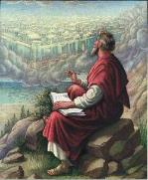
1 Peter 5:13
“She who is in Babylon, chosen together with you, sends you greetings, and so does my son, Mark.”

Slide 12
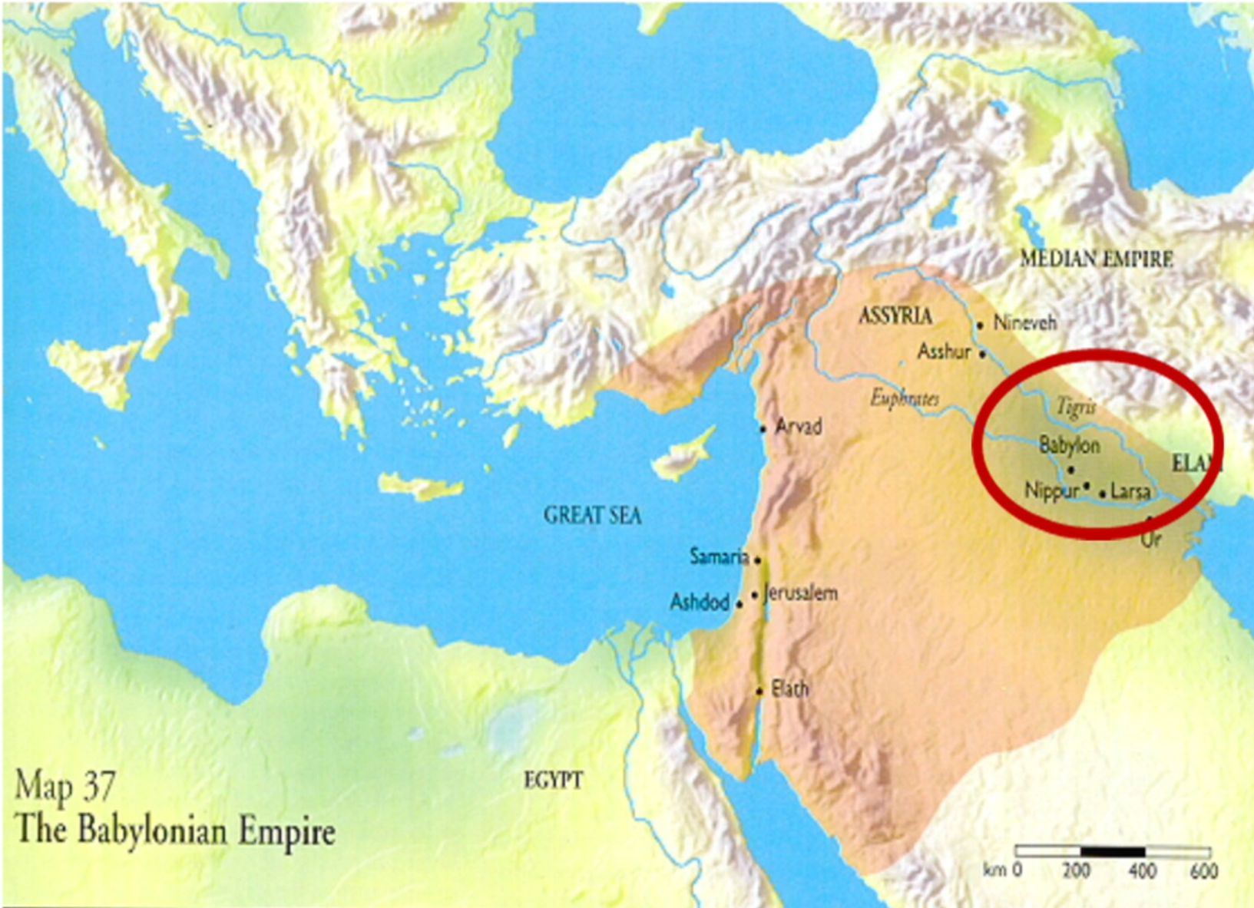

Slide 13

Galatians 2:7-8
“⁷ But on the contrary, seeing that I had been entrusted with the gospel to the uncircumcised, just as Peter had been to the circumcised ⁸ (for He who effectually worked for Peter in his apostleship to the circumcised effectually worked for me also to the Gentiles).”

Slide 14
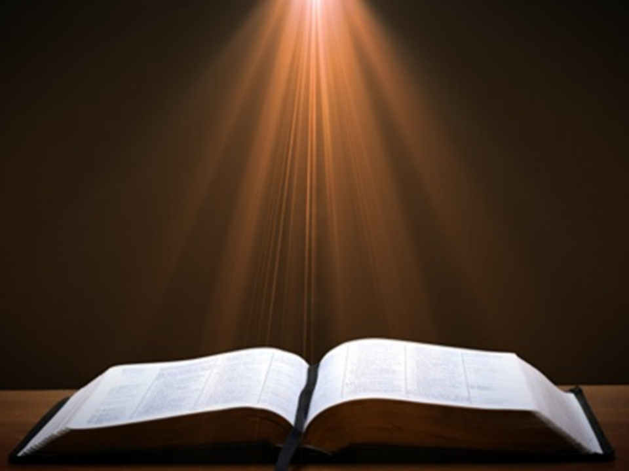
Acts 2:9–11
⁹ “Parthians and Medes and Elamites, and residents of Mesopotamia, Judea and Cappadocia, Pontus and Asia, ¹⁰ Phrygia and Pamphylia, Egypt and the districts of Libya around Cyrene, and visitors from Rome, both Jews and proselytes, ¹¹ Cretans and Arabs—we hear them in our own tongues speaking of the mighty deeds of God.”

Slide 15
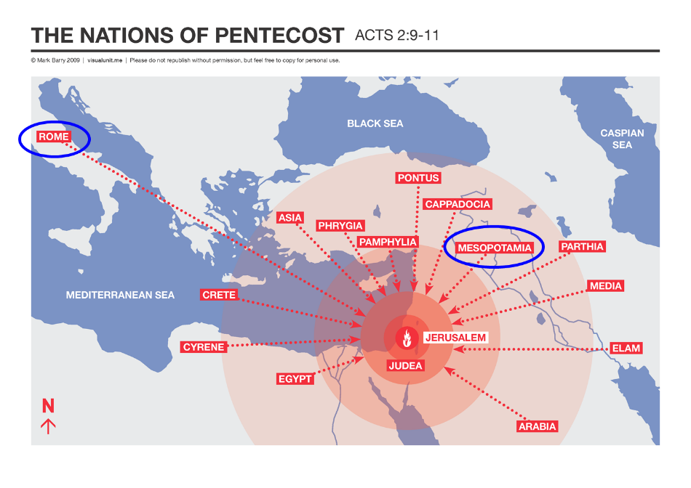

Slide 16
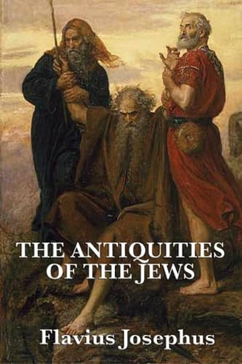
Josephus Antiquities, 15.2.2
“But when Hyrcanus was brought into Parthia the king Phraates treated him after a very gentle manner, as having already learned of what an illustrious family he was; on which account he set him free from his bonds, and gave him a habitation at Babylon, where there were Jews in great numbers. These Jews honored Hyrcanus as their high priest and king, as did all the Jewish nation that dwelt as far as Euphrates; which respect was very much to his satisfaction...”

Slide 17
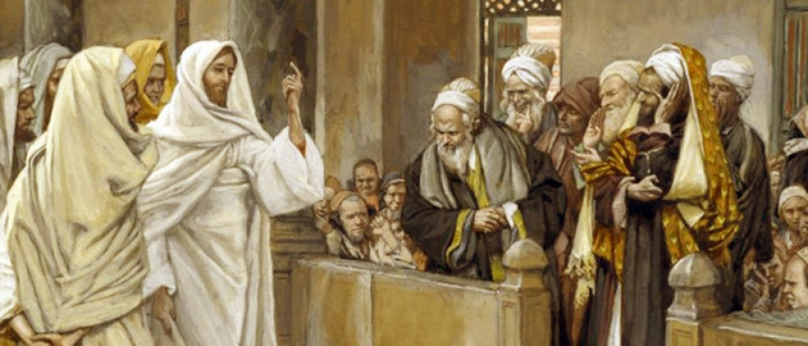
TYPES OF PHARISEES
TYPE | OVERTHROWN
Justification | Matthew 5:20
Sanctification | Galatians 3:3
Ecclesiology | Acts 15

Slide 18
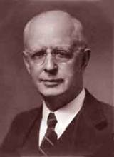
Lewis Sperry Chafer, vol. 7, Systematic Theology (Grand Rapids, MI: Kregel Publications, 1993), 265-66.
Belief – God’s One Condition for Justification
“…because upwards of 150 passages of Scripture condition salvation upon believing only (cf. John 3:16; Acts 16:31).”

Slide 19
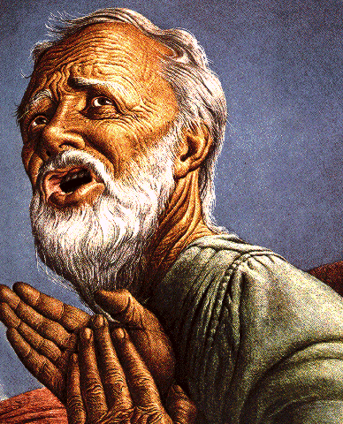
Belief – God’s One Condition for Justification
Gen 15:6
Then he believed in the LORD; and He reckoned it to him as righteousness.
John 3:16
For God so loved the world, that He gave His only begotten Son, that whoever believes in Him shall not perish, but have eternal life.
Acts 16:30-31
"Sirs, what must I do to be saved?" They said, "Believe in the Lord Jesus, and you will be saved..."

Slide 20
Acts 15:7-11 Peter’s Address
God chose Gentile salvation (7)
Spirit authenticated Gentile salvation (8-9)
Peter’s challenge (10)
Peter’s conclusion (11)

Slide 21


Acts 11:15-16
“¹⁵ And as I began to speak, the Holy Spirit fell upon them just as He did upon us at the beginning. ¹⁶ And I remembered the word of the Lord, how He used to say, ‘John baptized with water, but you will be baptized with the Holy Spirit.’”

Slide 22

Ephesians 2:15-16
“¹⁵ by abolishing in His flesh the enmity, which is the Law of commandments contained in ordinances, so that in Himself He might make the two into one new man, thus establishing peace, ¹⁶ and might reconcile them both in one body to God through the cross, by it having put to death the enmity.”

Slide 23

Jeremiah 31:31-34
“³¹ Behold, days are coming,” declares the Lord, “when I will make a new covenant with the house of Israel and with the house of Judah, ³² not like the covenant which I made with their fathers in the day I took them by the hand to bring them out of the land of Egypt, My covenant which they broke, although I was a husband to them,” declares the Lord. ³³ “But this is the covenant which I will make with the house of Israel after those days,” declares the Lord, I will put My law. . .

Slide 24
Jeremiah 31:31-34
. . . within them and on their heart I will write it; and I will be their God, and they shall be My people. ³⁴ They will not teach again, each man his neighbor and each man his brother, saying, ‘Know the Lord,’ for they will all know Me, from the least of them to the greatest of them,” declares the Lord, “for I will forgive their iniquity, and their sin I will remember no more.”

Slide 25
Acts 15:7-11 Peter’s Address
God chose Gentile salvation (7)
Spirit authenticated Gentile salvation (8-9)
Peter’s challenge (10)
Peter’s conclusion (11)

Slide 26
TYPES OF PHARISEES
TYPE | OVERTHROWN
Justification | Matthew 5:20
Sanctification | Galatians 3:3
Ecclesiology | Acts 15

Slide 27
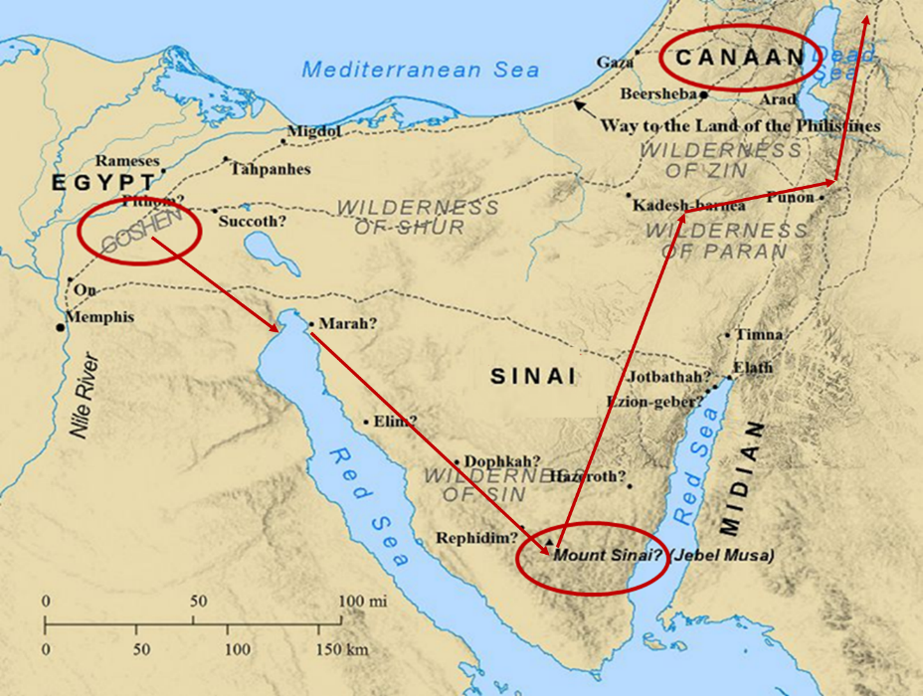

Slide 28
Six Parts of a Suzerain-Vassal Treaty in Deuteronomy
Preamble (1:1-5)
Prologue (1:6–4:40)
Covenant obligations (5–26)
Storage and reading instructions (27:2-3; 31:9, 24, 26)
Witnesses (32:1)
Blessings and curses (28)

Slide 29
ISRAEL'S JUDGMENTS
Division of the kingdom in 931 B.C. (1 Kgs. 12)
Assyrian judgment in 722 B.C. (2 Kgs. 17)
Babylonian captivity in 586 B.C. (2 Kgs. 25)
Rome Diaspora in A.D. 70 (Luke 19:41-44)

Slide 30
Acts 15:7-11 Peter’s Address
God chose Gentile salvation (7)
Spirit authenticated Gentile salvation (8-9)
Peter’s challenge (10)
Peter’s conclusion (11)

Slide 31

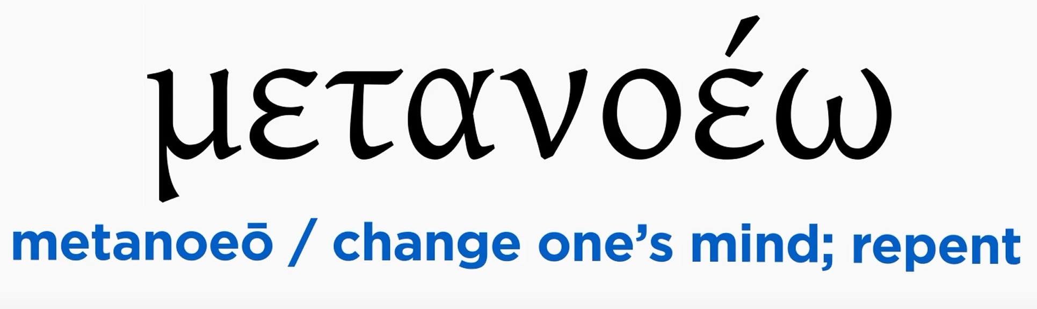
Acts 2:38
“Peter said to them, “Repent [metanoeō], and each of you be baptized in the name of Jesus Christ for (eis) the forgiveness of your sins; and you will receive the gift of the Holy Spirit.”

Slide 32

Acts 2:38
“Peter said to them, ‘Repent, and each of you be baptized in the name of Jesus Christ for (eis) the forgiveness of your sins; and you will receive the gift of the Holy Spirit.’”

Slide 33
Matthew 12:41
“The men of Nineveh will stand up with this generation at the judgment and will condemn it because they repented at [in the face of/because of] (eis) the preaching of Jonah; and behold, something greater than Jonah is here.”

Slide 34
Acts 11:15-16
“¹⁵ And as I began to speak, the Holy Spirit fell upon them just as He did upon us at the beginning. ¹⁶ And I remembered the word of the Lord, how He used to say, ‘John baptized with water, but you will be baptized with the Holy Spirit.’”

Slide 35
II. Declarations Acts 15:6-21
Meeting convened (6)
Peter’s address (7-11)
Barnabas’ & Paul’s testimony (12)
James’ address (13-21)

Slide 36
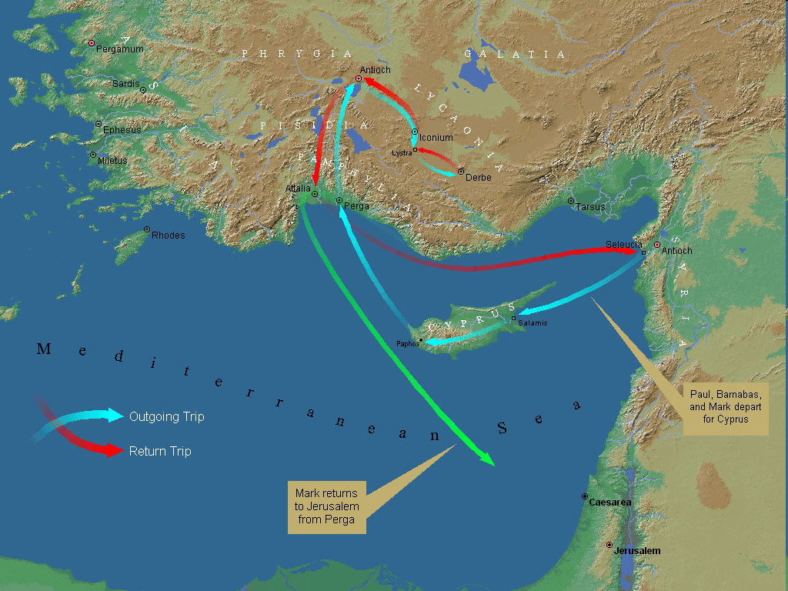
First Missionary Journey

Slide 37
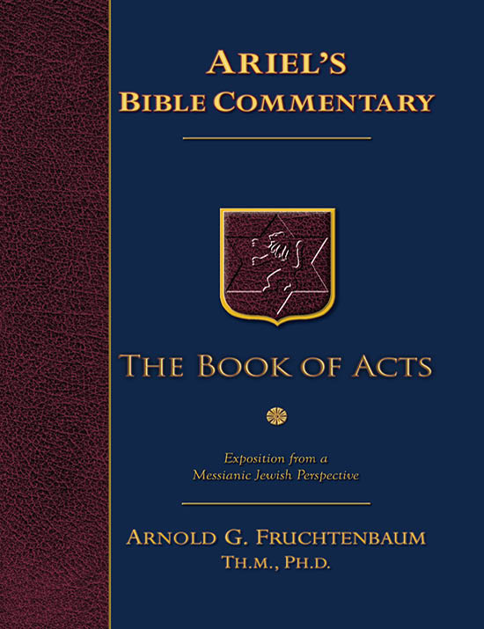
Dr. Arnold G. Fruchtenbaum
The Book of Acts, 83
“The apostles did many signs and wonders. In fact, the only ones who performed miracles in the book of Acts were the apostles or their delegates, such as Stephen (Acts 6:8). These apostolic delegates were appointed by the laying on of hands by the apostles. Signs and wonders were not performed by the believers at large.”

Slide 38

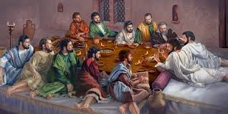
Ephesians 2:20
“having been built on the foundation of the apostles and prophets, Christ Jesus Himself being the corner stone.”

Slide 39
II. Declarations Acts 15:6-21
Meeting convened (6)
Peter’s address (7-11)
Barnabas’ & Paul’s testimony (12)
James’ address (13-21)

Slide 40
Acts 15:13-21 James’ Address
Introduction (13a)
Addressees (13b)
Peter’s address (14)
Old Testament citation (15-18)
Conclusions (19-21)

Slide 41
Acts 15:13-21 James’ Address
Introduction (13a)
Addressees (13b)
Peter’s address (14)
Old Testament citation (15-18)
Conclusions (19-21)

Slide 42

Acts 1:13-14
“ ¹³ When they had entered the city, they went up to the upper room where they were staying; that is, Peter and John and James and Andrew, Philip and Thomas, Bartholomew and Matthew, James the son of Alphaeus, and Simon the Zealot, and Judas the son of James. ¹⁴ These all with one mind were continually devoting themselves to prayer, along with the women, and Mary the mother of Jesus, and with His brothers.”

Slide 43
JAMES OF THE NEW TESTAMENT
Father of Judas (not Iscariot)
The son of Alphaeus
The son of Zebedee and brother of John
The half brother of Christ

Slide 44

Which James?
Father of Judas (not Iscariot)
The son of Alphaeus
The son of Zebedee and brother of John
The half brother of Christ

Slide 45
SIMILARITIES WITH ACTS 15
 | James | Acts 15
Greetings | 1:1 | 15:23
Visit | 1:27 | 15:14
Listen | 2:5 | 15:13
Turn | 5:19-20 | 15:19
Being called by God’s name | 2:7 | 15:17

Slide 46
Acts 15:13-21 James’ Address
Introduction (13a)
Addressees (13b)
Peter’s address (14)
Old Testament citation (15-18)
Conclusions (19-21)

Slide 47
TYPES OF PHARISEES
TYPE | OVERTHROWN
Justification | Matthew 5:20
Sanctification | Galatians 3:3
Ecclesiology | Acts 15

Slide 48
Acts 15:13-21 James’ Address
Introduction (13a)
Addressees (13b)
Peter’s address (14)
Old Testament citation (15-18)
Conclusions (19-21)

Slide 49

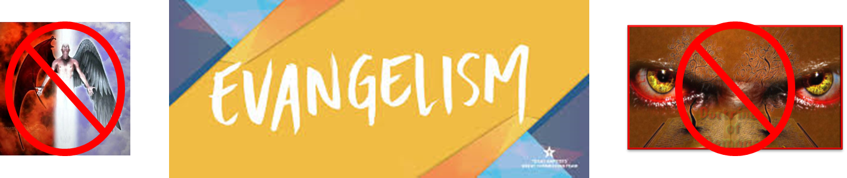
Matthew 16:18
“I also say to you that you are Peter (Petros), and upon this rock (petra) I will build [oikodomeō] My church; and the gates of Hades WILL NOT overpower it.”

Slide 50
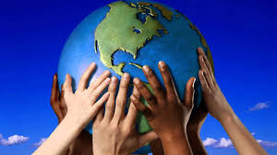
Acts 15:14
“Simeon has related how God first concerned Himself about taking from among the Gentiles a people for His name.”

Slide 51
Romans 11:25-26
“²⁵ For I do not want you, brethren, to be uninformed of this mystery—so that you will not be wise in your own estimation—that a partial hardening has happened to Israel until the fullness of the Gentiles has come in; ²⁶ and so all Israel will be saved; just as it is written, ‘The Deliverer will come from Zion, He will remove ungodliness from Jacob.’”

Slide 52
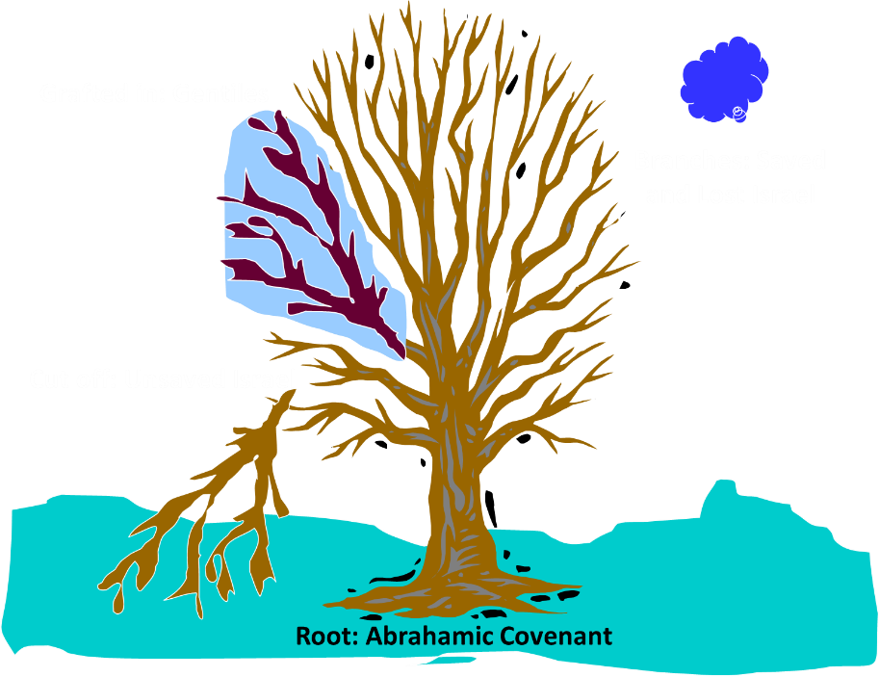
Notes:
52

Slide 53
Acts 15:13-21 James’ Address
Introduction (13a)
Addressees (13b)
Peter’s address (14)
Old Testament citation (15-18)
Conclusions (19-21)

Slide 54
Acts 15:15-18 Old Testament Citation
Introduction (15)
Amos 9:11-12 (16-18)

Slide 55
Acts 15:15-18 Old Testament Citation
Introduction (15)
Amos 9:11-12 (16-18)

Slide 56
Acts 15:15-18 Old Testament Citation
Introduction (15)
Amos 9:11-12 (16-18)

Slide 57
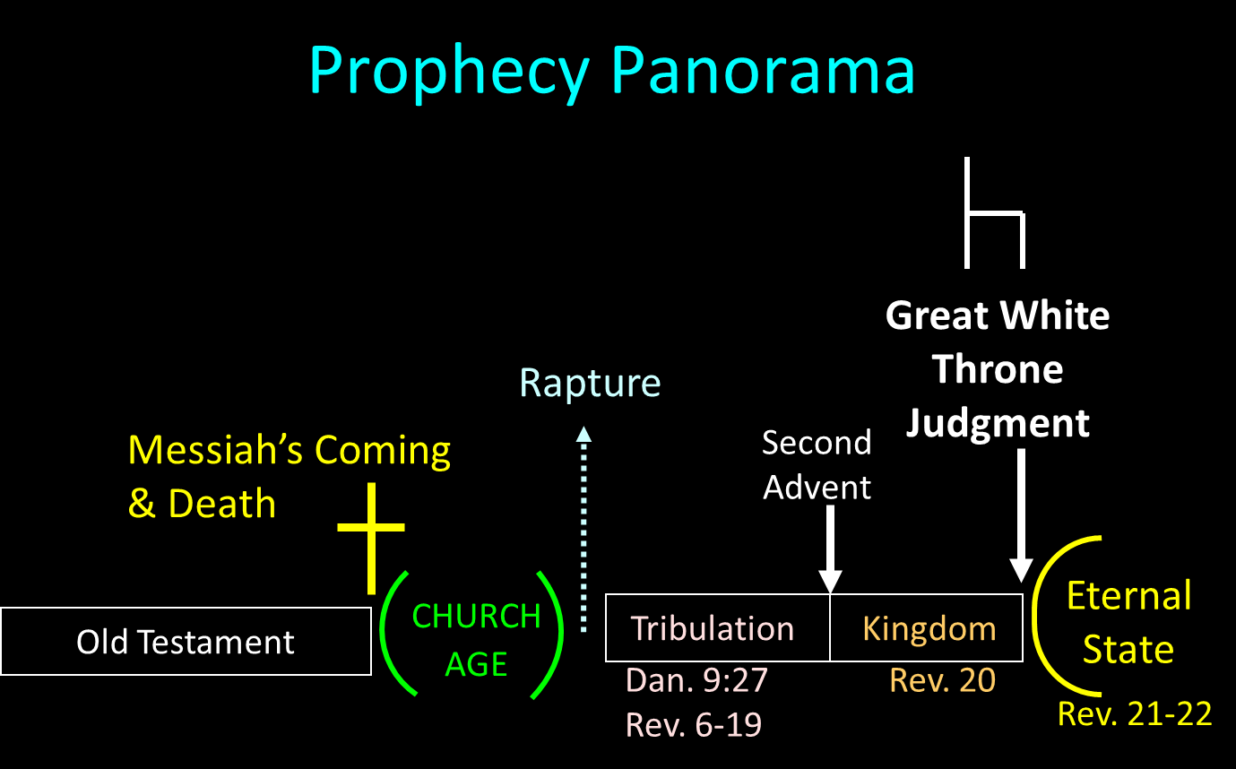

Slide 58
Acts 15:13-21 James’ Address
Introduction (13a)
Addressees (13b)
Peter’s address (14)
Old Testament citation (15-18)
Conclusions (19-21)

Slide 59
Acts 15:19-21 Conclusions
Concerning the Gentiles (19-20)
Concerning Moses (21)

Slide 60
Acts 15:19-21 Conclusions
Concerning the Gentiles (19-20)
Concerning Moses (21)

Slide 61
Acts 15:19-21 Concerning the Gentiles
Adherence to OT Law not required (19)
Abstentions to avoid offence (20)

Slide 62
Acts 15:19-21 Concerning the Gentiles
Adherence to OT Law not required (19)
Abstentions to avoid offence (20)

Slide 63
Acts 15:19-21 Concerning the Gentiles
Adherence to OT Law not required (19)
Abstentions to avoid offence (20)

Slide 64
Acts 15:20 Abstentions Reiterated
Food sacrificed to idols (20a)
Fornication (20b)
Things strangled (20c)
Blood (20d)

Slide 65
Acts 15:20 Abstentions Reiterated
Food sacrificed to idols (20a)
Fornication (20b)
Things strangled (20c)
Blood (20d)

Slide 66
Acts 15:20 Abstentions Reiterated
Food sacrificed to idols (20a)
Fornication (20b)
Things strangled (20c)
Blood (20d)

Slide 67
Acts 15:20 Abstentions Reiterated
Food sacrificed to idols (20a)
Fornication (20b)
Things strangled (20c)
Blood (20d)

Slide 68
Acts 15:20 Abstentions Reiterated
Food sacrificed to idols (20a)
Fornication (20b)
Things strangled (20c)
Blood (20d)

Slide 69
Acts 15:19-21 Conclusions
Concerning the Gentiles (19-20)
Concerning Moses (21)

Slide 70
Acts 15:1-35 Jerusalem Council
Occasion (1-5)
Declarations (6-21)
Decision (22-29)
Delivery (30-35)

