Slide 1
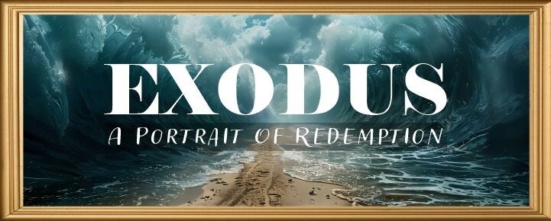


Slide 2
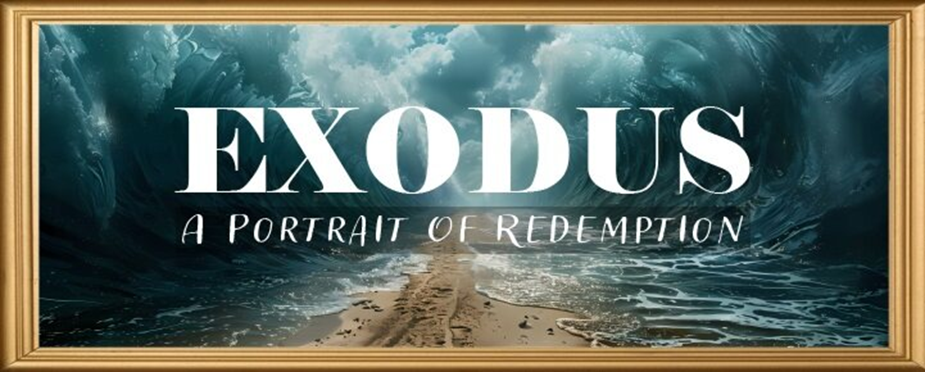
EXODUS STRUCTURE/OUTLINE
Redemption (1–18)
  Redemption (1:1–12:30)
  Liberation (12:31–15:21)
  Preservation (15:22–18:27)
Mosaic Covenant (19–40)
  Law (19–24)
  Tabernacle instructions (25–31)
  Apostasy (32–34)
  Tabernacle building (35–40)

Slide 3
REDEMPTION
(1:1–12:30)
Why redemption is necessary (Exod 1)
Development of the deliverer (Exod 2–4)
First confrontation with Pharaoh (Exod 5)
God reassures Moses (Exod 6:1–7:7)
Second confrontation with Pharaoh (Exod 7:8-13)
Plagues (Exod 7:14–12:30)

Slide 4
SECOND CONFRONTATION WITH PHARAOH
Exodus 7:1-25
  The Prophets (1-7)
  The Power (8-13)
  The Plagues (14-25)

Slide 5
SECOND CONFRONTATION WITH PHARAOH
Exodus 7:1-25
  The Prophets (1-7)
  The Power (8-13)
  The Plagues (14-25)

Slide 6
I. Exodus 7:1-7
The Prophets
    The delegation (1)
    The command (2)
    The result (3-5)
    The obedience (6)
    The ages (7)

Slide 7
I. Exodus 7:1-7
The Prophets
    The delegation (1)
    The command (2)
    The result (3-5)
    The obedience (6)
    The ages (7)

Slide 8
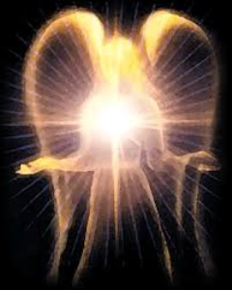
Satan’s Original State
Isaiah 14:12-15
5 “I will” statements
    Ascend to heaven (13)
    Raise my throne above the stars of God (13)
    Sit enthroned on the Mt. of the Assembly (13)
    Ascend above the tops of the clouds (14)
    Make myself like the Most High (14)

Slide 9
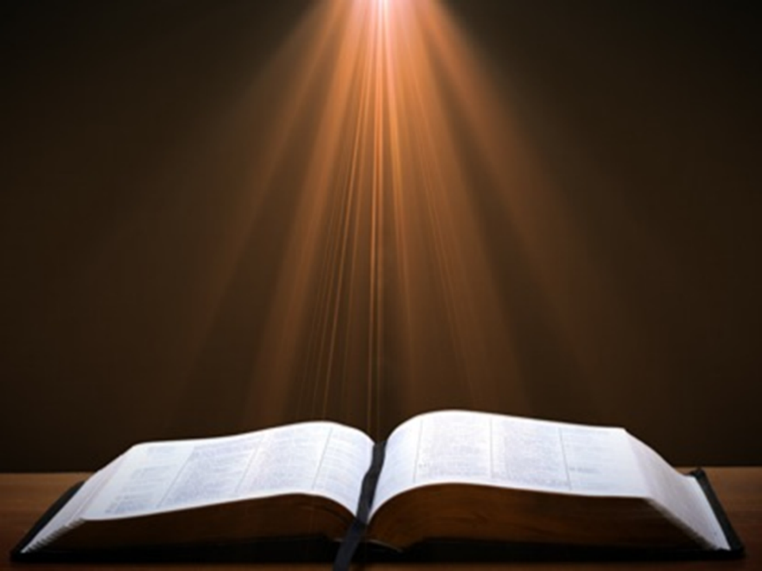

John 1:14
“And the Word became flesh, and dwelt among us, and we saw His glory, glory as of the only begotten [monogenēs] from the Father, full of grace and truth.”

Slide 10
I. Exodus 7:1-7
The Prophets
    The delegation (1)
    The command (2)
    The result (3-5)
    The obedience (6)
    The ages (7)

Slide 11

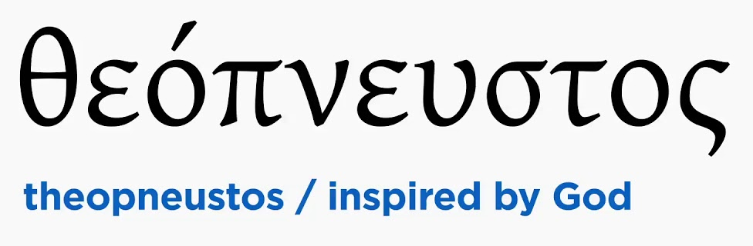
2 Timothy 3:16-17
“All Scripture is inspired by God [theopneustos] and profitable for teaching, for reproof, for correction, for training in righteousness; so that the man of God may be adequate, equipped for every good work.”

Slide 12


Matthew 4:4
“But He answered and said, “It is written, ‘Man shall not live on bread alone, but on every word that proceeds out of the mouth of God.’”

Slide 13

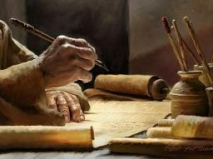
Acts 20:26-27
“²⁶ Therefore, I testify to you this day that I am innocent of the blood of all men. ²⁷ For I did not shrink from declaring to you the whole purpose of God.”

Slide 14
I. Exodus 7:1-7
The Prophets
    The delegation (1)
    The command (2)
    The result (3-5)
    The obedience (6)
    The ages (7)

Slide 15
Exodus 6:3-5
The Result
      Signs (3)
      Exodus (4)
      God’s glory (5)

Slide 16
Exodus 6:3-5
The Result
      Signs (3)
      Exodus (4)
      God’s glory (5)

Slide 17

Charles Ryrie
Ryrie Study Bible, page 96
Exodus 4:21 - “harden his heart. Ten times it is said that Pharaoh hardened his own heart (7:13, 14, 22; 8:15, 19, 32; 9:7, 34, 35; 13:15), and 10 times that God hardened Pharaoh’s heart (4:21; 7:3; 9:12; 10:1, 20, 27; 11:10; 14:4, 8, 17). Paul uses this as an example of the inscrutable will of God and of His mercy toward men (Rom. 9:14–18). Seven times Pharaoh hardened his own heart before God first hardened it, though the prediction that God would do it preceded all.”

Slide 18
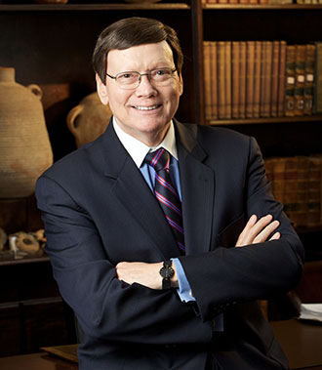
Dr. Ed Hindson
Hindson, E. E., & Mitchell, D. R., eds. (2010). King James Version Bible Commentary for Today: The Most Up-to-Date Commentary on the Time-Honored Text of the King James Version (p. 86). Thomas Nelson.
“4:21. I will harden his heart. An expression meaning ‘to strengthen his will.’ The text identifies the heart as the location of the volition, man’s decision-making ability. On seven occasions in the narrative, God hardens Pharaoh’s heart (9:12; 10:1, 20, 27; 11:10; 14:4, 8) or foretells that He will harden Pharaoh’s heart (4:21; 7:3), and nine times in the text, Pharaoh hardens his own heart (7:13, 14, 22; 8:15, 19, 32; 9:7, 34–35). For the initial five plagues, the text registers Pharaoh as the agent of hardening. Not until the sixth plague does God participate in the confirmation of Pharaoh’s own volitional choices.”

Slide 19
Romans 1:18-20
“¹⁸ For the wrath of God is revealed from heaven against all ungodliness and unrighteousness of men who suppress the truth in unrighteousness, ¹⁹ because that which is known about God is evident within them; for God made it evident to them. ²⁰ For since the creation of the world His invisible attributes, His eternal power and divine nature, have been clearly seen, being understood through what has been made, so that they are without excuse.”

Slide 20
Exodus 6:3-5
The Result
      Signs (3)
      Exodus (4)
      God’s glory (5)

Slide 21
Exodus 6:3-5
The Result
      Signs (3)
      Exodus (4)
      God’s glory (5)

Slide 22
Dispensational Theology is a System of Theology
Traditional-normative dispensational theology is a system that embodies three essential, fundamental concepts called the sine qua non (lit. “without which is not”):
The consistent use of a plain, normal, literal, grammatical-historical method of interpretation;
Which reveals that the Church is distinct from Israel;
God’s overall purpose is to bring glory to Himself (Eph. 1:6, 12, 14).
Dr. Charles Ryrie, Dispensationalism, pp. 38-41

Slide 23
Doxological Purpose
God’s ultimate purpose for the ages is to glorify Himself. Scripture is not human-centered, as though salvation were the principle point, but God-centered, because His glory is at the center.
The glory of God is the primary principle that unifies all dispensations, the program of salvation being just one of the means by which God glorifies Himself. Each successive revelation of God’s plan for the ages, as well as His dealing with the elect, non-elect, angels, and nations all manifest His glory.
Dictionary of Premillennial Theology, Charles Ryrie, p. 94

Slide 24
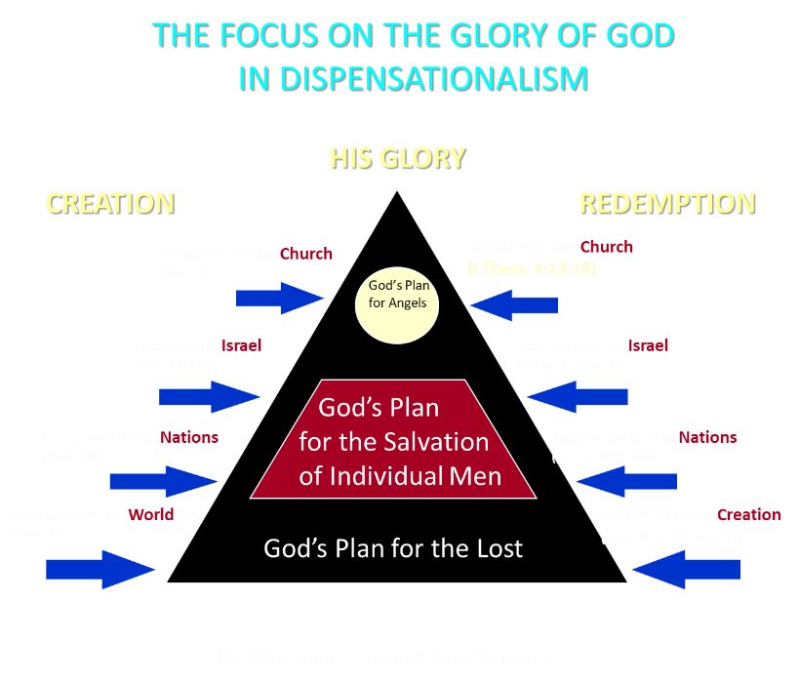

Slide 25

Ezekiel 36:22
“Therefore, say to the house of Israel, ‘This is what the Lord God says: “It is not for your sake, house of Israel, that I am about to act, but for My holy name, which you have profaned among the nations where you went.”

Slide 26
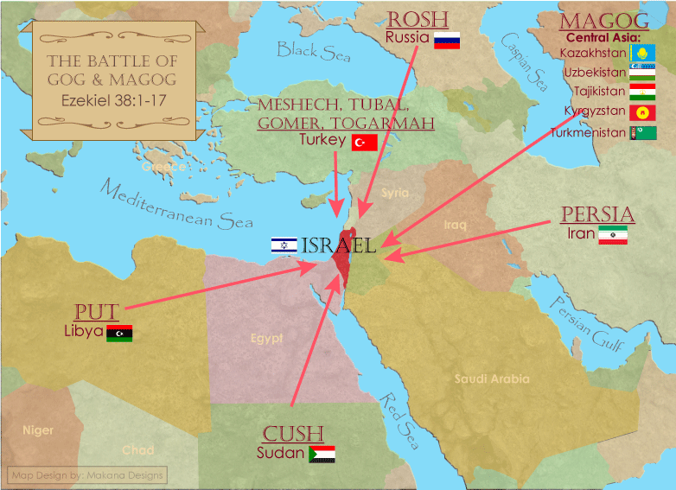

Slide 27
I. Exodus 7:1-7
The Prophets
    The delegation (1)
    The command (2)
    The result (3-5)
    The obedience (6)
    The ages (7)

Slide 28
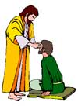
“SEVEN SIGNS” in Gospel of John
1. Changing Water into Wine | 2:11
2. Healing official’s son | 4:46-54
3. Healing an invalid at the Pool of Bethesda | 5:1-18
4. Feeding the 5,000 | 6:5-14
5. Walking on water | 6:16-21
6. Healing a blind man | 9:1-7
7. Raising dead Lazarus | 11:1-45

Slide 29
I. Exodus 7:1-7
The Prophets
    The delegation (1)
    The command (2)
    The result (3-5)
    The obedience (6)
    The ages (7)

Slide 30
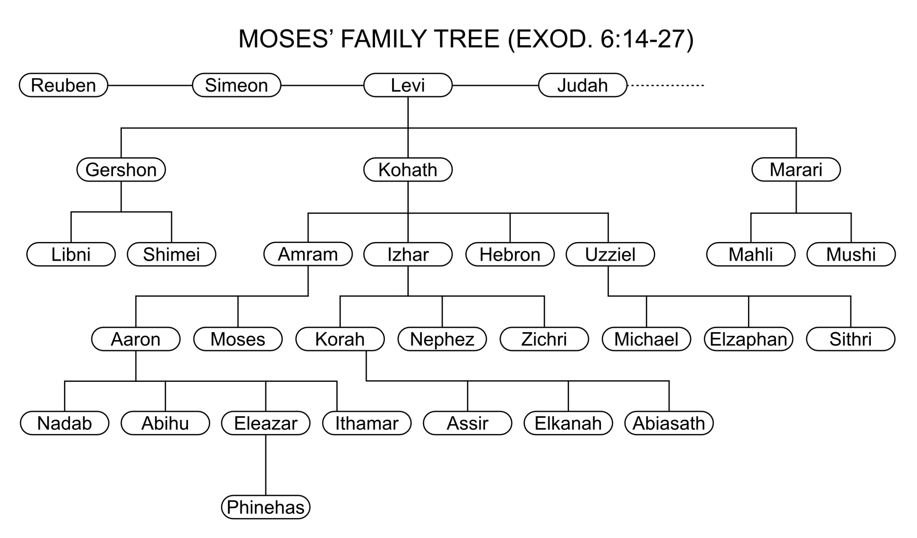

Slide 31
THREE PHASES OF MOSES’ 120 YEAR LIFE
LIFE PHASE | SCRIPTURE | YEARS | AGE | ACTIVITY
Natural Training | Acts 7:23 | 1526–1486 B.C. | 1-40 | Egyptian Education
Spiritual Training | Exod. 7:7 | 1486–1446 B.C. | 40-80 | Midian Shepherding
Ministry | Deut. 31:2; 34:7; Acts 7:36 | 1446–1406 B.C. | 80-120 | Exodus, Law, Wilderness Preservation, Pentateuch Authorship

Slide 32
SECOND CONFRONTATION WITH PHARAOH
Exodus 7:1-25
  The Prophets (1-7)
  The Power (8-13)
  The Plagues (14-25)

Slide 33
II. Exodus 7:8-13
The Power
    God’s miracle (8-10)
    Pharaoh’s miracle (11-12a)
    God’s supremacy (12b)
    Pharaoh’s hardening (13)

Slide 34
II. Exodus 7:8-13
The Power
    God’s miracle (8-10)
    Pharaoh’s miracle (11-12a)
    God’s supremacy (12b)
    Pharaoh’s hardening (13)

Slide 35
Exodus 7:8-10
God’s Miracle
      Instructions (8-9)
      Obedience (10)

Slide 36
Exodus 7:8-10
God’s Miracle
      Instructions (8-9)
      Obedience (10)

Slide 37
Exodus 7:8-10
God’s Miracle
      Instructions (8-9)
      Obedience (10)

Slide 38
“SEVEN SIGNS” in Gospel of John
1. Changing Water into Wine | 2:11
2. Healing official’s son | 4:46-54
3. Healing an invalid at the Pool of Bethesda | 5:1-18
4. Feeding the 5,000 | 6:5-14
5. Walking on water | 6:16-21
6. Healing a blind man | 9:1-7
7. Raising dead Lazarus | 11:1-45

Slide 39
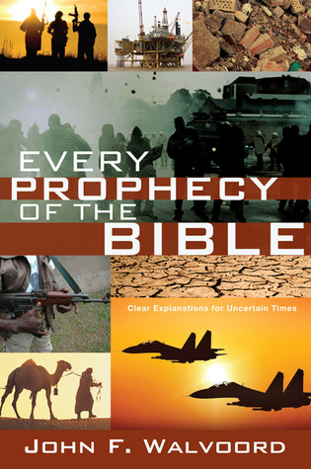

Slide 40

John 13:19; 14:29
“¹⁹ From now on I am telling you before it comes to pass, so that when it does occur, you may believe that I am He… ^{14:29} Now I have told you before it happens, so that when it happens, you may believe.”

Slide 41
What Happened to Christ’s Disciples?
Disciple | Place | Martyrdom
James the Son of Alpheus | Jerusalem | Clubbed to death
Simon the Zealot | Jerusalem | Martyred
James the Son of Zebedee | Judea (Acts 12:2) | Executed
Thaddeus | Mesopotamia | Beaten to death
Peter | Babylon, Rome | Crucified upside down
Matthew | Parthia (Tehran) | Beheaded
Notes:
109 prophecies…
Peter Stoner – SCIENCE SPEAKS, An Evaluation of Certain Christian Evidences
To fulfill just 8 prophecies =1 X 10 to the twenty-eighth power!
Can we visualize this with an illustration? Suppose we took an atheistic professor, blindfolded him and covered the state of Texas two feet deep with silver dollars. Then we put a check on one of those silver dollars and mixed them up. The odds of one person fulfilling just these eight prophecies would be the same as this atheistic professor selecting the silver dollar upon which we have placed a check, in his first try.
https://www.bereanpublishers.com/the-odds-of-eight-messianic-prophecies-coming-true/

Slide 42
What Happened to Christ’s Disciples?
Disciple | Place | Martyrdom
John | Asia Minor, Patmos, Ephesus | Fried in boiling oil
Philip | E. Turkey | Tortured & crucified
Thomas | India | Speared
Bartholomew | India | Flayed & crucified
Andrew | Ukraine, Russia, Greece | Hanged
Notes:
109 prophecies…
Peter Stoner – SCIENCE SPEAKS, An Evaluation of Certain Christian Evidences
To fulfill just 8 prophecies =1 X 10 to the twenty-eighth power!
Can we visualize this with an illustration? Suppose we took an atheistic professor, blindfolded him and covered the state of Texas two feet deep with silver dollars. Then we put a check on one of those silver dollars and mixed them up. The odds of one person fulfilling just these eight prophecies would be the same as this atheistic professor selecting the silver dollar upon which we have placed a check, in his first try.
https://www.bereanpublishers.com/the-odds-of-eight-messianic-prophecies-coming-true/

Slide 43
II. Exodus 7:8-13
The Power
    God’s miracle (8-10)
    Pharaoh’s miracle (11-12a)
    God’s supremacy (12b)
    Pharaoh’s hardening (13)

Slide 44

Satanic/Demonic Miracles
Exod. 7–8
Deut. 13:1-3
Job 1:12-19; 2:7-8
1 Sam. 28?
Matt. 7:21-23; 24:24
Acts 8:9; 16:16
Gal. 1:6-9
2 Thess. 2:9
Rev. 13:3, 13, 15; 16:13-14

Slide 45

Galatians 1:6–9
⁶ I am amazed that you are so quickly deserting Him who called you by the grace of Christ, for a different gospel; ⁷ which is really not another; only there are some who are disturbing you and want to distort the gospel of Christ. ⁸ But even if we, or an angel from heaven, should preach to you a gospel contrary to what we have preached to you, he is to be accursed! ⁹ As we have said before, so I say again now, if any man is preaching to you a gospel contrary to what you received, he is to be accursed!

Slide 46
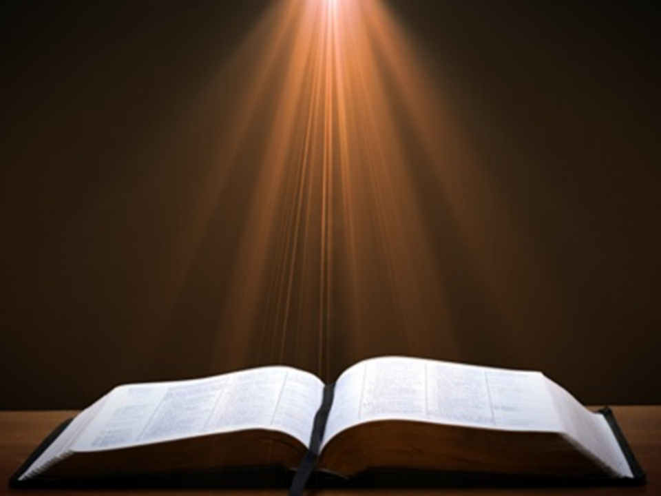
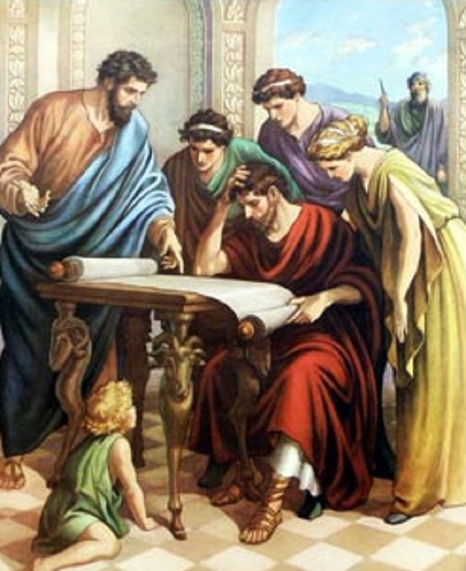
Acts 17:11
“Now these were more noble-minded than those in Thessalonica, for they received the word with great eagerness, examining the Scriptures daily to see whether these things were so.”

Slide 47
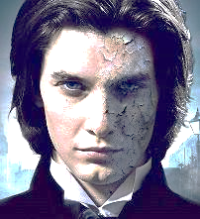
1 John 4:1
“Beloved, do not believe every spirit, but test the spirits to see whether they are from God, because many false prophets have gone out into the world.”

Slide 48
II. Exodus 7:8-13
The Power
    God’s miracle (8-10)
    Pharaoh’s miracle (11-12a)
    God’s supremacy (12b)
    Pharaoh’s hardening (13)

Slide 49
The Plagues of Egypt
NO. | DESCRIPTION | SCRIPTURE | Egyptian Deity
1. | Water to Blood | Exod. 7:14-25 | Hapi, Khnum
2. | Frogs | Exod. 8:1-15 | Heqt
3. | Gnats | Exod. 8:16-19 | Set
4. | Flies | Exod. 8:20-32 | Uatchit
5. | Disease on Cattle | Exod. 9:1-7 | Hathor, Apis
6. | Boils | Exod. 9:8-12 | Sekhmet, Serapis
7. | Hail | Exod. 9:13-35 | Seth, Nut
8. | Locusts | Exod. 10:1-20 | Seth, Nut, Osiris
9. | Darkness | Exod. 10:21-29 | Re, Horus, Atum
10. | Death of the First Born | Exod. 12:29-36 | Min, Osiris, Heqt, Isis

Slide 50

Ezekiel 28:13, 15
¹³ “You were in Eden, the garden of God; Every precious stone was your covering: The ruby, the topaz and the diamond; The beryl, the onyx and the jasper; The lapis lazuli, the turquoise and the emerald; And the gold, the workmanship of your settings and sockets, Was in you. On the day that you were created They were prepared… ¹⁵ “You were blameless in your ways From the day you were created Until unrighteousness was found in you.

Slide 51
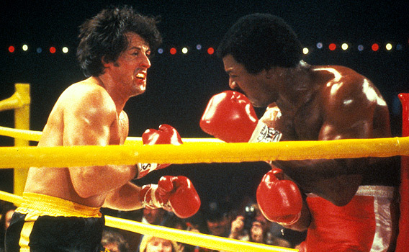

Slide 52
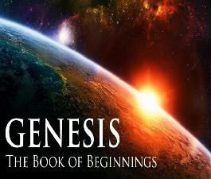
Refutation of Man’s Philosophies
(Gen 1:1)
Atheism – God created (Ps. 14:1)
Pantheism – God is transcendent over creation
Polytheism – One God created (Deut. 6:4; Isa 43:11; 44:6; 45:5)
Materialism – Matter began
Dualism – God alone created (Ezek. 28:13, 15)
Humanism – God rather than man created
Naturalism – God created
Morris, Genesis Record, 38

Slide 53
II. Exodus 7:8-13
The Power
    God’s miracle (8-10)
    Pharaoh’s miracle (11-12a)
    God’s supremacy (12b)
    Pharaoh’s hardening (13)

Slide 54
Charles Ryrie
Ryrie Study Bible, page 96
Exodus 4:21 - “harden his heart. Ten times it is said that Pharaoh hardened his own heart (7:13, 14, 22; 8:15, 19, 32; 9:7, 34, 35; 13:15), and 10 times that God hardened Pharaoh’s heart (4:21; 7:3; 9:12; 10:1, 20, 27; 11:10; 14:4, 8, 17). Paul uses this as an example of the inscrutable will of God and of His mercy toward men (Rom. 9:14–18). Seven times Pharaoh hardened his own heart before God first hardened it, though the prediction that God would do it preceded all.”

Slide 55
Dr. Ed Hindson
Hindson, E. E., & Mitchell, D. R., eds. (2010). King James Version Bible Commentary for Today: The Most Up-to-Date Commentary on the Time-Honored Text of the King James Version (p. 86). Thomas Nelson.
“4:21. I will harden his heart. An expression meaning ‘to strengthen his will.’ The text identifies the heart as the location of the volition, man’s decision-making ability. On seven occasions in the narrative, God hardens Pharaoh’s heart (9:12; 10:1, 20, 27; 11:10; 14:4, 8) or foretells that He will harden Pharaoh’s heart (4:21; 7:3), and nine times in the text, Pharaoh hardens his own heart (7:13, 14, 22; 8:15, 19, 32; 9:7, 34–35). For the initial five plagues, the text registers Pharaoh as the agent of hardening. Not until the sixth plague does God participate in the confirmation of Pharaoh’s own volitional choices.”

Slide 56
John 13:19; 14:29
“¹⁹ From now on I am telling you before it comes to pass, so that when it does occur, you may believe that I am He… ^{14:29} Now I have told you before it happens, so that when it happens, you may believe.”

Slide 58
What Happened to Christ’s Disciples?
Disciple | Place | Martyrdom
James the Son of Alpheus | Jerusalem | Clubbed to death
Simon the Zealot | Jerusalem | Martyred
James the Son of Zebedee | Judea (Acts 12:2) | Executed
Thaddeus | Mesopotamia | Beaten to death
Peter | Babylon, Rome | Crucified upside down
Matthew | Parthia (Tehran) | Beheaded
Notes:
109 prophecies…
Peter Stoner – SCIENCE SPEAKS, An Evaluation of Certain Christian Evidences
To fulfill just 8 prophecies =1 X 10 to the twenty-eighth power!
Can we visualize this with an illustration? Suppose we took an atheistic professor, blindfolded him and covered the state of Texas two feet deep with silver dollars. Then we put a check on one of those silver dollars and mixed them up. The odds of one person fulfilling just these eight prophecies would be the same as this atheistic professor selecting the silver dollar upon which we have placed a check, in his first try.
https://www.bereanpublishers.com/the-odds-of-eight-messianic-prophecies-coming-true/

Slide 59
What Happened to Christ’s Disciples?
Disciple | Place | Martyrdom
John | Asia Minor, Patmos, Ephesus | Fried in boiling oil
Philip | E. Turkey | Tortured & crucified
Thomas | India | Speared
Bartholomew | India | Flayed & crucified
Andrew | Ukraine, Russia, Greece | Hanged
Notes:
109 prophecies…
Peter Stoner – SCIENCE SPEAKS, An Evaluation of Certain Christian Evidences
To fulfill just 8 prophecies =1 X 10 to the twenty-eighth power!
Can we visualize this with an illustration? Suppose we took an atheistic professor, blindfolded him and covered the state of Texas two feet deep with silver dollars. Then we put a check on one of those silver dollars and mixed them up. The odds of one person fulfilling just these eight prophecies would be the same as this atheistic professor selecting the silver dollar upon which we have placed a check, in his first try.
https://www.bereanpublishers.com/the-odds-of-eight-messianic-prophecies-coming-true/

Slide 60
SECOND CONFRONTATION WITH PHARAOH
Exodus 7:1-25
  The Prophets (1-7)
  The Power (8-13)
  The Plagues (14-25)

Slide 61
III. Exodus 7:14-25
The Plagues
    Pharaoh’s condition (14)
    God’s instruction (15-19)
    Moses’ obedience (20-25)

Slide 62
III. Exodus 7:14-25
The Plagues
    Pharaoh’s condition (14)
    God’s instruction (15-19)
    Moses’ obedience (20-25)

Slide 63
III. Exodus 7:14-25
The Plagues
    Pharaoh’s condition (14)
    God’s instruction (15-19)
    Moses’ obedience (20-25)

Slide 64
Exodus 7:15-19
God’s Instructions
      Meet Pharaoh (15)
      Command to Pharaoh (16)
      Miracles for Pharaoh (17-19)

Slide 65
Exodus 7:15-19
God’s Instructions
      Meet Pharaoh (15)
      Command to Pharaoh (16)
      Miracles for Pharaoh (17-19)

Slide 66
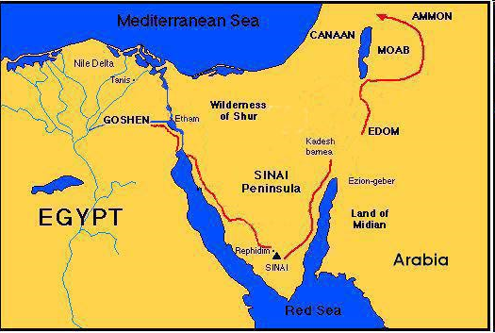

Slide 67
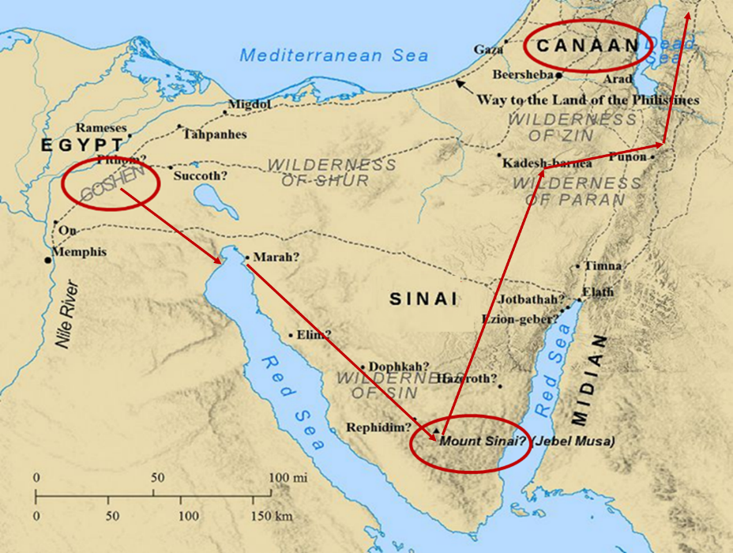

Slide 68
Exodus 7:15-19
God’s Instructions
      Meet Pharaoh (15)
      Command to Pharaoh (16)
      Miracles for Pharaoh (17-19)

Slide 69

Ephesians 2:8-10
“⁸ For by grace you have been saved through faith; and that not of yourselves, it is the gift of God; ⁹ not as a result of works, so that no one may boast. ¹⁰ For we are His workmanship, created in Christ Jesus for good works, which God prepared beforehand so that we would walk [peripateō, subjunctive mood] in them.”

Slide 70
Charles Ryrie
Ryrie Study Bible, page 96
Exodus 4:21 - “harden his heart. Ten times it is said that Pharaoh hardened his own heart (7:13, 14, 22; 8:15, 19, 32; 9:7, 34, 35; 13:15), and 10 times that God hardened Pharaoh’s heart (4:21; 7:3; 9:12; 10:1, 20, 27; 11:10; 14:4, 8, 17). Paul uses this as an example of the inscrutable will of God and of His mercy toward men (Rom. 9:14–18). Seven times Pharaoh hardened his own heart before God first hardened it, though the prediction that God would do it preceded all.”

Slide 71
Dr. Ed Hindson
Hindson, E. E., & Mitchell, D. R., eds. (2010). King James Version Bible Commentary for Today: The Most Up-to-Date Commentary on the Time-Honored Text of the King James Version (p. 86). Thomas Nelson.
“4:21. I will harden his heart. An expression meaning ‘to strengthen his will.’ The text identifies the heart as the location of the volition, man’s decision-making ability. On seven occasions in the narrative, God hardens Pharaoh’s heart (9:12; 10:1, 20, 27; 11:10; 14:4, 8) or foretells that He will harden Pharaoh’s heart (4:21; 7:3), and nine times in the text, Pharaoh hardens his own heart (7:13, 14, 22; 8:15, 19, 32; 9:7, 34–35). For the initial five plagues, the text registers Pharaoh as the agent of hardening. Not until the sixth plague does God participate in the confirmation of Pharaoh’s own volitional choices.”

Slide 72
Exodus 7:15-19
God’s Instructions
      Meet Pharaoh (15)
      Command to Pharaoh (16)
      Miracles for Pharaoh (17-19)

Slide 73
Exodus 7:17-19
Miracles to Pharaoh
      Nile (17-18)
      Waters of Egypt (19)

Slide 74
Exodus 7:17-19
Miracles to Pharaoh
      Nile (17-18)
      Waters of Egypt (19)

Slide 75
The Plagues of Egypt
NO. | DESCRIPTION | SCRIPTURE | Egyptian Deity
1. | Water to Blood | Exod. 7:14-25 | Hapi, Khnum
2. | Frogs | Exod. 8:1-15 | Heqt
3. | Gnats | Exod. 8:16-19 | Set
4. | Flies | Exod. 8:20-32 | Uatchit
5. | Disease on Cattle | Exod. 9:1-7 | Hathor, Apis
6. | Boils | Exod. 9:8-12 | Sekhmet, Serapis
7. | Hail | Exod. 9:13-35 | Seth, Nut
8. | Locusts | Exod. 10:1-20 | Seth, Nut, Osiris
9. | Darkness | Exod. 10:21-29 | Re, Horus, Atum
10. | Death of the First Born | Exod. 12:29-36 | Min, Osiris, Heqt, Isis

Slide 76
Dr. Ed Hindson
Hindson, E. E., & Mitchell, D. R., eds. (2010). King James Version Bible Commentary for Today: The Most Up-to-Date Commentary on the Time-Honored Text of the King James Version (p. 90). Thomas Nelson.
“The fourth purpose was to demonstrate the Lord’s superiority over Egypt’s voluminous number of false gods (12:12; 18:11; Num. 33:4). There were some eighty ancient-Egyptian gods, each one the personification of an animal or object. In addition, Pharaoh himself was considered to be the incarnation of the god Horus, with the court magicians serving as his priests. Each of the ten plagues was designed to challenge a specific god or gods within the Egyptian pantheon and ultimately to topple the credibility of Pharaoh’s own divinity as well (see Davis, Moses, pp. 79–129).”

Slide 77
Dr. Ed Hindson
Hindson, E. E., & Mitchell, D. R., eds. (2010). King James Version Bible Commentary for Today: The Most Up-to-Date Commentary on the Time-Honored Text of the King James Version (p. 91). Thomas Nelson.
“This plague, as were they all, was meant to demonstrate the Lord’s superiority over Pharaoh and his gods. The Nile River was considered sacred, the very bloodstream of the god Osirus. Other deities challenged by this particular plague were Khnum, the guardian of the Nile; Hapi, the spirit of the Nile; and Sepek, the crocodile god.”

Slide 78
Charles Ryrie
Ryrie Study Bible, page 100
Exodus 7:17 - “The reflection of the setting sun on the river might give the water a red appearance temporarily but would not cause the fish to die and the water to become unusable. Nor would red silting, not uncommon to the Nile, do this. This was a supernatural judgment. The water was turned to blood in terms of appearance (taste, smell, and texture).”

Slide 79
Exodus 7:17-19
Miracles to Pharaoh
      Nile (17-18)
      Waters of Egypt (19)

Slide 80
Dr. Ed Hindson
Hindson, E. E., & Mitchell, D. R., eds. (2010). King James Version Bible Commentary for Today: The Most Up-to-Date Commentary on the Time-Honored Text of the King James Version (p. 91). Thomas Nelson.
“Some hold that the first nine plagues may have been a series of miraculous intensifications of natural events. For example, they hold that this initial plague could have resulted from large quantities of red sediment, algae, or fungus that caused the water to take on the appearance of blood. While possible, this is unlikely, for this and other similar theories do not explain the text’s account of the immediate transformation of all water, including that which was previously stored in pools and containers.”

Slide 81
Dr. Ed Hindson
Hindson, E. E., & Mitchell, D. R., eds. (2010). King James Version Bible Commentary for Today: The Most Up-to-Date Commentary on the Time-Honored Text of the King James Version (p. 91). Thomas Nelson.
“Publicly, in front of Pharaoh and his servants, Aaron, at his brother’s command, took the rod, and smote the waters (v. 20). The now completely crimson water stank (v. 21) with an inundation of dead fish and proved undrinkable. The magnitude of the sign’s effect extended not merely to bodies of water but to every vessel that already contained drinking water.”

Slide 82
III. Exodus 7:14-25
The Plagues
    Pharaoh’s condition (14)
    God’s instruction (15-19)
    Moses’ obedience (20-25)

Slide 83
Exodus 7:20-25
Moses’ Obedience
      Nile to blood (20-21)
      Pharaoh’s miracle (22a)
      Pharaoh’s hardness (22b-23)
      Lasting results (24)
      Duration (25)

Slide 84
Exodus 7:20-25
Moses’ Obedience
      Nile to blood (20-21)
      Pharaoh’s miracle (22a)
      Pharaoh’s hardness (22b-23)
      Lasting results (24)
      Duration (25)

Slide 85
“SEVEN SIGNS” in Gospel of John
1. Changing Water into Wine | 2:11
2. Healing official’s son | 4:46-54
3. Healing an invalid at the Pool of Bethesda | 5:1-18
4. Feeding the 5,000 | 6:5-14
5. Walking on water | 6:16-21
6. Healing a blind man | 9:1-7
7. Raising dead Lazarus | 11:1-45

Slide 86
John 13:19; 14:29
“¹⁹ From now on I am telling you before it comes to pass, so that when it does occur, you may believe that I am He… ^{14:29} Now I have told you before it happens, so that when it happens, you may believe.”

Slide 88
What Happened to Christ’s Disciples?
Disciple | Place | Martyrdom
James the Son of Alpheus | Jerusalem | Clubbed to death
Simon the Zealot | Jerusalem | Martyred
James the Son of Zebedee | Judea (Acts 12:2) | Executed
Thaddeus | Mesopotamia | Beaten to death
Peter | Babylon, Rome | Crucified upside down
Matthew | Parthia (Tehran) | Beheaded
Notes:
109 prophecies…
Peter Stoner – SCIENCE SPEAKS, An Evaluation of Certain Christian Evidences
To fulfill just 8 prophecies =1 X 10 to the twenty-eighth power!
Can we visualize this with an illustration? Suppose we took an atheistic professor, blindfolded him and covered the state of Texas two feet deep with silver dollars. Then we put a check on one of those silver dollars and mixed them up. The odds of one person fulfilling just these eight prophecies would be the same as this atheistic professor selecting the silver dollar upon which we have placed a check, in his first try.
https://www.bereanpublishers.com/the-odds-of-eight-messianic-prophecies-coming-true/

Slide 89
What Happened to Christ’s Disciples?
Disciple | Place | Martyrdom
John | Asia Minor, Patmos, Ephesus | Fried in boiling oil
Philip | E. Turkey | Tortured & crucified
Thomas | India | Speared
Bartholomew | India | Flayed & crucified
Andrew | Ukraine, Russia, Greece | Hanged
Notes:
109 prophecies…
Peter Stoner – SCIENCE SPEAKS, An Evaluation of Certain Christian Evidences
To fulfill just 8 prophecies =1 X 10 to the twenty-eighth power!
Can we visualize this with an illustration? Suppose we took an atheistic professor, blindfolded him and covered the state of Texas two feet deep with silver dollars. Then we put a check on one of those silver dollars and mixed them up. The odds of one person fulfilling just these eight prophecies would be the same as this atheistic professor selecting the silver dollar upon which we have placed a check, in his first try.
https://www.bereanpublishers.com/the-odds-of-eight-messianic-prophecies-coming-true/

Slide 90
Exodus 7:20-25
Moses’ Obedience
      Nile to blood (20-21)
      Pharaoh’s miracle (22a)
      Pharaoh’s hardness (22b-23)
      Lasting results (24)
      Duration (25)

Slide 91
Satanic/Demonic Miracles
Exod. 7–8
Deut. 13:1-3
Job 1:12-19; 2:7-8
1 Sam. 28?
Matt. 7:21-23; 24:24
Acts 8:9; 16:16
Gal. 1:6-9
2 Thess. 2:9
Rev. 13:3, 13, 15; 16:13-14

Slide 92
Galatians 1:6–9
⁶ I am amazed that you are so quickly deserting Him who called you by the grace of Christ, for a different gospel; ⁷ which is really not another; only there are some who are disturbing you and want to distort the gospel of Christ. ⁸ But even if we, or an angel from heaven, should preach to you a gospel contrary to what we have preached to you, he is to be accursed! ⁹ As we have said before, so I say again now, if any man is preaching to you a gospel contrary to what you received, he is to be accursed!

Slide 93
Acts 17:11
“Now these were more noble-minded than those in Thessalonica, for they received the word with great eagerness, examining the Scriptures daily to see whether these things were so.”

Slide 94
1 John 4:1
“Beloved, do not believe every spirit, but test the spirits to see whether they are from God, because many false prophets have gone out into the world.”

Slide 95
Exodus 7:20-25
Moses’ Obedience
      Nile to blood (20-21)
      Pharaoh’s miracle (22a)
      Pharaoh’s hardness (22b-23)
      Lasting results (24)
      Duration (25)

Slide 96
Charles Ryrie
Ryrie Study Bible, page 96
Exodus 4:21 - “harden his heart. Ten times it is said that Pharaoh hardened his own heart (7:13, 14, 22; 8:15, 19, 32; 9:7, 34, 35; 13:15), and 10 times that God hardened Pharaoh’s heart (4:21; 7:3; 9:12; 10:1, 20, 27; 11:10; 14:4, 8, 17). Paul uses this as an example of the inscrutable will of God and of His mercy toward men (Rom. 9:14–18). Seven times Pharaoh hardened his own heart before God first hardened it, though the prediction that God would do it preceded all.”

Slide 97
Dr. Ed Hindson
Hindson, E. E., & Mitchell, D. R., eds. (2010). King James Version Bible Commentary for Today: The Most Up-to-Date Commentary on the Time-Honored Text of the King James Version (p. 86). Thomas Nelson.
“4:21. I will harden his heart. An expression meaning ‘to strengthen his will.’ The text identifies the heart as the location of the volition, man’s decision-making ability. On seven occasions in the narrative, God hardens Pharaoh’s heart (9:12; 10:1, 20, 27; 11:10; 14:4, 8) or foretells that He will harden Pharaoh’s heart (4:21; 7:3), and nine times in the text, Pharaoh hardens his own heart (7:13, 14, 22; 8:15, 19, 32; 9:7, 34–35). For the initial five plagues, the text registers Pharaoh as the agent of hardening. Not until the sixth plague does God participate in the confirmation of Pharaoh’s own volitional choices.”

Slide 98
Exodus 7:20-25
Moses’ Obedience
      Nile to blood (20-21)
      Pharaoh’s miracle (22a)
      Pharaoh’s hardness (22b-23)
      Lasting results (24)
      Duration (25)

Slide 99
Dr. Ed Hindson
Hindson, E. E., & Mitchell, D. R., eds. (2010). King James Version Bible Commentary for Today: The Most Up-to-Date Commentary on the Time-Honored Text of the King James Version (p. 91). Thomas Nelson.
“During this period, the sole source of fresh water throughout Egypt was the underground natural springs. The Egyptians now had to exert themselves. As the Hebrews had to gather their own straw, now the Egyptians were forced to dig round about the river (v. 24) for their own water.”

Slide 100

8 New Promises
Genesis 12:1-3
    Land (Gen. 12:1b)
    Great nation (Gen. 12:2a)
    Personal blessing (Gen. 12:2b)
    Great name (Gen. 12:2c)
    Blessing to others (Gen. 12:2d)
    Blessing to blessers (Gen. 12:3a)
    Cursing to cursers (Gen. 12:3b)
    Blessing to the world (Gen. 12:3c)

Slide 101

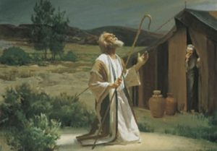
Genesis 12:3
“And I will bless those who bless you, And the one who curses you I will curse. And in you all the families of the earth will be blessed.”

Slide 102
Exodus 7:20-25
Moses’ Obedience
      Nile to blood (20-21)
      Pharaoh’s miracle (22a)
      Pharaoh’s hardness (22b-23)
      Lasting results (24)
      Duration (25)

Slide 103
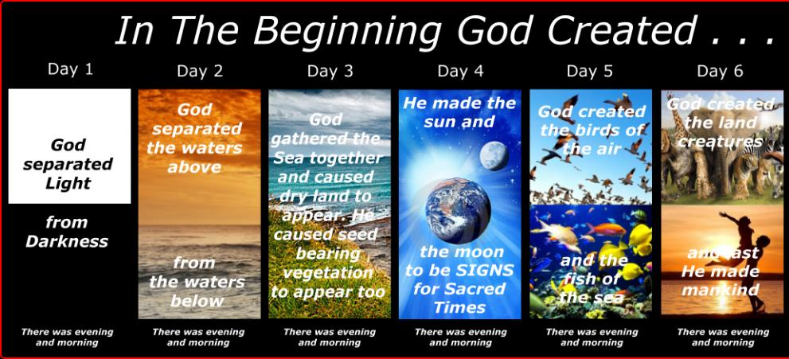
SHAPING AND POPULATING (GEN 1:1)
Day 1: | Light | Day 4: | Luminaries
Day 2: | Water, sky | Day 5: | Sea animals, birds
Day 3: | Land, vegetation | Day 6: | Land animals, man

Slide 104
Conclusion

Slide 105
SECOND CONFRONTATION WITH PHARAOH
Exodus 7:1-25
  The Prophets (1-7)
  The Power (8-13)
  The Plagues (14-25)

Slide 106
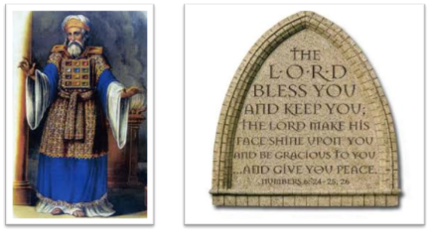
²⁴ The Lord bless you, and keep you; ²⁵ The Lord make His face shine on you, And be gracious to you; ²⁶ The Lord lift up His countenance on you, And give you peace.
Numbers 6:24–26 (NASB95)

