Slide 1
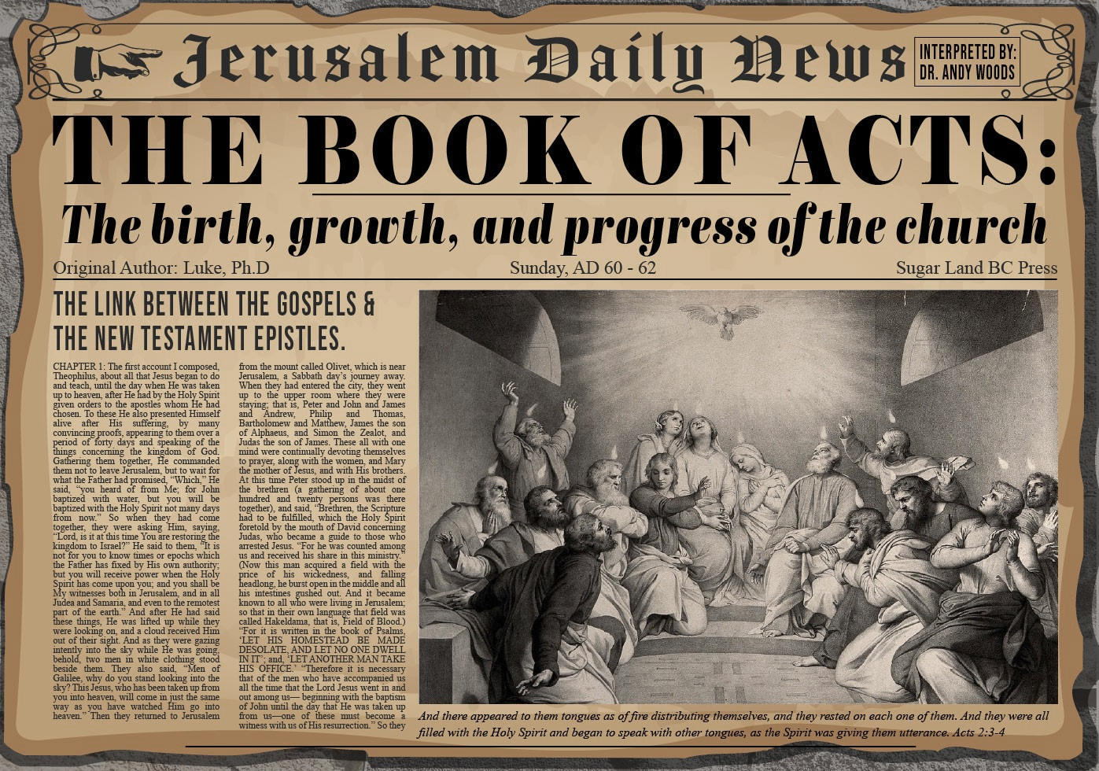


Slide 2

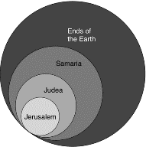
Acts 1:8
“but you will receive power when the Holy Spirit has come upon you; and you shall be My witnesses both in Jerusalem, and in all Judea and Samaria, and even to the remotest part of the earth.”

Slide 3
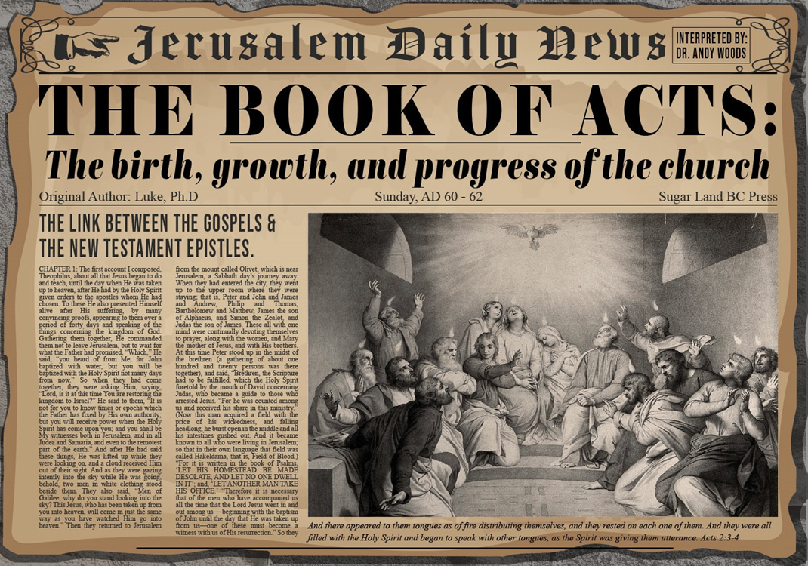
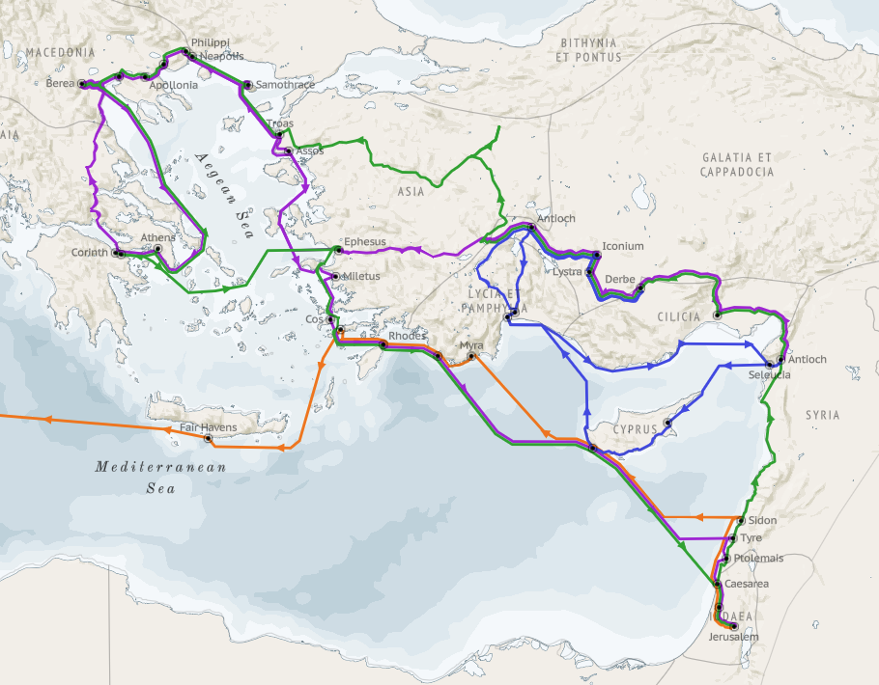
Structure (Acts 1:8)
Jerusalem (Acts 1–7)
Judea and Samaria (Acts 8–12)
Remotest part of the earth (Acts 13–28)
1st missionary journey (Acts 13–14)
Jerusalem council (Acts 15:1-35)
2nd missionary journey (Acts 15:36 –18:22)
3rd missionary journey (Acts 18:23–21:17)
Trip to Rome (Acts 21:18–28:31)

Slide 4
Acts 15:1-35 Jerusalem Council
Occasion (1-5)
Declarations (6-21)
Decision (22-29)
Delivery (30-35)

Slide 5
Acts 15:1-35 Jerusalem Council
Occasion (1-5)
Declarations (6-21)
Decision (22-29)
Delivery (30-35)

Slide 6
I. Occasion Acts 15:1-5
Issue: Gentile circumcision (1)
Antioch’s decision (2)
Journey to Jerusalem (3)
Arrival in Jerusalem (4-5)

Slide 7
I. Occasion Acts 15:1-5
Issue: Gentile circumcision (1)
Antioch’s decision (2)
Journey to Jerusalem (3)
Arrival in Jerusalem (4-5)

Slide 8
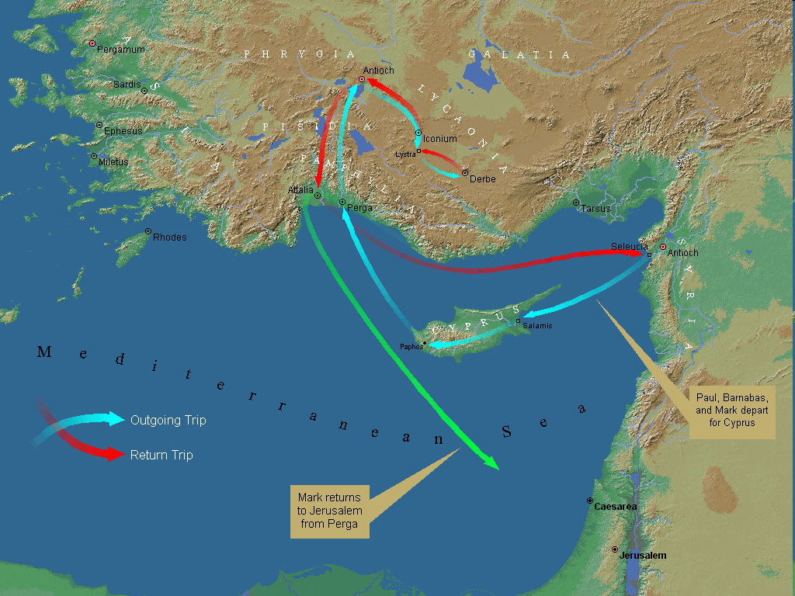
First Missionary Journey

Slide 9
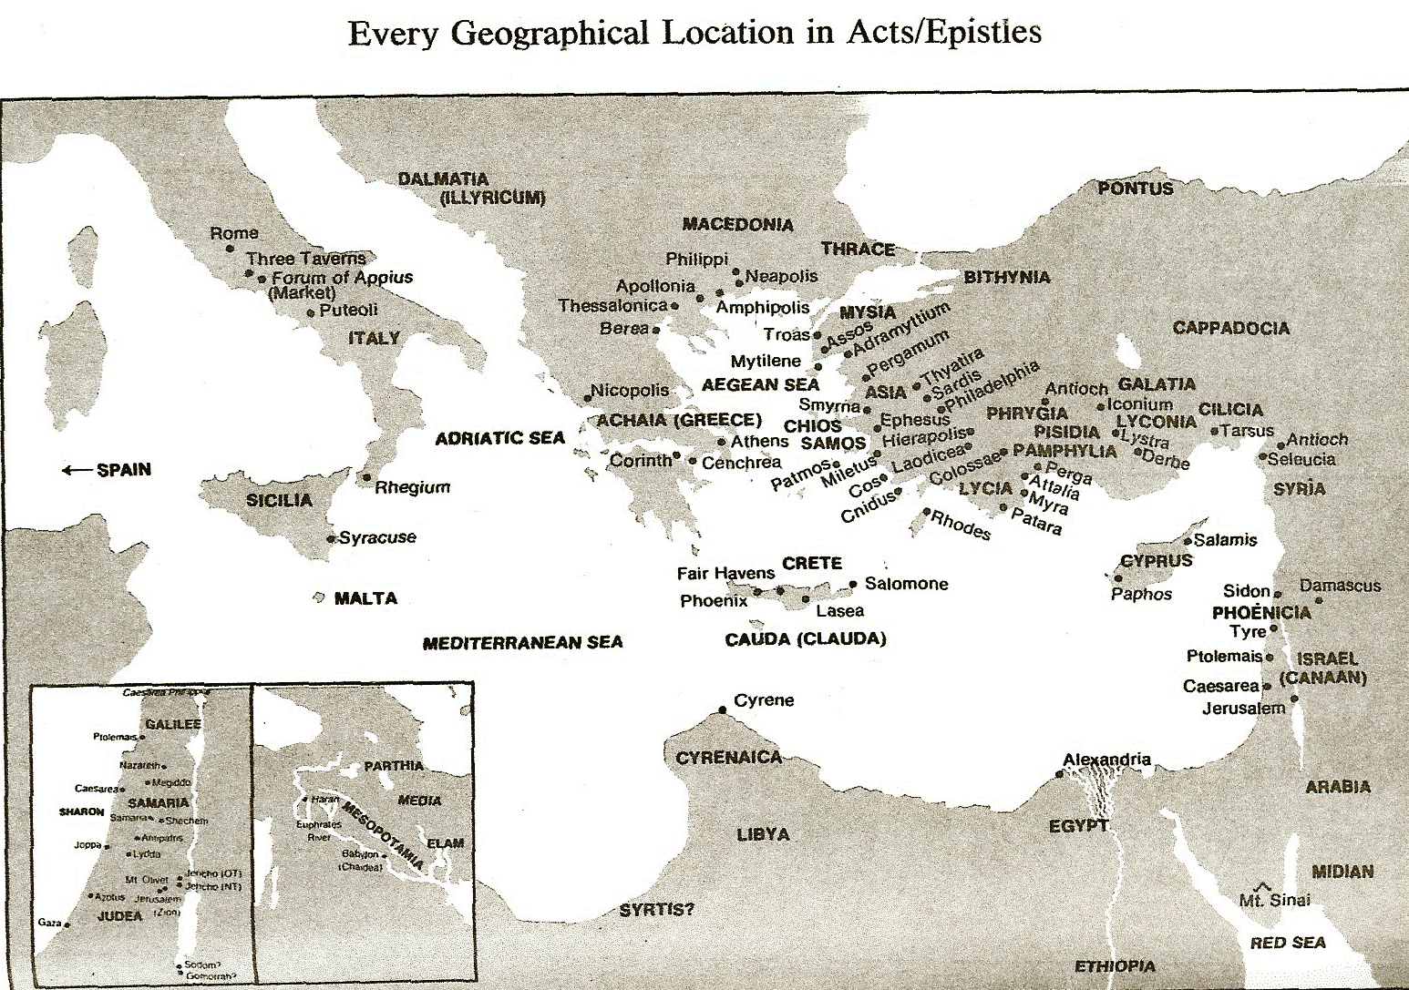

Slide 10
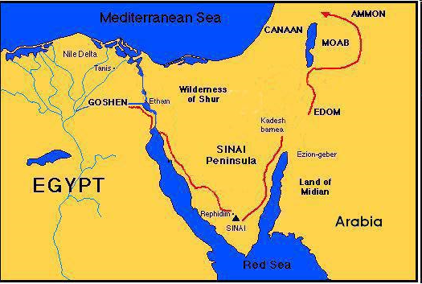

Slide 11

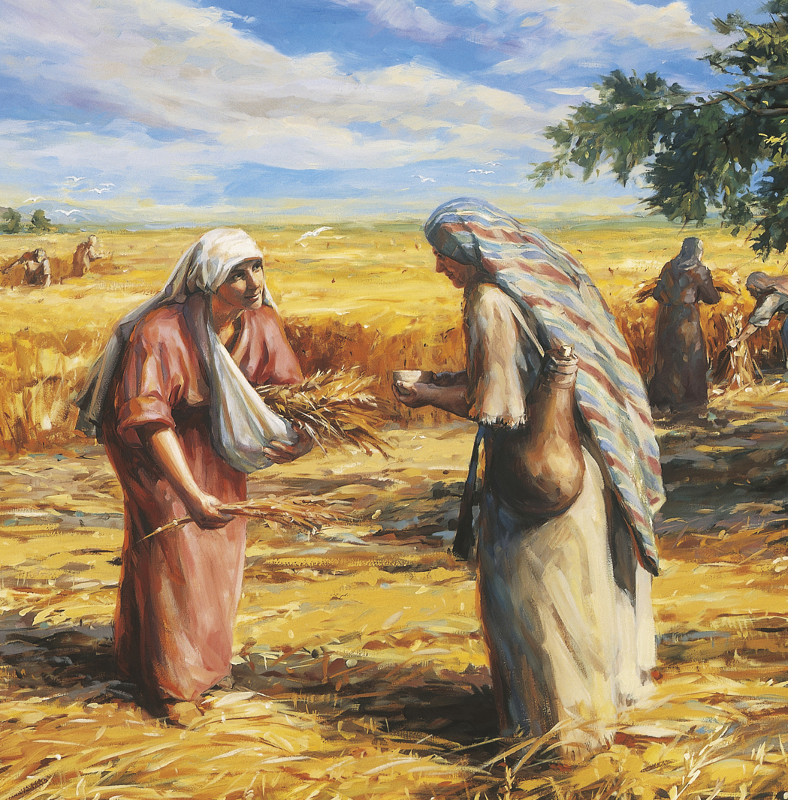
Ruth 1:16
“But Ruth said, “Do not urge me to leave you or turn back from following you; for where you go, I will go, and where you lodge, I will lodge. Your people shall be my people, and your God, my God.”

Slide 12
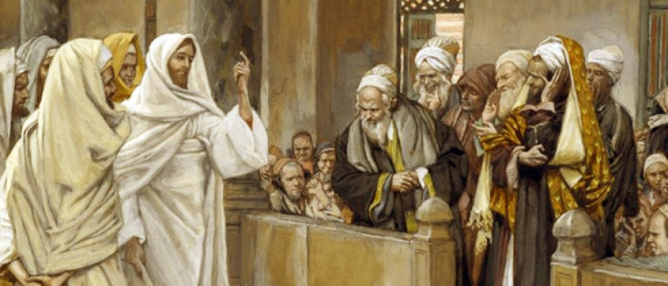
TYPES OF PHARISEES
TYPE | OVERTHROWN
Justification | Matthew 5:20
Sanctification | Galatians 3:3
Ecclesiology | Acts 15

Slide 13


Galatians 3:3
“Are you so foolish? Having begun by the Spirit, are you now being perfected by the flesh?”

Slide 14
I. Occasion Acts 15:1-5
Issue: Gentile circumcision (1)
Antioch’s decision (2)
Journey to Jerusalem (3)
Arrival in Jerusalem (4-5)

Slide 15

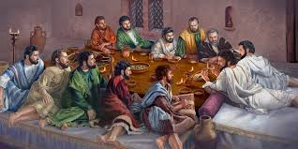
Ephesians 2:20
“having been built on the foundation of the apostles and prophets, Christ Jesus Himself being the corner stone.”

Slide 16
I. Occasion Acts 15:1-5
Issue: Gentile circumcision (1)
Antioch’s decision (2)
Journey to Jerusalem (3)
Arrival in Jerusalem (4-5)

Slide 18
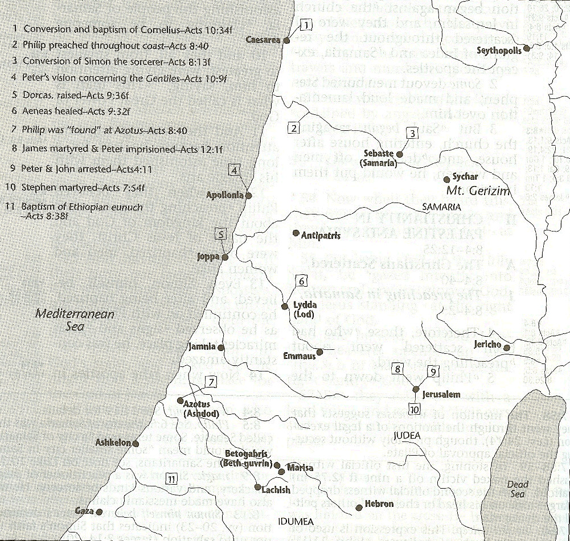

Slide 19
I. Occasion Acts 15:1-5
Issue: Gentile circumcision (1)
Antioch’s decision (2)
Journey to Jerusalem (3)
Arrival in Jerusalem (4-5)

Slide 20
Acts 15:4-5 Paul’s Message
Reception by leadership (4)
Opposition by Pharisees (5)

Slide 21
Acts 15:4-5 Paul’s Message
Reception by leadership (4)
Opposition by Pharisees (5)

Slide 22
Ephesians 2:20
“having been built on the foundation of the apostles and prophets, Christ Jesus Himself being the corner stone.”

Slide 23
First Missionary Journey

Slide 24
Acts 15:4-5 Paul’s Message
Reception by leadership (4)
Opposition by Pharisees (5)

Slide 25
TYPES OF PHARISEES
TYPE | OVERTHROWN
Justification | Matthew 5:20
Sanctification | Galatians 3:3
Ecclesiology | Acts 15

Slide 26
Acts 15:1-35 Jerusalem Council
Occasion (1-5)
Declarations (6-21)
Decision (22-29)
Delivery (30-35)

Slide 27
II. Declarations Acts 15:6-21
Meeting convened (6)
Peter’s address (7-11)
Barnabas’ & Paul’s testimony (12)
James’ address (13-21)

Slide 28
II. Declarations Acts 15:6-21
Meeting convened (6)
Peter’s address (7-11)
Barnabas’ & Paul’s testimony (12)
James’ address (13-21)

Slide 29
Ephesians 2:20
“having been built on the foundation of the apostles and prophets, Christ Jesus Himself being the corner stone.”

Slide 30
II. Declarations Acts 15:6-21
Meeting convened (6)
Peter’s address (7-11)
Barnabas’ & Paul’s testimony (12)
James’ address (13-21)

Slide 31
Acts 15:7-11 Peter’s Address
God chose Gentile salvation (7)
Spirit authenticated Gentile salvation (8-9)
Peter’s challenge (10)
Peter’s conclusion (11)

Slide 32
Acts 15:7-11 Peter’s Address
God chose Gentile salvation (7)
Spirit authenticated Gentile salvation (8-9)
Peter’s challenge (10)
Peter’s conclusion (11)

Slide 33
From Peter to Paul
Reference | Center | Person | Place | Outreach
Acts 1–12 | Jerusalem | Peter | Jerusalem, Judea, Samaria | Jewish
Acts 13–28 | Antioch | Paul | Uttermost parts | Gentiles

Slide 34
From Peter to Paul
Peter | Paul
Heals a man lame from birth (3:1-11) | Heals a man lame from birth (14:8-18)
Heals by shadow (5:15-16) | Heals by handkerchief (19:11-12)
Success is a cause of jealousy (5:17) | Success is a cause of jealousy (13:45)
Confronts a sorcerer (8:9-24) | Confronts a sorcerer (13:6-11)
Raises Dorcas (9:36-41) | Raises Eutychus (20:9-12)
Jailed and miraculously freed (12:3-19) | Jailed and miraculously freed (16:25-34)

Slide 35
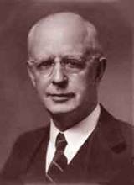
Lewis Sperry Chafer, vol. 7, Systematic Theology (Grand Rapids, MI: Kregel Publications, 1993), 265-66.
Belief – God’s One Condition for Justification
“…because upwards of 150 passages of Scripture condition salvation upon believing only (cf. John 3:16; Acts 16:31).”

Slide 36
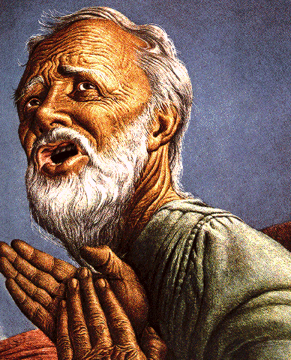
Belief – God’s One Condition for Justification
Gen 15:6
Then he believed in the LORD; and He reckoned it to him as righteousness.
John 3:16
For God so loved the world, that He gave His only begotten Son, that whoever believes in Him shall not perish, but have eternal life.
Acts 16:30-31
"Sirs, what must I do to be saved?" They said, "Believe in the Lord Jesus, and you will be saved..."

Slide 37
Acts 15:7-11 Peter’s Address
God chose Gentile salvation (7)
Spirit authenticated Gentile salvation (8-9)
Peter’s challenge (10)
Peter’s conclusion (11)

Slide 38


Acts 11:15-16
“¹⁵ And as I began to speak, the Holy Spirit fell upon them just as He did upon us at the beginning. ¹⁶ And I remembered the word of the Lord, how He used to say, ‘John baptized with water, but you will be baptized with the Holy Spirit.’”

Slide 39

Ephesians 2:15-16
“¹⁵ by abolishing in His flesh the enmity, which is the Law of commandments contained in ordinances, so that in Himself He might make the two into one new man, thus establishing peace, ¹⁶ and might reconcile them both in one body to God through the cross, by it having put to death the enmity.”

Slide 40
Acts 15:7-11 Peter’s Address
God chose Gentile salvation (7)
Spirit authenticated Gentile salvation (8-9)
Peter’s challenge (10)
Peter’s conclusion (11)

Slide 41
Six Parts of a Suzerain-Vassal Treaty in Deuteronomy
Preamble (1:1-5)
Prologue (1:6–4:40)
Covenant obligations (5–26)
Storage and reading instructions (27:2-3; 31:9, 24, 26)
Witnesses (32:1)
Blessings and curses (28)

Slide 42
ISRAEL'S JUDGMENTS
Division of the kingdom in 931 B.C. (1 Kgs. 12)
Assyrian judgment in 722 B.C. (2 Kgs. 17)
Babylonian captivity in 586 B.C. (2 Kgs. 25)
Rome Diaspora in A.D. 70 (Luke 19:41-44)

Slide 43
Acts 15:7-11 Peter’s Address
God chose Gentile salvation (7)
Spirit authenticated Gentile salvation (8-9)
Peter’s challenge (10)
Peter’s conclusion (11)

Slide 44

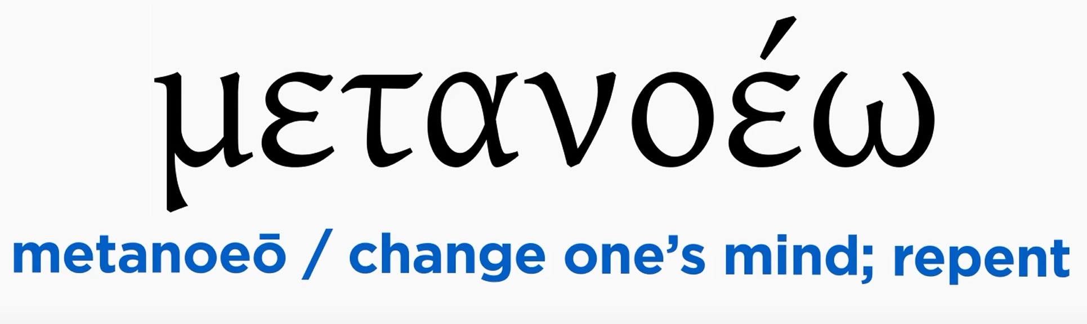
Acts 2:38
“Peter said to them, “Repent [metanoeō], and each of you be baptized in the name of Jesus Christ for (eis) the forgiveness of your sins; and you will receive the gift of the Holy Spirit.”

Slide 45

Acts 2:38
“Peter said to them, ‘Repent, and each of you be baptized in the name of Jesus Christ for (eis) the forgiveness of your sins; and you will receive the gift of the Holy Spirit.’”

Slide 46
Matthew 12:41
“The men of Nineveh will stand up with this generation at the judgment and will condemn it because they repented at [in the face of/because of] (eis) the preaching of Jonah; and behold, something greater than Jonah is here.”

Slide 47
Acts 11:15-16
“¹⁵ And as I began to speak, the Holy Spirit fell upon them just as He did upon us at the beginning. ¹⁶ And I remembered the word of the Lord, how He used to say, ‘John baptized with water, but you will be baptized with the Holy Spirit.’”

Slide 48
II. Declarations Acts 15:6-21
Meeting convened (6)
Peter’s address (7-11)
Barnabas’ & Paul’s testimony (12)
James’ address (13-21)

Slide 49
First Missionary Journey

Slide 50


Dr. Arnold G. Fruchtenbaum
The Book of Acts, 83
“The apostles did many signs and wonders. In fact, the only ones who performed miracles in the book of Acts were the apostles or their delegates, such as Stephen (Acts 6:8). These apostolic delegates were appointed by the laying on of hands by the apostles. Signs and wonders were not performed by the believers at large.”

Slide 51
Ephesians 2:20
“having been built on the foundation of the apostles and prophets, Christ Jesus Himself being the corner stone.”

Slide 52
II. Declarations Acts 15:6-21
Meeting convened (6)
Peter’s address (7-11)
Barnabas’ & Paul’s testimony (12)
James’ address (13-21)

Slide 53
Acts 15:13-21 James’ Address
Introduction (13a)
Addressees (13b)
Peter’s address (14)
Old Testament citation (15-18)
Conclusions (19-21)

Slide 54
Acts 15:13-21 James’ Address
Introduction (13a)
Addressees (13b)
Peter’s address (14)
Old Testament citation (15-18)
Conclusions (19-21)

Slide 55
JAMES OF THE NEW TESTAMENT
Father of Judas (not Iscariot)
The son of Alphaeus
The son of Zebedee and brother of John
The half brother of Christ

Slide 56
Acts 15:13-21 James’ Address
Introduction (13a)
Addressees (13b)
Peter’s address (14)
Old Testament citation (15-18)
Conclusions (19-21)

Slide 57
Acts 15:13-21 James’ Address
Introduction (13a)
Addressees (13b)
Peter’s address (14)
Old Testament citation (15-18)
Conclusions (19-21)

Slide 58

Acts 15:14
“Simeon has related how God first concerned Himself about taking from among the Gentiles a people for His name.”

Slide 59
Romans 11:25-26
“²⁵ For I do not want you, brethren, to be uninformed of this mystery—so that you will not be wise in your own estimation—that a partial hardening has happened to Israel until the fullness of the Gentiles has come in; ²⁶ and so all Israel will be saved; just as it is written, ‘The Deliverer will come from Zion, He will remove ungodliness from Jacob.’”

Slide 60
Acts 15:13-21 James’ Address
Introduction (13a)
Addressees (13b)
Peter’s address (14)
Old Testament citation (15-18)
Conclusions (19-21)

Slide 61
Acts 15:15-18 Old Testament Citation
Introduction (15)
Amos 9:11-12 (16-18)

Slide 62
Acts 15:15-18 Old Testament Citation
Introduction (15)
Amos 9:11-12 (16-18)

Slide 63
Acts 15:15-18 Old Testament Citation
Introduction (15)
Amos 9:11-12 (16-18)

Slide 64
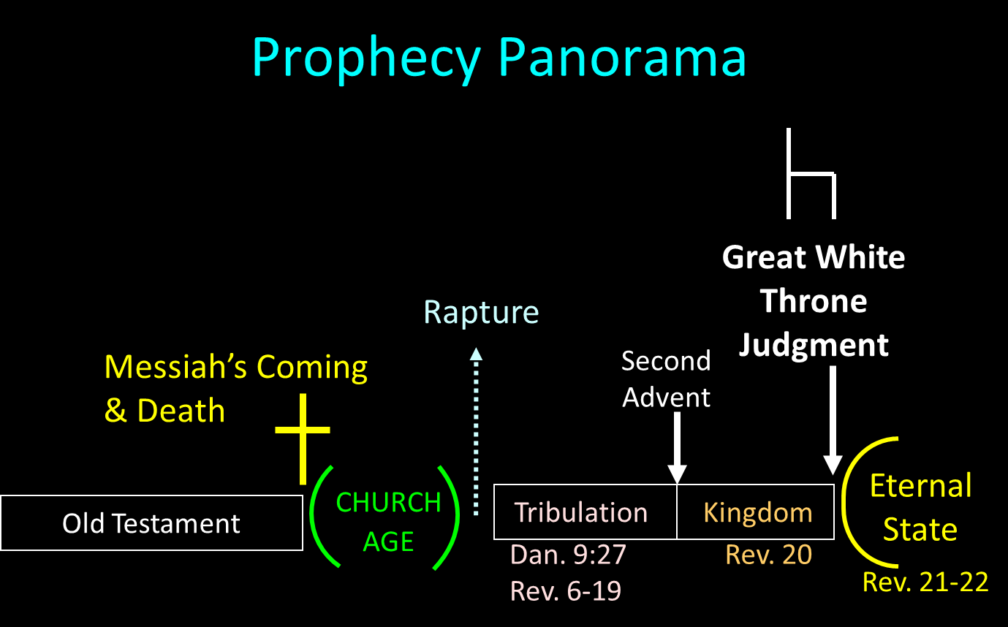

Slide 65
Acts 15:13-21 James’ Address
Introduction (13a)
Addressees (13b)
Peter’s address (14)
Old Testament citation (15-18)
Conclusions (19-21)

Slide 66
Acts 15:19-21 Conclusions
Concerning the Gentiles (19-20)
Concerning Moses (21)

Slide 67
Acts 15:19-21 Conclusions
Concerning the Gentiles (19-20)
Concerning Moses (21)

Slide 68
Acts 15:19-21 Concerning the Gentiles
Adherence to OT Law not required (19)
Abstentions to avoid offence (20)

Slide 69
Acts 15:19-21 Concerning the Gentiles
Adherence to OT Law not required (19)
Abstentions to avoid offence (20)

Slide 70
Acts 15:19-21 Concerning the Gentiles
Adherence to OT Law not required (19)
Abstentions to avoid offence (20)

Slide 71
Acts 15:20 Abstentions Reiterated
Food sacrificed to idols (20a)
Fornication (20b)
Things strangled (20c)
Blood (20d)

Slide 72
Acts 15:20 Abstentions Reiterated
Food sacrificed to idols (20a)
Fornication (20b)
Things strangled (20c)
Blood (20d)

Slide 73
Acts 15:20 Abstentions Reiterated
Food sacrificed to idols (20a)
Fornication (20b)
Things strangled (20c)
Blood (20d)

Slide 74
Acts 15:20 Abstentions Reiterated
Food sacrificed to idols (20a)
Fornication (20b)
Things strangled (20c)
Blood (20d)

Slide 75
Acts 15:20 Abstentions Reiterated
Food sacrificed to idols (20a)
Fornication (20b)
Things strangled (20c)
Blood (20d)

Slide 76
Acts 15:19-21 Conclusions
Concerning the Gentiles (19-20)
Concerning Moses (21)

Slide 77
Acts 15:1-35 Jerusalem Council
Occasion (1-5)
Declarations (6-21)
Decision (22-29)
Delivery (30-35)

Slide 78
III. Decision Acts 15:22-24
Selection of emissaries (22)
Addressees (22-23)
Repudiation of Judaizers (24)
Approval of Paul & Barnabas (25-26)
Authorization of Judas & Silas (27)
Spirit’s role in the decision (28)
Abstentions reiterated (29a-d)
Farewell (29e)

Slide 79
III. Decision Acts 15:22-24
Selection of emissaries (22)
Addressees (22-23)
Repudiation of Judaizers (24)
Approval of Paul & Barnabas (25-26)
Authorization of Judas & Silas (27)
Spirit’s role in the decision (28)
Abstentions reiterated (29a-d)
Farewell (29e)

Slide 80
Ephesians 2:20
“having been built on the foundation of the apostles and prophets, Christ Jesus Himself being the corner stone.”

Slide 81
III. Decision Acts 15:22-24
Selection of emissaries (22)
Addressees (22-23)
Repudiation of Judaizers (24)
Approval of Paul & Barnabas (25-26)
Authorization of Judas & Silas (27)
Spirit’s role in the decision (28)
Abstentions reiterated (29a-d)
Farewell (29e)

Slide 83
III. Decision Acts 15:22-24
Selection of emissaries (22)
Addressees (22-23)
Repudiation of Judaizers (24)
Approval of Paul & Barnabas (25-26)
Authorization of Judas & Silas (27)
Spirit’s role in the decision (28)
Abstentions reiterated (29a-d)
Farewell (29e)

Slide 84
III. Decision Acts 15:22-24
Selection of emissaries (22)
Addressees (22-23)
Repudiation of Judaizers (24)
Approval of Paul & Barnabas (25-26)
Authorization of Judas & Silas (27)
Spirit’s role in the decision (28)
Abstentions reiterated (29a-d)
Farewell (29e)

Slide 85
First Missionary Journey

Slide 86
III. Decision Acts 15:22-24
Selection of emissaries (22)
Addressees (22-23)
Repudiation of Judaizers (24)
Approval of Paul & Barnabas (25-26)
Authorization of Judas & Silas (27)
Spirit’s role in the decision (28)
Abstentions reiterated (29a-d)
Farewell (29e)

Slide 87
III. Decision Acts 15:22-24
Selection of emissaries (22)
Addressees (22-23)
Repudiation of Judaizers (24)
Approval of Paul & Barnabas (25-26)
Authorization of Judas & Silas (27)
Spirit’s role in the decision (28)
Abstentions reiterated (29a-d)
Farewell (29e)

Slide 88
III. Decision Acts 15:22-24
Selection of emissaries (22)
Addressees (22-23)
Repudiation of Judaizers (24)
Approval of Paul & Barnabas (25-26)
Authorization of Judas & Silas (27)
Spirit’s role in the decision (28)
Abstentions reiterated (29a-d)
Farewell (29e)

Slide 89
Acts 15:29a-d Abstentions Reiterated
Food sacrificed to idols (29a)
Blood (29b)
Things strangled (29c)
Fornication (29d)

Slide 90
Acts 15:29a-d Abstentions Reiterated
Food sacrificed to idols (29a)
Blood (29b)
Things strangled (29c)
Fornication (29d)

Slide 91
Acts 15:29a-d Abstentions Reiterated
Food sacrificed to idols (29a)
Blood (29b)
Things strangled (29c)
Fornication (29d)

Slide 92
Acts 15:29a-d Abstentions Reiterated
Food sacrificed to idols (29a)
Blood (29b)
Things strangled (29c)
Fornication (29d)

Slide 93
Acts 15:29a-d Abstentions Reiterated
Food sacrificed to idols (29a)
Blood (29b)
Things strangled (29c)
Fornication (29d)

Slide 94
III. Decision Acts 15:22-24
Selection of emissaries (22)
Addressees (22-23)
Repudiation of Judaizers (24)
Approval of Paul & Barnabas (25-26)
Authorization of Judas & Silas (27)
Spirit’s role in the decision (28)
Abstentions reiterated (29a-d)
Farewell (29e)

Slide 95
Acts 15:1-35 Jerusalem Council
Occasion (1-5)
Declarations (6-21)
Decision (22-29)
Delivery (30-35)

Slide 96
IV. Delivery Acts 15:30-35
Letter’s delivery to Antioch (30)
Letter’s result (31)
Judas’ & Silas’ ministry (32)
Judas’ & Silas’ departure (33)
Silas remains at Antioch (34)
Paul’s & Barnabas’ continuing ministry (35)

Slide 97
IV. Delivery Acts 15:30-35
Letter’s delivery to Antioch (30)
Letter’s result (31)
Judas’ & Silas’ ministry (32)
Judas’ & Silas’ departure (33)
Silas remains at Antioch (34)
Paul’s & Barnabas’ continuing ministry (35)

Slide 99
IV. Delivery Acts 15:30-35
Letter’s delivery to Antioch (30)
Letter’s result (31)
Judas’ & Silas’ ministry (32)
Judas’ & Silas’ departure (33)
Silas remains at Antioch (34)
Paul’s & Barnabas’ continuing ministry (35)

Slide 100
IV. Delivery Acts 15:30-35
Letter’s delivery to Antioch (30)
Letter’s result (31)
Judas’ & Silas’ ministry (32)
Judas’ & Silas’ departure (33)
Silas remains at Antioch (34)
Paul’s & Barnabas’ continuing ministry (35)

Slide 101
IV. Delivery Acts 15:30-35
Letter’s delivery to Antioch (30)
Letter’s result (31)
Judas’ & Silas’ ministry (32)
Judas’ & Silas’ departure (33)
Silas remains at Antioch (34)
Paul’s & Barnabas’ continuing ministry (35)

Slide 103
IV. Delivery Acts 15:30-35
Letter’s delivery to Antioch (30)
Letter’s result (31)
Judas’ & Silas’ ministry (32)
Judas’ & Silas’ departure (33)
Silas remains at Antioch (34)
Paul’s & Barnabas’ continuing ministry (35)

Slide 104
Acts 2:47
“praising God and having favor with all the people. And the Lord was adding to their number day by day those who were being saved.” (NASB)
“praising God and having favor with all the people. And the Lord added to the church daily those who were being saved.” (NKJV)

Slide 105
Author | Written | Earliest MSS | Time Span | No. MSS
Cesar | 100 to 44 b.c. | a.d. 900 | 1000 | 10
Plato | 427 to 347 b.c. | a.d. 900 | 1200 | 7
Thucydides | 460 to 400 b.c. | a.d. 900 | 1300 | 8
Tacitus | a.d. 100 | a.d. 1100 | 1000 | 20
Suetonius | a.d. 75 to 160 | a.d. 950 | 800 | 8
Homer (Illiad) | 900 b.c. | a.d. 400 | 500 | 643
New Testament | a.d. 40 to 100 | a.d. 125 | 25 to 50 | 24,000
Cesar | 100 to 44 b.c. | a.d. 900 | 1000 | 10
http://creationrevolution.com/2012/05/should-we-trust-the-bible/

Slide 106
Manuscript Evidence for Ancient Writings
Author | Written | Earliest Fragment/Copy | Time Span in Years | Number of Manuscripts
Cesar | 100 to 44 b.c. | a.d. 900 | 1000 | 10
Plato | 427 to 347 b.c. | a.d. 900 | 1200 | 7
Thucydides | 460 to 400 b.c. | a.d. 900 | 1300 | 8
Tacitus | a.d. 100 | a.d. 1100 | 1000 | 20
Suetonius | a.d. 75 to 160 | a.d. 950 | 800 | 8
Homer (Illiad) | 900 b.c. | a.d. 400 | 500 | 643
New Testament | a.d. 40 to 100 | a.d. 125 | 25 to 50 | 24,000
Information in this chart can be found in various sources. This chart was adapted from: Christian Apologetics, by Norman Geisler, 1976, p. 307; and Evidence That Demands a Verdict, by Josh McDowell, 1979, pp. 42, 43.

Slide 107
Dr. Arnold G. Fruchtenbaum
The Book of Acts, 330
﻿“Some ancient authorities insert, with variations, verse 34: But it seemed good unto Silas to abide there. Some Bibles may have the sentence in the main text, others in the margin. Either way, the verse was probably a scribal attempt to explain how Silas could leave with Paul from Antioch on the second missionary journey, in verse 40. Yet, most likely, the verse is not part of the original text, because verse 33 states that both Judas and Silas returned to Jerusalem. Apparently, Silas came back to Antioch later to accompany Paul.”

Slide 108
IV. Delivery Acts 15:30-35
Letter’s delivery to Antioch (30)
Letter’s result (31)
Judas’ & Silas’ ministry (32)
Judas’ & Silas’ departure (33)
Silas remains at Antioch (34)
Paul’s & Barnabas’ continuing ministry (35)

Slide 109
Acts 1:8
“but you will receive power when the Holy Spirit has come upon you; and you shall be My witnesses both in Jerusalem, and in all Judea and Samaria, and even to the remotest part of the earth.”

Slide 110
Structure (Acts 1:8)
Jerusalem (Acts 1–7)
Judea and Samaria (Acts 8–12)
Remotest part of the earth (Acts 13–28)
1st missionary journey (Acts 13–14)
Jerusalem council (Acts 15:1-35)
2nd missionary journey (Acts 15:36 –18:22)
3rd missionary journey (Acts 18:23–21:17)
Trip to Rome (Acts 21:18–28:31)

Slide 111
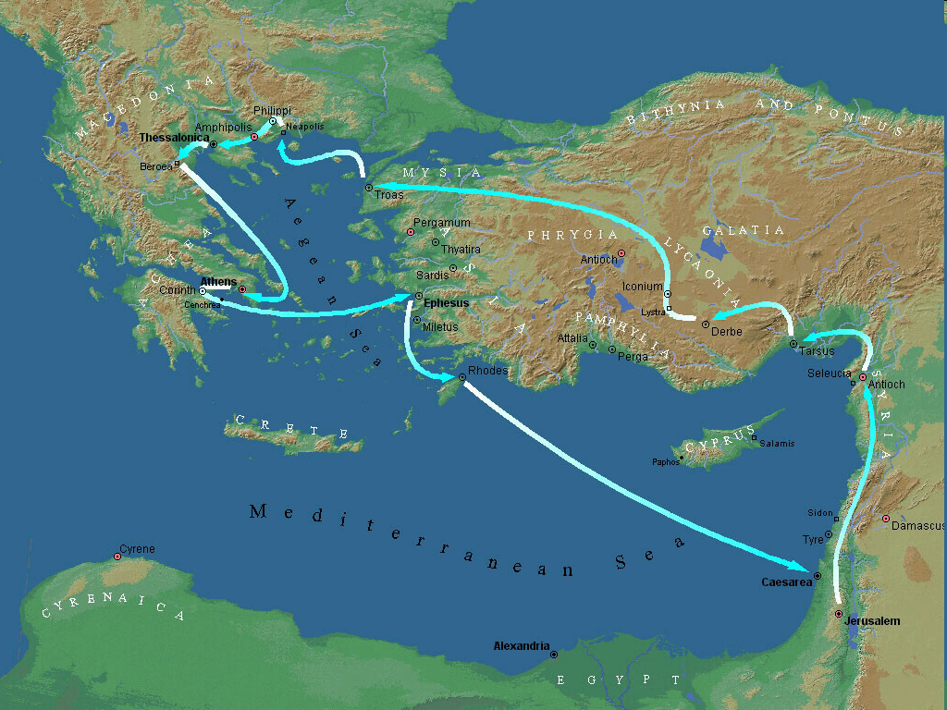
Second Missionary Journey

Slide 112
Acts 15:36‒18:22 2nd Missionary Journey
Schism between Paul & Barnabas (15:36-41)
Syria & Cilicia ministry (16:1-5)
Macedonian call (16:6-10)
Philippian ministry (16:11-40)
Thessalonica ministry (17:1-9)
Berean ministry (17:10-15)
Athens’ ministry (17:16-34)
Corinthian ministry (18:1-18)
Ephesus’ ministry (18:19-21)
Return to Antioch (18:22)

Slide 113
Acts 15:36‒18:22 2nd Missionary Journey
Schism between Paul & Barnabas (15:36-41)
Syria & Cilicia ministry (16:1-5)
Macedonian call (16:6-10)
Philippian ministry (16:11-40)
Thessalonica ministry (17:1-9)
Berean ministry (17:10-15)
Athens’ ministry (17:16-34)
Corinthian ministry (18:1-18)
Ephesus’ ministry (18:19-21)
Return to Antioch (18:22)

Slide 114
I. Schism Between Paul & Barnabas Acts 15:36-41
Paul’s suggestion (36)
Barnabas’ suggestion (37)
Paul’s refusal (38)
Paul’s & Barnabas’ schism (39)
Barnabas’ replacement (40)
Paul travels through Syria to Cilicia (41)

Slide 115
I. Schism Between Paul & Barnabas Acts 15:36-41
Paul’s suggestion (36)
Barnabas’ suggestion (37)
Paul’s refusal (38)
Paul’s & Barnabas’ schism (39)
Barnabas’ replacement (40)
Paul travels through Syria to Cilicia (41)

Slide 116
Second Missionary Journey

Slide 117
I. Schism Between Paul & Barnabas Acts 15:36-41
Paul’s suggestion (36)
Barnabas’ suggestion (37)
Paul’s refusal (38)
Paul’s & Barnabas’ schism (39)
Barnabas’ replacement (40)
Paul travels through Syria to Cilicia (41)

Slide 118
I. Schism Between Paul & Barnabas Acts 15:36-41
Paul’s suggestion (36)
Barnabas’ suggestion (37)
Paul’s refusal (38)
Paul’s & Barnabas’ schism (39)
Barnabas’ replacement (40)
Paul travels through Syria to Cilicia (41)

Slide 119
First Missionary Journey

Slide 120
I. Schism Between Paul & Barnabas Acts 15:36-41
Paul’s suggestion (36)
Barnabas’ suggestion (37)
Paul’s refusal (38)
Paul’s & Barnabas’ schism (39)
Barnabas’ replacement (40)
Paul travels through Syria to Cilicia (41)

Slide 121
Dr. Arnold G. Fruchtenbaum
The Book of Acts, 334
﻿“This disagreement between Paul and Barnabas led to a schism (v. 39): And there arose a sharp contention, so that they parted asunder one from the other. The Greek word for “contention,” paroxysmos, means ‘a very sharp disagreement.’ It seems that Barnabas, whose name means ‘son of consolation,’ lost his temper during the lengthy discussion. Barnabas stuck with his position to take Mark with him, and the dispute led to his departure. The Greek word for ‘parted asunder,’ apochōristhēnai, means ‘to separate,’ ‘to sever.’ There was no personal slander; they disagreed sharply only over the issue at hand. But it was an apocalyptic disaster.””

Slide 122
Dr. Arnold G. Fruchtenbaum
The Book of Acts, 335
﻿“Some later developments of this dispute are known from other Scriptures. In spite of their disagreement over Mark, Paul and Barnabas maintained fellowship. This is evident from I Corinthians 9:6, which was written during the third missionary journey and shows that the schism had healed. Colossians 4:10 also shows that they maintained fellowship. Furthermore, Paul himself was reconciled to Mark later on (Col. 4:10; II Tim. 4:11; Philemon 24).”

Slide 124
I. Schism Between Paul & Barnabas Acts 15:36-41
Paul’s suggestion (36)
Barnabas’ suggestion (37)
Paul’s refusal (38)
Paul’s & Barnabas’ schism (39)
Barnabas’ replacement (40)
Paul travels through Syria to Cilicia (41)

Slide 125
Dr. Arnold G. Fruchtenbaum
The Book of Acts, 335
﻿“Silas was a key individual: He was a leading Jerusalemite believer (Acts 15:22, 27); he had the gift of prophecy, receiving direct revelation from God (Acts 15:32); he, like Paul, was a Roman citizen, which would help him later (Acts 16:37); and in the book of Acts, while Silas was associated with Paul, at times he was also associated with Peter (I Pet. 5:12).”

Slide 126
I. Schism Between Paul & Barnabas Acts 15:36-41
Paul’s suggestion (36)
Barnabas’ suggestion (37)
Paul’s refusal (38)
Paul’s & Barnabas’ schism (39)
Barnabas’ replacement (40)
Paul travels through Syria to Cilicia (41)

Slide 128
Conclusion

Slide 129
Acts 15:1-35 Jerusalem Council
Occasion (1-5)
Declarations (6-21)
Decision (22-29)
Delivery (30-35)

