Slide 1



Slide 2

EXODUS STRUCTURE/OUTLINE
Redemption (1–18)
Redemption (1:1–12:30)
Liberation (12:31–15:21)
Preservation (15:22–18:27)
Mosaic Covenant (19–40)
Law (19–24)
Tabernacle instructions (25–31)
Apostasy (32–34)
Tabernacle building (35–40)

Slide 3
REDEMPTION (1:1–12:30)
Why redemption is necessary (Exod 1)
Development of the deliverer (Exod 2–4)
First confrontation with Pharaoh (Exod 5)
God reassures Moses (Exod 6:1–7:7)
Second confrontation with Pharaoh (Exod 7:8-13)
Plagues (Exod 7:14–12:30)

Slide 4
GOD REASSURES MOSES Exodus 6:1-30
Divine Reassurance (1-8)
Divine Command (9-13)
Moses’ & Aaron’s Levitical Heritage (14-27)
Conversation continued (28-30)

Slide 5
IV. Exodus 6:28-30 Conversation Continued
Timing (28)
Command (29)
Moses’ excuses (30)

Slide 6
IV. Exodus 6:28-30 Conversation Continued
Timing (28)
Command (29)
Moses’ excuses (30)

Slide 7
IV. Exodus 6:28-30 Conversation Continued
Timing (28)
Command (29)
Moses’ excuses (30)

Slide 8
Exodus 6:29 Command
God’s self identification (29a)
Command given (29b)

Slide 9
Exodus 6:29 Command
God’s self identification (29a)
Command given (29b)

Slide 10
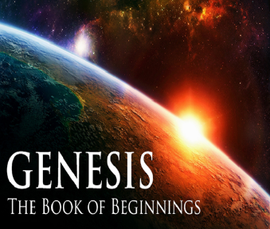
Names for God in Genesis
Elohim (1:1) – Power
Yahweh (2:4) – Relational
El Roi (Gen. 16:13) – Aware
El Olam (21:33) – Eternal
Jehovah Jireh (22:14) – Provision
God Isaac Feared (31:42, 53) – Reverenced
God, the God of Israel (33:20) – National

Slide 11
Exodus 6:29 Command
God’s self identification (29a)
Command given (29b)

Slide 12

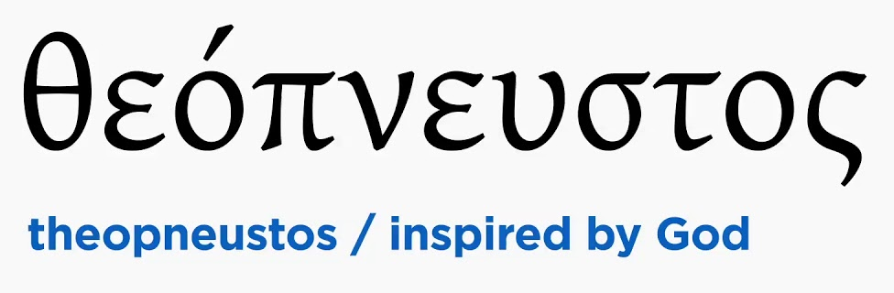
2 Timothy 3:16-17
“All Scripture is inspired by God [theopneustos] and profitable for teaching, for reproof, for correction, for training in righteousness; so that the man of God may be adequate, equipped for every good work.”

Slide 13


Matthew 4:4
“But He answered and said, “It is written, ‘Man shall not live on bread alone, but on every word that proceeds out of the mouth of God.’”

Slide 14


Acts 20:26-27
“²⁶ Therefore, I testify to you this day that I am innocent of the blood of all men. ²⁷ For I did not shrink from declaring to you the whole purpose of God.”

Slide 15
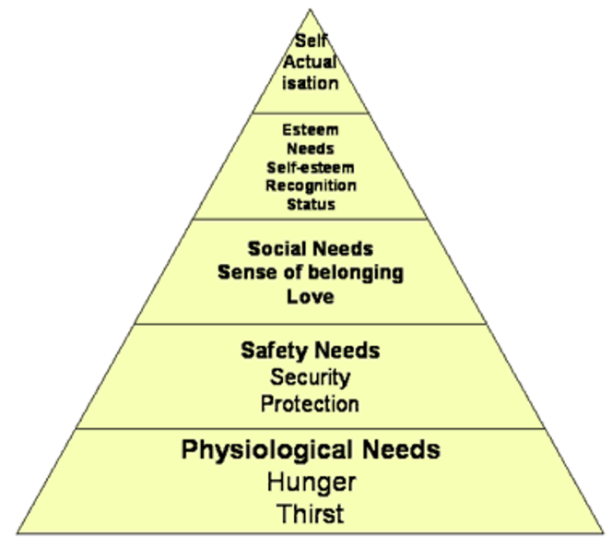
Maslow’s Hierarchy of Needs

Slide 16
IV. Exodus 6:28-30 Conversation Continued
Timing (28)
Command (29)
Moses’ excuses (30)

Slide 17
Exodus 5:30 Moses’ Excuses
Lack of eloquence (30a)
Pharaoh will not listen (30b)

Slide 18
Exodus 5:30 Moses’ Excuses
Lack of eloquence (30a)
Pharaoh will not listen (30b)

Slide 19
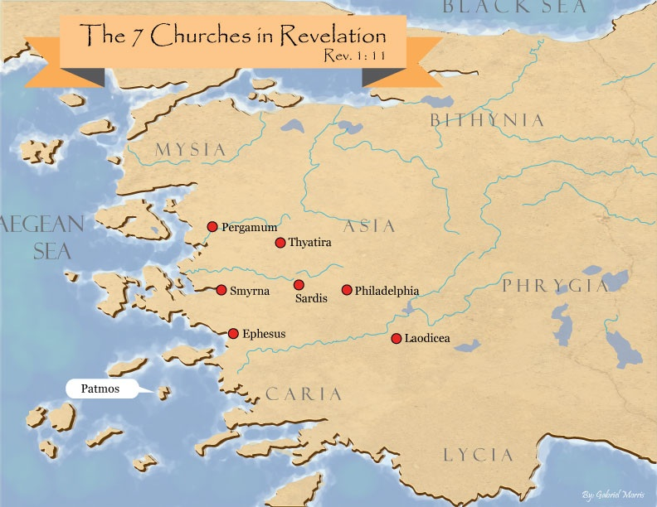
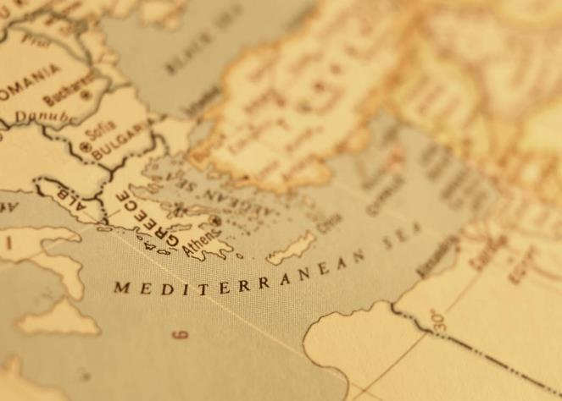

Slide 20
Exodus 5:30 Moses’ Excuses
Lack of eloquence (30a)
Pharaoh will not listen (30b)

Slide 21

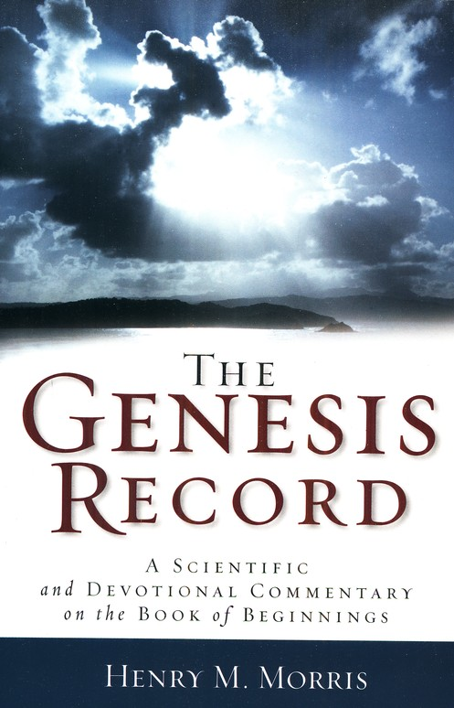
Dr. Henry M. Morris
The Genesis Record, 144
“The ancient quibble about ‘Cain’s wife’ is thus seen to be quite trivial. Long before Cain died, there was a large population in the earth. By the time of the Deluge, 1,656 years after Creation by the Ussher chronology, even using the above conservative assumptions, the world population would have been at least seven billion people!”

Slide 22
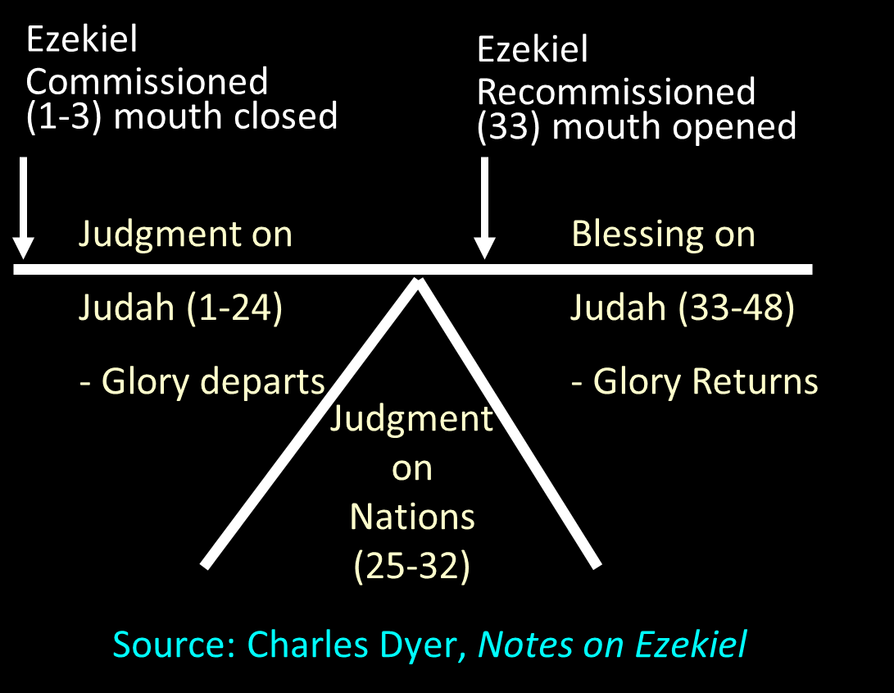

Slide 23
Acts 20:26-27
“²⁶ Therefore, I testify to you this day that I am innocent of the blood of all men. ²⁷ For I did not shrink from declaring to you the whole purpose of God.”

Slide 24
Conclusion

Slide 25
GOD REASSURES MOSES Exodus 6:1-30
Divine Reassurance (1-8)
Divine Command (9-13)
Moses’ & Aaron’s Levitical Heritage (14-27)
Conversation continued (28-30)

Slide 26
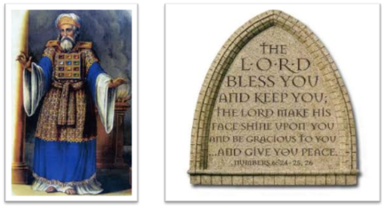
²⁴ The Lord bless you, and keep you; ²⁵ The Lord make His face shine on you, And be gracious to you; ²⁶ The Lord lift up His countenance on you, And give you peace.
Numbers 6:24–26 (NASB95)

