Slide 1
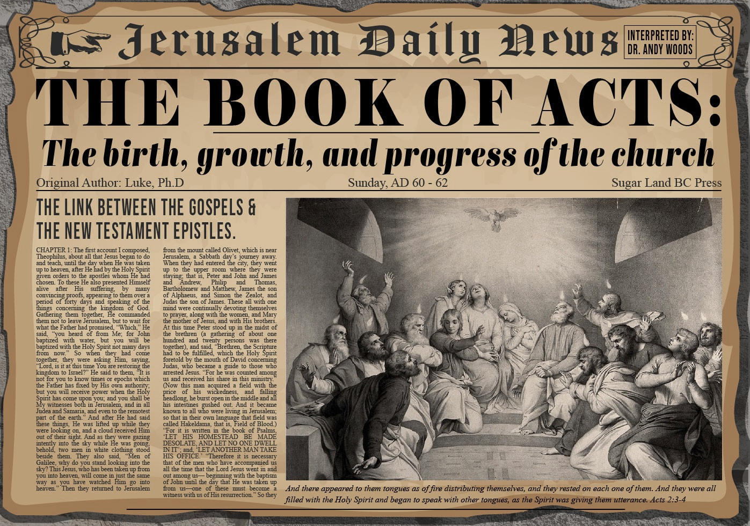


Slide 2

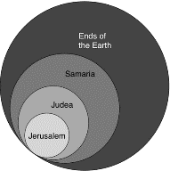
Acts 1:8
“but you will receive power when the Holy Spirit has come upon you; and you shall be My witnesses both in Jerusalem, and in all Judea and Samaria, and even to the remotest part of the earth.”

Slide 3
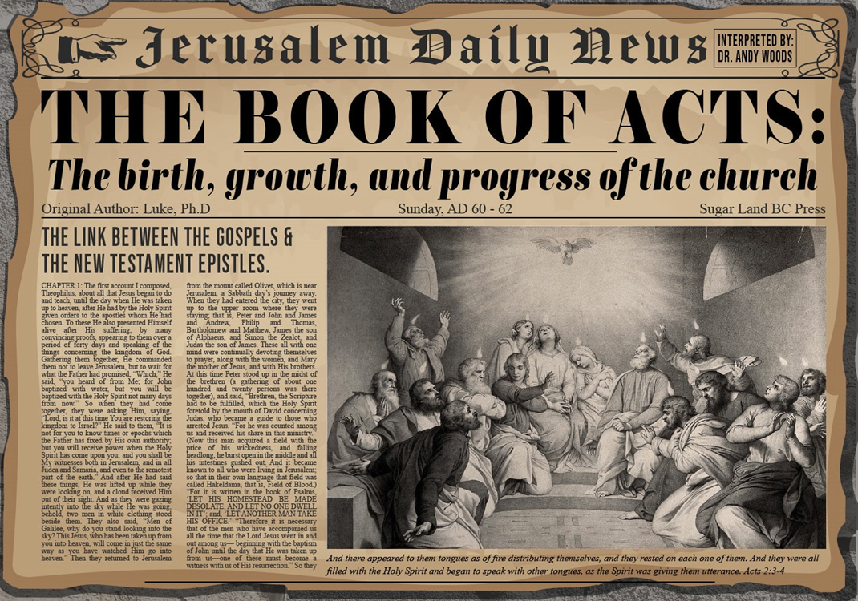
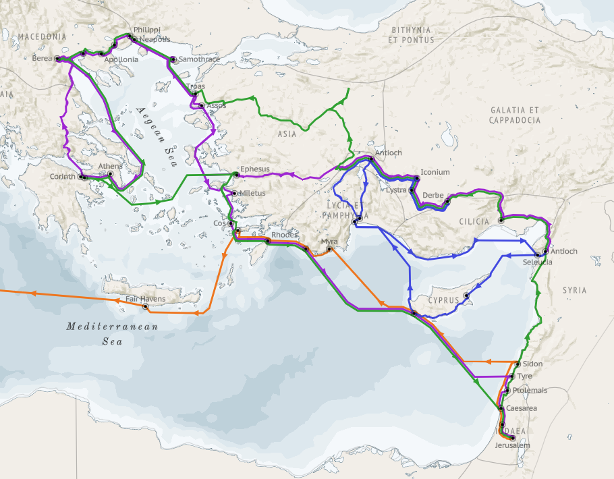
Structure (Acts 1:8)
Jerusalem (Acts 1–7)
Judea and Samaria (Acts 8–12)
Remotest part of the earth (Acts 13–28)
1st missionary journey (Acts 13–14)
Jerusalem council (Acts 15:1-35)
2nd missionary journey (Acts 15:36 –18:22)
3rd missionary journey (Acts 18:23–21:17)
Trip to Rome (Acts 21:18–28:31)

Slide 4
Acts 13‒14 1st Missionary Journey
Paul & Barnabas’ appointment (13:1-3)
Cyprus ministry (13:4-12)
Pisidian Antioch ministry (13:13-52)
Iconium ministry (14:1-7)
Lystra ministry (14:8-20a)
Derbe ministry (14:20b-21a)
Return to Antioch (14:21b-28)

Slide 5
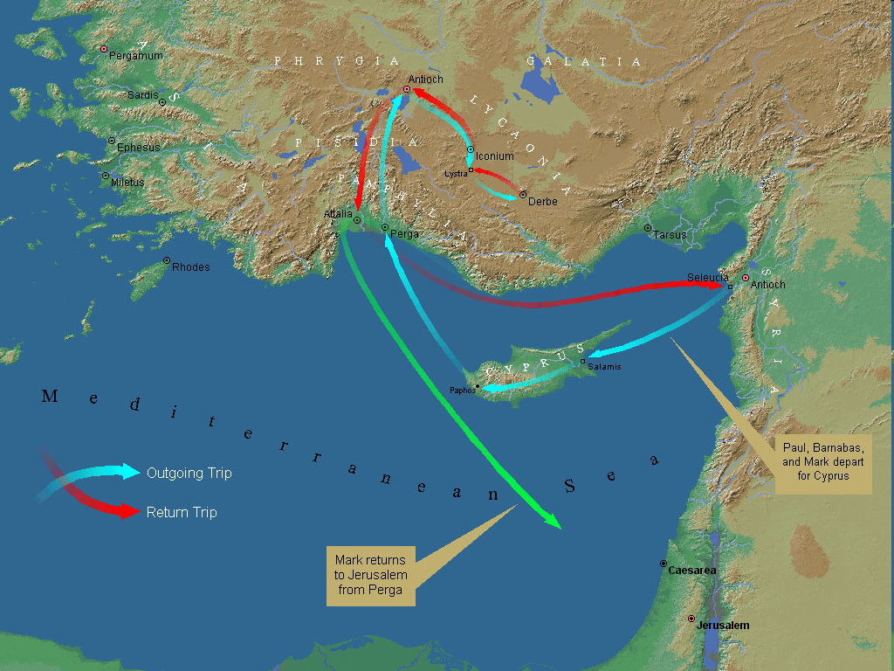
First Missionary Journey

Slide 6
VII. Return to Syrian Antioch Acts 14:21b-28
Return route (21b)
Ministries in revisited cities (22-23)
Route to Antioch (24-26)
Report to Antioch Church (27-28)

Slide 7
Acts 14:27-28 Report to the Antioch Church
Missionary report (27)
Transitional statement (28)

Slide 8
Acts 14:27-28 Report to the Antioch Church
Missionary report (27)
Transitional statement (28)

Slide 9
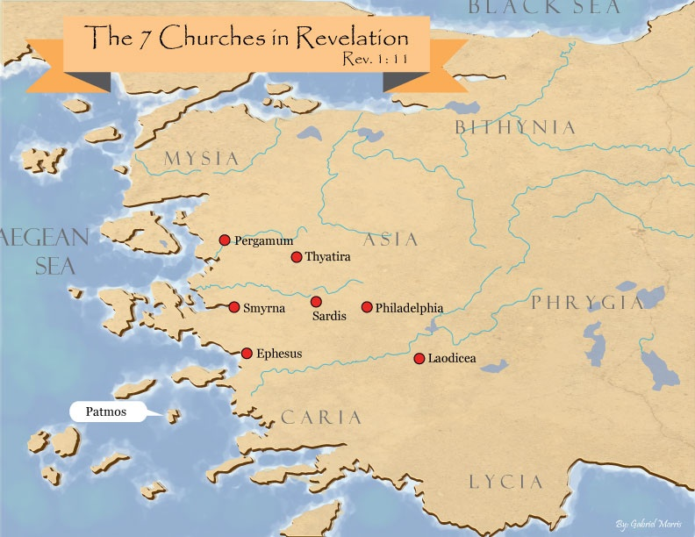
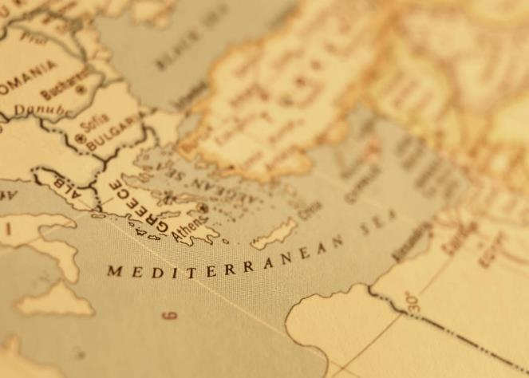

Slide 10
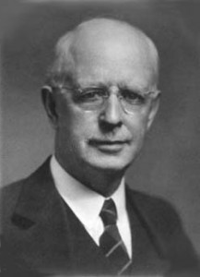
Lewis Sperry Chafer
vol. 7, Systematic Theology (Grand Rapids, MI: Kregel Publications, 1993), 265-66.
“This vital newness of mind is a part of believing, after all, and therefore it may be and is used as a synonym for believing at times (cf. Acts 17:30; 20:21; 26:20; Rom. 2:4; 2Tim. 2:25; 2 Pet. 3:9). Repentance nevertheless cannot be added to believing as a condition of salvation, because upwards of 150 passages of Scripture condition salvation upon believing only (cf. John 3:16; Acts 16:31).”

Slide 11
Acts 14:27-28 Report to the Antioch Church
Missionary report (27)
Transitional statement (28)

Slide 12
Paul’s Ministry Chronology
# OF BOOKS | JOURNEY | ACTS | DATE | BOOKS
1 | 1 | 13–14 | 48–49 | Gal
2 | 2 | 15:36–18:22 | 50–52 | 1–2 Thess
3 | 3 | 18:23–21:17 | 53–57 | 1–2 Cor, Rom
4 | 4 | 28:16-31 | 60–62 | Eph, Col, Phlm, Phlp
2 | Between Imprisonments | Post Acts | 62–66 | 1 Tim, Titus
1 | 2nd Imprisonment | Post Acts | 67 | 2 Tim

Slide 13
Paul’s Ministry Chronology
# OF BOOKS | JOURNEY | ACTS | DATE | BOOKS
1 | 1 | 13–14 | 48–49 | Gal
2 | 2 | 15:36–18:22 | 50–52 | 1–2 Thess
3 | 3 | 18:23–21:17 | 53–57 | 1–2 Cor, Rom
4 | 4 | 28:16-31 | 60–62 | Eph, Col, Phlm, Phlp
2 | Between Imprisonments | Post Acts | 62–66 | 1 Tim, Titus
1 | 2nd Imprisonment | Post Acts | 67 | 2 Tim

Slide 14
First Missionary Journey

Slide 15
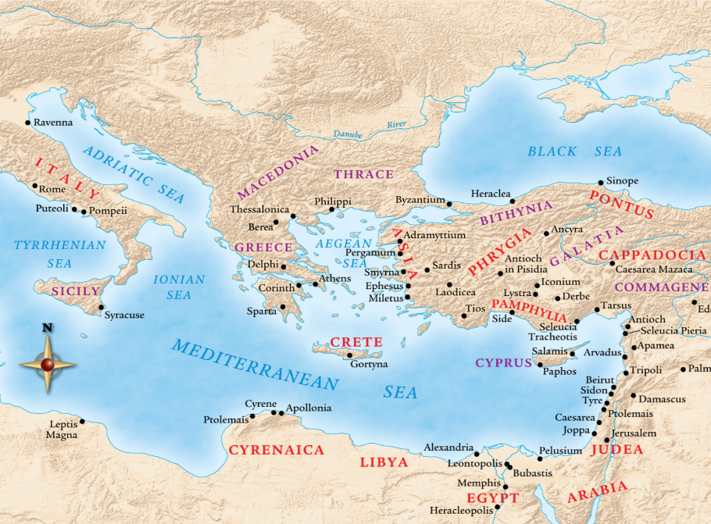

Slide 16


Galatians 3:3
“Are you so foolish? Having begun by the Spirit, are you now being perfected by the flesh?”

Slide 17
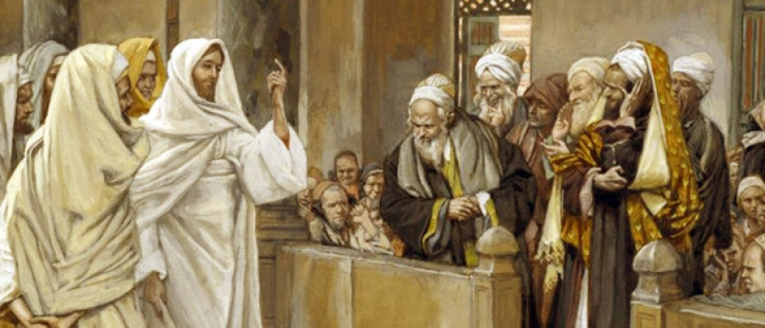
TYPES OF PHARISEES
TYPE | OVERTHROWN
Justification | Matthew 5:20
Sanctification | Galatians 3:3
Ecclesiology | Acts 15

Slide 18
Paul’s Ministry Chronology
# OF BOOKS | JOURNEY | ACTS | DATE | BOOKS
1 | 1 | 13–14 | 48–49 | Gal
2 | 2 | 15:36–18:22 | 50–52 | 1–2 Thess
3 | 3 | 18:23–21:17 | 53–57 | 1–2 Cor, Rom
4 | 4 | 28:16-31 | 60–62 | Eph, Col, Phlm, Phlp
2 | Between Imprisonments | Post Acts | 62–66 | 1 Tim, Titus
1 | 2nd Imprisonment | Post Acts | 67 | 2 Tim

Slide 19
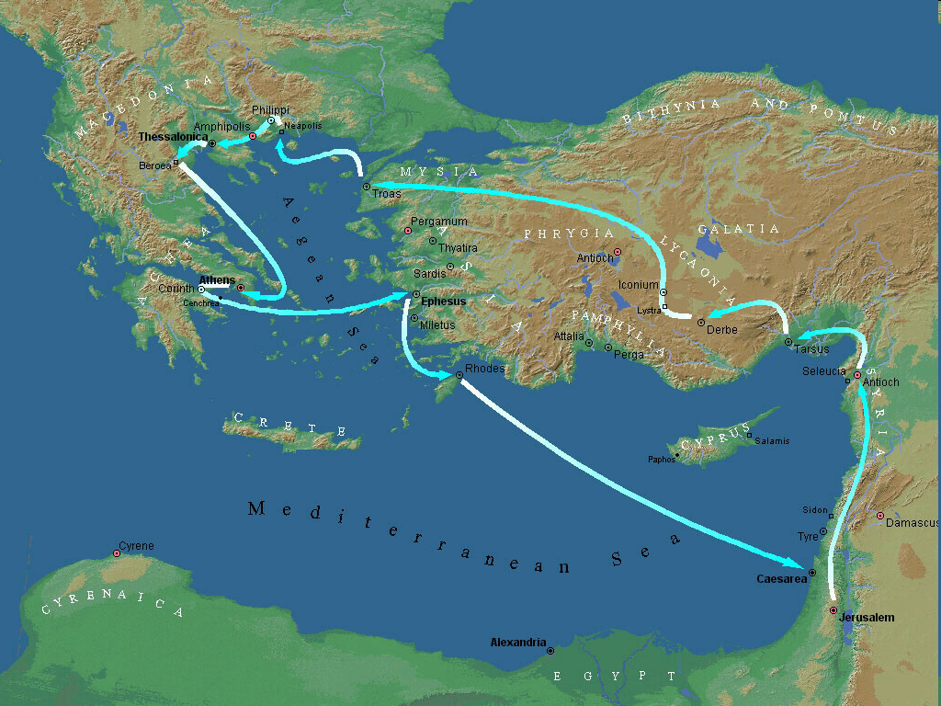
Second Missionary Journey

Slide 21

1 Thessalonians 4:13-18
¹³ "But we do not want you to be uninformed, brethren, about those who are asleep, so that you will not grieve as do the rest who have no hope. ¹⁴ For if we believe that Jesus died and rose again, even so God will bring with Him those who have fallen asleep in Jesus. ¹⁵ For this we say to you by the word of the Lord, that we who are alive and remain until the coming of the Lord, will not precede. . .

Slide 22
1 Thessalonians 4:13-18
. . . those who have fallen asleep. ¹⁶ For the Lord Himself descend from heaven with a shout, with the voice of the archangel and with the trumpet of God, and the dead in Christ will rise first. ¹⁷ Then we who are alive and remain will be caught up together with them in the clouds to meet the Lord in the air, and so we shall always be with the Lord. ¹⁸ Therefore comfort one another with these words."

Slide 23
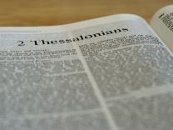
2 Thessalonians 2:1-12
Problem (2:1-2)
Prerequisites for the Day of the Lord (2:3-12)
The apostasy (2:3a)
Advent of the lawless one (2:3b-4)
Removal of the restrainer (2:5-7)
Destruction of the lawless one (2:8-9)
Destruction of lawless one’s followers (2:10-12)

Slide 24
Paul’s Ministry Chronology
# OF BOOKS | JOURNEY | ACTS | DATE | BOOKS
1 | 1 | 13–14 | 48–49 | Gal
2 | 2 | 15:36–18:22 | 50–52 | 1–2 Thess
3 | 3 | 18:23–21:17 | 53–57 | 1–2 Cor, Rom
4 | 4 | 28:16-31 | 60–62 | Eph, Col, Phlm, Phlp
2 | Between Imprisonments | Post Acts | 62–66 | 1 Tim, Titus
1 | 2nd Imprisonment | Post Acts | 67 | 2 Tim

Slide 25
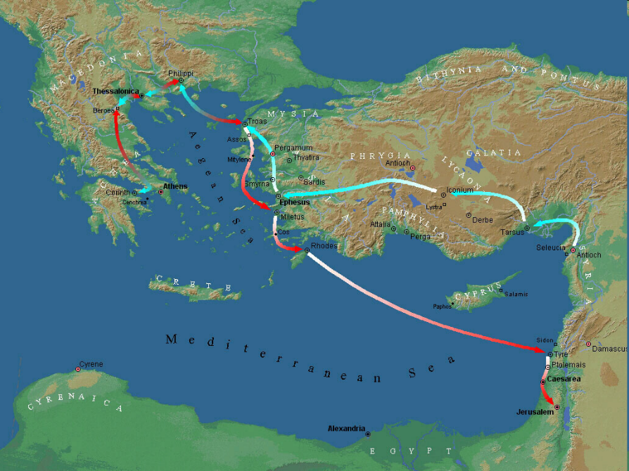

Slide 29
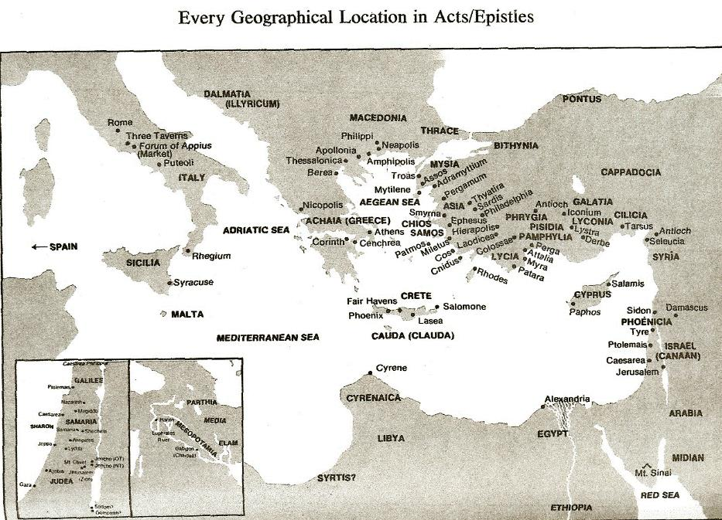

Slide 30
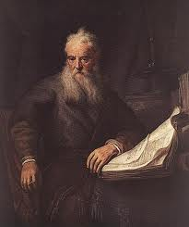
Romans Outline
Salutation (1:1-17)
Sin (1:18–3:20)
Salvation (3:21–5:21)
Sanctification (6–8)
Sovereignty (9–11)
Service (12:1–15:13)
Summation (15:14–16:27)

Slide 31
Paul’s Ministry Chronology
# OF BOOKS | JOURNEY | ACTS | DATE | BOOKS
1 | 1 | 13–14 | 48–49 | Gal
2 | 2 | 15:36–18:22 | 50–52 | 1–2 Thess
3 | 3 | 18:23–21:17 | 53–57 | 1–2 Cor, Rom
4 | 4 | 28:16-31 | 60–62 | Eph, Col, Phlm, Phlp
2 | Between Imprisonments | Post Acts | 62–66 | 1 Tim, Titus
1 | 2nd Imprisonment | Post Acts | 67 | 2 Tim

Slide 32
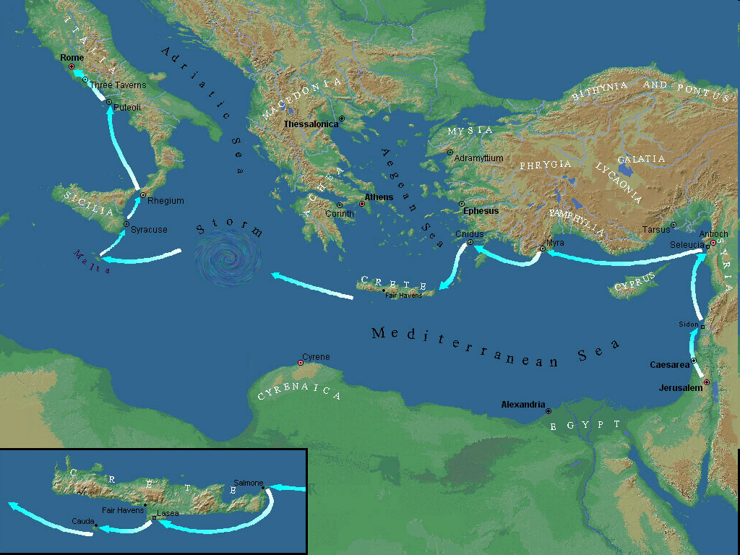

Slide 34
Ephesians 4:1
Therefore…
1-3
4-6

Slide 35
EPHESIANS: WHAT IS INSIDE?
1–3 | 4–6
Relationship | Responsibility
Doctrine | Deed
Orthodoxy | Orthopraxy
Knowledge | Wisdom
Belief | Behavior
Position | Practice
Privileges | Responsibility

Slide 36


Slide 38

Philippians Outline
CHAPTER 1
God can use negative circumstances to bring about positive results
CHAPTER 2
Christ’s example of servanthood
CHAPTER 3
Avoiding legalism
CHAPTER 4
Reliance upon Christ’s strength for daily life

Slide 39
Paul’s Ministry Chronology
# OF BOOKS | JOURNEY | ACTS | DATE | BOOKS
1 | 1 | 13–14 | 48–49 | Gal
2 | 2 | 15:36–18:22 | 50–52 | 1–2 Thess
3 | 3 | 18:23–21:17 | 53–57 | 1–2 Cor, Rom
4 | 4 | 28:16-31 | 60–62 | Eph, Col, Phlm, Phlp
2 | Between Imprisonments | Post Acts | 62–66 | 1 Tim, Titus
1 | 2nd Imprisonment | Post Acts | 67 | 2 Tim

Slide 42

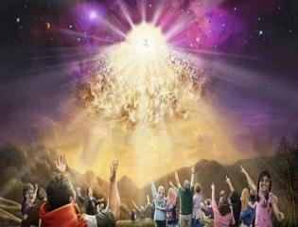

Titus 2:13
“Looking for the blessed hope and the appearing of the glory of our great God and Savior, Christ Jesus.”
42

Slide 43
Paul’s Ministry Chronology
# OF BOOKS | JOURNEY | ACTS | DATE | BOOKS
1 | 1 | 13–14 | 48–49 | Gal
2 | 2 | 15:36–18:22 | 50–52 | 1–2 Thess
3 | 3 | 18:23–21:17 | 53–57 | 1–2 Cor, Rom
4 | 4 | 28:16-31 | 60–62 | Eph, Col, Phlm, Phlp
2 | Between Imprisonments | Post Acts | 62–66 | 1 Tim, Titus
1 | 2nd Imprisonment | Post Acts | 67 | 2 Tim

Slide 44
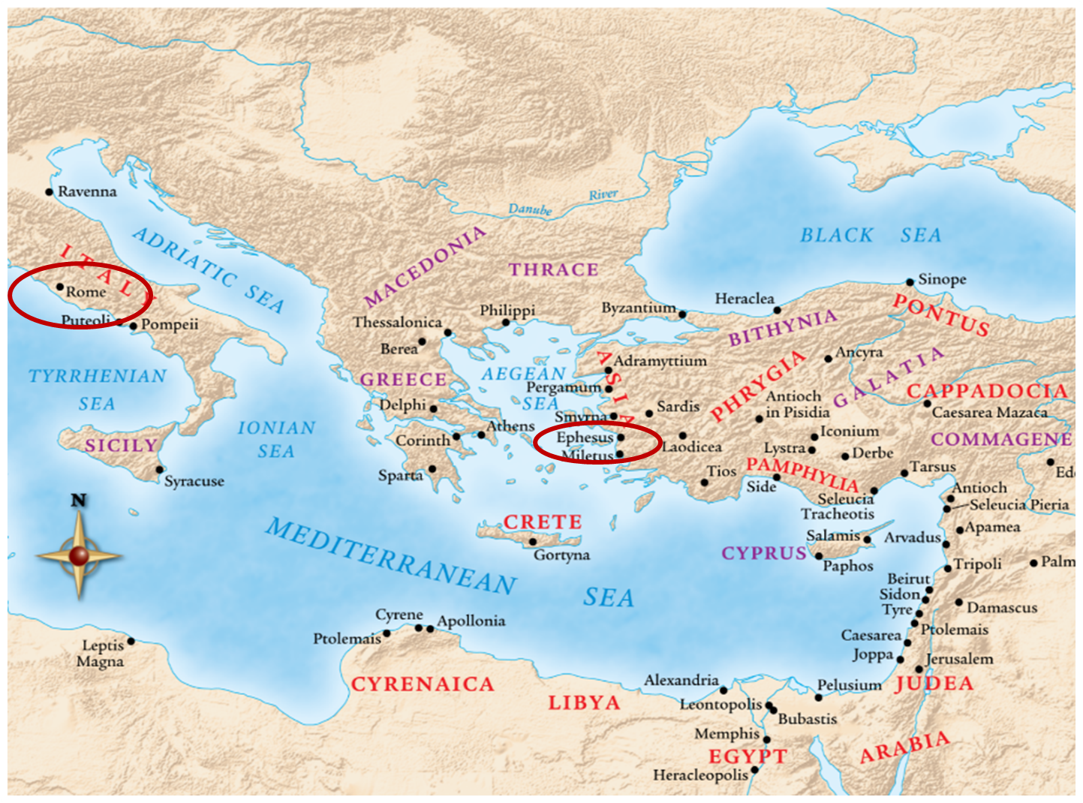

Slide 45
Paul’s Two Roman Imprisonments Contrasted
First Imprisonment (Acts 28:16-31) | Second Imprisonment (2 Tim)
Wrote prison epistles | Wrote 2 Timothy
Religious charges | Political charges
Local and sporadic persecutions (AD 60-63) | Neronian persecution (AD 64-68)
Decent conditions (house) | Poor conditions (dungeon)
Many friends | Virtually alone
Evangelistic opportunities | Opportunities restricted
Optimistic for release (Phil 1:24-26) | Execution anticipated (2 Tim 4:6)
Adapted from Nelson's Complete Book of Charts and Maps, 433.

Slide 46
ORDER OF PAUL’S LETTERS | ORDER OF PAUL’S LETTERS
1. | Galatians | A.D. 49
2. | 1‒2 Thessalonians | A.D. 51
3. | 1‒2 Corinthians | A.D. 56
4. | Romans | A.D. 57
5. | Ephesians, Colossians, Philemon, Philippians | A.D. 60‒62
6. | 1 Timothy, Titus | A.D. 62‒66
7. | 2 Timothy | A.D. 67

Slide 47
Conclusion

Slide 48
Acts 13‒14 1st Missionary Journey
Paul & Barnabas’ appointment (13:1-3)
Cyprus ministry (13:4-12)
Pisidian Antioch ministry (13:13-52)
Iconium ministry (14:1-7)
Lystra ministry (14:8-20a)
Derbe ministry (14:20b-21a)
Return to Antioch (14:21b-28)

