Slide 1



Slide 2

EXODUS STRUCTURE/OUTLINE
Redemption (1–18)
Redemption (1:1–12:30)
Liberation (12:31–15:21)
Preservation (15:22–18:27)
Mosaic Covenant (19–40)
Law (19–24)
Tabernacle instructions (25–31)
Apostasy (32–34)
Tabernacle building (35–40)

Slide 3
REDEMPTION (1:1–12:30)
Why redemption is necessary (Exod 1)
Development of the deliverer (Exod 2–4)
First confrontation with Pharaoh (Exod 5)
God reassures Moses (Exod 6:1–7:7)
Second confrontation with Pharaoh (Exod 7:8-13)
Plagues (Exod 7:14–12:30)

Slide 4
GOD REASSURES MOSES Exodus 6:1-30
Divine Reassurance (1-8)
Divine Command (9-13)
Moses’ & Aaron’s Levitical Heritage (14-27)
Conversation continued (28-30)

Slide 5
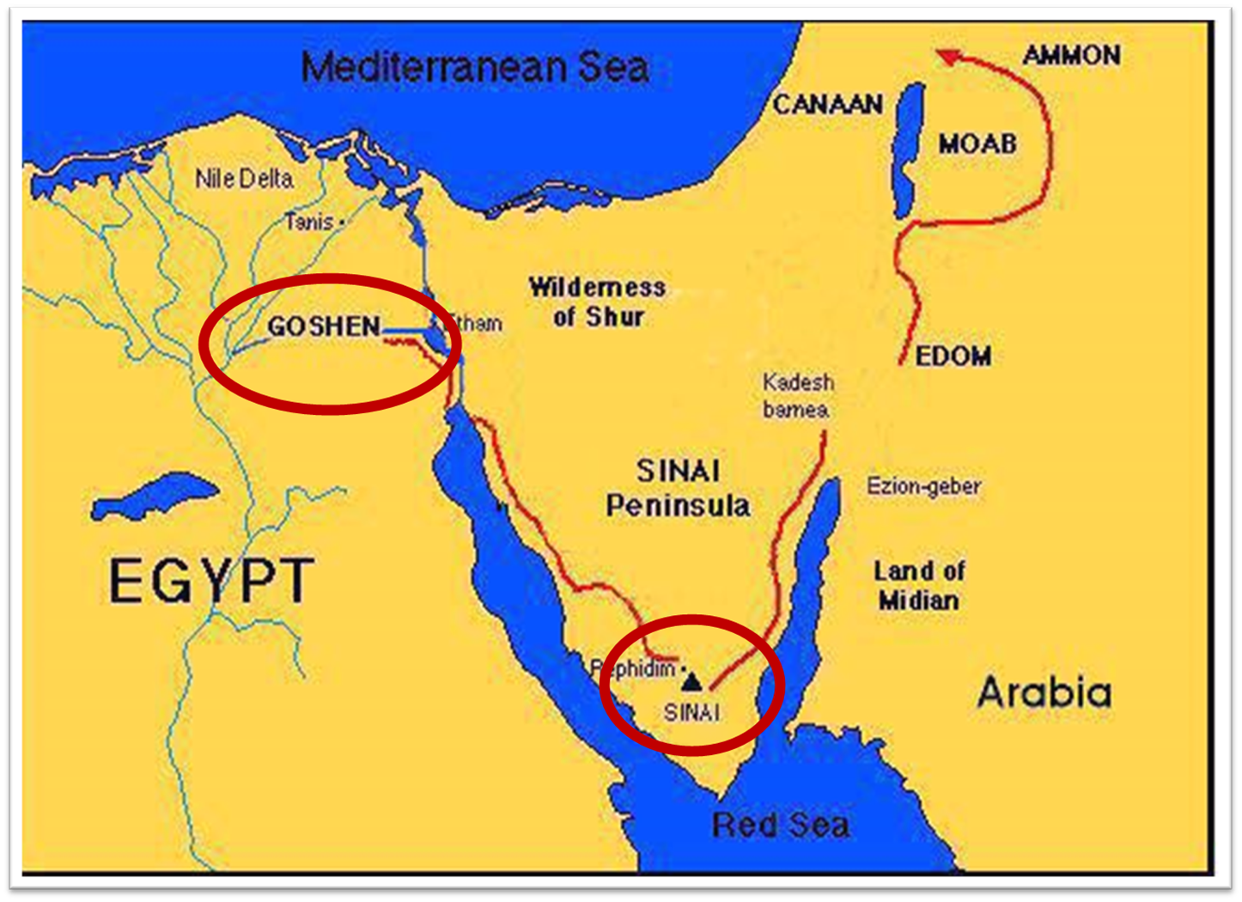

Slide 6
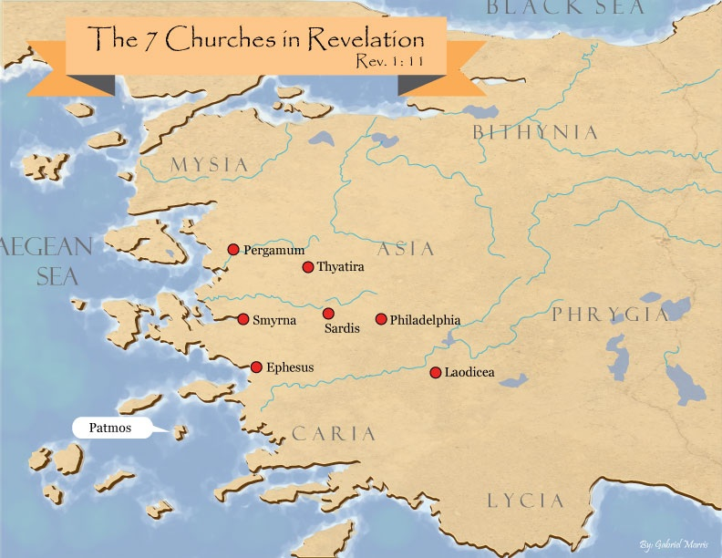
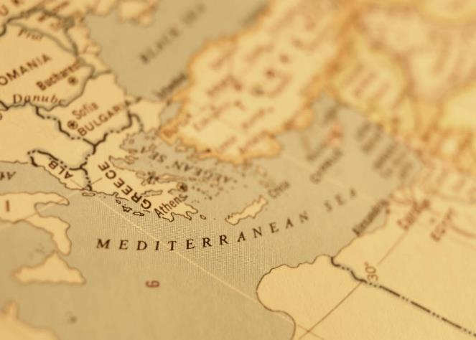

Slide 7

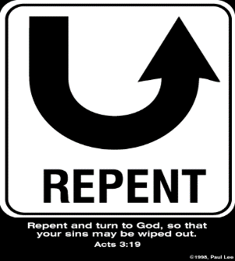
Revelation 2:5
so what? - points of application!
“Therefore remember from where you have fallen, and repent and do the deeds you did at first; or else I am coming to you and will remove your lampstand out of its place—unless you repent.”

Slide 8
III. Exodus 6:14-27 Moses’ & Aaron’s Levitical heritage
Reuben (14)
Simeon (15)
Levi (16-25)
Genealogy’s purpose (26-27)

Slide 9
III. Exodus 6:14-27 Moses’ & Aaron’s Levitical heritage
Reuben (14)
Simeon (15)
Levi (16-25)
Genealogy’s purpose (26-27)

Slide 10
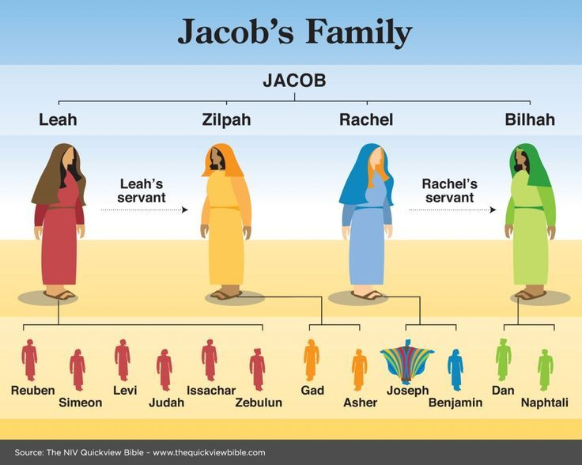

Slide 11
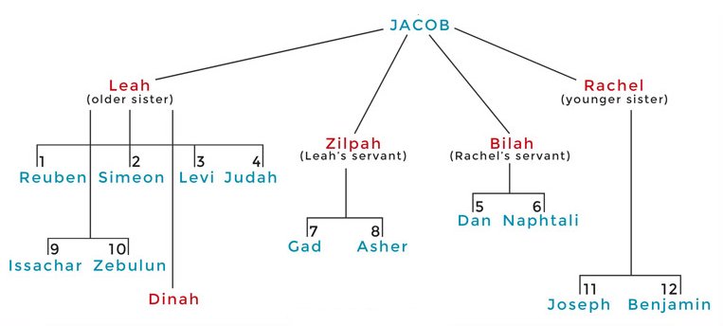

Slide 12
III. Exodus 6:14-27 Moses’ & Aaron’s Levitical heritage
Reuben (14)
Simeon (15)
Levi (16-25)
Genealogy’s purpose (26-27)

Slide 13
III. Exodus 6:14-27 Moses’ & Aaron’s Levitical heritage
Reuben (14)
Simeon (15)
Levi (16-25)
Genealogy’s purpose (26-27)

Slide 14
Exodus 6:16-25 Levi
Introduction (16)
Gershonites (17)
Kohathites (18)
Merarites (19)
Kohathite lineage (20-25)

Slide 15
Exodus 6:16-25 Levi
Introduction (16)
Gershonites (17)
Kohathites (18)
Merarites (19)
Kohathite lineage (20-25)

Slide 16
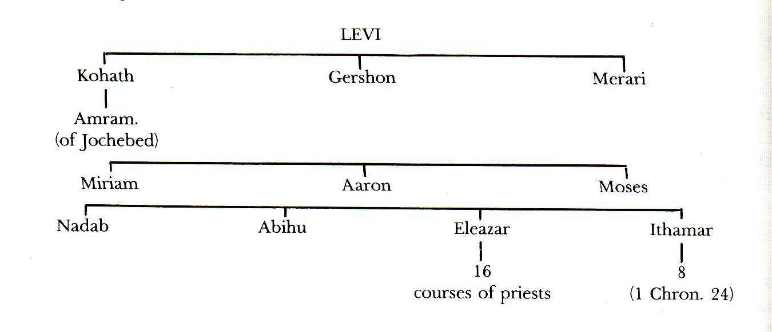

Slide 17
Exodus 6:16-25 Levi
Introduction (16)
Gershonites (17)
Kohathites (18)
Merarites (19)
Kohathite lineage (20-25)

Slide 18
Exodus 6:16-25 Levi
Introduction (16)
Gershonites (17)
Kohathites (18)
Merarites (19)
Kohathite lineage (20-25)

Slide 20
Exodus 6:16-25 Levi
Introduction (16)
Gershonites (17)
Kohathites (18)
Merarites (19)
Kohathite lineage (20-25)

Slide 21
Exodus 6:16-25 Levi
Introduction (16)
Gershonites (17)
Kohathites (18)
Merarites (19)
Kohathite lineage (20-25)

Slide 22
Exodus 6:20-25 Kohathite Lineage
Amram (20)
Izhar (21)
Uzziel (22)
Aaron (23)
Korah (24)
Eleazar (25)

Slide 23
Exodus 6:20-25 Kohathite Lineage
Amram (20)
Izhar (21)
Uzziel (22)
Aaron (23)
Korah (24)
Eleazar (25)

Slide 25
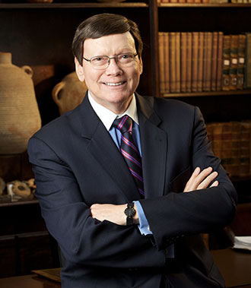
Dr. Ed Hindson
Hindson, E. E., & Mitchell, D. R., eds. (2010). King James Version Bible Commentary for Today: The Most Up-to-Date Commentary on the Time-Honored Text of the King James Version (p. 89). Thomas Nelson.
“Moses’ father, Amram, and mother, Jochebed, who was not only Amram’s wife but also his aunt, are listed. The law against such interfamilial marriage had not yet been given by God at Sinai.”

Slide 26
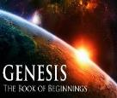
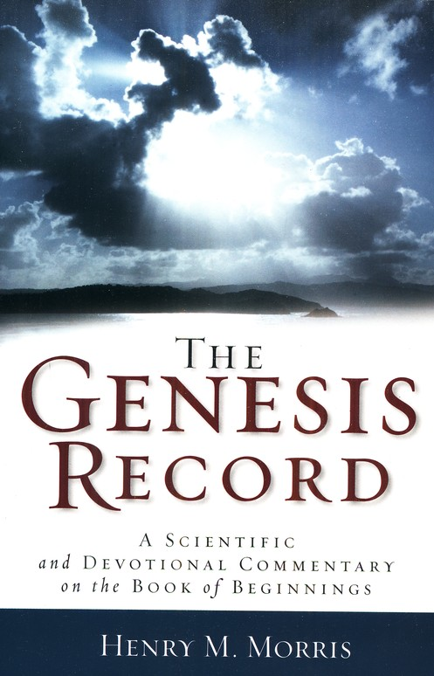
Dr. Henry M. Morris
The Genesis Record, 144
“The ancient quibble about ‘Cain’s wife’ is thus seen to be quite trivial. Long before Cain died, there was a large population in the earth. By the time of the Deluge, 1,656 years after Creation by the Ussher chronology, even using the above conservative assumptions, the world population would have been at least seven billion people!”

Slide 27

Dr. Henry M. Morris
The Genesis Record, 143-44
“In order to get this process of multiplication started, of course, at least one of Adam’s sons had to marry one of Adam’s daughters. Probably, in that first generation, all marriages were brother-sister marriages. In that early time, there were no mutant genes in the genetic systems of any of these children, so that no genetic harm could have resulted from close marriages. Many, many generations later, during the time of Moses, such mutations had accumulated to the point where such unions were genetically dangerous, so that incest was thenceforth prohibited in the Mosaic laws.”

Slide 28
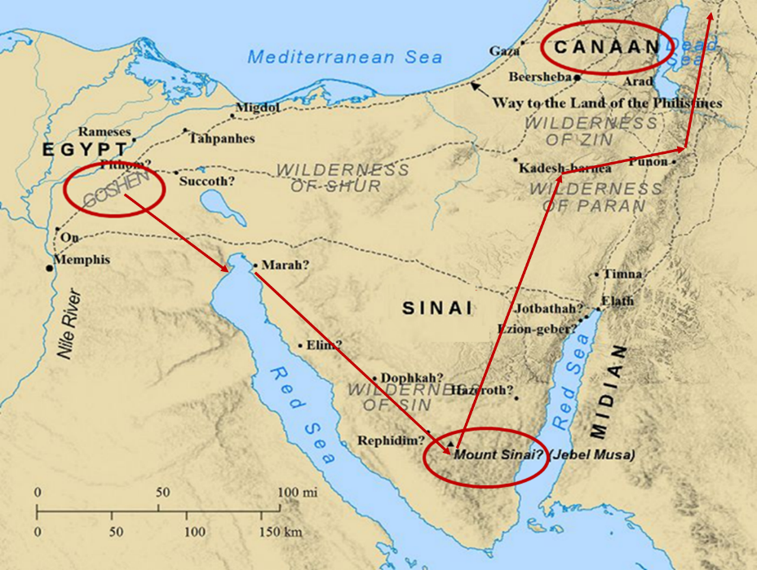

Slide 30
Exodus 6:20-25 Kohathite Lineage
Amram (20)
Izhar (21)
Uzziel (22)
Aaron (23)
Korah (24)
Eleazar (25)

Slide 31
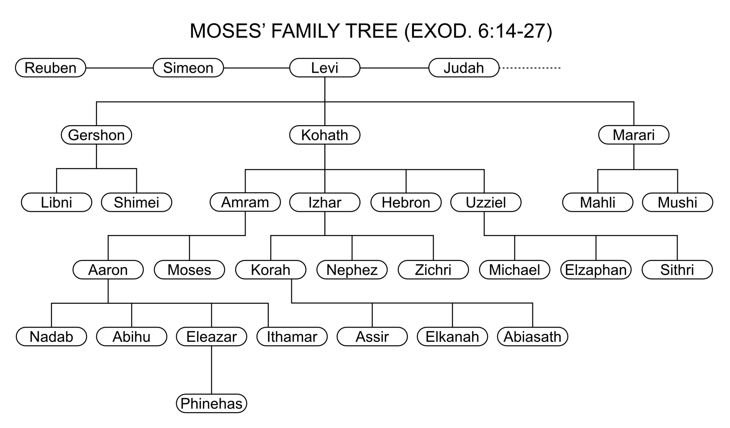

Slide 33
Exodus 6:20-25 Kohathite Lineage
Amram (20)
Izhar (21)
Uzziel (22)
Aaron (23)
Korah (24)
Eleazar (25)

Slide 35
Exodus 6:20-25 Kohathite Lineage
Amram (20)
Izhar (21)
Uzziel (22)
Aaron (23)
Korah (24)
Eleazar (25)

Slide 37
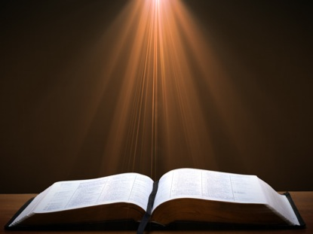
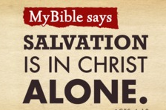
Acts 4:12
“And there is salvation in no one else; for there is no other name under heaven that has been given among men by which we must [dei] be saved.”

Slide 38
Exodus 6:20-25 Kohathite Lineage
Amram (20)
Izhar (21)
Uzziel (22)
Aaron (23)
Korah (24)
Eleazar (25)

Slide 40
Exodus 6:20-25 Kohathite Lineage
Amram (20)
Izhar (21)
Uzziel (22)
Aaron (23)
Korah (24)
Eleazar (25)

Slide 42

Revelation 1:6
“and He has made us to be a kingdom, priests to His God and Father—to Him be the glory and the dominion forever and ever. Amen.”

Slide 43
Revelation 5:10
“You have made them to be a kingdom and priests to our God; and they will reign [basileuō] upon the earth [gē].”

Slide 44
III. Exodus 6:14-27 Moses’ & Aaron’s Levitical heritage
Reuben (14)
Simeon (15)
Levi (16-25)
Genealogy’s purpose (26-27)

Slide 45
GOD REASSURES MOSES Exodus 6:1-30
Divine Reassurance (1-8)
Divine Command (9-13)
Moses’ & Aaron’s Levitical Heritage (14-27)
Conversation continued (28-30)

Slide 46
IV. Exodus 6:28-30 Conversation Continued
Timing (28)
Command (29)
Moses’ excuses (30)

Slide 47
IV. Exodus 6:28-30 Conversation Continued
Timing (28)
Command (29)
Moses’ excuses (30)

Slide 48
IV. Exodus 6:28-30 Conversation Continued
Timing (28)
Command (29)
Moses’ excuses (30)

Slide 49
Exodus 6:29 Command
God’s self identification (29a)
Command given (29b)

Slide 50
Exodus 6:29 Command
God’s self identification (29a)
Command given (29b)

Slide 51
Exodus 6:29 Command
God’s self identification (29a)
Command given (29b)

Slide 52

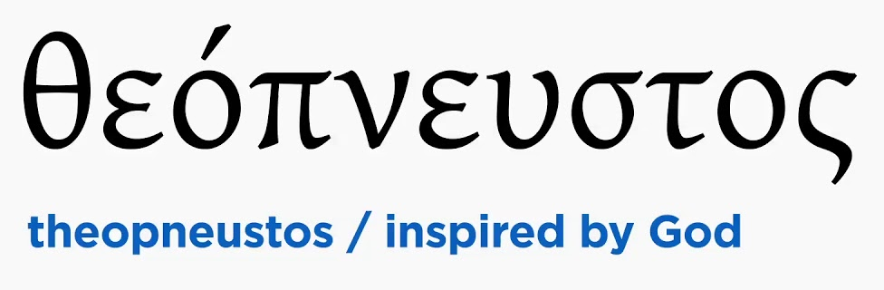
2 Timothy 3:16-17
“All Scripture is inspired by God [theopneustos] and profitable for teaching, for reproof, for correction, for training in righteousness; so that the man of God may be adequate, equipped for every good work.”

Slide 53


Matthew 4:4
“But He answered and said, “It is written, ‘Man shall not live on bread alone, but on every word that proceeds out of the mouth of God.’”

Slide 54

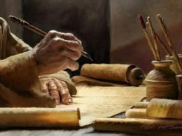
Acts 20:26-27
“²⁶ Therefore, I testify to you this day that I am innocent of the blood of all men. ²⁷ For I did not shrink from declaring to you the whole purpose of God.”

Slide 55
IV. Exodus 6:28-30 Conversation Continued
Timing (28)
Command (29)
Moses’ excuses (30)

Slide 56
Exodus 5:30 Moses’ Excuses
Lack of eloquence (30a)
Pharaoh will not listen (30b)

Slide 57
Exodus 5:30 Moses’ Excuses
Lack of eloquence (30a)
Pharaoh will not listen (30b)

Slide 58
Exodus 5:30 Moses’ Excuses
Lack of eloquence (30a)
Pharaoh will not listen (30b)

Slide 59
Conclusion

Slide 60
GOD REASSURES MOSES Exodus 6:1-30
Divine Reassurance (1-8)
Divine Command (9-13)
Moses’ & Aaron’s Levitical Heritage (14-27)
Conversation continued (28-30)

Slide 61
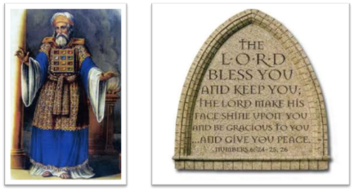
²⁴ The Lord bless you, and keep you; ²⁵ The Lord make His face shine on you, And be gracious to you; ²⁶ The Lord lift up His countenance on you, And give you peace.
Numbers 6:24–26 (NASB95)

