Slide 1
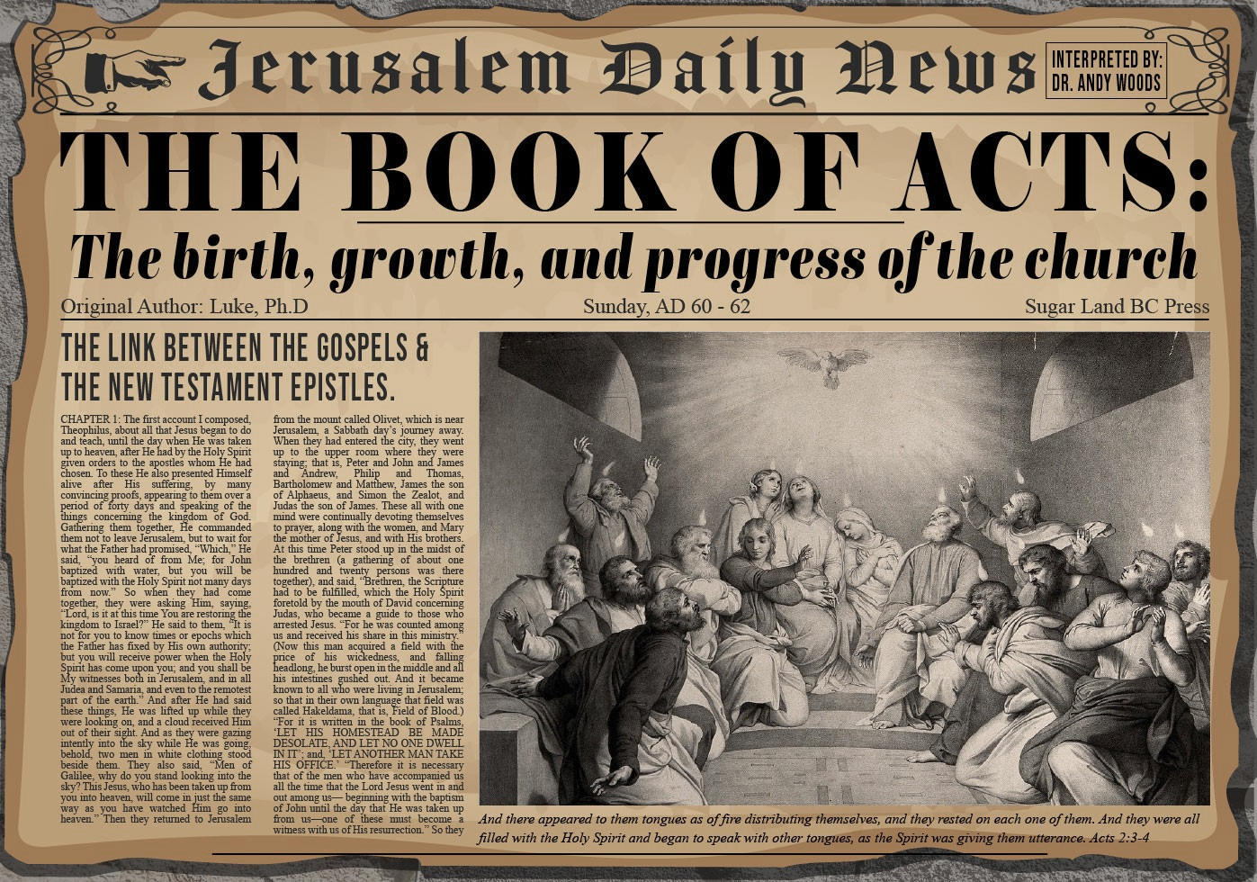


Slide 2

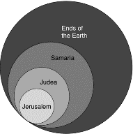
Acts 1:8
“but you will receive power when the Holy Spirit has come upon you; and you shall be My witnesses both in Jerusalem, and in all Judea and Samaria, and even to the remotest part of the earth.”

Slide 3
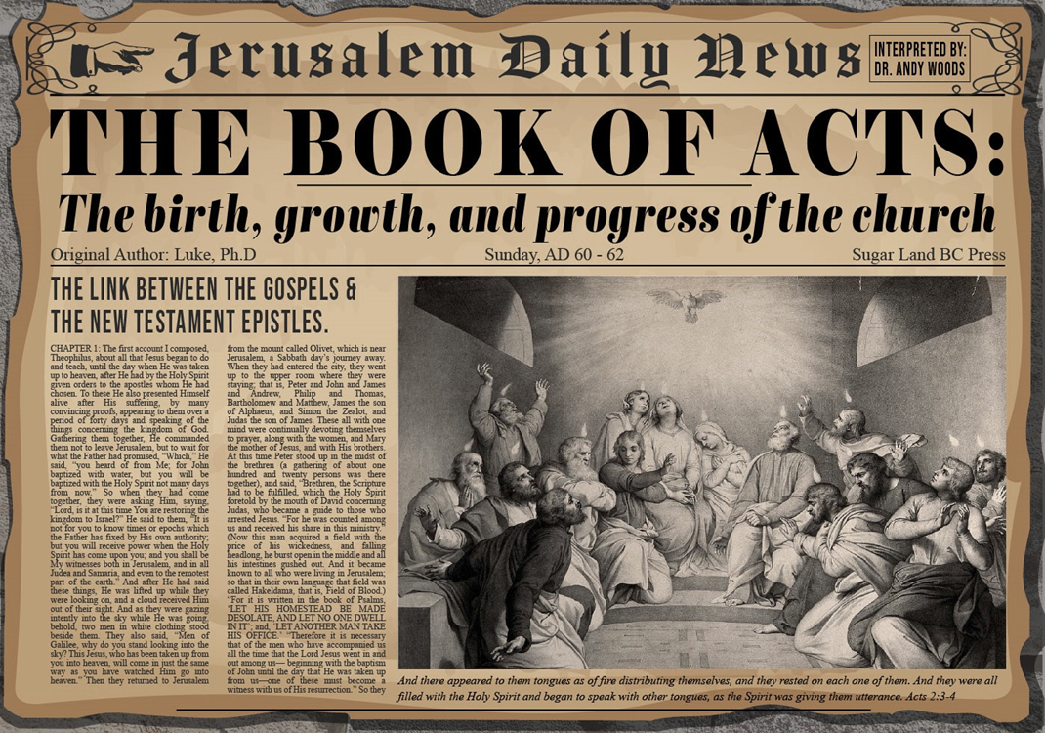
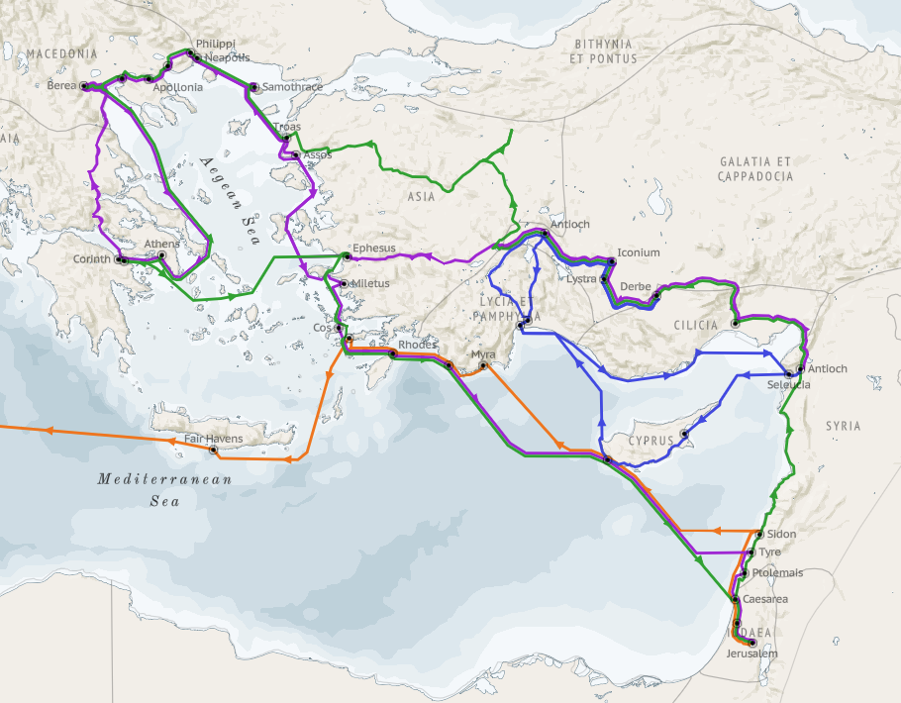
Structure (Acts 1:8)
Jerusalem (Acts 1–7)
Judea and Samaria (Acts 8–12)
Remotest part of the earth (Acts 13–28)
1st missionary journey (Acts 13–14)
Jerusalem council (Acts 15:1-35)
2nd missionary journey (Acts 15:36 –18:22)
3rd missionary journey (Acts 18:23–21:17)
Trip to Rome (Acts 21:18–28:31)

Slide 4
Acts 13‒14 1st Missionary Journey
Paul & Barnabas’ appointment (13:1-3)
Cyprus ministry (13:4-12)
Pisidian Antioch ministry (13:13-52)
Iconium ministry (14:1-7)
Lystra ministry (14:8-20a)
Derbe ministry (14:20b-21a)
Return to Antioch (14:21b-28)

Slide 5
VI. Derbe Ministry Acts 14:20b-21a
Journey to Derbe (20b)
Ministry in Derbe (21a)

Slide 6
VI. Derbe Ministry Acts 14:20b-21a
Journey to Derbe (20b)
Ministry in Derbe (21a)

Slide 7
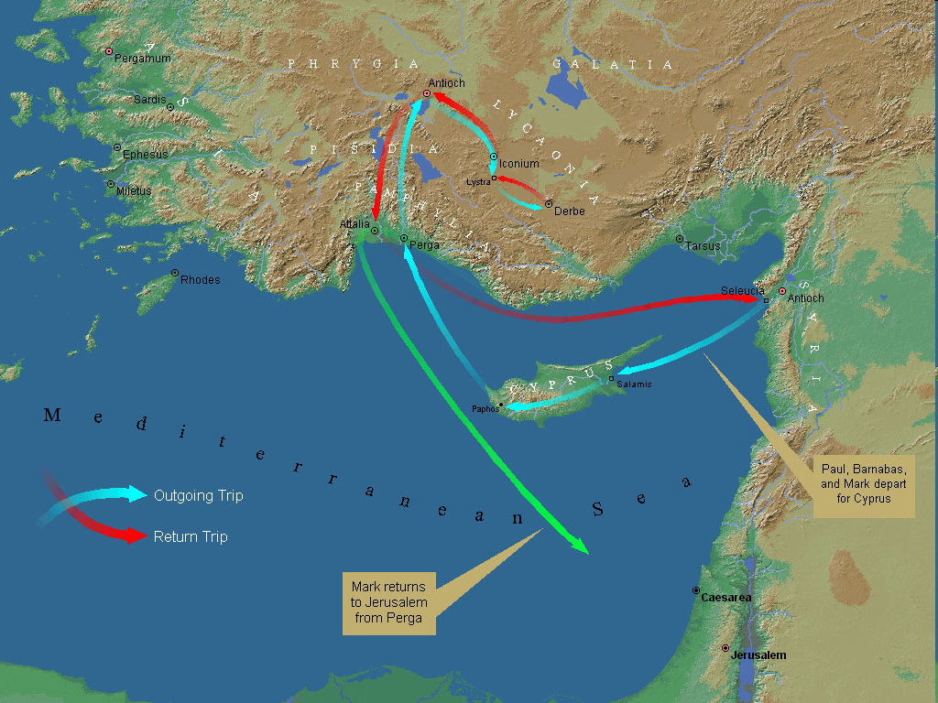
First Missionary Journey

Slide 8
VI. Derbe Ministry Acts 14:20b-21a
Journey to Derbe (20b)
Ministry in Derbe (21a)

Slide 9
Acts 13‒14 1st Missionary Journey
Paul & Barnabas’ appointment (13:1-3)
Cyprus ministry (13:4-12)
Pisidian Antioch ministry (13:13-52)
Iconium ministry (14:1-7)
Lystra ministry (14:8-20a)
Derbe ministry (14:20b-21a)
Return to Antioch (14:21b-28)

Slide 10
VII. Return to Syrian Antioch Acts 14:21b-28
Return route (21b)
Ministries in revisited cities (22-23)
Route to Antioch (24-26)
Report to Antioch Church (27-28)

Slide 11
VII. Return to Syrian Antioch Acts 14:21b-28
Return route (21b)
Ministries in revisited cities (22-23)
Route to Antioch (24-26)
Report to Antioch Church (27-28)

Slide 12

First Missionary Journey

Slide 13
VII. Return to Syrian Antioch Acts 14:21b-28
Return route (21b)
Ministries in revisited cities (22-23)
Route to Antioch (24-26)
Report to Antioch Church (27-28)

Slide 14
Acts 14:22-23 Ministries in revisited cities
Confirmation (22a)
Exhortation (22b)
Appointment of elders (23)

Slide 15
Acts 14:22-23 Ministries in revisited cities
Confirmation (22a)
Exhortation (22b)
Appointment of elders (23)

Slide 16

Ephesians 4:11-16
“¹¹ And He gave some as apostles, and some as prophets, and some as evangelists, and some as pastors and teachers, ¹² for the equipping of the saints for the work of service, to the building up of the body of Christ;”

Slide 17
Ephesians 4:11-16
“¹³ until we all attain to the unity of the faith, and of the knowledge of the Son of God, to a mature man, to the measure of the stature which belongs to the fullness of Christ. ¹⁴ As a result, we are no longer to be children, tossed here and there by waves and carried about by every wind of doctrine, by the trickery of men, by craftiness in deceitful scheming;”

Slide 18
Ephesians 4:11-16
“¹⁵ but speaking the truth in love, we are to grow up in all aspects into Him who is the head, even Christ, ¹⁶ from whom the whole body, being fitted and held together by what every joint supplies, according to the proper working of each individual part, causes the growth of the body for the building up of itself in love.”

Slide 19
Acts 14:22-23 Ministries in revisited cities
Confirmation (22a)
Exhortation (22b)
Appointment of elders (23)

Slide 20
Acts 14:22-23 Ministries in revisited cities
Confirmation (22a)
Exhortation (22b)
Appointment of elders (23)

Slide 21

Local Church Government
Episcopalian / bishop rule – Acts 15:2, 6
Congregational rule – Acts 6:1-7
Presbyterian / elder rule – Acts 20:28; 1 Tim 5:17; 4:14

Slide 22
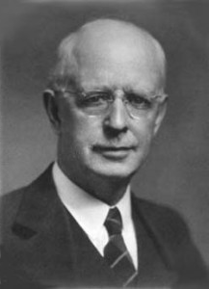
Lewis Sperry Chafer
vol. 7, Systematic Theology (Grand Rapids, MI: Kregel Publications, 1993), 265-66.
“This vital newness of mind is a part of believing, after all, and therefore it may be and is used as a synonym for believing at times (cf. Acts 17:30; 20:21; 26:20; Rom. 2:4; 2Tim. 2:25; 2 Pet. 3:9). Repentance nevertheless cannot be added to believing as a condition of salvation, because upwards of 150 passages of Scripture condition salvation upon believing only (cf. John 3:16; Acts 16:31).”

Slide 23
VII. Return to Syrian Antioch Acts 14:21b-28
Return route (21b)
Ministries in revisited cities (22-23)
Route to Antioch (24-26)
Report to Antioch Church (27-28)

Slide 24
Acts 14:24-26 Route to Antioch
Through Pisidia to Pamphylia (24)
Speaking the Word in Perga (25a)
To Attalia (25b)
To Antioch via boat (26)

Slide 25
Acts 14:24-26 Route to Antioch
Through Pisidia to Pamphylia (24)
Speaking the Word in Perga (25a)
To Attalia (25b)
To Antioch via boat (26)

Slide 26
First Missionary Journey

Slide 27
Acts 14:24-26 Route to Antioch
Through Pisidia to Pamphylia (24)
Speaking the Word in Perga (25a)
To Attalia (25b)
To Antioch via boat (26)

Slide 28
First Missionary Journey

Slide 29
Acts 14:24-26 Route to Antioch
Through Pisidia to Pamphylia (24)
Speaking the Word in Perga (25a)
To Attalia (25b)
To Antioch via boat (26)

Slide 30
First Missionary Journey

Slide 31
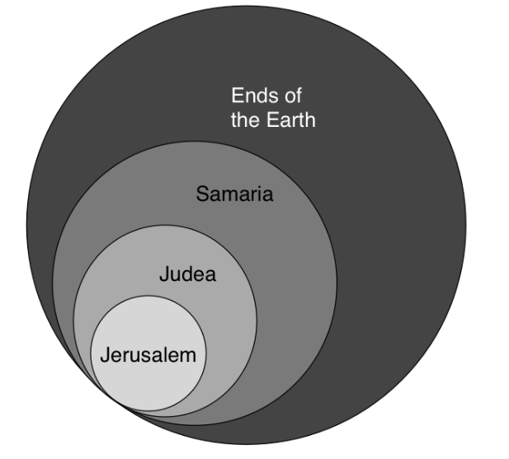
Acts 1:8
“but you will receive power when the Holy Spirit has come upon you; and you shall be My witnesses both in Jerusalem, and in all Judea and Samaria, and even to the remotest part of the earth.”

Slide 32

Acts Message
Birth and growth of the church numerically, geographically, ethnically.
Components
Numerically (progress reports)
Geographically (From Jerusalem to Rome)
Ethnically (From Judaism to Gentile domination)

Slide 33
Acts 14:24-26 Route to Antioch
Through Pisidia to Pamphylia (24)
Speaking the Word in Perga (25a)
To Attalia (25b)
To Antioch via boat (26)

Slide 34
First Missionary Journey

Slide 35
VII. Return to Syrian Antioch Acts 14:21b-28
Return route (21b)
Ministries in revisited cities (22-23)
Route to Antioch (24-26)
Report to Antioch Church (27-28)

Slide 36
Acts 14:27-28 Report to the Antioch Church
Missionary report (27)
Transitional statement (28)

Slide 37
Acts 14:27-28 Report to the Antioch Church
Missionary report (27)
Transitional statement (28)

Slide 38
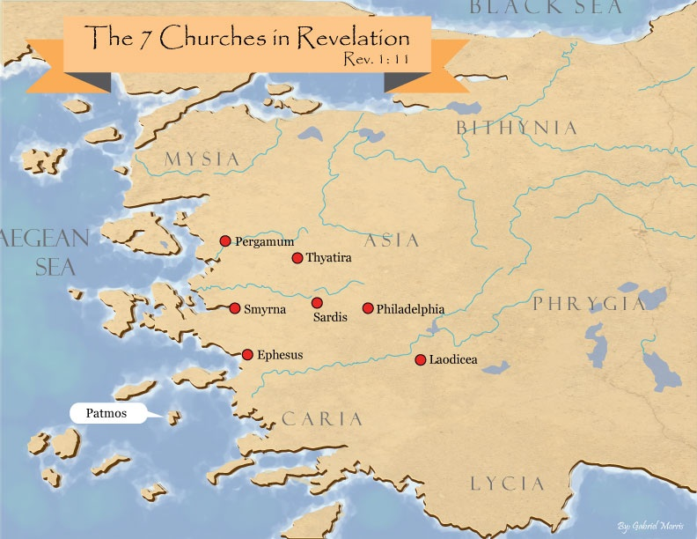
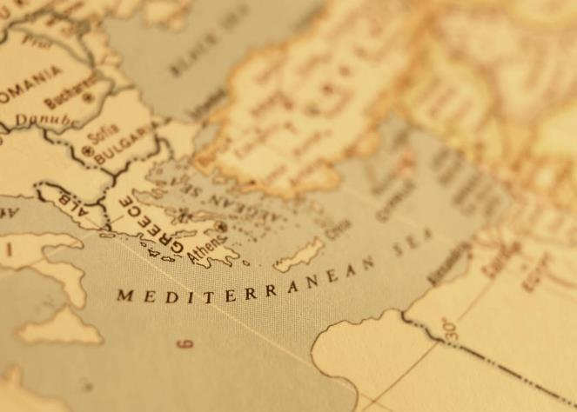

Slide 39
Lewis Sperry Chafer
vol. 7, Systematic Theology (Grand Rapids, MI: Kregel Publications, 1993), 265-66.
“This vital newness of mind is a part of believing, after all, and therefore it may be and is used as a synonym for believing at times (cf. Acts 17:30; 20:21; 26:20; Rom. 2:4; 2Tim. 2:25; 2 Pet. 3:9). Repentance nevertheless cannot be added to believing as a condition of salvation, because upwards of 150 passages of Scripture condition salvation upon believing only (cf. John 3:16; Acts 16:31).”

Slide 40
Acts 14:27-28 Report to the Antioch Church
Missionary report (27)
Transitional statement (28)

Slide 41
Paul’s Ministry Chronology
# OF BOOKS | JOURNEY | ACTS | DATE | BOOKS
1 | 1 | 13–14 | 48–49 | Gal
2 | 2 | 15:36–18:22 | 50–52 | 1–2 Thess
3 | 3 | 18:23–21:17 | 53–57 | 1–2 Cor, Rom
4 | 4 | 28:16-31 | 60–62 | Eph, Col, Phlm, Phlp
2 | Between Imprisonments | Post Acts | 62–66 | 1 Tim, Titus
1 | 2nd Imprisonment | Post Acts | 67 | 2 Tim

Slide 42
ORDER OF PAUL’S LETTERS | ORDER OF PAUL’S LETTERS
1. | Galatians | A.D. 49
2. | 1‒2 Thessalonians | A.D. 51
3. | 1‒2 Corinthians | A.D. 56
4. | Romans | A.D. 57
5. | Ephesians, Colossians, Philemon, Philippians | A.D. 60‒62
6. | 1 Timothy, Titus | A.D. 62‒66
7. | 2 Timothy | A.D. 67

Slide 43
Conclusion

Slide 44
Acts 13‒14 1st Missionary Journey
Paul & Barnabas’ appointment (13:1-3)
Cyprus ministry (13:4-12)
Pisidian Antioch ministry (13:13-52)
Iconium ministry (14:1-7)
Lystra ministry (14:8-20a)
Derbe ministry (14:20b-21a)
Return to Antioch (14:21b-28)

