Slide 1



Slide 2

EXODUS STRUCTURE/OUTLINE
Redemption (1–18)
Redemption (1:1–12:30)
Liberation (12:31–15:21)
Preservation (15:22–18:27)
Mosaic Covenant (19–40)
Law (19–24)
Tabernacle instructions (25–31)
Apostasy (32–34)
Tabernacle building (35–40)

Slide 3
REDEMPTION (1:1–12:30)
Why redemption is necessary (Exod 1)
Development of the deliverer (Exod 2–4)
First confrontation with Pharaoh (Exod 5)
God reassures Moses (Exod 6:1–7:7)
Second confrontation with Pharaoh (Exod 7:8-13)
Plagues (Exod 7:14–12:30)

Slide 4
GOD REASSURES MOSES Exodus 6:1-30
Divine Reassurance (1-8)
Divine Command (9-13)
Moses’ & Aaron’s Levitical Heritage (14-27)
Conversation continued (28-30)

Slide 5
II. Exodus 6:9-13 Divine Command
Israel rejects reassurances (9)
God commands Moses to speak to Pharaoh (10-11)
Moses’ objections (12)
God repeats the command to Moses & Aaron (13)

Slide 6
II. Exodus 6:9-13 Divine Command
Israel rejects reassurances (9)
God commands Moses to speak to Pharaoh (10-11)
Moses’ objections (12)
God repeats the command to Moses & Aaron (13)

Slide 7

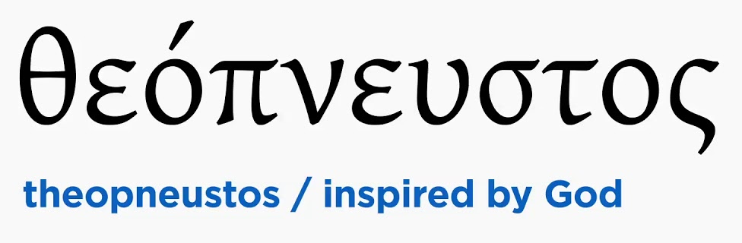
2 Timothy 3:16-17
“All Scripture is inspired by God [theopneustos] and profitable for teaching, for reproof, for correction, for training in righteousness; so that the man of God may be adequate, equipped for every good work.”

Slide 8


Matthew 4:4
“But He answered and said, “It is written, ‘Man shall not live on bread alone, but on every word that proceeds out of the mouth of God.’”

Slide 9


Acts 20:26-27
“²⁶ Therefore, I testify to you this day that I am innocent of the blood of all men. ²⁷ For I did not shrink from declaring to you the whole purpose of God.”

Slide 10

Genesis 6:1-3
“¹ Now it came about, when men began to multiply on the face of the land, and daughters were born to them, ² that the sons of God saw that the daughters of men were beautiful; and they took wives for themselves, whomever they chose. ³ Then the Lord said, “My Spirit shall not strive with man forever, because he also is flesh; nevertheless his days shall be one hundred and twenty years.”

Slide 11
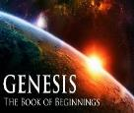
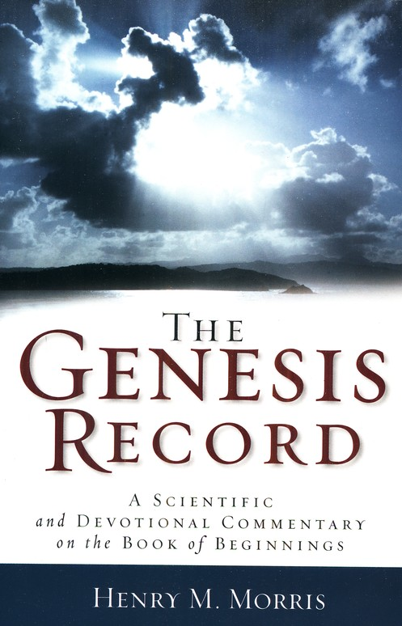
Dr. Henry M. Morris
The Genesis Record, 144
“The ancient quibble about ‘Cain’s wife’ is thus seen to be quite trivial. Long before Cain died, there was a large population in the earth. By the time of the Deluge, 1,656 years after Creation by the Ussher chronology, even using the above conservative assumptions, the world population would have been at least seven billion people!”

Slide 12
II. Exodus 6:9-13 Divine Command
Israel rejects reassurances (9)
God commands Moses to speak to Pharaoh (10-11)
Moses’ objections (12)
God repeats the command to Moses & Aaron (13)

Slide 13
II. Exodus 6:9-13 Divine Command
Israel rejects reassurances (9)
God commands Moses to speak to Pharaoh (10-11)
Moses’ objections (12)
God repeats the command to Moses & Aaron (13)

Slide 14
Exodus 6:12 Moses’ Objections
Israel’s objections (12a)
Lack of eloquence (12b)

Slide 15
Exodus 6:12 Moses’ Objections
Israel’s objections (12a)
Lack of eloquence (12b)

Slide 16
Exodus 6:12 Moses’ Objections
Israel’s objections (12a)
Lack of eloquence (12b)

Slide 17
II. Exodus 6:9-13 Divine Command
Israel rejects reassurances (9)
God commands Moses to speak to Pharaoh (10-11)
Moses’ objections (12)
God repeats the command to Moses & Aaron (13)

Slide 18
Exodus 6:12 God Repeats Command to Moses & Aaron
To Israel (13a)
To Pharaoh (13b)

Slide 19
Exodus 6:12 God Repeats Command to Moses & Aaron
To Israel (13a)
To Pharaoh (13b)

Slide 20
Exodus 6:12 God Repeats Command to Moses & Aaron
To Israel (13a)
To Pharaoh (13b)

Slide 21
GOD REASSURES MOSES Exodus 6:1-30
Divine Reassurance (1-8)
Divine Command (9-13)
Moses’ & Aaron’s Levitical Heritage (14-27)
Conversation continued (28-30)

Slide 22
III. Exodus 6:14-27 Moses’ & Aaron’s Levitical heritage
Reuben (14)
Simeon (15)
Levi (16-25)
Genealogy’s purpose (26-27)

Slide 23
III. Exodus 6:14-27 Moses’ & Aaron’s Levitical heritage
Reuben (14)
Simeon (15)
Levi (16-25)
Genealogy’s purpose (26-27)

Slide 24
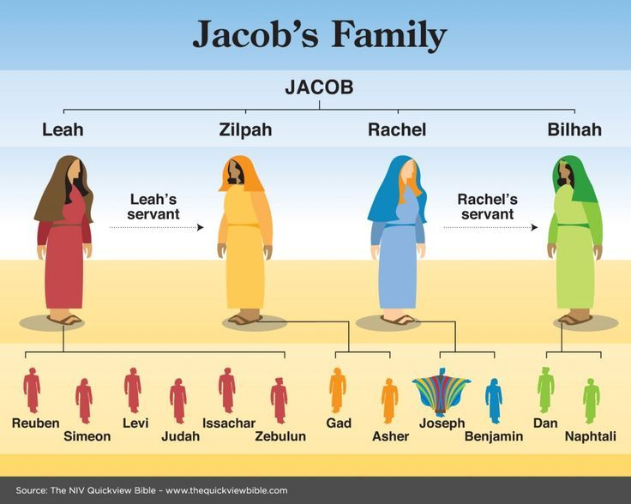

Slide 25
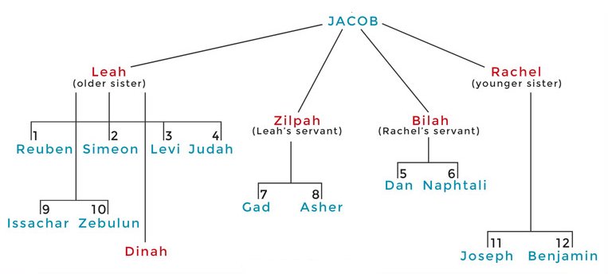

Slide 26
III. Exodus 6:14-27 Moses’ & Aaron’s Levitical heritage
Reuben (14)
Simeon (15)
Levi (16-25)
Genealogy’s purpose (26-27)

Slide 27
III. Exodus 6:14-27 Moses’ & Aaron’s Levitical heritage
Reuben (14)
Simeon (15)
Levi (16-25)
Genealogy’s purpose (26-27)

Slide 28
Exodus 6:16-25 Levi
Introduction (16)
Gershonites (17)
Kohathites (18)
Merarites (19)
Kohathite lineage (20-25)

Slide 29
Exodus 6:16-25 Levi
Introduction (16)
Gershonites (17)
Kohathites (18)
Merarites (19)
Kohathite lineage (20-25)

Slide 30
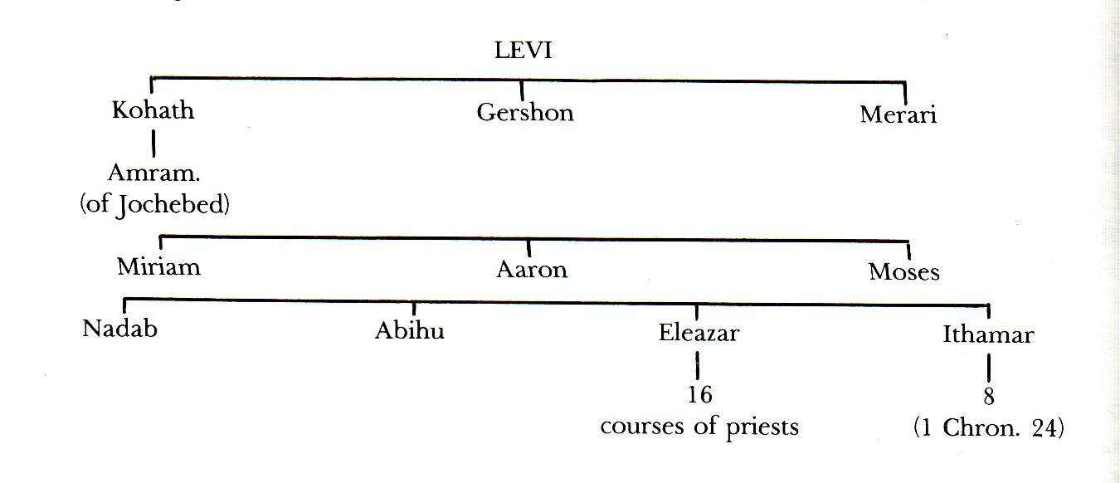

Slide 31
Exodus 6:16-25 Levi
Introduction (16)
Gershonites (17)
Kohathites (18)
Merarites (19)
Kohathite lineage (20-25)

Slide 32
Exodus 6:16-25 Levi
Introduction (16)
Gershonites (17)
Kohathites (18)
Merarites (19)
Kohathite lineage (20-25)

Slide 34
Exodus 6:16-25 Levi
Introduction (16)
Gershonites (17)
Kohathites (18)
Merarites (19)
Kohathite lineage (20-25)

Slide 35
Exodus 6:16-25 Levi
Introduction (16)
Gershonites (17)
Kohathites (18)
Merarites (19)
Kohathite lineage (20-25)

Slide 36
Exodus 6:20-25 Kohathite Lineage
Amram (20)
Izhar (21)
Uzziel (22)
Aaron (23)
Korah (24)
Eleazar (25)

Slide 37
Exodus 6:20-25 Kohathite Lineage
Amram (20)
Izhar (21)
Uzziel (22)
Aaron (23)
Korah (24)
Eleazar (25)

Slide 39
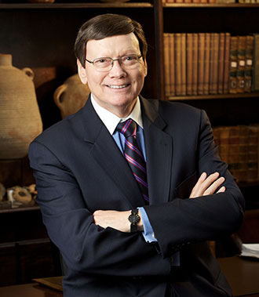
Dr. Ed Hindson
Hindson, E. E., & Mitchell, D. R., eds. (2010). King James Version Bible Commentary for Today: The Most Up-to-Date Commentary on the Time-Honored Text of the King James Version (p. 89). Thomas Nelson.
“Moses’ father, Amram, and mother, Jochebed, who was not only Amram’s wife but also his aunt, are listed. The law against such interfamilial marriage had not yet been given by God at Sinai.”

Slide 40
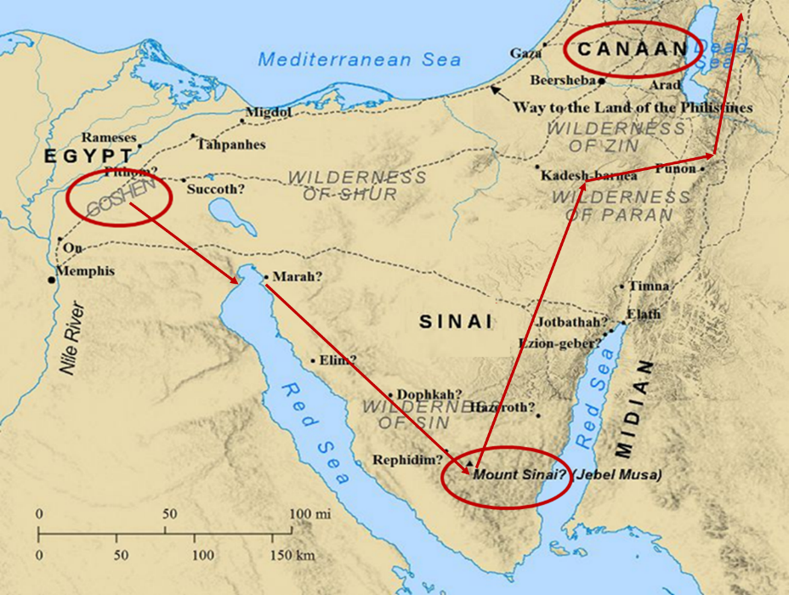

Slide 41
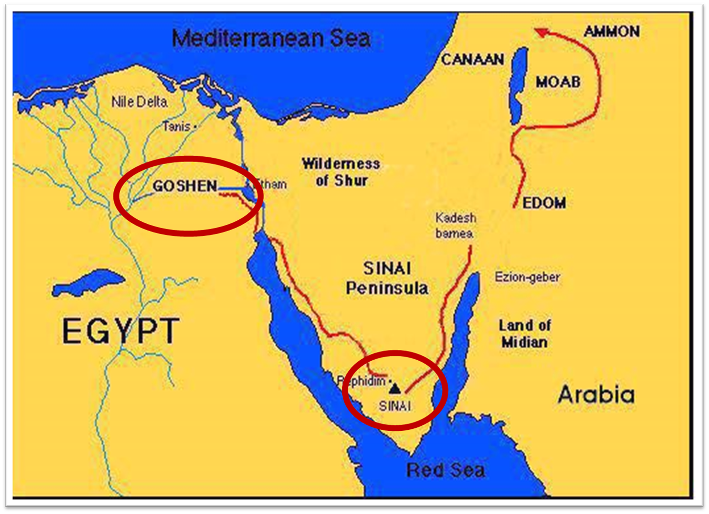

Slide 42
Exodus 6:20-25 Kohathite Lineage
Amram (20)
Izhar (21)
Uzziel (22)
Aaron (23)
Korah (24)
Eleazar (25)

Slide 43
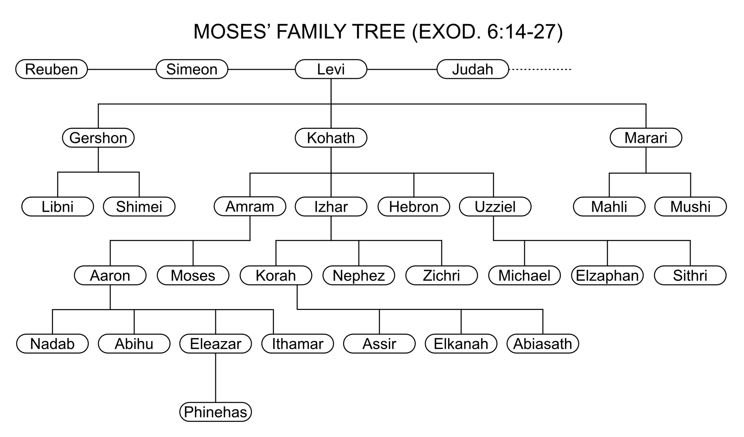

Slide 44
Exodus 6:20-25 Kohathite Lineage
Amram (20)
Izhar (21)
Uzziel (22)
Aaron (23)
Korah (24)
Eleazar (25)

Slide 46
Exodus 6:20-25 Kohathite Lineage
Amram (20)
Izhar (21)
Uzziel (22)
Aaron (23)
Korah (24)
Eleazar (25)

Slide 48
Exodus 6:20-25 Kohathite Lineage
Amram (20)
Izhar (21)
Uzziel (22)
Aaron (23)
Korah (24)
Eleazar (25)

Slide 50
Exodus 6:20-25 Kohathite Lineage
Amram (20)
Izhar (21)
Uzziel (22)
Aaron (23)
Korah (24)
Eleazar (25)

Slide 52


Revelation 1:6
“and He has made us to be a kingdom, priests to His God and Father—to Him be the glory and the dominion forever and ever. Amen.”

Slide 53
Revelation 5:10
“You have made them to be a kingdom and priests to our God; and they will reign [basileuō] upon the earth [gē].”

Slide 54
III. Exodus 6:14-27 Moses’ & Aaron’s Levitical heritage
Reuben (14)
Simeon (15)
Levi (16-25)
Genealogy’s purpose (26-27)

Slide 55
GOD REASSURES MOSES Exodus 6:1-30
Divine Reassurance (1-8)
Divine Command (9-13)
Moses’ & Aaron’s Levitical Heritage (14-27)
Conversation continued (28-30)

Slide 56
IV. Exodus 6:28-30 Conversation Continued
Timing (28)
Command (29)
Moses’ excuses (30)

Slide 57
IV. Exodus 6:28-30 Conversation Continued
Timing (28)
Command (29)
Moses’ excuses (30)

Slide 58
IV. Exodus 6:28-30 Conversation Continued
Timing (28)
Command (29)
Moses’ excuses (30)

Slide 59
Exodus 6:29 Command
God’s self identification (29a)
Command given (29b)

Slide 60
Exodus 6:29 Command
God’s self identification (29a)
Command given (29b)

Slide 61
Exodus 6:29 Command
God’s self identification (29a)
Command given (29b)

Slide 62
2 Timothy 3:16-17
“All Scripture is inspired by God [theopneustos] and profitable for teaching, for reproof, for correction, for training in righteousness; so that the man of God may be adequate, equipped for every good work.”

Slide 63
Matthew 4:4
“But He answered and said, “It is written, ‘Man shall not live on bread alone, but on every word that proceeds out of the mouth of God.’”

Slide 64
Acts 20:26-27
“²⁶ Therefore, I testify to you this day that I am innocent of the blood of all men. ²⁷ For I did not shrink from declaring to you the whole purpose of God.”

Slide 65
IV. Exodus 6:28-30 Conversation Continued
Timing (28)
Command (29)
Moses’ excuses (30)

Slide 66
Exodus 5:30 Moses’ Excuses
Lack of eloquence (30a)
Pharaoh will not listen (30b)

Slide 67
Exodus 5:30 Moses’ Excuses
Lack of eloquence (30a)
Pharaoh will not listen (30b)

Slide 68
Exodus 5:30 Moses’ Excuses
Lack of eloquence (30a)
Pharaoh will not listen (30b)

Slide 69
Conclusion

Slide 70
GOD REASSURES MOSES Exodus 6:1-30
Divine Reassurance (1-8)
Divine Command (9-13)
Moses’ & Aaron’s Levitical Heritage (14-27)
Conversation continued (28-30)

Slide 71
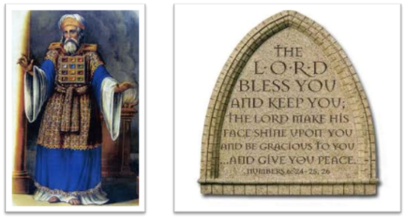
²⁴ The Lord bless you, and keep you; ²⁵ The Lord make His face shine on you, And be gracious to you; ²⁶ The Lord lift up His countenance on you, And give you peace.
Numbers 6:24–26 (NASB95)

