Slide 1
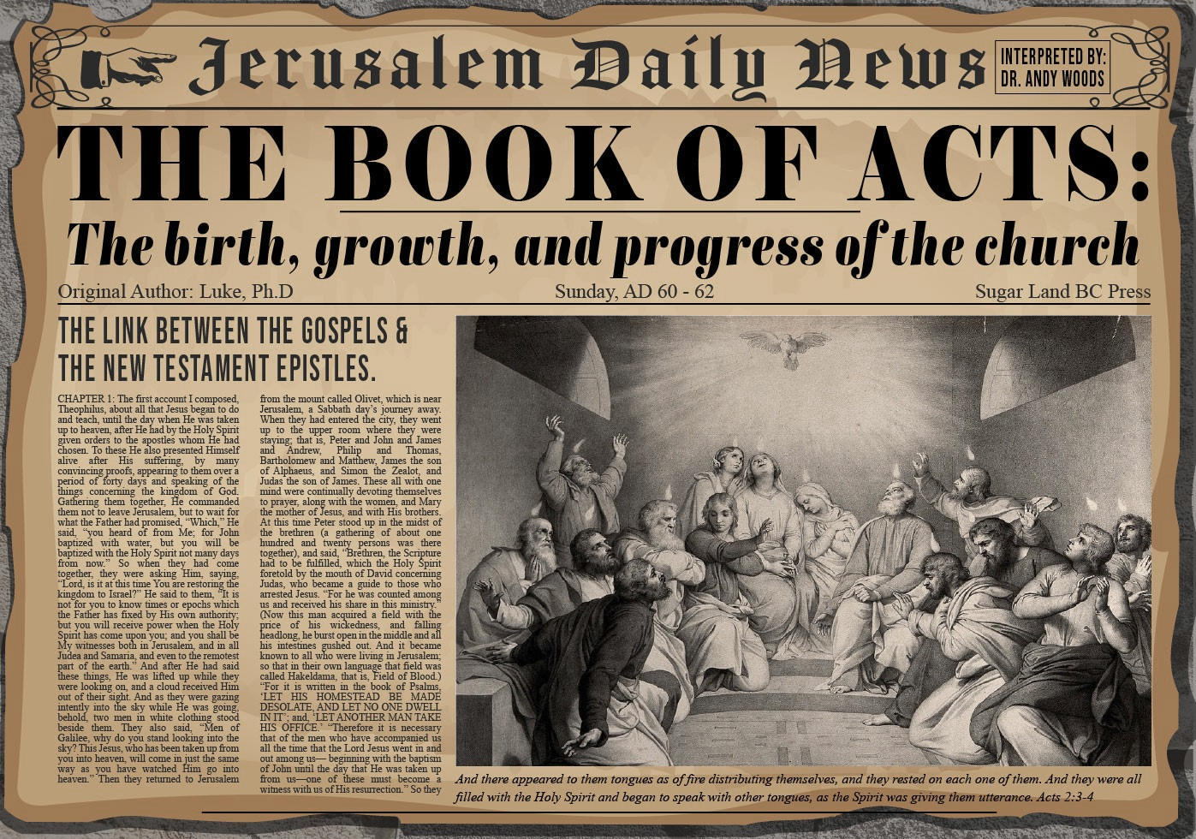


Slide 2

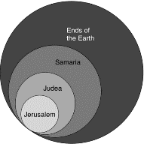
Acts 1:8
“but you will receive power when the Holy Spirit has come upon you; and you shall be My witnesses both in Jerusalem, and in all Judea and Samaria, and even to the remotest part of the earth.”

Slide 3
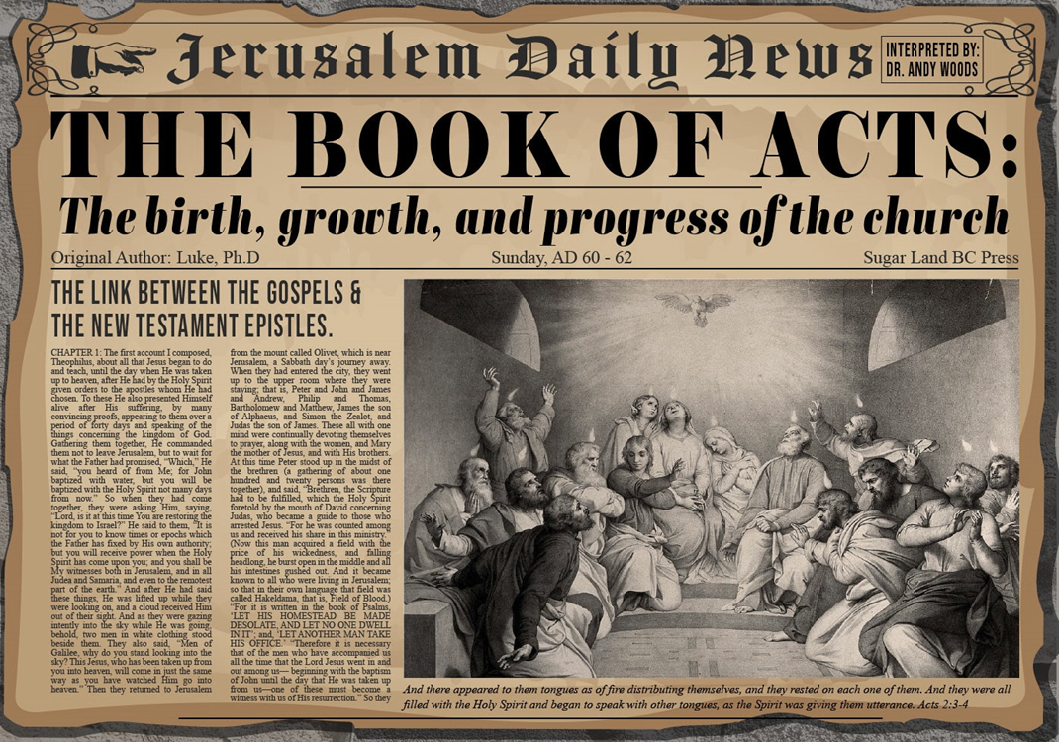
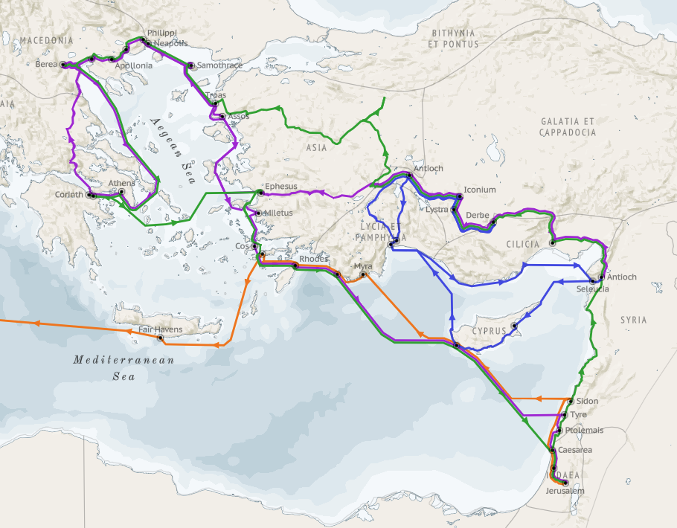
Structure (Acts 1:8)
Jerusalem (Acts 1–7)
Judea and Samaria (Acts 8–12)
Remotest part of the earth (Acts 13–28)
1st missionary journey (Acts 13–14)
Jerusalem council (Acts 15:1-35)
2nd missionary journey (Acts 15:36 –18:22)
3rd missionary journey (Acts 18:23–21:17)
Trip to Rome (Acts 21:18–28:31)

Slide 4
Acts 13‒14 1st Missionary Journey
Paul & Barnabas’ appointment (13:1-3)
Cyprus ministry (13:4-12)
Pisidian Antioch ministry (13:13-52)
Iconium ministry (14:1-7)
Lystra ministry (14:8-20a)
Derbe ministry (14:20b-21a)
Return to Antioch (14:21b-28)

Slide 5
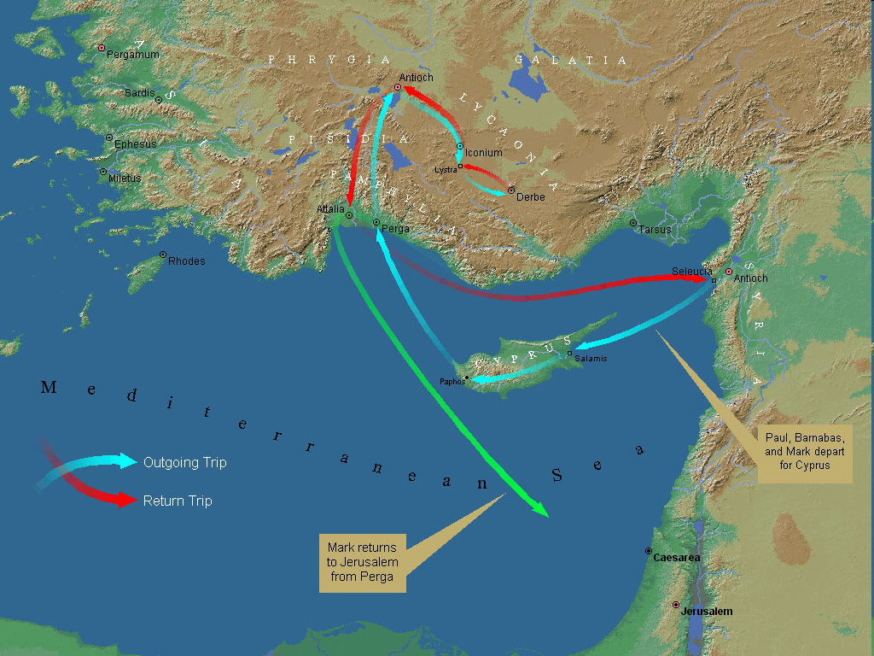
First Missionary Journey

Slide 6
V. Lystra Ministry Acts 14:8-20a
Healing (8-10)
Misidentification (11-13)
Apostolic reaction (14)
Apostolic message (15-17)
Reaction to the message (18-20a)

Slide 7
Acts 14:15-17 Apostolic Reaction
Question of deniability (15a)
Mere men & servants (15b)
Call to repentance (15c)
God’s attributes (15d-17)

Slide 8
Acts 13:15d-17 God’s Attributes
Living (15d)
Creator (15e)
Patient (16)
Revealer (17a)
Good (17b)

Slide 9

Genesis 6:1-4
“¹ Now it came about, when men began to multiply on the face of the land, and daughters were born to them, ² that the sons of God saw that the daughters of men were beautiful; and they took wives for themselves, whomever they chose. ³ Then the Lord said, ‘My Spirit shall not strive with man forever, because he also is flesh; nevertheless his days shall be one hundred and twenty years.’ ⁴ The Nephilim were on the earth in those days, and also afterward, when the sons of God came in to the daughters of men, and they bore children to them. Those were the mighty men who were of old, men of renown.”

Slide 10


2 Peter 3:9
“The Lord is not slow about His promise, as some count slowness, but is patient toward you, not wishing for any to perish but for all to come to repentance.”

Slide 11
Acts 13:15d-17 God’s Attributes
Living (15d)
Creator (15e)
Patient (16)
Revealer (17a)
Good (17b)

Slide 12

General vs. Special Revelation
 | General | Special
Examples | Nature, conscience (Rom 1–2) | Incarnation, Scripture, miracles
Availability | All | Some
Accomplishment | Accountability (Rom 1) | Salvation (Acts 4:12; 2 Tim 3:15)
Form | Non-written or non-verbal | Written
Quality | Natural | Supernatural, miraculous

Slide 13

Romans 1:18–20
¹⁸ For the wrath of God is revealed from heaven against all ungodliness and unrighteousness of men who suppress the truth in unrighteousness, ¹⁹ because that which is known about God is evident within them; for God made it evident to them. ²⁰ For since the creation of the world His invisible attributes, His eternal power and divine nature, have been clearly seen, being understood through what has been made, so that they are without excuse.

Slide 14
Acts 13:15d-17 God’s Attributes
Living (15d)
Creator (15e)
Patient (16)
Revealer (17a)
Good (17b)

Slide 15
V. Lystra Ministry Acts 14:8-20a
Healing (8-10)
Misidentification (11-13)
Apostolic reaction (14)
Apostolic message (15-17)
Reaction to the message (18-20a)

Slide 16
Acts 14:18-20a Reaction to the Message
Apostolic restraining (18)
Jewish opposition (19)
Miraculous recovery (20a)

Slide 17
Acts 14:18-20a Reaction to the Message
Apostolic restraining (18)
Jewish opposition (19)
Miraculous recovery (20a)

Slide 18
Acts 14:18-20a Reaction to the Message
Apostolic restraining (18)
Jewish opposition (19)
Miraculous recovery (20a)

Slide 19
First Missionary Journey

Slide 20
Acts 14:18-20a Reaction to the Message
Apostolic restraining (18)
Jewish opposition (19)
Miraculous recovery (20a)

Slide 21

2 Peter 1:5-7
⁵ “Now for this very reason also, applying all diligence, in your faith supply moral excellence, and in your moral excellence, knowledge, ⁶ and in your knowledge, self-control, and in your self-control, perseverance, and in your perseverance, godliness, ⁷ and in your godliness, brotherly kindness, and in your brotherly kindness, love.”

Slide 22
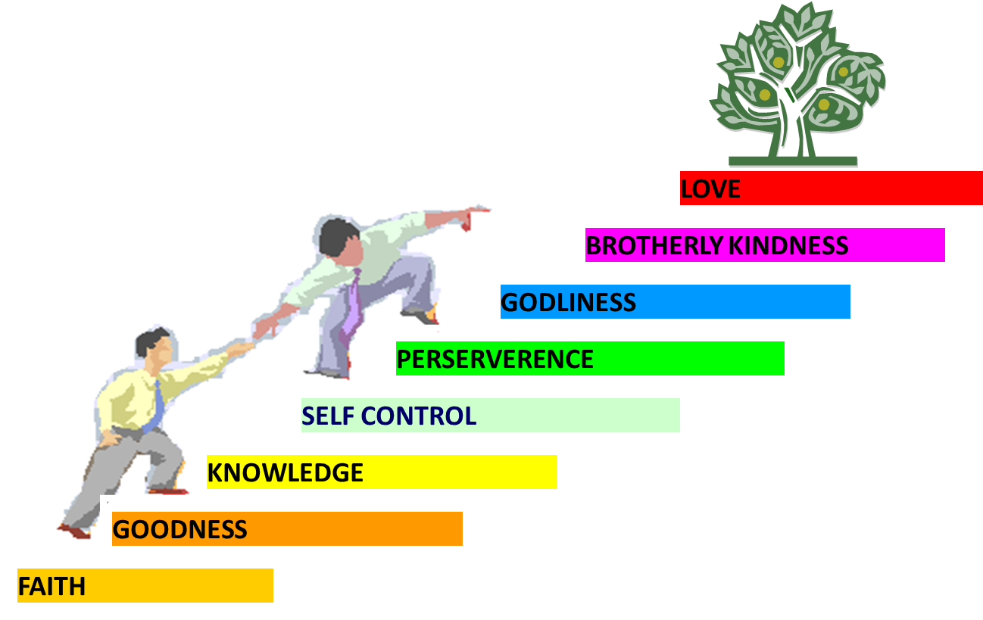
PORTRAIT OF GROWTH 1:5-7

Slide 23
Acts 13‒14 1st Missionary Journey
Paul & Barnabas’ appointment (13:1-3)
Cyprus ministry (13:4-12)
Pisidian Antioch ministry (13:13-52)
Iconium ministry (14:1-7)
Lystra ministry (14:8-20a)
Derbe ministry (14:20b-21a)
Return to Antioch (14:21b-28)

Slide 24
VI. Derbe Ministry Acts 14:20b-21a
Journey to Derbe (20b)
Ministry in Derbe (21a)

Slide 25
VI. Derbe Ministry Acts 14:20b-21a
Journey to Derbe (20b)
Ministry in Derbe (21a)

Slide 26
First Missionary Journey

Slide 27
VI. Derbe Ministry Acts 14:20b-21a
Journey to Derbe (20b)
Ministry in Derbe (21a)

Slide 28
Acts 13‒14 1st Missionary Journey
Paul & Barnabas’ appointment (13:1-3)
Cyprus ministry (13:4-12)
Pisidian Antioch ministry (13:13-52)
Iconium ministry (14:1-7)
Lystra ministry (14:8-20a)
Derbe ministry (14:20b-21a)
Return to Antioch (14:21b-28)

Slide 29
VII. Return to Syrian Antioch Acts 14:21b-28
Return route (21b)
Ministries in revisited cities (22-23)
Route to Antioch (24-26)
Report to Antioch Church (27-28)

Slide 30
VII. Return to Syrian Antioch Acts 14:21b-28
Return route (21b)
Ministries in revisited cities (22-23)
Route to Antioch (24-26)
Report to Antioch Church (27-28)

Slide 31

First Missionary Journey

Slide 32
VII. Return to Syrian Antioch Acts 14:21b-28
Return route (21b)
Ministries in revisited cities (22-23)
Route to Antioch (24-26)
Report to Antioch Church (27-28)

Slide 33
Acts 14:22-23 Ministries in revisited cities
Confirmation (22a)
Exhortation (22b)
Appointment of elders (23)

Slide 34
Acts 14:22-23 Ministries in revisited cities
Confirmation (22a)
Exhortation (22b)
Appointment of elders (23)

Slide 35
Acts 14:22-23 Ministries in revisited cities
Confirmation (22a)
Exhortation (22b)
Appointment of elders (23)

Slide 36
Acts 14:22-23 Ministries in revisited cities
Confirmation (22a)
Exhortation (22b)
Appointment of elders (23)

Slide 37

Local Church Government
Episcopalian / bishop rule – Acts 15:2, 6
Congregational rule – Acts 6:1-7
Presbyterian / elder rule – Acts 20:28; 1 Tim 5:17; 4:14

Slide 38
VII. Return to Syrian Antioch Acts 14:21b-28
Return route (21b)
Ministries in revisited cities (22-23)
Route to Antioch (24-26)
Report to Antioch Church (27-28)

Slide 39
Acts 14:24-26 Route to Antioch
Through Pisidia to Pamphylia (24)
Speaking the Word in Perga (25a)
To Attalia (25b)
To Antioch via boat (26)

Slide 40
Acts 14:24-26 Route to Antioch
Through Pisidia to Pamphylia (24)
Speaking the Word in Perga (25a)
To Attalia (25b)
To Antioch via boat (26)

Slide 41
First Missionary Journey

Slide 42
Acts 14:24-26 Route to Antioch
Through Pisidia to Pamphylia (24)
Speaking the Word in Perga (25a)
To Attalia (25b)
To Antioch via boat (26)

Slide 43
First Missionary Journey

Slide 44
Acts 14:24-26 Route to Antioch
Through Pisidia to Pamphylia (24)
Speaking the Word in Perga (25a)
To Attalia (25b)
To Antioch via boat (26)

Slide 45
First Missionary Journey

Slide 46
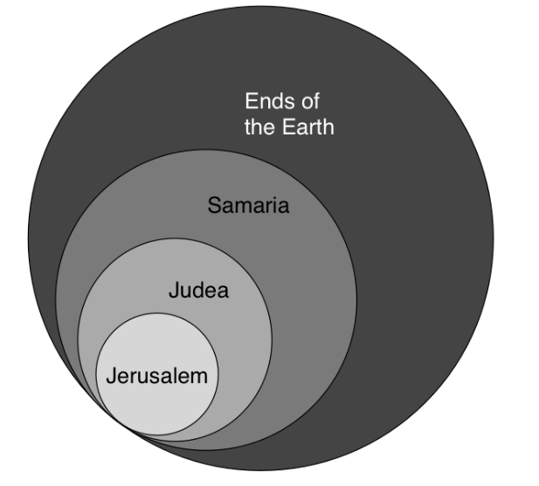
Acts 1:8
“but you will receive power when the Holy Spirit has come upon you; and you shall be My witnesses both in Jerusalem, and in all Judea and Samaria, and even to the remotest part of the earth.”

Slide 47

Acts Message
Birth and growth of the church numerically, geographically, ethnically.
Components
Numerically (progress reports)
Geographically (From Jerusalem to Rome)
Ethnically (From Judaism to Gentile domination)

Slide 48
Acts 14:24-26 Route to Antioch
Through Pisidia to Pamphylia (24)
Speaking the Word in Perga (25a)
To Attalia (25b)
To Antioch via boat (26)

Slide 49
First Missionary Journey

Slide 50
VII. Return to Syrian Antioch Acts 14:21b-28
Return route (21b)
Ministries in revisited cities (22-23)
Route to Antioch (24-26)
Report to Antioch Church (27-28)

Slide 51
Acts 14:27-28 Report to the Antioch Church
Missionary report (27)
Transitional statement (28)

Slide 52
Acts 14:27-28 Report to the Antioch Church
Missionary report (27)
Transitional statement (28)

Slide 53
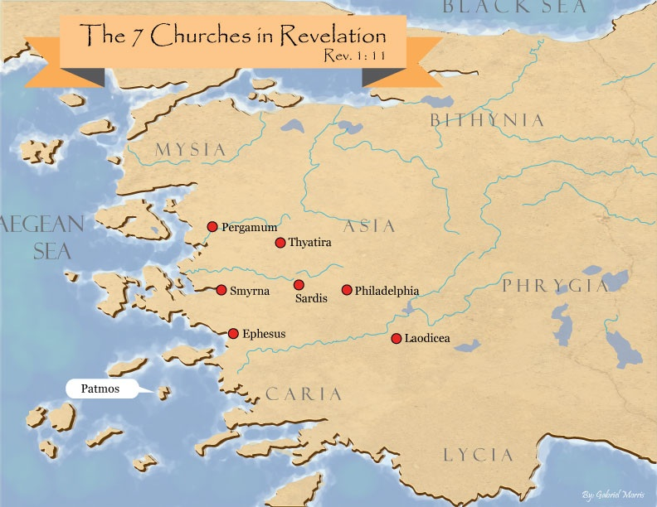
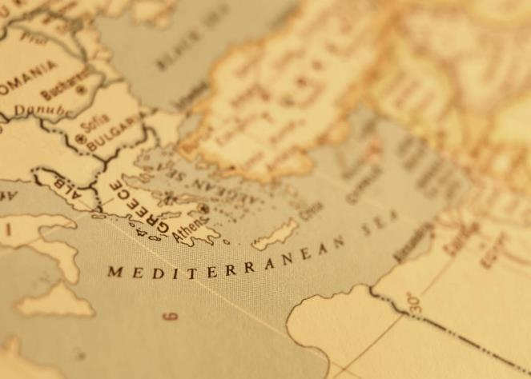

Slide 54
Acts 14:27-28 Report to the Antioch Church
Missionary report (27)
Transitional statement (28)

Slide 55
Paul’s Ministry Chronology
# OF BOOKS | JOURNEY | ACTS | DATE | BOOKS
1 | 1 | 13–14 | 48–49 | Gal
2 | 2 | 15:36–18:22 | 50–52 | 1–2 Thess
3 | 3 | 18:23–21:17 | 53–57 | 1–2 Cor, Rom
4 | 4 | 28:16-31 | 60–62 | Eph, Col, Phlm, Phlp
2 | Between Imprisonments | Post Acts | 62–66 | 1 Tim, Titus
1 | 2nd Imprisonment | Post Acts | 67 | 2 Tim

Slide 56
ORDER OF PAUL’S LETTERS | ORDER OF PAUL’S LETTERS
1. | Galatians | A.D. 49
2. | 1‒2 Thessalonians | A.D. 51
3. | 1‒2 Corinthians | A.D. 56
4. | Romans | A.D. 57
5. | Ephesians, Colossians, Philemon, Philippians | A.D. 60‒62
6. | 1 Timothy, Titus | A.D. 62‒66
7. | 2 Timothy | A.D. 67

Slide 57
Conclusion

Slide 58
Acts 13‒14 1st Missionary Journey
Paul & Barnabas’ appointment (13:1-3)
Cyprus ministry (13:4-12)
Pisidian Antioch ministry (13:13-52)
Iconium ministry (14:1-7)
Lystra ministry (14:8-20a)
Derbe ministry (14:20b-21a)
Return to Antioch (14:21b-28)

