Slide 1



Slide 2

EXODUS STRUCTURE/OUTLINE
Redemption (1–18)
Redemption (1:1–12:30)
Liberation (12:31–15:21)
Preservation (15:22–18:27)
Mosaic Covenant (19–40)
Law (19–24)
Tabernacle instructions (25–31)
Apostasy (32–34)
Tabernacle building (35–40)

Slide 3
REDEMPTION (1:1–12:30)
Why redemption is necessary (Exod 1)
Development of the deliverer (Exod 2–4)
First confrontation with Pharaoh (Exod 5)
God reassures Moses (Exod 6:1–7:7)
Second confrontation with Pharaoh (Exod 7:8-13)
Plagues (Exod 7:14–12:30)

Slide 4
GOD REASSURES MOSES Exodus 6:1-30
Divine Reassurance (1-8)
Divine Command (9-13)
Moses’ & Aaron’s Levitical Heritage (14-27)
Conversation continued (28-30)

Slide 5
GOD REASSURES MOSES Exodus 6:1-30
Divine Reassurance (1-8)
Divine Command (9-13)
Moses’ & Aaron’s Levitical Heritage (14-27)
Conversation continued (28-30)

Slide 6
I. Exodus 6:1-8 Divine Reassurance
Divine compulsion (1)
Divine promises (2-8)

Slide 7
I. Exodus 6:1-8 Divine Reassurance
Divine compulsion (1)
Divine promises (2-8)

Slide 8

Charles Ryrie Ryrie Study Bible, page 96
Exodus 4:21 - “harden his heart. Ten times it is said that Pharaoh hardened his own heart (7:13, 14, 22; 8:15, 19, 32; 9:7, 34, 35; 13:15), and 10 times that God hardened Pharaoh’s heart (4:21; 7:3; 9:12; 10:1, 20, 27; 11:10; 14:4, 8, 17). Paul uses this as an example of the inscrutable will of God and of His mercy toward men (Rom. 9:14–18). Seven times Pharaoh hardened his own heart before God first hardened it, though the prediction that God would do it preceded all.”

Slide 9
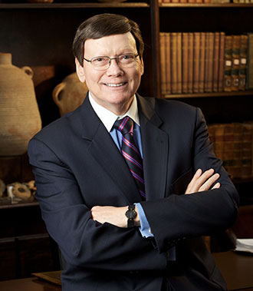
Dr. Ed Hindson
Hindson, E. E., & Mitchell, D. R., eds. (2010). King James Version Bible Commentary for Today: The Most Up-to-Date Commentary on the Time-Honored Text of the King James Version (p. 86). Thomas Nelson.
“4:21. I will harden his heart. An expression meaning ‘to strengthen his will.’ The text identifies the heart as the location of the volition, man’s decision-making ability. On seven occasions in the narrative, God hardens Pharaoh’s heart (9:12; 10:1, 20, 27; 11:10; 14:4, 8) or foretells that He will harden Pharaoh’s heart (4:21; 7:3), and nine times in the text, Pharaoh hardens his own heart (7:13, 14, 22; 8:15, 19, 32; 9:7, 34–35). For the initial five plagues, the text registers Pharaoh as the agent of hardening. Not until the sixth plague does God participate in the confirmation of Pharaoh’s own volitional choices.”

Slide 10
I. Exodus 6:1-8 Divine Reassurance
Divine compulsion (1)
Divine promises (2-8)

Slide 11
Exodus 6:2-8 Divine Promises
Introduction: I am the Lord (2)
Patriarchal enhancement (3)
Three divine declarations (4-5)
Seven related promises (6-8b)
Conclusion: I am the Lord (8c)

Slide 12
Exodus 6:2-8 Divine Promises
Introduction: I am the Lord (2)
Patriarchal enhancement (3)
Three divine declarations (4-5)
Seven related promises (6-8b)
Conclusion: I am the Lord (8c)

Slide 13
Exodus 6:2-8 Divine Promises
Introduction: I am the Lord (2)
Patriarchal enhancement (3)
Three divine declarations (4-5)
Seven related promises (6-8b)
Conclusion: I am the Lord (8c)

Slide 14
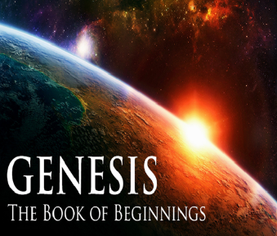
Names for God in Genesis
Elohim (1:1) – Power
Yahweh (2:4) – Relational
El Roi (Gen. 16:13) – Aware
El Shaddai (Gen. 17:1) – Almighty
El Olam (21:33) – Eternal
Jehovah Jireh (22:14) – Provision
God Isaac Feared (31:42, 53) – Reverenced
God, the God of Israel (33:20) – National

Slide 15
Dr. Ed Hindson
Hindson, E. E., & Mitchell, D. R., eds. (2010). King James Version Bible Commentary for Today: The Most Up-to-Date Commentary on the Time-Honored Text of the King James Version (p. 88). Thomas Nelson.
“Although they were well aware of God’s sole personal name…it would have been impossible for the patriarchs to have experienced the Lord in the way He was now revealing Himself. The patriarchs knew the Lord as the architect of the Abrahamic covenant and the guarantor of its promises. They had not lived long enough to witness those promises brought to fruition, as Moses’ generation would soon have the privilege to realize. God was about to reveal much more of Himself and His power to the patriarch’s descendants than the patriarchs themselves had ever experienced.”

Slide 16
Exodus 6:2-8 Divine Promises
Introduction: I am the Lord (2)
Patriarchal enhancement (3)
Three divine declarations (4-5)
Seven related promises (6-8b)
Conclusion: I am the Lord (8c)

Slide 17
Exodus 6:4-5 Three Divine Declarations
I have established: covenant (4)
I have heard: groaning (5a)
I have remembered: covenant (5b)

Slide 18
Exodus 6:4-5 Three Divine Declarations
I have established: covenant (4)
I have heard: groaning (5a)
I have remembered: covenant (5b)

Slide 19
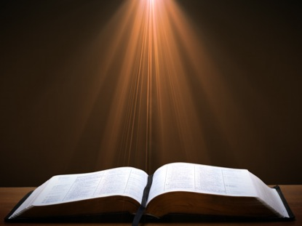
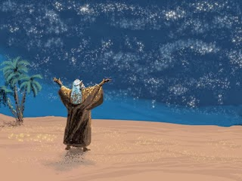
Genesis 15:18
“On that day the Lord made a covenant with Abram, saying, ‘To your descendants I have given this land, From the river of Egypt as far as the great river, the river Euphrates:”

Slide 20

Evidence of Abrahamic Covenant’s Unconditional Nature
ANE covenant ratification ceremony (Gen 15)
Lack of stated conditions for Israel’s obedience (Gen 15)
Covenant's eternality (Gen 17:7, 13, 19; Ps. 90:2)
Covenant's immutability (Heb 6:13-18; Mal. 3:6)
Trans-generational reaffirmation despite perpetual national disobedience (Jer 31:35-37)
Walvoord, The Millennial Kingdom, 149-52

Slide 21

Land Promises Fulfilled in the Time of Joshua (Josh. 11:23; 21:43-45) or Solomon (1 Kgs. 4:21)?
Extended context (Josh 13:1-7; Judges 1:19, 21, 27, 29, 30-36)
Land gained in conquest was only a fraction of what was promised (1 Kgs. 4:25)
Jerusalem not conquered in Joshua’s day (Josh 15:63; 2 Sam 5)
Solomon’s reign extended to the border of Egypt (1 Kgs. 4:21) and not the River of Egypt (Gen. 15:18)
Solomon’s reign was tributary only (1 Kgs. 4:21)
Forever? (Gen 17:7-8, 13, 19)
Reaffirmation of land promises long after Joshua and Solomon’s time (Amos 9:11-15)
Fruchtenbaum, Israelology, 521-22, 631-32

Slide 22
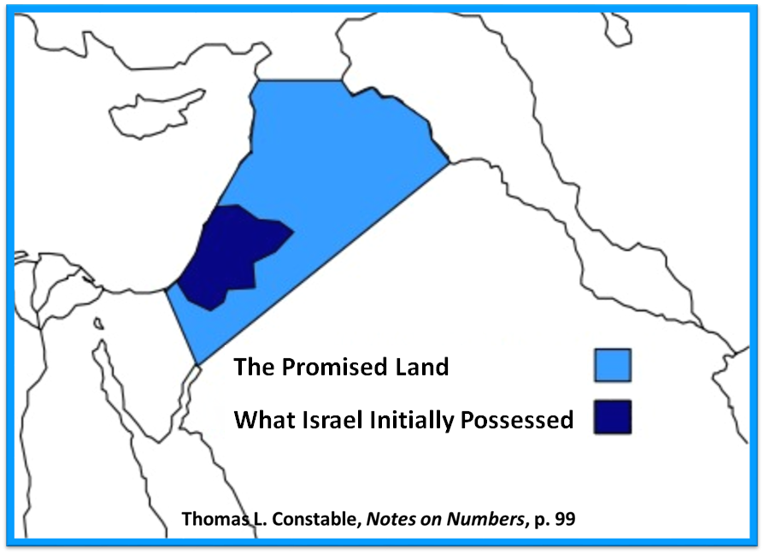

Slide 23
Exodus 6:4-5 Three Divine Declarations
I have established: covenant (4)
I have heard: groaning (5a)
I have remembered: covenant (5b)

Slide 24
Exodus 6:4-5 Three Divine Declarations
I have established: covenant (4)
I have heard: groaning (5a)
I have remembered: covenant (5b)

Slide 25

Exodus 2:24
“So God heard their groaning; and God remembered His covenant with Abraham, Isaac, and Jacob.”

Slide 26
Ezekiel 36:22
“Therefore, say to the house of Israel, ‘This is what the Lord God says: “It is not for your sake, house of Israel, that I am about to act, but for My holy name, which you have profaned among the nations where you went.”

Slide 27
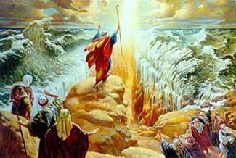
IMPORTANCE
God’s promises & covenant to Israel remain literal, reliable, unconditional, and unfulfilled (Gen. 23)
Basis of God’s intervention in history (Gen. 15:14-16; Exod. 2:24)
God must once again move His hand in history to fulfill His Word (Ezek. 36:22)
Forms the expectation of a future earthly kingdom

Slide 28
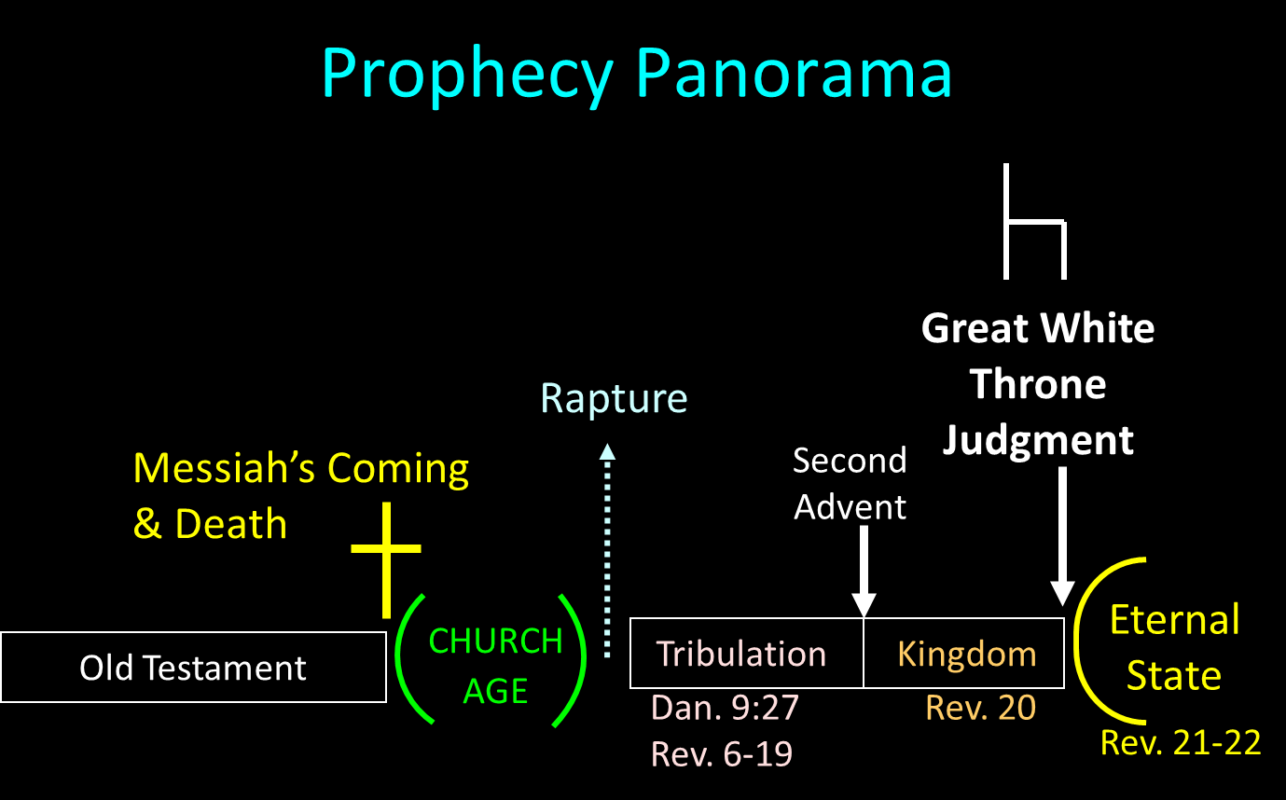

Slide 29
Exodus 6:2-8 Divine Promises
Introduction: I am the Lord (2)
Patriarchal enhancement (3)
Three divine declarations (4-5)
Seven related promises (6-8b)
Conclusion: I am the Lord (8c)

Slide 30
8 New Promises Genesis 12:1-3
Land (Gen. 12:1b)
Great nation (Gen. 12:2a)
Personal blessing (Gen. 12:2b)
Great name (Gen. 12:2c)
Blessing to others (Gen. 12:2d)
Blessing to blessers (Gen. 12:3a)
Cursing to cursers (Gen. 12:3b)
Blessing to the world (Gen. 12:3c)

Slide 31
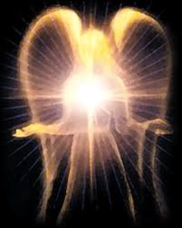
Satan’s Original State
Isaiah 14:12-15
5 “I will” statements
Ascend to heaven (13)
Raise my throne above the stars of God (13)
Sit enthroned on the Mt. of the Assembly (13)
Ascend above the tops of the clouds (14)
Make myself like the Most High (14)

Slide 32
Exodus 6:6-8b Seven Related Promises
Out of Egyptian burdens (6a)
Deliverance from slavery (6b)
Redeem you by power (6c)
Make you my people (7a)
Be your God (7b)
Bring you to your land (8a)
Give you your land inheritance (8b)

Slide 33
Exodus 6:6-8b Seven Related Promises
Out of Egyptian burdens (6a)
Deliverance from slavery (6b)
Redeem you by power (6c)
Make you my people (7a)
Be your God (7b)
Bring you to your land (8a)
Give you your land inheritance (8b)

Slide 34
Exodus 6:6-8b Seven Related Promises
Out of Egyptian burdens (6a)
Deliverance from slavery (6b)
Redeem you by power (6c)
Make you my people (7a)
Be your God (7b)
Bring you to your land (8a)
Give you your land inheritance (8b)

Slide 35
Exodus 6:6-8b Seven Related Promises
Out of Egyptian burdens (6a)
Deliverance from slavery (6b)
Redeem you by power (6c)
Make you my people (7a)
Be your God (7b)
Bring you to your land (8a)
Give you your land inheritance (8b)

Slide 36
The Plagues of Egypt
NO. | DESCRIPTION | SCRIPTURE | Egyptian Deity
1. | Water to Blood | Exod. 7:14-25 | Hapi, Khnum
2. | Frogs | Exod. 8:1-15 | Heqt
3. | Gnats | Exod. 8:16-19 | Set
4. | Flies | Exod. 8:20-32 | Uatchit
5. | Disease on Cattle | Exod. 9:1-7 | Hathor, Apis
6. | Boils | Exod. 9:8-12 | Sekhmet, Serapis
7. | Hail | Exod. 9:13-35 | Seth, Nut
8. | Locusts | Exod. 10:1-20 | Seth, Nut, Osiris
9. | Darkness | Exod. 10:21-29 | Re, Horus, Atum
10. | Death of the First Born | Exod. 12:29-36 | Min, Osiris, Heqt, Isis

Slide 37
Exodus 6:6-8b Seven Related Promises
Out of Egyptian burdens (6a)
Deliverance from slavery (6b)
Redeem you by power (6c)
Make you my people (7a)
Be your God (7b)
Bring you to your land (8a)
Give you your land inheritance (8b)

Slide 38
Exodus 6:6-8b Seven Related Promises
Out of Egyptian burdens (6a)
Deliverance from slavery (6b)
Redeem you by power (6c)
Make you my people (7a)
Be your God (7b)
Bring you to your land (8a)
Give you your land inheritance (8b)

Slide 39
Names for God in Genesis
Elohim (1:1) – Power
Yahweh (2:4) – Relational
El Roi (Gen. 16:13) – Aware
El Shaddai (Gen. 17:1) – Almighty
El Olam (21:33) – Eternal
Jehovah Jireh (22:14) – Provision
God Isaac Feared (31:42, 53) – Reverenced
God, the God of Israel (33:20) – National

Slide 40
Exodus 6:6-8b Seven Related Promises
Out of Egyptian burdens (6a)
Deliverance from slavery (6b)
Redeem you by power (6c)
Make you my people (7a)
Be your God (7b)
Bring you to your land (8a)
Give you your land inheritance (8b)

Slide 41
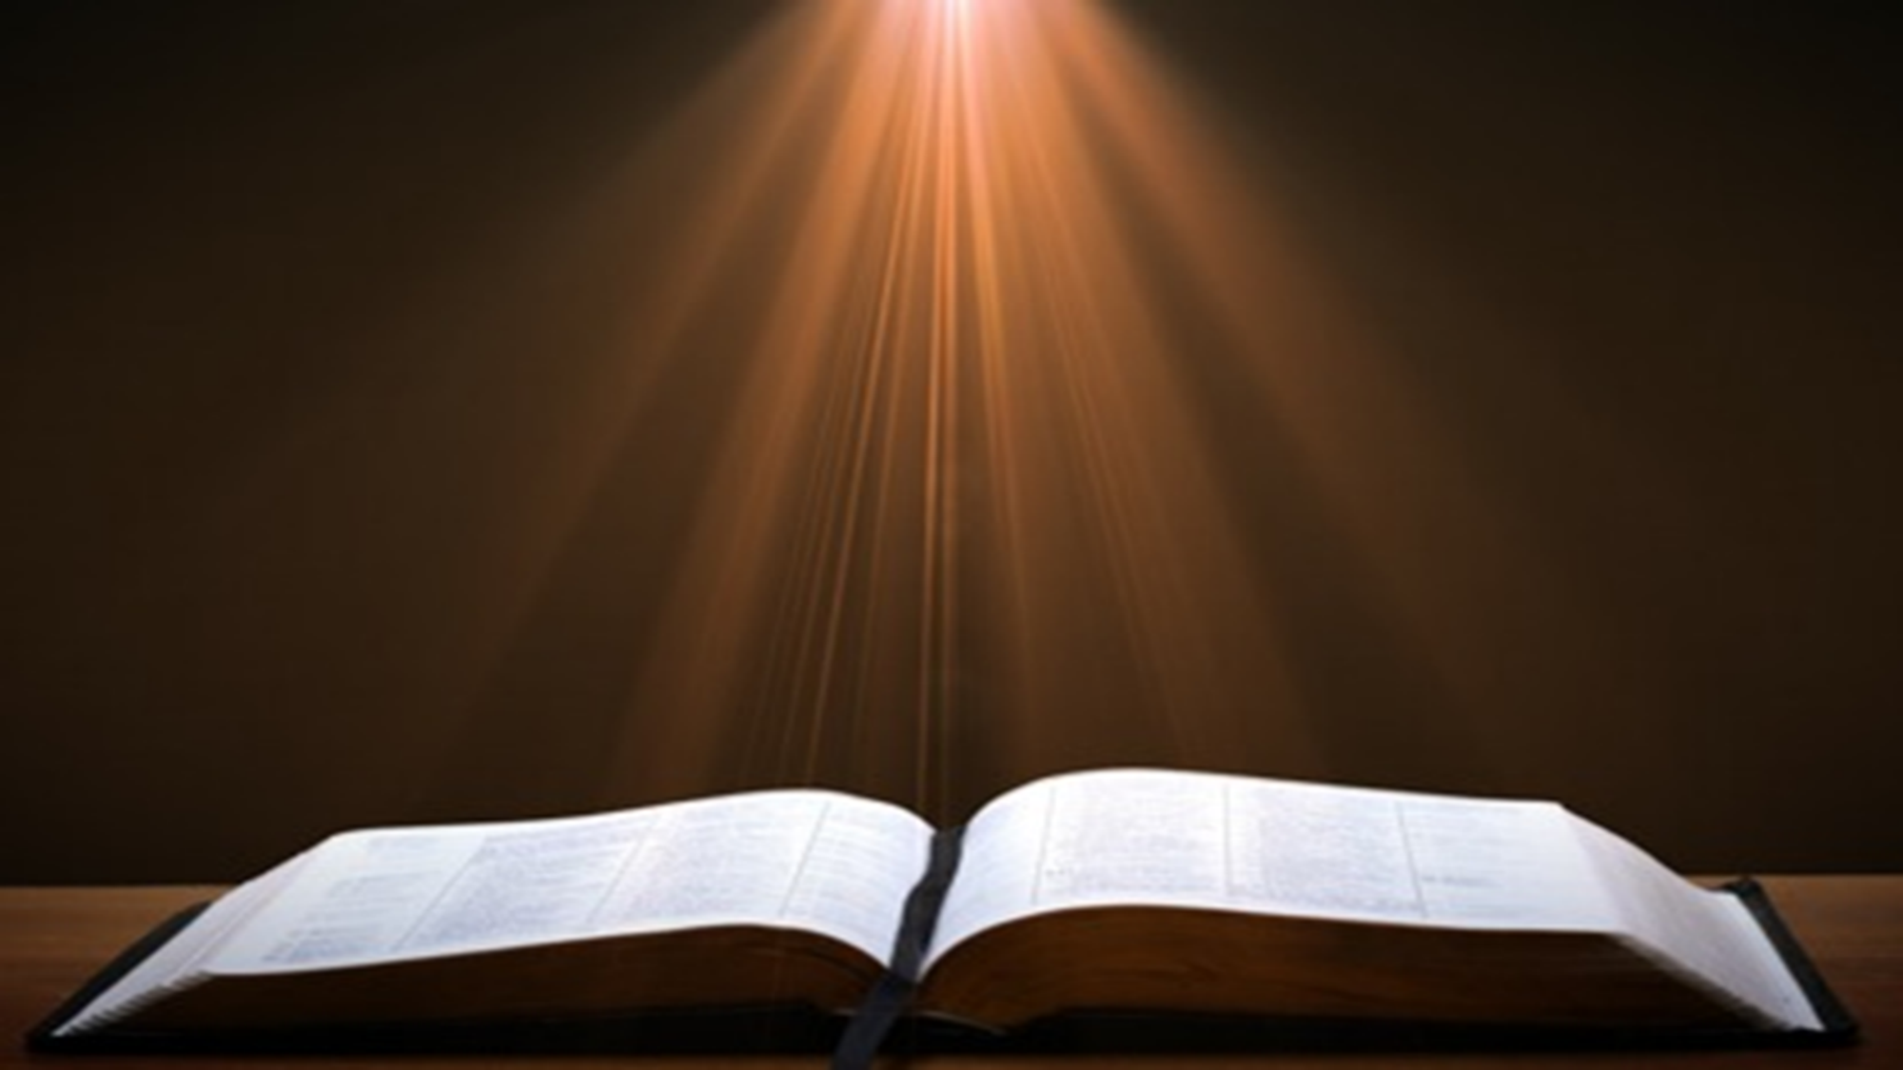
Genesis 15:18-21
¹⁸ On that day the Lord made a covenant with Abram, saying, “To your descendants I have given this land, From the river of Egypt as far as the great river, the river Euphrates: ¹⁹ the Kenite and the Kenizzite and the Kadmonite ²⁰ and the Hittite and the Perizzite and the Rephaim ²¹ and the Amorite and the Canaanite and the Girgashite and the Jebusite.”

Slide 43

Joel 3:2
I will gather all the nations And bring them down to the valley of Jehoshaphat. Then I will enter into judgment with them there On behalf of My people and My inheritance, Israel, Whom they have scattered among the nations; And they have divided up My land.

Slide 44
Exodus 6:6-8b Seven Related Promises
Out of Egyptian burdens (6a)
Deliverance from slavery (6b)
Redeem you by power (6c)
Make you my people (7a)
Be your God (7b)
Bring you to your land (8a)
Give you your land inheritance (8b)

Slide 45
Evidence of Abrahamic Covenant’s Unconditional Nature
ANE covenant ratification ceremony (Gen 15)
Lack of stated conditions for Israel’s obedience (Gen 15)
Covenant's eternality (Gen 17:7, 13, 19; Ps. 90:2)
Covenant's immutability (Heb 6:13-18; Mal. 3:6)
Trans-generational reaffirmation despite perpetual national disobedience (Jer 31:35-37)
Walvoord, The Millennial Kingdom, 149-52

Slide 46
Land Promises Fulfilled in the Time of Joshua (Josh. 11:23; 21:43-45) or Solomon (1 Kgs. 4:21)?
Extended context (Josh 13:1-7; Judges 1:19, 21, 27, 29, 30-36)
Land gained in conquest was only a fraction of what was promised (1 Kgs. 4:25)
Jerusalem not conquered in Joshua’s day (Josh 15:63; 2 Sam 5)
Solomon’s reign extended to the border of Egypt (1 Kgs. 4:21) and not the River of Egypt (Gen. 15:18)
Solomon’s reign was tributary only (1 Kgs. 4:21)
Forever? (Gen 17:7-8, 13, 19)
Reaffirmation of land promises long after Joshua and Solomon’s time (Amos 9:11-15)
Fruchtenbaum, Israelology, 521-22, 631-32

Slide 48
Exodus 6:2-8 Divine Promises
Introduction: I am the Lord (2)
Patriarchal enhancement (3)
Three divine declarations (4-5)
Seven related promises (6-8b)
Conclusion: I am the Lord (8c)

Slide 49
GOD REASSURES MOSES Exodus 6:1-30
Divine Reassurance (1-8)
Divine Command (9-13)
Moses’ & Aaron’s Levitical Heritage (14-27)
Conversation continued (28-30)

Slide 50
II. Exodus 6:9-13 Divine Command
Israel rejects reassurances (9)
God commands Moses to speak to Pharaoh (10-11)
Moses’ objections (12)
God repeats the command to Moses & Aaron (13)

Slide 51
II. Exodus 6:9-13 Divine Command
Israel rejects reassurances (9)
God commands Moses to speak to Pharaoh (10-11)
Moses’ objections (12)
God repeats the command to Moses & Aaron (13)

Slide 52

Genesis 6:1-3
“¹ Now it came about, when men began to multiply on the face of the land, and daughters were born to them, ² that the sons of God saw that the daughters of men were beautiful; and they took wives for themselves, whomever they chose. ³ Then the Lord said, “My Spirit shall not strive with man forever, because he also is flesh; nevertheless his days shall be one hundred and twenty years.”

Slide 53


Dr. Henry M. Morris
The Genesis Record, 144
“The ancient quibble about ‘Cain’s wife’ is thus seen to be quite trivial. Long before Cain died, there was a large population in the earth. By the time of the Deluge, 1,656 years after Creation by the Ussher chronology, even using the above conservative assumptions, the world population would have been at least seven billion people!”

Slide 54
II. Exodus 6:9-13 Divine Command
Israel rejects reassurances (9)
God commands Moses to speak to Pharaoh (10-11)
Moses’ objections (12)
God repeats the command to Moses & Aaron (13)

Slide 55
II. Exodus 6:9-13 Divine Command
Israel rejects reassurances (9)
God commands Moses to speak to Pharaoh (10-11)
Moses’ objections (12)
God repeats the command to Moses & Aaron (13)

Slide 56
Exodus 6:12 Moses’ Objections
Israel’s objections (12a)
Lack of eloquence (12b)

Slide 57
Exodus 6:12 Moses’ Objections
Israel’s objections (12a)
Lack of eloquence (12b)

Slide 58
Exodus 6:12 Moses’ Objections
Israel’s objections (12a)
Lack of eloquence (12b)

Slide 59
II. Exodus 6:9-13 Divine Command
Israel rejects reassurances (9)
God commands Moses to speak to Pharaoh (10-11)
Moses’ objections (12)
God repeats the command to Moses & Aaron (13)

Slide 60
Exodus 6:12 God Repeats Command to Moses & Aaron
To Israel (13a)
To Pharaoh (13b)

Slide 61
Exodus 6:12 God Repeats Command to Moses & Aaron
To Israel (13a)
To Pharaoh (13b)

Slide 62
Exodus 6:12 God Repeats Command to Moses & Aaron
To Israel (13a)
To Pharaoh (13b)

Slide 63
GOD REASSURES MOSES Exodus 6:1-30
Divine Reassurance (1-8)
Divine Command (9-13)
Moses’ & Aaron’s Levitical Heritage (14-27)
Conversation continued (28-30)

Slide 64
III. Exodus 6:14-27 Moses’ & Aaron’s Levitical heritage
Reuben (14)
Simeon (15)
Levi (16-25)
Genealogy’s purpose (26-27)

Slide 65
III. Exodus 6:14-27 Moses’ & Aaron’s Levitical heritage
Reuben (14)
Simeon (15)
Levi (16-25)
Genealogy’s purpose (26-27)

Slide 66
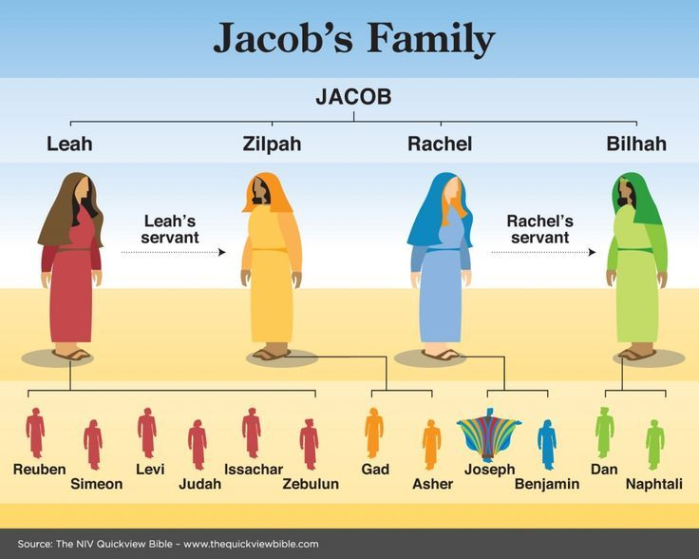

Slide 67
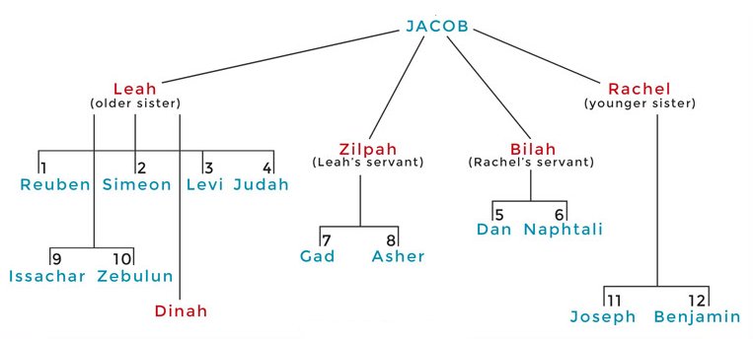

Slide 68
III. Exodus 6:14-27 Moses’ & Aaron’s Levitical heritage
Reuben (14)
Simeon (15)
Levi (16-25)
Genealogy’s purpose (26-27)

Slide 69
III. Exodus 6:14-27 Moses’ & Aaron’s Levitical heritage
Reuben (14)
Simeon (15)
Levi (16-25)
Genealogy’s purpose (26-27)

Slide 70
Exodus 6:16-25 Levi
Introduction (16)
Gershonites (17)
Kohathites (18)
Merarites (19)
Kohathite lineage (20-25)

Slide 71
Exodus 6:16-25 Levi
Introduction (16)
Gershonites (17)
Kohathites (18)
Merarites (19)
Kohathite lineage (20-25)

Slide 72
Exodus 6:16-25 Levi
Introduction (16)
Gershonites (17)
Kohathites (18)
Merarites (19)
Kohathite lineage (20-25)

Slide 73
Exodus 6:16-25 Levi
Introduction (16)
Gershonites (17)
Kohathites (18)
Merarites (19)
Kohathite lineage (20-25)

Slide 74
Exodus 6:16-25 Levi
Introduction (16)
Gershonites (17)
Kohathites (18)
Merarites (19)
Kohathite lineage (20-25)

Slide 75
Exodus 6:16-25 Levi
Introduction (16)
Gershonites (17)
Kohathites (18)
Merarites (19)
Kohathite lineage (20-25)

Slide 76
Exodus 6:20-25 Kohathite Lineage
Amram (20)
Izhar (21)
Uzziel (22)
Aaron (23)
Korah (24)
Eleazar (25)

Slide 77
Exodus 6:20-25 Kohathite Lineage
Amram (20)
Izhar (21)
Uzziel (22)
Aaron (23)
Korah (24)
Eleazar (25)

Slide 78
Dr. Ed Hindson
Hindson, E. E., & Mitchell, D. R., eds. (2010). King James Version Bible Commentary for Today: The Most Up-to-Date Commentary on the Time-Honored Text of the King James Version (p. 89). Thomas Nelson.
“Moses’ father, Amram, and mother, Jochebed, who was not only Amram’s wife but also his aunt, are listed. The law against such interfamilial marriage had not yet been given by God at Sinai.”

Slide 79
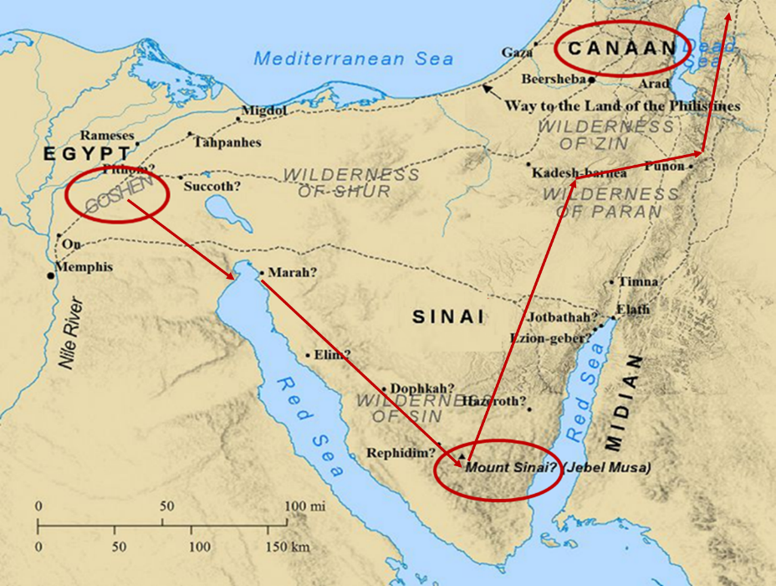

Slide 80
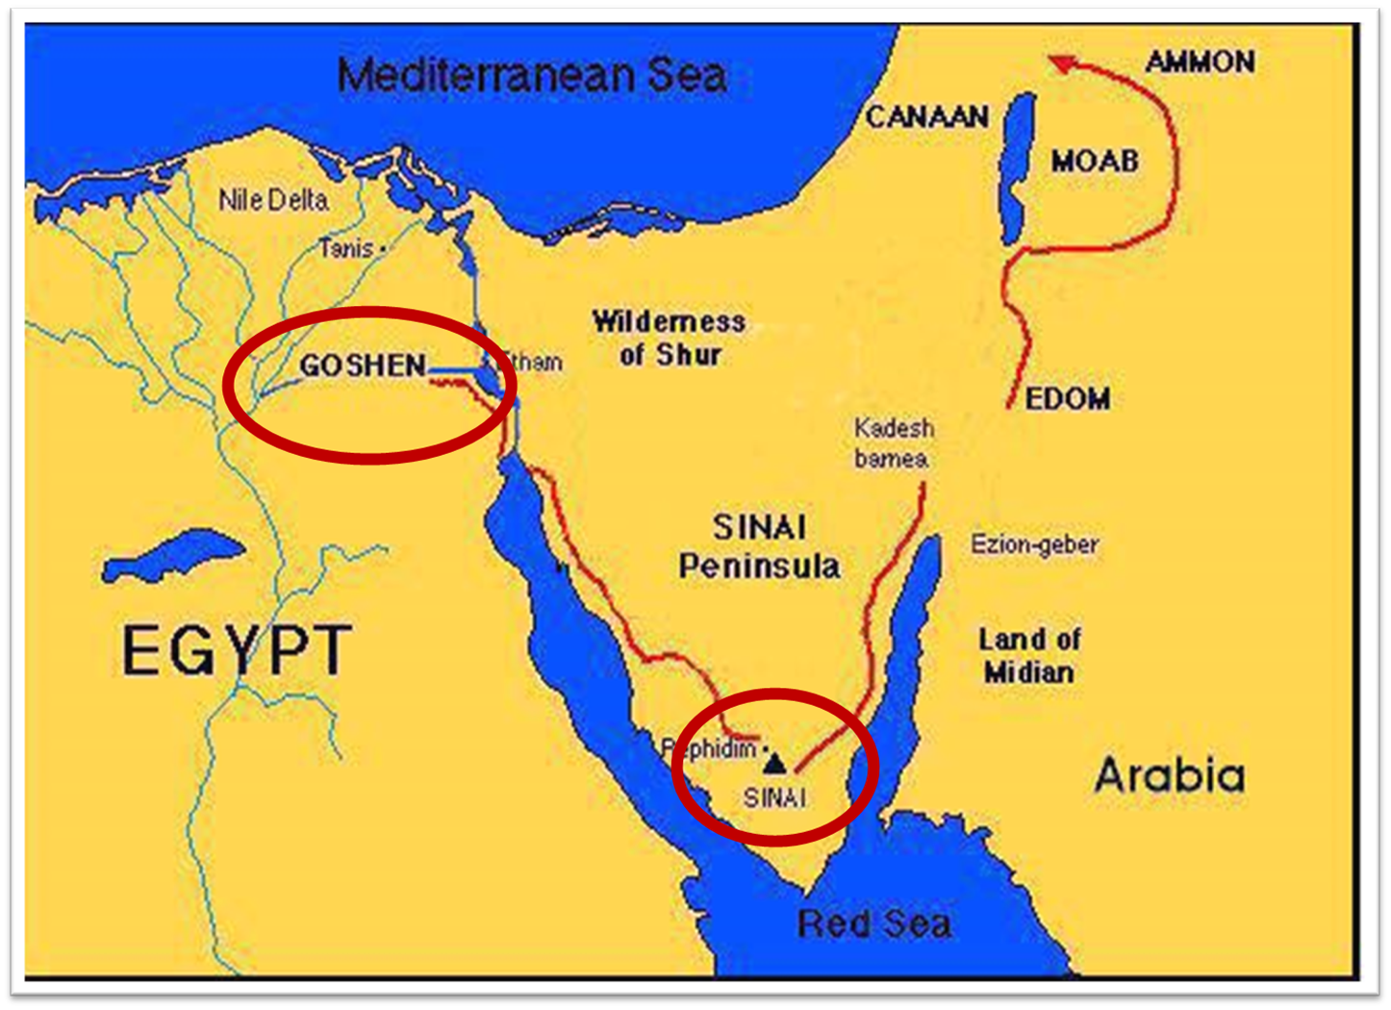

Slide 81
Exodus 6:20-25 Kohathite Lineage
Amram (20)
Izhar (21)
Uzziel (22)
Aaron (23)
Korah (24)
Eleazar (25)

Slide 82
Exodus 6:20-25 Kohathite Lineage
Amram (20)
Izhar (21)
Uzziel (22)
Aaron (23)
Korah (24)
Eleazar (25)

Slide 83
Exodus 6:20-25 Kohathite Lineage
Amram (20)
Izhar (21)
Uzziel (22)
Aaron (23)
Korah (24)
Eleazar (25)

Slide 84
Exodus 6:20-25 Kohathite Lineage
Amram (20)
Izhar (21)
Uzziel (22)
Aaron (23)
Korah (24)
Eleazar (25)

Slide 85
Exodus 6:20-25 Kohathite Lineage
Amram (20)
Izhar (21)
Uzziel (22)
Aaron (23)
Korah (24)
Eleazar (25)

Slide 86
III. Exodus 6:14-27 Moses’ & Aaron’s Levitical heritage
Reuben (14)
Simeon (15)
Levi (16-25)
Genealogy’s purpose (26-27)

Slide 87
GOD REASSURES MOSES Exodus 6:1-30
Divine Reassurance (1-8)
Divine Command (9-13)
Moses’ & Aaron’s Levitical Heritage (14-27)
Conversation continued (28-30)

Slide 88
IV. Exodus 6:28-30 Conversation Continued
Timing (28)
Command (29)
Moses’ excuses (30)

Slide 89
IV. Exodus 6:28-30 Conversation Continued
Timing (28)
Command (29)
Moses’ excuses (30)

Slide 90
IV. Exodus 6:28-30 Conversation Continued
Timing (28)
Command (29)
Moses’ excuses (30)

Slide 91
Exodus 6:29 Command
God’s self identification (29a)
Command given (29b)

Slide 92
Exodus 6:29 Command
God’s self identification (29a)
Command given (29b)

Slide 93
Exodus 6:29 Command
God’s self identification (29a)
Command given (29b)

Slide 94

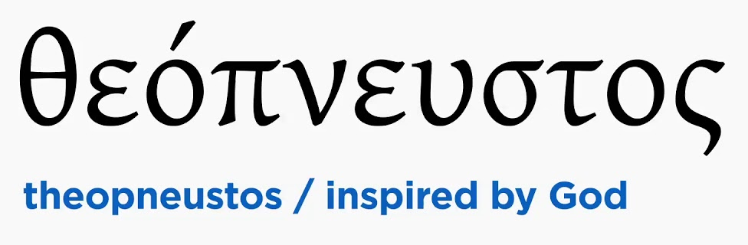
2 Timothy 3:16-17
“All Scripture is inspired by God [theopneustos] and profitable for teaching, for reproof, for correction, for training in righteousness; so that the man of God may be adequate, equipped for every good work.”

Slide 95


Matthew 4:4
“But He answered and said, “It is written, ‘Man shall not live on bread alone, but on every word that proceeds out of the mouth of God.’”

Slide 96

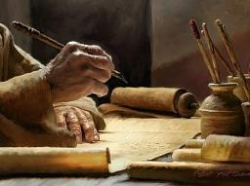
Acts 20:26-27
“²⁶ Therefore, I testify to you this day that I am innocent of the blood of all men. ²⁷ For I did not shrink from declaring to you the whole purpose of God.”

Slide 97
IV. Exodus 6:28-30 Conversation Continued
Timing (28)
Command (29)
Moses’ excuses (30)

Slide 98
Exodus 5:30 Moses’ Excuses
Lack of eloquence (30a)
Pharaoh will not listen (30b)

Slide 99
Exodus 5:30 Moses’ Excuses
Lack of eloquence (30a)
Pharaoh will not listen (30b)

Slide 100
Exodus 5:30 Moses’ Excuses
Lack of eloquence (30a)
Pharaoh will not listen (30b)

Slide 101
Conclusion

Slide 102
GOD REASSURES MOSES Exodus 6:1-30
Divine Reassurance (1-8)
Divine Command (9-13)
Moses’ & Aaron’s Levitical Heritage (14-27)
Conversation continued (28-30)

Slide 103
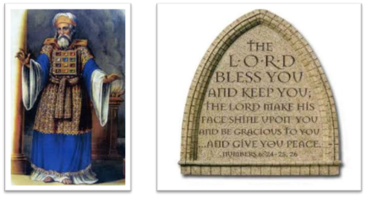
²⁴ The Lord bless you, and keep you; ²⁵ The Lord make His face shine on you, And be gracious to you; ²⁶ The Lord lift up His countenance on you, And give you peace.
Numbers 6:24–26 (NASB95)

