Slide 1
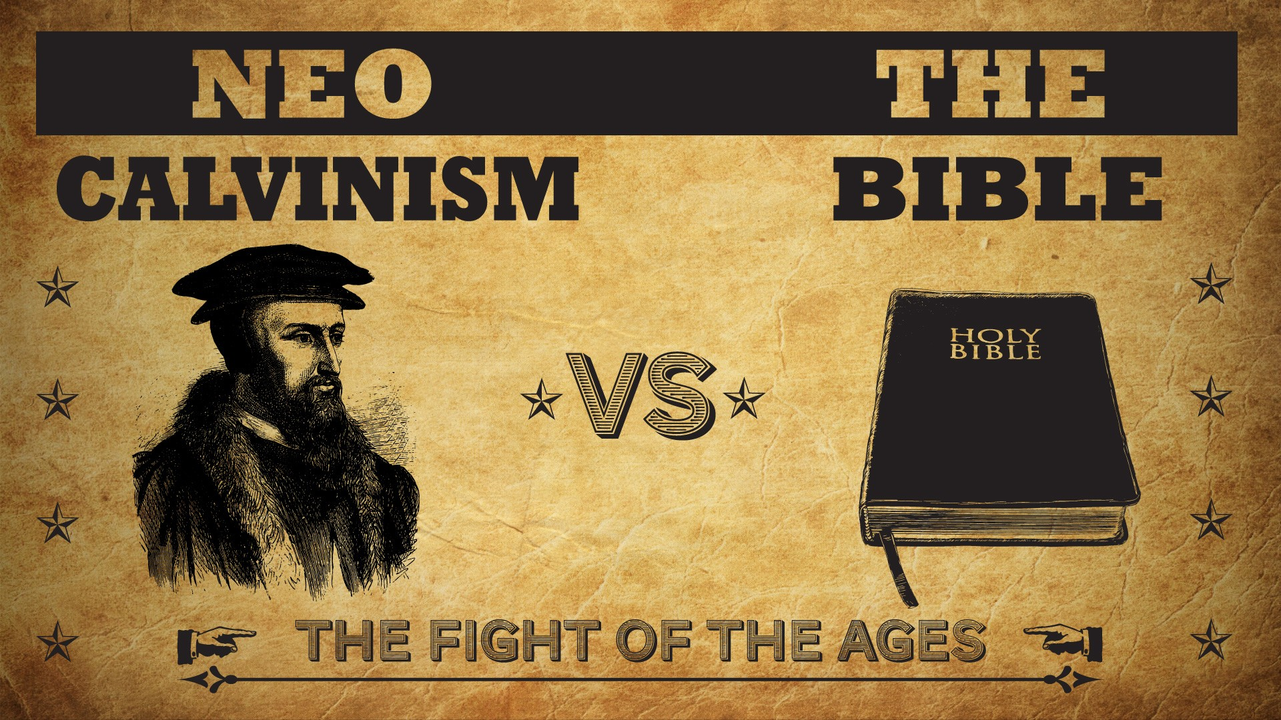


Slide 2
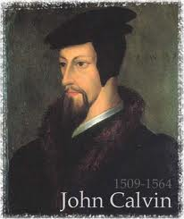
Neo-Calvinism vs. The Bible
Calvinism’s Mixed Blessing
Why Critique Calvinism?
The Source of Calvin’s Theology
Calvin’s Manner of Life
TULIP Through the Grid of Scripture
Conclusion

Slide 3

V. Running TULIP Through the Grid of Scripture
Total Depravity
Unconditional Election
Limited Atonement
Irresistible Grace
Perseverance of the Saints

Slide 4
Perseverance of the Saints
Calvinistic definition
Examples
Problems with the Calvinistic understanding

Slide 5

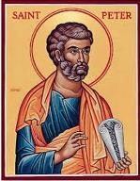
1 Peter 1:4-5
“to obtain an inheritance which is imperishable and undefiled and will not fade away, reserved in heaven for you, ⁵ who are protected by the power of God through faith for a salvation ready to be revealed in the last time.”

Slide 6
Perseverance of the Saints = Perseverance in Good Works to the End of One’s Life to Prove that He is One of the Elect
“P” stands for “Perseverance of the Saints.” This is what Calvinists say gives them the assurance of eternal security, but in actuality “the emphasis is upon the believer’s faithfulness in persevering—not upon God’s keeping power … uncertainty as to one’s ultimate salvation is, in fact, built into the very fabric of Calvinism itself.”
Bob Kirkland, Calvinism: None Dare Call It Heresy; Spotlight on the Life and Teachings of John Calvin (Eureka, MT: Lighthouse Trails, 2018), 34.

Slide 7
Perseverance of the Saints
Calvinistic definition
Examples
Problems with the Calvinistic understanding

Slide 8


John Calvin
John Calvin, Calvin’s Calvinism: God’s Eternal Predestination and Secret Providence (Reformed Free Publishing Association, Kindle edition from the 2009 2nd edition), Kindle location 532.
Calvin said: “[T]hose who do not persevere unto the end belong not to the calling of God. The Fall of Adam was not by accident, nor by chance, but was ordained by the secret counsel of God.”

Slide 9
Perseverance of the Saints
Calvinistic definition
Examples
Problems with the Calvinistic understanding

Slide 10
Problems with the Calvinistic Perseverance Definition
Final salvation is unbiblical
Scriptural examples of non-persevering saints
Support only found in out of context verses (Luke 4:9-12)
Subtle form of works salvation
Preferability of immediate death following conversion?
Lessens the importance of practical sanctification
Lessens the importance of the Bema Seat warnings
Destroys the assurance of salvation

Slide 11
Out of Context Verses Used to Support the Perseverance of the Saints
Matthew 24:13
John 15:5-6, 8
2 Corinthians 13:5
Ephesians 2:10
Hebrews 12:14
Revelation 13:10
Revelation 14:12

Slide 12


2 Corinthians 13:5
“Test yourselves to see if you are in the faith; examine yourselves! Or do you not recognize this about yourselves, that Jesus Christ is in you—unless indeed you fail the test?”

Slide 13

John MacArthur
John F. MacArthur, The Gospel According to Jesus: What Does Jesus Mean When He Says, "Follow Me"? (Grand Rapids: Zondervan, 1988), 190.
“Doubts about one’s salvation are not wrong...Scripture encourages self-examination...In 2 Corinthians 13:5, Paul wrote, ‘Test yourselves to see if you are in the faith; examine yourselves! Or do you not recognize this about yourselves, that Jesus Christ is in you—unless indeed you fail the test?’ That admonition is largely ignored—and often explained away—in the contemporary church.”

Slide 14

The New Geneva Study Bible
Luder Whitlock and Bruce Waltke R.C. Sproul, Moises Silva, et al, eds., The New Geneva Study Bible: Bringing the Light of the Reformation to Scripture (Nashville, TN: Thomas Nelson, 1995), 1844.
“Paul’s words help clarify the doctrine of assurance of faith. Paul asks the Corinthians to examine their own lives for evidence of salvation. Such evidence would include trust in Christ (Heb. 3:6), obedience to God (Matt. 7:21), growth in holiness (Heb. 12:14; 1 John 3:3), the fruit of the Spirit (Gal. 5:22, 23), love for other Christians (1 John 3:14), positive influence on others (Matt. 5:16), adhering to the apostolic teaching (1 John 4:2), and the testimony of the Holy Spirit within them (Rom. 8:15, 16).”

Slide 15
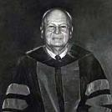
James Oliver Buswell, Jr.,
A Systematic Theology of the Christian Religion, 2 vols., vol. 2 (Grand Rapids: Zondervan, 1962), 147.
“But my point is that so long as a professing Christian is in the state of carnality, no pastor, no Christian friend, has the slightest ground for holding that this carnal person has ever been regenerated...it is a pastor’s duty to counsel such a person. “You do not give evidence of being in a regenerate state. You must remember Paul’s warning, ‘Examine yourselves whether you are in the faith; prove yourselves. Do you not know yourselves, that Jesus Christ is in you? You are not reprobate, are you?’ (2 Corinthians 13:5).”

Slide 16
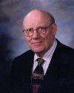
Warren W. Wiersbe
The Wiersbe Bible Commentary (Colorado Springs, CO: David Cook, 2007), 542.
“Paul told the Corinthians that they should examine their hearts to see if they were really born again and members of the family of God. Do you have the witness of the Holy Spirit in your heart? (Ro 8:9, 16) Do you love the brethren? (1Jn 3:14) Do you practice righteousness? (1John 2:29; 3:9) Have you overcome the world so that you are living a life of godly separation? (1John 5:4) These are just a few of the tests we can apply to our own lives to be certain that we are the children of God. In one of the churches I pastored, we had a teenager who was the center of every problem in the youth group…”

Slide 17
Warren W. Wiersbe
The Wiersbe Bible Commentary (Colorado Springs, CO: David Cook, 2007), 542.
“One summer when he went off to our church youth camp...At one of the meetings, he got up and announced that he had been saved that week! His Christian profession up to that time had been counterfeit. He experienced a dramatic change in his life, and today he is serving the Lord faithfully. No doubt many of the problems in the church at Corinth were caused by people who professed to be saved, but who had never repented and trusted Jesus Christ. Our churches are filled with such people today. Paul called such people reprobate, which means ‘counterfeit, discredited after a test.’”

Slide 18
Three Tenses of Salvation
Phase | Justification | Sanctification | Glorification
Tense | Past | Present | Future
Saved from sin’s: | Penalty | Power | Presence
Scripture | Eph 2:8-9; Titus 3:5 | Philip 2:12 | Rom 5:10

Slide 19
Three Tenses of Salvation
Phase | Justification | Sanctification | Glorification
Tense | Past | Present | Future
Saved from sin’s: | Penalty | Power | Presence
Scripture | Eph 2:8-9; Titus 3:5 | Philip 2:12 | Rom 5:10

Slide 20
Three Tenses of Salvation
Phase | Justification | Sanctification | Glorification
Tense | Past | Present | Future
Saved from sin’s: | Penalty | Power | Presence
Scripture | Eph 2:8-9; Titus 3:5 | Philip 2:12 | Rom 5:10

Slide 21

http://boldgrace.org/article/152/21-Tough-Questions-Pre-Order

Slide 22
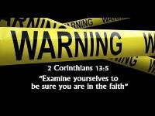
9 Reasons Favoring the Progressive Sanctification View
The Corinthians' Assumed Believing Status
Proving Oneself Applies to the Believer
Disqualification Applies to the Believer
In the Faith Refers to Experience Rather than Position
Christ in You Relates to Progressive Sanctification

Slide 23
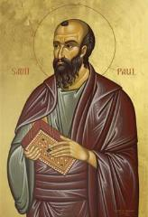
1 Corinthians 1:2
“To the church of God that is in Corinth, to those sanctified in Christ Jesus, called to be saints together with all those who in every place call upon the name of our Lord Jesus Christ, both their Lord and ours.”

Slide 24
2 Corinthians 1:1
"To the church of God that is at Corinth, with all the saints who are in the whole of Achaia."

Slide 25

THE CORINTHIANS' ASSUMED BELIEVING STATUS
1 Corinthians – 1:2; 3:1, 5, 6:11, 19-20
2 Corinthians – 1:1, 21-22, 24; 3:2-3; 6:14-16; 8:9; 10:15

Slide 26
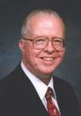
Zane C. Hodges
Absolutely Free! A Biblical Reply to Lordship Salvation (Grand Rapids: Zondervan, 1989), 200.
“Regrettably...these forceful words have been sadly misconstrued. They have been read by some interpreters as though they were a challenge to the Corinthians to find out whether they were really saved or not! This is unthinkable. After twelve chapters in which Paul takes their Christianity for granted, can he only now be asking them to make sure they are born again?...Let the readers of this book examine 2 Corinthians on their own. They will see clearly how often the apostle affirms in one way or another his conviction that his readers are genuinely Christian.”

Slide 27
9 Reasons Favoring the Progressive Sanctification View
The Corinthians' Assumed Believing Status
Proving Oneself Applies to the Believer
Disqualification Applies to the Believer
In the Faith Refers to Experience Rather than Position
Christ in You Relates to Progressive Sanctification

Slide 28
2 Corinthians 13:5
“Test yourselves to see if you are in the faith; examine yourselves! Or do you not recognize this about yourselves, that Jesus Christ is in you—unless indeed you fail the test?”

Slide 29
2 Timothy 2:15
“Be diligent to present yourself approved to God as a workman who does not need to be ashamed, accurately handling the word of truth.”

Slide 30
9 Reasons Favoring the Progressive Sanctification View
The Corinthians' Assumed Believing Status
Proving Oneself Applies to the Believer
Disqualification Applies to the Believer
In the Faith Refers to Experience Rather than Position
Christ in You Relates to Progressive Sanctification

Slide 31

2 Corinthians 13:5
“Test yourselves to see if you are in the faith; examine yourselves! Or do you not recognize this about yourselves, that Jesus Christ is in you—unless indeed you fail the test?”

Slide 32
1 Corinthians 9:27
“but I discipline my body and make it my slave, so that, after I have preached to others, I myself will not be disqualified.”

Slide 33
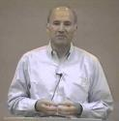
Joseph Dillow
Final Destiny: The Future Reign of the Servant Kings (Monument, CO: Panyim, 2012), 454.
if adokimos or disqualified here means that "...the apostle Paul was not certain that he would go to heaven...one wonders...how any Christian in the history of the church could ever know for certain that God was his Father!"

Slide 34
Scripture’s Five Crowns (Rev 4:10: 3:11; 2 John 8)
Scripture | Crown | Purpose
1 Cor. 9:24-27 | Incorruptible | Gaining mastery over the flesh
1 Thess. 2:19-20 | Rejoicing | Soul winning
Jas. 1:12; Rev. 2:10 | Life | Enduring trials
1 Pet. 5:2-4 | Glory | Shepherding God’s people
2 Tim. 4:8 | Righteousness | Longing for His appearing

Slide 35
9 Reasons Favoring the Progressive Sanctification View
The Corinthians' Assumed Believing Status
Proving Oneself Applies to the Believer
Disqualification Applies to the Believer
In the Faith Refers to Experience Rather than Position
Christ in You Relates to Progressive Sanctification

Slide 36
2 Corinthians 13:5
“Test yourselves to see if you are in the faith; examine yourselves! Or do you not recognize this about yourselves, that Jesus Christ is in you—unless indeed you fail the test?”

Slide 37
1 Corinthians 16:13-15
“Be on the alert, stand firm in the faith, act like men, be strong. Let all that you do be done in love. Now I urge you, brethren…”

Slide 38
1 Peter 5:8-9
⁸ ”Be of sober spirit, be on the alert. Your adversary, the devil, prowls around like a roaring lion, seeking someone to devour. ⁹ But resist him, firm in your faith, knowing that the same experiences of suffering are being accomplished by your brethren who are in the world.”

Slide 39
9 Reasons Favoring the Progressive Sanctification View
The Corinthians' Assumed Believing Status
Proving Oneself Applies to the Believer
Disqualification Applies to the Believer
In the Faith Refers to Experience Rather than Position
Christ in You Relates to Progressive Sanctification

Slide 40
2 Corinthians 13:5
“Test yourselves to see if you are in the faith; examine yourselves! Or do you not recognize this about yourselves, that Jesus Christ is in you—unless indeed you fail the test?”

Slide 41
Galatians 4:19
“My children, with whom I am again in labor until Christ is formed in you—”

Slide 42
Galatians 3:3
“Are you so foolish? Having begun by the Spirit, are you now being perfected by the flesh?”

Slide 43
Galatians 4:6
“Because you are sons, God has sent forth the Spirit of His Son into our hearts, crying, “Abba! Father!”

Slide 44
Galatians 5:16
“But I say, walk by the Spirit, and you will not carry out the desire of the flesh.”

Slide 45
9 Reasons Favoring the Progressive Sanctification View
Reform View Destroys the Passage's Symmetry
Only Believers Experience Discipline
Scripture Nowhere Tells Believers to Test the Authenticity of Their Faith
The Reformed View Damages Assurance of Salvation

Slide 46
2 Corinthians 13:3
“Since you are seeking for proof of the Christ who speaks in me, and who is not weak toward you, but mighty in you.”

Slide 47
2 Corinthians 13:6-7
“⁶ But I trust that you will realize that we ourselves do not fail the test. ⁷ Now we pray to God that you do no wrong; not that we ourselves may appear approved, but that you may do what is right, even though we may appear unapproved.”

Slide 48
2 Corinthians 13:5
“Test yourselves to see if you are in the faith; examine yourselves! Or do you not recognize this about yourselves, that Jesus Christ is in you—unless indeed you fail the test?”

Slide 49
9 Reasons Favoring the Progressive Sanctification View
Reform View Destroys the Passage's Symmetry
Only Believers Experience Discipline
Scripture Nowhere Tells Believers to Test the Authenticity of Their Faith
The Reformed View Damages Assurance of Salvation

Slide 50
2 Corinthians 13:1
“This is the third time I am coming to you. Every fact is to be confirmed by the testimony of two or three witnesses.”

Slide 51
Matthew 18:15-17
¹⁵ “If your brother sins, go and show him his fault in private; if he listens to you, you have won your brother. ¹⁶ But if he does not listen to you, take one or two more with you, so that by the mouth of two or three witnesses every fact may be confirmed. ¹⁷ If he refuses to listen to them, tell it to the church; and if he refuses to listen even to the church, let him be to you as a Gentile and a tax collector.”

Slide 52
9 Reasons Favoring the Progressive Sanctification View
Reform View Destroys the Passage's Symmetry
Only Believers Experience Discipline
Scripture Nowhere Tells Believers to Test the Authenticity of Their Faith
The Reformed View Damages Assurance of Salvation

Slide 53
Joseph Dillow
Final Destiny: The Future Reign of the Servant Kings (Monument, CO: Panyim, 2012), 454.
“Nowhere in the Bible is a Christian asked to examine either his faith or his life to find out if he is a Christian. He is told only to look outside of himself to Christ alone for his assurance that he is a Christian. The Christian is, however, often told to examine his walk of faith and life to see if he is walking in fellowship and in conformity to God's commands.”

Slide 54
Matthew 7:15-20
¹⁵ “Beware of the false prophets, who come to you in sheep’s clothing, but inwardly are ravenous wolves. ¹⁶ You will know them by their fruits. Grapes are not gathered from thorn bushes nor figs from thistles, are they? ¹⁷ So every good tree bears good fruit, but the bad tree bears bad fruit. ¹⁸ A good tree cannot produce bad fruit, nor can a bad tree produce good fruit. ¹⁹ Every tree that does not bear good fruit is cut down and thrown into the fire. ²⁰ So then, you will know them by their fruits.

Slide 55
Revelation 2:2
“² I know your deeds and your toil and perseverance, and that you cannot tolerate evil men, and you put to the test those who call themselves apostles, and they are not, and you found them to be false.”

Slide 56
9 Reasons Favoring the Progressive Sanctification View
Reform View Destroys the Passage's Symmetry
Only Believers Experience Discipline
Scripture Nowhere Tells Believers to Test the Authenticity of Their Faith
The Reformed View Damages Assurance of Salvation

Slide 57
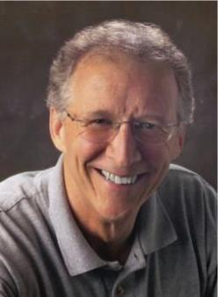
John Piper
John Piper and Pastoral Staff, TULIP: What We Believe about the Five Points of Calvinism: Position Paper of the Pastoral Staff (Desiring God Ministries, 1997), 25, cited in Dave Hunt, What Love is This?, 379.
“No Christian can be sure that he is a true believer. Hence, there is an ongoing need to be dedicated to the Lord and to deny ourselves so that we might make it.”

Slide 58

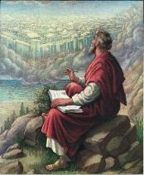
John 5:24
“Truly, truly, I say to you, he who hears My word, and believes Him who sent Me, has eternal life, and does not come into judgment, but has passed out of death into life.”

Slide 59


1 John 5:13
“These things I have written to you who believe in the name of the Son of God, so that you may know that you have eternal life.”

Slide 60
Out of Context Verses Used to Support the Perseverance of the Saints
Matthew 24:13
John 15:5-6, 8
2 Corinthians 13:5
Ephesians 2:10
Hebrews 12:14
Revelation 13:10
Revelation 14:12

Slide 61
Ephesians 2:8-10
“⁸ For by grace you have been saved through faith; and that not of yourselves, it is the gift of God; ⁹ not as a result of works, so that no one may boast. ¹⁰ For we are His workmanship, created in Christ Jesus for good works, which God prepared beforehand so that we would walk [peripateō, subjunctive mood] in them.”

Slide 62
Out of Context Verses Used to Support the Perseverance of the Saints
Matthew 24:13
John 15:5-6, 8
2 Corinthians 13:5
Ephesians 2:10
Hebrews 12:14
Revelation 13:10
Revelation 14:12

Slide 63

Hebrews 12:14 (NKJV)
“Pursue peace with all people, and holiness, without which no one will see the Lord.”

Slide 64
Hebrews 12:14
Holy life + faith to get to heaven
Others seeing the Lord though the believer's life and witness
Not seeing the Lord in heaven
Context = personal relationships with others (Heb. 12:14a, 15b)
Not requiring faith + holy life to get to heaven

Slide 65
Hebrews 12:14
Holy life + faith to get to heaven
Others seeing the Lord though the believer's life and witness
Not seeing the Lord in heaven
Context = personal relationships with others (Heb. 12:14a, 15b)
Not requiring faith + holy life to get to heaven

Slide 66
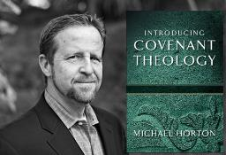
Without Personal Holiness No One Will See the Lord
“The New Testament lays before us a vast array of conditions for final salvation. Not only initial repentance and faith, but perseverance in both, demonstrated in love toward God and neighbor, are part of that holiness without which no one will see the lord (Hebrews 12:14)."
Horton, Michael. (2006). Introducing Covenant Theology (p. 182). Grand Rapids: Baker.

Slide 67

John Piper
Does God Really Save Us by Faith Alone?
https://www.desiringgod.org/articles/does-god-really-save-us-by-faith-alone
“Essential to the Christian life and necessary for final salvation is the killing of sin (Romans 8:13) and the pursuit of holiness (Hebrews 12:14).”

Slide 68
Hebrews 12:14
Holy life + faith to get to heaven
Others seeing the Lord though the believer's life and witness
Not seeing the Lord in heaven
Context = personal relationships with others (Heb. 12:14a, 15b)
Not requiring faith + holy life to get to heaven

Slide 69
Hebrews 12:14
Holy life + faith to get to heaven
Others seeing the Lord though the believer's life and witness
Not seeing the Lord in heaven
Context = personal relationships with others (Heb. 12:14a, 15b)
Not requiring faith + holy life to get to heaven

Slide 70
Hebrews 12:14
Holy life + faith to get to heaven
Others seeing the Lord though the believer's life and witness
Not seeing the Lord in heaven
Context = personal relationships with others (Heb. 12:14a, 15b)
Not requiring faith + holy life to get to heaven

Slide 71
Hebrews 12:14 (NKJV)
“Pursue peace with all people, and holiness, without which no one will see the Lord.”

Slide 72
Hebrews 12:14
Holy life + faith to get to heaven
Others seeing the Lord though the believer's life and witness
Not seeing the Lord in heaven
Context = personal relationships with others (Heb. 12:14a, 15b)
Not requiring faith + holy life to get to heaven

Slide 73
Out of Context Verses Used to Support the Perseverance of the Saints
Matthew 24:13
John 15:5-6, 8
2 Corinthians 13:5
Ephesians 2:10
Hebrews 12:14
Revelation 13:10
Revelation 14:12

Slide 74

Revelation 13:10
“If anyone is destined for captivity, to captivity he goes; if anyone kills with the sword, with the sword he must be killed. Here is the perseverance and the faith of the saints.”

Slide 75
Out of Context Verses Used to Support the Perseverance of the Saints
Matthew 24:13
John 15:5-6, 8
2 Corinthians 13:5
Ephesians 2:10
Hebrews 12:14
Revelation 13:10
Revelation 14:12

Slide 76

Revelation 14:12
“Here is the perseverance of the saints who keep the commandments of God and their faith in Jesus.”

Slide 77
Problems with the Calvinistic Perseverance Definition
Final salvation is unbiblical
Scriptural examples of non-persevering saints
Support only found in out of context verses
Subtle form of works salvation
Preferability of immediate death following conversion?
Lessens the importance of practical sanctification
Lessens the importance of the Bema Seat warnings
Destroys the assurance of salvation

Slide 78
John Piper
John Piper and Pastoral Staff, TULIP: What We Believe about the Five Points of Calvinism: Position Paper of the Pastoral Staff (Desiring God Ministries, 1997), 25, cited in Dave Hunt, What Love is This?, 379.
“No Christian can be sure that he is a true believer. Hence, there is an ongoing need to be dedicated to the Lord and to deny ourselves so that we might make it.”

Slide 79
John 5:24
“Truly, truly, I say to you, he who hears My word, and believes Him who sent Me, has eternal life, and does not come into judgment, but has passed out of death into life.”

Slide 80
Titus 2:14
“who gave Himself for us to redeem us from every lawless deed, and to purify for Himself a people for His own possession, zealous for good deeds.”

Slide 81
Problems with the Calvinistic Perseverance Definition
Final salvation is unbiblical
Scriptural examples of non-persevering saints
Support only found in out of context verses
Subtle form of works salvation
Preferability of immediate death following conversion?
Lessens the importance of practical sanctification
Lessens the importance of the Bema Seat warnings
Destroys the assurance of salvation

Slide 82
Problems with the Calvinistic Perseverance Definition
Final salvation is unbiblical
Scriptural examples of non-persevering saints
Support only found in out of context verses
Subtle form of works salvation
Preferability of immediate death following conversion?
Lessens the importance of practical sanctification
Lessens the importance of the Bema Seat warnings
Destroys the assurance of salvation

Slide 83
Problems with the Calvinistic Perseverance Definition
Final salvation is unbiblical
Scriptural examples of non-persevering saints
Support only found in out of context verses
Subtle form of works salvation
Preferability of immediate death following conversion?
Lessens the importance of practical sanctification
Lessens the importance of the Bema Seat warnings
Destroys the assurance of salvation

Slide 84
Scripture’s Five Crowns (1 Cor 3:15; 9:27; 1 John 2:28; 2 John 8; Rev 3:11)
SCRIPTURE | CROWN | PURPOSE
1 Cor. 9:24-27 | Incorruptible | Gaining mastery over the flesh
1 Thess. 2:19-20 | Rejoicing | Soul winning
Jas. 1:12; Rev. 2:10 | Life | Enduring trials
1 Pet. 5:2-4 | Glory | Shepherding God’s people
2 Tim. 4:8 | Righteousness | Longing for His appearing

Slide 85
Problems with the Calvinistic Perseverance Definition
Final salvation is unbiblical
Scriptural examples of non-persevering saints
Support only found in out of context verses
Subtle form of works salvation
Preferability of immediate death following conversion?
Lessens the importance of practical sanctification
Lessens the importance of the Bema Seat warnings
Destroys the assurance of salvation

Slide 86

Destroys the Assurance of Salvation
The Biblical View of the Assurance of Salvation
Examples of How the “Perseverance of the Saints” Destroys the Assurance of Salvation
Calvinism’s “Two Kinds of Faith” Doctrine damages the Assurance of Salvation

Slide 87
Destroys the Assurance of Salvation
The Biblical View of the Assurance of Salvation
Examples of How the “Perseverance of the Saints” Destroys the Assurance of Salvation
Calvinism’s “Two Kinds of Faith” Doctrine damages the Assurance of Salvation

Slide 88
John 5:24
“Truly, truly, I say to you, he who hears My word, and believes Him who sent Me, has eternal life, and does not come into judgment, but has passed out of death into life.”

Slide 89
1 John 5:13
“These things I have written to you who believe in the name of the Son of God, so that you may know that you have eternal life.”

Slide 90
DTS Doctrinal Statement Article XI—Assurance
“We believe it is the privilege, not only of some, but of all by the Spirit through faith who are born again in Christ as revealed in the Scriptures, to be assured of their salvation from the very day they take Him to be their Savior and that this assurance is not founded upon any fancied discovery of their own worthiness or fitness, but wholly upon the testimony of God in His written Word, exciting within His children filial love...”

Slide 91
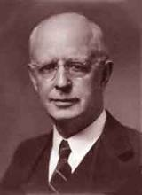
Lewis Sperry Chafer, Salvation: A Clear Doctrinal Analysis (Grand Rapids: Zondervan, 1977), 60. Italics added
Lewis Sperry Chafer
“There is a normal Christian experience. There are new and blessed emotions and desires. Old things do pass away; and behold all things do become new; but all such experiences are but secondary evidences, as to the fact of salvation, in that they grow out of that positive repose of faith which is the primary evidence.”

Slide 92
Joseph Dillow
Final Destiny: The Future Reign of the Servant Kings (Monument, CO: Panyim, 2012), 454.
“Nowhere in the Bible is a Christian asked to examine either his faith or his life to find out if he is a Christian. He is told only to look outside of himself to Christ alone for his assurance that he is a Christian. The Christian is, however, often told to examine his walk of faith and life to see if he is walking in fellowship and in conformity to God's commands.”

Slide 93
Destroys the Assurance of Salvation
The Biblical View of the Assurance of Salvation
Examples of How the “Perseverance of the Saints” Destroys the Assurance of Salvation
Calvinism’s “Two Kinds of Faith” Doctrine damages the Assurance of Salvation

Slide 94
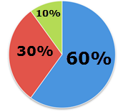
Assurance of Salvation in Calvinism?

Slide 95
Calvinism and the Assurance of Salvation
“Once fully indoctrinated into Calvinism, the Calvinist is left wondering for the rest of his life if he is one of the elect. This is not a walk of faith but of doubt, and it is totally unscriptural. Scripture says that we can walk in assurance of eternal life.”
Bob Kirkland, Calvinism: None Dare Call It Heresy; Spotlight on the Life and Teachings of John Calvin (Eureka, MT: Lighthouse Trails, 2018), 102.

Slide 96
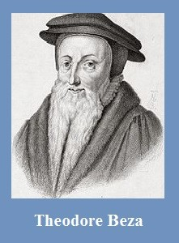
Theodore Beza
(1519‒1605)
A Little Book of Christian Questions and Responses, pp. 96-97
“Therefore, I am elect, is first perceived from sanctification begun in me, that is, by my hating of sin and my loving of righteousness.”

Slide 97
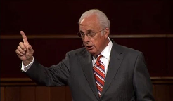
John MacArthur
The Gospel According to Jesus, p. 23
“Genuine assurance comes from seeing the Holy Spirit’s transforming work in one’s life.”

Slide 98
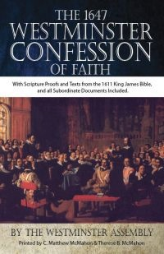
Westminster Confession Chapter XVII, Article III – Of the Assurance of Grace and Salvation
“This infallible assurance doth not so belong to the essence of faith, but that a true believer will wait long, and conflict with many difficulties before he be a partaker of it.”

Slide 99
Even John Calvin himself did not possess assurance of salvation. Writing in his will shortly before his death in 1564, he declared: “I testify also and profess that I humbly seek from God, that He may so will me to be washed and purified by the great Redeemer’s blood, shed for the sins of the human race, that it may be permitted me to stand before His tribunal under the covert of the Redeemer Himself” (italics added).
John Calvin
Norman F. Douty, The Death of Christ (Irving, TX: Williams & Watrous Pub. Co., Revised and Enlarged Edition, 1978), p. 176, citing John Calvin from F. F. Bruce’s “Answers and Questions,” Questions 1331, in The Harvester (Exeter) January 1966.

Slide 100
John Piper
John Piper and Pastoral Staff, TULIP: What We Believe about the Five Points of Calvinism: Position Paper of the Pastoral Staff (Desiring God Ministries, 1997), 25, cited in Dave Hunt, What Love is This?, 379.
“No Christian can be sure that he is a true believer. Hence, there is an ongoing need to be dedicated to the Lord and to deny ourselves so that we might make it.”

Slide 101
John Piper
John Piper’s Interview on Family Life Radio April 14, 2020
https://www.familylife.com/podcast/familylife-today/strategies-for-standing-firm-through-coronavirus/
“What causes me to be anxious is the possibility that I may not be a Christian—that I might be fake / that everything I’ve ever done might be a farce—those are horrible, horrible thoughts; right?”

Slide 102

R.C. Sproul, Jr.
“Assurance of Salvation” (Tabletalk, Ligonier Ministries, 1989), p. 20
“A while back I had one of those moments… Suddenly the question hit me: ‘R.C. what if you are not one of the redeemed? What if your destiny is not heaven after all, but hell?’ Let me tell you that I was flooded in my body with the chill that went from my head to the bottom of my spine. I was terrified. I begin to take stock of my life, and I looked at my performance. My sins came pouring into my mind, and the more I looked at myself the worst I felt. I thought, ‘maybe it’s really true. Maybe I’m not saved after all.’...Then I remembered John 6:68. Jesus had been giving out hard teaching, and many of His former followers had left Him. When He asked Peter if he was also going to leave, Peter said, ‘where else can we go? Only you have the words of eternal life.’ In other words, Peter was also uncomfortable, but he realized that being uncomfortable with Jesus was better than any other option.”

Slide 103
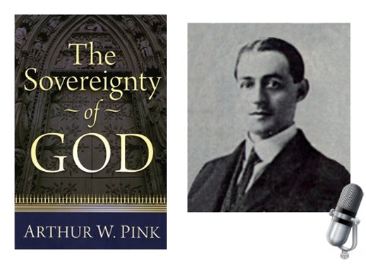
A. W. Pink
Practical Christianity, p. 16.
“Readers, if there is a reserve in your obedience, you are on your way to hell.”

Slide 104

R.T. Kendall
R. T. Kendall, Calvin and English Calvinism to 1649
(Oxford: Oxford University Press, 1979), 2.
Interestingly, it has been recorded that “nearly all of the Puritan ‘divines’ [men who were Calvinistic and taught perseverance] went through great dread and despair on their deathbeds as they realized their lives did not give perfect evidence that they were elect.”

Slide 105
R.T. Kendall
R.T. Kendall, Grace: You Don't Deserve It. You Can't Buy It. You Can't Live without It. (Lake Mary, FL: Charisma House, 2006), 3.
“I went to Oxford in 1973 to study John Owen’s doctrine of the priestly work of Christ. It turned out that my thesis took a different direction, but it plunged me deep indeed into the Puritans (p. 3).”

Slide 106
R.T. Kendall
R.T. Kendall, Grace: You Don't Deserve It. You Can't Buy It. You Can't Live without It. (Lake Mary, FL: Charisma House, 2006), 3.
“For no one could claim to be saved if they did not keep the works of the Law. Not that you could lose your salvation; it only meant you were not really converted in the first place if there was not a careful keeping of the Ten Commandments. After all, one dare not look directly to Christ for assurance—that would be presumptuous; one looked to his own faithfulness in keeping the Law first, and then—and only then—did one have the warrant to look to Christ for salvation. I kept telling myself that what these Puritans wrote surely was not what they appeared to be saying. I kept reading” (p. 3).

Slide 107
R.T. Kendall
R.T. Kendall, Grace: You Don't Deserve It. You Can't Buy It. You Can't Live without It. (Lake Mary, FL: Charisma House, 2006), 4.
“Most of the Puritans that I read can be described in this scenario: How do you know you are saved? By your sanctification. How do you know you have sanctification? By good works. How do you know what good works are? By the Ten Commandments (p. 4).”

Slide 108
R.T. Kendall
R.T. Kendall, Grace: You Don't Deserve It. You Can't Buy It. You Can't Live without It. (Lake Mary, FL: Charisma House, 2006), 4.
“It is not that they believed you are saved by good works; it was merely that you could not know you are saved unless you kept the Ten Commandments. Martin Luther’s discovery that we are justified by faith alone had sadly passed behind a cloud (p. 4).”

Slide 109
R.T. Kendall
R.T. Kendall, Grace: You Don't Deserve It. You Can't Buy It. You Can't Live without It. (Lake Mary, FL: Charisma House, 2006), 4.
“I was also surprised to learn how so many of the Puritans died. William Perkins (1558-1602), the architectural mind for what became the tradition that led to the historic Westminster Confession of Faith, died ‘in the conflict of a troubled conscience.’ His immediate successor Paul Baynes (d. 1617) ‘went out of this world, with far less comfort than many weaker Christians enjoy.’ Sadly, this kind of dying testimony was not uncommon (p. 4).”

Slide 110
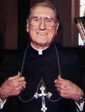
Cardinal John O’Connor of NY
quoted in Samuel Howe Verhovek, Cardinal Defends a Jailed Bishop Who Warned Cuomo on Abortion, New York Times, February 1, 1990.
“Church teaching is that I don't know, at any given moment, what my eternal future will be… I can hope, pray, do my very best – but I still don't know. Pope John II doesn't absolutely know that he will go to heaven, nor does mother Theresa of Calcutta, unless either has had a special divine revelation.”

Slide 111
Destroys the Assurance of Salvation
The Biblical View of the Assurance of Salvation
Examples of How the “Perseverance of the Saints” Destroys the Assurance of Salvation
Calvinism’s “Two Kinds of Faith” Doctrine damages the Assurance of Salvation

Slide 112

William Hendriksen
William Hendriksen, A Commentary on the Gospel of John, 3d ed. (London: Banner of Truth Trust, 1964), p. 127. (1978). Bibliotheca Sacra, 135. (1978). Bibliotheca Sacra, 135.
“Many trusted in his name; i.e., because of the manner in which his power was displayed they accepted him as a great prophet and perhaps even as the Messiah. This, however, is not the same as saying that they surrendered their hearts to him. Not all faith is saving faith...”

Slide 113
John MacArthur
The Gospel According to Jesus, p. 173
“As a divine gift, faith is neither transient nor impotent. It has an abiding quality that guarantees its endurance to the end.”
John F. MacArthur, The Gospel According to Jesus: What Does Jesus Mean When He Says, "Follow Me"? (Grand Rapids: Zondervan, 1988), 173.

Slide 114
John MacArthur
The Gospel According to Jesus, p. 173
“…The faith God gives can never evaporate.”

Slide 115
John MacArthur
Saved Without A Doubt, p. 177
“If a person fails to love and obey the Lord through the trials of life, then there is no evidence that he possesses saving faith. How many people do you know who came to church for a while, had a little trouble in their lives, and left? Although they may have made a profession of faith in Christ, they cannot be identified as those who love Him because their lives are not characterized by enduring obedience.”

Slide 116
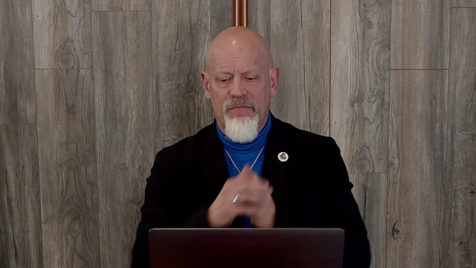
James White
James R. White, The Potter’s Freedom
(Amityville, NY: Calvary Press Publishing, 2000), 293.
“Why do some stumble and fall while others persevere? Is it that some are better, stronger, than others? No. The reason lies in the difference between having saving faith and a faith that is not divine in origin or nature. Many are those who make professions not based upon regeneration, and the ‘faith’ that is theirs will not last…These are those who have false, human faith that does not last. But those with true faith produce fruit and remain.”

Slide 117


Slide 118
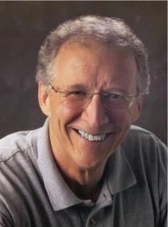
John Piper
John Piper, Desiring God (Sisters, OR: Multnomah, 1986), 65. This quote also appeared verbatim in the 1996 reprinting of Desiring God, but it was rephrased in the 2003 and 2011 editions.
“Saving faith is no simple thing. It has many dimensions. ‘Believe on the Lord Jesus’ is a massive command. It contains a hundred other things. Unless we see this, the array of conditions for salvation in the New Testament will be utterly perplexing.”

Slide 119
R.C. Sproul – Bob Wilkin as quoted in:
Bob Wilkin, “Ligonier National Conference” (The Grace Report, July 2000); http://www.gracebiblestudies.org/Resources/Web/www.duluthbible.org/g_f_j/EternalSecurity12.htm
“During the first message presented at Ligonier’s Conference in Orlando last June, Dr. R. C. Sproul indicated that Dr. James Boice, a scheduled speaker at the conference, was dying in faith that very night. Then at the end of the message he asked all 5,000 of us present to pray that Jim dies in faith. This struck me as sad. Here was a great pastor, theologian, teacher, and author. Yet Sproul was not sure that he was regenerate. (In Reformed thought, if a person fails to die in faith, he proved he was never saved in the first place.) I was reminded of R.T. Kendall’s remark that nearly to a man the Puritan divines [men who were Calvinistic and taught perseverance] died doubting whether they were saved and fearing they were going to hell. Dr. Boice died that very night, June 15th.”

Slide 120
“Believe” Defined
“pisteuō…’to believe,’ also ‘to be persuaded of,’ and hence, ‘to place confidence in, to trust,’ signifies, in this sense of the word, reliance upon, not mere credence. It is most frequent in the writings of the apostle John, especially the Gospel. He does not use the noun…Of the writers of the Gospels…uses of the verb…John ninety-nine.”
W. E. Vine, Merrill F. Unger, and William White, Vine's Complete Expository Dictionary of the Old and New Testament Words (Nashville: Nelson, 1996), 61.

Slide 121
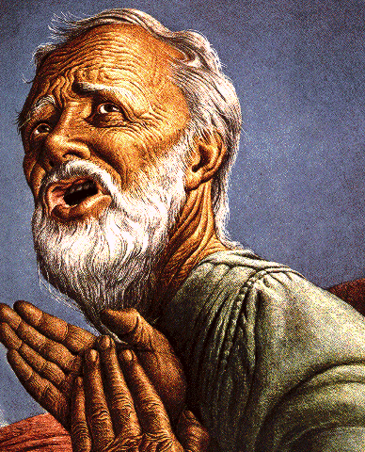
Belief – God’s One Condition for Justification
Gen 15:6
Then he believed in the LORD; and He reckoned it to him as righteousness.
John 3:16
For God so loved the world, that He gave His only begotten Son, that whoever believes in Him shall not perish, but have eternal life.
Acts 16:30-31
"Sirs, what must I do to be saved?" They said, "Believe in the Lord Jesus, and you will be saved..."

Slide 122
Passage Conditioning Salvation on Faith Alone (Sola Fide)
Genesis 15:6
John 3:16; 5:24; 6:28-29, 47; 16:8-9; 20:30-31
Acts 16:30-31
Romans 1:16; Ephesians 2:8-9
Hebrews 11:6

Slide 123
Romans 4:5
“But to the one who does not work, but believes in Him who justifies the ungodly, his faith is credited as righteousness.”

Slide 124
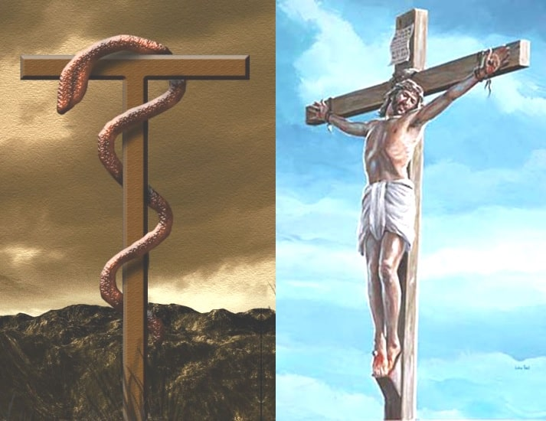
John 3:14-15
“¹⁴ As Moses lifted up the serpent in the wilderness, even so must the Son of Man be lifted up; ¹⁵ so that whoever believes will in Him have eternal life.”

Slide 125
Numbers 21:8-9
“⁸ Then the Lord said to Moses, ‘Make a fiery serpent, and set it on a standard; and it shall come about, that everyone who is bitten, when he looks at it, he will live.’ ⁹ And Moses made a bronze serpent and set it on the standard; and it came about, that if a serpent bit any man, when he looked to the bronze serpent, he lived.”

Slide 126

John 5:24
“Truly, truly, I say to you, he who hears My word, and believes Him who sent Me, has eternal life, and does not come into judgment, but has passed out of death into life.”

Slide 127


John 20:30-31
“Therefore many other signs Jesus also performed in the presence of the disciples, which are not written in this book; but these have been written so that you may believe that Jesus is the Christ, the Son of God; and that believing you may have life in His name.”

Slide 128
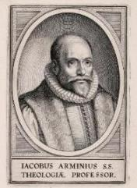
John 20:30-31?
Present tense participle “believing”-John 3:16, 18; 5:24
Abuse of the present tense
Present tense does not always require continual behavior
Mark 6:14
John the “the one continually baptizing?”
John already dead!
Not describing continual baptizing
Just describing him
How many times doe you have to MURDER before you are a MURDERER? Once! Same with a FISHERMAN & BELIEVER

Slide 129
John 20:30-31?
Does not preclude ongoing faith but does not require it
Other verb forms also used to describe belief (John 8:30-31)
It is possible for a Christian to struggle with faith
2 Tim. 2:13 – “faithless” = unbelieving
Jas. 1:5-8
Peter’s sinking and three-fold denial

Slide 130
John 20:30-31?
Present tense participle “believing” – John 3:16, 18; 5:24
Abuse of the present tense
Present tense does not always require continual behavior
Mark 6:14
John the “the one continually baptizing?”
John already dead!
Not describing continual baptizing
Just describing him
How many times doe you have to MURDER before you are a MURDERER? Once! Same with a FISHERMAN & BELIEVER

Slide 131
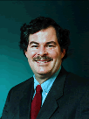
Believing Forever? – No! Take Off Your Theological Lenses!
“The aspectual force of the present ho pisteuōn seems to be in contrast with ho pisteusas…The present was the tense of choice most likely because the NT writers by and large saw continual belief as a necessary condition of salvation. Along these lines, it seems significant that the promise of salvation is almost always given to ho pisteuōn, almost never to ho pisteusas…”
Daniel B. Wallace, Greek Grammar Beyond the Basics: An Exegetical Syntax of the New Testament with Scripture, Subject, and Greek Word Indexes (Grand Rapids: Zondervan, 1996), 621, n. 22.

Slide 132
John 20:30-31?
Present tense participle “believing” – John 3:16, 18; 5:24
Abuse of the present tense
Present tense does not always require continual behavior
Mark 6:14
John the “the one continually baptizing?”
John already dead!
Not describing continual baptizing
Just describing him
How many times doe you have to MURDER before you are a MURDERER? Once! Same with a FISHERMAN & BELIEVER

Slide 133
John 20:30-31?
Present tense participle “believing” – John 3:16, 18; 5:24
Abuse of the present tense
Present tense does not always require continual behavior
Mark 6:14
John the “the one continually baptizing?”
John already dead!
Not describing continual baptizing
Just describing him
How many times doe you have to MURDER before you are a MURDERER? Once! Same with a FISHERMAN & BELIEVER

Slide 134

Present Tense Participle Does Not Always Mean Forever
John 4:13 John 4:26 John 4:36 John 5:3 John 5:24 John 6:14 |  | John 11:26-27 Mark 6:14 Mark 14:20 Luke 16:18 Gal. 3:13
Bob Wilkin, “The One Who Believes: Is Continuous Faith Required to be Born Again?,” online: http://www.faithalone.org/magazine/y2006/06jf1.html, accessed 06 May 2015.

Slide 135
John 20:30-31?
Present tense participle “believing” – John 3:16, 18; 5:24
Abuse of the present tense
Present tense does not always require continual behavior
Mark 6:14
John the “the one continually baptizing?”
John already dead!
Not describing continual baptizing
Just describing him
How many times doe you have to MURDER before you are a MURDERER? Once! Same with a FISHERMAN & BELIEVER

Slide 136
John 20:30-31?
Present tense participle “believing” – John 3:16, 18; 5:24
Abuse of the present tense
Present tense does not always require continual behavior
Mark 6:14
John the “the one continually baptizing?”
John already dead!
Not describing continual baptizing
Just describing him
How many times doe you have to MURDER before you are a MURDERER? Once! Same with a FISHERMAN & BELIEVER

Slide 137
John 20:30-31?
Does not preclude ongoing faith but does not require it
Other verb forms also used to describe belief (John 8:30-31)
It is possible for a Christian to struggle with faith
2 Tim. 2:13 – “faithless” = unbelieving
Jas. 1:5-8
Peter’s sinking and three-fold denial

Slide 138
John 20:30-31?
Does not preclude ongoing faith but does not require it
Other verb forms also used to describe belief (John 8:30-31)
It is possible for a Christian to struggle with faith
2 Tim. 2:13 – “faithless” = unbelieving
Jas. 1:5-8
Peter’s sinking and three-fold denial

Slide 139
John 8:30-31
“As He spoke these things, many came to *believe in Him. So Jesus was saying to those Jews who had ⁺believed Him, “If you continue in My word, then you are truly disciples of Mine.”
* aorist active indicative
⁺ perfect active participle

Slide 140
John 20:30-31?
Does not preclude ongoing faith but does not require it
Other verb forms also used to describe belief (John 8:30-31)
It is possible for a Christian to struggle with faith
2 Tim. 2:13 – “faithless” = unbelieving
Jas. 1:5-8
Peter’s sinking and three-fold denial

Slide 141
John 20:30-31?
Does not preclude ongoing faith but does not require it
Other verb forms also used to describe belief (John 8:30-31)
It is possible for a Christian to struggle with faith
2 Tim. 2:13 – “faithless” = unbelieving
Jas. 1:5-8
Peter’s sinking and three-fold denial

Slide 142
2 Timothy 2:13
“If we are faithless [without faith], He remains faithful, for He cannot deny Himself.”

Slide 143
John 20:30-31?
Does not preclude ongoing faith but does not require it
Other verb forms also used to describe belief (John 8:30-31)
It is possible for a Christian to struggle with faith
2 Tim. 2:13 – “faithless” = unbelieving
Jas. 1:5-8
Peter’s sinking and three-fold denial

Slide 144
James 1:5-8
“But if any of you lacks wisdom, let him ask of God, who gives to all generously and without reproach, and it will be given to him. ⁶ But he must ask in faith without any doubting, for the one who doubts is like the surf of the sea, driven and tossed by the wind. ⁷ For that man ought not to expect that he will receive anything from the Lord, ⁸ being a double-minded man, unstable in all his ways.”

Slide 145
John 20:30-31?
Does not preclude ongoing faith but does not require it
Other verb forms also used to describe belief (John 8:30-31)
It is possible for a Christian to struggle with faith
2 Tim. 2:13 – “faithless” = unbelieving
Jas. 1:5-8
Peter’s sinking and three-fold denial

Slide 146
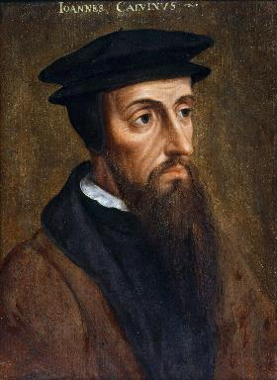
Neo-Calvinism vs. The Bible
Why Critique Calvinism?
The Source of Calvin’s Theology
Calvin’s Manner of Life
TULIP Through the Grid of Scripture
Conclusion

Slide 147
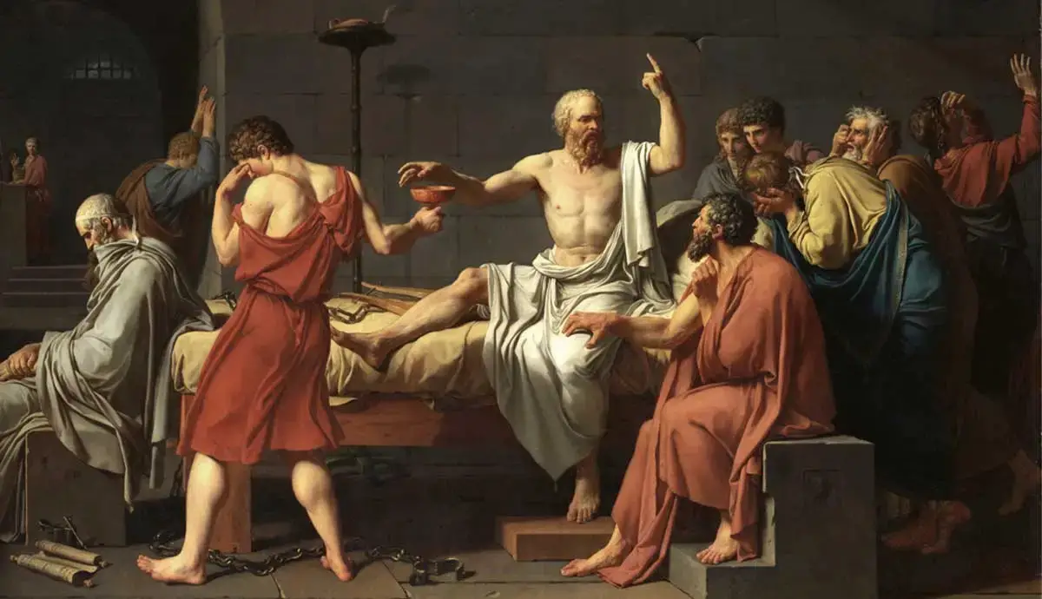
Colossians 2:8
⁸“See to it that no one takes you captive through philosophy and empty deception, according to the tradition of men, according to the elementary principles of the world, rather than according to Christ.”

Slide 148
Calvinism is an Imposed Philosophy Upon Scripture
“Likewise, John Calvin…latched onto little more than a single word (predestinate) and ran with it. Then, rather than carefully looking to the whole of Scripture to verify his precepts and conclusions, he looked to the writings of Augustine to verify his thinking. The result is that, as with Catholicism, we now have ‘another gospel’ that is not solely based on Scripture but on the confused thinking and misconstrued assumptions of a mere man. With Calvin, rather than changing his views to fit Scripture, he changed the meaning of words in Scripture to fit his now distorted view of God and salvation.”
Bob Kirkland, Calvinism: None Dare Call It Heresy; Spotlight on the Life and Teachings of John Calvin (Eureka, MT: Lighthouse Trails, 2018), 97.

