Slide 1
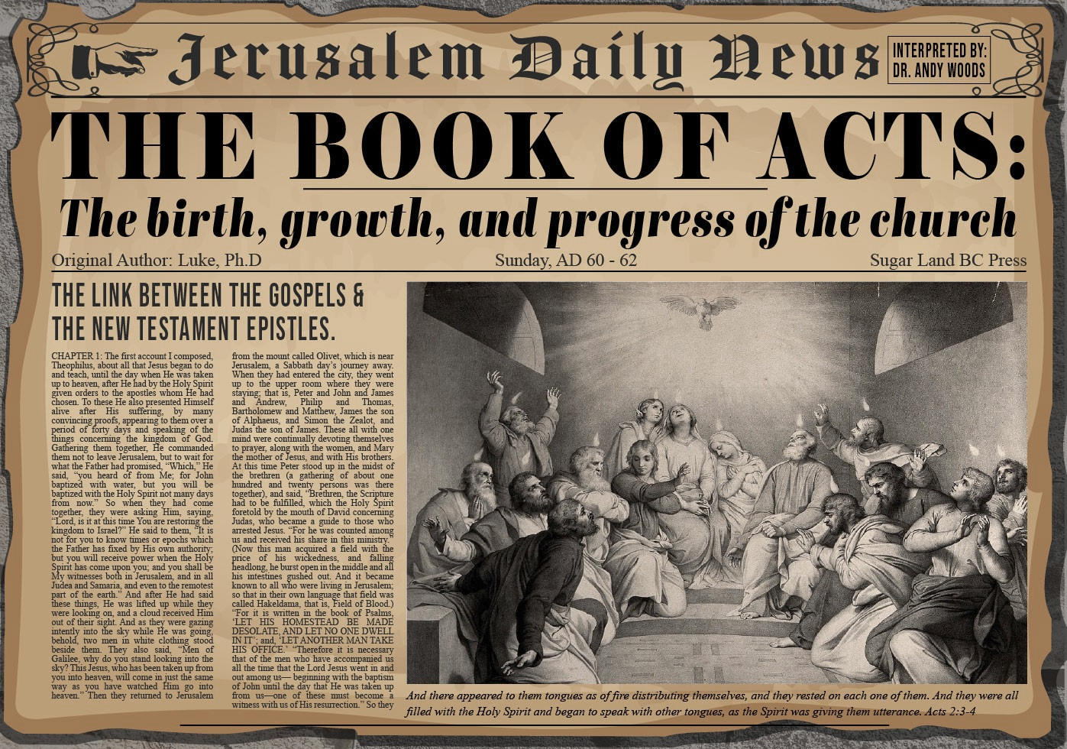


Slide 2
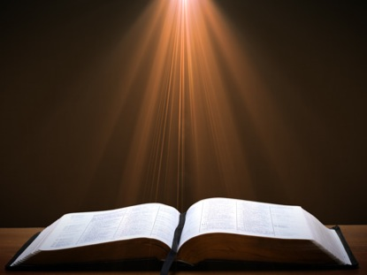
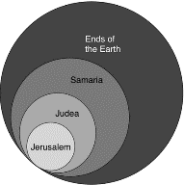
Acts 1:8
“but you will receive power when the Holy Spirit has come upon you; and you shall be My witnesses both in Jerusalem, and in all Judea and Samaria, and even to the remotest part of the earth.”

Slide 3
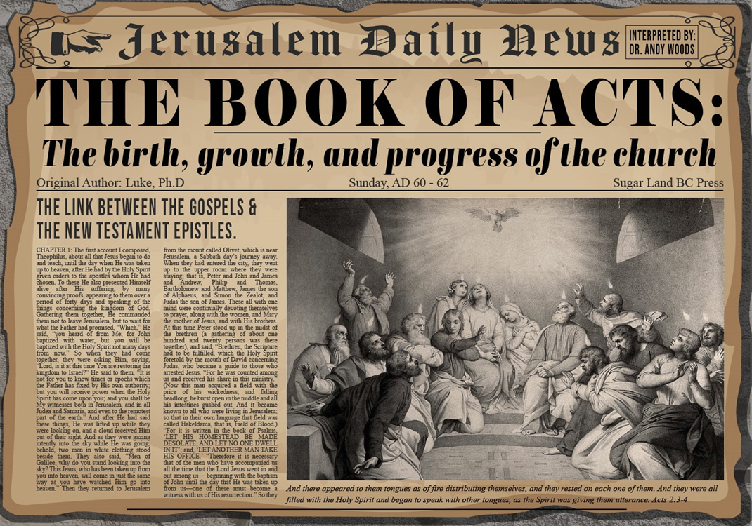
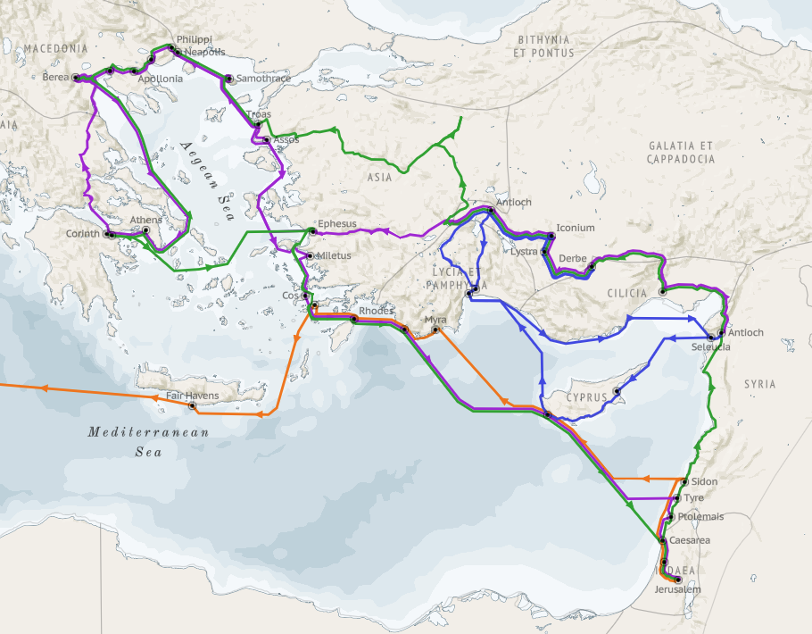
Structure (Acts 1:8)
  Jerusalem (Acts 1–7)
  Judea and Samaria (Acts 8–12)
  Remotest part of the earth (Acts 13–28)
  1st missionary journey (Acts 13–14)
  Jerusalem council (Acts 15:1-35)
  2nd missionary journey (Acts 15:36 –18:22)
  3rd missionary journey (Acts 18:23–21:17)
  Trip to Rome (Acts 21:18–28:31)

Slide 4
Acts 13‒14
1st Missionary Journey
  Paul & Barnabas’ appointment (13:1-3)
  Cyprus ministry (13:4-12)
  Pisidian Antioch ministry (13:13-52)
  Iconium ministry (14:1-7)
  Lystra ministry (14:8-20a)
  Derbe ministry (14:20b-21a)
  Return to Antioch (14:21b-28)

Slide 5
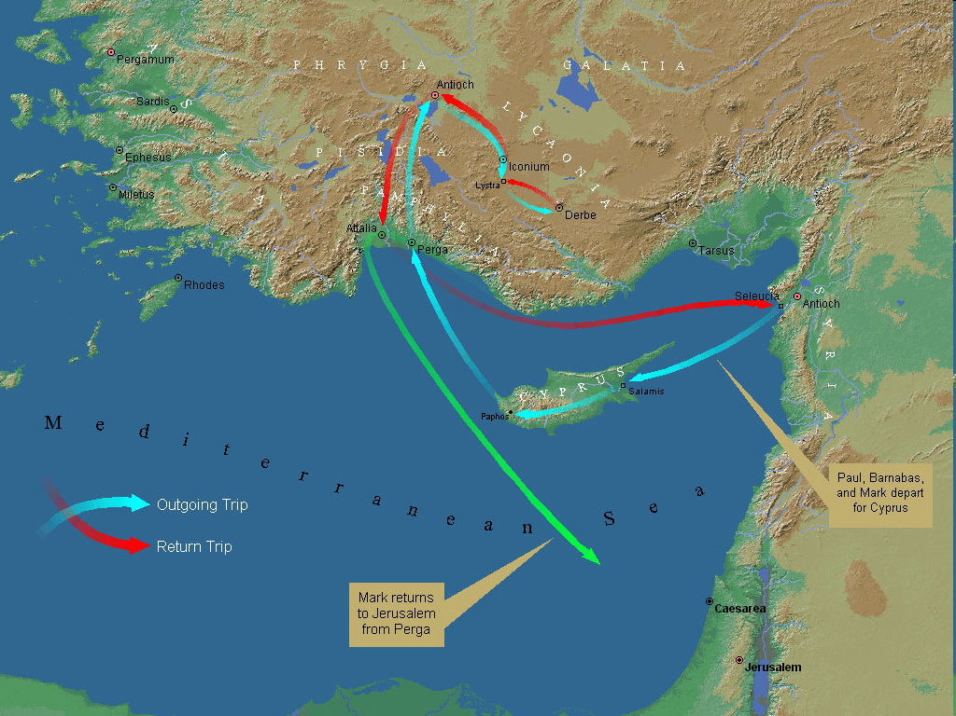
First Missionary Journey

Slide 6
V. Lystra Ministry
Acts 14:8-20a
  Healing (8-10)
  Misidentification (11-13)
  Apostolic reaction (14)
  Apostolic message (15-17)
  Reaction to the message (18-20a)

Slide 7
V. Lystra Ministry
Acts 14:8-20a
  Healing (8-10)
  Misidentification (11-13)
  Apostolic reaction (14)
  Apostolic message (15-17)
  Reaction to the message (18-20a)

Slide 8
Acts 14:8-10
Healing
      Candidate (8)
      Circumstances (9)
      Healing (10)

Slide 9
Acts 14:8-10
Healing
      Candidate (8)
      Circumstances (9)
      Healing (10)

Slide 10
From Peter to Paul
Peter | Paul
Heals a man lame from birth (3:1-11) | Heals a man lame from birth (14:8-18)
Heals by shadow (5:15-16) | Heals by handkerchief (19:11-12)
Success is a cause of jealousy (5:17) | Success is a cause of jealousy (13:45)
Confronts a sorcerer (8:9-24) | Confronts a sorcerer (13:6-11)
Raises Dorcas (9:36-41) | Raises Eutychus (20:9-12)
Jailed and miraculously freed (12:3-19) | Jailed and miraculously freed (16:25-34)

Slide 11
Acts 14:8-10
Healing
      Candidate (8)
      Circumstances (9)
      Healing (10)

Slide 12
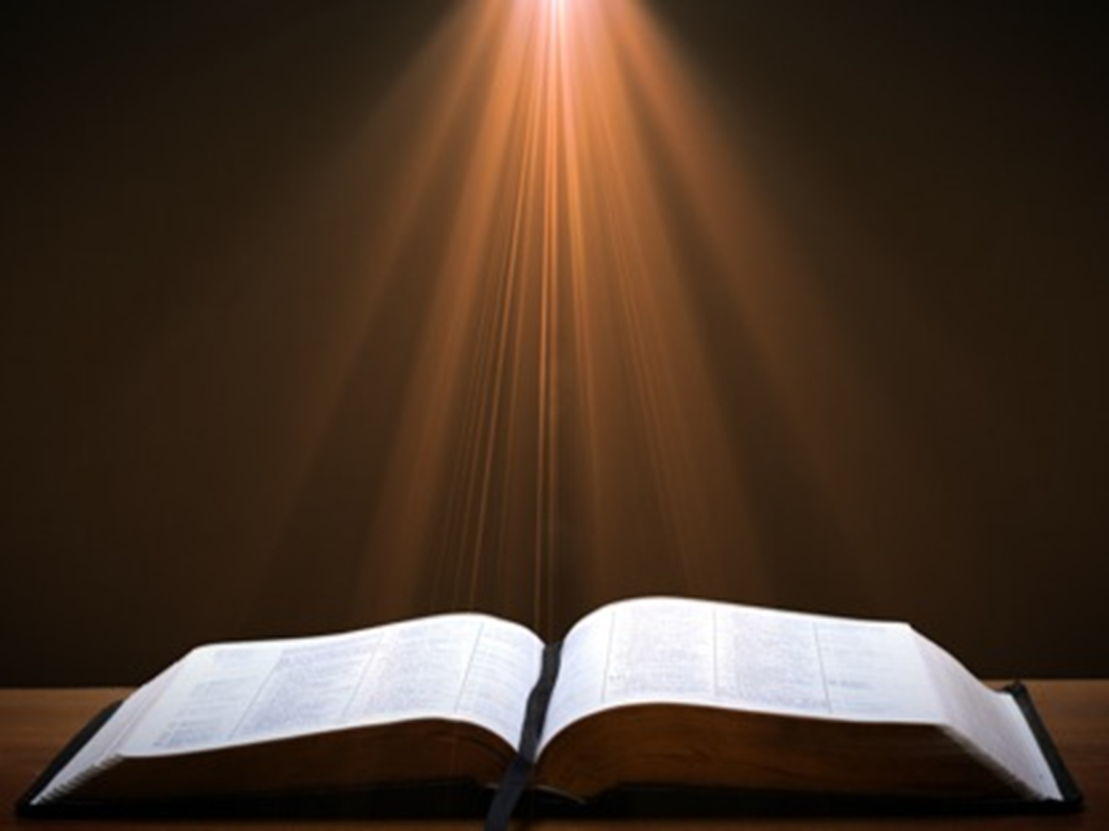
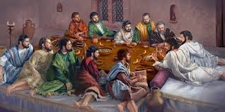
Ephesians 2:20
“having been built on the foundation of the apostles and prophets, Christ Jesus Himself being the corner stone.”

Slide 13
Acts 14:8-10
Healing
      Candidate (8)
      Circumstances (9)
      Healing (10)

Slide 14
From Peter to Paul
Peter | Paul
Heals a man lame from birth (3:1-11) | Heals a man lame from birth (14:8-18)
Heals by shadow (5:15-16) | Heals by handkerchief (19:11-12)
Success is a cause of jealousy (5:17) | Success is a cause of jealousy (13:45)
Confronts a sorcerer (8:9-24) | Confronts a sorcerer (13:6-11)
Raises Dorcas (9:36-41) | Raises Eutychus (20:9-12)
Jailed and miraculously freed (12:3-19) | Jailed and miraculously freed (16:25-34)

Slide 15
V. Lystra Ministry
Acts 14:8-20a
  Healing (8-10)
  Misidentification (11-13)
  Apostolic reaction (14)
  Apostolic message (15-17)
  Reaction to the message (18-20a)

Slide 16
Acts 14:11-13
Misidentification
      General (11)
      Specific (12)
      Sacrificial response (13)

Slide 17
Acts 14:11-13
Misidentification
      General (11)
      Specific (12)
      Sacrificial response (13)

Slide 18
First Missionary Journey

Slide 19
Acts 14:11-13
Misidentification
      General (11)
      Specific (12)
      Sacrificial response (13)

Slide 20
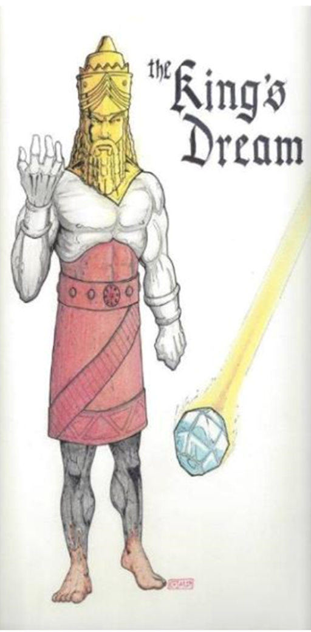

Slide 21

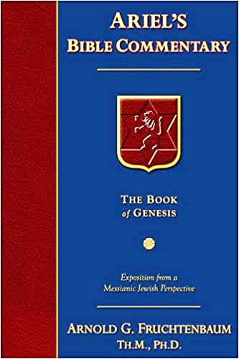
Dr. Arnold G. Fruchtenbaum
The Book of Acts, 306
“It is interesting to note that archaeologists have uncovered records of dedications to both gods by men with Lycaonian names. Bruce explains: ‘Of two inscriptions of Sedasa, near Lystra, dating from c. A.D. 250…one records the dedication to Zeus of a statue of Hermes along with a sundial, by men with Lycaonian names, the other mentions “priests of Zeus”…A further indication of the joint worship of Zeus and Hermes in these parts is probably to be found in a stone altar discovered near Lystra…in 1926, dedicated to the “Hearer of Prayers” (presumably Zeus) and Hermes.’ These archeological findings prove historically what Luke recorded, namely, that Jupiter and Mercury were the two gods jointly worshipped by the people of Lystra.”

Slide 22
Acts 14:11-13
Misidentification
      General (11)
      Specific (12)
      Sacrificial response (13)

Slide 23
Dr. Arnold G. Fruchtenbaum
The Book of Acts, 307
“The sudden urge to sacrifice to two human beings who were mistakenly identified as the gods Jupiter and Mercury can be understood from the background of the legend of Baucis and Philemon. This legend was recorded by the Roman historian Ovid. It claims that Jupiter and Mercury, disguised as men, came down into the Phrygian hill country, but no one in that area was willing to provide hospitality to them, except one elderly couple named Baucis and Philemon. The two gods destroyed the local population for its lack of hospitality, before rewarding Baucis and Philemon by making them the priest and priestess of the temple of Jupiter. This legend was prevalent in Lystra, and because the people had just seen a miracle, they felt that the two gods had come again. Not wanting to be destroyed, they were ready to offer sacrifices.”

Slide 24
V. Lystra Ministry
Acts 14:8-20a
  Healing (8-10)
  Misidentification (11-13)
  Apostolic reaction (14)
  Apostolic message (15-17)
  Reaction to the message (18-20a)

Slide 25
Acts 14:14
Apostolic Reaction
      Greek communication (14a)
      Rending of garments (14b)

Slide 26
Acts 14:14
Apostolic Reaction
      Greek communication (14a)
      Rending of garments (14b)

Slide 27
Acts 14:14
Apostolic Reaction
      Greek communication (14a)
      Rending of garments (14b)

Slide 28
V. Lystra Ministry
Acts 14:8-20a
  Healing (8-10)
  Misidentification (11-13)
  Apostolic reaction (14)
  Apostolic message (15-17)
  Reaction to the message (18-20a)

Slide 29
Acts 14:15-17
Apostolic Reaction
      Question of deniability (15a)
      Mere men & servants (15b)
      Call to repentance (15c)
      God’s attributes (15d-17)

Slide 30
Acts 14:15-17
Apostolic Reaction
      Question of deniability (15a)
      Mere men & servants (15b)
      Call to repentance (15c)
      God’s attributes (15d-17)

Slide 31
Acts 14:15-17
Apostolic Reaction
      Question of deniability (15a)
      Mere men & servants (15b)
      Call to repentance (15c)
      God’s attributes (15d-17)

Slide 32
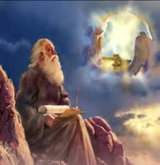
Revelation’s Method of Communication
  From the Father
  to Christ the Son
  to an angel
  to John
  to a book
  to a reader or preacher
  to a listener or the seven churches

Slide 33
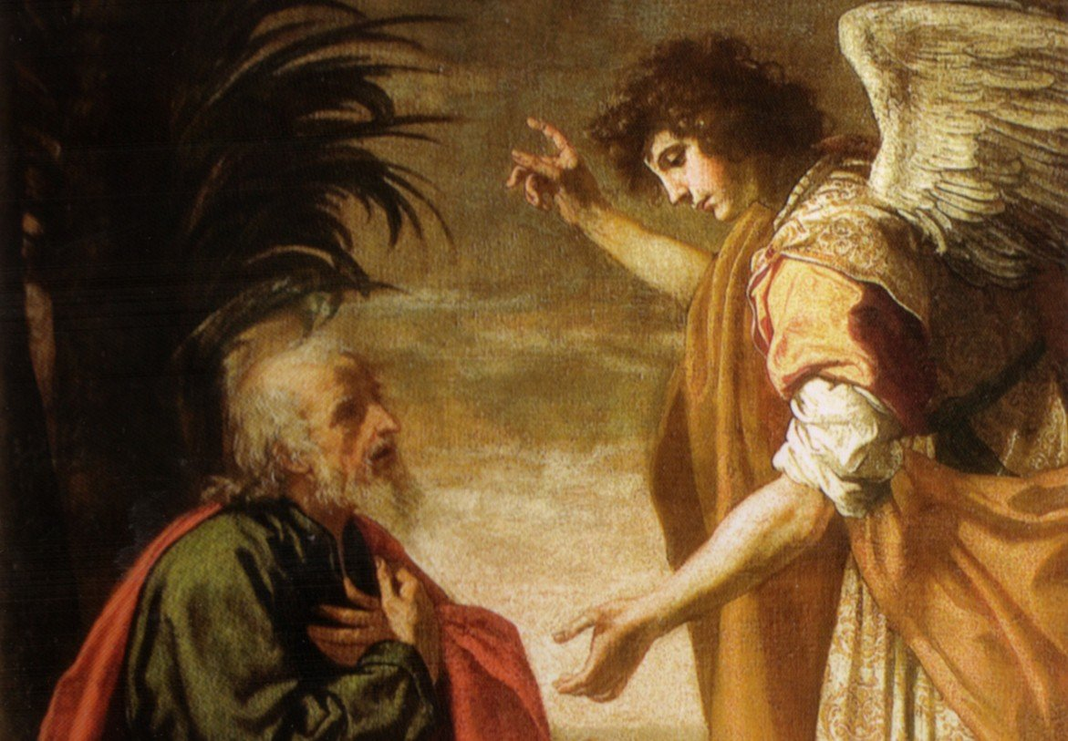
Revelation 19:10
“Then I fell at his feet to worship him. But he said to me, ‘Do not do that; I am a fellow servant of yours and your brethren who hold the testimony of Jesus; worship God. For the testimony of Jesus is the spirit of prophecy.’”

Slide 34
Acts 14:15-17
Apostolic Reaction
      Question of deniability (15a)
      Mere men & servants (15b)
      Call to repentance (15c)
      God’s attributes (15d-17)

Slide 35
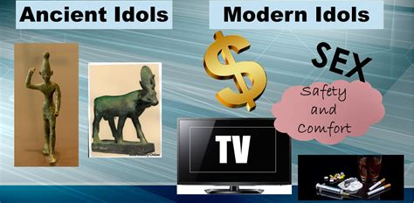
1 Thessalonians 1:9
“For they themselves report about us what kind of a reception we had with you, and how you turned to God from idols to serve a living and true God.”

Slide 36

Revelation 9:20-21
“The rest of mankind, who were not killed by these plagues, did not repent of the works of their hands, so as not to worship demons, and the idols of gold and of silver and of brass and of stone and of wood, which can neither see nor hear nor walk; ²¹ and they did not repent of their murders nor of their sorceries (pharmakov) nor of their immorality nor of their thefts.”

Slide 37
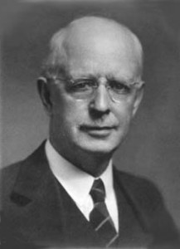
Lewis Sperry Chafer
vol. 7, Systematic Theology (Grand Rapids, MI: Kregel Publications, 1993), 265-66.
“This vital newness of mind is a part of believing, after all, and therefore it may be and is used as a synonym for believing at times (cf. Acts 17:30; 20:21; 26:20; Rom. 2:4; 2Tim. 2:25; 2 Pet. 3:9). Repentance nevertheless cannot be added to believing as a condition of salvation, because upwards of 150 passages of Scripture condition salvation upon believing only (cf. John 3:16; Acts 16:31).”

Slide 38
Acts 14:15-17
Apostolic Reaction
      Question of deniability (15a)
      Mere men & servants (15b)
      Call to repentance (15c)
      God’s attributes (15d-17)

Slide 39
Acts 13:15d-17
God’s Attributes
      Living (15d)
      Creator (15e)
      Patient (16)
      Revealer (17a)
      Good (17b)

Slide 40
Acts 13:15d-17
God’s Attributes
      Living (15d)
      Creator (15e)
      Patient (16)
      Revealer (17a)
      Good (17b)

Slide 41
1 Thessalonians 1:9
“For they themselves report about us what kind of a reception we had with you, and how you turned to God from idols to serve a living and true God.”

Slide 42
CHRIST’S HIGH PRIESTLY ACTIVITIES IN HIS PRESENT SESSION
Sustains creation (Col. 1:16-17)
Head over the Church (Eph. 1:22-23)
Groom of the Church (Eph. 5:22-33)
Building the Church (Matt. 16:18; Acts 2:41; 4:4)
Bestowal of Spiritual Gifts (Eph. 4:7-12)
Melchizedekian High Priestly role (Heb. 6:20)
Keeps the Saints (John 10:27-29; 1 Pet. 1:5)
Intercedes for the Saints (Rom. 8:34; Heb. 7:25)
Advocate for the Saints (Heb. 9:24; 1 John 2:1)
Restores broken fellowship (1 John 1:9)
Disciplines His children (Heb. 12:5-13)

Slide 43
Acts 13:15d-17
God’s Attributes
      Living (15d)
      Creator (15e)
      Patient (16)
      Revealer (17a)
      Good (17b)

Slide 44

Exodus 20:8-11
⁸ “Remember the sabbath day, to keep it holy. ⁹ Six days you shall labor and do all your work, ¹⁰ but the seventh day is a sabbath of the Lord your God; in it you shall not do any work, you or your son or your daughter, your male or your female servant or your cattle or your sojourner who stays with you. ¹¹ For in six days the Lord made the heavens and the earth, the sea and all that is in them, and rested on the seventh day; therefore the Lord blessed the sabbath day and made it holy.”

Slide 45
Exodus 31:15-17
¹⁵ ‘For six days work may be done, but on the seventh day there is a sabbath of complete rest, holy to the Lord; whoever does any work on the sabbath day shall surely be put to death. ¹⁶ ‘So the sons of Israel shall observe the sabbath, to celebrate the sabbath throughout their generations as a perpetual covenant.’ ¹⁷ “It is a sign between Me and the sons of Israel forever; for in six days the Lord made heaven and earth, but on the seventh day He ceased from labor, and was refreshed.”

Slide 46
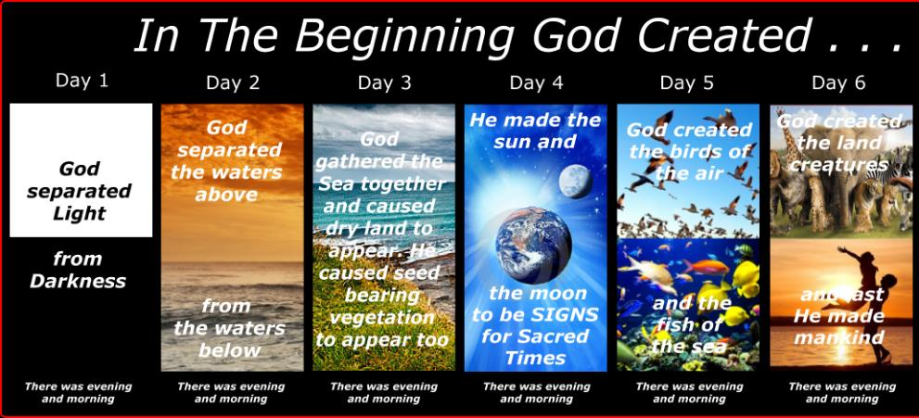
Shaping and Populating (Gen 1:1)
Day 1: | Light | Day 4: | Luminaries
Day 2: | Water, sky | Day 5: | Sea animals, birds
Day 3: | Land, vegetation | Day 6: | Land animals, man

Slide 47

General vs. Special Revelation
 | General | Special
Examples | Nature, conscience (Rom 1–2) | Incarnation, Scripture, miracles
Availability | All | Some
Accomplishment | Accountability (Rom 1) | Salvation (Acts 4:12; 2 Tim 3:15)
Form | Non-written or non-verbal | Written
Quality | Natural | Supernatural, miraculous

Slide 48
Acts 13:15d-17
God’s Attributes
      Living (15d)
      Creator (15e)
      Patient (16)
      Revealer (17a)
      Good (17b)

Slide 49

Genesis 6:1-4
“¹ Now it came about, when men began to multiply on the face of the land, and daughters were born to them, ² that the sons of God saw that the daughters of men were beautiful; and they took wives for themselves, whomever they chose. ³ Then the Lord said, ‘My Spirit shall not strive with man forever, because he also is flesh; nevertheless his days shall be one hundred and twenty years.’ ⁴ The Nephilim were on the earth in those days, and also afterward, when the sons of God came in to the daughters of men, and they bore children to them. Those were the mighty men who were of old, men of renown.”

Slide 50


2 Peter 3:9
“The Lord is not slow about His promise, as some count slowness, but is patient toward you, not wishing for any to perish but for all to come to repentance.”

Slide 51
Acts 13:15d-17
God’s Attributes
      Living (15d)
      Creator (15e)
      Patient (16)
      Revealer (17a)
      Good (17b)

Slide 52
General vs. Special Revelation
 | General | Special
Examples | Nature, conscience (Rom 1–2) | Incarnation, Scripture, miracles
Availability | All | Some
Accomplishment | Accountability (Rom 1) | Salvation (Acts 4:12; 2 Tim 3:15)
Form | Non-written or non-verbal | Written
Quality | Natural | Supernatural, miraculous

Slide 53
Acts 13:15d-17
God’s Attributes
      Living (15d)
      Creator (15e)
      Patient (16)
      Revealer (17a)
      Good (17b)

Slide 54
V. Lystra Ministry
Acts 14:8-20a
  Healing (8-10)
  Misidentification (11-13)
  Apostolic reaction (14)
  Apostolic message (15-17)
  Reaction to the message (18-20a)

Slide 55
Acts 14:18-20a
Reaction to the Message
      Apostolic restraining (18)
      Jewish opposition (19)
      Miraculous recovery (20a)

Slide 56
Acts 14:18-20a
Reaction to the Message
      Apostolic restraining (18)
      Jewish opposition (19)
      Miraculous recovery (20a)

Slide 57
Acts 14:18-20a
Reaction to the Message
      Apostolic restraining (18)
      Jewish opposition (19)
      Miraculous recovery (20a)

Slide 58
First Missionary Journey

Slide 59
Acts 14:18-20a
Reaction to the Message
      Apostolic restraining (18)
      Jewish opposition (19)
      Miraculous recovery (20a)

Slide 60

2 Peter 1:5-7
⁵ “Now for this very reason also, applying all diligence, in your faith supply moral excellence, and in your moral excellence, knowledge, ⁶ and in your knowledge, self-control, and in your self-control, perseverance, and in your perseverance, godliness, ⁷ and in your godliness, brotherly kindness, and in your brotherly kindness, love.”

Slide 61
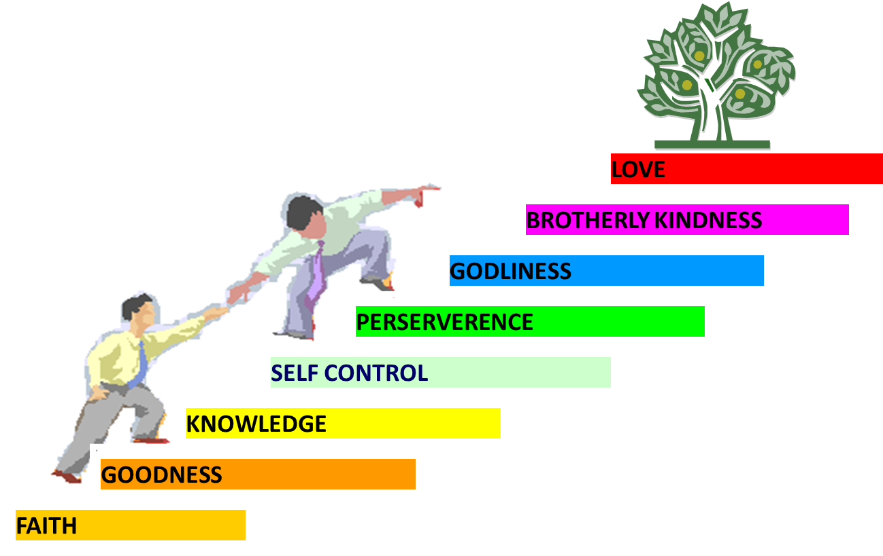
PORTRAIT OF GROWTH
1:5-7

Slide 62
Acts 13‒14
1st Missionary Journey
  Paul & Barnabas’ appointment (13:1-3)
  Cyprus ministry (13:4-12)
  Pisidian Antioch ministry (13:13-52)
  Iconium ministry (14:1-7)
  Lystra ministry (14:8-20a)
  Derbe ministry (14:20b-21a)
  Return to Antioch (14:21b-28)

Slide 63
VI. Derbe Ministry
Acts 14:20b-21a
  Journey to Derbe (20b)
  Ministry in Derbe (20a)

Slide 64
VI. Derbe Ministry
Acts 14:20b-21a
  Journey to Derbe (20b)
  Ministry in Derbe (20a)

Slide 65
First Missionary Journey

Slide 66
VI. Derbe Ministry
Acts 14:20b-21a
  Journey to Derbe (20b)
  Ministry in Derbe (20a)

Slide 67
Acts 13‒14
1st Missionary Journey
  Paul & Barnabas’ appointment (13:1-3)
  Cyprus ministry (13:4-12)
  Pisidian Antioch ministry (13:13-52)
  Iconium ministry (14:1-7)
  Lystra ministry (14:8-20a)
  Derbe ministry (14:20b-21a)
  Return to Antioch (14:21b-28)

Slide 68
VII. Return to Syrian Antioch
Acts 14:21b-28
  Return route (21b)
  Ministries in revisited cities (22-23)
  Route to Antioch (24-26)
  Report to Antioch Church (27-28)

Slide 69
VII. Return to Syrian Antioch
Acts 14:21b-28
  Return route (21b)
  Ministries in revisited cities (22-23)
  Route to Antioch (24-26)
  Report to Antioch Church (27-28)

Slide 70

First Missionary Journey

Slide 71
VII. Return to Syrian Antioch
Acts 14:21b-28
  Return route (21b)
  Ministries in revisited cities (22-23)
  Route to Antioch (24-26)
  Report to Antioch Church (27-28)

Slide 72
Acts 14:22-23
Ministries in revisited cities
      Confirmation (22a)
      Exhortation (22b)
      Appointment of elders (23)

Slide 73
Acts 14:22-23
Ministries in revisited cities
      Confirmation (22a)
      Exhortation (22b)
      Appointment of elders (23)

Slide 74
Acts 14:22-23
Ministries in revisited cities
      Confirmation (22a)
      Exhortation (22b)
      Appointment of elders (23)

Slide 75
Acts 14:22-23
Ministries in revisited cities
      Confirmation (22a)
      Exhortation (22b)
      Appointment of elders (23)

Slide 76

Local Church Government
Episcopalian / bishop rule – Acts 15:2, 6
Congregational rule – Acts 6:1-7
Presbyterian / elder rule – Acts 20:28; 1 Tim 5:17; 4:14

Slide 77
VII. Return to Syrian Antioch
Acts 14:21b-28
  Return route (21b)
  Ministries in revisited cities (22-23)
  Route to Antioch (24-26)
  Report to Antioch Church (27-28)

Slide 78
Acts 14:24-26
Route to Antioch
      Through Pisidia to Pamphylia (24)
      Speaking the Word in Perga (25a)
      To Attalia (25b)
      To Antioch via boat (26)

Slide 79
Acts 14:24-26
Route to Antioch
      Through Pisidia to Pamphylia (24)
      Speaking the Word in Perga (25a)
      To Attalia (25b)
      To Antioch via boat (26)

Slide 80
First Missionary Journey

Slide 81
Acts 14:24-26
Route to Antioch
      Through Pisidia to Pamphylia (24)
      Speaking the Word in Perga (25a)
      To Attalia (25b)
      To Antioch via boat (26)

Slide 82
First Missionary Journey

Slide 83
Acts 14:24-26
Route to Antioch
      Through Pisidia to Pamphylia (24)
      Speaking the Word in Perga (25a)
      To Attalia (25b)
      To Antioch via boat (26)

Slide 84
First Missionary Journey

Slide 85
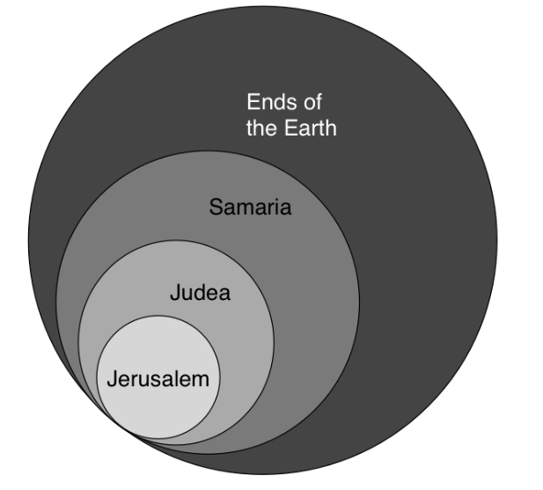
Acts 1:8
“but you will receive power when the Holy Spirit has come upon you; and you shall be My witnesses both in Jerusalem, and in all Judea and Samaria, and even to the remotest part of the earth.”

Slide 86

Acts Message
  Birth and growth of the church numerically, geographically, ethnically.
  Components
  Numerically (progress reports)
  Geographically (From Jerusalem to Rome)
  Ethnically (From Judaism to Gentile domination)

Slide 87
Acts 14:24-26
Route to Antioch
      Through Pisidia to Pamphylia (24)
      Speaking the Word in Perga (25a)
      To Attalia (25b)
      To Antioch via boat (26)

Slide 88
First Missionary Journey

Slide 89
VII. Return to Syrian Antioch
Acts 14:21b-28
  Return route (21b)
  Ministries in revisited cities (22-23)
  Route to Antioch (24-26)
  Report to Antioch Church (27-28)

Slide 90
Acts 14:27-28
Report to the Antioch Church
      Missionary report (27)
      Transitional statement (28)

Slide 91
Acts 14:27-28
Report to the Antioch Church
      Missionary report (27)
      Transitional statement (28)

Slide 92
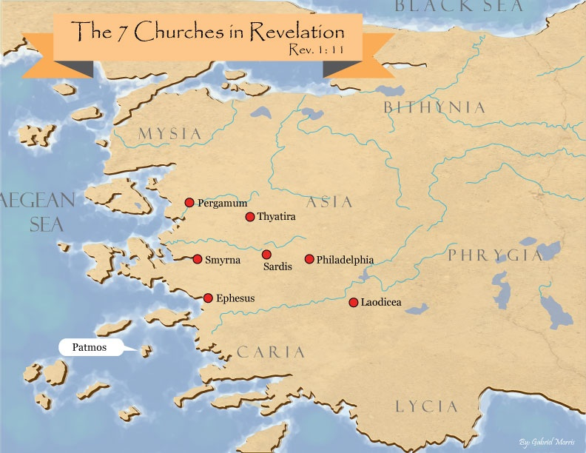
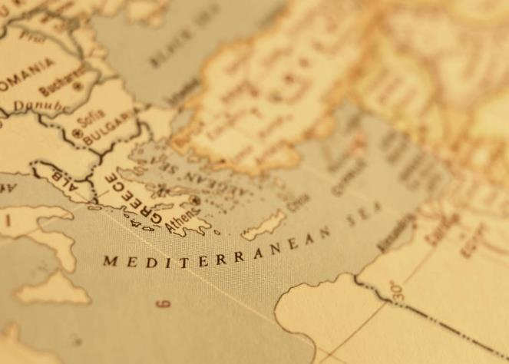

Slide 93
Acts 14:27-28
Report to the Antioch Church
      Missionary report (27)
      Transitional statement (28)

Slide 94
Paul’s Ministry Chronology
# OF BOOKS | JOURNEY | ACTS | DATE | BOOKS
1 | 1 | 13–14 | 48–49 | Gal
2 | 2 | 15:36–18:22 | 50–52 | 1–2 Thess
3 | 3 | 18:23–21:17 | 53–57 | 1–2 Cor, Rom
4 | 4 | 28:16-31 | 60–62 | Eph, Col, Phlm, Phlp
2 | Between Imprisonments | Post Acts | 62–66 | 1 Tim, Titus
1 | 2nd Imprisonment | Post Acts | 67 | 2 Tim

Slide 95
ORDER OF PAUL’S LETTERS | ORDER OF PAUL’S LETTERS
1. | Galatians | A.D. 49
2. | 1‒2 Thessalonians | A.D. 51
3. | 1‒2 Corinthians | A.D. 56
4. | Romans | A.D. 57
5. | Ephesians, Colossians, Philemon, Philippians | A.D. 60‒62
6. | 1 Timothy, Titus | A.D. 62‒66
7. | 2 Timothy | A.D. 67

Slide 96
Conclusion

Slide 97
Acts 13‒14
1st Missionary Journey
  Paul & Barnabas’ appointment (13:1-3)
  Cyprus ministry (13:4-12)
  Pisidian Antioch ministry (13:13-52)
  Iconium ministry (14:1-7)
  Lystra ministry (14:8-20a)
  Derbe ministry (14:20b-21a)
  Return to Antioch (14:21b-28)

