Slide 1



Slide 2

EXODUS STRUCTURE/OUTLINE
Redemption (1–18)
  Redemption (1:1–12:30)
  Liberation (12:31–15:21)
  Preservation (15:22–18:27)
Mosaic Covenant (19–40)
  Law (19–24)
  Tabernacle instructions (25–31)
  Apostasy (32–34)
  Tabernacle building (35–40)

Slide 3
REDEMPTION
(1:1–12:30)
Why redemption is necessary (Exod 1)
Development of the deliverer (Exod 2–4)
First confrontation with Pharaoh (Exod 5)
God reassures Moses (Exod 6:1–7:7)
Second confrontation with Pharaoh (Exod 7:18-13)
Plagues (Exod 7:14–12:30)

Slide 4
1st MEETING WITH PHARAOH
Exodus 5:1-23
  Problem of Pharaoh (1-19)
  Problem of Israel (20-23)

Slide 5
II. Exodus 5:1-19
Problem of Israel
    Israel complains to Moses (20-21)
    Moses complains to God (22-23)

Slide 6
II. Exodus 5:1-19
Problem of Israel
    Israel complains to Moses (20-21)
    Moses complains to God (22-23)

Slide 7
Exodus 5:20-21
Israel Complains to Moses
      The meeting (20)
      The complaint (21)

Slide 8
Exodus 5:20-21
Israel Complains to Moses
      The meeting (20)
      The complaint (21)

Slide 9
Exodus 5:20-21
Israel Complains to Moses
      The meeting (20)
      The complaint (21)

Slide 10

Local Church Government
Episcopalian / bishop rule – Acts 15:2, 6
Congregational rule – Acts 6:1-7
Presbyterian / elder rule – Acts 20:28; 1 Tim 5:17; 4:14

Slide 11
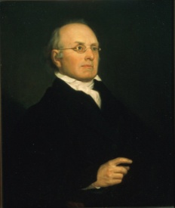
Joseph Story
"The next amendment is: ‘A well regulated militia being necessary to the security of a free state, the right of the people to keep and bear arms shall not be infringed.’ The importance of this article will scarcely be doubted by any persons, who have duly reflected upon the subject…The right of the citizens to keep and bear arms has justly been considered, as the palladium of the liberties of a republic since it offers a strong moral check against the. . ."
Joseph Story, Commentaries on the Constitution of the United States (Boston, MA: Hilliard, Gray, 1833), 3:746-747, sections 1889-1890.

Slide 12
Joseph Story
“…usurpation and arbitrary power of rulers; and will generally, even if these are successful in the first instance, enable the people to resist and triumph over them…There is certainly no small danger, that indifference may lead to disgust, and disgust to contempt; and thus gradually undermine all the protection intended by this clause of our national bill of rights."
Joseph Story, Commentaries on the Constitution of the United States (Boston, MA: Hilliard, Gray, 1833), 3:746-747, sections 1889-1890.

Slide 13
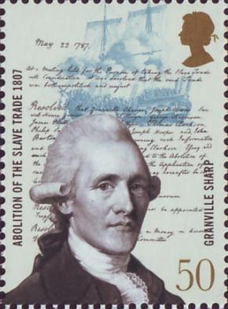
Granville Sharp
"No Englishman can be truly loyal who opposed the principles of English law whereby the people are required to have arms of defence in peace, for mutual as well as private defence…The laws of England always required the people to be armed, and not only armed, but to be expert in arms."
Les Adams, The Second Amendment Primer: A Citizen’s Guidebook to the History, Sources, and Authorities for the Constitutional Guarantee of the Right to Keep and Bear Arms (NY: Skyhorse, 2013), 63.

Slide 14


Slide 15
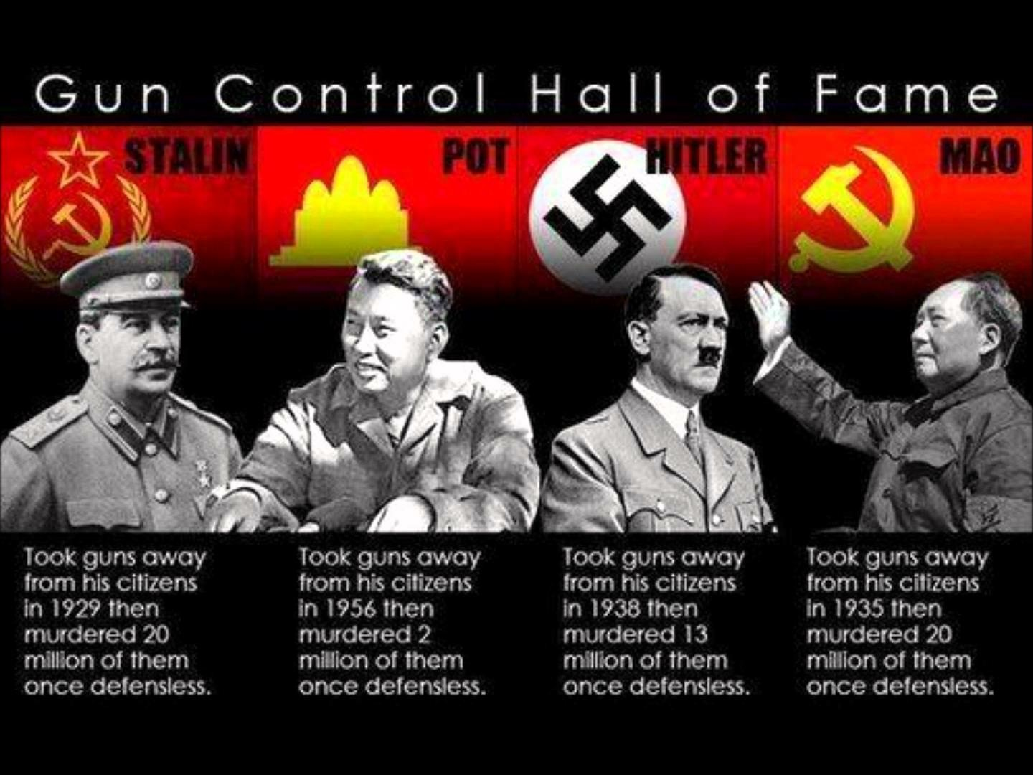

Slide 16


Slide 17
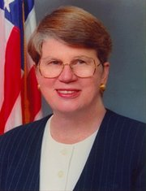
Speech by Attorney General Janet Reno, Newark, New Jersey, May 5, 1995. Quoted in James Bovard, “Waco Must Get a Hearing,” Wall Street Journal, May 15, 1995.
Former Attorney General Janet Reno
“You are part of a government that has given its people more freedom…than any other government in the history of the world.”

Slide 18
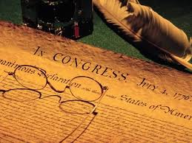
Declaration of Independence
“the Laws of Nature and of Nature’s God,”
“we hold these truths to be self evident, that all men are created equal,”
“they are endowed by their Creator with certain unalienable Rights,”
“appealing to the Supreme Judge of the world for the rectitude of our intentions,”
“with firm reliance on the protection of Divine Providence.”
Church of the Holy Trinity v. U.S., 143 U.S. 457, 467-68 (1892)

Slide 19
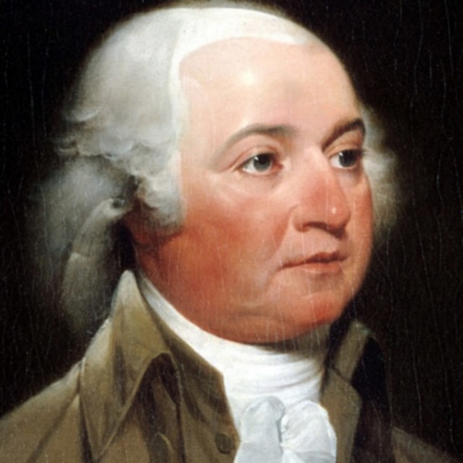
John Adams
John Adams - America's second President "Rights [are] antecedent to all earthly government; Rights...cannot be repealed or restrained by human laws; Rights [are] derived from the great Legislature of the universe."
John Adams, The Works of John Adams, Second President of the United States, ed. Charles Francis Adams, 10 vols. (Boston: Little, Brown, 1856), 3:449.

Slide 20


Slide 21
II. Exodus 5:1-19
Problem of Israel
    Israel complains to Moses (20-21)
    Moses complains to God (22-23)

Slide 22
Exodus 5:22-23
Moses Complains to God
      Worsening situation (22)
      No deliverance (23)

Slide 23
Exodus 5:22-23
Moses Complains to God
      Worsening situation (22)
      No deliverance (23)

Slide 24
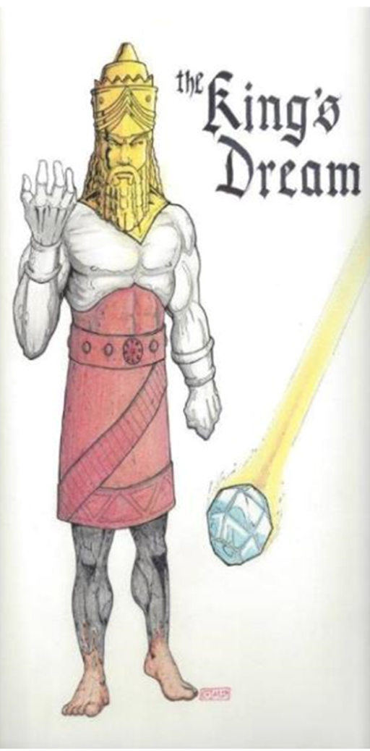

Slide 25
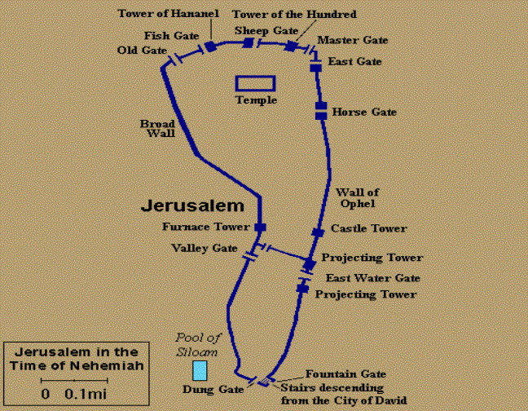
Gates of Nehemiah

Slide 26
Exodus 5:22-23
Moses Complains to God
      Worsening situation (22)
      No deliverance (23)

Slide 27
The Plagues of Egypt
NO. | DESCRIPTION | SCRIPTURE | Egyptian Deity
1. | Water to Blood | Exod. 7:14-25 | Hapi, Khnum
2. | Frogs | Exod. 8:1-15 | Heqt
3. | Gnats | Exod. 8:16-19 | Set
4. | Flies | Exod. 8:20-32 | Uatchit
5. | Disease on Cattle | Exod. 9:1-7 | Hathor, Apis
6. | Boils | Exod. 9:8-12 | Sekhmet, Serapis
7. | Hail | Exod. 9:13-35 | Seth, Nut
8. | Locusts | Exod. 10:1-20 | Seth, Nut, Osiris
9. | Darkness | Exod. 10:21-29 | Re, Horus, Atum
10. | Death of the First Born | Exod. 12:29-36 | Min, Osiris, Heqt, Isis

Slide 28
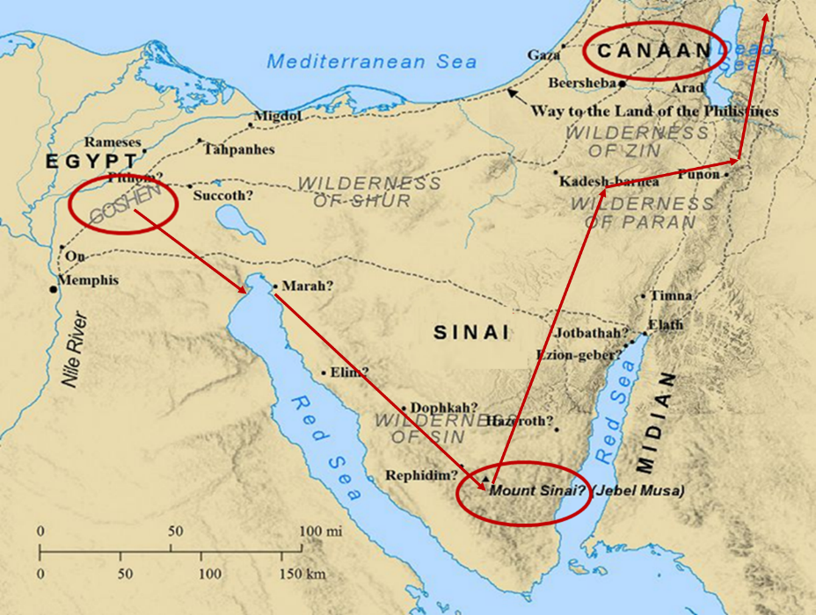

Slide 29
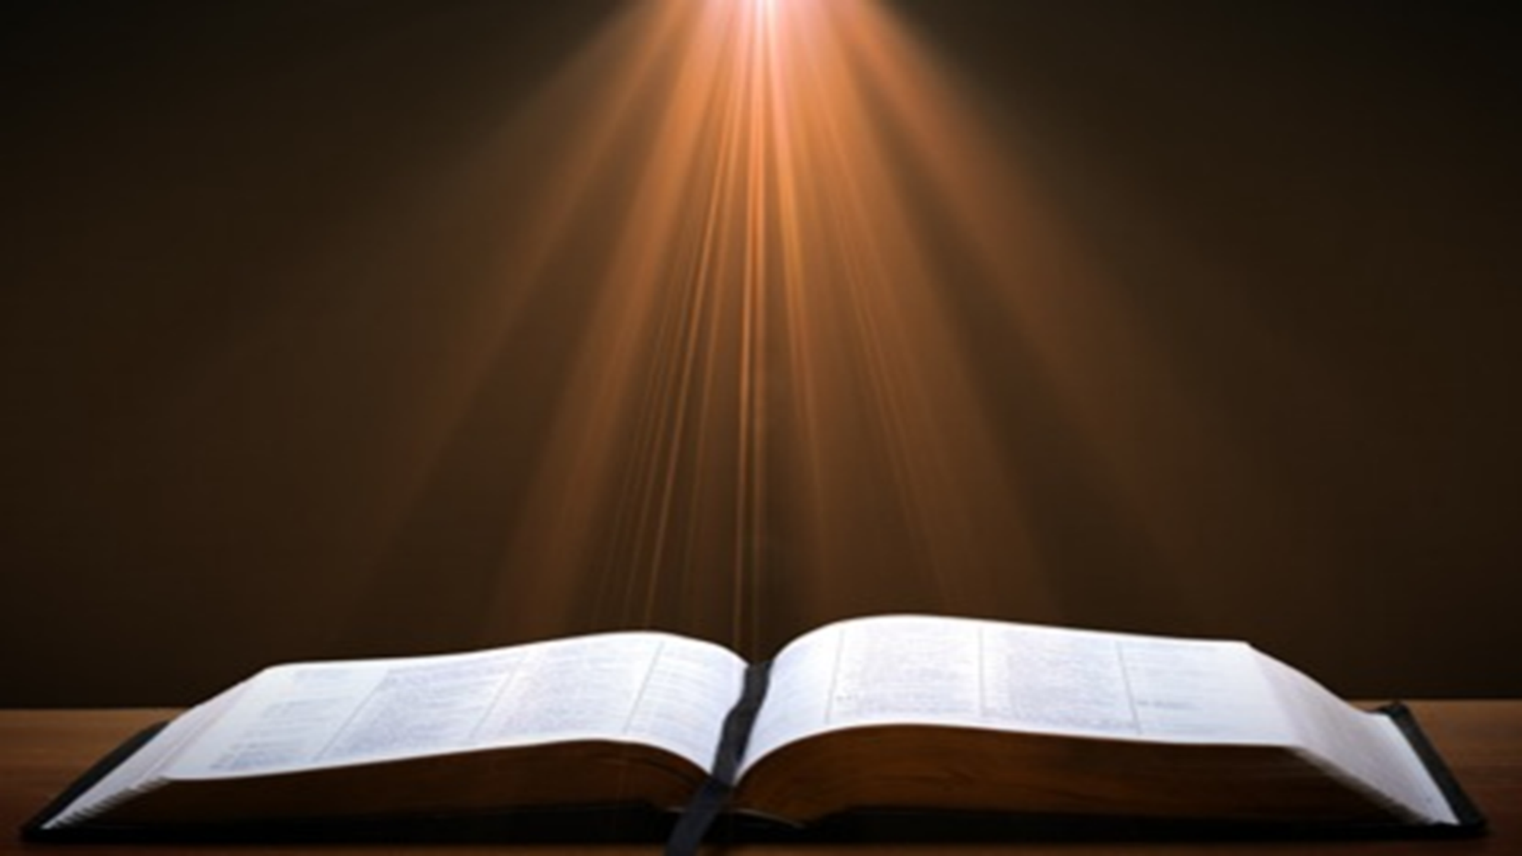
Romans 8:19-23
¹⁹ For the anxious longing of the creation waits eagerly for the revealing of the sons of God. ²⁰ For the creation was subjected to futility, not willingly, but because of Him who subjected it, in hope ²¹ that the creation itself also will be set free from its slavery to corruption into the freedom of the glory of the children of God. ²² For we know that the whole creation groans and suffers the pains of childbirth together until now. ²³ And not only this, but also we ourselves, having the first fruits of the Spirit, even we ourselves groan within ourselves, waiting eagerly for our adoption as sons, the redemption of our body.”

Slide 30
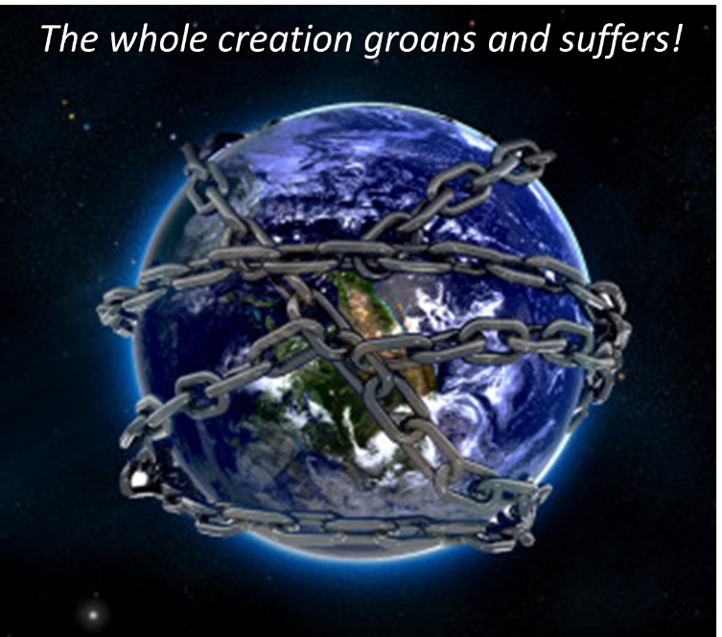

Slide 31
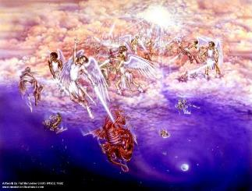
Satan as Ruler of this World
Job 1:7; 2:2
Luke 4:5-7
John 12:31; 14:30; 16:11
2 Corinthians 4:4
Ephesians 2:2
1 John 4:4; 5:19

Slide 32

Names & Titles Demonstrating Satan’s Post-Fall, Earthly Authority
(Job 1:7; 2:2; Luke 4:5-8; Rom. 8:19-22)
Prince of this world (John 12:31; 14:30; 16:11)
God of this age (2 Cor. 4:4)
Prince and power of the air (Eph. 2:2)
Who the believer wrestles with (Eph. 6:12)
Roaring lion (1 Pet. 5:8)
Whole world lies in his power (1 John 5:19)

Slide 33
Ultimate Exodus
(Rev 11:15)
Sores: 6th plague (Ex 9:8-12), 1st bowl (Rev 16:1-2)
Rivers to blood: 1st plague (Ex 7:19-21), 3rd bowl (Rev 16:4-7)
Darkness: 9th plague (Ex 10:21-23), 5th bowl (Rev 16:10-11)
Frogs: 2nd plague (Ex 7:25‒8:15), 6th bowl (Rev 16:13)
Hail: 7th plague (Ex 9:22-26), 7th bowl (Rev 16:17-21)

Slide 34

2 Peter 1:19-21
“¹⁹ So we have the prophetic word made more sure, to which you do well to pay attention as to a lamp shining in a dark place, until the day dawns and the morning star arises in your hearts. ²⁰ But know this first of all, that no prophecy of Scripture is a matter of one’s own interpretation, ²¹ for no prophecy was ever made by an act of human will, but men moved by the Holy Spirit spoke from God.”
Notes:
Psa 119:105 – lamp of prophecy

Slide 35
AUTHORITY OF SCRIPTURE
V. 19
More sure than eyewitness testimony
World is in the Dark, Scripture is the Light
Morning Star = Jesus
  Rev. 2:28; 22:16

Slide 36

Revelation 2:28; 22:16
“^{2:28} and I will give him the morning star... ^{22:16} “I, Jesus, have sent My angel to testify to you these things for the churches. I am the root and the descendant of David, the bright morning star.”

Slide 37
Conclusion

Slide 38
1st MEETING WITH PHARAOH
Exodus 5:1-23
  Problem of Pharaoh (1-19)
  Problem of Israel (20-23)

Slide 39
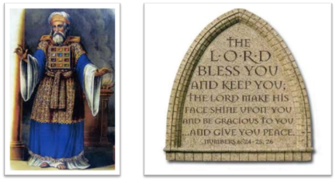
²⁴ The Lord bless you, and keep you; ²⁵ The Lord make His face shine on you, And be gracious to you; ²⁶ The Lord lift up His countenance on you, And give you peace.
Numbers 6:24–26 (NASB95)

