Slide 1
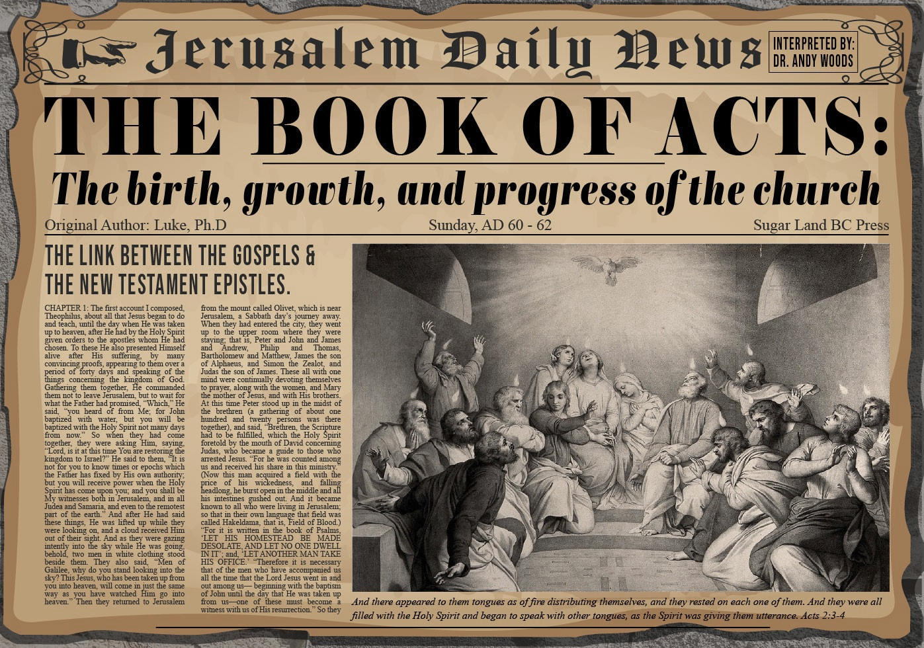


Slide 2
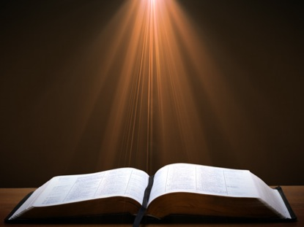
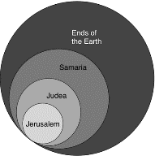
Acts 1:8
“but you will receive power when the Holy Spirit has come upon you; and you shall be My witnesses both in Jerusalem, and in all Judea and Samaria, and even to the remotest part of the earth.”

Slide 3
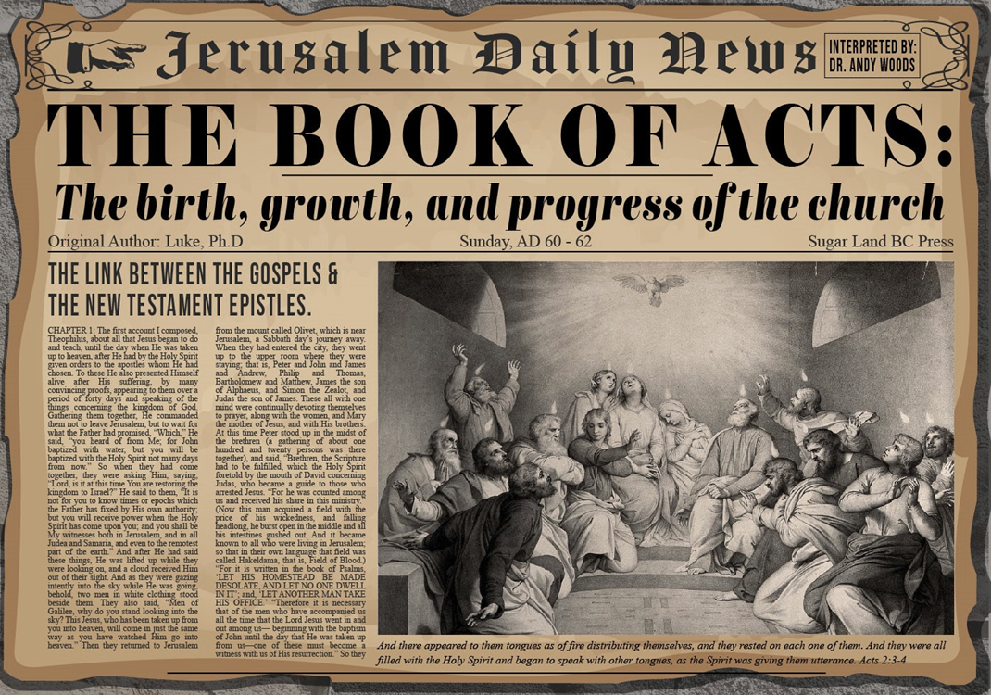
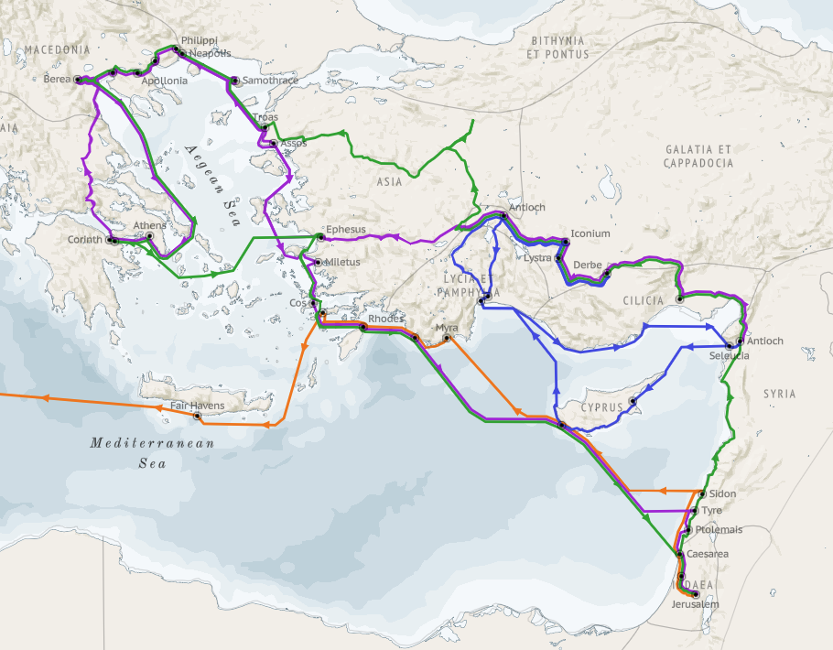
Structure (Acts 1:8)
  Jerusalem (Acts 1–7)
  Judea and Samaria (Acts 8–12)
  Remotest part of the earth (Acts 13–28)
  1st missionary journey (Acts 13–14)
  Jerusalem council (Acts 15:1-35)
  2nd missionary journey (Acts 15:36 –18:22)
  3rd missionary journey (Acts 18:23–21:17)
  Trip to Rome (Acts 21:18–28:31)

Slide 4
Acts 13‒14
1st Missionary Journey
  Paul & Barnabas’ appointment (13:1-3)
  Cyprus ministry (13:4-12)
  Pisidian Antioch ministry (13:13-52)
  Iconium ministry (14:1-7)
  Lystra ministry (14:8-20a)
  Derbe ministry (14:20b-21a)
  Return to Antioch (14:21b-28)

Slide 5
IV. Iconium Ministry
Acts 14:1-7
  Preaching (1)
  Unbelieving response (2)
  Ministry (3)
  Division (4)
  Conspiracy (5)
  Escape to Lystra & Derbe (6)
  Lystra & Derbe ministry introduction (7)

Slide 6
IV. Iconium Ministry
Acts 14:1-7
  Preaching (1)
  Unbelieving response (2)
  Ministry (3)
  Division (4)
  Conspiracy (5)
  Escape to Lystra & Derbe (6)
  Lystra & Derbe ministry introduction (7)

Slide 7
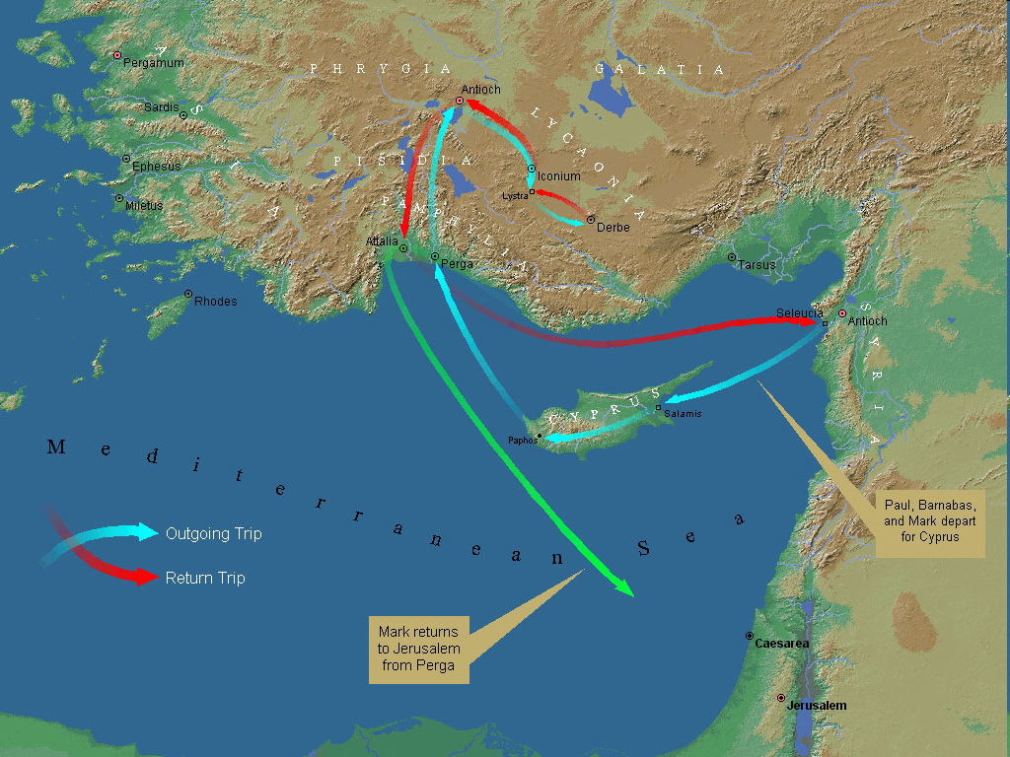
First Missionary Journey

Slide 8
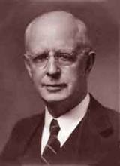
Lewis Sperry Chafer, vol. 7, Systematic Theology
(Grand Rapids, MI: Kregel Publications, 1993), 265-66.
Belief-God’s One Condition for Justification
“…because upwards of 150 passages of Scripture condition salvation upon believing only (cf. John 3:16; Acts 16:31).”

Slide 9
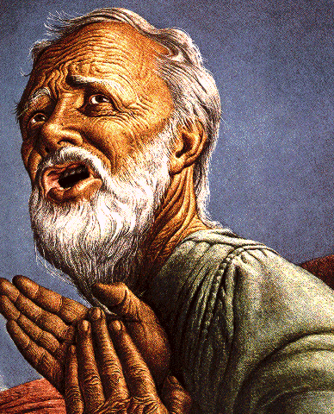
Belief – God’s One Condition for Justification
Gen 15:6
Then he believed in the LORD; and He reckoned it to him as righteousness.
John 3:16
For God so loved the world, that He gave His only begotten Son, that whoever believes in Him shall not perish, but have eternal life.
Acts 16:30-31
"Sirs, what must I do to be saved?" They said, "Believe in the Lord Jesus, and you will be saved..."

Slide 10
IV. Iconium Ministry
Acts 14:1-7
  Preaching (1)
  Unbelieving response (2)
  Ministry (3)
  Division (4)
  Conspiracy (5)
  Escape to Lystra & Derbe (6)
  Lystra & Derbe ministry introduction (7)

Slide 11
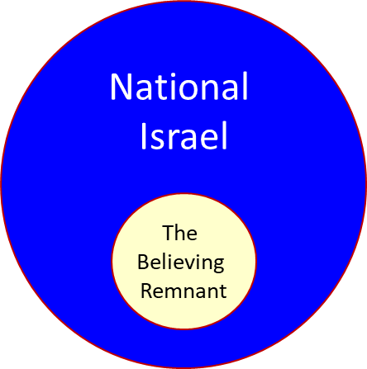

Slide 12
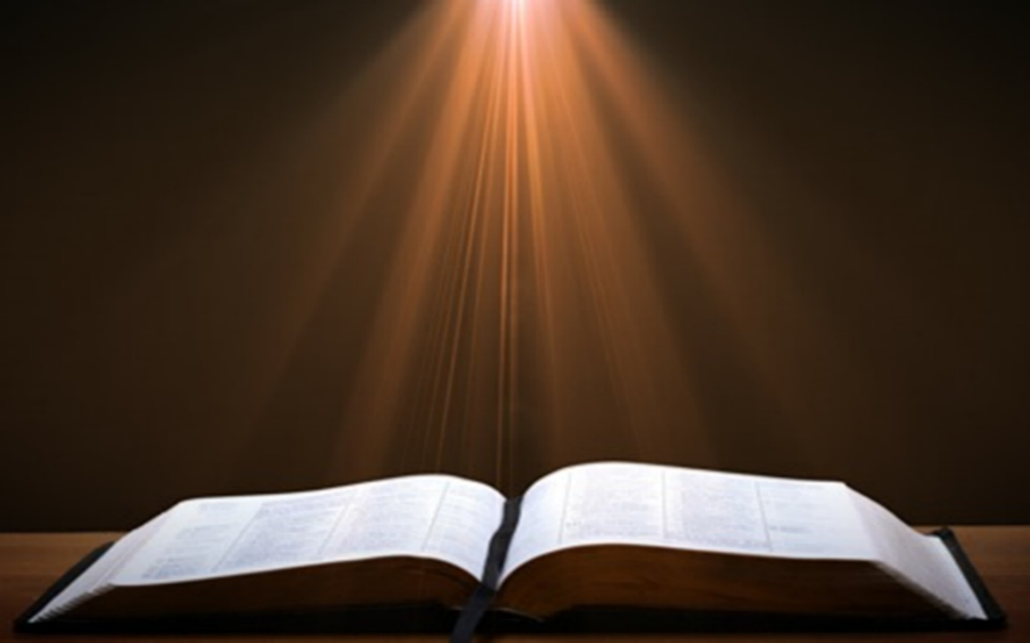
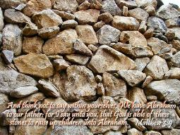
Matthew 3:9
“and do not suppose that you can say to yourselves, ‘We have Abraham for our father’; for I say to you that from these stones God is able to raise up children to Abraham.”

Slide 13


Romans 2:28-29
“²⁸ For he is not a Jew who is one outwardly, nor is circumcision that which is outward in the flesh. ²⁹ But he is a Jew who is one inwardly; and circumcision is that which is of the heart, by the Spirit, not by the letter; and his praise is not from men, but from God.”

Slide 14
Romans 9:6
“But it is not as though the word of God has failed. For they are not all Israel who are descended from Israel.”

Slide 15
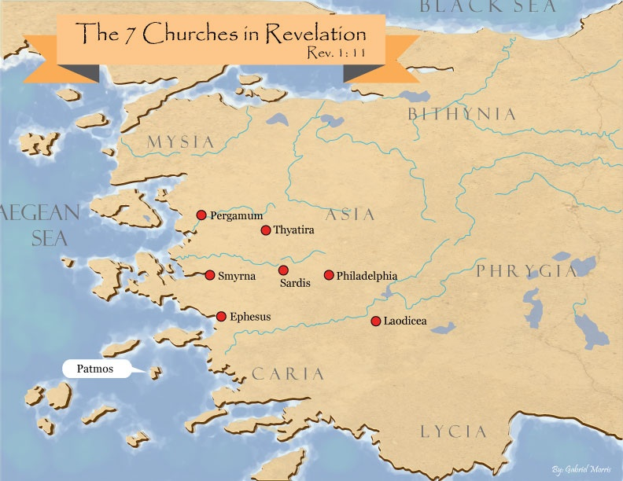
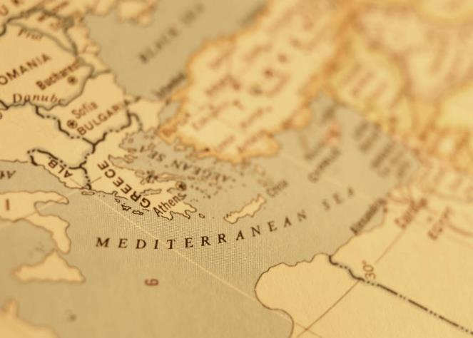

Slide 16

Revelation 2:9
“I know your tribulation and your poverty (but you are rich), and the blasphemy by those who say they are Jews and are not, but are a synagogue of Satan.”

Slide 18
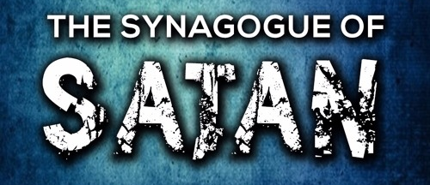
Revelation 3:9
“Behold, I will cause those of the synagogue of Satan, who say that they are Jews and are not, but lie—I will make them come and bow down at your feet, and make them know that I have loved you.”

Slide 19

Zechariah 13:8-9
⁸“It will come about in all the land,” Declares the Lord, “That two parts in it will be cut off and perish; But the third will be left in it. ⁹“And I will bring the third part through the fire, Refine them as silver is refined, And test them as gold is tested. They will call on My name, And I will answer them; I will say, ‘They are My people,’ And they will say, ‘The Lord is my God.’ ”

Slide 20
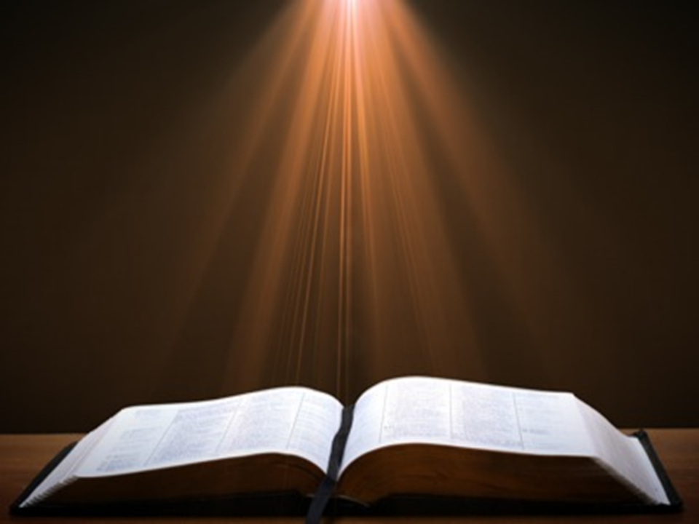
Ezekiel 20:33-38
³³ “As I live,” declares the Lord God, “surely with a mighty hand and with an outstretched arm and with wrath poured out, I shall be king over you. ³⁴ I will bring you out from the peoples and gather you from the lands where you are scattered, with a mighty hand and with an outstretched arm and with wrath poured out; ³⁵ and I will bring you into the wilderness of the peoples, and there I will enter into judgment with you face to face. ³⁶ As I entered into . . .

Slide 21
Ezekiel 20:33-38
. . . judgment with your fathers in the in the wilderness of the land of Egypt, so I will enter into judgment with you,” declares the Lord God. ³⁷ “I will make you pass under the rod, and I will bring you into the bond of the covenant; ³⁸ and I will purge from you the rebels and those who transgress against Me; I will bring them out of the land where they sojourn, but they will not enter the land of Israel. Thus you will know that I am the Lord.

Slide 22
IV. Iconium Ministry
Acts 14:1-7
  Preaching (1)
  Unbelieving response (2)
  Ministry (3)
  Division (4)
  Conspiracy (5)
  Escape to Lystra & Derbe (6)
  Lystra & Derbe ministry introduction (7)

Slide 23

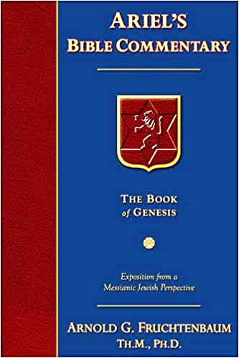
Dr. Arnold G. Fruchtenbaum
The Book of Acts, 303
“To authenticate the message of grace, God granted signs and wonders to be done by their hands. Again, only the apostles and their [de]legates (Acts 5:16; 8:7; 16:18; 19:11-12) were able to do these signs and wonders. This may be what Galatians 3:5 refers to, when it states: ‘He therefore that supplies to you the Spirit, and works miracles among you, does he it by the works of the law, or by the hearing of faith?’ Miracles were not being done on the basis of the Mosaic Law, but on the basis of grace through faith.”

Slide 24

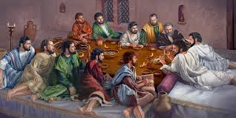
Ephesians 2:20
“having been built on the foundation of the apostles and prophets, Christ Jesus Himself being the corner stone.”

Slide 25
IV. Iconium Ministry
Acts 14:1-7
  Preaching (1)
  Unbelieving response (2)
  Ministry (3)
  Division (4)
  Conspiracy (5)
  Escape to Lystra & Derbe (6)
  Lystra & Derbe ministry introduction (7)

Slide 26
IV. Iconium Ministry
Acts 14:1-7
  Preaching (1)
  Unbelieving response (2)
  Ministry (3)
  Division (4)
  Conspiracy (5)
  Escape to Lystra & Derbe (6)
  Lystra & Derbe ministry introduction (7)

Slide 27
Acts 14:5
Conspiracy
      Rushing (5a)
      Shaming (5b)
      Execution (5c)

Slide 28
Acts 14:5
Conspiracy
      Rushing (5a)
      Shaming (5b)
      Execution (5c)

Slide 29
Acts 14:5
Conspiracy
      Rushing (5a)
      Shaming (5b)
      Execution (5c)

Slide 30
Acts 14:5
Conspiracy
      Rushing (5a)
      Shaming (5b)
      Execution (5c)

Slide 31
IV. Iconium Ministry
Acts 14:1-7
  Preaching (1)
  Unbelieving response (2)
  Ministry (3)
  Division (4)
  Conspiracy (5)
  Escape to Lystra & Derbe (6)
  Lystra & Derbe ministry introduction (7)

Slide 32
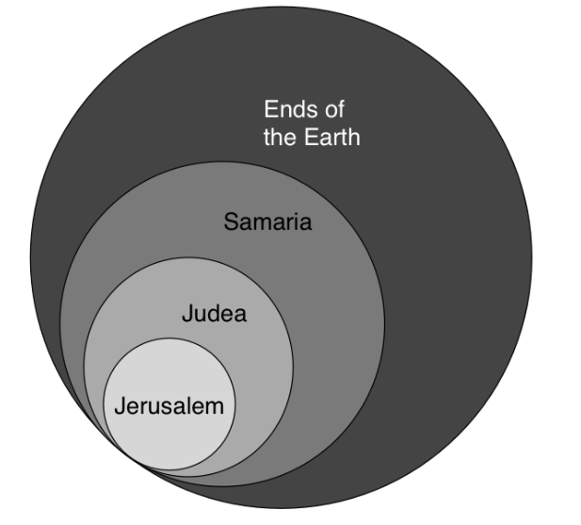
Acts 1:8
“but you will receive power when the Holy Spirit has come upon you; and you shall be My witnesses both in Jerusalem, and in all Judea and Samaria, and even to the remotest part of the earth.”

Slide 33
First Missionary Journey

Slide 34
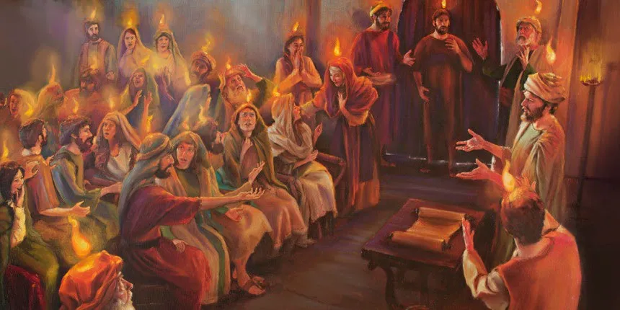
Unique Characteristics
  Sermons
  Miracles wrought by the Holy Spirit
  Background for Pauline letters
  Accurate history
  Places and names
  Volume
  Gentile

Slide 35

Acts Message
  Birth and growth of the church numerically, geographically, ethnically.
  Components
  Numerically (progress reports)
  Geographically (From Jerusalem to Rome)
  Ethnically (From Judaism to Gentile domination)

Slide 36
IV. Iconium Ministry
Acts 14:1-7
  Preaching (1)
  Unbelieving response (2)
  Ministry (3)
  Division (4)
  Conspiracy (5)
  Escape to Lystra & Derbe (6)
  Lystra & Derbe ministry introduction (7)

Slide 37
Conclusion

Slide 38
Acts 13‒14
1st Missionary Journey
  Paul & Barnabas’ appointment (13:1-3)
  Cyprus ministry (13:4-12)
  Pisidian Antioch ministry (13:13-52)
  Iconium ministry (14:1-7)
  Lystra ministry (14:8-20a)
  Derbe ministry (14:20b-21a)
  Return to Antioch (14:21b-28)

Slide 39
IV. Iconium Ministry
Acts 14:1-7
  Preaching (1)
  Unbelieving response (2)
  Ministry (3)
  Division (4)
  Conspiracy (5)
  Escape to Lystra & Derbe (6)
  Lystra & Derbe ministry introduction (7)

Slide 40
Acts 13‒14
1st Missionary Journey
  Paul & Barnabas’ appointment (13:1-3)
  Cyprus ministry (13:4-12)
  Pisidian Antioch ministry (13:13-52)
  Iconium ministry (14:1-7)
  Lystra ministry (14:8-20a)
  Derbe ministry (14:20b-21a)
  Return to Antioch (14:21b-28)

