Slide 1



Slide 2


Slide 3

EXODUS STRUCTURE/OUTLINE
Redemption (1–18)
  Redemption (1:1–12:30)
  Liberation (12:31–15:21)
  Preservation (15:22–18:27)
Mosaic Covenant (19–40)
  Law (19–24)
  Tabernacle instructions (25–31)
  Apostasy (32–34)
  Tabernacle building (35–40)

Slide 4
REDEMPTION
(1:1–12:30)
Why redemption is necessary (Exod 1)
Development of the deliverer (Exod 2–4)
First confrontation with Pharaoh (Exod 5)
God reassures Moses (Exod 6:1–7:7)
Second confrontation with Pharaoh (Exod 7:18-13)
Plagues (Exod 7:14–12:30)

Slide 5
1st MEETING WITH PHARAOH
Exodus 5:1-23
  Problem of Pharaoh (1-19)
  Problem of Israel (20-23)

Slide 6
I. Exodus 5:1-19
Problem of Pharaoh
    Request of Pharaoh (1)
    Refusal by Pharaoh (2)
    Request of Pharaoh (3)
    Pharaoh increases Israel’s burden (4-19)

Slide 7
Exodus 5:4-19
Pharaoh Increases Israel’s Burden
      Orders to Moses & Aaron (4-5)
      Orders to taskmasters & foremen (6-9)
      Orders followed (10-14)
      Foremens’ response (15-19)

Slide 8
Exodus 5:4-19
Pharaoh Increases Israel’s Burden
      Orders to Moses & Aaron (4-5)
      Orders to taskmasters & foremen (6-9)
      Orders followed (10-14)
      Foremens’ response (15-19)

Slide 9
Exodus 5:4-19
Pharaoh Increases Israel’s Burden
      Orders to Moses & Aaron (4-5)
      Orders to taskmasters & foremen (6-9)
      Orders followed (10-14)
      Foremens’ response (15-19)

Slide 10
Exodus 5:4-19
Pharaoh Increases Israel’s Burden
      Orders to Moses & Aaron (4-5)
      Orders to taskmasters & foremen (6-9)
      Orders followed (10-14)
      Foremens’ response (15-19)

Slide 11
Exodus 5:10-14
Orders Followed
      Burden upon Israel (10-13)
      Burden upon the foremen (14)

Slide 12
Exodus 5:10-14
Orders Followed
      Burden upon Israel (10-13)
      Burden upon the foremen (14)

Slide 13
Exodus 5:10-14
Orders Followed
      Burden upon Israel (10-13)
      Burden upon the foremen (14)

Slide 14
Exodus 5:4-19
Pharaoh Increases Israel’s Burden
      Orders to Moses & Aaron (4-5)
      Orders to taskmasters & foremen (6-9)
      Orders followed (10-14)
      Foremens’ response (15-19)

Slide 15
Exodus 5:10-14
Foremens’ Response
      To Pharaoh (15-16)
      Pharaoh’s response (17-18)
      Foremens’ reaction (19)

Slide 16
Exodus 5:10-14
Foremens’ Response
      To Pharaoh (15-16)
      Pharaoh’s response (17-18)
      Foremens’ reaction (19)

Slide 17
Exodus 5:10-14
Foremens’ Response
      To Pharaoh (15-16)
      Pharaoh’s response (17-18)
      Foremens’ reaction (19)

Slide 18
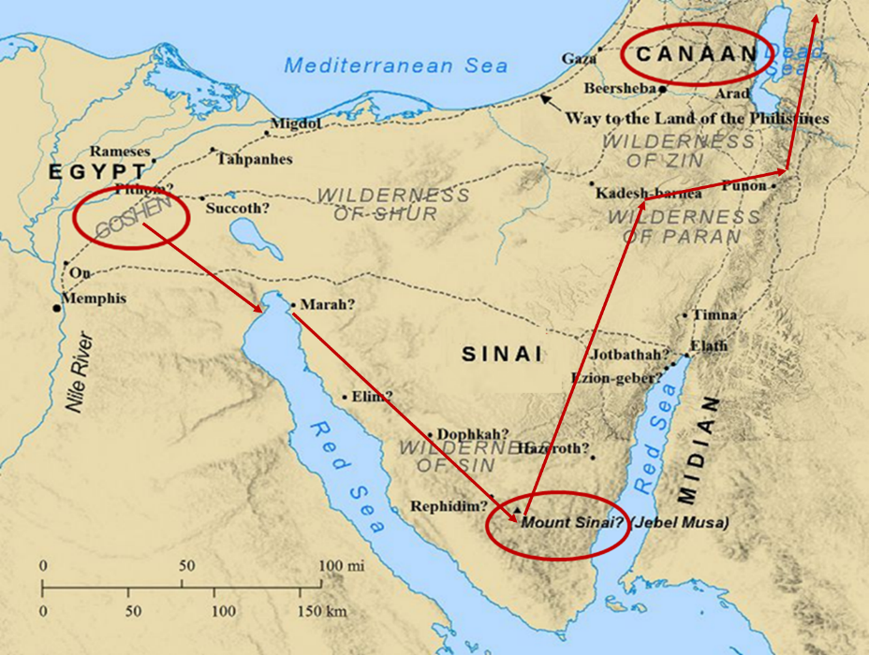

Slide 19
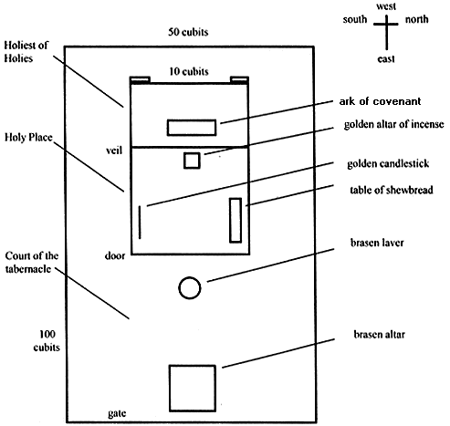
Tabernacle Diagram

Slide 20
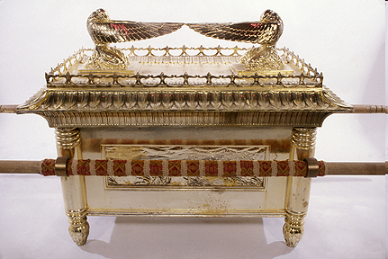
Ark of the Covenant

Slide 21
Exodus 5:10-14
Foremens’ Response
      To Pharaoh (15-16)
      Pharaoh’s response (17-18)
      Foremens’ reaction (19)

Slide 23
1st MEETING WITH PHARAOH
Exodus 5:1-23
  Problem of Pharaoh (1-19)
  Problem of Israel (20-23)

Slide 24
II. Exodus 5:1-19
Problem of Israel
    Israel complains to Moses (20-21)
    Moses complains to God (22-23)

Slide 25
II. Exodus 5:1-19
Problem of Israel
    Israel complains to Moses (20-21)
    Moses complains to God (22-23)

Slide 26
Exodus 5:20-21
Israel Complains to Moses
      The meeting (20)
      The complaint (21)

Slide 27
Exodus 5:20-21
Israel Complains to Moses
      The meeting (20)
      The complaint (21)

Slide 28
Exodus 5:20-21
Israel Complains to Moses
      The meeting (20)
      The complaint (21)

Slide 29
II. Exodus 5:1-19
Problem of Israel
    Israel complains to Moses (20-21)
    Moses complains to God (22-23)

Slide 30
Exodus 5:22-23
Moses Complains to God
      Worsening situation (22)
      No deliverance (23)

Slide 31
Exodus 5:22-23
Moses Complains to God
      Worsening situation (22)
      No deliverance (23)

Slide 32
Exodus 5:22-23
Moses Complains to God
      Worsening situation (22)
      No deliverance (23)

Slide 33

Romans 8:19-23
¹⁹ For the anxious longing of the creation waits eagerly for the revealing of the sons of God. ²⁰ For the creation was subjected to futility, not willingly, but because of Him who subjected it, in hope ²¹ that the creation itself also will be set free from its slavery to corruption into the freedom of the glory of the children of God. ²² For we know that the whole creation groans and suffers the pains of childbirth together until now. ²³ And not only this, but also we ourselves, having the first fruits of the Spirit, even we ourselves groan within ourselves, waiting eagerly for our adoption as sons, the redemption of our body.”

Slide 34
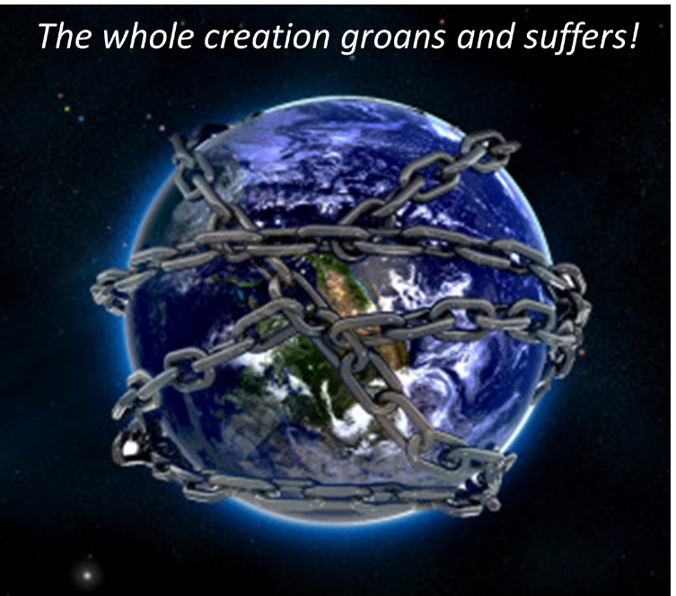

Slide 35
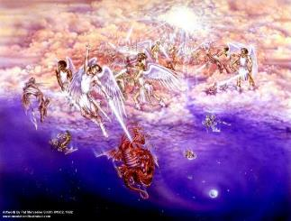
Satan as Ruler of this World
Job 1:7; 2:2
Luke 4:5-7
John 12:31; 14:30; 16:11
2 Corinthians 4:4
Ephesians 2:2
1 John 4:4; 5:19

Slide 36

Names & Titles Demonstrating Satan’s Post-Fall, Earthly Authority
(Job 1:7; 2:2; Luke 4:5-8; Rom. 8:19-22)
Prince of this world (John 12:31; 14:30; 16:11)
God of this age (2 Cor. 4:4)
Prince and power of the air (Eph. 2:2)
Who the believer wrestles with (Eph. 6:12)
Roaring lion (1 Pet. 5:8)
Whole world lies in his power (1 John 5:19)

Slide 37
Ultimate Exodus
(Rev 11:15)
Sores: 6th plague (Ex 9:8-12), 1st bowl (Rev 16:1-2)
Rivers to blood: 1st plague (Ex 7:19-21), 3rd bowl (Rev 16:4-7)
Darkness: 9th plague (Ex 10:21-23), 5th bowl (Rev 16:10-11)
Frogs: 2nd plague (Ex 7:25‒8:15), 6th bowl (Rev 16:13)
Hail: 7th plague (Ex 9:22-26), 7th bowl (Rev 16:17-21)

Slide 38

2 Peter 1:19-21
“¹⁹ So we have the prophetic word made more sure, to which you do well to pay attention as to a lamp shining in a dark place, until the day dawns and the morning star arises in your hearts. ²⁰ But know this first of all, that no prophecy of Scripture is a matter of one’s own interpretation, ²¹ for no prophecy was ever made by an act of human will, but men moved by the Holy Spirit spoke from God.”
Notes:
Psa 119:105 – lamp of prophecy

Slide 39
AUTHORITY OF SCRIPTURE
V. 19
More sure than eyewitness testimony
World is in the Dark, Scripture is the Light
Morning Star = Jesus
  Rev. 2:28; 22:16

Slide 40

Revelation 2:28; 22:16
“^{2:28} and I will give him the morning star... ^{22:16} “I, Jesus, have sent My angel to testify to you these things for the churches. I am the root and the descendant of David, the bright morning star.”

Slide 41
Conclusion

Slide 42
1st MEETING WITH PHARAOH
Exodus 5:1-23
  Problem of Pharaoh (1-19)
  Problem of Israel (20-23)

Slide 43
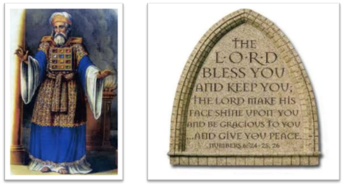
²⁴ The Lord bless you, and keep you; ²⁵ The Lord make His face shine on you, And be gracious to you; ²⁶ The Lord lift up His countenance on you, And give you peace.
Numbers 6:24–26 (NASB95)

