Slide 1
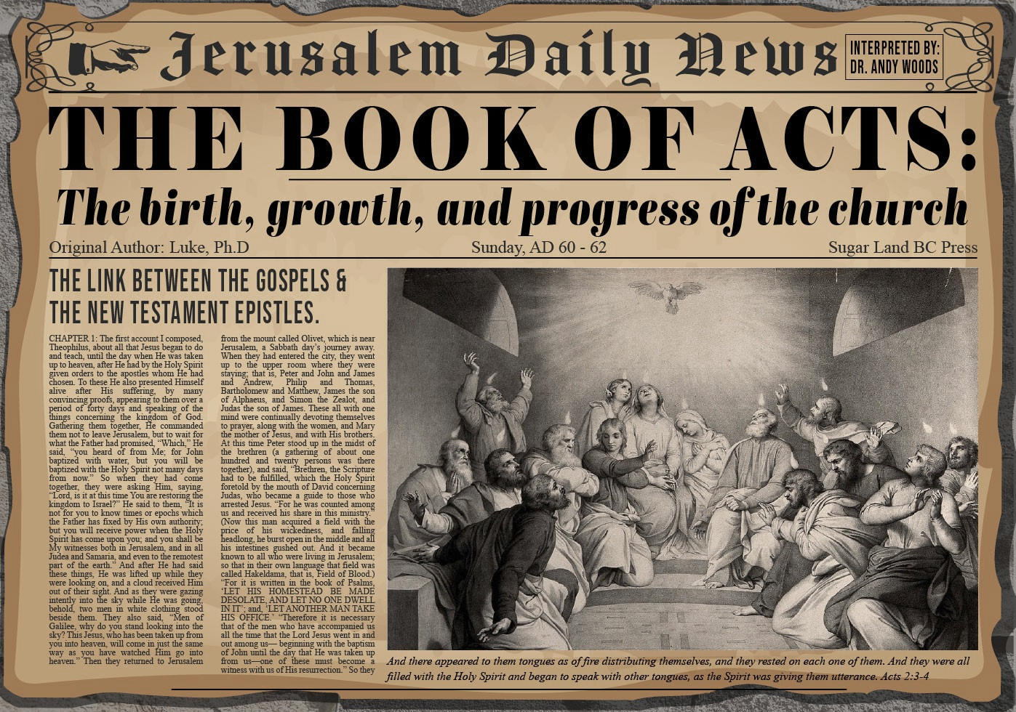


Slide 2
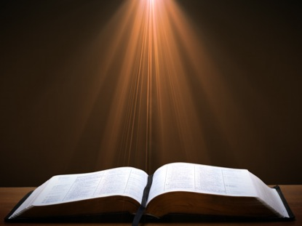
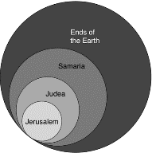
Acts 1:8
“but you will receive power when the Holy Spirit has come upon you; and you shall be My witnesses both in Jerusalem, and in all Judea and Samaria, and even to the remotest part of the earth.”

Slide 3
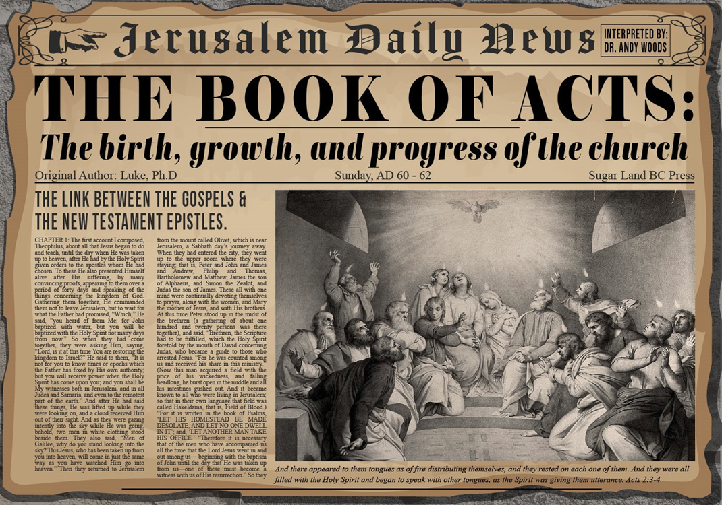
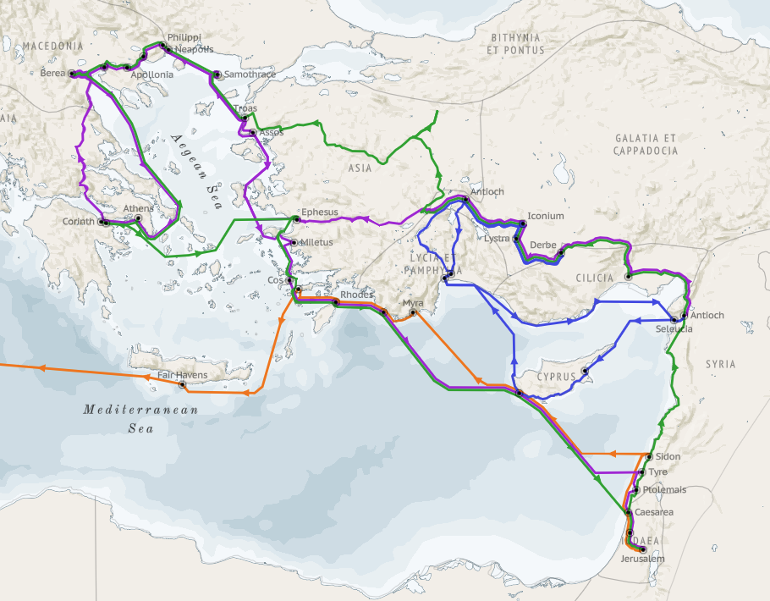
Structure (Acts 1:8)
  Jerusalem (Acts 1–7)
  Judea and Samaria (Acts 8–12)
  Remotest part of the earth (Acts 13–28)
  1st missionary journey (Acts 13–14)
  Jerusalem council (Acts 15:1-35)
  2nd missionary journey (Acts 15:36 –18:22)
  3rd missionary journey (Acts 18:23–21:17)
  Trip to Rome (Acts 21:18–28:31)

Slide 4
Acts 13‒14
1st Missionary Journey
  Paul & Barnabas’ appointment (13:1-3)
  Cyprus ministry (13:4-12)
  Pisidian Antioch ministry (13:13-52)
  Iconium ministry (14:1-7)
  Lystra ministry (14:8-20a)
  Derbe ministry (14:20b-21a)
  Return to Antioch (14:21b-28)

Slide 5
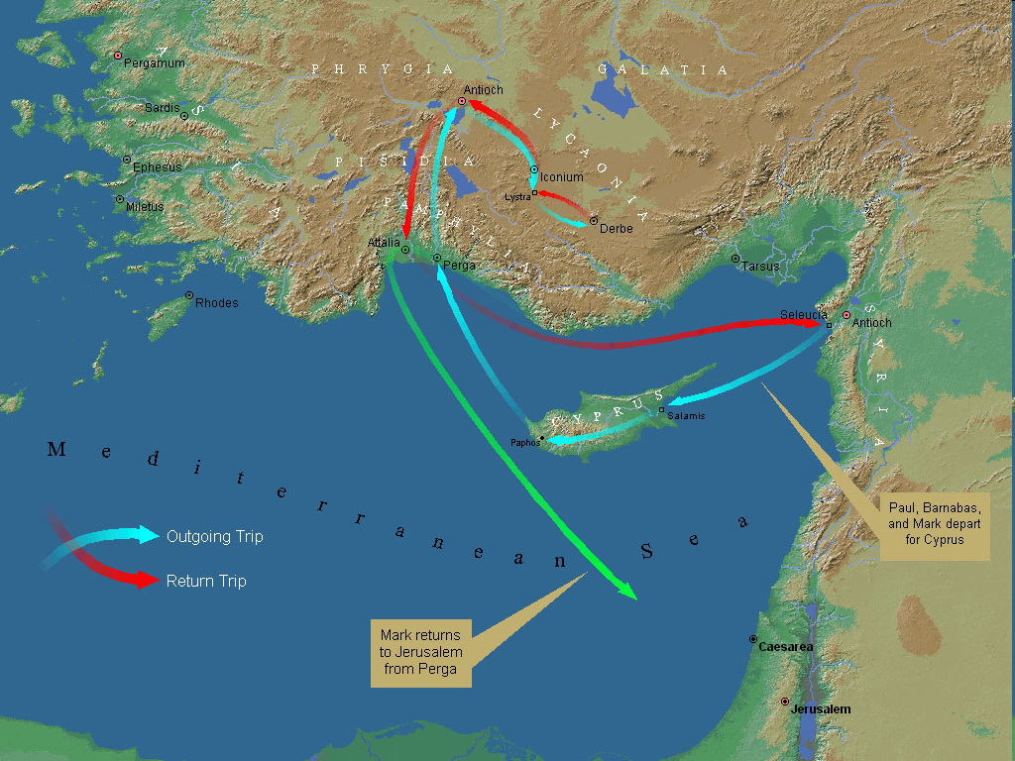
First Missionary Journey

Slide 6
III. Pisidia Antioch Ministry
Acts 13:13-52
  Journey to Pisidian Antioch (13-15)
  Paul’s message (16-41)
  Results of Paul’s message (42-52)

Slide 7
Acts 13:16-41
Paul’s Message
      Introduction (16)
      Historical background (17-22)
      Messiah (23-25)
      Gospel (26-29)
      Resurrection (30-37)
      Application to Paul’s audience (38-39)
      Warning (40-41)

Slide 8
III. Pisidia Antioch Ministry
Acts 13:13-52
  Journey to Pisidian Antioch (13-15)
  Paul’s message (16-41)
  Results of Paul’s message (42-52)

Slide 9
Acts 13:42-53
Results of Paul’s Message
      Immediate results (42-43)
      Subsequent results (44-49)
      Results for the Apostles (50-52)

Slide 10
Acts 13:50-52
Results for the Apostles
      Jewish opposition to the Gospel (50)
      Apostles’ response (51)
      Impact on the Pisidian Antioch Church (52)

Slide 11
Acts 13:50-52
Results for the Apostles
      Jewish opposition to the Gospel (50)
      Apostles’ response (51)
      Impact on the Pisidian Antioch Church (52)

Slide 12
Acts 13:50-52
Results for the Apostles
      Jewish opposition to the Gospel (50)
      Apostles’ response (51)
      Impact on the Pisidian Antioch Church (52)

Slide 13

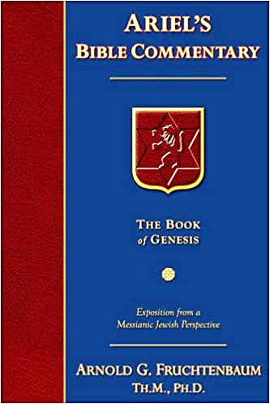
Dr. Arnold G. Fruchtenbaum
The Book of Acts, 301
“The apostolic response is given in verse 51: But they shook off the dust of their feet against them. This action was a visible, physical, symbolic measure marking a complete break of fellowship and renunciation with a person or community. It was also what Yeshua had commanded His disciples to do (Mt. 10:14; Mk. 6:11; Lk. 9:5). The procedure was to take the sandals off the feet, and the dust was shaken toward the group or place being renounced as a symbolic token. Then the apostles went to Iconium, the next city to be evangelized.”

Slide 14

Biblical Basis for Separation?
2 Thess. 3:6, 14
1 Cor. 5:11
2 Cor. 6:14-18
Rom. 16:17
Eph. 5:11
Titus 3:9-11
2 John 9-11

Slide 15

2 John 7-11
“⁷ For many deceivers have gone out into the world, those who do not acknowledge Jesus Christ as coming in the flesh. This is the deceiver and the antichrist. ⁸ Watch yourselves, that you do not lose what we have accomplished, but that you may receive a full reward. ⁹ Anyone who goes too far and does not abide in the teaching of Christ, does not have God; the one who abides in the teaching, he has both the Father and the Son. ¹⁰ If anyone comes to you and does not bring this teaching, do not receive him into your house, and do not give him a greeting; ¹¹ for the one who gives him a greeting participates in his evil deeds.”

Slide 16

What to Separate From?
False doctrine – 1 Tim. 4:16; Titus 1:9
Divisive persons – Rom. 16:17; Titus 3:9-11
Immorality – 1 Cor. 5:9-11; Eph. 5:11
General disobedience to Scripture –2 Thess. 3:6, 14

Slide 17
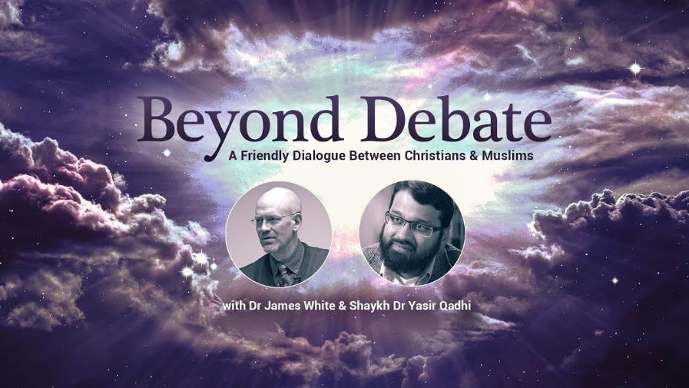

Slide 18
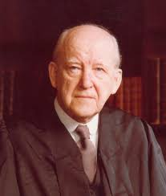
D. Martyn Lloyd-Jones
Knowing the Times (Carlisle, PA: The Banner of Truth Trust, 1989; reprint, 2001), 161-62.
“To regard a church, or a council of churches, as a forum in which fundamental matters can be debated and discussed, or as an opportunity for witness-bearing, is sheer confusion and muddled thinking. There is to be no discussion about ‘the foundation’, as we have seen. If men do not accept that, they are not brethren and we can have no dialogue with them. We are to preach to such and to evangelize them. Discussion takes place among the brethren who share the same life and subscribe to the same essential truths. It is right and good that brethren should discuss together matters which are not essential to salvation and about which there is, and always has been, and always will be, legitimate differences of opinion. We can do no better at that point than quote the old adage, ‘In things essential, unity, in things indifferent liberty, in all things charity.’”

Slide 19
D. Martyn Lloyd-Jones
Knowing the Times (Carlisle, PA: The Banner of Truth Trust, 1989; reprint, 2001), 161-62.
“Before there can be any real discussion and dialogue and exchange there must be agreement concerning primary and fundamental matters. Without the acceptance of certain axioms and propositions in geometry, for example, it is idle to attempt to solve any problem. If certain people refuse to accept the axioms, and are constantly querying and disputing them, clearly there is no point of contact between them and those who do accept them. It is precisely the same in the realm of the church. Those who question and query, let alone deny, the great cardinal truths that have been accepted throughout the centuries do not belong to the church, and to regard them as brethren is to betray the truth. As we have already reminded ourselves, the apostle Paul tells us clearly what our attitude to them should be: ‘A man that is a heretic after the first and second admonition reject’ (Tit. 3:10).”

Slide 20
D. Martyn Lloyd-Jones
Knowing the Times (Carlisle, PA: The Banner of Truth Trust, 1989; reprint, 2001), 161-62.
“They are to be regarded as unbelievers and need to be called to repentance and acceptance of the truth as it is in Christ Jesus. To give the impression that they are Christians with whom other Christians disagree about certain matters is to confuse the genuine seeker and enquirer who is outside. But such is the position prevailing today. It is based upon a failure to understand the nature of the New Testament church which is ‘the pillar and ground of the truth’ (1 Tim. 3:15). In the same way it is a sheer waste of time to discuss or debate the implications of Christianity with people who are not agreed as to what Christianity is. Failure to realize this constitutes the very essence of the modern confusion.”

Slide 21
First Missionary Journey

Slide 22
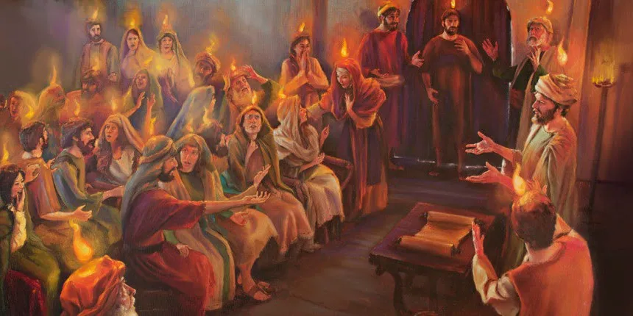
Unique Characteristics
  Sermons
  Miracles wrought by the Holy Spirit
  Background for Pauline letters
  Accurate history
  Places and names
  Volume
  Gentile

Slide 23

Acts Message
  Birth and growth of the church numerically, geographically, ethnically.
  Components
  Numerically (progress reports)
  Geographically (From Jerusalem to Rome)
  Ethnically (From Judaism to Gentile domination)

Slide 24
Acts 13:50-52
Results for the Apostles
      Jewish opposition to the Gospel (50)
      Apostles’ response (51)
      Impact on the Pisidian Antioch Church (52)

Slide 25
Acts 13:52
Impact on the Pisidian Antioch Church
      Joy (52a)
      Holy Spirit (52b)

Slide 26
Acts 13:52
Impact on the Pisidian Antioch Church
      Joy (52a)
      Holy Spirit (52b)

Slide 27
Acts 13:52
Impact on the Pisidian Antioch Church
      Joy (52a)
      Holy Spirit (52b)

Slide 28

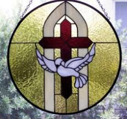
John 14:16-17
¹⁶ I will ask the Father, and He will give you another Helper, that He may be with you forever; ¹⁷ that is the Spirit of truth, whom the world cannot receive, because it does not see Him or know Him, but you know Him because He abides with you and will be in you.

Slide 29
Acts 13‒14
1st Missionary Journey
  Paul & Barnabas’ appointment (13:1-3)
  Cyprus ministry (13:4-12)
  Pisidian Antioch ministry (13:13-52)
  Iconium ministry (14:1-7)
  Lystra ministry (14:8-20a)
  Derbe ministry (14:20b-21a)
  Return to Antioch (14:21b-28)

Slide 30
IV. Iconium Ministry
Acts 14:1-7
  Preaching (1)
  Unbelieving response (2)
  Ministry (3)
  Division (4)
  Conspiracy (5)
  Escape to Lystra & Derbe (6)
  Lystra & Derbe ministry introduction (7)

Slide 31
IV. Iconium Ministry
Acts 14:1-7
  Preaching (1)
  Unbelieving response (2)
  Ministry (3)
  Division (4)
  Conspiracy (5)
  Escape to Lystra & Derbe (6)
  Lystra & Derbe ministry introduction (7)

Slide 32
First Missionary Journey

Slide 33
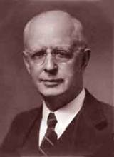
Lewis Sperry Chafer, vol. 7, Systematic Theology
(Grand Rapids, MI: Kregel Publications, 1993), 265-66.
Belief-God’s One Condition for Justification
“…because upwards of 150 passages of Scripture condition salvation upon believing only (cf. John 3:16; Acts 16:31).”

Slide 34
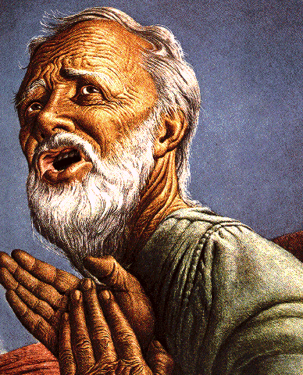
Belief – God’s One Condition for Justification
Gen 15:6
Then he believed in the LORD; and He reckoned it to him as righteousness.
John 3:16
For God so loved the world, that He gave His only begotten Son, that whoever believes in Him shall not perish, but have eternal life.
Acts 16:30-31
"Sirs, what must I do to be saved?" They said, "Believe in the Lord Jesus, and you will be saved..."

Slide 35
IV. Iconium Ministry
Acts 14:1-7
  Preaching (1)
  Unbelieving response (2)
  Ministry (3)
  Division (4)
  Conspiracy (5)
  Escape to Lystra & Derbe (6)
  Lystra & Derbe ministry introduction (7)

Slide 36
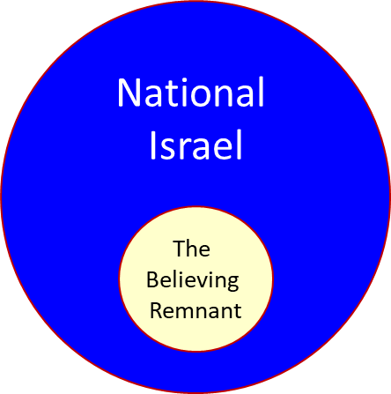

Slide 37
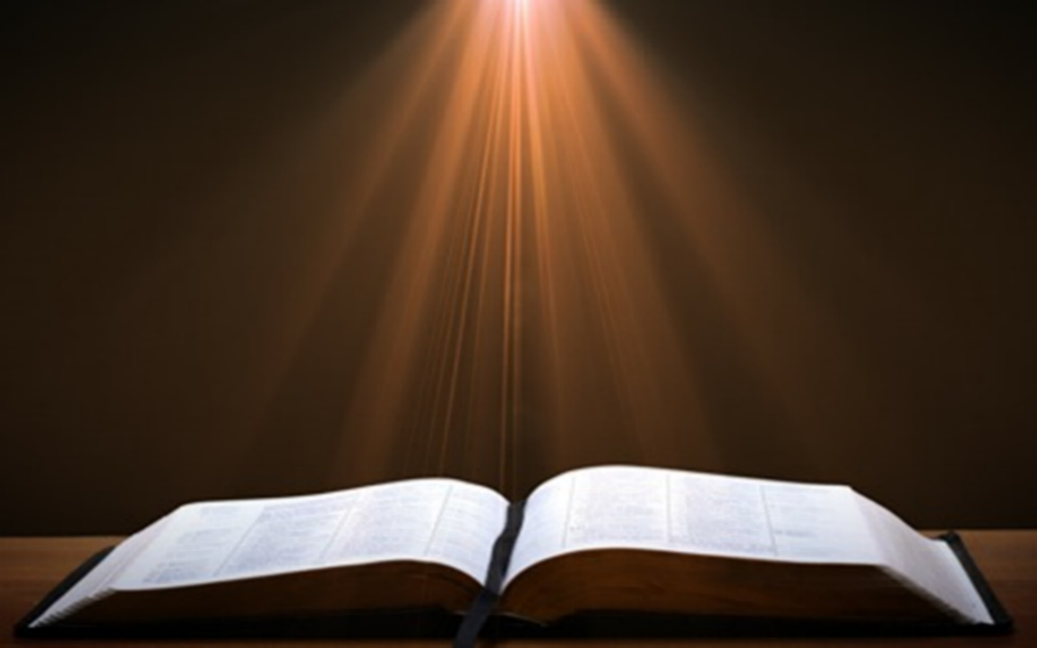
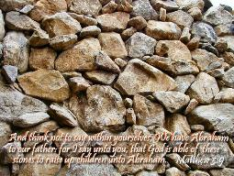
Matthew 3:9
“and do not suppose that you can say to yourselves, ‘We have Abraham for our father’; for I say to you that from these stones God is able to raise up children to Abraham.”

Slide 38


Romans 2:28-29
“²⁸ For he is not a Jew who is one outwardly, nor is circumcision that which is outward in the flesh. ²⁹ But he is a Jew who is one inwardly; and circumcision is that which is of the heart, by the Spirit, not by the letter; and his praise is not from men, but from God.”

Slide 39
Romans 9:6
“But it is not as though the word of God has failed. For they are not all Israel who are descended from Israel.”

Slide 40
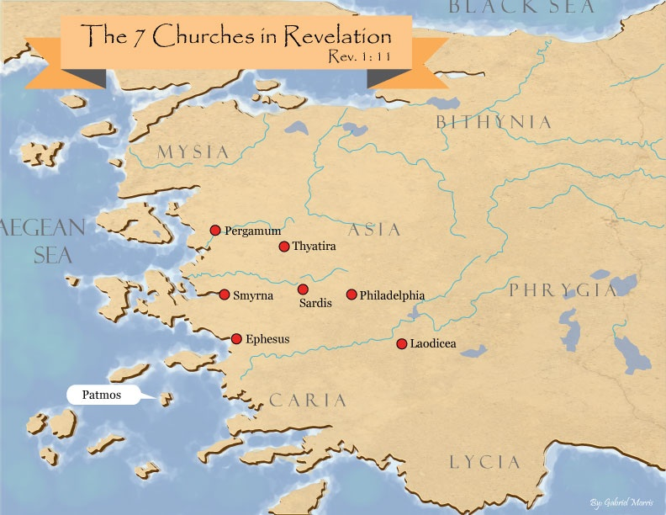
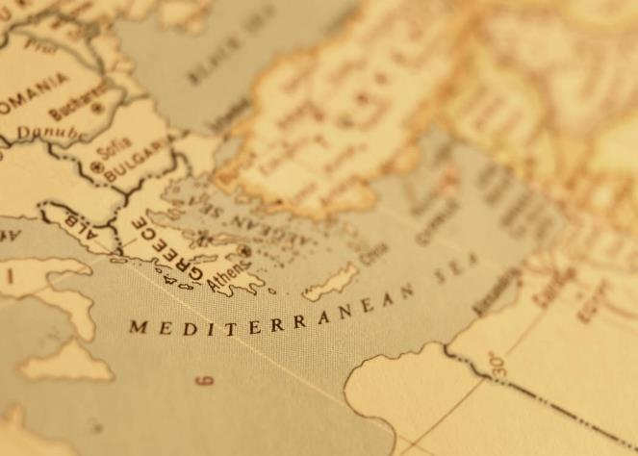

Slide 41

Revelation 2:9
“I know your tribulation and your poverty (but you are rich), and the blasphemy by those who say they are Jews and are not, but are a synagogue of Satan.”

Slide 43

Revelation 3:9
“Behold, I will cause those of the synagogue of Satan, who say that they are Jews and are not, but lie—I will make them come and bow down at your feet, and make them know that I have loved you.”

Slide 44

Zechariah 13:8-9
⁸“It will come about in all the land,” Declares the Lord, “That two parts in it will be cut off and perish; But the third will be left in it. ⁹“And I will bring the third part through the fire, Refine them as silver is refined, And test them as gold is tested. They will call on My name, And I will answer them; I will say, ‘They are My people,’ And they will say, ‘The Lord is my God.’ ”

Slide 45
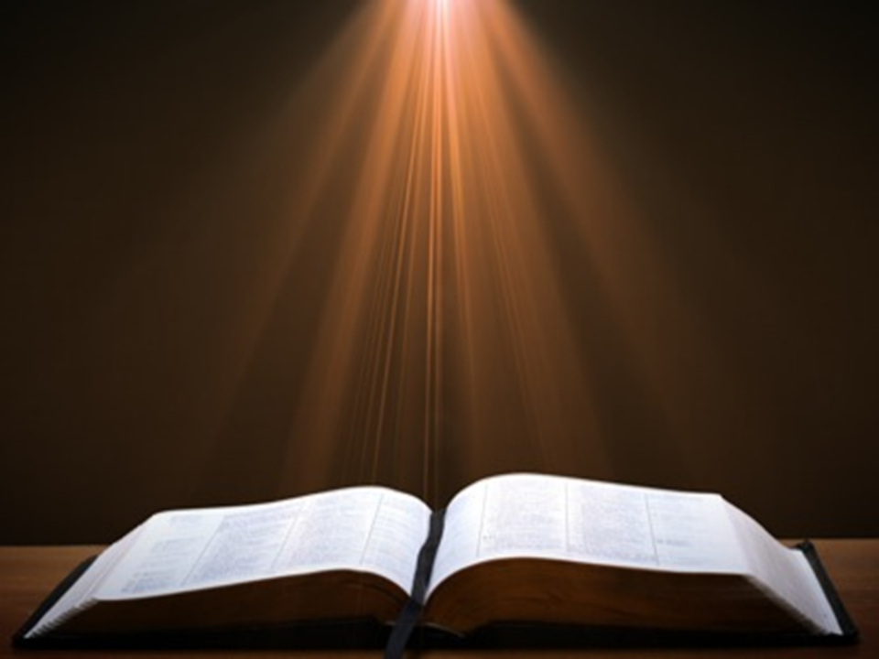
Ezekiel 20:33-38
³³ “As I live,” declares the Lord God, “surely with a mighty hand and with an outstretched arm and with wrath poured out, I shall be king over you. ³⁴ I will bring you out from the peoples and gather you from the lands where you are scattered, with a mighty hand and with an outstretched arm and with wrath poured out; ³⁵ and I will bring you into the wilderness of the peoples, and there I will enter into judgment with you face to face. ³⁶ As I entered into . . .

Slide 46
Ezekiel 20:33-38
. . . judgment with your fathers in the in the wilderness of the land of Egypt, so I will enter into judgment with you,” declares the Lord God. ³⁷ “I will make you pass under the rod, and I will bring you into the bond of the covenant; ³⁸ and I will purge from you the rebels and those who transgress against Me; I will bring them out of the land where they sojourn, but they will not enter the land of Israel. Thus you will know that I am the Lord.

Slide 47
IV. Iconium Ministry
Acts 14:1-7
  Preaching (1)
  Unbelieving response (2)
  Ministry (3)
  Division (4)
  Conspiracy (5)
  Escape to Lystra & Derbe (6)
  Lystra & Derbe ministry introduction (7)

Slide 48
Dr. Arnold G. Fruchtenbaum
The Book of Acts, 303
“To authenticate the message of grace, God granted signs and wonders to be done by their hands. Again, only the apostles and their legates (Acts 5:16; 8:7; 16:18; 19:11-12) were able to do these signs and wonders. This may be what Galatians 3:5 refers to, when it states: ‘He therefore that supplies to you the Spirit, and works miracles among you, does he it by the works of the law, or by the hearing of faith? Miracles were not being done on the basis of the Mosaic Law, but on the basis of grace through faith.’”

Slide 49

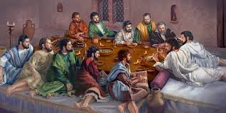
Ephesians 2:20
“having been built on the foundation of the apostles and prophets, Christ Jesus Himself being the corner stone.”

Slide 50
IV. Iconium Ministry
Acts 14:1-7
  Preaching (1)
  Unbelieving response (2)
  Ministry (3)
  Division (4)
  Conspiracy (5)
  Escape to Lystra & Derbe (6)
  Lystra & Derbe ministry introduction (7)

Slide 51
IV. Iconium Ministry
Acts 14:1-7
  Preaching (1)
  Unbelieving response (2)
  Ministry (3)
  Division (4)
  Conspiracy (5)
  Escape to Lystra & Derbe (6)
  Lystra & Derbe ministry introduction (7)

Slide 52
Acts 14:5
Conspiracy
      Rushing (5a)
      Shaming (5b)
      Execution (5c)

Slide 53
Acts 14:5
Conspiracy
      Rushing (5a)
      Shaming (5b)
      Execution (5c)

Slide 54
Acts 14:5
Conspiracy
      Rushing (5a)
      Shaming (5b)
      Execution (5c)

Slide 55
Acts 14:5
Conspiracy
      Rushing (5a)
      Shaming (5b)
      Execution (5c)

Slide 56
IV. Iconium Ministry
Acts 14:1-7
  Preaching (1)
  Unbelieving response (2)
  Ministry (3)
  Division (4)
  Conspiracy (5)
  Escape to Lystra & Derbe (6)
  Lystra & Derbe ministry introduction (7)

Slide 57
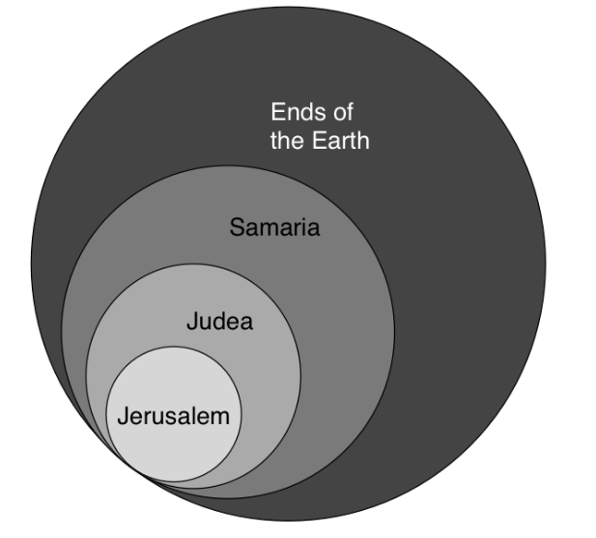
Acts 1:8
“but you will receive power when the Holy Spirit has come upon you; and you shall be My witnesses both in Jerusalem, and in all Judea and Samaria, and even to the remotest part of the earth.”

Slide 58
First Missionary Journey

Slide 59
IV. Iconium Ministry
Acts 14:1-7
  Preaching (1)
  Unbelieving response (2)
  Ministry (3)
  Division (4)
  Conspiracy (5)
  Escape to Lystra & Derbe (6)
  Lystra & Derbe ministry introduction (7)

Slide 60
Acts 13‒14
1st Missionary Journey
  Paul & Barnabas’ appointment (13:1-3)
  Cyprus ministry (13:4-12)
  Pisidian Antioch ministry (13:13-52)
  Iconium ministry (14:1-7)
  Lystra ministry (14:8-20a)
  Derbe ministry (14:20b-21a)
  Return to Antioch (14:21b-28)

Slide 61
First Missionary Journey

Slide 62
V. Lystra Ministry
Acts 14:8-20a
  Healing (8-10)
  Misidentification (11-13)
  Apostolic reaction (14)
  Apostolic message (15-17)
  Reaction to the message (18-20a)

Slide 63
V. Lystra Ministry
Acts 14:8-20a
  Healing (8-10)
  Misidentification (11-13)
  Apostolic reaction (14)
  Apostolic message (15-17)
  Reaction to the message (18-20a)

Slide 64
Acts 14:8-10
Healing
      Candidate (8)
      Circumstances (9)
      Healing (10)

Slide 65
Acts 14:8-10
Healing
      Candidate (8)
      Circumstances (9)
      Healing (10)

Slide 66
From Peter to Paul
Peter | Paul
Heals a man lame from birth (3:1-11) | Heals a man lame from birth (14:8-18)
Heals by shadow (5:15-16) | Heals by handkerchief (19:11-12)
Success is a cause of jealousy (5:17) | Success is a cause of jealousy (13:45)
Confronts a sorcerer (8:9-24) | Confronts a sorcerer (13:6-11)
Raises Dorcas (9:36-41) | Raises Eutychus (20:9-12)
Jailed and miraculously freed (12:3-19) | Jailed and miraculously freed (16:25-34)

Slide 67
Acts 14:8-10
Healing
      Candidate (8)
      Circumstances (9)
      Healing (10)

Slide 68
Ephesians 2:20
“having been built on the foundation of the apostles and prophets, Christ Jesus Himself being the corner stone.”

Slide 69
Acts 14:8-10
Healing
      Candidate (8)
      Circumstances (9)
      Healing (10)

Slide 70
From Peter to Paul
Peter | Paul
Heals a man lame from birth (3:1-11) | Heals a man lame from birth (14:8-18)
Heals by shadow (5:15-16) | Heals by handkerchief (19:11-12)
Success is a cause of jealousy (5:17) | Success is a cause of jealousy (13:45)
Confronts a sorcerer (8:9-24) | Confronts a sorcerer (13:6-11)
Raises Dorcas (9:36-41) | Raises Eutychus (20:9-12)
Jailed and miraculously freed (12:3-19) | Jailed and miraculously freed (16:25-34)

Slide 71
V. Lystra Ministry
Acts 14:8-20a
  Healing (8-10)
  Misidentification (11-13)
  Apostolic reaction (14)
  Apostolic message (15-17)
  Reaction to the message (18-20a)

Slide 72
Acts 14:11-13
Misidentification
      General (11)
      Specific (12)
      Sacrificial response (13)

Slide 73
Acts 14:11-13
Misidentification
      General (11)
      Specific (12)
      Sacrificial response (13)

Slide 74
Acts 14:11-13
Misidentification
      General (11)
      Specific (12)
      Sacrificial response (13)

Slide 75
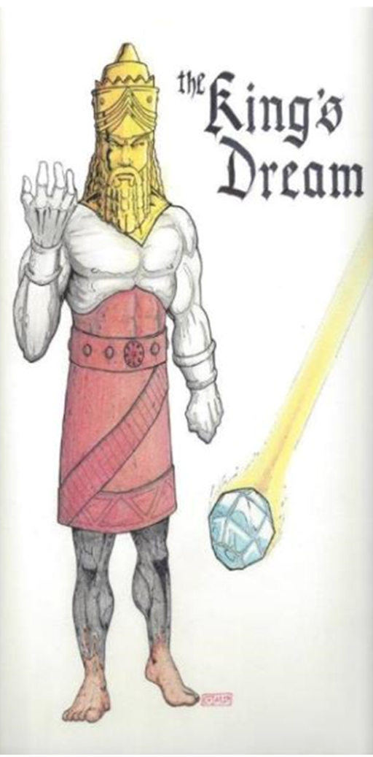

Slide 76
Dr. Arnold G. Fruchtenbaum
The Book of Acts, 306
“It is interesting to note that archaeologists have uncovered records of dedications to both gods by men with Lycaonian names. Bruce explains: ‘Of two inscriptions of Sedasa, near Lystra, dating from c. A.D. 250…one records the dedication to Zeus of a statue of Hermes along with a sundial, by men with Lycaonian names, the other mentions “priests of Zeus”…A further indication of the joint worship of Zeus and Hermes in these parts is probably to be found in a stone altar discovered near Lystra…in 1926, dedicated to the “Hearer of Prayers” (presumably Zeus) and Hermes.’ These archeological findings prove historically what Luke recorded, namely, that Jupiter and Mercury were the two gods jointly worshipped by the people of Lystra.”

Slide 77
Acts 14:11-13
Misidentification
      General (11)
      Specific (12)
      Sacrificial response (13)

Slide 78
Dr. Arnold G. Fruchtenbaum
The Book of Acts, 307
“The sudden urge to sacrifice to two human beings who were mistakenly identified as the gods Jupiter and Mercury can be understood from the background of the legend of Baucis and Philemon. This legend was recorded by the Roman historian Ovid. It claims that Jupiter and Mercury, disguised as men, came down into the Phrygian hill country, but no one in that area was willing to provide hospitality to them, except one elderly couple named Baucis and Philemon. The two gods destroyed the local population for its lack of hospitality, before rewarding Baucis and Philemon by making them the priest and priestess of the temple of Jupiter. This legend was prevalent in Lystra, and because the people had just seen a miracle, they felt that the two gods had come again. Not wanting to be destroyed, they were ready to offer sacrifices.”

Slide 79
V. Lystra Ministry
Acts 14:8-20a
  Healing (8-10)
  Misidentification (11-13)
  Apostolic reaction (14)
  Apostolic message (15-17)
  Reaction to the message (18-20a)

Slide 80
Acts 14:14
Apostolic Reaction
      Greek communication (14a)
      Rending of garments (14b)

Slide 81
Acts 14:14
Apostolic Reaction
      Greek communication (14a)
      Rending of garments (14b)

Slide 82
Acts 14:14
Apostolic Reaction
      Greek communication (14a)
      Rending of garments (14b)

Slide 83
V. Lystra Ministry
Acts 14:8-20a
  Healing (8-10)
  Misidentification (11-13)
  Apostolic reaction (14)
  Apostolic message (15-17)
  Reaction to the message (18-20a)

Slide 84
Acts 14:15-17
Apostolic Reaction
      Question of deniability (15a)
      Mere men & servants (15b)
      Call to repentance (15c)
      God’s attributes (15d-17)

Slide 85
Acts 14:15-17
Apostolic Reaction
      Question of deniability (15a)
      Mere men & servants (15b)
      Call to repentance (15c)
      God’s attributes (15d-17)

Slide 86
Acts 14:15-17
Apostolic Reaction
      Question of deniability (15a)
      Mere men & servants (15b)
      Call to repentance (15c)
      God’s attributes (15d-17)

Slide 87
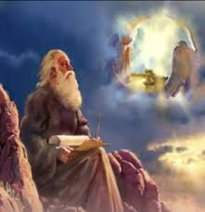
Method of Communication
From the Father
to Christ the Son
to an angel
to John
to a book
to a reader or preacher
to a listener or the seven churches

Slide 88
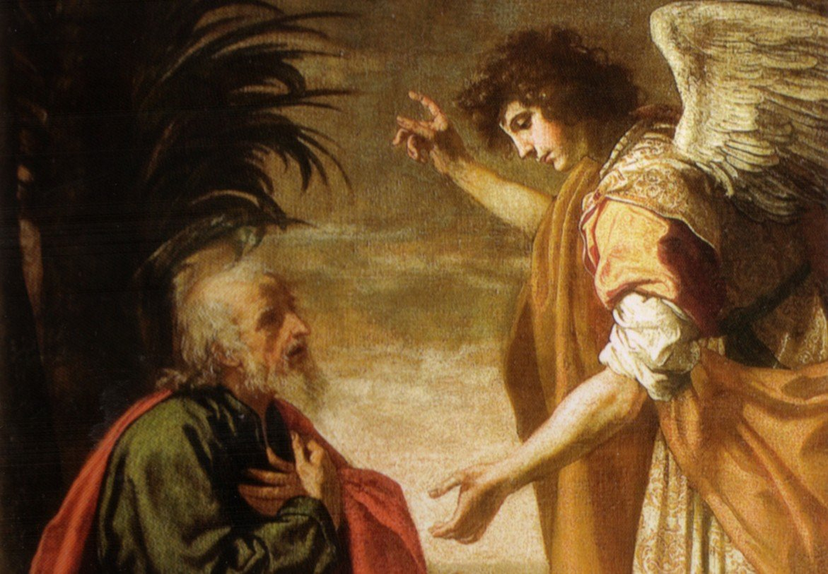
Revelation 19:10
“Then I fell at his feet to worship him. But he said to me, ‘Do not do that; I am a fellow servant of yours and your brethren who hold the testimony of Jesus; worship God. For the testimony of Jesus is the spirit of prophecy.’”

Slide 89
Acts 14:15-17
Apostolic Reaction
      Question of deniability (15a)
      Mere men & servants (15b)
      Call to repentance (15c)
      God’s attributes (15d-17)

Slide 90
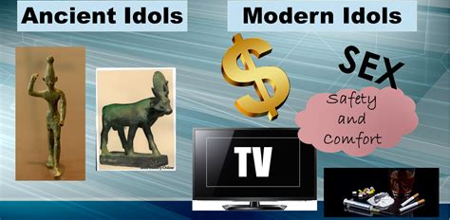
1 Thessalonians 1:9
“For they themselves report about us what kind of a reception we had with you, and how you turned to God from idols to serve a living and true God.”

Slide 91

Revelation 9:20-21
“The rest of mankind, who were not killed by these plagues, did not repent of the works of their hands, so as not to worship demons, and the idols of gold and of silver and of brass and of stone and of wood, which can neither see nor hear nor walk; ²¹ and they did not repent of their murders nor of their sorceries (pharmakov) nor of their immorality nor of their thefts.”

Slide 92
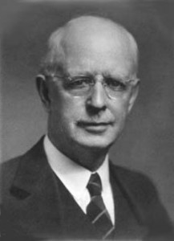
Lewis Sperry Chafer
vol. 7, Systematic Theology (Grand Rapids, MI: Kregel Publications, 1993), 265-66.
“This vital newness of mind is a part of believing, after all, and therefore it may be and is used as a synonym for believing at times (cf. Acts 17:30; 20:21; 26:20; Rom. 2:4; 2Tim. 2:25; 2 Pet. 3:9). Repentance nevertheless cannot be added to believing as a condition of salvation, because upwards of 150 passages of Scripture condition salvation upon believing only (cf. John 3:16; Acts 16:31).”

Slide 93
Acts 14:15-17
Apostolic Reaction
      Question of deniability (15a)
      Mere men & servants (15b)
      Call to repentance (15c)
      God’s attributes (15d-17)

Slide 94
Acts 13:15d-17
God’s Attributes
      Living (15d)
      Creator (15e)
      Patient (16)
      Revealer (17a)
      Good (17b)

Slide 95
Acts 13:15d-17
God’s Attributes
      Living (15d)
      Creator (15e)
      Patient (16)
      Revealer (17a)
      Good (17b)

Slide 96
1 Thessalonians 1:9
“For they themselves report about us what kind of a reception we had with you, and how you turned to God from idols to serve a living and true God.”

Slide 97
CHRIST’S HIGH PRIESTLY ACTIVITIES IN HIS PRESENT SESSION
Sustains creation (Col. 1:16-17)
Head over the Church (Eph. 1:22-23)
Groom of the Church (Eph. 5:22-33)
Building the Church (Matt. 16:18; Acts 2:41; 4:4)
Bestowal of Spiritual Gifts (Eph. 4:7-12)
Melchizedekian High Priestly role (Heb. 6:20)
Keeps the Saints (John 10:27-29; 1 Pet. 1:5)
Intercedes for the Saints (Rom. 8:34; Heb. 7:25)
Advocate for the Saints (Heb. 9:24; 1 John 2:1)
Restores broken fellowship (1 John 1:9)
Disciplines His children (Heb. 12:5-13)

Slide 98
Acts 13:15d-17
God’s Attributes
      Living (15d)
      Creator (15e)
      Patient (16)
      Revealer (17a)
      Good (17b)

Slide 99

Exodus 20:8-11
⁸ “Remember the sabbath day, to keep it holy. ⁹ Six days you shall labor and do all your work, ¹⁰ but the seventh day is a sabbath of the Lord your God; in it you shall not do any work, you or your son or your daughter, your male or your female servant or your cattle or your sojourner who stays with you. ¹¹ For in six days the Lord made the heavens and the earth, the sea and all that is in them, and rested on the seventh day; therefore the Lord blessed the sabbath day and made it holy.”

Slide 100
Exodus 31:15-17
¹⁵ ‘For six days work may be done, but on the seventh day there is a sabbath of complete rest, holy to the Lord; whoever does any work on the sabbath day shall surely be put to death. ¹⁶ ‘So the sons of Israel shall observe the sabbath, to celebrate the sabbath throughout their generations as a perpetual covenant.’ ¹⁷ “It is a sign between Me and the sons of Israel forever; for in six days the Lord made heaven and earth, but on the seventh day He ceased from labor, and was refreshed.”

Slide 101
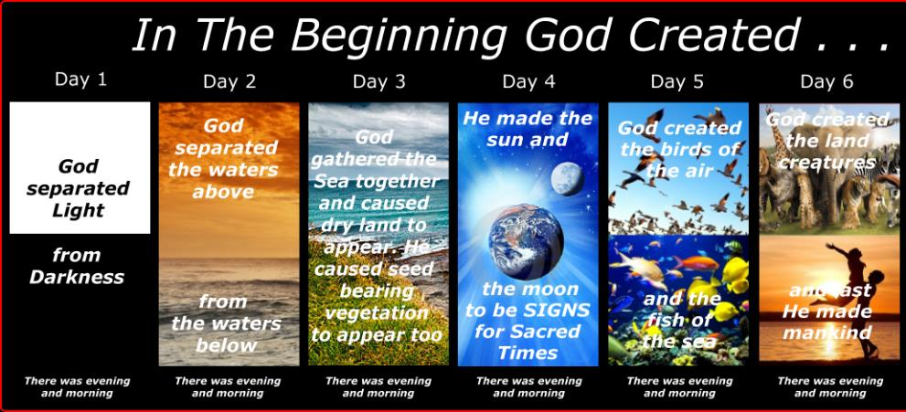
Shaping and Populating (Gen 1:1)
Day 1: | Light | Day 4: | Luminaries
Day 2: | Water, sky | Day 5: | Sea animals, birds
Day 3: | Land, vegetation | Day 6: | Land animals, man

Slide 102

General vs. Special Revelation
 | General | Special
Examples | Nature, conscience (Rom 1–2) | Incarnation, Scripture, miracles
Availability | All | Some
Accomplishment | Accountability (Rom 1) | Salvation (Acts 4:12; 2 Tim 3:15)
Form | Non-written or non-verbal | Written
Quality | Natural | Supernatural, miraculous

Slide 103
Acts 13:15d-17
God’s Attributes
      Living (15d)
      Creator (15e)
      Patient (16)
      Revealer (17a)
      Good (17b)

Slide 104

Genesis 6:1-4
“¹ Now it came about, when men began to multiply on the face of the land, and daughters were born to them, ² that the sons of God saw that the daughters of men were beautiful; and they took wives for themselves, whomever they chose. ³ Then the Lord said, ‘My Spirit shall not strive with man forever, because he also is flesh; nevertheless his days shall be one hundred and twenty years.’ ⁴ The Nephilim were on the earth in those days, and also afterward, when the sons of God came in to the daughters of men, and they bore children to them. Those were the mighty men who were of old, men of renown.”

Slide 105


2 Peter 3:9
“The Lord is not slow about His promise, as some count slowness, but is patient toward you, not wishing for any to perish but for all to come to repentance.”

Slide 106
Acts 13:15d-17
God’s Attributes
      Living (15d)
      Creator (15e)
      Patient (16)
      Revealer (17a)
      Good (17b)

Slide 107
General vs. Special Revelation
 | General | Special
Examples | Nature, conscience (Rom 1–2) | Incarnation, Scripture, miracles
Availability | All | Some
Accomplishment | Accountability (Rom 1) | Salvation (Acts 4:12; 2 Tim 3:15)
Form | Non-written or non-verbal | Written
Quality | Natural | Supernatural, miraculous

Slide 108
Acts 13:15d-17
God’s Attributes
      Living (15d)
      Creator (15e)
      Patient (16)
      Revealer (17a)
      Good (17b)

Slide 109
V. Lystra Ministry
Acts 14:8-20a
  Healing (8-10)
  Misidentification (11-13)
  Apostolic reaction (14)
  Apostolic message (15-17)
  Reaction to the message (18-20a)

Slide 110
Acts 14:18-20a
Reaction to the Message
      Apostolic restraining (18)
      Jewish opposition (19)
      Miraculous recovery (20a)

Slide 111
Acts 14:18-20a
Reaction to the Message
      Apostolic restraining (18)
      Jewish opposition (19)
      Miraculous recovery (20a)

Slide 112
Acts 14:18-20a
Reaction to the Message
      Apostolic restraining (18)
      Jewish opposition (19)
      Miraculous recovery (20a)

Slide 113
First Missionary Journey

Slide 114
Acts 14:18-20a
Reaction to the Message
      Apostolic restraining (18)
      Jewish opposition (19)
      Miraculous recovery (20a)

Slide 115

2 Peter 1:5-7
⁵ “Now for this very reason also, applying all diligence, in your faith supply moral excellence, and in your moral excellence, knowledge, ⁶ and in your knowledge, self-control, and in your self-control, perseverance, and in your perseverance, godliness, ⁷ and in your godliness, brotherly kindness, and in your brotherly kindness, love.”

Slide 116
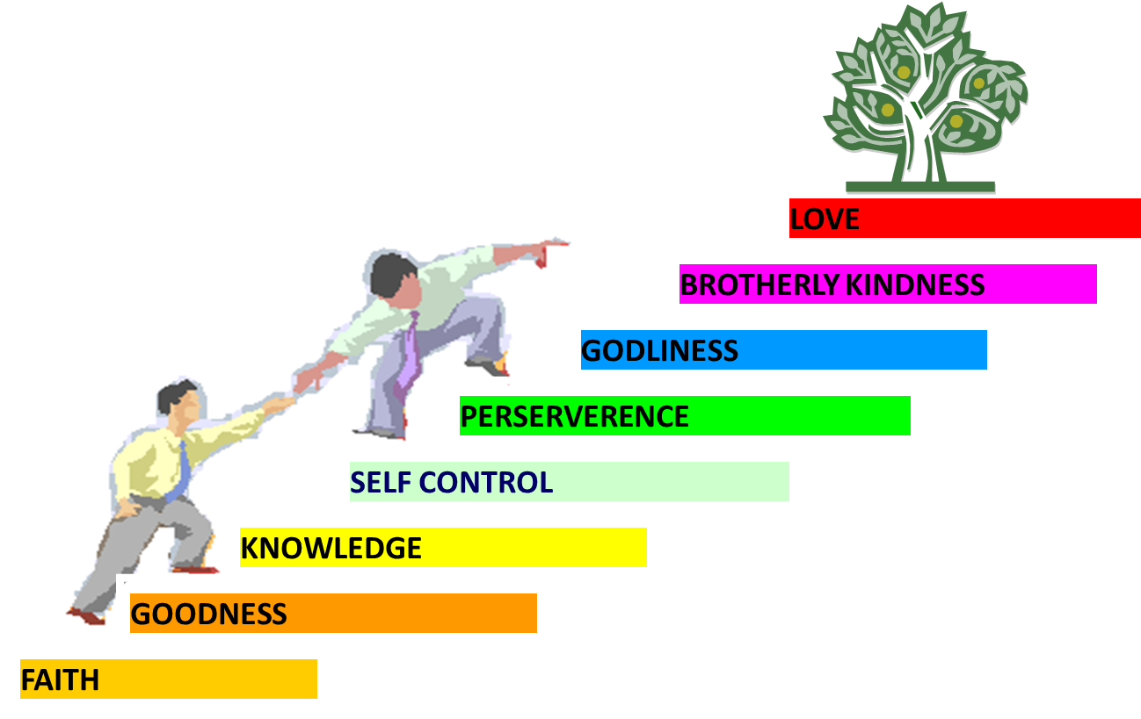
PORTRAIT OF GROWTH
1:5-7

Slide 117
Acts 13‒14
1st Missionary Journey
  Paul & Barnabas’ appointment (13:1-3)
  Cyprus ministry (13:4-12)
  Pisidian Antioch ministry (13:13-52)
  Iconium ministry (14:1-7)
  Lystra ministry (14:8-20a)
  Derbe ministry (14:20b-21a)
  Return to Antioch (14:21b-28)

Slide 118
VI. Derbe Ministry
Acts 14:20b-21a
  Journey to Derbe (20b)
  Ministry in Derbe (20a)

Slide 119
VI. Derbe Ministry
Acts 14:20b-21a
  Journey to Derbe (20b)
  Ministry in Derbe (20a)

Slide 120
First Missionary Journey

Slide 121
VI. Derbe Ministry
Acts 14:20b-21a
  Journey to Derbe (20b)
  Ministry in Derbe (20a)

Slide 122
Acts 13‒14
1st Missionary Journey
  Paul & Barnabas’ appointment (13:1-3)
  Cyprus ministry (13:4-12)
  Pisidian Antioch ministry (13:13-52)
  Iconium ministry (14:1-7)
  Lystra ministry (14:8-20a)
  Derbe ministry (14:20b-21a)
  Return to Antioch (14:21b-28)

Slide 123
VII. Return to Syrian Antioch
Acts 14:21b-28
  Return route (21b)
  Ministries in revisited cities (22-23)
  Route to Antioch (24-26)
  Report to Antioch Church (27-28)

Slide 124
VII. Return to Syrian Antioch
Acts 14:21b-28
  Return route (21b)
  Ministries in revisited cities (22-23)
  Route to Antioch (24-26)
  Report to Antioch Church (27-28)

Slide 125

First Missionary Journey

Slide 126
VII. Return to Syrian Antioch
Acts 14:21b-28
  Return route (21b)
  Ministries in revisited cities (22-23)
  Route to Antioch (24-26)
  Report to Antioch Church (27-28)

Slide 127
Acts 14:22-23
Ministries in revisited cities
      Confirmation (22a)
      Exhortation (22b)
      Appointment of elders (23)

Slide 128
Acts 14:22-23
Ministries in revisited cities
      Confirmation (22a)
      Exhortation (22b)
      Appointment of elders (23)

Slide 129
Acts 14:22-23
Ministries in revisited cities
      Confirmation (22a)
      Exhortation (22b)
      Appointment of elders (23)

Slide 130
Acts 14:22-23
Ministries in revisited cities
      Confirmation (22a)
      Exhortation (22b)
      Appointment of elders (23)

Slide 131

Local Church Government
Episcopalian / bishop rule – Acts 15:2, 6
Congregational rule – Acts 6:1-7
Presbyterian / elder rule – Acts 20:28; 1 Tim 5:17; 4:14

Slide 132
VII. Return to Syrian Antioch
Acts 14:21b-28
  Return route (21b)
  Ministries in revisited cities (22-23)
  Route to Antioch (24-26)
  Report to Antioch Church (27-28)

Slide 133
Acts 14:24-26
Route to Antioch
      Through Pisidia to Pamphylia (24)
      Speaking the Word in Perga (25a)
      To Attalia (25b)
      To Antioch via boat (26)

Slide 134
Acts 14:24-26
Route to Antioch
      Through Pisidia to Pamphylia (24)
      Speaking the Word in Perga (25a)
      To Attalia (25b)
      To Antioch via boat (26)

Slide 135
First Missionary Journey

Slide 136
Acts 14:24-26
Route to Antioch
      Through Pisidia to Pamphylia (24)
      Speaking the Word in Perga (25a)
      To Attalia (25b)
      To Antioch via boat (26)

Slide 137
First Missionary Journey

Slide 138
Acts 14:24-26
Route to Antioch
      Through Pisidia to Pamphylia (24)
      Speaking the Word in Perga (25a)
      To Attalia (25b)
      To Antioch via boat (26)

Slide 139
First Missionary Journey

Slide 140
Acts 1:8
“but you will receive power when the Holy Spirit has come upon you; and you shall be My witnesses both in Jerusalem, and in all Judea and Samaria, and even to the remotest part of the earth.”

Slide 141
Acts Message
  Birth and growth of the church numerically, geographically, ethnically.
  Components
  Numerically (progress reports)
  Geographically (From Jerusalem to Rome)
  Ethnically (From Judaism to Gentile domination)

Slide 142
Acts 14:24-26
Route to Antioch
      Through Pisidia to Pamphylia (24)
      Speaking the Word in Perga (25a)
      To Attalia (25b)
      To Antioch via boat (26)

Slide 143
First Missionary Journey

Slide 144
VII. Return to Syrian Antioch
Acts 14:21b-28
  Return route (21b)
  Ministries in revisited cities (22-23)
  Route to Antioch (24-26)
  Report to Antioch Church (27-28)

Slide 145
Acts 14:27-28
Report to the Antioch Church
      Missionary report (27)
      Transitional statement (28)

Slide 146
Acts 14:27-28
Report to the Antioch Church
      Missionary report (27)
      Transitional statement (28)

Slide 148
Acts 14:27-28
Report to the Antioch Church
      Missionary report (27)
      Transitional statement (28)

Slide 149
Paul’s Ministry Chronology
# OF BOOKS | JOURNEY | ACTS | DATE | BOOKS
1 | 1 | 13–14 | 48–49 | Gal
2 | 2 | 15:36–18:22 | 50–52 | 1–2 Thess
3 | 3 | 18:23–21:17 | 53–57 | 1–2 Cor, Rom
4 | 4 | 28:16-31 | 60–62 | Eph, Col, Phlm, Phlp
2 | Between Imprisonments | Post Acts | 62–66 | 1 Tim, Titus
1 | 2nd Imprisonment | Post Acts | 67 | 2 Tim

Slide 150
ORDER OF PAUL’S LETTERS | ORDER OF PAUL’S LETTERS
1. | Galatians | A.D. 49
2. | 1‒2 Thessalonians | A.D. 51
3. | 1‒2 Corinthians | A.D. 56
4. | Romans | A.D. 57
5. | Ephesians, Colossians, Philemon, Philippians | A.D. 60‒62
6. | 1 Timothy, Titus | A.D. 62‒66
7. | 2 Timothy | A.D. 67

Slide 151
Conclusion

Slide 152
Acts 13‒14
1st Missionary Journey
  Paul & Barnabas’ appointment (13:1-3)
  Cyprus ministry (13:4-12)
  Pisidian Antioch ministry (13:13-52)
  Iconium ministry (14:1-7)
  Lystra ministry (14:8-20a)
  Derbe ministry (14:20b-21a)
  Return to Antioch (14:21b-28)

