Slide 1



Slide 2

EXODUS STRUCTURE/OUTLINE
Redemption (1–18)
  Redemption (1:1–12:30)
  Liberation (12:31–15:21)
  Preservation (15:22–18:27)
Mosaic Covenant (19–40)
  Law (19–24)
  Tabernacle instructions (25–31)
  Apostasy (32–34)
  Tabernacle building (35–40)

Slide 3
REDEMPTION
(1:1–12:30)
Why redemption is necessary (Exod 1)
Development of the deliverer (Exod 2–4)
First confrontation with Pharaoh (Exod 5)
God reassures Moses (Exod 6:1–7:7)
Second confrontation with Pharaoh (Exod 7:18-13)
Plagues (Exod 7:14–12:30)

Slide 4
1st MEETING WITH PHARAOH
Exodus 5:1-23
  Problem of Pharaoh (1-19)
  Problem of Israel (20-23)

Slide 5
1st MEETING WITH PHARAOH
Exodus 5:1-23
  Problem of Pharaoh (1-19)
  Problem of Israel (20-23)

Slide 6
I. Exodus 5:1-19
Problem of Pharaoh
    Request of Pharaoh (1)
    Refusal by Pharaoh (2)
    Request of Pharaoh (3)
    Pharaoh increases Israel’s burden (4-19)

Slide 7
I. Exodus 5:1-19
Problem of Pharaoh
    Request of Pharaoh (1)
    Refusal by Pharaoh (2)
    Request of Pharaoh (3)
    Pharaoh increases Israel’s burden (4-19)

Slide 8
Exodus 5:1
Request of Pharaoh
      Request stated (1a)
      Reasons for the request (1b)

Slide 9
Exodus 5:1
Request of Pharaoh
      Request stated (1a)
      Reasons for the request (1b)

Slide 10
Exodus 5:1
Request of Pharaoh
      Request stated (1a)
      Reasons for the request (1b)

Slide 11
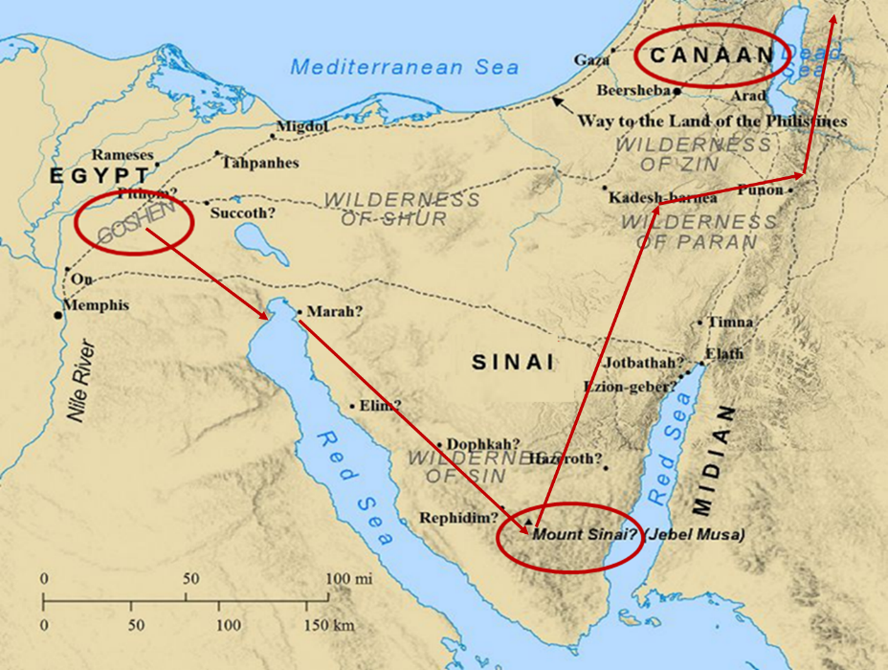

Slide 12
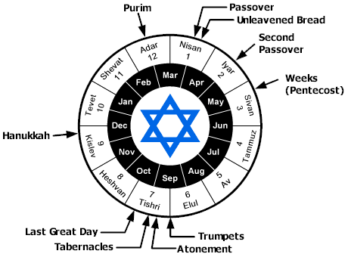

Slide 13
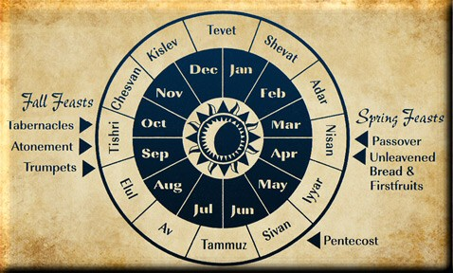

Slide 14
Levitical Feasts (Leviticus 23)
Feast | Season | Purpose | Type
Passover | Spring | Redemption | 1 Cor 5:7
Unleavened Bread | Spring | Separation | John 6:35
1st Fruits | Spring | Praise | 1 Cor 15:20
Pentecost | Spring | Praise | Acts 2:1-4
Trumpets | Fall | New Year | Matt 24:31
Atonement | Fall | Lev 16 | Zech 12:10
Booths | Fall | Wilderness provision | Zech 14:16-18

Slide 15
I. Exodus 5:1-19
Problem of Pharaoh
    Request of Pharaoh (1)
    Refusal by Pharaoh (2)
    Request of Pharaoh (3)
    Pharaoh increases Israel’s burden (4-19)

Slide 16
Exodus 5:2
Refusal by Pharaoh
      Reasons (2a)
      Response (2b)

Slide 17
Exodus 5:2
Refusal by Pharaoh
      Reasons (2a)
      Response (2b)

Slide 18
The Plagues of Egypt
NO. | DESCRIPTION | SCRIPTURE | Egyptian Deity
1. | Water to Blood | Exod. 7:14-25 | Hapi, Khnum
2. | Frogs | Exod. 8:1-15 | Heqt
3. | Gnats | Exod. 8:16-19 | Set
4. | Flies | Exod. 8:20-32 | Uatchit
5. | Disease on Cattle | Exod. 9:1-7 | Hathor, Apis
6. | Boils | Exod. 9:8-12 | Sekhmet, Serapis
7. | Hail | Exod. 9:13-35 | Seth, Nut
8. | Locusts | Exod. 10:1-20 | Seth, Nut, Osiris
9. | Darkness | Exod. 10:21-29 | Re, Horus, Atum
10. | Death of the First Born | Exod. 12:29-36 | Min, Osiris, Heqt, Isis

Slide 19

Matthew 7:21-23
“Not everyone who says to Me, ‘Lord, Lord,’ will enter the kingdom of heaven, but he who does the will of My Father who is in heaven will enter. ²² Many will say to Me on that day, ‘Lord, Lord, did we not prophesy in Your name, and in Your name cast out demons, and in Your name perform many miracles?’ ²³ And then I will declare to them, ‘I never knew [ginōskō] you; depart from Me, you who practice lawlessness.’”

Slide 20
Exodus 5:2
Refusal by Pharaoh
      Reasons (2a)
      Response (2b)

Slide 21
I. Exodus 5:1-19
Problem of Pharaoh
    Request of Pharaoh (1)
    Refusal by Pharaoh (2)
    Request of Pharaoh (3)
    Pharaoh increases Israel’s burden (4-19)

Slide 22
Exodus 5:3
Refusal of Pharaoh
      Request (3a)
      Consequence (3b)

Slide 23
Exodus 5:3
Refusal of Pharaoh
      Request (3a)
      Consequence (3b)

Slide 24
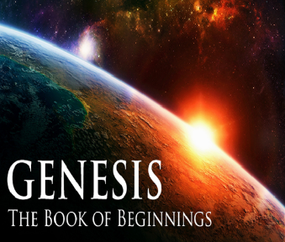
Names for God in Genesis
Elohim (1:1) – Power
Yahweh (2:4) – Relational
El Roi (Gen. 16:13) – Aware
El Olam (21:33) – Eternal
Jehovah Jireh (22:14) – Provision
God Isaac Feared (31:42, 53) – Reverenced
God, the God of Israel (33:20) – National

Slide 25

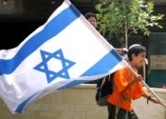
Zechariah 14:2-3
“² For I will gather all the nations against Jerusalem to battle, and the city will be captured, the houses plundered, the women ravished and half of the city exiled, but the rest of the people will not be cut off from the city.” ³ Then the Lord will go forth and fight against those nations, as when He fights on a day of battle.”
25

Slide 26
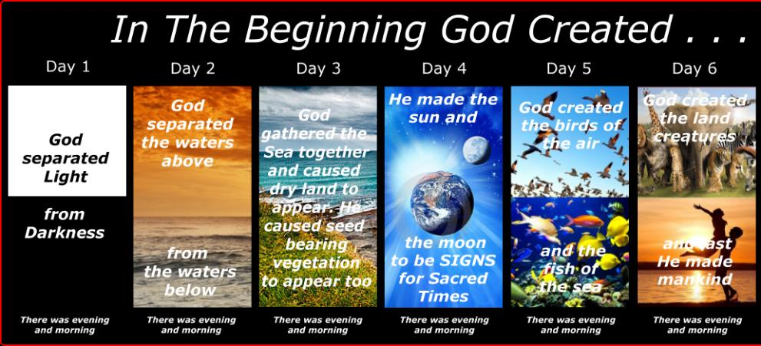
SHAPING AND POPULATING (GEN 1:1)
Day 1: | Light | Day 4: | Luminaries
Day 2: | Water, sky | Day 5: | Sea animals, birds
Day 3: | Land, vegetation | Day 6: | Land animals, man

Slide 28
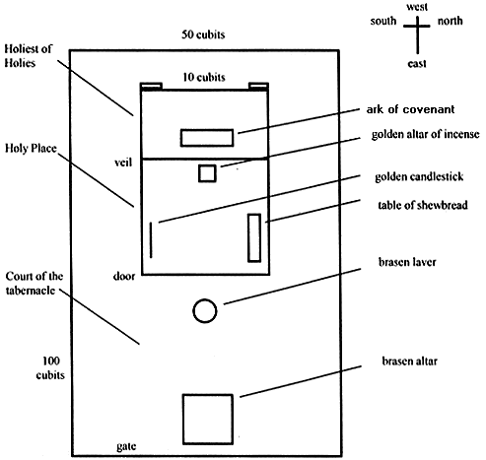
Tabernacle Diagram

Slide 29
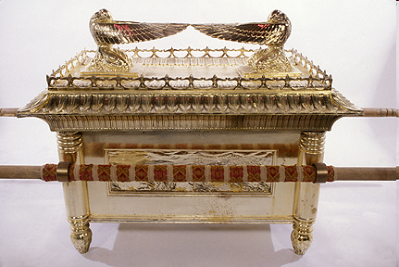
Ark of the Covenant

Slide 30


Slide 31


John 13:19; 14:29
“¹⁹ From now on I am telling you before it comes to pass, so that when it does occur, you may believe that I am He… ^{14:29} Now I have told you before it happens, so that when it happens, you may believe.”

Slide 32
Exodus 5:3
Refusal of Pharaoh
      Request (3a)
      Consequence (3b)

Slide 33
Six Parts of a Suzerain-Vassal Treaty in Deuteronomy
Preamble (1:1-5)
Prologue (1:6–4:40)
Covenant obligations (5–26)
Storage and reading instructions (27:2-3; 31:9, 24, 26)
Witnesses (32:1)
Blessings and curses (28)

Slide 34
I. Exodus 5:1-19
Problem of Pharaoh
    Request of Pharaoh (1)
    Refusal by Pharaoh (2)
    Request of Pharaoh (3)
    Pharaoh increases Israel’s burden (4-19)

Slide 35
Exodus 5:4-19
Pharaoh Increases Israel’s Burden
      Orders to Moses & Aaron (4-5)
      Orders to taskmasters & foremen (6-9)
      Orders followed (10-14)
      Foremens’ response (15-19)

Slide 36
Exodus 5:4-19
Pharaoh Increases Israel’s Burden
      Orders to Moses & Aaron (4-5)
      Orders to taskmasters & foremen (6-9)
      Orders followed (10-14)
      Foremens’ response (15-19)

Slide 37
Exodus 5:4-19
Pharaoh Increases Israel’s Burden
      Orders to Moses & Aaron (4-5)
      Orders to taskmasters & foremen (6-9)
      Orders followed (10-14)
      Foremens’ response (15-19)

Slide 38
Exodus 5:4-19
Pharaoh Increases Israel’s Burden
      Orders to Moses & Aaron (4-5)
      Orders to taskmasters & foremen (6-9)
      Orders followed (10-14)
      Foremens’ response (15-19)

Slide 39
Exodus 5:10-14
Orders Followed
      Burden upon Israel (10-13)
      Burden upon the foremen (14)

Slide 40
Exodus 5:10-14
Orders Followed
      Burden upon Israel (10-13)
      Burden upon the foremen (14)

Slide 41
Exodus 5:10-14
Orders Followed
      Burden upon Israel (10-13)
      Burden upon the foremen (14)

Slide 42
Exodus 5:4-19
Pharaoh Increases Israel’s Burden
      Orders to Moses & Aaron (4-5)
      Orders to taskmasters & foremen (6-9)
      Orders followed (10-14)
      Foremens’ response (15-19)

Slide 43
Exodus 5:10-14
Foremens’ Response
      To Pharaoh (15-16)
      Pharaoh’s response (17-18)
      Foremens’ reaction (19)

Slide 44
Exodus 5:10-14
Foremens’ Response
      To Pharaoh (15-16)
      Pharaoh’s response (17-18)
      Foremens’ reaction (19)

Slide 45
Exodus 5:10-14
Foremens’ Response
      To Pharaoh (15-16)
      Pharaoh’s response (17-18)
      Foremens’ reaction (19)

Slide 46
Tabernacle Diagram

Slide 47
Ark of the Covenant

Slide 48
Exodus 5:10-14
Foremens’ Response
      To Pharaoh (15-16)
      Pharaoh’s response (17-18)
      Foremens’ reaction (19)

Slide 49
1st MEETING WITH PHARAOH
Exodus 5:1-23
  Problem of Pharaoh (1-19)
  Problem of Israel (20-23)

Slide 50
II. Exodus 5:1-19
Problem of Israel
    Israel complains to Moses (20-21)
    Moses complains to God (22-23)

Slide 51
II. Exodus 5:1-19
Problem of Israel
    Israel complains to Moses (20-21)
    Moses complains to God (22-23)

Slide 52
Exodus 5:20-21
Israel Complains to Moses
      The meeting (20)
      The complaint (21)

Slide 53
Exodus 5:20-21
Israel Complains to Moses
      The meeting (20)
      The complaint (21)

Slide 54
Exodus 5:20-21
Israel Complains to Moses
      The meeting (20)
      The complaint (21)

Slide 55
II. Exodus 5:1-19
Problem of Israel
    Israel complains to Moses (20-21)
    Moses complains to God (22-23)

Slide 56
Exodus 5:22-23
Moses Complains to God
      Worsening situation (22)
      No deliverance (23)

Slide 57
Exodus 5:22-23
Moses Complains to God
      Worsening situation (22)
      No deliverance (23)

Slide 58
Exodus 5:22-23
Moses Complains to God
      Worsening situation (22)
      No deliverance (23)

Slide 59

Romans 8:19-23
¹⁹ For the anxious longing of the creation waits eagerly for the revealing of the sons of God. ²⁰ For the creation was subjected to futility, not willingly, but because of Him who subjected it, in hope ²¹ that the creation itself also will be set free from its slavery to corruption into the freedom of the glory of the children of God. ²² For we know that the whole creation groans and suffers the pains of childbirth together until now. ²³ And not only this, but also we ourselves, having the first fruits of the Spirit, even we ourselves groan within ourselves, waiting eagerly for our adoption as sons, the redemption of our body.”

Slide 60
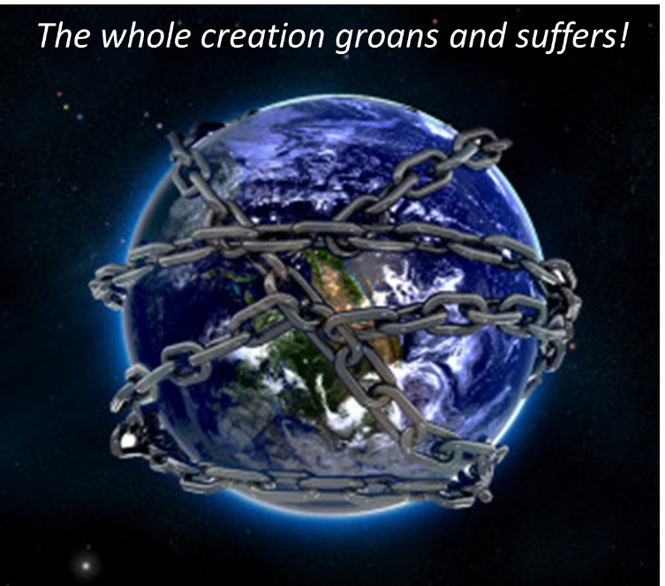

Slide 61
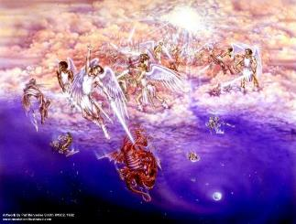
Satan as Ruler of this World
Job 1:7; 2:2
Luke 4:5-7
John 12:31; 14:30; 16:11
2 Corinthians 4:4
Ephesians 2:2
1 John 4:4; 5:19

Slide 62

Names & Titles Demonstrating Satan’s Post-Fall, Earthly Authority
(Job 1:7; 2:2; Luke 4:5-8; Rom. 8:19-22)
Prince of this world (John 12:31; 14:30; 16:11)
God of this age (2 Cor. 4:4)
Prince and power of the air (Eph. 2:2)
Who the believer wrestles with (Eph. 6:12)
Roaring lion (1 Pet. 5:8)
Whole world lies in his power (1 John 5:19)

Slide 63
Ultimate Exodus
(Rev 11:15)
Sores: 6th plague (Ex 9:8-12), 1st bowl (Rev 16:1-2)
Rivers to blood: 1st plague (Ex 7:19-21), 3rd bowl (Rev 16:4-7)
Darkness: 9th plague (Ex 10:21-23), 5th bowl (Rev 16:10-11)
Frogs: 2nd plague (Ex 7:25‒8:15), 6th bowl (Rev 16:13)
Hail: 7th plague (Ex 9:22-26), 7th bowl (Rev 16:17-21)

Slide 64
2 Peter 1:19-21
“¹⁹ So we have the prophetic word made more sure, to which you do well to pay attention as to a lamp shining in a dark place, until the day dawns and the morning star arises in your hearts. ²⁰ But know this first of all, that no prophecy of Scripture is a matter of one’s own interpretation, ²¹ for no prophecy was ever made by an act of human will, but men moved by the Holy Spirit spoke from God.”
Notes:
Psa 119:105 – lamp of prophecy

Slide 65
AUTHORITY OF SCRIPTURE
V. 19
More sure than eyewitness testimony
World is in the Dark, Scripture is the Light
Morning Star = Jesus
  Rev. 2:28; 22:16

Slide 66

Revelation 2:28; 22:16
“^{2:28} and I will give him the morning star... ^{22:16} “I, Jesus, have sent My angel to testify to you these things for the churches. I am the root and the descendant of David, the bright morning star.”

Slide 67
Conclusion

Slide 68
1st MEETING WITH PHARAOH
Exodus 5:1-23
  Problem of Pharaoh (1-19)
  Problem of Israel (20-23)

Slide 69
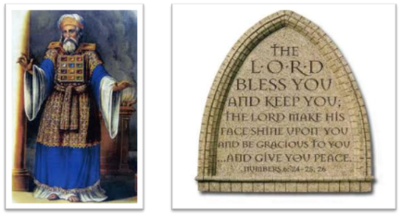
²⁴ The Lord bless you, and keep you; ²⁵ The Lord make His face shine on you, And be gracious to you; ²⁶ The Lord lift up His countenance on you, And give you peace.
Numbers 6:24–26 (NASB95)

