Slide 1

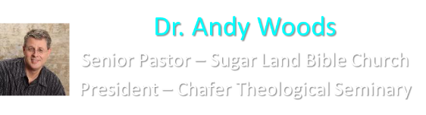

Slide 2

EXODUS STRUCTURE/OUTLINE
Redemption (1–18)
  Redemption (1:1–12:30)
  Liberation (12:31–15:21)
  Preservation (15:22–18:27)
Mosaic Covenant (19–40)
  Law (19–24)
  Tabernacle instructions (25–31)
  Apostasy (32–34)
  Tabernacle building (35–40)

Slide 3
REDEMPTION
(1:1–12:30)
Why redemption is necessary (Exod 1)
Development of the deliverer (Exod 2–4)
First confrontation with Pharaoh (Exod 5)
God reassures Moses (Exod 6:1–7:7)
Second confrontation with Pharaoh (Exod 7:18-13)
Plagues (Exod 7:14–12:30)

Slide 4
THREE PHASES OF MOSES’ 120 YEAR LIFE
LIFE PHASE | SCRIPTURE | YEARS | AGE | ACTIVITY
Natural Training | Acts 7:23 | 1526–1486 B.C. | 1-40 | Egyptian Education
Spiritual Training | Exod. 7:7 | 1486–1446 B.C. | 40-80 | Midian Shepherding
Ministry | Deut. 31:2; 34:7; Acts 7:36 | 1446–1406 B.C. | 80-120 | Exodus, Law, Wilderness Preservation, Pentateuch Authorship

Slide 5
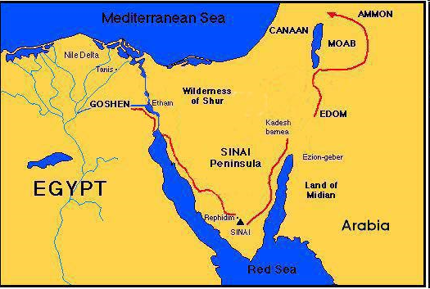

Slide 6
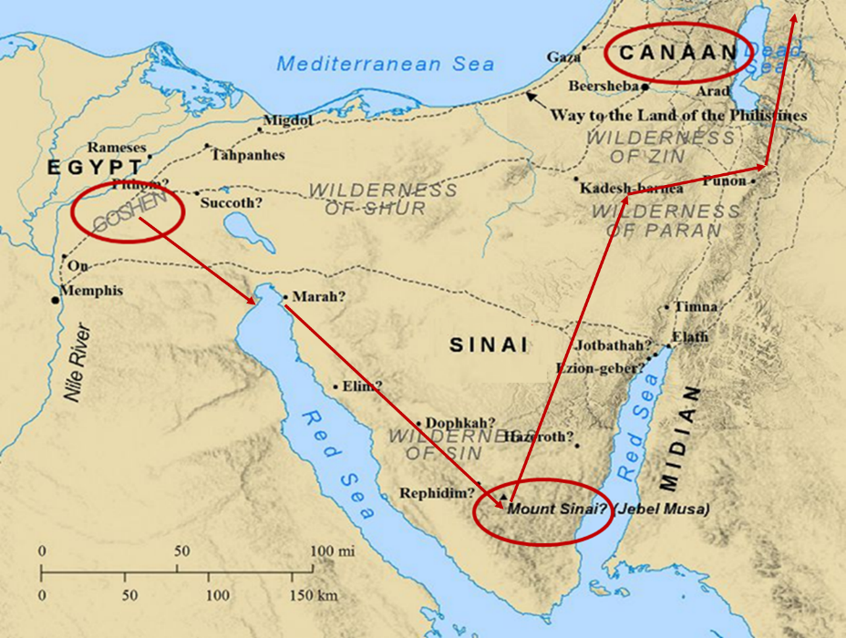

Slide 8
MOSES’ CALLING
Exodus 4:1-31
  Third objection (1-9)
  Fourth objection (10-12)
  Fifth objection (13-17)
  Moses returns to Egypt (18-20)
  God to harden Pharaoh (21-23)
  Moses refusal to circumcise Gershom (24-26)
  Moses’ meetings (27-31)

Slide 9
VII. Exodus 4:27-31
Moses’ Meetings
  With Aaron (27-28)
  With Israel’s leaders (29-31)

Slide 10
VII. Exodus 4:27-31
Moses’ Meetings
  With Aaron (27-28)
  With Israel’s leaders (29-31)

Slide 11
Exodus 4:27-28
With Aaron
      The meeting (27)
      The telling (28)

Slide 12
Exodus 4:27-28
With Aaron
      The meeting (27)
      The telling (28)

Slide 15
Exodus 4:27-28
With Aaron
      The meeting (27)
      The telling (28)

Slide 16
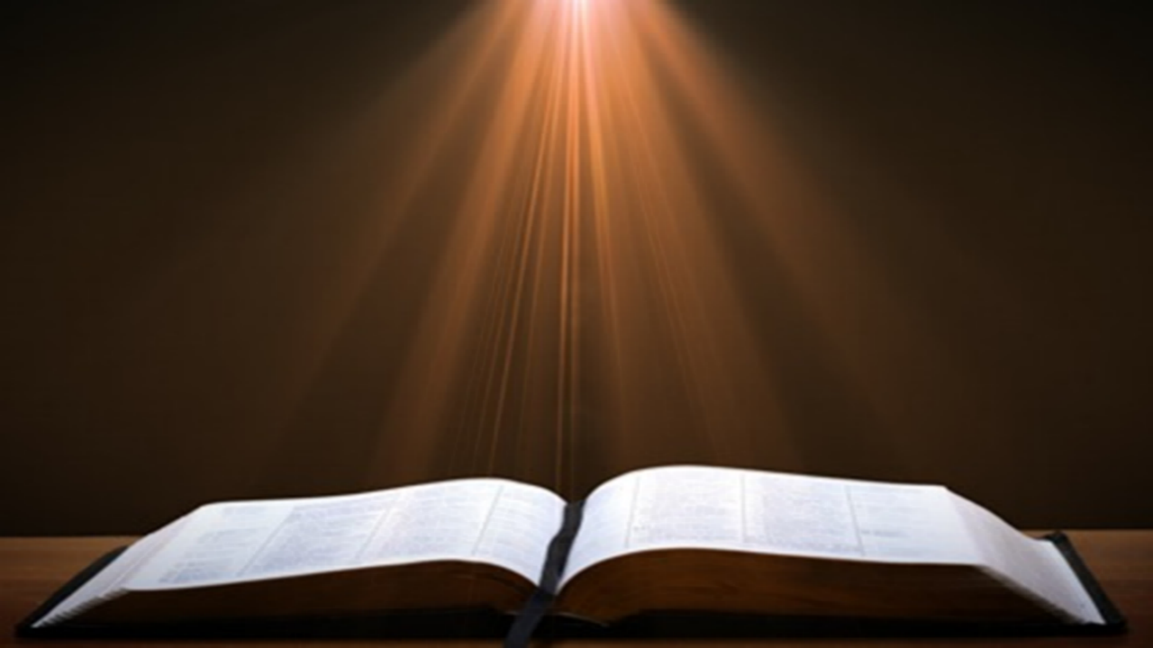
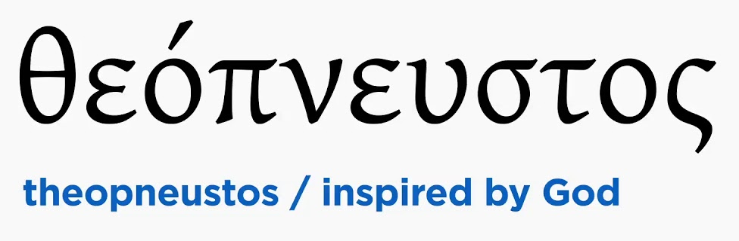
2 Timothy 3:16-17
“All Scripture is inspired by God [theopneustos] and profitable for teaching, for reproof, for correction, for training in righteousness; so that the man of God may be adequate, equipped for every good work.”

Slide 17


Matthew 4:4
“But He answered and said, “It is written, ‘Man shall not live on bread alone, but on every word that proceeds out of the mouth of God.’”

Slide 18

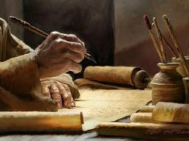
Acts 20:26-27
“²⁶ Therefore, I testify to you this day that I am innocent of the blood of all men. ²⁷ For I did not shrink from declaring to you the whole purpose of God.”

Slide 19
VII. Exodus 4:27-31
Moses’ Meetings
  With Aaron (27-28)
  With Israel’s leaders (29-31)

Slide 20
Exodus 4:29-31
With Israel’s Leaders
      Assembly (29)
      Proclamation (30)
      Response (31)

Slide 21
Exodus 4:29-31
With Israel’s Leaders
      Assembly (29)
      Proclamation (30)
      Response (31)

Slide 22
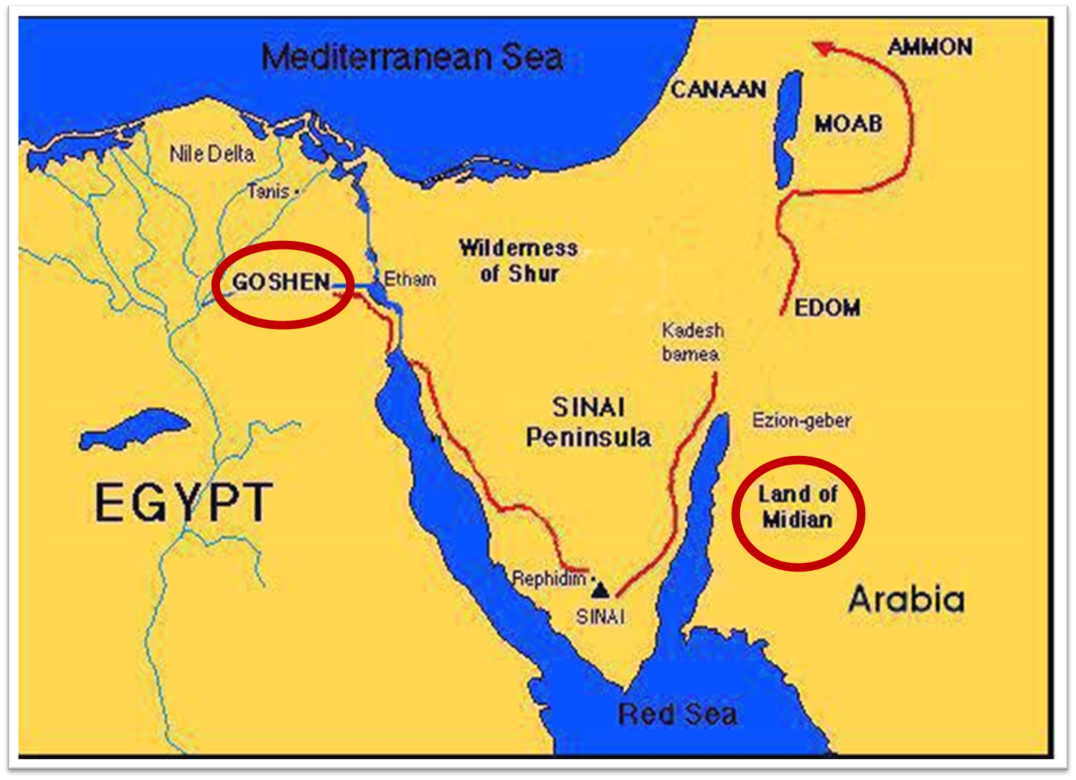

Slide 23
Exodus 4:29-31
With Israel’s Leaders
      Assembly (29)
      Proclamation (30)
      Response (31)

Slide 24
Exodus 4:30
The Proclamation
      Words (30a)
      Signs (30b)

Slide 25
Exodus 4:30
The Proclamation
      Words (30a)
      Signs (30b)

Slide 26
2 Timothy 3:16-17
“All Scripture is inspired by God [theopneustos] and profitable for teaching, for reproof, for correction, for training in righteousness; so that the man of God may be adequate, equipped for every good work.”

Slide 27
Matthew 4:4
“But He answered and said, “It is written, ‘Man shall not live on bread alone, but on every word that proceeds out of the mouth of God.’”

Slide 28
Acts 20:26-27
“²⁶ Therefore, I testify to you this day that I am innocent of the blood of all men. ²⁷ For I did not shrink from declaring to you the whole purpose of God.”

Slide 29
Exodus 4:30
The Proclamation
      Words (30a)
      Signs (30b)

Slide 30
Exodus 4:2-9
Proofs
      1st proof (2-5)
      2nd proof (6-8)
      3rd proof (9)

Slide 31
Exodus 4:29-31
With Israel’s Leaders
      Assembly (29)
      Proclamation (30)
      Response (31)

Slide 32
Exodus 4:31
The Response
      Faith (31a)
      Worship (31b)

Slide 33
Exodus 4:31
The Response
      Faith (31a)
      Worship (31b)

Slide 35
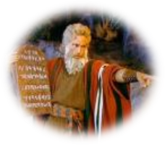
Exodus 14:30-31
³⁰ Thus the Lord saved Israel that day from the hand of the Egyptians, and Israel saw the Egyptians dead on the seashore. ³¹ When Israel saw the great power which the Lord had used against the Egyptians, the people feared the Lord, and they believed in the Lord and in His servant Moses.”

Slide 36
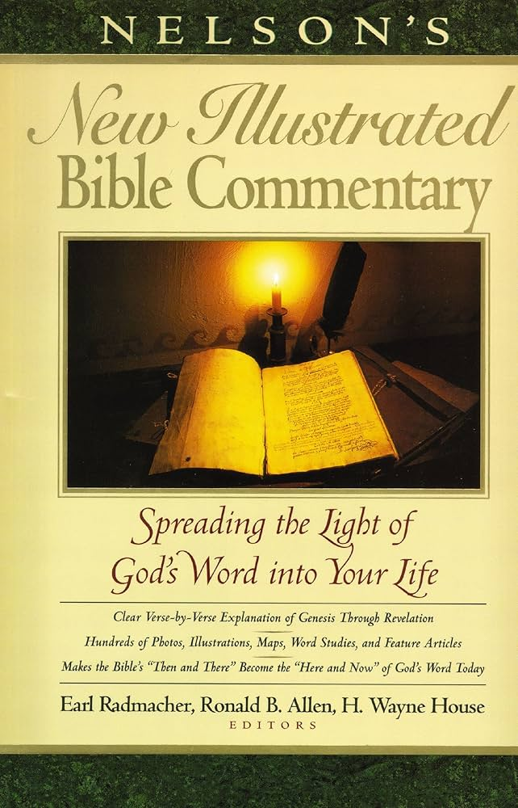
Exodus 14:31
“When we read so the people feared the Lord and the words that follow, we are meant to understand that the community had come to saving faith and so were a reborn people. They believed the Lord (the same wording used of Abraham’s saving faith in Gen. 15:6; read Paul’s comments in Rom. 4)…The people were transformed spiritually even as they were delivered physically.”
Nelson's New Illustrated Bible Commentary, 113.

Slide 37

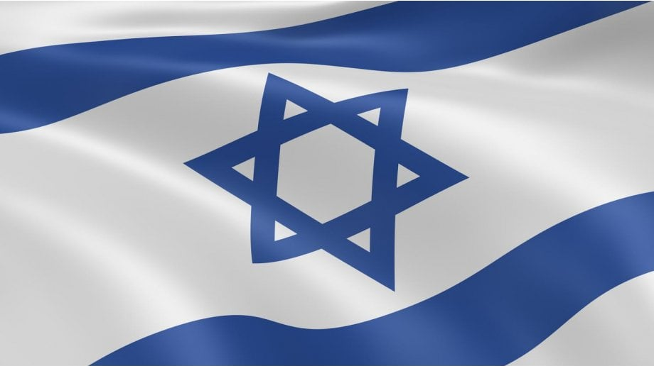
Exodus 2:24
“So, God heard their groaning; and God remembered His covenant with Abraham, Isaac, and Jacob.”

Slide 38
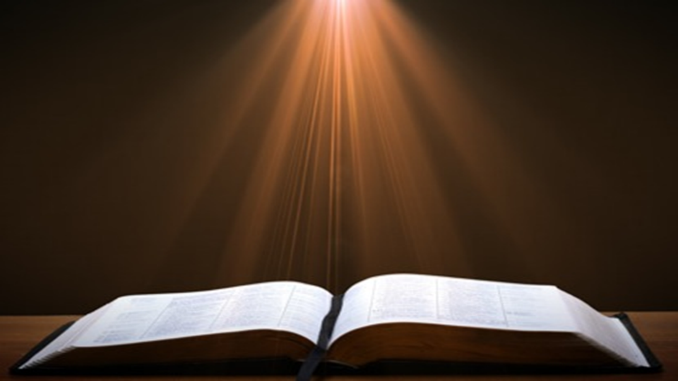
Genesis 15:18-21
¹⁸ On that day the Lord made a covenant with Abram, saying, “To your descendants I have given this land, From the river of Egypt as far as the great river, the river Euphrates: ¹⁹ the Kenite and the Kenizzite and the Kadmonite ²⁰ and the Hittite and the Perizzite and the Rephaim ²¹ and the Amorite and the Canaanite and the Girgashite and the Jebusite.”

Slide 39
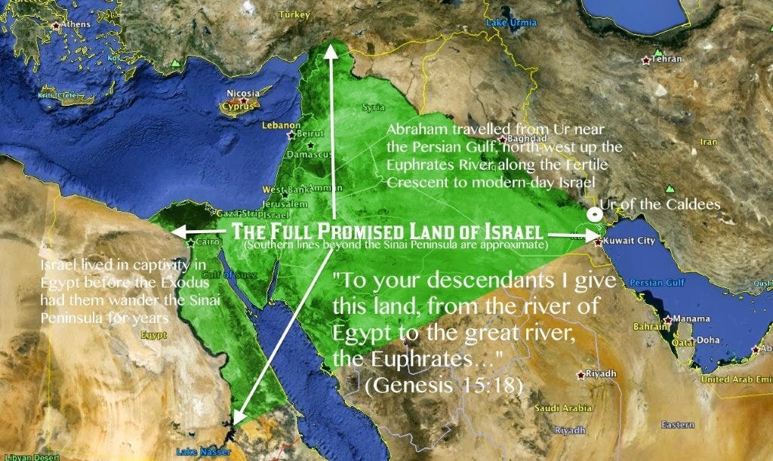

Slide 40
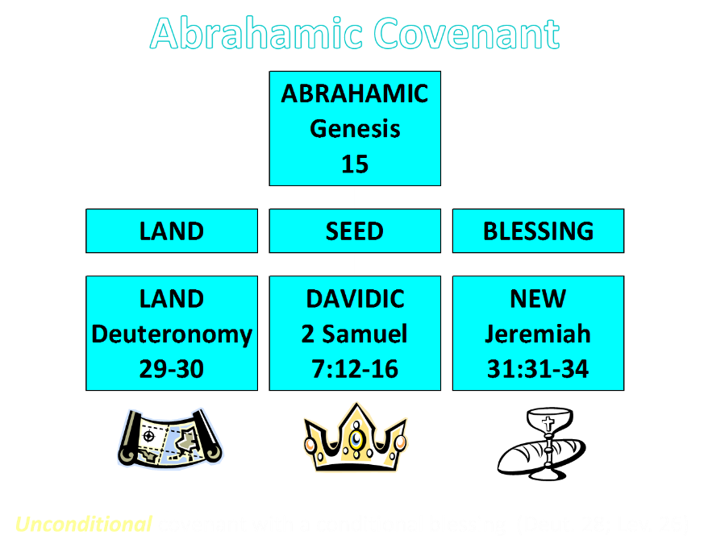

Slide 41
Ezekiel 36:22
“Therefore, say to the house of Israel, ‘This is what the Lord God says: “It is not for your sake, house of Israel, that I am about to act, but for My holy name, which you have profaned among the nations where you went.”

Slide 42
Exodus 4:31
The Response
      Faith (31a)
      Worship (31b)

Slide 43
Conclusion

Slide 44
MOSES’ CALLING
Exodus 4:1-31
  Third objection (1-9)
  Fourth objection (10-12)
  Fifth objection (13-17)
  Moses returns to Egypt (18-20)
  God to harden Pharaoh (21-23)
  Moses refusal to circumcise Gershom (24-26)
  Moses’ meetings (27-31)

Slide 45
VII. Exodus 4:27-31
Moses’ Meetings
  With Aaron (27-28)
  With Israel’s leaders (29-31)

Slide 46
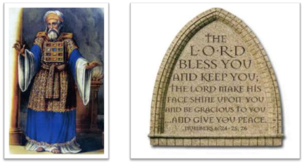
²⁴ The Lord bless you, and keep you; ²⁵ The Lord make His face shine on you, And be gracious to you; ²⁶ The Lord lift up His countenance on you, And give you peace.
Numbers 6:24–26 (NASB95)

