Slide 1


Slide 2
INTRODUCTORY MATTERS OF JONAH
Who wrote it? Jonah
When was it written? 770-750 BC
Who was it written to? Israel
Historicity of the book? Fact!
Genre of the book? Historical Narrative
What is it all about? (Message) To showcase God’s universal love and plan of redemption which extends beyond Israel to include all nations

Slide 3
INTRODUCTORY MATTERS OF JONAH
Why was it written? (Purpose) Expose Israel’s ethnocentrism and encourage national repentance
What’s in it? (Survey) Defiance (1-2) Compliance (3-4)
Christ in Jonah? Yes, through Messianic typology
What makes this book unique? 5 unique things
Structure/outline of the book?

Slide 4
Outline of Jonah
Defiance (1-2)
  The running prophet (1)
  The praying prophet (2)
Compliance (3-4)
  The preaching prophet (3)
  The pouting prophet (4)

Slide 5
INTRODUCTORY MATTERS OF JONAH
Why was it written? (Purpose) Expose Israel’s ethnocentrism and encourage national repentance
What’s in it? (Survey) Defiance (1-2) Compliance (3-4)
Christ in Jonah? Yes, through Messianic typology
What makes this book unique? 5 unique things
Structure/outline of the book?

Slide 6
“…and behold, something greater than Jonah is here.”
Matthew 12:41c

Slide 7
B. The Praying Prophet (2)
  A Divine Rescue (2:7)
    Jonah remembers God (7a)
    Jonah’s prayer answered (7b)
  Jonah’s Vow of Faithfulness (2:8-9)
    Rejection of Idols (8)
    Jonah’s thanksgiving (9)
  A Divine Response (2:10)
    God’s control over nature (10a)
    Jonah’s deliverance (10b)

Slide 8
Outline of Jonah
Defiance (1-2)
  The running prophet (1)
  The praying prophet (2)
Compliance (3-4)
  The preaching prophet (3)
  The pouting prophet (4)

Slide 9
A. The Preaching Prophet (3:1-10)
Jonah’s re-commission (1-2)
Jonah’s sermon to Nineveh (3-4)
Nineveh's response (5-9)
God’s response (10)

Slide 10
A. The Preaching Prophet (3:1-10)
Jonah’s re-commission (1-2)
  God’s attributes in action (1)
  God’s Instructions (2)
Jonah’s sermon to Nineveh (3-4)
  Jonah’s obedience (3)
  Jonah’s sermon (4)
Nineveh's response (5-9)
God’s response (10)

Slide 11
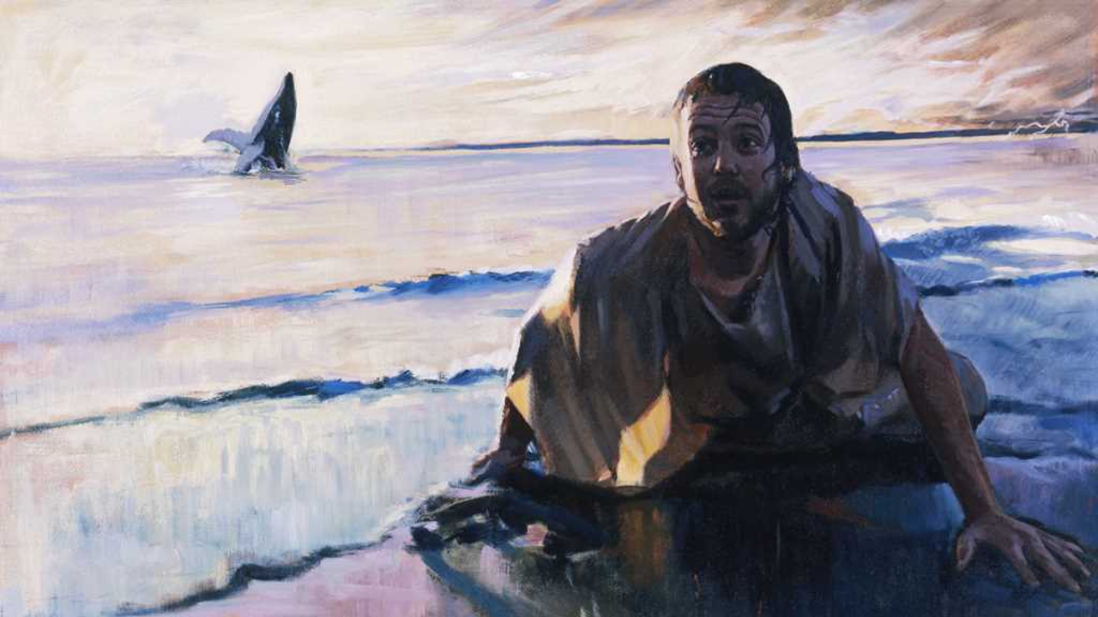
“Then the LORD commanded the fish, and it vomited Jonah up onto the dry land.”
Jonah 2:10

Slide 12
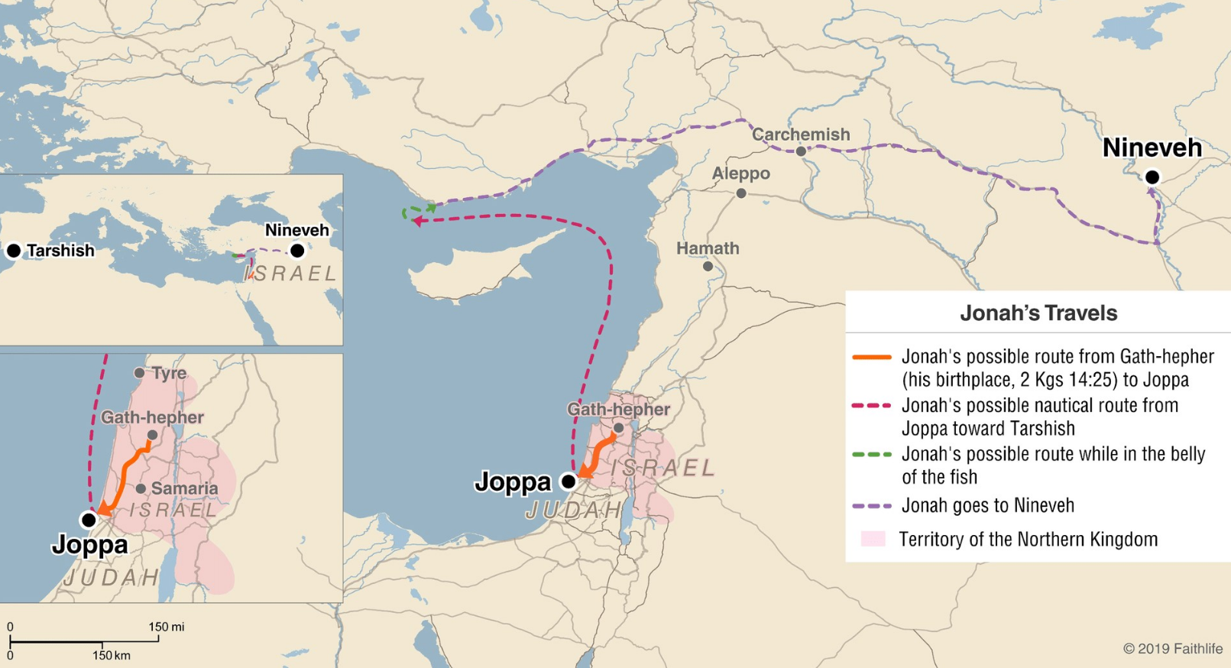

Slide 13
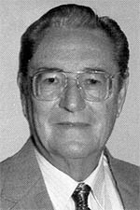
“The Prophet Jonah and His Message Part 1.”
by Gerald B. Stanton
From: Bibliotheca Sacra
“The Book of Jonah is geographically accurate. Much of the action takes place on the Mediterranean Sea. Jaffa is a modern city, of course, and its location reveals why Jonah “went down to Joppa.” The ruins of ancient Nineveh have been excavated. One of the most conspicuous mounds in the midst of the ruins is called the “Yunas” mound. Yunas is the native word for Jonah, indeed, and tradition is that it contains the tomb of the ancient prophet. This mound is so sacred to the natives that no large-scale excavation has been permitted, but still it was this word “Yunas” that led to the identification of the site of Nineveh.”

Slide 14
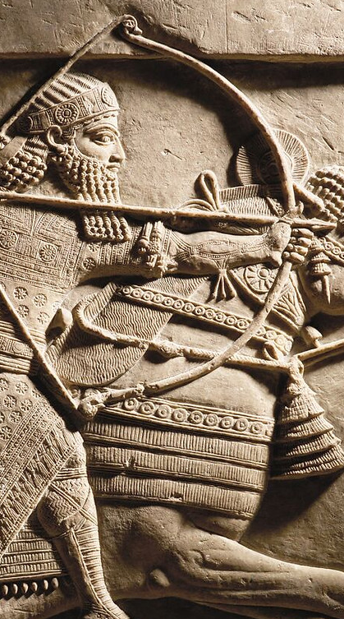
KINGS OF ASSYRIA
KING | REIGN | KING | REIGN
Ashur-uballit I | 1365–1330 | Shamsi-Adad V | 824–810
Adad-nirari I | 1307–1275 | Adad-nirari III | 810–782
Shalmaneser I | 1274–1245 | Shalmaneser IV | 782–773
Tukulti-Ninurta I | 1244–1208 | Ashur-dan III | 773–754
Ashur-dan I | 1179–1133 | Ashur-nirari V | 754–745
Tiglath-pileser I | 1115–1076 | Tiglath-pileser III | 745–727
Ashur-rabi II | 1012–972 | Shalmaneser V | 727–722
Ashur-resh-ishi II | 972–967 | Sargon II | 721–705
Tiglath-pileser II | 967–935 | Sennacherib | 704–681
Ashur-dan II | 935–912 | Esarhaddon | 681–669
Adad-nirari II | 912–889 | Ashur-banipal | 669–633
Tukulti-Ninurta II | 889–884 | Ashur-etil-ilani | 633–622
Ashur-nasir-apal II | 884–858 | Sin-shur-ishkun | 621–612
Shalmaneser III | 858–824 | Ashur-uballit | 612–608

Slide 16
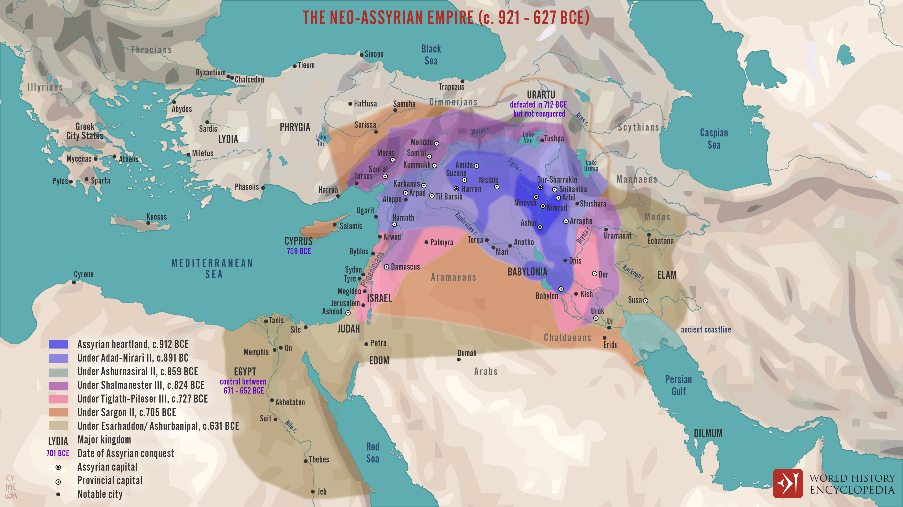

Slide 17
A. The Preaching Prophet (3:1-10)
Jonah’s re-commission (1-2)
  God’s attributes in action (1)
  God’s Instructions (2)
Jonah’s sermon to Nineveh (3-4)
  Jonah’s obedience (3)
  Jonah’s sermon (4)
Nineveh's response (5-9)
God’s response (10)

Slide 18
“Then the LORD passed by in front of him and proclaimed, “The LORD, the LORD God, compassionate and gracious, slow to anger, and abounding in lovingkindness and truth; who keeps lovingkindness for thousands, who forgives iniquity, transgression and sin; yet He will by no means leave the guilty unpunished, visiting the iniquity of fathers on the children and on the grandchildren to the third and fourth generations.”
Exodus 34:6-7

Slide 19
channun חַנּוּן – gracious, kind, merciful
  Root – hen חַן – grace, favor freely given
rachum רַחוּם – compassionate, merciful
  Root – rehem רחם – womb, bowels

Slide 20
“But You, O Lord, are a God merciful and gracious (rachum רַחוּם and channun חַנּוּן), Slow to anger and abundant in lovingkindness and truth.”
Psalm 86:15
“The LORD is gracious and merciful (channun חַנּוּן and rachum רַחוּם); Slow to anger and great in lovingkindness. The LORD is good to all, And His mercies (rachamim רַחַם) are over all His works.”
Psalm 145:8-9

Slide 21
channun חַנּוּן – gracious, kind, merciful
  Root – hen חַן – grace, favor freely given
rachum רַחוּם – compassionate, merciful
  Root – rehem רחם – womb, bowels

Slide 22
Mercy - the undeserved kindness or forgiveness shown to someone who is guilty, suffering, or in need.
Compassion - the deep, heartfelt sympathy and willingness to relieve another’s distress—an active, emotional identification with the suffering of others which leads to action.
Graciousness - the undeserved kindness and or favor to men in need.

Slide 23
“Then the LORD passed by in front of him and proclaimed, “The LORD, the LORD God, compassionate and gracious, slow to anger, and abounding in lovingkindness and truth; who keeps lovingkindness for thousands, who forgives iniquity, transgression and sin; yet He will by no means leave the guilty unpunished, visiting the iniquity of fathers on the children and on the grandchildren to the third and fourth generations.”
Exodus 34:6-7

Slide 24
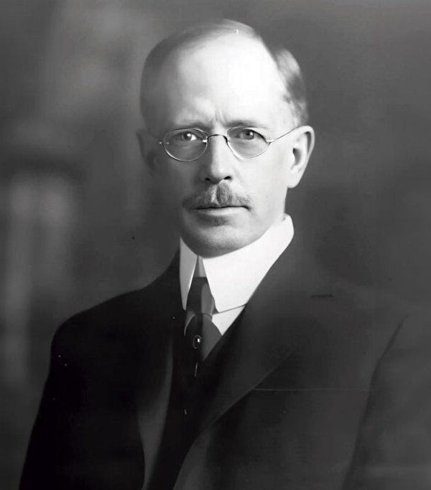

“Grace: An Exposition of God’s Marvelous Gift”
Grace is not withheld because of demerit
Grace cannot be lessened because of demerit
Grace cannot incur a debt
Grace is not exercised in the just payment of a debt
Grace is never the over-payment of a debt
Grace does not appear in the immediate divine dealings with the sins of the unsaved
Grace does not appear in the immediate divine dealings with the sins of the saved

Slide 25
“Grace: An Exposition of God’s Marvelous Gift”
“…grace finds its greatest triumph and glory in the sphere of human helplessness. Grace ceases to be grace if God is compelled to withdraw it in the presence of human failure and sin. In fact, grace cannot be exercised where there is the slightest degree of human merit to be recognized.”

Slide 26
“Grace: An Exposition of God’s Marvelous Gift”
Grace is not withheld because of demerit
Grace cannot be lessened because of demerit
Grace cannot incur a debt
Grace is not exercised in the just payment of a debt
Grace is never the over-payment of a debt
Grace does not appear in the immediate divine dealings with the sins of the unsaved
Grace does not appear in the immediate divine dealings with the sins of the saved

Slide 27
“Grace: An Exposition of God’s Marvelous Gift”
Grace is not withheld because of demerit
Grace cannot be lessened because of demerit
Grace cannot incur a debt
Grace is not exercised in the just payment of a debt
Grace is never the over-payment of a debt
Grace does not appear in the immediate divine dealings with the sins of the unsaved
Grace does not appear in the immediate divine dealings with the sins of the saved

Slide 28
“Grace: An Exposition of God’s Marvelous Gift”
Grace is not withheld because of demerit
Grace cannot be lessened because of demerit
Grace cannot incur a debt
Grace is not exercised in the just payment of a debt
Grace is never the over-payment of a debt
Grace does not appear in the immediate divine dealings with the sins of the unsaved
Grace does not appear in the immediate divine dealings with the sins of the saved

Slide 29
“For by grace you have been saved through faith; and that not of yourselves, it is the gift of God; not as a result of works, so that no one may boast.”
Ephesians 2:8-9

Slide 30
“Grace: An Exposition of God’s Marvelous Gift”
Grace is not withheld because of demerit
Grace cannot be lessened because of demerit
Grace cannot incur a debt
Grace is not exercised in the just payment of a debt
Grace is never the over-payment of a debt
Grace does not appear in the immediate divine dealings with the sins of the unsaved
Grace does not appear in the immediate divine dealings with the sins of the saved

Slide 31
“Grace: An Exposition of God’s Marvelous Gift”
“Grace speaks of a gift, not of barter or trade however unequal. It is pure kindness, not the fulfilling of an obligation. An act in order to be gracious must stand disassociated and alone. Divine salvation is, therefore, the kindness of God toward sinners. It is not less than it would be had they sinned less. It is not more than it would be had they sinned more. It is wholly unrelated to every question of human merit. Grace is neither treating a person as he deserves, nor treating a person better than he deserves. It is treating a person graciously without the slightest reference to his deserts. Grace is infinite love expressing itself in infinite goodness.”

Slide 32
“Grace: An Exposition of God’s Marvelous Gift”
Grace is not withheld because of demerit
Grace cannot be lessened because of demerit
Grace cannot incur a debt
Grace is not exercised in the just payment of a debt
Grace is never the over-payment of a debt
Grace does not appear in the immediate divine dealings with the sins of the unsaved
Grace does not appear in the immediate divine dealings with the sins of the saved

Slide 33
“…being justified as a gift by His grace through the redemption which is in Christ Jesus…” Rom 3:25
“In Him we have redemption through His blood, the forgiveness of our trespasses, according to the riches of His grace which He lavished on us. In all wisdom and insight.” Eph 1:7

Slide 34
“When you were dead in your transgressions and the uncircumcision of your flesh, He made you alive together with Him, having forgiven us all our transgressions, having canceled out the certificate of debt consisting of decrees against us, which was hostile to us; and He has taken it out of the way, having nailed it to the cross.” Colossians 2:13-14

Slide 35
“Grace: An Exposition of God’s Marvelous Gift”
Grace is not withheld because of demerit
Grace cannot be lessened because of demerit
Grace cannot incur a debt
Grace is not exercised in the just payment of a debt
Grace is never the over-payment of a debt
Grace does not appear in the immediate divine dealings with the sins of the unsaved
Grace does not appear in the immediate divine dealings with the sins of the saved

Slide 36
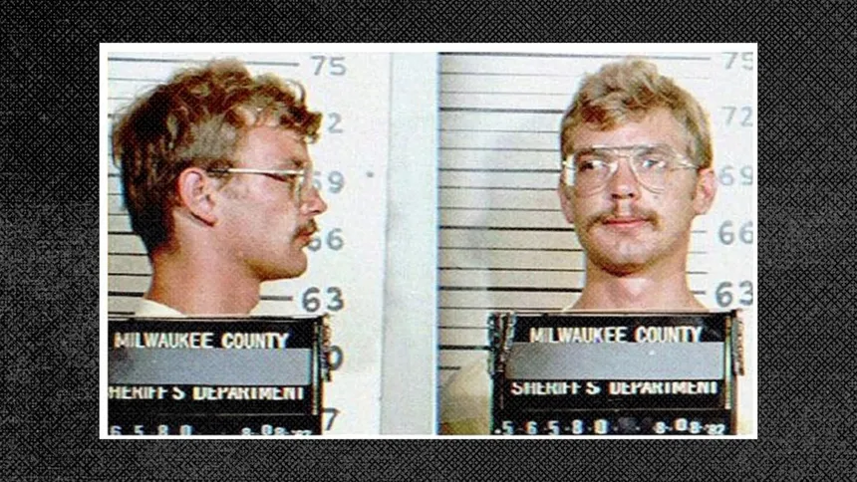

Slide 37
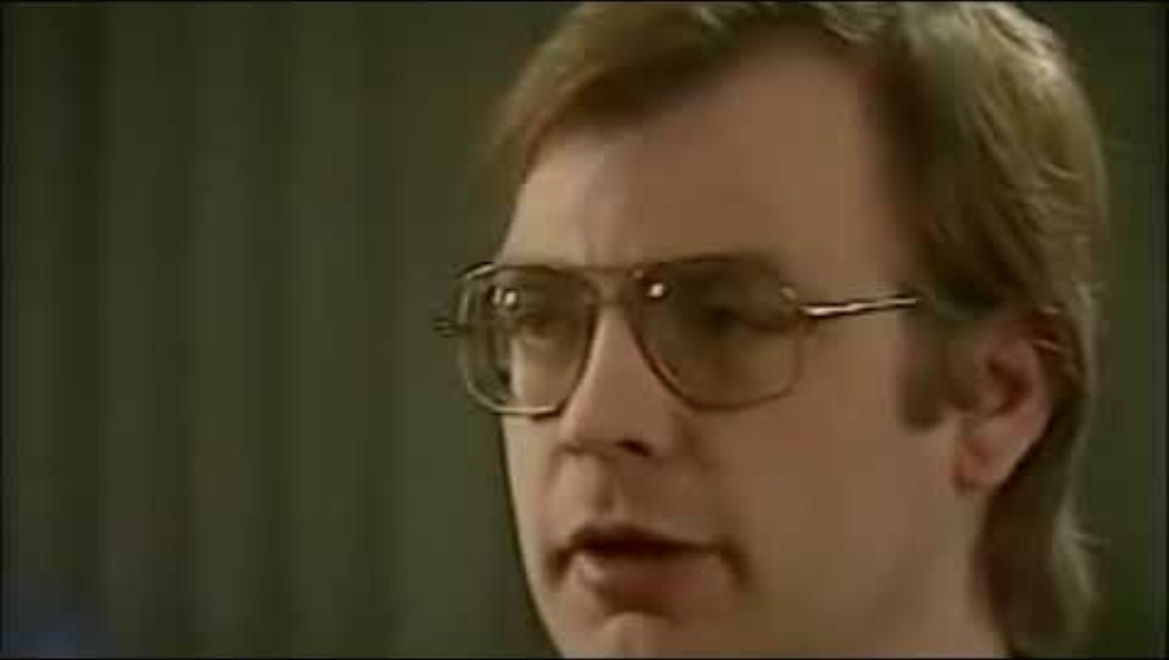

Slide 38
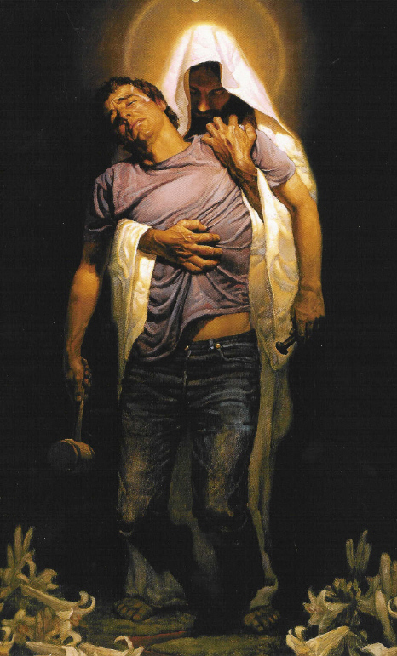
1 Timothy 1:15-17 (NIV)
Here is a trustworthy saying that deserves full acceptance: Christ Jesus came into the world to save sinners—of whom I am the worst. But for that very reason I was shown mercy so that in me, the worst of sinners, Christ Jesus might display his unlimited (perfect, NASB) patience as an example for those who would believe on him and receive eternal life. Now to the King eternal, immortal, invisible, the only God, be honor and glory for ever and ever.

Slide 39
A. The Preaching Prophet (3:1-10)
Jonah’s re-commission (1-2)
  God’s attributes in action (1)
  God’s Instructions (2)
Jonah’s sermon to Nineveh (3-4)
  Jonah’s obedience (3)
  Jonah’s sermon (4)
Nineveh's response (5-9)
God’s response (10)

Slide 40
“No one has seen God at any time; the only begotten God who is in the bosom of the Father, He has explained Him.”
John 1:18

Slide 41

“For the time will come when they will not endure sound doctrine; but wanting to have their ears tickled, they will accumulate for themselves teachers in accordance to their own desires, and will turn away their ears from the truth and will turn aside to myths.”
2 Timothy 4:3

Slide 42
“Therefore, I testify to you this day that I am innocent of the blood of all men. “For I did not shrink from declaring to you the whole purpose of God.”
Acts 20:26-27

Slide 43
Ezekiel 33:6-9
“Now as for you, son of man, I have appointed you a watchman for the house of Israel; so you will hear a message from My mouth and give them warning from Me. “When I say to the wicked, ‘O wicked man, you will surely die,’ and you do not speak to warn the wicked from his way, that wicked man shall die in his iniquity, but his blood I will require from your hand. “But if you on your part warn a wicked man to turn from his way and he does not turn from his way, he will die in his iniquity, but you have delivered your life.”

Slide 44
A. The Preaching Prophet (3:1-10)
Jonah’s re-commission (1-2)
  God’s attributes in action (1)
  God’s Instructions (2)
Jonah’s sermon to Nineveh (3-4)
  Jonah’s obedience (3)
  Jonah’s sermon (4)
Nineveh's response (5-9)
God’s response (10)

Slide 46
INTRODUCTORY MATTERS OF JONAH
Who wrote it? Jonah
When was it written? 770-750 BC
Who was it written to? Israel
Historicity of the book? Fact!
Genre of the book? Historical Narrative
What is it all about? (Message) To showcase God’s universal love and plan of redemption which extends beyond Israel to include all nations

Slide 47
A. The Preaching Prophet (3:1-10)
Jonah’s re-commission (1-2)
  God’s attributes in action (1)
  God’s Instructions (2)
Jonah’s sermon to Nineveh (3-4)
  Jonah’s obedience (3)
  Jonah’s sermon (4)
Nineveh's response (5-9)
God’s response (10)

Slide 48
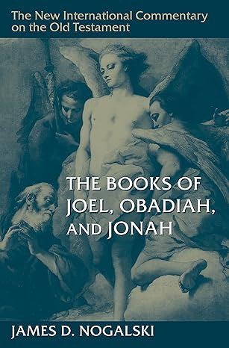
NICOT - “The Books of Joel, Obadiah, and Jonah”
“When one reads this sermon within the broader context of Jonah’s flight (ch. 1) and his chagrin at Yahweh’s mercy (ch. 4), especially in light of the statement indicating that Yahweh’s mercy was the reason Jonah fled in the first place (4:2), it becomes painfully obvious that Jonah’s lucid brevity should not be interpreted positively. Jonah is not acting out of a sense of conviction that the delivery of the message will cause the Ninevites to change their ways. Rather, Jonah’s actions should be understood as those of a child forced to do something the child does not want to do. Jonah does just enough to fulfill his commission. He was expected to deliver a message of impending judgment, and that is precisely what he does—that and nothing more. He did not want the Ninevites to change. He wants them to ignore his message so that Yahweh would be forced to follow through with the judgment as promised.”

Slide 49
A. The Preaching Prophet (3:1-10)
Jonah’s re-commission (1-2)
  God’s attributes in action (1)
  God’s Instructions (2)
Jonah’s sermon to Nineveh (3-4)
  Jonah’s obedience (3)
  Jonah’s sermon (4)
Nineveh's response (5-9)
God’s response (10)

Slide 50
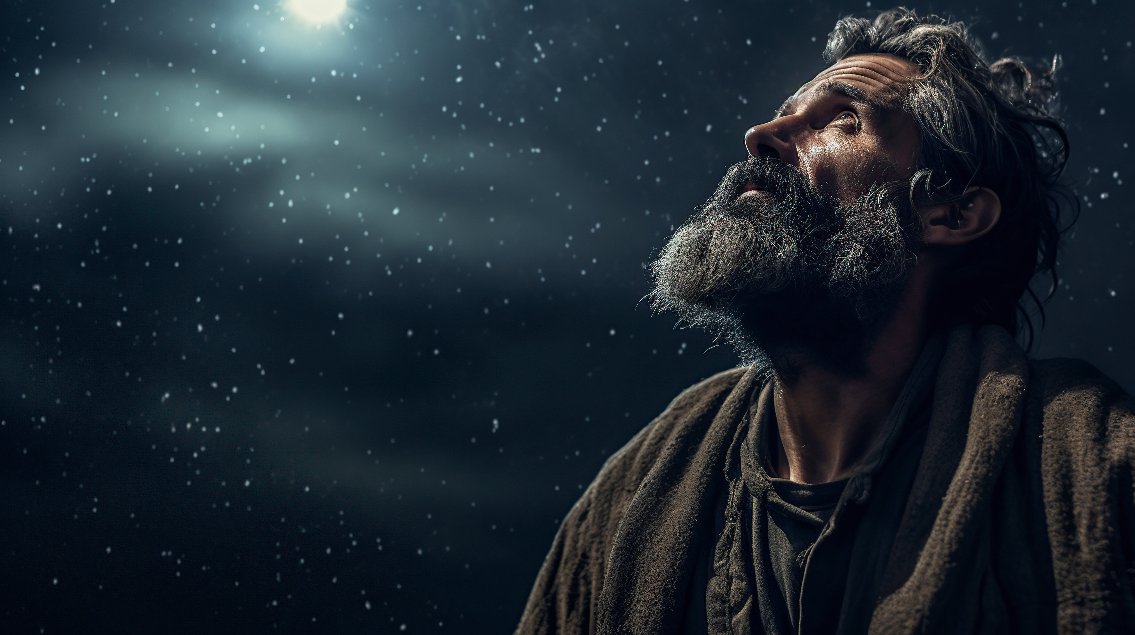
“Then he believed in the LORD; and He reckoned it to him as righteousness.”
Genesis 15:6

Slide 51
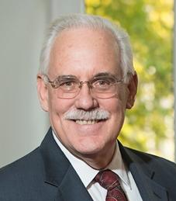

“How Were People Saved in the Old Testament”
“Faith was the necessary condition for salvation in the OT as well as in the New: “And the people of Nineveh believed God…And Abraham believed in the LORD and He counted it to him as righteousness” (Genesis 15:6). This is not a generic faith in the existence of God, but rather, a specific faith in the revelation of the true God who is the sole origin of salvation. “Salvation belongs to the Lord” (Jonah 2:9).

Slide 52
for just as JONAH WAS THREE DAYS AND THREE NIGHTS IN THE BELLY OF THE SEA MONSTER, so will the Son of Man be three days and three nights in the heart of the earth. “The men of Nineveh will stand up with this generation at the judgment, and will condemn it because they repented at the preaching of Jonah; and behold, something greater than Jonah is here.
Matthew 12:41c

Slide 53
Conclusion

Slide 54
A. The Preaching Prophet (3:1-10)
Jonah’s re-commission (1-2)
  God’s attributes in action (1)
  God’s Instructions (2)
Jonah’s sermon to Nineveh (3-4)
  Jonah’s obedience (3)
  Jonah’s sermon (4)
Nineveh's response (5-9)
God’s response (10)

