Slide 1
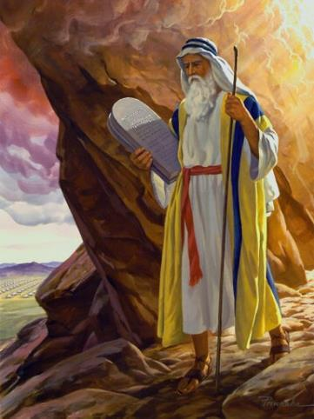
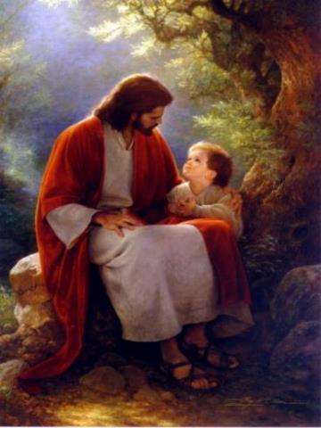
Law and Grace: An Overview
Jim McGowan, Th.D.
Sugar Land Bible Church
08-17-2025
…but grace and truth were realized through Jesus Christ - John 1:17
For the Law was given through Moses…
Special thanks to Dr. Vern Peterman for access to his insights and resources.

Slide 2
Session 47 Outline
  Review
    Purpose, Aim, and Objective
    Session 46
  Forgiving Sins – Matthew 9:1-17
    General Information
    Matthew 9:1-17
  Concluding Observations

Slide 3

OUR PURPOSE, AIM AND OBJECTIVE
Law and Grace
…is to Compare and Contrast Law and Grace so as to properly understand these two important themes and how they are related to the life of the New Testament Believer.

Slide 4
POINTS OF CONTRAST AND COMPARISON
Law vs. Grace: Session 1: An Overview
Governing Principle | LAW | GRACE
Steward | MOSES | CHRIST
People Group | ISRAEL | CHURCH
Whose Works are you depending on? | Self | Christ
Baptism (Identification) | Into Moses (Law) | Into Christ
Ministry Characteristic | Death /Condemnation | Spirit /Righteousness
Nature of Blessings | Conditional (If) / Earthly | Unconditional / Heavenly
Earthly Difficulties | Curses for disobedience | Growth or discipline
Notes:
Points of Comparison & Contrast
Steward MOSES CHRIST
Scripture portrays both Moses and Christ as Stewards. Each was entrusted by God with the establishment of something.
Principle Israel under Law The Church under Grace
The principle of Law reigns over Israel while the principle of Grace reigns over the Church.
Who’s Works are you depending on? Self Christ
Under the Law – Do’s and Don’ts to be blessed or cursed. Under Grace we rely on Christ’s works! It is His works that save and make me who I am “In Christ”.
People Group ISRAEL CHURCH
Baptism Into Moses Into Christ
The people groups mentioned above are spoken of as having been baptized into (identified with and joined to) either Moses (LAW) or Christ (GRACE). We as believers have been baptized into Christ which has great significance for us.
Ministry Characteristic Death Condemnation Spirit Righteousness
2 Cor. 3
Nature of Blessings Conditional (If) / Earthly Unconditional / Heavenly
Deut. 28:1-14 (Blessings) 15-68 (Curses) Eph. 1:3; 4 (practical implications)
Earthly Difficulties Curses for disobedience Growth or discipline
NEXT SLIDE

Slide 5

Henry Ironside
The Continual Burnt Offering: Daily Meditations on the Word of God (p. 265). Neptune, NJ: Loizeaux Brothers.
In Romans 7 we have a man renewed by the Spirit of God, but struggling under law, hoping thereby to subdue or find deliverance from the power of the old Adamic nature. In chapter 8 we have God’s way of deliverance through the death and resurrection of Christ with which the believer is identified before God. The chapter begins with “no condemnation” and ends with “no separation.” All who are in Christ Jesus are accepted in the Beloved and as free from every charge of guilt as He is Himself. He paid our penalty on the cross. Now we are linked up with Him in resurrection, not under law but under grace.

Slide 6
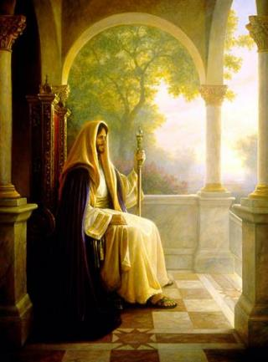
Matthew’s 3-Fold Purpose
Law and Grace: Review Matthew
To explain:
  that Jesus in whom they had believed was the long-awaited Jewish Messiah
  why the kingdom had been postponed despite the fact that the king had arrived
  the interim program of God during the kingdom’s absence

Slide 7
Matthew’s Message
Law and Grace: Review The SOM – Matthew
Jesus is the predicted Jewish king who ushered in an interim program by building the sons of the kingdom into the Church in between Israel’s past rejection and future acceptance of her king.

Slide 8
Session 47 Outline
  Review
    Purpose, Aim, and Objective
    Session 46
  Forgiving Sins – Matthew 9:1-17
    General Information
    Matthew 9:1-17
  Concluding Observations

Slide 9
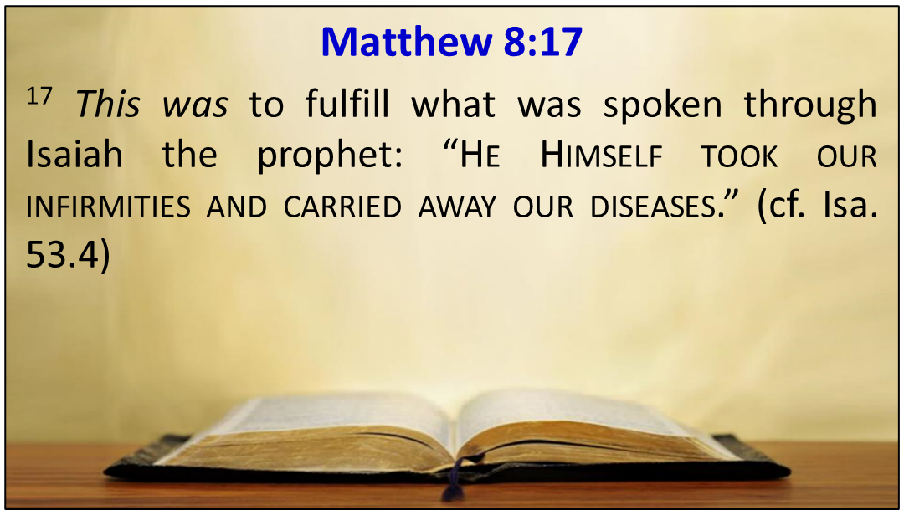
Law and Grace: Review Session 46 – Matthew 8:14-34
JESUS, THE MESSIAH, VALIDATED!
Matthew 8:14-34
Matthew 8 consists of several accounts of Jesus performing miracles that validated His singular identity as God’s Messiah, the King of Israel (Matthew 8:17; Isaiah 29:18-19…).

Slide 10
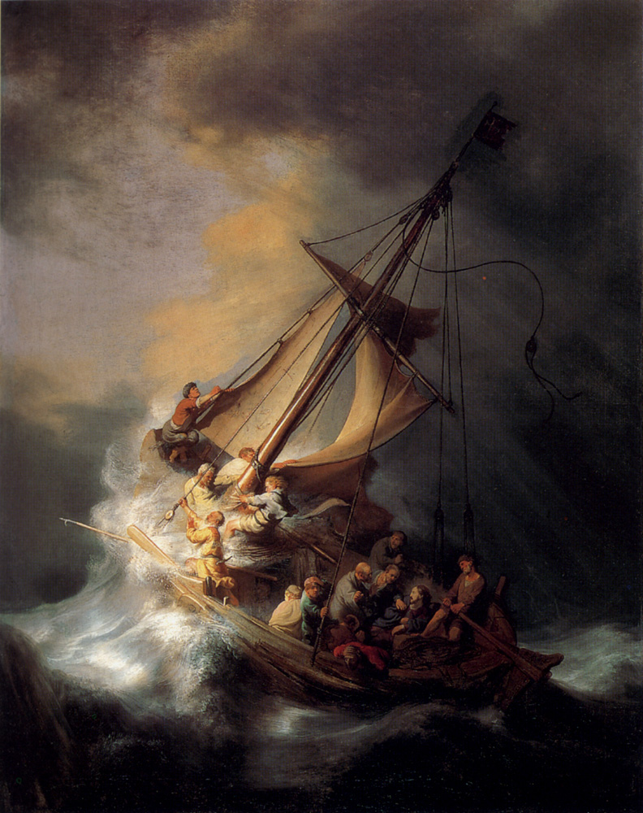
Law and Grace: Review Session 46 – Matthew 8:14-34
JESUS, THE MESSIAH, VALIDATED!
Matthew 8:14-34
In Matthew 8:14-34 we saw Jesus:
  cure Peter’s mother-in-law (14-15),
  publicly cast out demons (16-17),
  calm a storm and challenge those who would be His disciples (18-27), and
  privately cast out demons and drown a herd of swine (28-34).

Slide 11
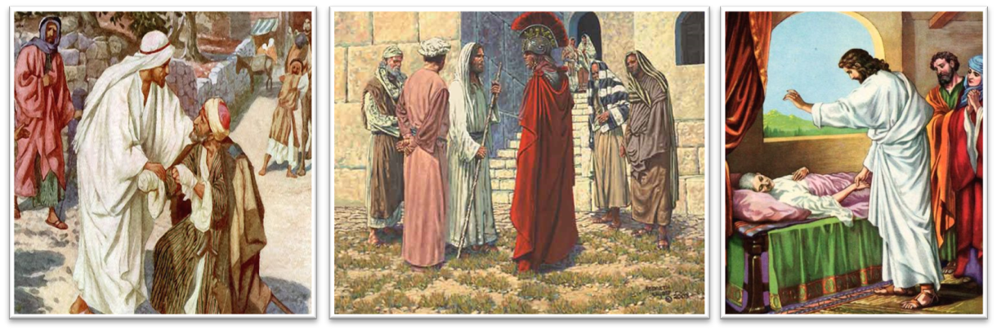
Law and Grace: Review Session 46 – Matthew 8:14-34
Dr. Arnold Fruchtenbaum
The Messianic Bible Study Collection (Vol. 3, pp. 3–4). Ariel Ministries. (1983).
The purpose of all His miracles between [Matthew] chapters 4 and 12 is to authenticate His Person and His message. They are signs to force the nation of Israel to come to a decision regarding two things: first, His Person, that He is the Messiah; and secondly, His message, the gospel of the Kingdom.

Slide 12
Session 47 Outline
  Review
    Purpose, Aim, and Objective
    Session 46
  Forgiving Sins – Matthew 9:1-17
    General Information
    Matthew 9:1-17
  Concluding Observations

Slide 13
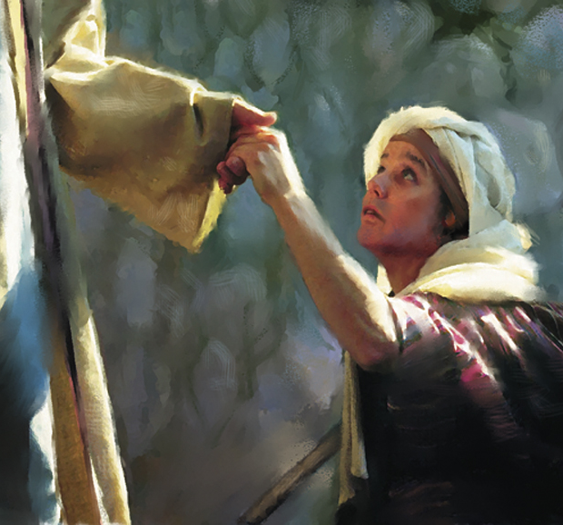
Law and Grace: Session 47 – Matthew 9:1-17
ABOUT JESUS’ MIRACLES
Matthew 8-9
Matthew chapters 8 and 9 are both emphasize Jesus’ miracles. Why?
Because these miracles validate His message of the gospel of the kingdom…

Slide 14
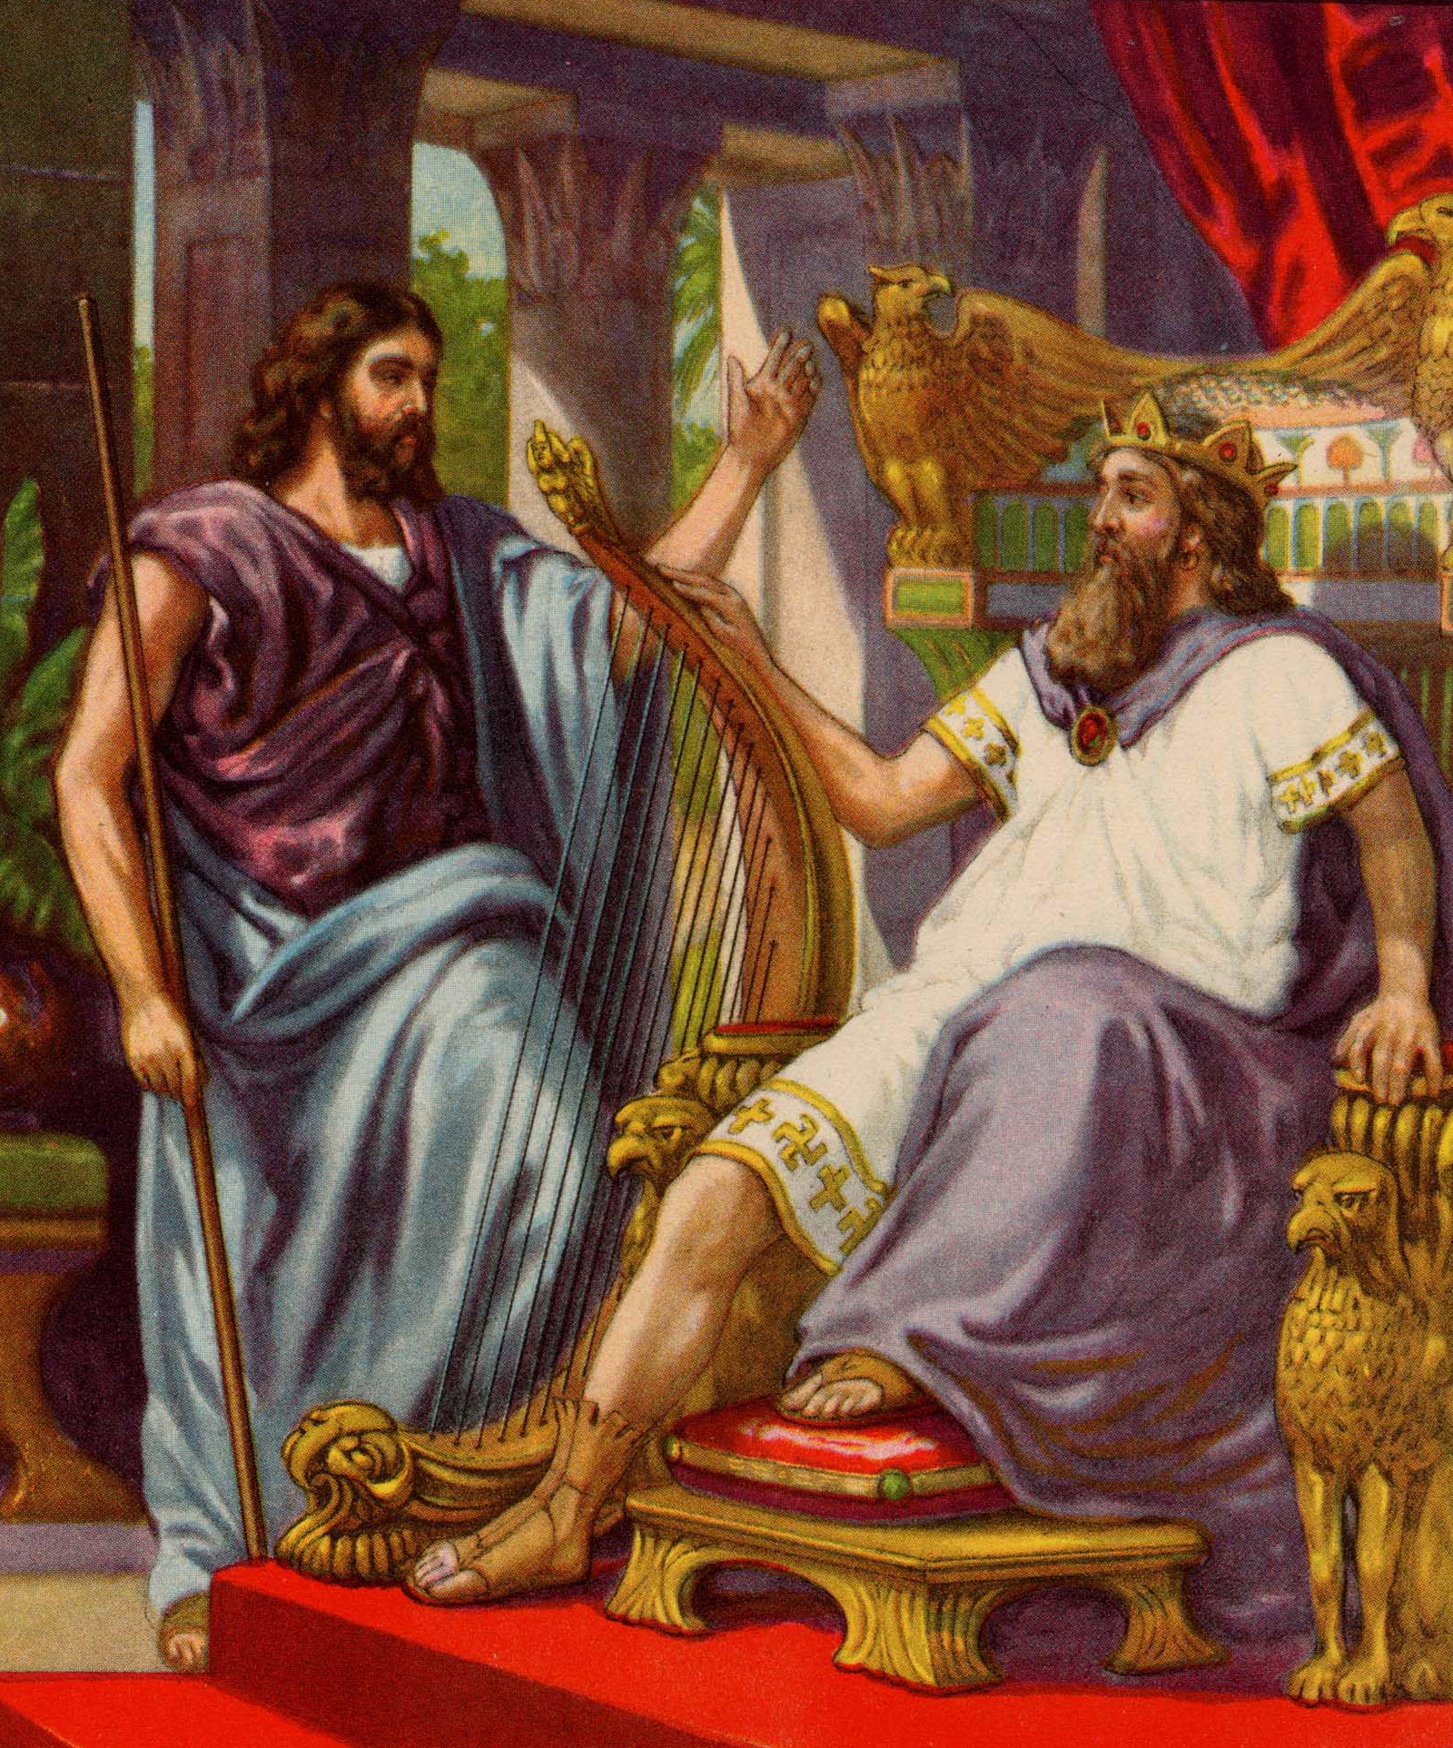

Law and Grace: Session 47 – Matthew 9:1-17
ABOUT JESUS’ MIRACLES
Matthew 8-9
…and because these miracles validate His claim to be the long-promised King of Israel, the Messiah, who will reign over Israel, as the prophesied descendent of King David, and of Judah, the Lion, the One whose kingdom will never end. (cf. Isaiah 29:18-19; 30:26; 35:5-6; 42:7; 61:1-3; Jeremiah 30:17)

Slide 15

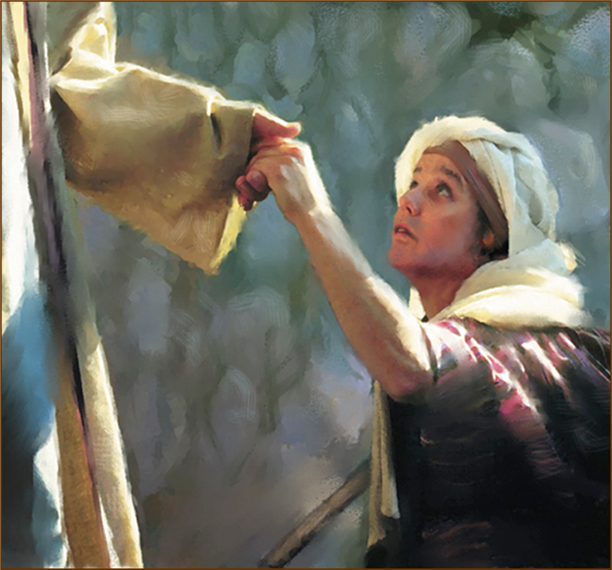
Isaiah 35:5-6
⁵ Then the eyes of the blind will be opened and the ears of the deaf will be unstopped. ⁶ Then the lame will leap like a deer, and the tongue of the mute will shout for joy. (cf. Isaiah 29:18-19; 30:26; 42:7; 61:1-3 Jeremiah 30:17)

Slide 16
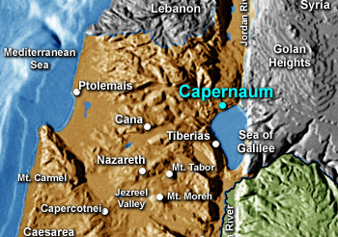
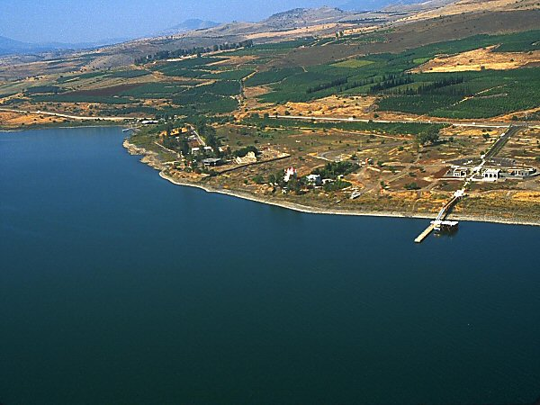
Law and Grace: Session 47 – Matthew 9:1-17
JESUS RETURNED BY BOAT BACK TO - CAPERNAUM
Matthew 9:1

Slide 17
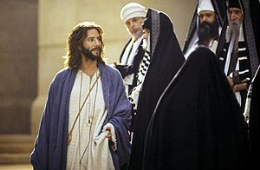
Law and Grace: Session 47 – Matthew 9:1-17
AN UNSPOKEN ACCUSATION
Matthew 9:2-8
While Jesus did not incur any opposition from the scribes and Pharisees in chapter 8, we’ll find that this is the first of three instances of opposition in this passage.
Jesus begins to perform a miracle, but the scribes think Jesus is blaspheming by ‘forgiving sins’.

Slide 18
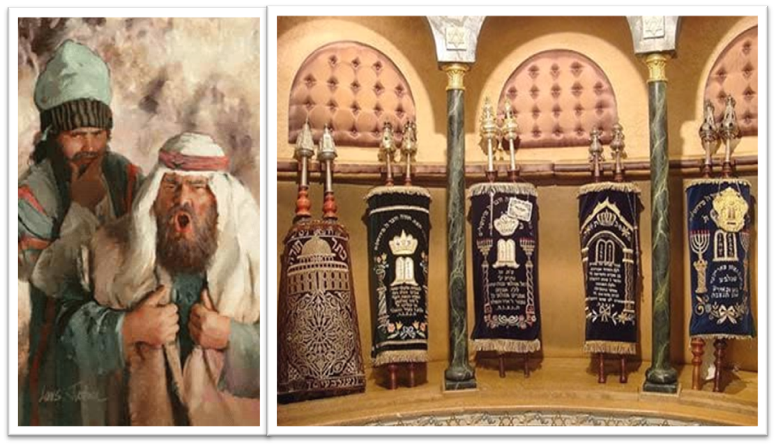
Law and Grace: Session 47 – Matthew 9:1-17
AN UNSPOKEN ACCUSATION
Matthew 9:2-8
We’ll see that the point of tension between Jesus and the scribes comes from the Law of Moses.

Slide 19
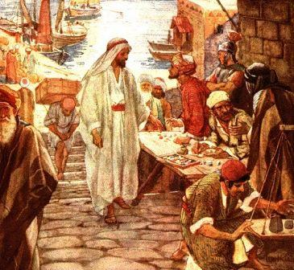
Law and Grace: Session 47 – Matthew 9:1-17
TWO ISSUES NOT FROM MIRACLES
Matthew 9:9-17
In vv. 9-17 two issues arise.
Vs. 9-13: Jesus calls Matthew, the tax collector, and the Pharisees question His disciples about eating with the tax collectors and sinners.

Slide 20
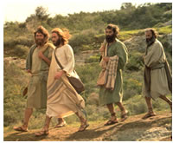
Law and Grace: Session 47 – Matthew 9:1-17
TWO ISSUES NOT FROM MIRACLES
Matthew 9:9-17
Vs. 14-17: Disciples of John the Baptist then ask Jesus why it is that they and the Pharisees fast, but they don’t see Jesus’ disciples fasting according to the traditions of the Jews.

Slide 21
Session 47 Outline
  Review
    Purpose, Aim, and Objective
    Session 46
  Forgiving Sins – Matthew 9:1-17
    General Information
    Matthew 9:1-17
  Concluding Observations

Slide 22
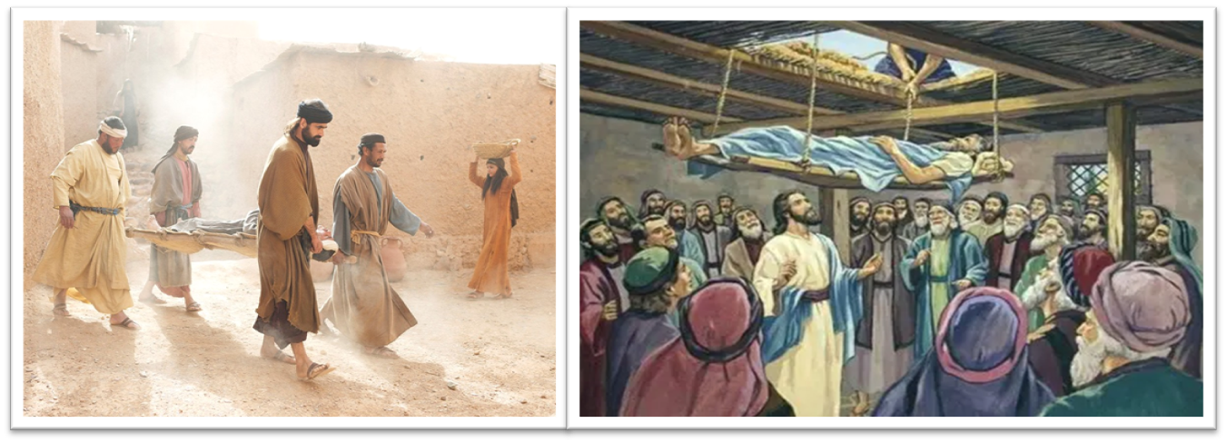
MATTHEW 9:1-2
¹ Getting into a boat, Jesus crossed over the sea and came to His own city. ² And they brought to Him a paralytic lying on a bed. Seeing their faith, Jesus said to the paralytic, “Take courage, son; your sins are forgiven.”

Slide 23
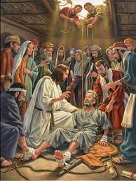
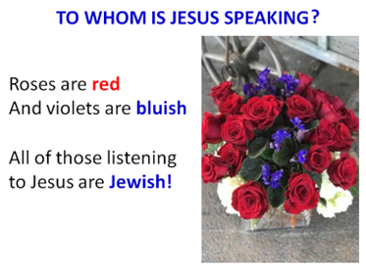
Law and Grace: Session 47 – Matthew 9:1-17
“YOUR SINS ARE NOW FORGIVEN”
Matthew 9:2
Though others had brought the man who was paralyzed to Jesus, He speaks directly to the man, encouraging him and saying that his sins are now forgiven.

Slide 24
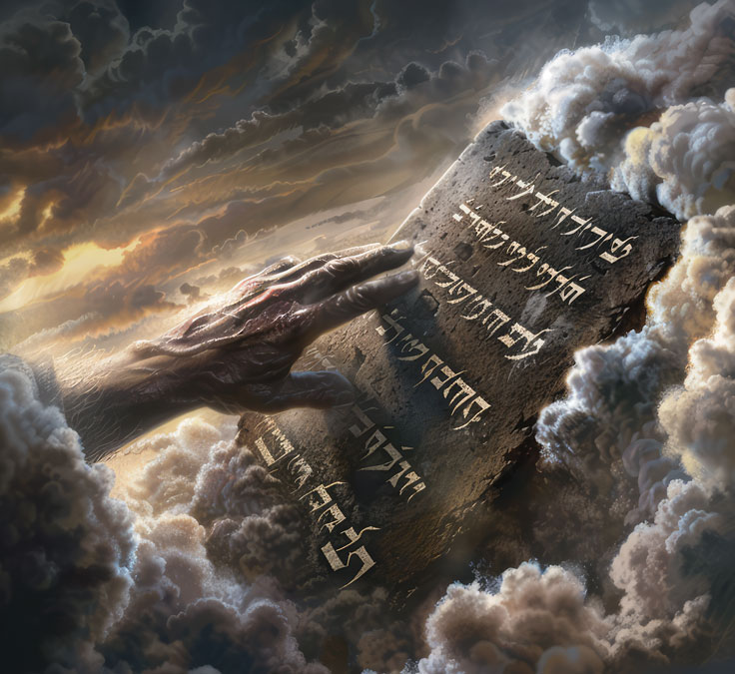
Law and Grace: Session 47 – Matthew 9:1-17
“YOUR SINS ARE NOW FORGIVEN”
Matthew 9:2
The curses for breaking the Law of Moses, enumerated in Deuteronomy 28 and other O.T. passages (cf. Exodus 15:26, Psalm 103:3, and Isaiah 33:24) that came upon the ISRAELITES WHO WERE ALL UNDER THE LAW OF MOSES, IMPLY that this man is sick because of his sin.

Slide 25
Deuteronomy 28:58-59
^{“58} “If you are not careful to observe all the words of this law which are written in this book, to fear this honored and awesome name, the LORD your God, ⁵⁹ then the LORD will bring extraordinary plagues on you and your descendants, even severe and lasting plagues, and miserable and chronic sicknesses” (cf. Exodus 15:26, Psalm 103:3, and Isaiah 33:24).

Slide 26
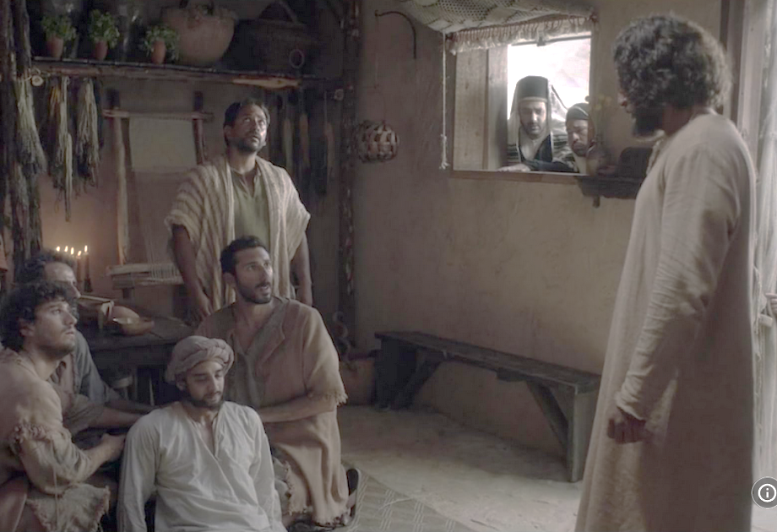
MATTHEW 9:3-4
³ And some of the scribes said to themselves, “This fellow blasphemes.” ⁴And Jesus knowing their thoughts said, “Why are you thinking evil in your hearts? …

Slide 27
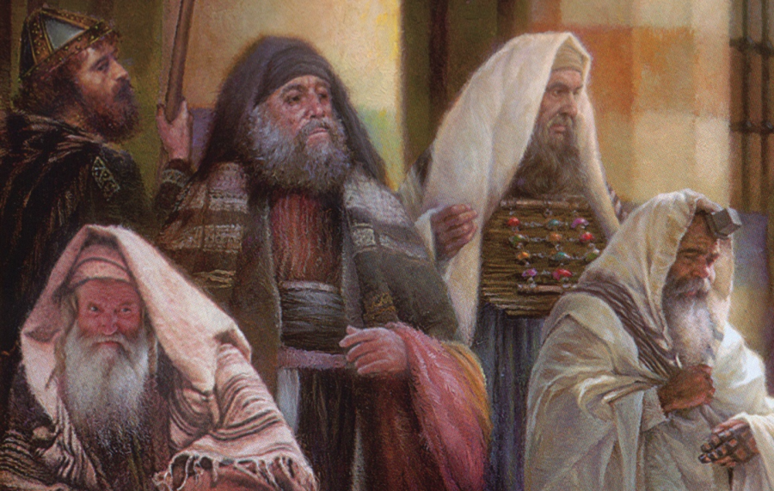
Law and Grace: Session 47 – Matthew 9:1-17
“WHY ARE YOU THINKING EVIL?”
Matthew 9:3-4
The scribes, [and Pharisees cf. Luke 5:21] are thinking that Jesus’ statement that this man’s sins are now forgiven is just blasphemy, since only God can forgive sins (cf. Mark 2:6-7).

Slide 28
MATTHEW 9:3-4
³ And some of the scribes said to themselves, “This fellow blasphemes.” ⁴And Jesus knowing their thoughts said, “Why are you thinking evil in your hearts? …

Slide 29
Law and Grace: Session 47 – Matthew 9:1-17
“WHY ARE YOU THINKING EVIL?”
Matthew 9:3-4
Jesus knows what they are thinking, either because He can read their expressions, or He has divine insight.
Notice that Jesus does not say that they’re thinking that He is evil, but their thinking is evil.

Slide 30
MATTHEW 9:5
⁵ “Which is easier, to say, ‘Your sins are forgiven,’ or to say, ‘Get up, and walk’?...

Slide 31
Law and Grace: Session 47 – Matthew 9:1-17
“WHICH IS EASIER?”
Matthew 9:5
By intentionally phrasing the question this way, Jesus was affirming that forgiving the sins of this Israelite, in this specific case, was equivalent to healing him.
Why? Because of the connection between sin and sickness in the Law of Moses!
Under the Law, when God forgave a Jew’s sins He removed the consequences of the curse for those sins, one of which was sickness and disease.

Slide 32
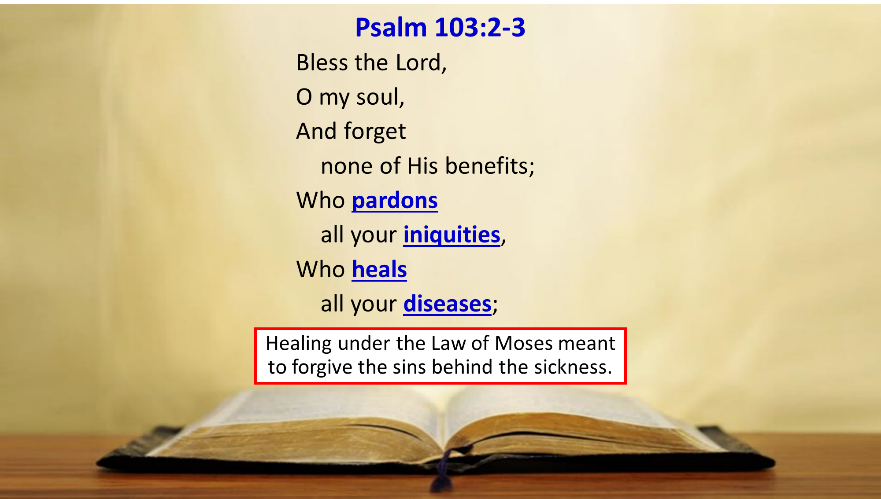
Law and Grace: Session 47 – Matthew 9:1-17
“WHICH IS EASIER?”
Matthew 9:5

Slide 33
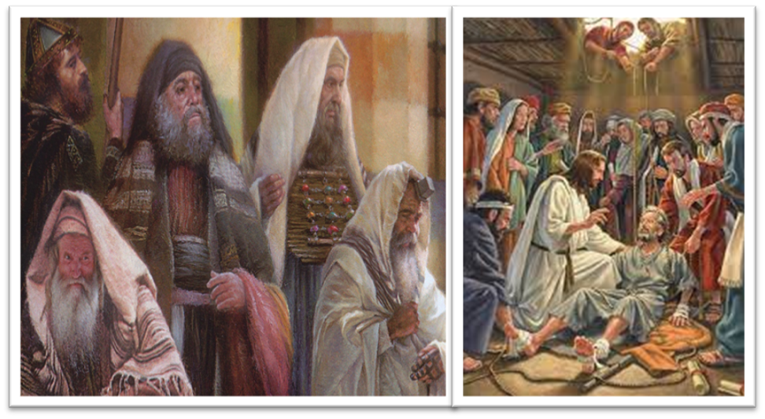
MATTHEW 9:6a
⁶ “But so that you may know that the Son of Man has authority on earth to forgive sins”—then He said to the paralytic, “Get up, pick up your bed and go home.”...

Slide 34
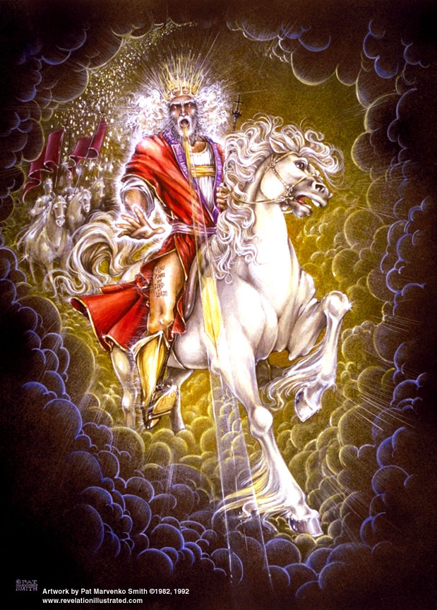
Law and Grace: Session 47 – Matthew 9:1-17
“BUT SO THAT ALL Y’ALL MAY KNOW…”
Matthew 9:6a
Jesus referred to Himself as *‘the Son of Man’ about 75 times in the four Gospels, including here in v. 6.
Being the Messiah, the Son of Man, the Son of God, and showing His power to heal and forgive sins, fits with the passages shown and listed earlier.
*The term ‘the Son of Man’ comes from Daniel 7:13-14, and means that Jesus is Messiah, who will come in power and glory.

Slide 35
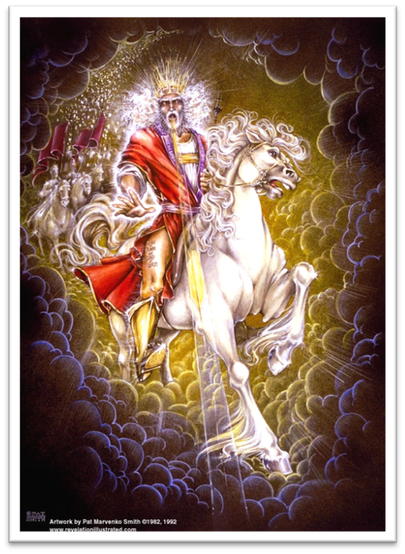
DANIEL 7:13-14
¹³ “I kept looking in the night visions, And behold, with the clouds of heaven One like a Son of Man was coming, And He came up to the Ancient of Days And was presented before Him. ¹⁴ “And to Him was given dominion, Glory and a kingdom, That all the peoples, nations and men of every language Might serve Him. His dominion is an everlasting dominion Which will not pass away; And His kingdom is one Which will not be destroyed.

Slide 36
MATTHEW 9:6b
⁶ “But so that you may know that the Son of Man has authority on earth to forgive sins”—then He said to the paralytic, “Get up, pick up your bed and go home.”…

Slide 37
Law and Grace: Session 47 – Matthew 9:1-17
“GO, PICK UP YOUR BED, AND GO HOME.”
Matthew 9:6b
Jesus could have just told the man that His sins were forgiven.
He could have just told the man that he was now healed and could pick up his bed and go home.

Slide 38
Law and Grace: Session 47 – Matthew 9:1-17
“GO, PICK UP YOUR BED, AND GO HOME.”
Matthew 9:6b
But to make His point clear to the Scribes [Pharisees], and everyone present, Jesus does both.
He validates His place as the Holy Messiah, forgiving sins and healing, also saying that He is the son of Man of Daniel’s prophecy.

Slide 39
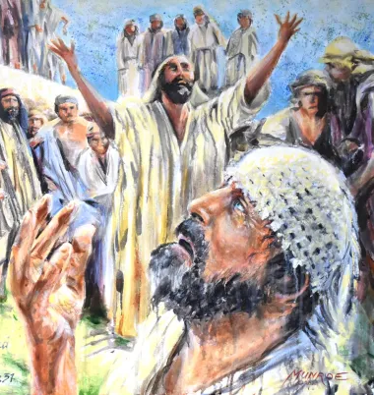
MATTHEW 9:7-8
⁷ And he got up and went home. ⁸ But when the crowds saw this, they were awestruck, and glorified God, who had given such authority to men.

Slide 40
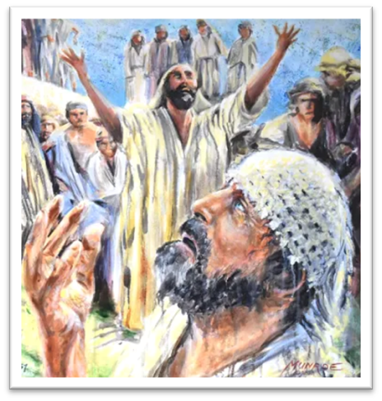
Law and Grace: Session 47 – Matthew 9:1-17
BUT DOES THE CROWD ‘GET IT’?
Matthew 9:7-8
The man is healed, so he gets up, picks up his bed and walks home, just as Jesus had told him to do.
And everything that Jesus has said and done, declares who He was and now is – the Holy Messiah.

Slide 41

Law and Grace: Session 47 – Matthew 9:1-17
BUT DOES THE CROWD ‘GET IT’?
Matthew 9:7-8
While the crowd is amazed and they even glorify God, they do not come to recognize Jesus as the Holy Messiah of God, the long-promised King of Israel now come.
They don’t ‘get it’.

Slide 42
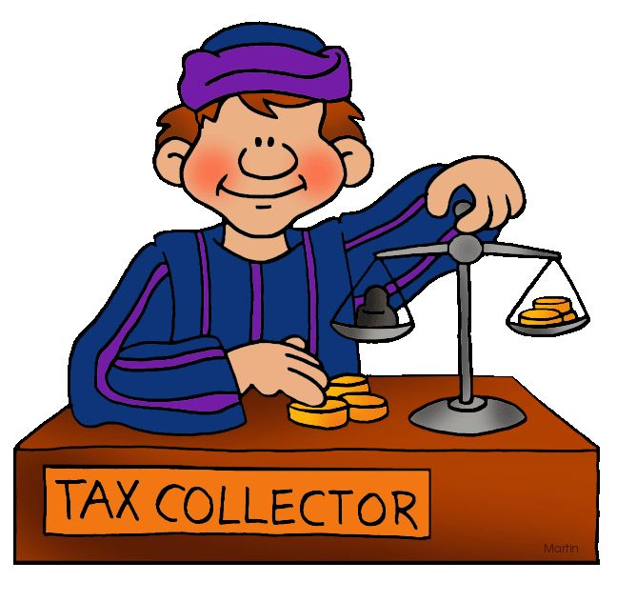
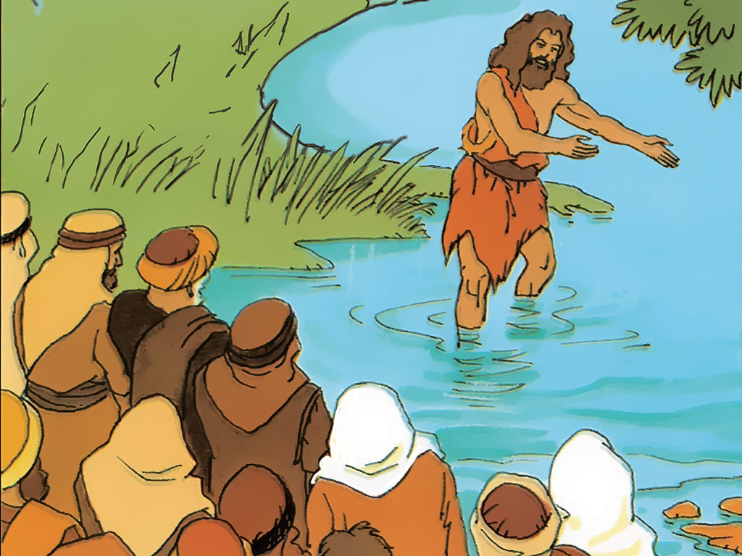
Law and Grace: Session 47 – Matthew 9:1-17
TWO ISSUES NOT FROM MIRACLES
Matthew 9:9-17
In this passage two issues arise, but not from any miracles.
  Vs. 9-13: Jesus calls Matthew, the tax collector, and the Pharisees question His disciples about eating with the tax collectors and sinners.
  Vs. 14-17: the disciples of both John the Baptist and the Pharisees ask Jesus why it is that they fast, but they don’t see Jesus disciples fasting according to the Jewish traditions.

Slide 43
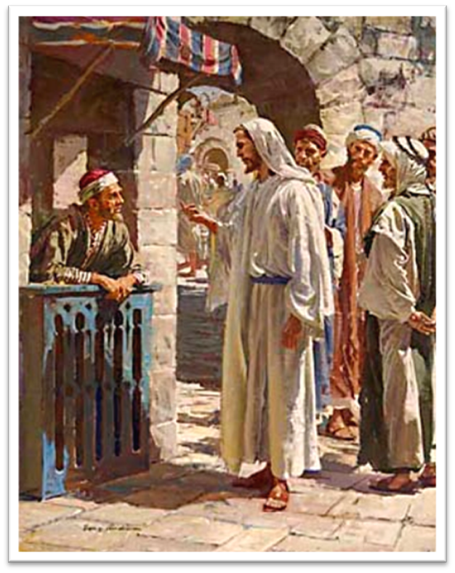
MATTHEW 9:9
⁹ As Jesus went on from there, He saw a man called Matthew, sitting in the tax collector’s booth; and He said to him, “Follow Me!” And he got up and followed Him.

Slide 44
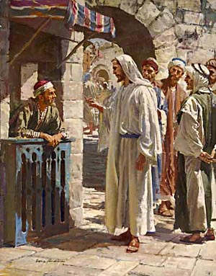
Law and Grace: Session 47 – Matthew 9:1-17
MATTHEW’S CALLING TO BE A DISCIPLE
Matthew 9:9
Matthew was a tax collector for the Roman government. The tax collectors were deeply despised among the Jews, and the loathing regularly manifested in tax revolts.
Matthew seems to have had a toll booth tax collecting role, with the taxes enforced by the nearby Roman garrison, but Jesus calls Matthew to be His disciple.

Slide 45
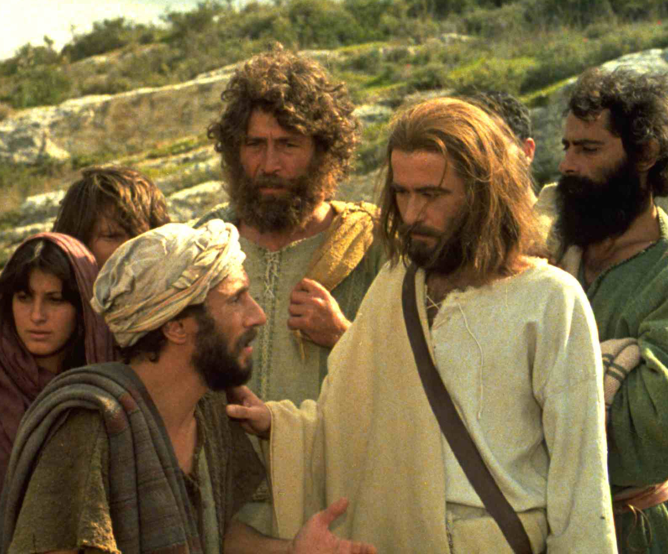
Law and Grace: Session 47 – Matthew 9:1-17
WHAT IT MEANT TO BE JESUS’ DISCIPLE
Matthew 9:9
To be a disciple in the context of 1st century Israel was to follow your rabbi with devotion to the rabbi’s every word, listening carefully and memorizing all the sayings of the rabbi.

Slide 46
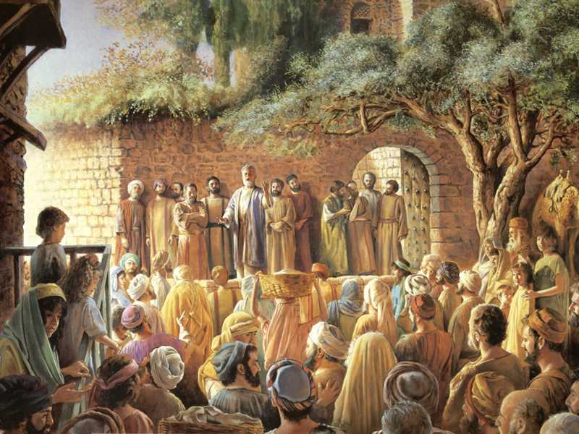
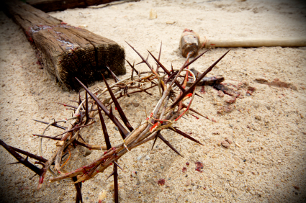
Law and Grace: Session 47 – Matthew 9:1-17
WHAT IT MEANT TO BE JESUS’ DISCIPLE
Matthew 9:9
But even with many advance notices, the disciples would not begin to know for a few years that their rabbi would die for their sins, be buried and be raised, nor that they’d be apostles for the church body… nor that they would die for their message and testimony for Christ.

Slide 47
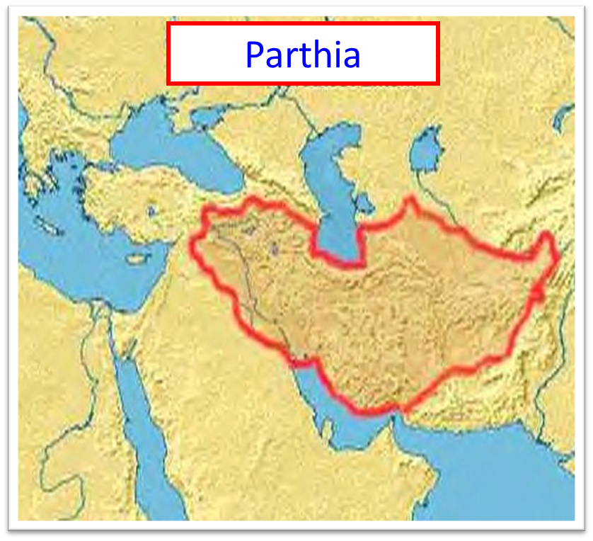
Law and Grace: Session 47 – Matthew 9:1-17
SO, WHATEVER HAPPENED TO MATTHEW?
Matthew, author of the gospel by his name, also called Levi, is recorded to have preached the gospel in Parthia and to have been martyred in Ethiopia.

Slide 48
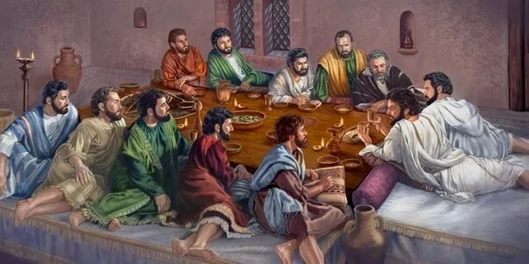
MATTHEW 9:10-12
¹⁰ Then it happened that as Jesus was reclining at the table in the house, behold, many tax collectors and sinners came and were dining with Jesus and His disciples. ¹¹ When the Pharisees saw this, they said to His disciples, “Why is your Teacher eating with the tax collectors and sinners?” ¹² But when Jesus heard this, He said, “It is not those who are healthy who need a physician, but those who are sick.”

Slide 49
Law and Grace: Session 47 – Matthew 9:1-17
TAX COLLECTORS AND SINNERS
Matthew 9:10-12
Based on their pharisaic interpretation of the Law of Moses, human logic and some assumptions, the rabbis had developed complex and at times inconsistent traditions about food and with whom one was or was not to eat.

Slide 50
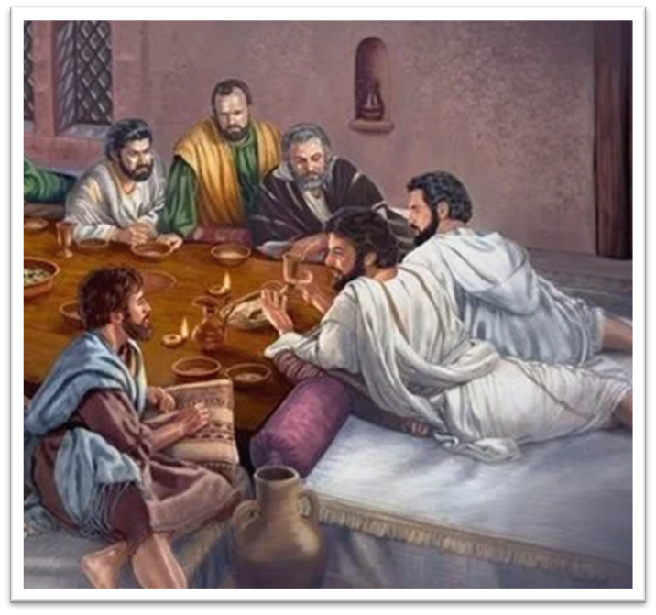
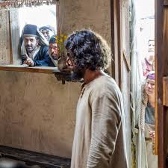
Law and Grace: Session 47 – Matthew 9:1-17
TAX COLLECTORS AND SINNERS
Matthew 9:10-12
While there was great disagreement among them about the details, it was universally believed that eating with the tax collectors and the other sinners was ‘out of bounds’.

Slide 51
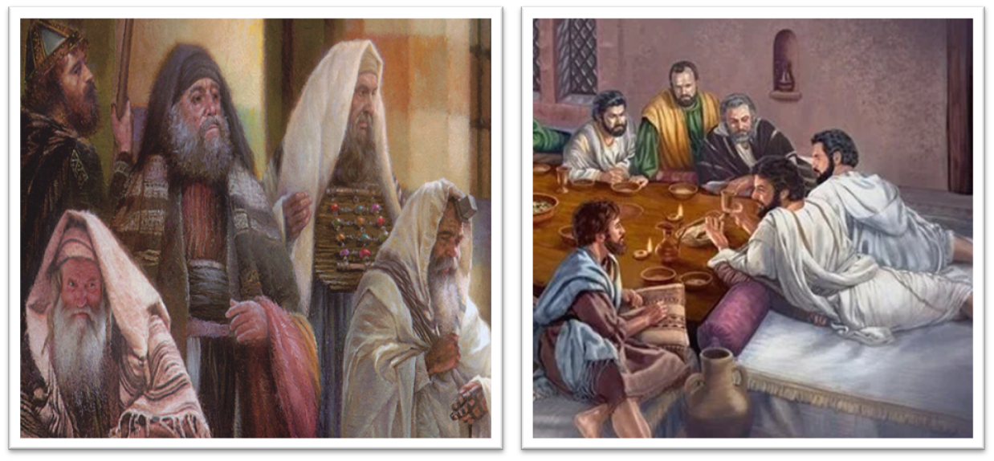
MATTHEW 9:13
¹³ “But go and learn what this means: ‘I desire compassion, and not sacrifice,’ for I did not come to call the righteous, but sinners.”

Slide 52
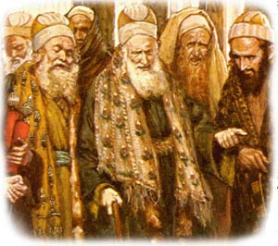
Law and Grace: Session 47 – Matthew 9:1-17
“GO AND LEARN”
Matthew 9:10-13
When the Pharisees see that Jesus is eating with the tax collectors and sinners, they ask Jesus’ disciples ‘Why?’.

Slide 53
Law and Grace: Session 47 – Matthew 9:1-17
“GO AND LEARN”
Matthew 9:10-13
Jesus, hearing this turns them to Hosea 6:6, which says that God desires hearts after Him more than just external rituals.
Jesus would minister to those who recognized their need for the Savior rather than those who would not see their need and would reject the Savior.

Slide 54
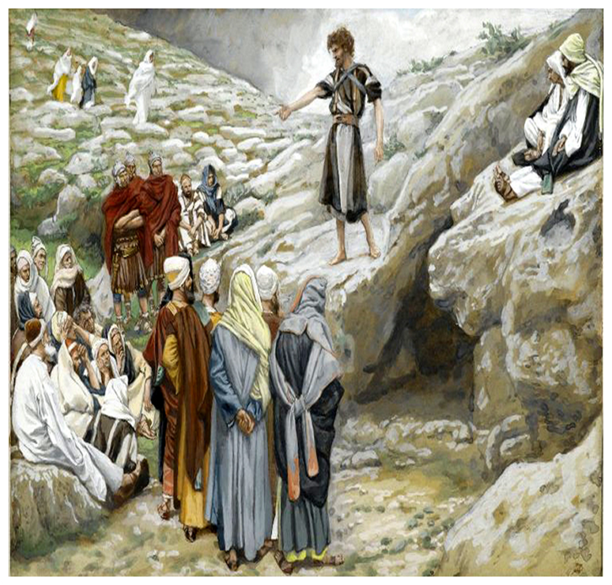
MATTHEW 9:14
¹⁴ Then the disciples of John came to Him, asking, “Why do we and the Pharisees fast, but Your disciples do not fast?”

Slide 55
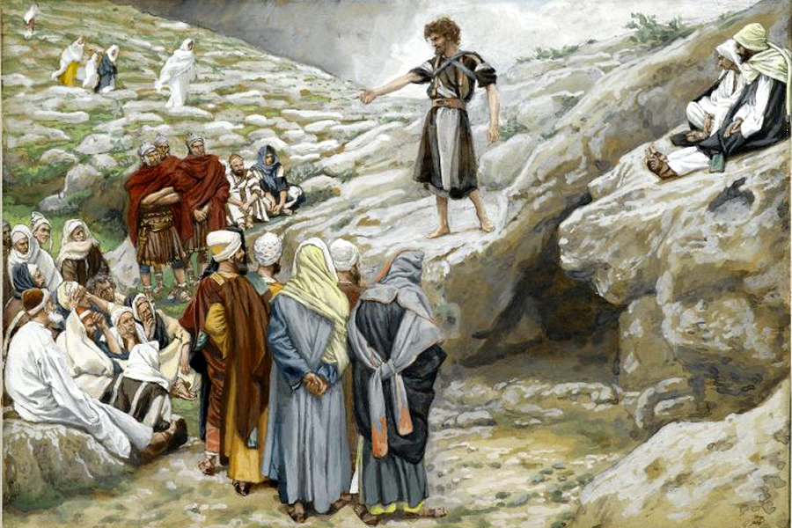
Law and Grace: Session 47 – Matthew 9:1-17
THE DISCIPLES OF JOHN THE BAPTIST ASK
Matthew 9:14-17
Some disciples of John the Baptist ask Jesus why it is that His disciples don’t fast like they and the Pharisees do.

Slide 56
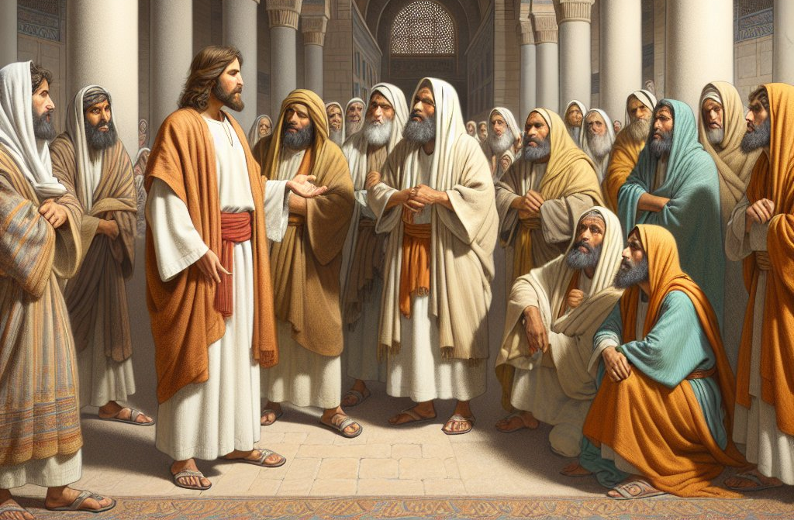
Law and Grace: Session 47 – Matthew 9:1-17
THE DISCIPLES OF JOHN THE BAPTIST ASK
Matthew 9:14-17
Jesus will later refer to fasting, but the Law of Moses did not call for fasting though the Jews had their ‘traditions’.

Slide 57
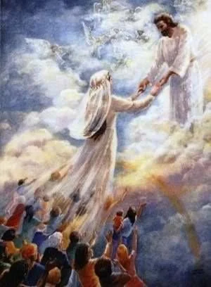
MATTHEW 9:15
¹⁵ And Jesus said to them, “The attendants of the bridegroom cannot mourn as long as the bridegroom is with them, can they? But the days will come when the bridegroom is taken away from them, and then they will fast.

Slide 58
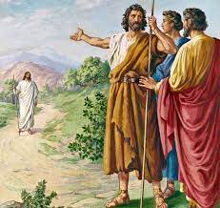
Law and Grace: Session 47 – Matthew 9:1-17
THE DISCIPLES OF JOHN THE BAPTIST ASK
Matthew 9:15
Jesus tells them that His attendants could not mourn (fast) while He is with them. John himself said Christ was the bridegroom and he the friend (John 3:29).

Slide 59
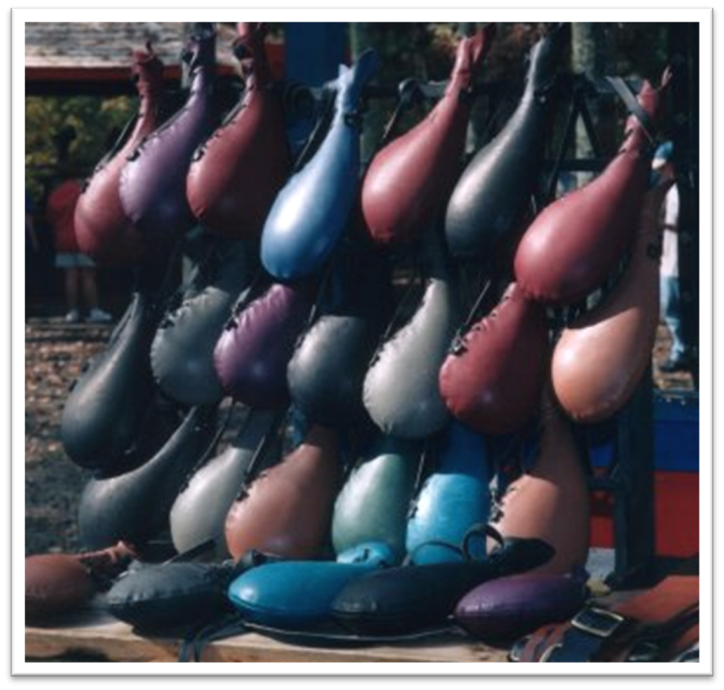
MATTHEW 9:16-17
¹⁶ “But no one puts a patch of unshrunk cloth on an old garment; for the patch pulls away from the garment, and a worse tear results. ¹⁷ “Nor do people put new wine into old wineskins; otherwise the wineskins burst, and the wine pours out and the wineskins are ruined; but they put new wine into fresh wineskins, and both are preserved.”

Slide 60
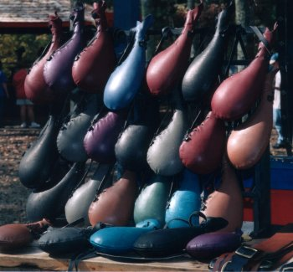
Law and Grace: Session 47 – Matthew 9:1-17
OLD GARMENTS AND OLD WINESKINS
Matthew 9:16-17
Jesus says that the old (παλαιός: worn out) garment and the old wineskins cannot be repaired.
What is Jesus talking about?

Slide 61
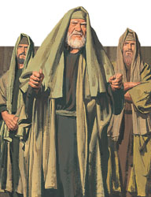
Law and Grace: Session 47 – Matthew 9:1-17
OLD GARMENTS AND OLD WINESKINS
Matthew 9:16-17
In saying this Jesus is telling the disciples of John the Baptist, that:
  What he is introducing and offering cannot be forced into or contained within the old worn-out traditions of Judaism! And,
  They need to leave the ways of John and follow Jesus because John was just preparing the way.

Slide 62

Law and Grace: Session 47 – Matthew 9:1-17
OLD GARMENTS AND OLD WINESKINS
Matthew 9:16-17
“The point of these two illustrations was that Jesus could not patch or pour His new ministry into old Judaism.”
(Constable, T. (2003). Tom Constable’s Expository Notes on the Bible (Mt 9:15).

Slide 63
Session 47 Outline
  Review
    Purpose, Aim, and Objective
    Session 46
  Forgiving Sins – Matthew 9:1-17
    General Information
    Matthew 9:1-17
  Concluding Observations

Slide 64
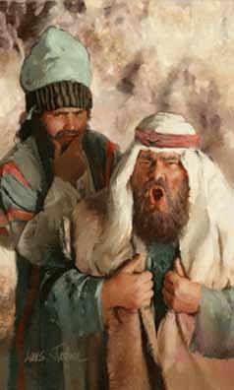
Law and Grace: Session 47 – Matthew 9:1-17
DID THE PHARISEES RECOGNIZE THEIR NEED?
Matthew 9:1-17
The Pharisees did not recognize their need for the Savior.
They believed their competence in the Law of Moses and the traditions was totally adequate to meet their needs, so they rejected Christ.

Slide 65
Law and Grace: Session 47 – Matthew 9:1-17
DID JOHN THE BAPTIST’S DISCIPLES RECOGNIZE THEIR NEED?
Matthew 9:1-17
John the Baptist’s disciples were all recognizing their need, at least to the point of being John’s disciples.
But they didn’t see their need for the One to whom John had been pointing!
“Behold the Lamb of God!”
“He must increase
and I must decrease!”

Slide 66

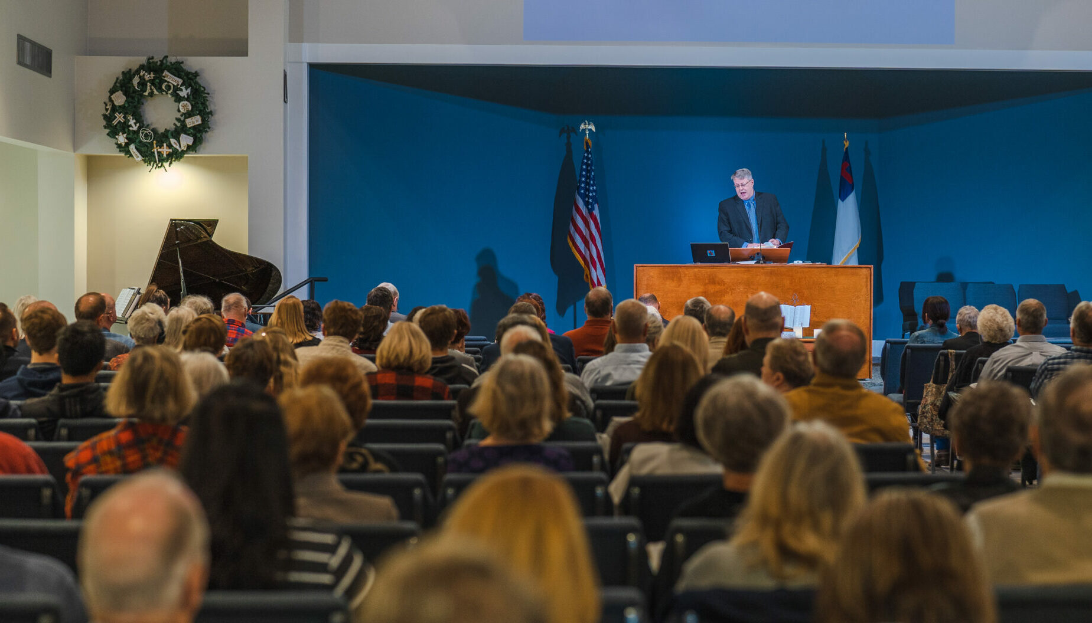
Law and Grace: Session 47 – Matthew 9:1-17
DO WE RECOGNIZE OUR NEED?
Matthew 9:1-17
As we gather here this morning, we should ask ourselves, do we recognize our need for Christ? Or are we here because it’s our tradition?
Is our sincere motivation to feed on God’s word in order to grow?

Slide 67



Colossians 1:28
²⁸ We proclaim Him (Christ), admonishing every man (ἄνθρωπος) and teaching every man (ἄνθρωπος) with all wisdom, so that we may present every man (ἄνθρωπος) complete [τέλειος; mature] in Christ.

Slide 68
Law and Grace: An Overview
Jim McGowan, Th.D.
Sugar Land Bible Church
08-17-2025
…but grace and truth were realized through Jesus Christ - John 1:17
For the Law was given through Moses…
Special thanks to Dr. Vern Peterman for access to his insights and resources.

