Slide 1
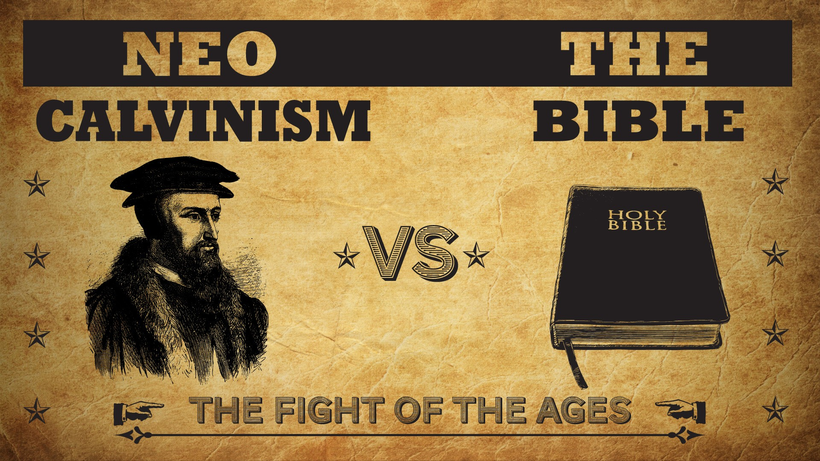


Slide 2
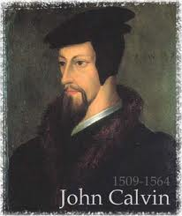
Neo-Calvinism vs. The Bible
Calvinism’s Mixed Blessing
Why Critique Calvinism?
The Source of Calvin’s Theology
Calvin’s Manner of Life
TULIP Through the Grid of Scripture
Conclusion

Slide 3
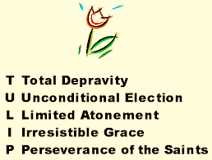
V. Running TULIP Through the Grid of Scripture
Total Depravity
Unconditional Election
Limited Atonement
Irresistible Grace
Perseverance of the Saints

Slide 4
Perseverance of the Saints
  Calvinistic definition
  Examples
  Problems with the Calvinistic understanding

Slide 5
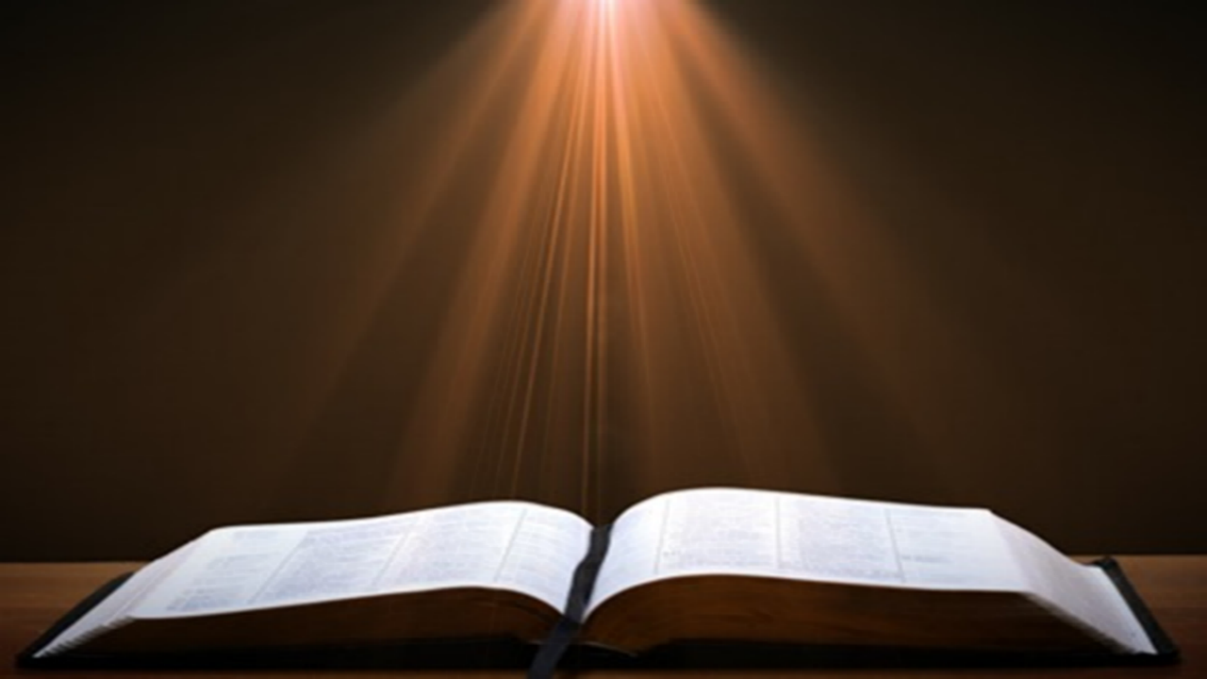
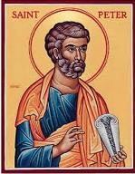
1 Peter 1:4-5
“to obtain an inheritance which is imperishable and undefiled and will not fade away, reserved in heaven for you, ⁵ who are protected by the power of God through faith for a salvation ready to be revealed in the last time.”

Slide 6
Perseverance of the Saints = Perseverance in Good Works to the End of One’s Life to Prove that He is One of the Elect
“P” stands for “Perseverance of the Saints.” This is what Calvinists say gives them the assurance of eternal security, but in actuality “the emphasis is upon the believer’s faithfulness in persevering—not upon God’s keeping power … uncertainty as to one’s ultimate salvation is, in fact, built into the very fabric of Calvinism itself.”
Bob Kirkland, Calvinism: None Dare Call It Heresy; Spotlight on the Life and Teachings of John Calvin (Eureka, MT: Lighthouse Trails, 2018), 34.

Slide 7
Perseverance of the Saints
  Calvinistic definition
  Examples
  Problems with the Calvinistic understanding

Slide 8


John Calvin
John Calvin, Calvin’s Calvinism: God’s Eternal Predestination and Secret Providence (Reformed Free Publishing Association, Kindle edition from the 2009 2nd edition), Kindle location 532.
Calvin said: “[T]hose who do not persevere unto the end belong not to the calling of God. The Fall of Adam was not by accident, nor by chance, but was ordained by the secret counsel of God.”

Slide 9
Perseverance of the Saints
  Calvinistic definition
  Examples
  Problems with the Calvinistic understanding

Slide 10
Problems with the Calvinistic Perseverance Definition
Final salvation is unbiblical
Scriptural examples of non-persevering saints
Support only found in out of context verses
Subtle form of works salvation
Preferability of immediate death following conversion?
Lessens the importance of practical sanctification
Lessens the importance of the Bema Seat warnings
Destroys the assurance of salvation

Slide 11
Examples of Old Testament Non-Persevering Saints
Noah (Gen. 9:20-23; Heb. 11:7)
Lot (Gen. 13; 19; 2 Pet. 2:7-8)
Moses (Num. 20:11-12; Deut. 32:5; Matt. 17:1-3; Heb. 11:23-29; Rev. 11:6)
Exodus’ generation (Num. 13‒14; Heb. 11:29)
Samson (Judges 13‒16; Heb. 11:32)
Saul (1 Sam. 28; 31)
Solomon (1 Kgs. 11:4, 9-10)

Slide 12
Examples of New Testament Non-Persevering Saints
Untrustworthy believers (John 2:23-25)
Non-confessing believers (John 12:42)
Ananias and Sapphira (Acts 5:1-11)
Simon the Sorcerer (Acts 8:13)
Immature believers at Corinth (1 Cor. 3:1-3)
Unrewarded believers at Corinth (1 Cor. 3:15)
Disciplined believers at Corinth (1 Cor. 11:27-32)
Demas (2 Tim. 4:10; Col. 4:14)
Immature believers in Hebrews (Heb. 5:11-14)
Seven churches in Asia Minor (Rev. 3:19)

Slide 13
Examples of New Testament Non-Persevering Saints
Untrustworthy believers (John 2:23-25)
Non-confessing believers (John 12:42)
Ananias and Sapphira (Acts 5:1-11)
Simon the Sorcerer (Acts 8:13)
Immature believers at Corinth (1 Cor. 3:1-3)
Unrewarded believers at Corinth (1 Cor. 3:15)
Disciplined believers at Corinth (1 Cor. 11:27-32)
Demas (2 Tim. 4:10; Col. 4:14)
Immature believers in Hebrews (Heb. 5:11-14)
Seven churches in Asia Minor (Rev. 3:19)

Slide 14

John 12:42
“Nevertheless many even of the rulers believed in Him, but because of the Pharisees they were not confessing Him, for fear that they would be put out of the synagogue.”

Slide 15
John 19:38
“After these things Joseph of Arimathea, being a disciple of Jesus, but a secret one for fear of the Jews, asked Pilate that he might take away the body of Jesus; and Pilate granted permission. So he came and took away His body.”

Slide 16
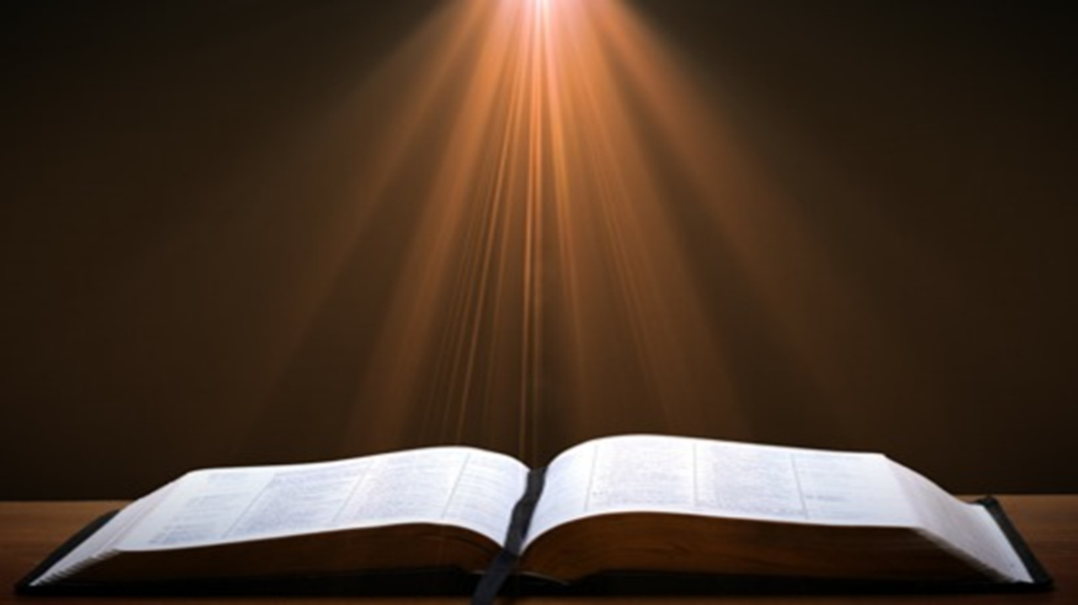
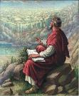
John 20:30-31
“Therefore many other signs Jesus also performed in the presence of the disciples, which are not written in this book; but these have been written so that you may believe that Jesus is the Christ, the Son of God; and that believing you may have life in His name.”

Slide 17
Examples of New Testament Non-Persevering Saints
Untrustworthy believers (John 2:23-25)
Non-confessing believers (John 12:42)
Ananias and Sapphira (Acts 5:1-11)
Simon the Sorcerer (Acts 8:13)
Immature believers at Corinth (1 Cor. 3:1-3)
Unrewarded believers at Corinth (1 Cor. 3:15)
Disciplined believers at Corinth (1 Cor. 11:27-32)
Demas (2 Tim. 4:10; Col. 4:14)
Immature believers in Hebrews (Heb. 5:11-14)
Seven churches in Asia Minor (Rev. 3:19)

Slide 18
Examples of New Testament Non-Persevering Saints
Untrustworthy believers (John 2:23-25)
Non-confessing believers (John 12:42)
Ananias and Sapphira (Acts 5:1-11)
Simon the Sorcerer (Acts 8:13)
Immature believers at Corinth (1 Cor. 3:1-3)
Unrewarded believers at Corinth (1 Cor. 3:15)
Disciplined believers at Corinth (1 Cor. 11:27-32)
Demas (2 Tim. 4:10; Col. 4:14)
Immature believers in Hebrews (Heb. 5:11-14)
Seven churches in Asia Minor (Rev. 3:19)

Slide 19
Examples of New Testament Non-Persevering Saints
Untrustworthy believers (John 2:23-25)
Non-confessing believers (John 12:42)
Ananias and Sapphira (Acts 5:1-11)
Simon the Sorcerer (Acts 8:13)
Immature believers at Corinth (1 Cor. 3:1-3)
Unrewarded believers at Corinth (1 Cor. 3:15)
Disciplined believers at Corinth (1 Cor. 11:27-32)
Demas (2 Tim. 4:10; Col. 4:14)
Immature believers in Hebrews (Heb. 5:11-14)
Seven churches in Asia Minor (Rev. 3:19)

Slide 20


Slide 21

Calvin said: “[W]hat they [the Christians at Corinth] had attained so far is nothing, unless they keep steadily on; because it is not enough that they once started off on the way of the Lord, if they do not make an effort to reach the goal.”
John Calvin
John Calvin, The First Epistle of Paul the Apostle to the Corinthians (Grand Rapids, MI: Eerdmans Publishing Company, 1960), p. 197.

Slide 22
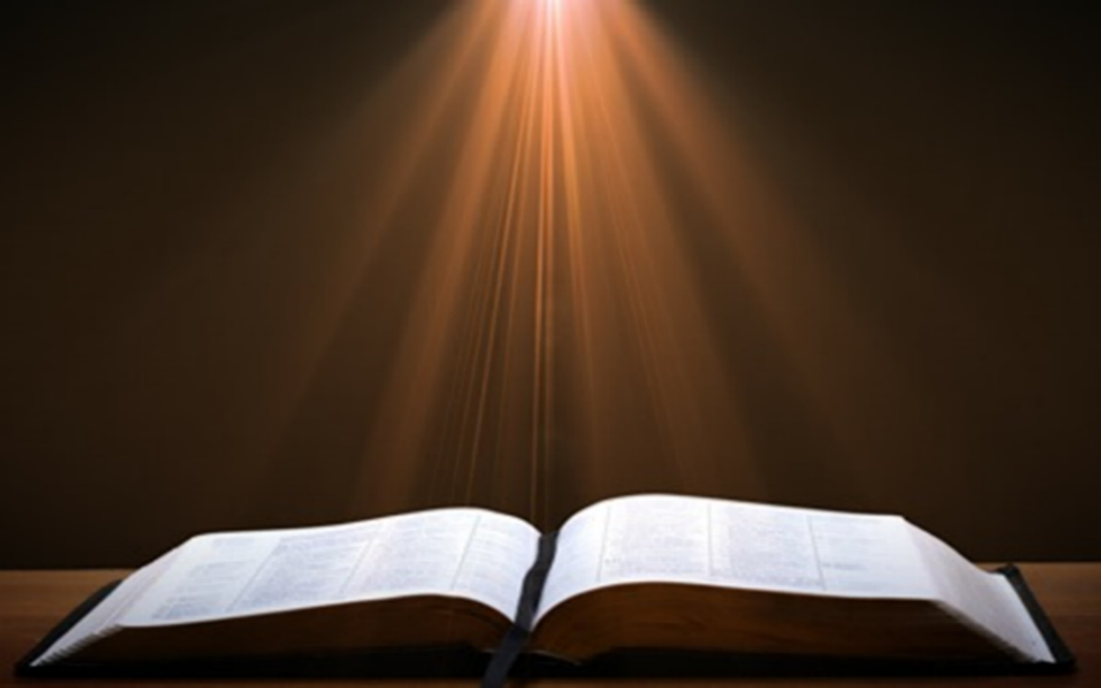
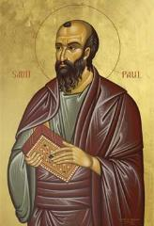
1 Corinthians 1:2
“To the CHURCH of God that is in Corinth, to those sanctified in Christ Jesus, called to be SAINTS together with all those who in every place call upon the name of OUR Lord Jesus Christ, both their Lord and OURS.”

Slide 23
2 Corinthians 1:1
"To the church of God that is at Corinth, with all the SAINTS who are in the whole of Achaia."

Slide 24
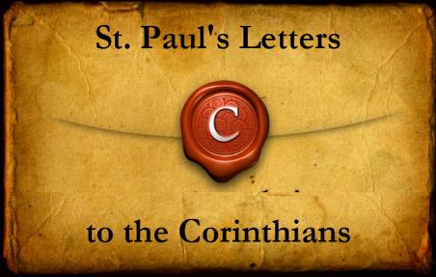
The Corinthians' Assumed Believing Status
1 Corinthians – 1:2; 3:1, 5, 6:11, 19-20
2 Corinthians – 1:1, 21-22, 24; 3:2-3; 6:14-16; 8:9; 10:15

