Slide 1

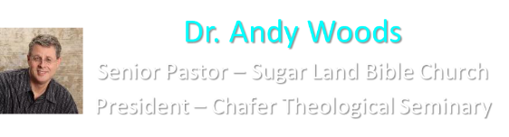

Slide 2

EXODUS STRUCTURE/OUTLINE
Redemption (1–18)
  Redemption (1:1–12:30)
  Liberation (12:31–15:21)
  Preservation (15:22–18:27)
Mosaic Covenant (19–40)
  Law (19–24)
  Tabernacle instructions (25–31)
  Apostasy (32–34)
  Tabernacle building (35–40)

Slide 3
REDEMPTION
(1:1–12:30)
Why redemption is necessary (Exod 1)
Development of the deliverer (Exod 2–4)
First confrontation with Pharaoh (Exod 5)
God reassures Moses (Exod 6:1–7:7)
Second confrontation with Pharaoh (Exod 7:18-13)
Plagues (Exod 7:14–12:30)

Slide 4
THREE PHASES OF MOSES’ 120 YEAR LIFE
LIFE PHASE | SCRIPTURE | YEARS | AGE | ACTIVITY
Natural Training | Acts 7:23 | 1526–1486 B.C. | 1-40 | Egyptian Education
Spiritual Training | Exod. 7:7 | 1486–1446 B.C. | 40-80 | Midian Shepherding
Ministry | Deut. 31:2; 34:7; Acts 7:36 | 1446–1406 B.C. | 80-120 | Exodus, Law, Wilderness Preservation, Pentateuch Authorship

Slide 5
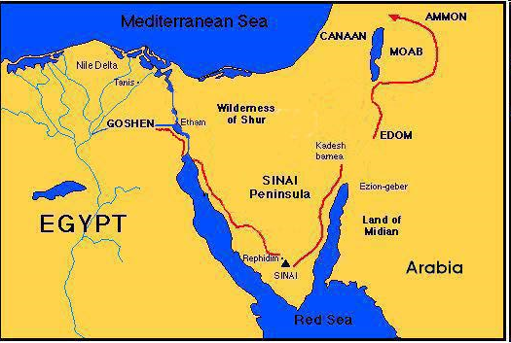

Slide 6
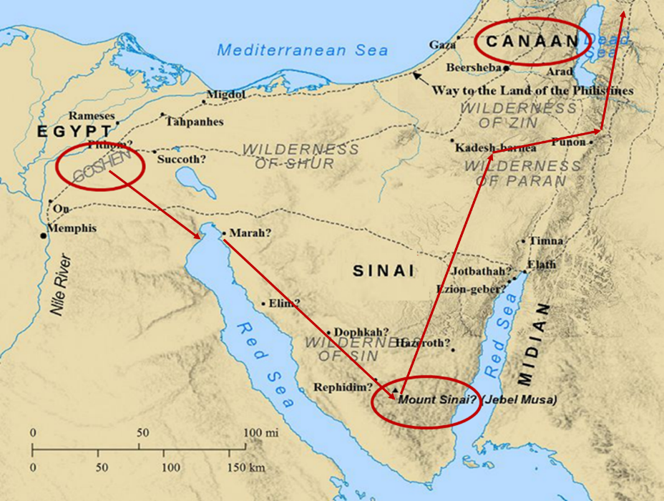

Slide 8
MOSES’ CALLING
Exodus 4:1-31
  Third objection (1-9)
  Fourth objection (10-12)
  Fifth objection (13-17)
  Moses returns to Egypt (18-20)
  God to harden Pharaoh (21-23)
  Moses refusal to circumcise Gershom (24-26)
  Moses’ meetings (27-31)

Slide 9
V. Exodus 4:21-23
God to Harden Pharaoh
    God’s hardening (21)
    Israel’s sonship (22)
    Covenant reciprocity (23)

Slide 10
V. Exodus 4:21-23
God to Harden Pharaoh
    God’s hardening (21)
    Israel’s sonship (22)
    Covenant reciprocity (23)

Slide 11

Charles Ryrie
Ryrie Study Bible, page 96
Exodus 4:21 - “harden his heart. Ten times it is said that Pharaoh hardened his own heart (7:13, 14, 22; 8:15, 19, 32; 9:7, 34, 35; 13:15), and 10 times that God hardened Pharaoh’s heart (4:21; 7:3; 9:12; 10:1, 20, 27; 11:10; 14:4, 8, 17). Paul uses this as an example of the inscrutable will of God and of His mercy toward men (Rom. 9:14–18). Seven times Pharaoh hardened his own heart before God first hardened it, though the prediction that God would do it preceded all.”

Slide 12
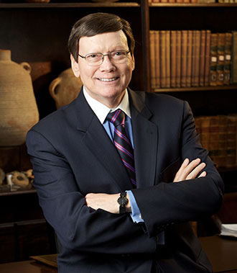
Dr. Ed Hindson
Hindson, E. E., & Mitchell, D. R., eds. (2010). King James Version Bible Commentary for Today: The Most Up-to-Date Commentary on the Time-Honored Text of the King James Version (p. 86). Thomas Nelson.
“4:21. I will harden his heart. An expression meaning ‘to strengthen his will.’ The text identifies the heart as the location of the volition, man’s decision-making ability. On seven occasions in the narrative, God hardens Pharaoh’s heart (9:12; 10:1, 20, 27; 11:10; 14:4, 8) or foretells that He will harden Pharaoh’s heart (4:21; 7:3), and nine times in the text, Pharaoh hardens his own heart (7:13, 14, 22; 8:15, 19, 32; 9:7, 34–35). For the initial five plagues, the text registers Pharaoh as the agent of hardening. Not until the sixth plague does God participate in the confirmation of Pharaoh’s own volitional choices.”

Slide 13
The Plagues of Egypt
NO. | DESCRIPTION | SCRIPTURE | Egyptian Deity
1. | Water to Blood | Exod. 7:14-25 | Hapi, Khnum
2. | Frogs | Exod. 8:1-15 | Heqt
3. | Gnats | Exod. 8:16-19 | Set
4. | Flies | Exod. 8:20-32 | Uatchit
5. | Disease on Cattle | Exod. 9:1-7 | Hathor, Apis
6. | Boils | Exod. 9:8-12 | Sekhmet, Serapis
7. | Hail | Exod. 9:13-35 | Seth, Nut
8. | Locusts | Exod. 10:1-20 | Seth, Nut, Osiris
9. | Darkness | Exod. 10:21-29 | Re, Horus, Atum
10. | Death of the First Born | Exod. 12:29-36 | Min, Osiris, Heqt, Isis

Slide 14
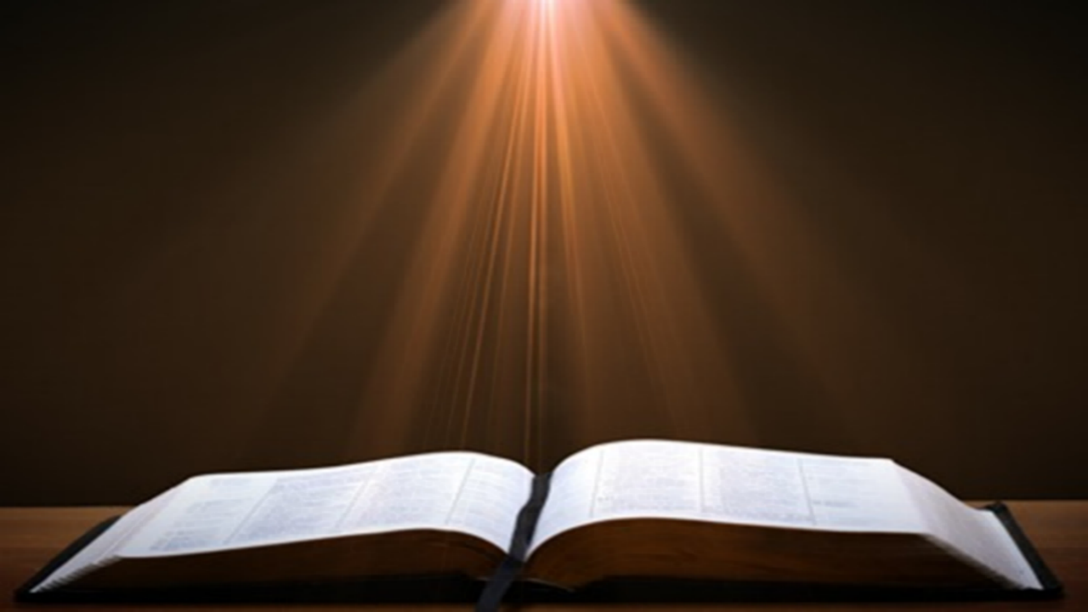
Romans 1:18-20
“¹⁸ For the wrath of God is revealed from heaven against all ungodliness and unrighteousness of men who suppress the truth in unrighteousness, ¹⁹ because that which is known about God is evident within them; for God made it evident to them. ²⁰ For since the creation of the world His invisible attributes, His eternal power and divine nature, have been clearly seen, being understood through what has been made, so that they are without excuse.”

Slide 15
V. Exodus 4:21-23
God to Harden Pharaoh
    God’s hardening (21)
    Israel’s sonship (22)
    Covenant reciprocity (23)

Slide 16
V. Exodus 4:21-23
God to Harden Pharaoh
    God’s hardening (21)
    Israel’s sonship (22)
    Covenant reciprocity (23)

Slide 17
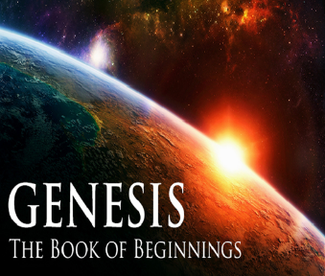
8 New Promises
Genesis 12:1-3
    Land (Gen. 12:1b)
    Great nation (Gen. 12:2a)
    Personal blessing (Gen. 12:2b)
    Great name (Gen. 12:2c)
    Blessing to others (Gen. 12:2d)
    Blessing to blessers (Gen. 12:3a)
    Cursing to cursers (Gen. 12:3b)
    Blessing to the world (Gen. 12:3c)

Slide 18

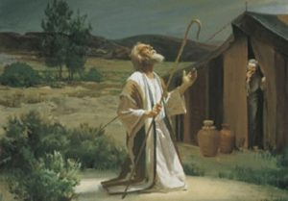
Genesis 12:3
“And I will bless those who bless you, And the one who curses you I will curse. And in you all the families of the earth will be blessed.”

Slide 20
The Plagues of Egypt
NO. | DESCRIPTION | SCRIPTURE | Egyptian Deity
1. | Water to Blood | Exod. 7:14-25 | Hapi, Khnum
2. | Frogs | Exod. 8:1-15 | Heqt
3. | Gnats | Exod. 8:16-19 | Set
4. | Flies | Exod. 8:20-32 | Uatchit
5. | Disease on Cattle | Exod. 9:1-7 | Hathor, Apis
6. | Boils | Exod. 9:8-12 | Sekhmet, Serapis
7. | Hail | Exod. 9:13-35 | Seth, Nut
8. | Locusts | Exod. 10:1-20 | Seth, Nut, Osiris
9. | Darkness | Exod. 10:21-29 | Re, Horus, Atum
10. | Death of the First Born | Exod. 12:29-36 | Min, Osiris, Heqt, Isis

Slide 21
MOSES’ CALLING
Exodus 4:1-31
  Third objection (1-9)
  Fourth objection (10-12)
  Fifth objection (13-17)
  Moses returns to Egypt (18-20)
  God to harden Pharaoh (21-23)
  Moses refusal to circumcise Gershom (24-26)
  Moses’ meetings (27-31)

Slide 22
VI. Exodus 4:24-26
Moses’ Refusal to Circumcise
  God’s anger (24)
  Zipporah’s action (25-26)

Slide 23
VI. Exodus 4:24-26
Moses’ Refusal to Circumcise
  God’s anger (24)
  Zipporah’s action (25-26)

Slide 24
Genesis 12‒25
Abraham’s Early Journeys
Unconditional promises (Gen. 12:1-3) From Haran to Canaan (Gen. 12:4-5) In Canaan (Gen. 12:6-9) In Egypt (Gen. 12:10-20) Abram and Lot Separate (Gen. 13:1-13) Reaffirmation of Abram’s promises (Gen. 13:14-18) Abram Rescues Lot (14:1-24) Abrahamic Covenant (15:1-21) Hagar & Ishmael (16:1-16) Circumcision (Gen. 17:1-27) | Sodom & Gomorrah (Gen. 18‒19) Abraham & Abimelech (Gen. 20) Isaac’s birth (Gen. 21:1-7) Ishmael’s expulsion (21:8-21) Abraham & Abimelech’s covenant (21:22-34) Abraham sacrifices Isaac (22) Sarah’s death (23) Isaac’s marriage (24) Abraham & Keturah (25:1-6) Abraham’s death (25:7-11)

Slide 25
Dr. Ed Hindson
Hindson, E. E., & Mitchell, D. R., eds. (2010). King James Version Bible Commentary for Today: The Most Up-to-Date Commentary on the Time-Honored Text of the King James Version (p. 86). Thomas Nelson.
“4:24. Apparently, Moses failed to circumcise his second son, Eliezer, in violation of the Abrahamic covenant (Gen. 17:9–14). It would have been flagrantly inappropriate for God’s chosen representative, the deliverer of His people, not to comply with such a basic command, the very sign and symbol of the covenant relationship itself.”

Slide 26
VI. Exodus 4:24-26
Moses’ Refusal to Circumcise
  God’s anger (24)
  Zipporah’s action (25-26)

Slide 28
Six Parts of a Suzerain-Vassal Treaty in Deuteronomy
Preamble (1:1-5)
Prologue (1:6–4:40)
Covenant obligations (5–26)
Storage and reading instructions (27:2-3; 31:9, 24, 26)
Witnesses (32:1)
Blessings and curses (28)

Slide 29
MOSES’ CALLING
Exodus 4:1-31
  Third objection (1-9)
  Fourth objection (10-12)
  Fifth objection (13-17)
  Moses returns to Egypt (18-20)
  God to harden Pharaoh (21-23)
  Moses refusal to circumcise Gershom (24-26)
  Moses’ meetings (27-31)

Slide 30
VII. Exodus 4:27-31
Moses’ Meetings
  With Aaron (27-28)
  With Israel’s leaders (29-31)

Slide 31
VII. Exodus 4:27-31
Moses’ Meetings
  With Aaron (27-28)
  With Israel’s leaders (29-31)

Slide 32
Exodus 4:27-28
With Aaron
      The meeting (27)
      The telling (28)

Slide 33
Exodus 4:27-28
With Aaron
      The meeting (27)
      The telling (28)

Slide 35
Exodus 4:27-28
With Aaron
      The meeting (27)
      The telling (28)

Slide 36
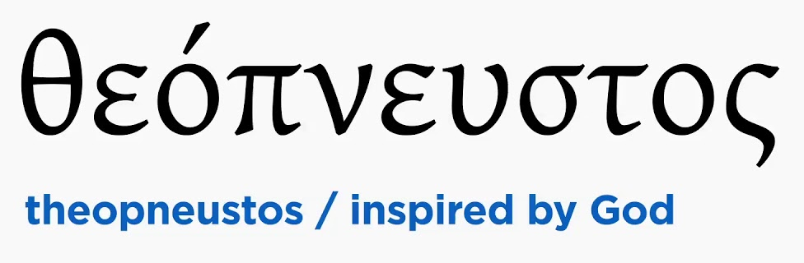
2 Timothy 3:16-17
“All Scripture is inspired by God [theopneustos] and profitable for teaching, for reproof, for correction, for training in righteousness; so that the man of God may be adequate, equipped for every good work.”

Slide 37
VII. Exodus 4:27-31
Moses’ Meetings
  With Aaron (27-28)
  With Israel’s leaders (29-31)

Slide 38
Exodus 4:29-31
With Israel’s Leaders
      Assembly (29)
      Proclamation (30)
      Response (31)

Slide 39
Exodus 4:29-31
With Israel’s Leaders
      Assembly (29)
      Proclamation (30)
      Response (31)

Slide 40
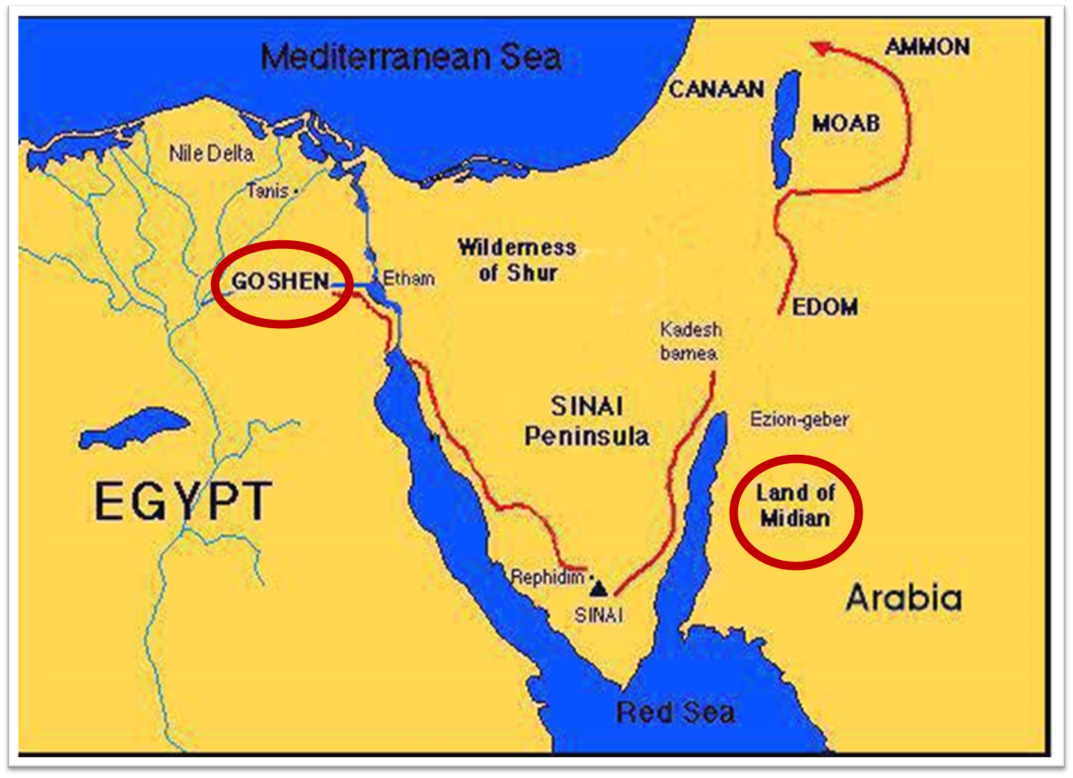

Slide 41
Exodus 4:29-31
With Israel’s Leaders
      Assembly (29)
      Proclamation (30)
      Response (31)

Slide 42
Exodus 4:30
The Proclamation
      Words (30a)
      Signs (30b)

Slide 43
Exodus 4:30
The Proclamation
      Words (30a)
      Signs (30b)

Slide 44
2 Timothy 3:16-17
“All Scripture is inspired by God [theopneustos] and profitable for teaching, for reproof, for correction, for training in righteousness; so that the man of God may be adequate, equipped for every good work.”

Slide 45
Exodus 4:30
The Proclamation
      Words (30a)
      Signs (30b)

Slide 46
Exodus 4:2-9
Proofs
      1st proof (2-5)
      2nd proof (6-8)
      3rd proof (9)

Slide 47
Exodus 4:29-31
With Israel’s Leaders
      Assembly (29)
      Proclamation (30)
      Response (31)

Slide 48
Exodus 4:31
The Response
      Faith (31a)
      Worship (31b)

Slide 49
Exodus 4:31
The Response
      Faith (31a)
      Worship (31b)

Slide 51
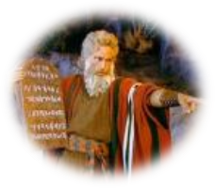
Exodus 14:30-31
³⁰ Thus the Lord saved Israel that day from the hand of the Egyptians, and Israel saw the Egyptians dead on the seashore. ³¹ When Israel saw the great power which the Lord had used against the Egyptians, the people feared the Lord, and they believed in the Lord and in His servant Moses.”

Slide 52
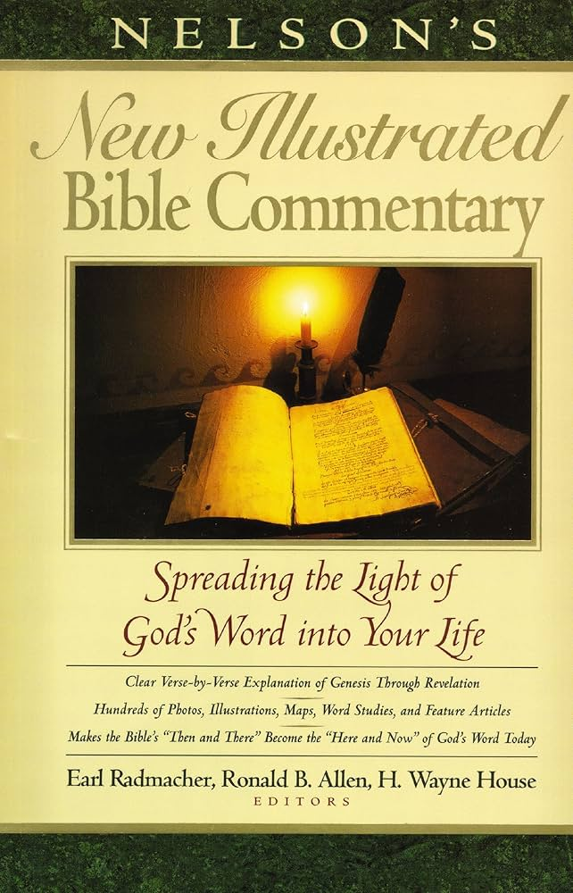
Exodus 14:31
“When we read so the people feared the Lord and the words that follow, we are meant to understand that the community had come to saving faith and so were a reborn people. They believed the Lord (the same wording used of Abraham’s saving faith in Gen. 15:6; read Paul’s comments in Rom. 4)…The people were transformed spiritually even as they were delivered physically.”
Nelson's New Illustrated Bible Commentary, 113.

Slide 53

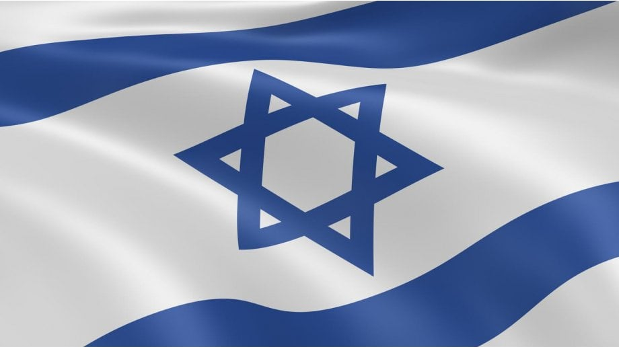
Exodus 2:24
“So, God heard their groaning; and God remembered His covenant with Abraham, Isaac, and Jacob.”

Slide 54
Exodus 4:31
The Response
      Faith (31a)
      Worship (31b)

Slide 55
Conclusion

Slide 56
MOSES’ CALLING
Exodus 4:1-31
  Third objection (1-9)
  Fourth objection (10-12)
  Fifth objection (13-17)
  Moses returns to Egypt (18-20)
  God to harden Pharaoh (21-23)
  Moses refusal to circumcise Gershom (24-26)
  Moses’ meetings (27-31)

Slide 57
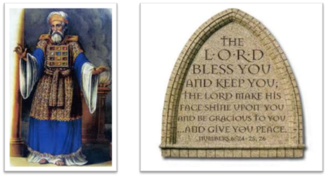
²⁴ The Lord bless you, and keep you; ²⁵ The Lord make His face shine on you, And be gracious to you; ²⁶ The Lord lift up His countenance on you, And give you peace.
Numbers 6:24–26 (NASB95)

