Slide 1

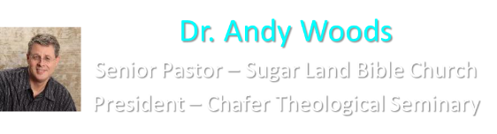

Slide 2

EXODUS STRUCTURE/OUTLINE
Redemption (1–18)
  Redemption (1:1–12:30)
  Liberation (12:31–15:21)
  Preservation (15:22–18:27)
Mosaic Covenant (19–40)
  Law (19–24)
  Tabernacle instructions (25–31)
  Apostasy (32–34)
  Tabernacle building (35–40)

Slide 3
REDEMPTION
(1:1–12:30)
Why redemption is necessary (Exod 1)
Development of the deliverer (Exod 2–4)
First confrontation with Pharaoh (Exod 5)
God reassures Moses (Exod 6:1–7:7)
Second confrontation with Pharaoh (Exod 7:18-13)
Plagues (Exod 7:14–12:30)

Slide 4
THREE PHASES OF MOSES’ 120 YEAR LIFE
LIFE PHASE | SCRIPTURE | YEARS | AGE | ACTIVITY
Natural Training | Acts 7:23 | 1526–1486 B.C. | 1-40 | Egyptian Education
Spiritual Training | Exod. 7:7 | 1486–1446 B.C. | 40-80 | Midian Shepherding
Ministry | Deut. 31:2; 34:7; Acts 7:36 | 1446–1406 B.C. | 80-120 | Exodus, Law, Wilderness Preservation, Pentateuch Authorship

Slide 5
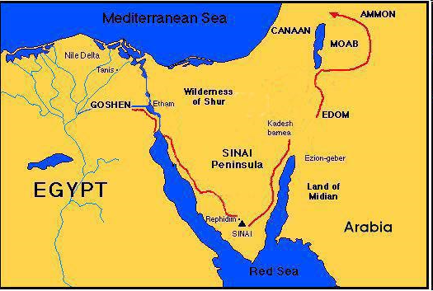

Slide 6
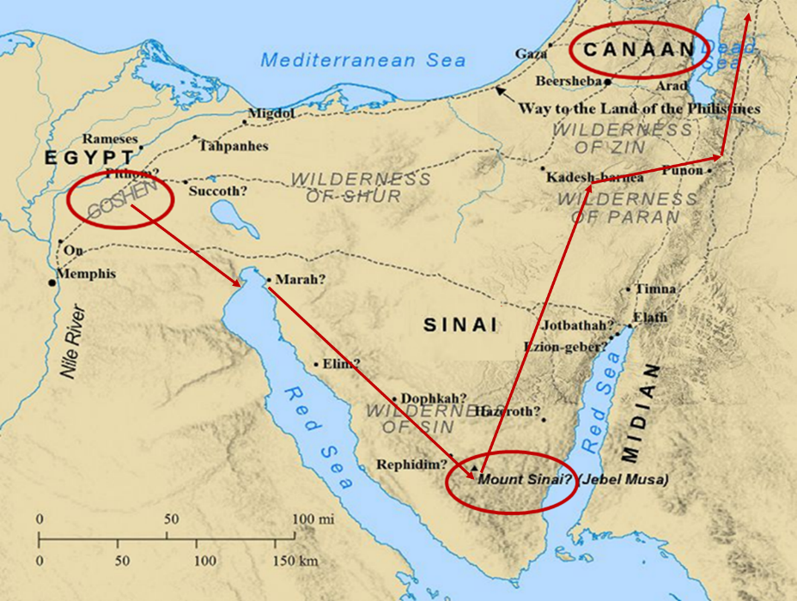

Slide 7
MOSES’ CALLING
Exodus 4:1-31
  Third objection (1-9)
  Fourth objection (10-12)
  Fifth objection (13-17)
  Moses returns to Egypt (18-20)
  God to harden Pharaoh (21-23)
  Moses refusal to circumcise Gershom (24-26)
  Moses’ meetings (27-31)

Slide 8
II. Exodus 4:10-12
Fourth Objection
    Objection: poor speaker (10)
    Response: God’s sovereignty (11-12)

Slide 9
MOSES’ CALLING
Exodus 4:1-31
  Third objection (1-9)
  Fourth objection (10-12)
  Fifth objection (13-17)
  Moses returns to Egypt (18-20)
  God to harden Pharaoh (21-23)
  Moses refusal to circumcise Gershom (24-26)
  Moses’ meetings (27-31)

Slide 10
III. Exodus 4:13-17
Fifth Objection
    Objection: send another (13)
    Response: Aaron as spokesman (14-17)

Slide 11
III. Exodus 4:13-17
Fifth Objection
    Objection: send another (13)
    Response: Aaron as spokesman (14-17)

Slide 12
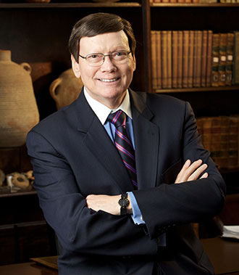
Dr. Ed Hindson
Hindson, E. E., & Mitchell, D. R., eds. (2010). King James Version Bible Commentary for Today: The Most Up-to-Date Commentary on the Time-Honored Text of the King James Version (p. 85). Thomas Nelson.
“4:13. …Ultimately, it came down to the fact that Moses simply did not care for the position being divinely offered and turned it down flat. He entreated the Lord to choose a replacement and send someone else.”

Slide 13
III. Exodus 4:13-17
Fifth Objection
    Objection: send another (13)
    Response: Aaron as spokesman (14-17)

Slide 14
Dr. Ed Hindson
Hindson, E. E., & Mitchell, D. R., eds. (2010). King James Version Bible Commentary for Today: The Most Up-to-Date Commentary on the Time-Honored Text of the King James Version (p. 85). Thomas Nelson.
“4:14. The anger of the Lord was kindled. At this response from Moses, the Lord’s patience finally ran out with His servant, and He lost his temper. No more gentle, reassuring answers were forthcoming.”

Slide 15
Dr. Ed Hindson
Hindson, E. E., & Mitchell, D. R., eds. (2010). King James Version Bible Commentary for Today: The Most Up-to-Date Commentary on the Time-Honored Text of the King James Version (p. 85-86). Thomas Nelson.
“4:15–16. The Lord answered Moses’ request by bringing a third party into the equation, Moses’ brother, Aaron. God begrudgingly indulged Moses’ reluctance to expound the divine message. Although Moses was commissioned to serve as God’s mouthpiece, Aaron was likewise commissioned to be Moses’ mouthpiece. A three-way system was arranged whereby God would first speak to Moses. Moses would then convey the divine will to Aaron. Finally, Aaron would then publicly broadcast the message.”

Slide 16
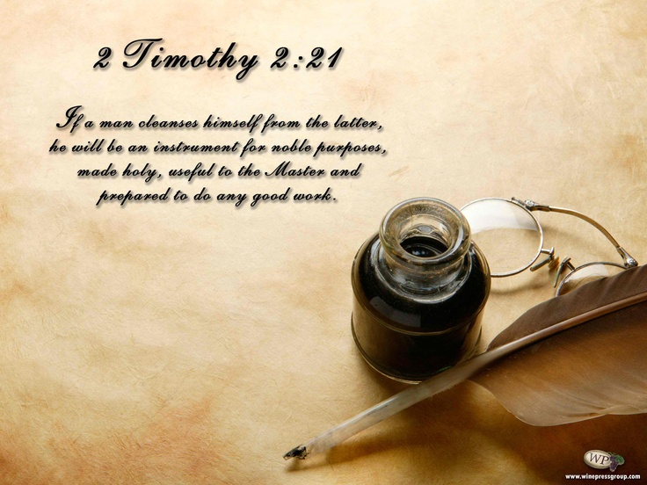
2 Timothy 2:2
Teacher (2:2): four generations (from Paul to Timothy, from Timothy to faithful men, from faithful men to others)

Slide 17
MOSES’ CALLING
Exodus 4:1-31
  Third objection (1-9)
  Fourth objection (10-12)
  Fifth objection (13-17)
  Moses returns to Egypt (18-20)
  God to harden Pharaoh (21-23)
  Moses refusal to circumcise Gershom (24-26)
  Moses’ meetings (27-31)

Slide 18
IV. Exodus 4:18-20
Moses Returns to Egypt
    Jethro’s permission (18)
    God’s comfort (19)
    Moses’ return (20)

Slide 19
IV. Exodus 4:18-20
Moses Returns to Egypt
    Jethro’s permission (18)
    God’s comfort (19)
    Moses’ return (20)

Slide 20


Slide 21
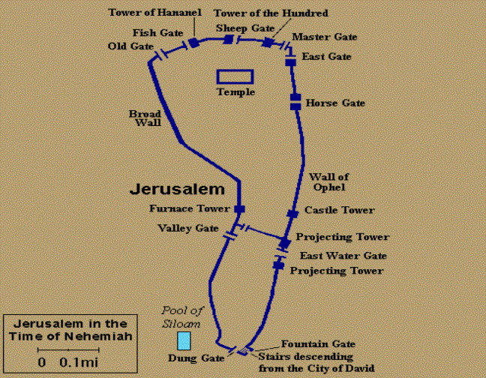
GATES OF NEHEMIAH

Slide 22
IV. Exodus 4:18-20
Moses Returns to Egypt
    Jethro’s permission (18)
    God’s comfort (19)
    Moses’ return (20)

Slide 23
DATE OF THE EXODUS
1446 b.c.
  Literal numbers
  Oppression – Thutmose III
  Exodus – Amenhotep II

Slide 24
IV. Exodus 4:18-20
Moses Returns to Egypt
    Jethro’s permission (18)
    God’s comfort (19)
    Moses’ return (20)

Slide 25
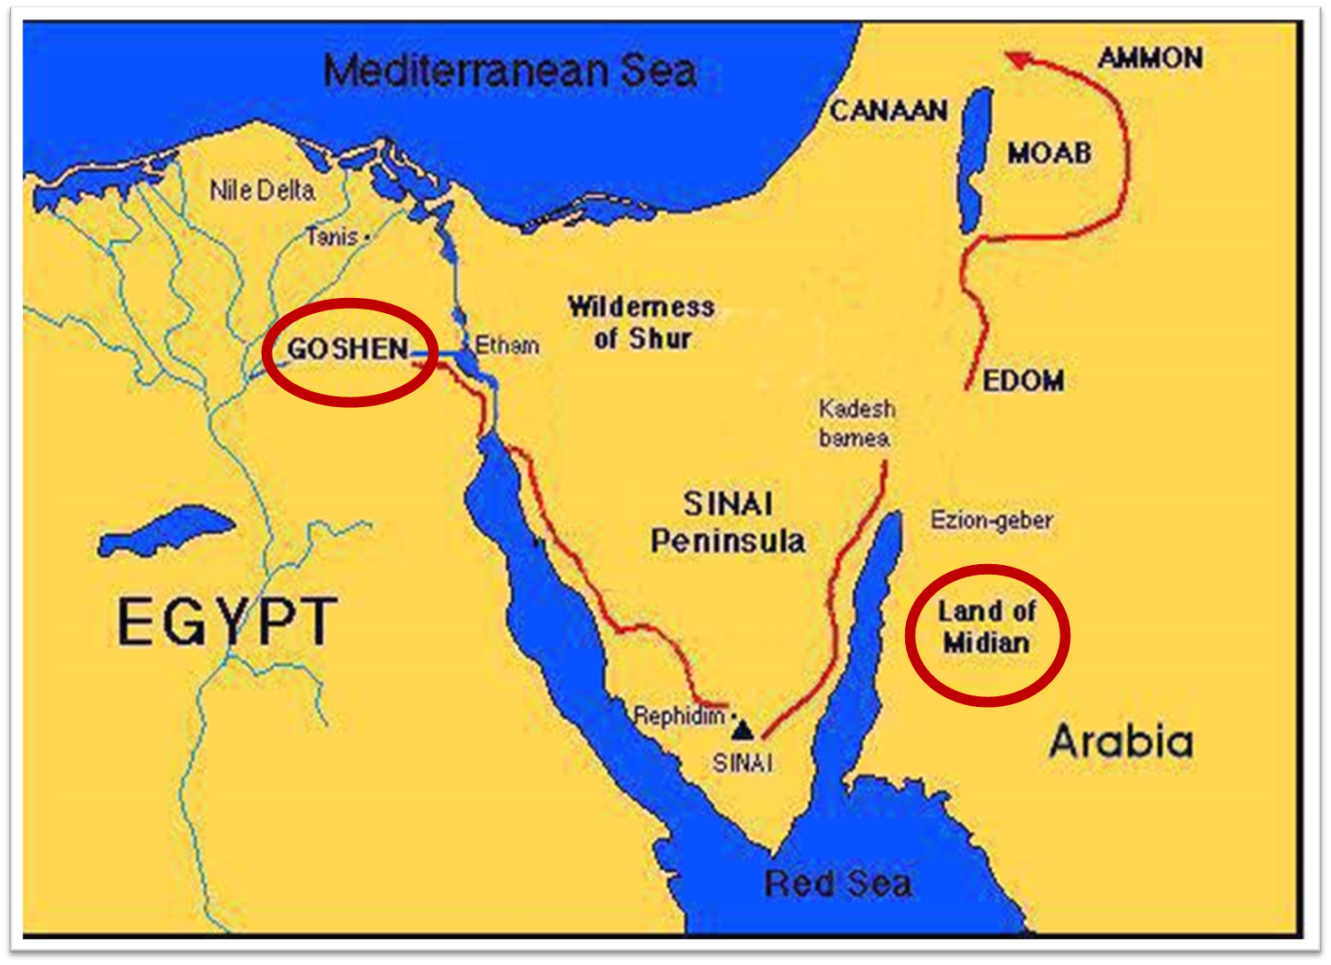

Slide 26
MOSES’ CALLING
Exodus 4:1-31
  Third objection (1-9)
  Fourth objection (10-12)
  Fifth objection (13-17)
  Moses returns to Egypt (18-20)
  God to harden Pharaoh (21-23)
  Moses refusal to circumcise Gershom (24-26)
  Moses’ meetings (27-31)

Slide 27
V. Exodus 4:21-23
God to Harden Pharaoh
    God’s hardening (21)
    Israel’s sonship (22)
    Covenant reciprocity (23)

Slide 28
V. Exodus 4:21-23
God to Harden Pharaoh
    God’s hardening (21)
    Israel’s sonship (22)
    Covenant reciprocity (23)

Slide 29

Charles Ryrie
Ryrie Study Bible, page 96
Exodus 4:21 - “harden his heart. Ten times it is said that Pharaoh hardened his own heart (7:13, 14, 22; 8:15, 19, 32; 9:7, 34, 35; 13:15), and 10 times that God hardened Pharaoh’s heart (4:21; 7:3; 9:12; 10:1, 20, 27; 11:10; 14:4, 8, 17). Paul uses this as an example of the inscrutable will of God and of His mercy toward men (Rom. 9:14–18). Seven times Pharaoh hardened his own heart before God first hardened it, though the prediction that God would do it preceded all.”

Slide 30
Dr. Ed Hindson
Hindson, E. E., & Mitchell, D. R., eds. (2010). King James Version Bible Commentary for Today: The Most Up-to-Date Commentary on the Time-Honored Text of the King James Version (p. 86). Thomas Nelson.
“4:21. I will harden his heart. An expression meaning ‘to strengthen his will.’ The text identifies the heart as the location of the volition, man’s decision-making ability. On seven occasions in the narrative, God hardens Pharaoh’s heart (9:12; 10:1, 20, 27; 11:10; 14:4, 8) or foretells that He will harden Pharaoh’s heart (4:21; 7:3), and nine times in the text, Pharaoh hardens his own heart (7:13, 14, 22; 8:15, 19, 32; 9:7, 34–35). For the initial five plagues, the text registers Pharaoh as the agent of hardening. Not until the sixth plague does God participate in the confirmation of Pharaoh’s own volitional choices.”

Slide 31
The Plagues of Egypt
NO. | DESCRIPTION | SCRIPTURE | Egyptian Deity
1. | Water to Blood | Exod. 7:14-25 | Hapi, Khnum
2. | Frogs | Exod. 8:1-15 | Heqt
3. | Gnats | Exod. 8:16-19 | Set
4. | Flies | Exod. 8:20-32 | Uatchit
5. | Disease on Cattle | Exod. 9:1-7 | Hathor, Apis
6. | Boils | Exod. 9:8-12 | Sekhmet, Serapis
7. | Hail | Exod. 9:13-35 | Seth, Nut
8. | Locusts | Exod. 10:1-20 | Seth, Nut, Osiris
9. | Darkness | Exod. 10:21-29 | Re, Horus, Atum
10. | Death of the First Born | Exod. 12:29-36 | Min, Osiris, Heqt, Isis

Slide 32
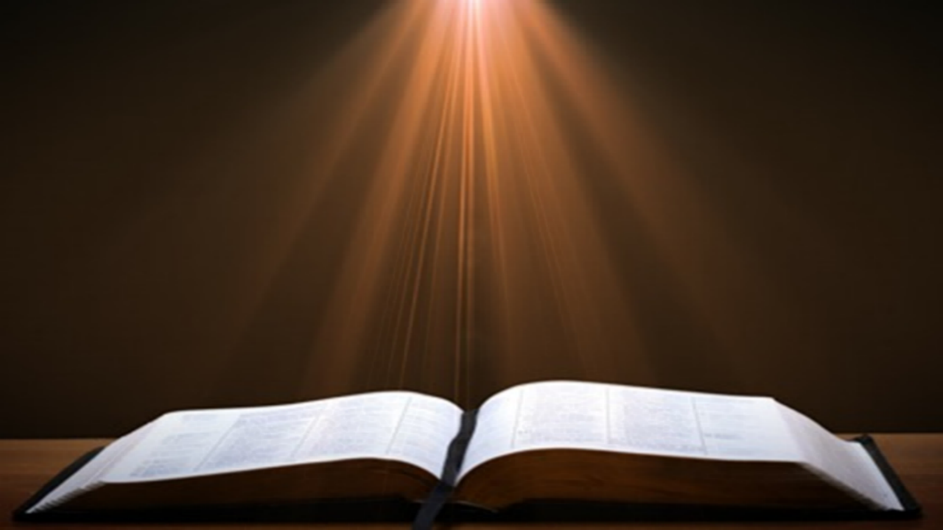
Romans 1:18-20
“¹⁸ For the wrath of God is revealed from heaven against all ungodliness and unrighteousness of men who suppress the truth in unrighteousness, ¹⁹ because that which is known about God is evident within them; for God made it evident to them. ²⁰ For since the creation of the world His invisible attributes, His eternal power and divine nature, have been clearly seen, being understood through what has been made, so that they are without excuse.”

Slide 33
V. Exodus 4:21-23
God to Harden Pharaoh
    God’s hardening (21)
    Israel’s sonship (22)
    Covenant reciprocity (23)

Slide 34
V. Exodus 4:21-23
God to Harden Pharaoh
    God’s hardening (21)
    Israel’s sonship (22)
    Covenant reciprocity (23)

Slide 35
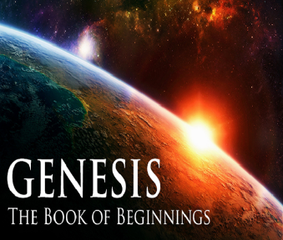
8 New Promises
Genesis 12:1-3
    Land (Gen. 12:1b)
    Great nation (Gen. 12:2a)
    Personal blessing (Gen. 12:2b)
    Great name (Gen. 12:2c)
    Blessing to others (Gen. 12:2d)
    Blessing to blessers (Gen. 12:3a)
    Cursing to cursers (Gen. 12:3b)
    Blessing to the world (Gen. 12:3c)

Slide 36

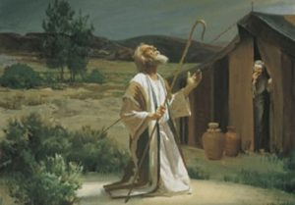
Genesis 12:3
“And I will bless those who bless you, And the one who curses you I will curse. And in you all the families of the earth will be blessed.”

Slide 38
The Plagues of Egypt
NO. | DESCRIPTION | SCRIPTURE | Egyptian Deity
1. | Water to Blood | Exod. 7:14-25 | Hapi, Khnum
2. | Frogs | Exod. 8:1-15 | Heqt
3. | Gnats | Exod. 8:16-19 | Set
4. | Flies | Exod. 8:20-32 | Uatchit
5. | Disease on Cattle | Exod. 9:1-7 | Hathor, Apis
6. | Boils | Exod. 9:8-12 | Sekhmet, Serapis
7. | Hail | Exod. 9:13-35 | Seth, Nut
8. | Locusts | Exod. 10:1-20 | Seth, Nut, Osiris
9. | Darkness | Exod. 10:21-29 | Re, Horus, Atum
10. | Death of the First Born | Exod. 12:29-36 | Min, Osiris, Heqt, Isis

Slide 39
MOSES’ CALLING
Exodus 4:1-31
  Third objection (1-9)
  Fourth objection (10-12)
  Fifth objection (13-17)
  Moses returns to Egypt (18-20)
  God to harden Pharaoh (21-23)
  Moses refusal to circumcise Gershom (24-26)
  Moses’ meetings (27-31)

Slide 40
VI. Exodus 4:24-26
Moses’ Refusal to Circumcise
  God’s anger (24)
  Zipporah’s action (25-26)

Slide 41
VI. Exodus 4:24-26
Moses’ Refusal to Circumcise
  God’s anger (24)
  Zipporah’s action (25-26)

Slide 42
Genesis 12‒25
Abraham’s Early Journeys
Unconditional promises (Gen. 12:1-3) From Haran to Canaan (Gen. 12:4-5) In Canaan (Gen. 12:6-9) In Egypt (Gen. 12:10-20) Abram and Lot Separate (Gen. 13:1-13) Reaffirmation of Abram’s promises (Gen. 13:14-18) Abram Rescues Lot (14:1-24) Abrahamic Covenant (15:1-21) Hagar & Ishmael (16:1-16) Circumcision (Gen. 17:1-27) | Sodom & Gomorrah (Gen. 18‒19) Abraham & Abimelech (Gen. 20) Isaac’s birth (Gen. 21:1-7) Ishmael’s expulsion (21:8-21) Abraham & Abimelech’s covenant (21:22-34) Abraham sacrifices Isaac (22) Sarah’s death (23) Isaac’s marriage (24) Abraham & Keturah (25:1-6) Abraham’s death (25:7-11)

Slide 43
Dr. Ed Hindson
Hindson, E. E., & Mitchell, D. R., eds. (2010). King James Version Bible Commentary for Today: The Most Up-to-Date Commentary on the Time-Honored Text of the King James Version (p. 86). Thomas Nelson.
“4:24. Apparently, Moses failed to circumcise his second son, Eliezer, in violation of the Abrahamic covenant (Gen. 17:9–14). It would have been flagrantly inappropriate for God’s chosen representative, the deliverer of His people, not to comply with such a basic command, the very sign and symbol of the covenant relationship itself.”

Slide 44
VI. Exodus 4:24-26
Moses’ Refusal to Circumcise
  God’s anger (24)
  Zipporah’s action (25-26)

Slide 45
MOSES’ CALLING
Exodus 4:1-31
  Third objection (1-9)
  Fourth objection (10-12)
  Fifth objection (13-17)
  Moses returns to Egypt (18-20)
  God to harden Pharaoh (21-23)
  Moses refusal to circumcise Gershom (24-26)
  Moses’ meetings (27-31)

Slide 46
VII. Exodus 4:27-31
Moses’ Meetings
  With Aaron (27-28)
  With Israel’s leaders (29-31)

Slide 47
VII. Exodus 4:27-31
Moses’ Meetings
  With Aaron (27-28)
  With Israel’s leaders (29-31)

Slide 48
Exodus 4:27-28
With Aaron
      The meeting (27)
      The telling (28)

Slide 49
Exodus 4:27-28
With Aaron
      The meeting (27)
      The telling (28)

Slide 51
Exodus 4:27-28
With Aaron
      The meeting (27)
      The telling (28)

Slide 52
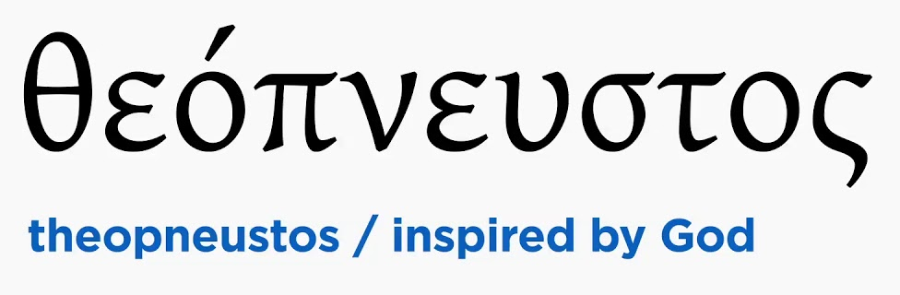
2 Timothy 3:16-17
“All Scripture is inspired by God [theopneustos] and profitable for teaching, for reproof, for correction, for training in righteousness; so that the man of God may be adequate, equipped for every good work.”

Slide 53
VII. Exodus 4:27-31
Moses’ Meetings
  With Aaron (27-28)
  With Israel’s leaders (29-31)

Slide 54
Exodus 4:29-31
With Israel’s Leaders
      Assembly (29)
      Proclamation (30)
      Response (31)

Slide 55
Exodus 4:29-31
With Israel’s Leaders
      Assembly (29)
      Proclamation (30)
      Response (31)

Slide 57
Exodus 4:29-31
With Israel’s Leaders
      Assembly (29)
      Proclamation (30)
      Response (31)

Slide 58
Exodus 4:30
The Proclamation
      Words (30a)
      Signs (30b)

Slide 59
Exodus 4:30
The Proclamation
      Words (30a)
      Signs (30b)

Slide 60
2 Timothy 3:16-17
“All Scripture is inspired by God [theopneustos] and profitable for teaching, for reproof, for correction, for training in righteousness; so that the man of God may be adequate, equipped for every good work.”

Slide 61
Exodus 4:30
The Proclamation
      Words (30a)
      Signs (30b)

Slide 62
Exodus 4:29-31
With Israel’s Leaders
      Assembly (29)
      Proclamation (30)
      Response (31)

Slide 63
Exodus 4:31
The Response
      Faith (31a)
      Worship (31b)

Slide 64
Exodus 4:31
The Response
      Faith (31a)
      Worship (31b)

Slide 66
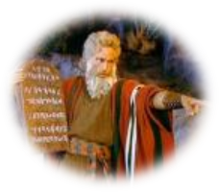
Exodus 14:30-31
³⁰ Thus the Lord saved Israel that day from the hand of the Egyptians, and Israel saw the Egyptians dead on the seashore. ³¹ When Israel saw the great power which the Lord had used against the Egyptians, the people feared the Lord, and they believed in the Lord and in His servant Moses.”

Slide 67
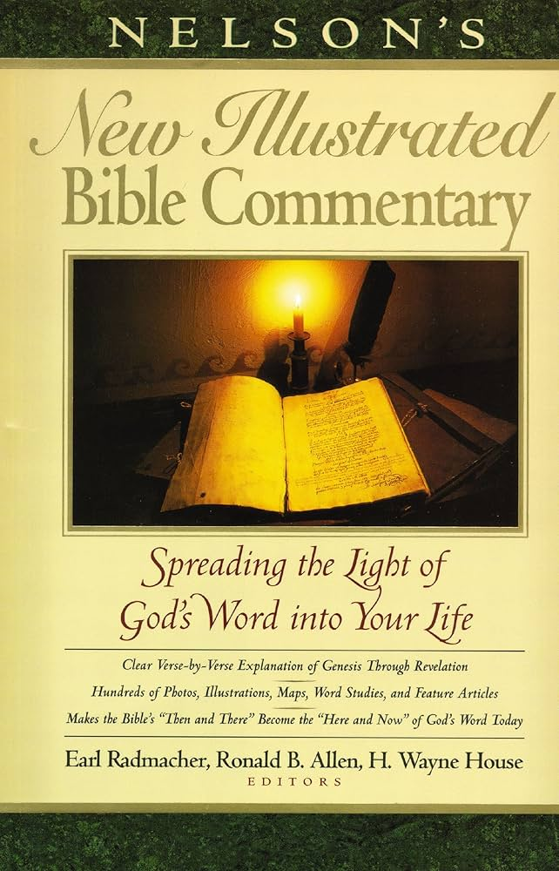
Exodus 14:31
“When we read so the people feared the Lord and the words that follow, we are meant to understand that the community had come to saving faith and so were a reborn people. They believed the Lord (the same wording used of Abraham’s saving faith in Gen. 15:6; read Paul’s comments in Rom. 4)…The people were transformed spiritually even as they were delivered physically.”
Nelson's New Illustrated Bible Commentary, 113.

Slide 68


Exodus 2:24
“So, God heard their groaning; and God remembered His covenant with Abraham, Isaac, and Jacob.”

Slide 69
Exodus 4:31
The Response
      Faith (31a)
      Worship (31b)

Slide 70
Conclusion

Slide 71
MOSES’ CALLING
Exodus 4:1-31
  Third objection (1-9)
  Fourth objection (10-12)
  Fifth objection (13-17)
  Moses returns to Egypt (18-20)
  God to harden Pharaoh (21-23)
  Moses refusal to circumcise Gershom (24-26)
  Moses’ meetings (27-31)

Slide 72
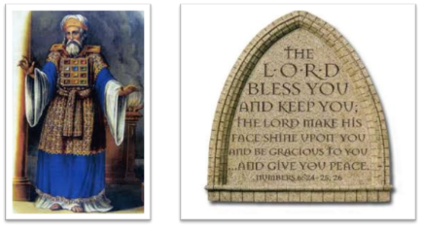
²⁴ The Lord bless you, and keep you; ²⁵ The Lord make His face shine on you, And be gracious to you; ²⁶ The Lord lift up His countenance on you, And give you peace.
Numbers 6:24–26 (NASB95)

