Slide 1

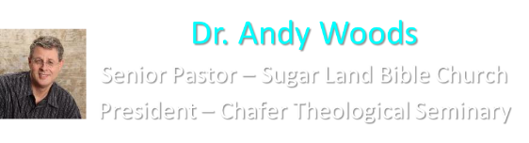

Slide 2

EXODUS STRUCTURE/OUTLINE
Redemption (1–18)
  Redemption (1:1–12:30)
  Liberation (12:31–15:21)
  Preservation (15:22–18:27)
Mosaic Covenant (19–40)
  Law (19–24)
  Tabernacle instructions (25–31)
  Apostasy (32–34)
  Tabernacle building (35–40)

Slide 3
REDEMPTION
(1:1–12:30)
Why redemption is necessary (Exod 1)
Development of the deliverer (Exod 2–4)
First confrontation with Pharaoh (Exod 5)
God reassures Moses (Exod 6:1–7:7)
Second confrontation with Pharaoh (Exod 7:18-13)
Plagues (Exod 7:14–12:30)

Slide 4
THREE PHASES OF MOSES’ 120 YEAR LIFE
LIFE PHASE | SCRIPTURE | YEARS | AGE | ACTIVITY
Natural Training | Acts 7:23 | 1526–1486 B.C. | 1-40 | Egyptian Education
Spiritual Training | Exod. 7:7 | 1486–1446 B.C. | 40-80 | Midian Shepherding
Ministry | Deut. 31:2; 34:7; Acts 7:36 | 1446–1406 B.C. | 80-120 | Exodus, Law, Wilderness Preservation, Pentateuch Authorship

Slide 5
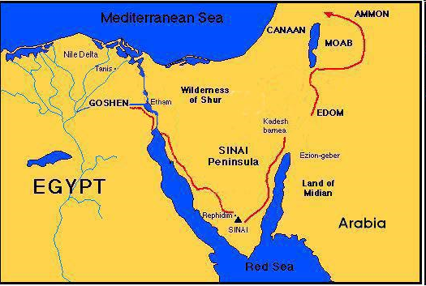

Slide 6
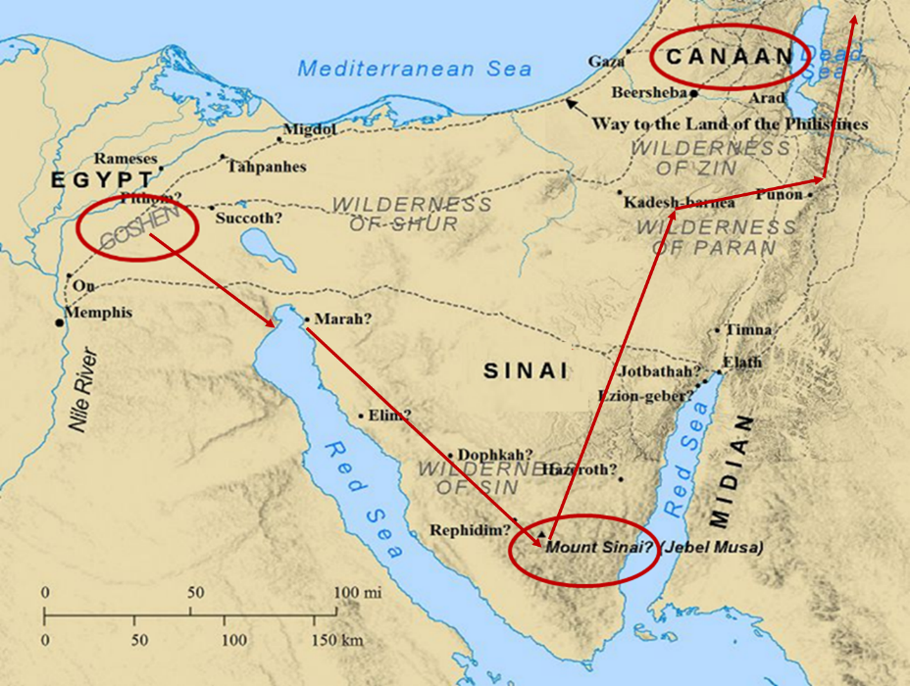

Slide 7
MOSES’ CALLING
Exodus 4:1-31
  Third objection (1-9)
  Fourth objection (10-12)
  Fifth objection (13-17)
  Moses returns to Egypt (18-20)
  God to harden Pharaoh (21-23)
  Moses refusal to circumcise Gershom (24-26)
  Moses’ meetings (27-31)

Slide 8
MOSES’ CALLING
Exodus 4:1-31
  Third objection (1-9)
  Fourth objection (10-12)
  Fifth objection (13-17)
  Moses returns to Egypt (18-20)
  God to harden Pharaoh (21-23)
  Moses refusal to circumcise Gershom (24-26)
  Moses’ meetings (27-31)

Slide 9
I. Exodus 4:1-9
Third Objection
    Objection: Israel will not believe (1)
    Response: proofs (2-9)

Slide 10
I. Exodus 4:1-9
Third Objection
    Objection: Israel will not believe (1)
    Response: proofs (2-9)

Slide 11
I. Exodus 4:1-9
Third Objection
    Objection: Israel will not believe (1)
    Response: proofs (2-9)

Slide 12
Exodus 4:2-9
Proofs
      1st proof (2-5)
      2nd proof (6-8)
      3rd proof (9)

Slide 13
Exodus 4:2-9
Proofs
      1st proof (2-5)
      2nd proof (6-8)
      3rd proof (9)

Slide 14

Evidence of Abrahamic Covenant’s Unconditional Nature
ANE covenant ratification ceremony (Gen 15)
Lack of stated conditions for Israel’s obedience (Gen 15)
Covenant's eternality (Gen 17:7, 13, 19; Ps. 90:2)
Covenant's immutability (Heb 6:13-18; Mal. 3:6)
Trans-generational reaffirmation despite perpetual national disobedience (Jer 31:35-37)
Walvoord, The Millennial Kingdom, 149-52

Slide 15

Land Promises Fulfilled in the Time of Joshua (Josh. 11:23; 21:43-45) or Solomon (1 Kgs. 4:21)?
Extended context (Josh 13:1-7; Judges 1:19, 21, 27, 29, 30-36)
Land gained in conquest was only a fraction of what was promised (1 Kgs. 4:25)
Jerusalem not conquered in Joshua’s day (Josh 15:63; 2 Sam 5)
Solomon’s reign extended to the border of Egypt (1 Kgs. 4:21) and not the River of Egypt (Gen. 15:18)
Solomon’s reign was tributary only (1 Kgs. 4:21)
Forever? (Gen 17:7-8, 13, 19)
Reaffirmation of land promises long after Joshua and Solomon’s time (Amos 9:11-15)
Fruchtenbaum, Israelology, 521-22, 631-32

Slide 16
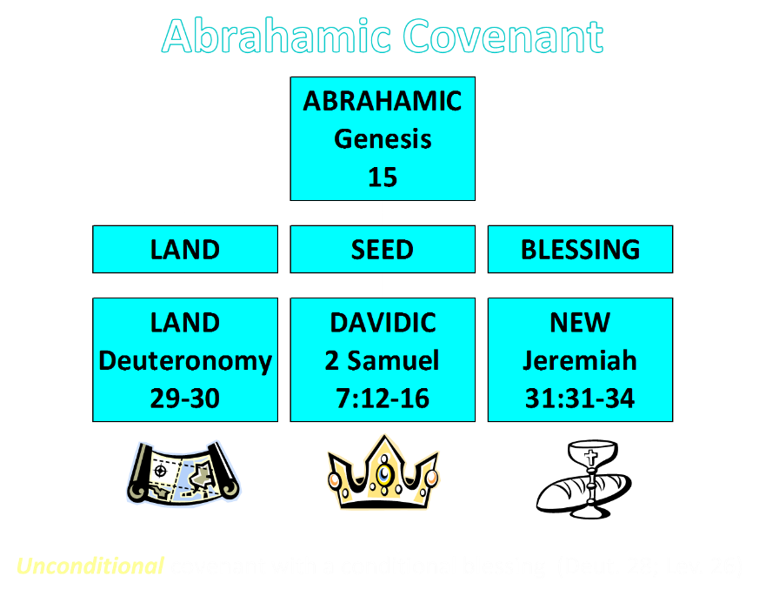

Slide 17
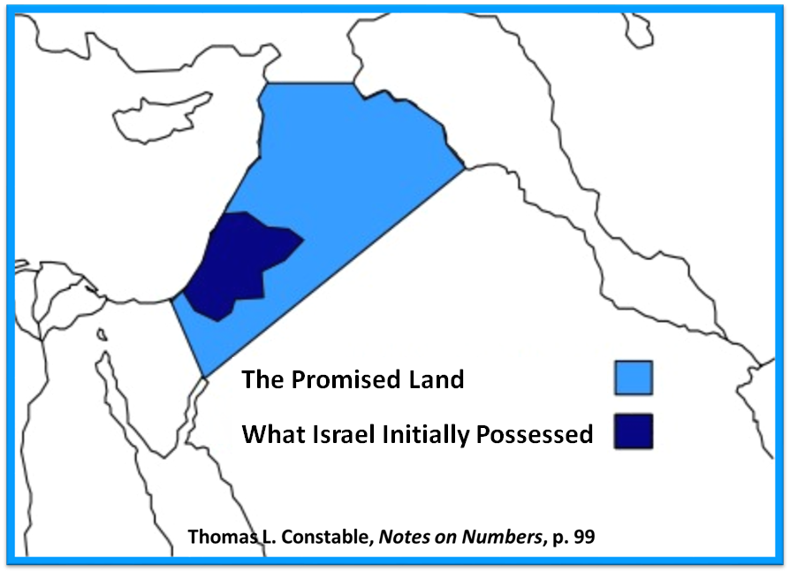

Slide 18
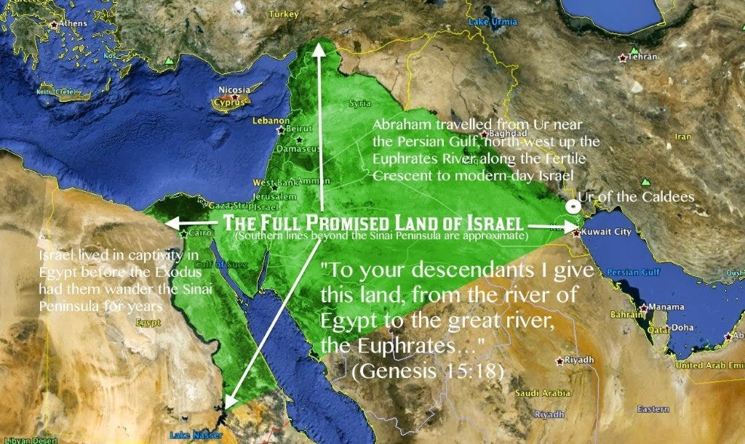

Slide 19
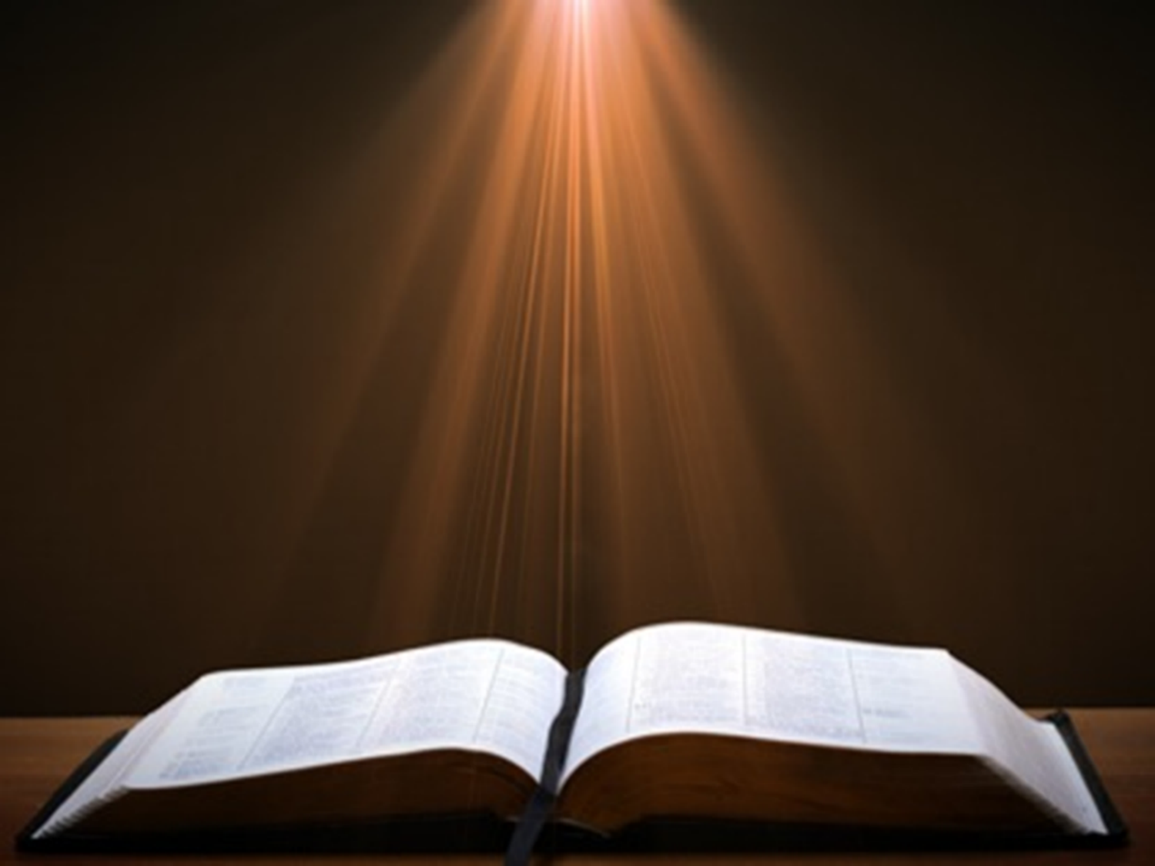
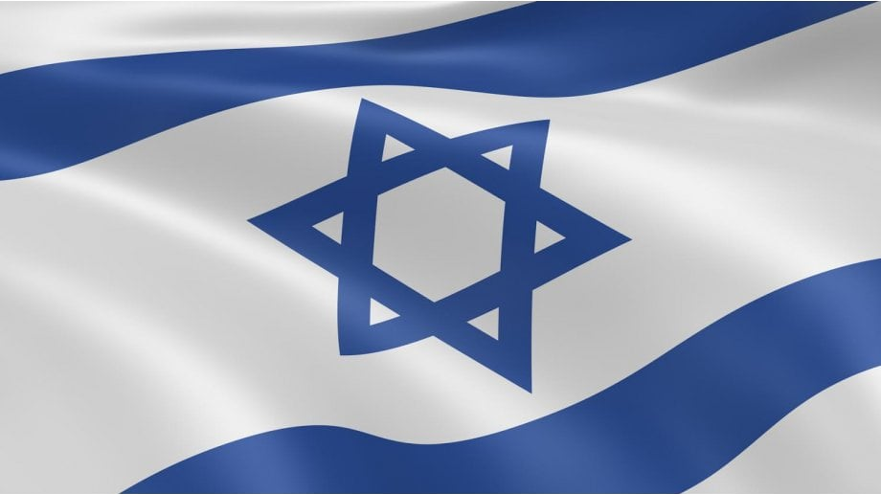
Exodus 2:24
“So, God heard their groaning; and God remembered His covenant with Abraham, Isaac, and Jacob.”

Slide 20
Exodus 4:2-9
Proofs
      1st proof (2-5)
      2nd proof (6-8)
      3rd proof (9)

Slide 21
Exodus 4:2-9
Proofs
      1st proof (2-5)
      2nd proof (6-8)
      3rd proof (9)

Slide 22

Charles Ryrie
Ryrie Study Bible, page 95
Exodus 4:9 - “If Moses could turn the water of the Nile, considered the source of the prosperity of Egypt, into blood, a sign of death, surely his power over Pharaoh would be acknowledged.”

Slide 23
The Plagues of Egypt
NO. | DESCRIPTION | SCRIPTURE | Egyptian Deity
1. | Water to Blood | Exod. 7:14-25 | Hapi, Khnum
2. | Frogs | Exod. 8:1-15 | Heqt
3. | Gnats | Exod. 8:16-19 | Set
4. | Flies | Exod. 8:20-32 | Uatchit
5. | Disease on Cattle | Exod. 9:1-7 | Hathor, Apis
6. | Boils | Exod. 9:8-12 | Sekhmet, Serapis
7. | Hail | Exod. 9:13-35 | Seth, Nut
8. | Locusts | Exod. 10:1-20 | Seth, Nut, Osiris
9. | Darkness | Exod. 10:21-29 | Re, Horus, Atum
10. | Death of the First Born | Exod. 12:29-36 | Min, Osiris, Heqt, Isis

Slide 24
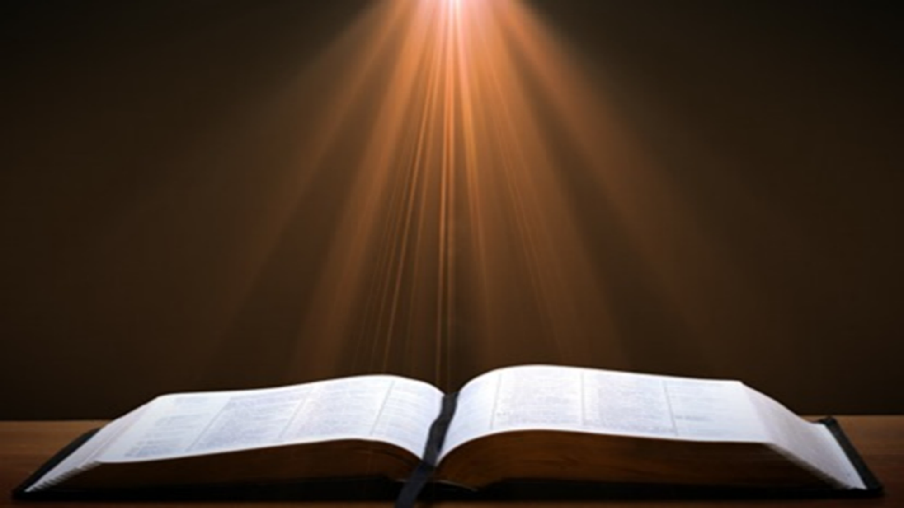
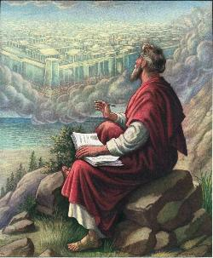
John 20:30-31
“Therefore, many other signs Jesus also performed in the presence of the disciples, which are not written in this book; but these have been written so that you may believe that Jesus is the Christ, the Son of God; and that believing you may have life in His name.”

Slide 25
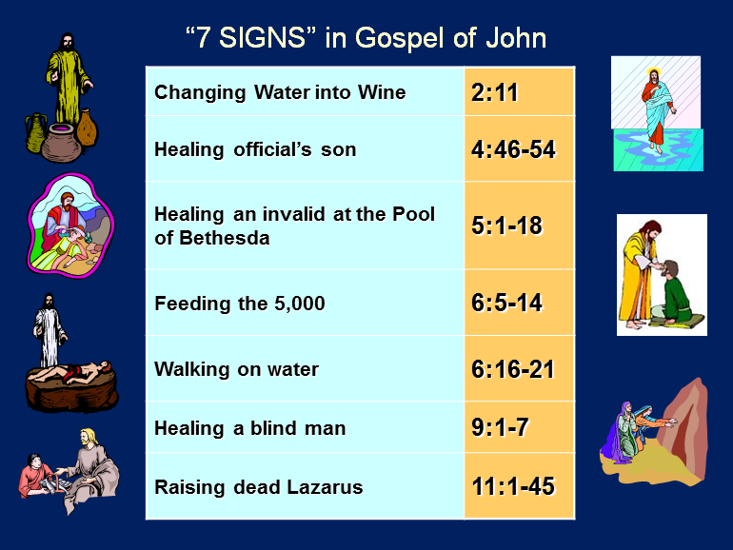

Slide 26
MOSES’ CALLING
Exodus 4:1-31
  Third objection (1-9)
  Fourth objection (10-12)
  Fifth objection (13-17)
  Moses returns to Egypt (18-20)
  God to harden Pharaoh (21-23)
  Moses refusal to circumcise Gershom (24-26)
  Moses’ meetings (27-31)

Slide 27
II. Exodus 4:10-12
Fourth Objection
    Objection: poor speaker (10)
    Response: God’s sovereignty (11-12)

Slide 28
II. Exodus 4:10-12
Fourth Objection
    Objection: poor speaker (10)
    Response: God’s sovereignty (11-12)

Slide 29
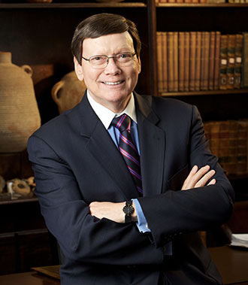
Dr. Ed Hindson
Hindson, E. E., & Mitchell, D. R., eds. (2010). King James Version Bible Commentary for Today: The Most Up-to-Date Commentary on the Time-Honored Text of the King James Version (p. 85). Thomas Nelson.
“4:10. Remarkably, Moses raised a fourth and final objection, bemoaning to the Lord that he was not a commanding speaker, being slow of speech, and of a slow tongue. In light of Stephen’s testimony of Moses’ abilities (Acts 7:22), it would seem that a speech impediment was not the flaw that Moses has in mind. Rather, it was a fear of intimidation before the Egyptian court and apprehension that he lacked commensurate eloquence and adequate fluency for the task.”

Slide 30
II. Exodus 4:10-12
Fourth Objection
    Objection: poor speaker (10)
    Response: God’s sovereignty (11-12)

Slide 32

Romans 8:19-23
¹⁹ For the anxious longing of the creation waits eagerly for the revealing of the sons of God. ²⁰ For the creation was subjected to futility, not willingly, but because of Him who subjected it, in hope ²¹ that the creation itself also will be set free from its slavery to corruption into the freedom of the glory of the children of God. ²² For we know that the whole creation groans and suffers the pains of childbirth together until now. ²³ And not only this, but also we ourselves, having the first fruits of the Spirit, even we ourselves groan within ourselves, waiting eagerly for our adoption as sons, the redemption of our body.”

Slide 33
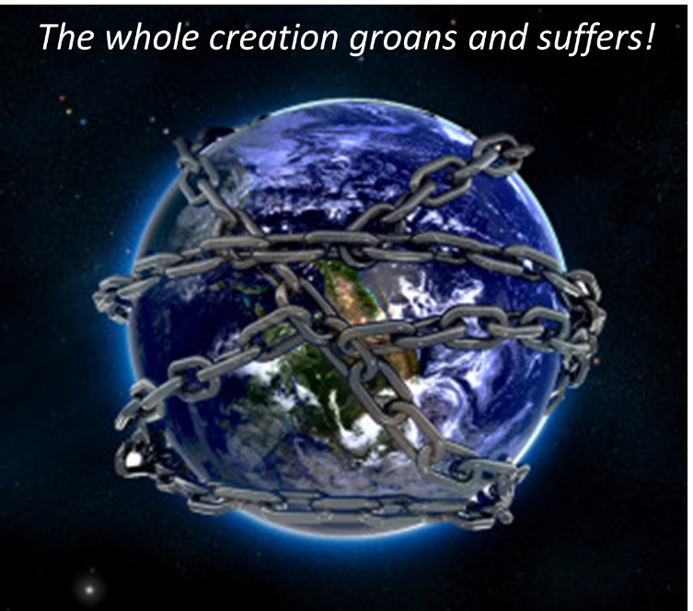

Slide 34
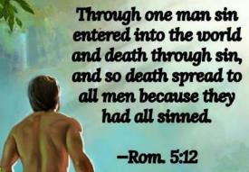
Genesis 3:19
“By the sweat of your face You will eat bread, Till you return to the ground, Because from it you were taken; For you are dust, And to dust you shall return.”

Slide 35
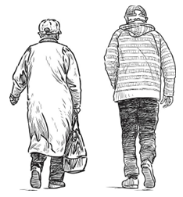
2 Corinthians 4:16
“Therefore, we do not lose heart, but though our outer man is decaying, yet our inner man is being renewed day by day.”

Slide 36
Uniformitarianism is not Biblicism
Era | Scripture | Distinctives
1. Creation | Gen. 1-2 | No death
2. Fall | Gen. 3-6 | Death, painful pregnancy & toil, long life spans, no human government
3. Flood | Gen. 7-10 | Shorter life spans, one language, no nations, human government
4. Babel | Gen. 11-present | No global government, multiple languages, nations, ethnicities

Slide 37
Uniformitarianism is not Biblicism
Era | Scripture | Distinctives
5. Antichrist | Rapture to 2nd Advent | Global government, restrainer removed
6. Kingdom | Rev. 20:1-10 | Long life spans, kingdom conditions, reality of death, renovated earth
7. Eternal State | Rev. 21-22 | No death, new earth

Slide 38
MOSES’ CALLING
Exodus 4:1-31
  Third objection (1-9)
  Fourth objection (10-12)
  Fifth objection (13-17)
  Moses returns to Egypt (18-20)
  God to harden Pharaoh (21-23)
  Moses refusal to circumcise Gershom (24-26)
  Moses’ meetings (27-31)

Slide 39
III. Exodus 4:13-17
Fifth Objection
    Objection: send another (13)
    Response: Aaron as spokesman (14-17)

Slide 40
III. Exodus 4:13-17
Fifth Objection
    Objection: send another (13)
    Response: Aaron as spokesman (14-17)

Slide 41
Dr. Ed Hindson
Hindson, E. E., & Mitchell, D. R., eds. (2010). King James Version Bible Commentary for Today: The Most Up-to-Date Commentary on the Time-Honored Text of the King James Version (p. 85). Thomas Nelson.
“4:13. …Ultimately, it came down to the fact that Moses simply did not care for the position being divinely offered and turned it down flat. He entreated the Lord to choose a replacement and send someone else.”

Slide 42
III. Exodus 4:13-17
Fifth Objection
    Objection: send another (13)
    Response: Aaron as spokesman (14-17)

Slide 43
Dr. Ed Hindson
Hindson, E. E., & Mitchell, D. R., eds. (2010). King James Version Bible Commentary for Today: The Most Up-to-Date Commentary on the Time-Honored Text of the King James Version (p. 85). Thomas Nelson.
“4:14. The anger of the Lord was kindled. At this response from Moses, the Lord’s patience finally ran out with His servant, and He lost his temper. No more gentle, reassuring answers were forthcoming.”

Slide 44
Dr. Ed Hindson
Hindson, E. E., & Mitchell, D. R., eds. (2010). King James Version Bible Commentary for Today: The Most Up-to-Date Commentary on the Time-Honored Text of the King James Version (p. 85-86). Thomas Nelson.
“4:15–16. The Lord answered Moses’ request by bringing a third party into the equation, Moses’ brother, Aaron. God begrudgingly indulged Moses’ reluctance to expound the divine message. Although Moses was commissioned to serve as God’s mouthpiece, Aaron was likewise commissioned to be Moses’ mouthpiece. A three-way system was arranged whereby God would first speak to Moses. Moses would then convey the divine will to Aaron. Finally, Aaron would then publicly broadcast the message.”

Slide 45
MOSES’ CALLING
Exodus 4:1-31
  Third objection (1-9)
  Fourth objection (10-12)
  Fifth objection (13-17)
  Moses returns to Egypt (18-20)
  God to harden Pharaoh (21-23)
  Moses refusal to circumcise Gershom (24-26)
  Moses’ meetings (27-31)

Slide 46
IV. Exodus 4:18-20
Moses Returns to Egypt
    Jethro’s permission (18)
    God’s comfort (19)
    Moses’ return (20)

Slide 47
IV. Exodus 4:18-20
Moses Returns to Egypt
    Jethro’s permission (18)
    God’s comfort (19)
    Moses’ return (20)

Slide 48


Slide 49
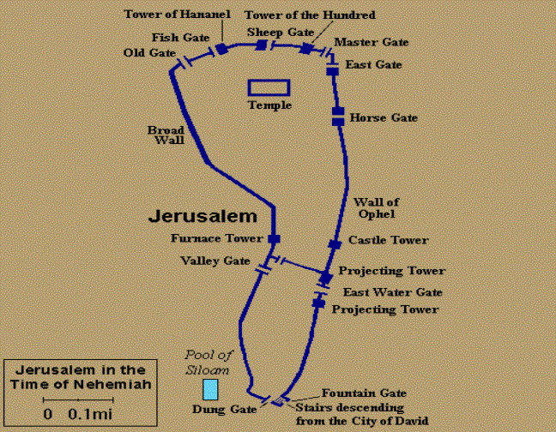
GATES OF NEHEMIAH

Slide 50
IV. Exodus 4:18-20
Moses Returns to Egypt
    Jethro’s permission (18)
    God’s comfort (19)
    Moses’ return (20)

Slide 51
DATE OF THE EXODUS
1446 b.c.
  Literal numbers
  Oppression – Thutmose III
  Exodus – Amenhotep II

Slide 52
IV. Exodus 4:18-20
Moses Returns to Egypt
    Jethro’s permission (18)
    God’s comfort (19)
    Moses’ return (20)

Slide 53
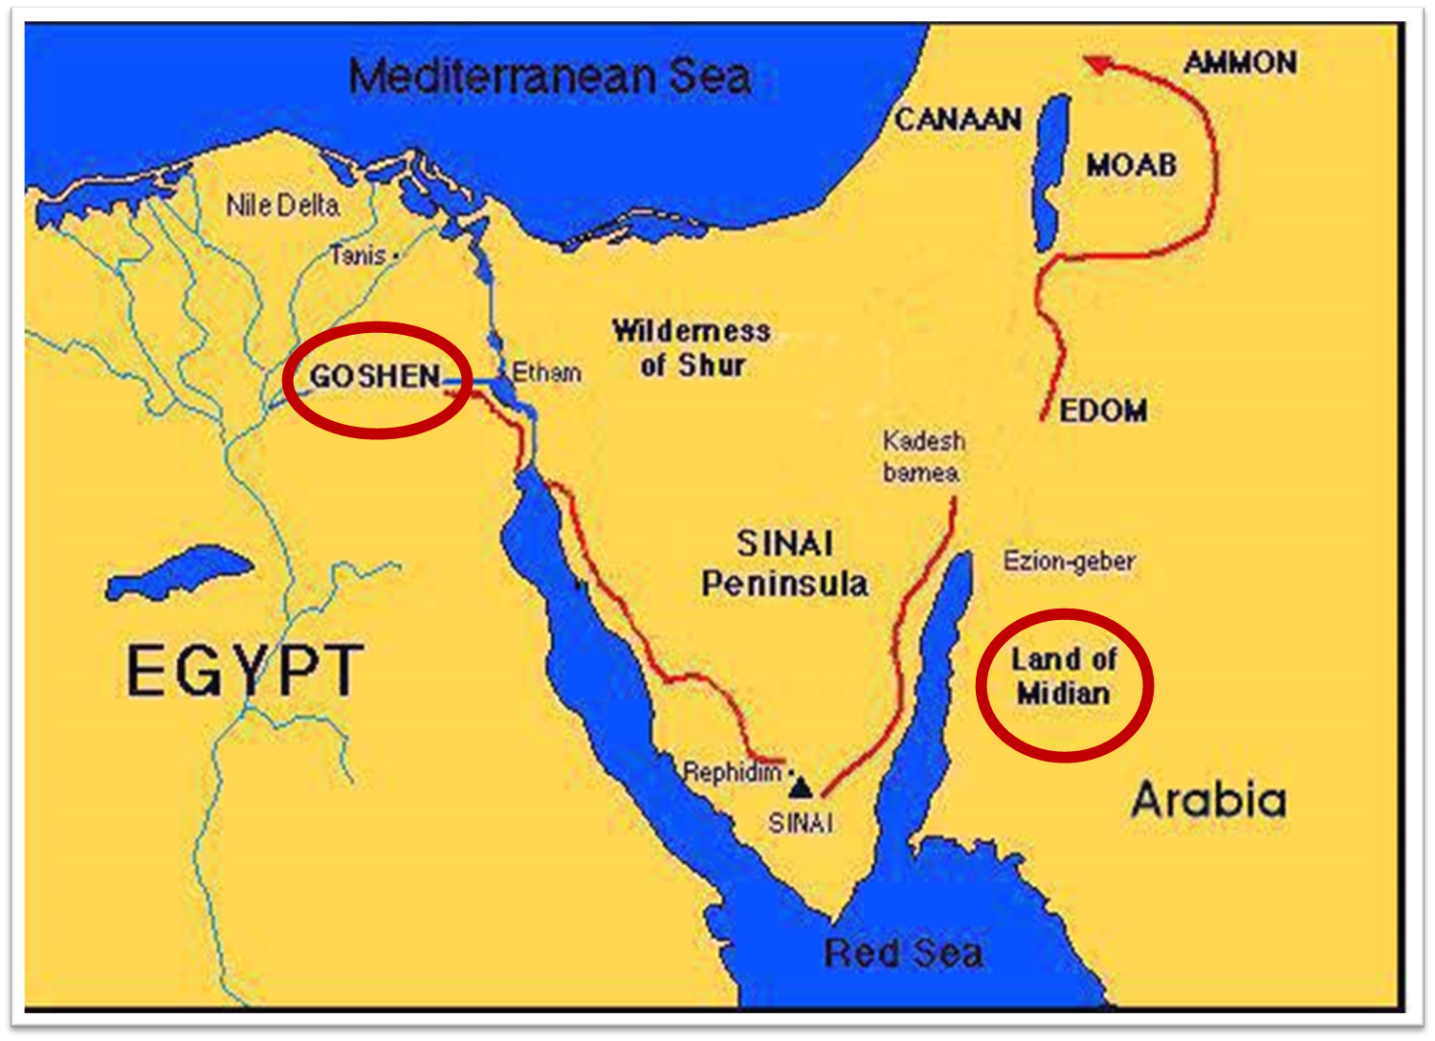

Slide 54
MOSES’ CALLING
Exodus 4:1-31
  Third objection (1-9)
  Fourth objection (10-12)
  Fifth objection (13-17)
  Moses returns to Egypt (18-20)
  God to harden Pharaoh (21-23)
  Moses refusal to circumcise Gershom (24-26)
  Moses’ meetings (27-31)

Slide 55
V. Exodus 4:21-23
God to Harden Pharaoh
    God’s hardening (21)
    Israel’s sonship (22)
    Covenant reciprocity (23)

Slide 56
V. Exodus 4:21-23
God to Harden Pharaoh
    God’s hardening (21)
    Israel’s sonship (22)
    Covenant reciprocity (23)

Slide 57
Charles Ryrie
Ryrie Study Bible, page 96
Exodus 4:21 - “harden his heart. Ten times it is said that Pharaoh hardened his own heart (7:13, 14, 22; 8:15, 19, 32; 9:7, 34, 35; 13:15), and 10 times that God hardened Pharaoh’s heart (4:21; 7:3; 9:12; 10:1, 20, 27; 11:10; 14:4, 8, 17). Paul uses this as an example of the inscrutable will of God and of His mercy toward men (Rom. 9:14–18). Seven times Pharaoh hardened his own heart before God first hardened it, though the prediction that God would do it preceded all.”

Slide 58
Dr. Ed Hindson
Hindson, E. E., & Mitchell, D. R., eds. (2010). King James Version Bible Commentary for Today: The Most Up-to-Date Commentary on the Time-Honored Text of the King James Version (p. 86). Thomas Nelson.
“4:21. I will harden his heart. An expression meaning ‘to strengthen his will.’ The text identifies the heart as the location of the volition, man’s decision-making ability. On seven occasions in the narrative, God hardens Pharaoh’s heart (9:12; 10:1, 20, 27; 11:10; 14:4, 8) or foretells that He will harden Pharaoh’s heart (4:21; 7:3), and nine times in the text, Pharaoh hardens his own heart (7:13, 14, 22; 8:15, 19, 32; 9:7, 34–35). For the initial five plagues, the text registers Pharaoh as the agent of hardening. Not until the sixth plague does God participate in the confirmation of Pharaoh’s own volitional choices.”

Slide 59
V. Exodus 4:21-23
God to Harden Pharaoh
    God’s hardening (21)
    Israel’s sonship (22)
    Covenant reciprocity (23)

Slide 60
V. Exodus 4:21-23
God to Harden Pharaoh
    God’s hardening (21)
    Israel’s sonship (22)
    Covenant reciprocity (23)

Slide 61
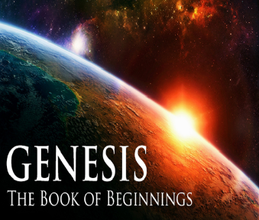
8 New Promises
Genesis 12:1-3
    Land (Gen. 12:1b)
    Great nation (Gen. 12:2a)
    Personal blessing (Gen. 12:2b)
    Great name (Gen. 12:2c)
    Blessing to others (Gen. 12:2d)
    Blessing to blessers (Gen. 12:3a)
    Cursing to cursers (Gen. 12:3b)
    Blessing to the world (Gen. 12:3c)

Slide 62

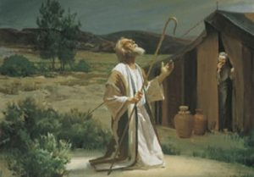
Genesis 12:3
“And I will bless those who bless you, And the one who curses you I will curse. And in you all the families of the earth will be blessed.”

Slide 64
The Plagues of Egypt
NO. | DESCRIPTION | SCRIPTURE | Egyptian Deity
1. | Water to Blood | Exod. 7:14-25 | Hapi, Khnum
2. | Frogs | Exod. 8:1-15 | Heqt
3. | Gnats | Exod. 8:16-19 | Set
4. | Flies | Exod. 8:20-32 | Uatchit
5. | Disease on Cattle | Exod. 9:1-7 | Hathor, Apis
6. | Boils | Exod. 9:8-12 | Sekhmet, Serapis
7. | Hail | Exod. 9:13-35 | Seth, Nut
8. | Locusts | Exod. 10:1-20 | Seth, Nut, Osiris
9. | Darkness | Exod. 10:21-29 | Re, Horus, Atum
10. | Death of the First Born | Exod. 12:29-36 | Min, Osiris, Heqt, Isis

Slide 65
MOSES’ CALLING
Exodus 4:1-31
  Third objection (1-9)
  Fourth objection (10-12)
  Fifth objection (13-17)
  Moses returns to Egypt (18-20)
  God to harden Pharaoh (21-23)
  Moses refusal to circumcise Gershom (24-26)
  Moses’ meetings (27-31)

Slide 66
VI. Exodus 4:24-26
Moses’ Refusal to Circumcise
  God’s anger (24)
  Zipporah’s action (25-26)

Slide 67
VI. Exodus 4:24-26
Moses’ Refusal to Circumcise
  God’s anger (24)
  Zipporah’s action (25-26)

Slide 68
Genesis 12‒25
Abraham’s Early Journeys
Unconditional promises (Gen. 12:1-3) From Haran to Canaan (Gen. 12:4-5) In Canaan (Gen. 12:6-9) In Egypt (Gen. 12:10-20) Abram and Lot Separate (Gen. 13:1-13) Reaffirmation of Abram’s promises (Gen. 13:14-18) Abram Rescues Lot (14:1-24) Abrahamic Covenant (15:1-21) Hagar & Ishmael (16:1-16) Circumcision (Gen. 17:1-27) | Sodom & Gomorrah (Gen. 18‒19) Abraham & Abimelech (Gen. 20) Isaac’s birth (Gen. 21:1-7) Ishmael’s expulsion (21:8-21) Abraham & Abimelech’s covenant (21:22-34) Abraham sacrifices Isaac (22) Sarah’s death (23) Isaac’s marriage (24) Abraham & Keturah (25:1-6) Abraham’s death (25:7-11)

Slide 69
Dr. Ed Hindson
Hindson, E. E., & Mitchell, D. R., eds. (2010). King James Version Bible Commentary for Today: The Most Up-to-Date Commentary on the Time-Honored Text of the King James Version (p. 86). Thomas Nelson.
“4:24. Apparently, Moses failed to circumcise his second son, Eliezer, in violation of the Abrahamic covenant (Gen. 17:9–14). It would have been flagrantly inappropriate for God’s chosen representative, the deliverer of His people, not to comply with such a basic command, the very sign and symbol of the covenant relationship itself.”

Slide 70
VI. Exodus 4:24-26
Moses’ Refusal to Circumcise
  God’s anger (24)
  Zipporah’s action (25-26)

Slide 71
MOSES’ CALLING
Exodus 4:1-31
  Third objection (1-9)
  Fourth objection (10-12)
  Fifth objection (13-17)
  Moses returns to Egypt (18-20)
  God to harden Pharaoh (21-23)
  Moses refusal to circumcise Gershom (24-26)
  Moses’ meetings (27-31)

Slide 72
VII. Exodus 4:27-31
Moses’ Meetings
  With Aaron (27-28)
  With Israel’s leaders (29-31)

Slide 73
VII. Exodus 4:27-31
Moses’ Meetings
  With Aaron (27-28)
  With Israel’s leaders (29-31)

Slide 74
Exodus 4:27-28
With Aaron
      The meeting (27)
      The telling (28)

Slide 75
Exodus 4:27-28
With Aaron
      The meeting (27)
      The telling (28)

Slide 77
Exodus 4:27-28
With Aaron
      The meeting (27)
      The telling (28)

Slide 78

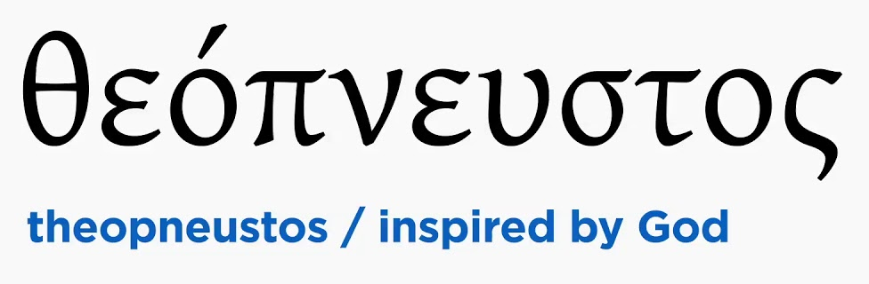
2 Timothy 3:16-17
“All Scripture is inspired by God [theopneustos] and profitable for teaching, for reproof, for correction, for training in righteousness; so that the man of God may be adequate, equipped for every good work.”

Slide 79
VII. Exodus 4:27-31
Moses’ Meetings
  With Aaron (27-28)
  With Israel’s leaders (29-31)

Slide 80
Exodus 4:29-31
With Israel’s Leaders
      Assembly (29)
      Proclamation (30)
      Response (31)

Slide 81
Exodus 4:29-31
With Israel’s Leaders
      Assembly (29)
      Proclamation (30)
      Response (31)

Slide 83
Exodus 4:29-31
With Israel’s Leaders
      Assembly (29)
      Proclamation (30)
      Response (31)

Slide 84
Exodus 4:30
The Proclamation
      Words (30a)
      Signs (30b)

Slide 85
Exodus 4:30
The Proclamation
      Words (30a)
      Signs (30b)

Slide 86
2 Timothy 3:16-17
“All Scripture is inspired by God [theopneustos] and profitable for teaching, for reproof, for correction, for training in righteousness; so that the man of God may be adequate, equipped for every good work.”

Slide 87
Exodus 4:30
The Proclamation
      Words (30a)
      Signs (30b)

Slide 88
Exodus 4:29-31
With Israel’s Leaders
      Assembly (29)
      Proclamation (30)
      Response (31)

Slide 89
Exodus 4:31
The Response
      Faith (31a)
      Worship (31b)

Slide 90
Exodus 4:31
The Response
      Faith (31a)
      Worship (31b)

Slide 92
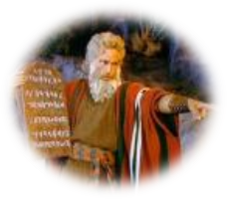
Exodus 14:30-31
³⁰ Thus the Lord saved Israel that day from the hand of the Egyptians, and Israel saw the Egyptians dead on the seashore. ³¹ When Israel saw the great power which the Lord had used against the Egyptians, the people feared the Lord, and they believed in the Lord and in His servant Moses.”

Slide 93
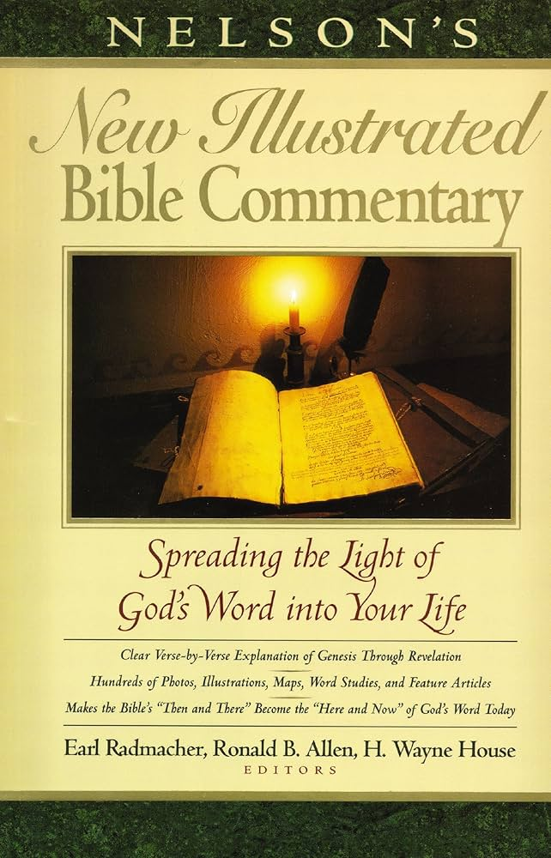
Exodus 14:31
“When we read so the people feared the Lord and the words that follow, we are meant to understand that the community had come to saving faith and so were a reborn people. They believed the Lord (the same wording used of Abraham’s saving faith in Gen. 15:6; read Paul’s comments in Rom. 4)…The people were transformed spiritually even as they were delivered physically.”
Nelson's New Illustrated Bible Commentary, 113.

Slide 94
Exodus 2:24
“So, God heard their groaning; and God remembered His covenant with Abraham, Isaac, and Jacob.”

Slide 95
Exodus 4:31
The Response
      Faith (31a)
      Worship (31b)

Slide 96
Conclusion

Slide 97
MOSES’ CALLING
Exodus 4:1-31
  Third objection (1-9)
  Fourth objection (10-12)
  Fifth objection (13-17)
  Moses returns to Egypt (18-20)
  God to harden Pharaoh (21-23)
  Moses refusal to circumcise Gershom (24-26)
  Moses’ meetings (27-31)

Slide 98
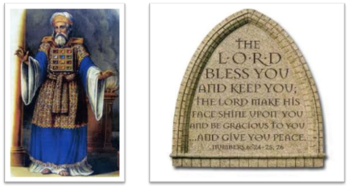
²⁴ The Lord bless you, and keep you; ²⁵ The Lord make His face shine on you, And be gracious to you; ²⁶ The Lord lift up His countenance on you, And give you peace.
Numbers 6:24–26 (NASB95)

