Slide 1
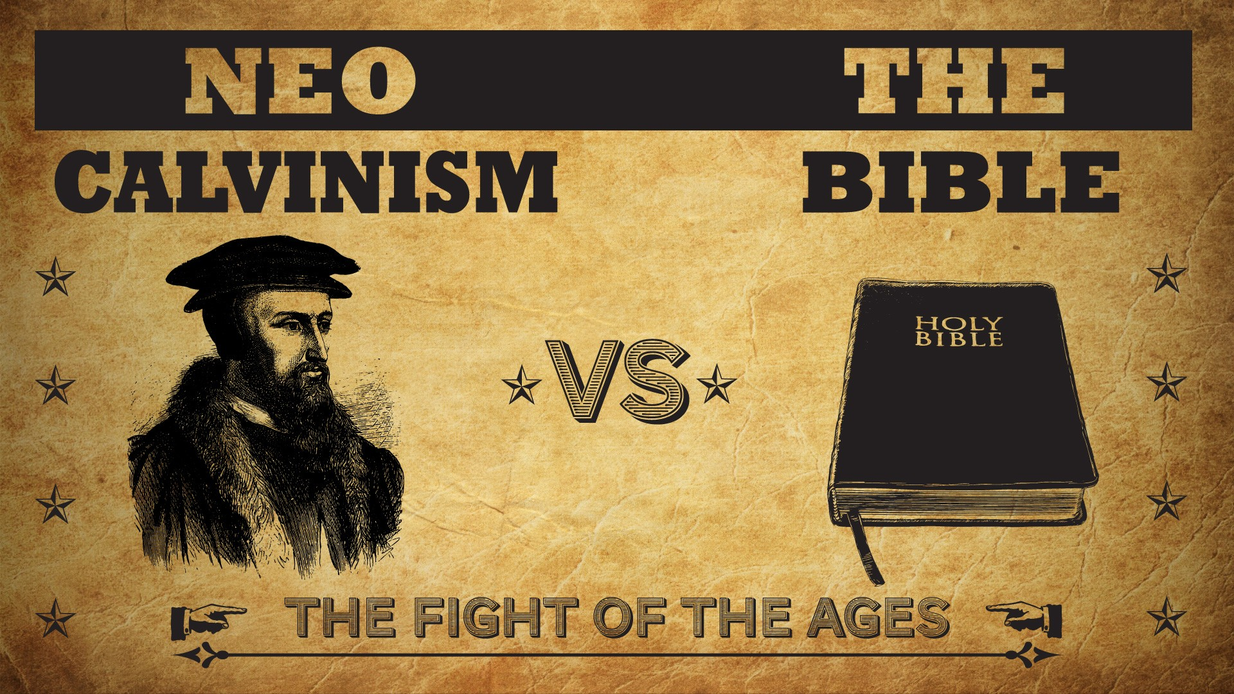


Slide 2
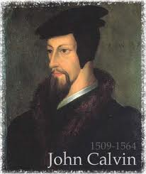
Neo-Calvinism vs. The Bible
Calvinism’s Mixed Blessing
Why Critique Calvinism?
The Source of Calvin’s Theology
Calvin’s Manner of Life
TULIP Through the Grid of Scripture
Conclusion

Slide 3
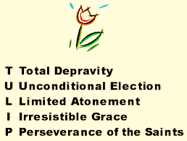
V. Running TULIP Through the Grid of Scripture
Total Depravity
Unconditional Election
Limited Atonement
Irresistible Grace
Perseverance of the Saints

Slide 4
Perseverance of the Saints
  Calvinistic definition
  Examples
  Problems with the Calvinistic understanding

Slide 5
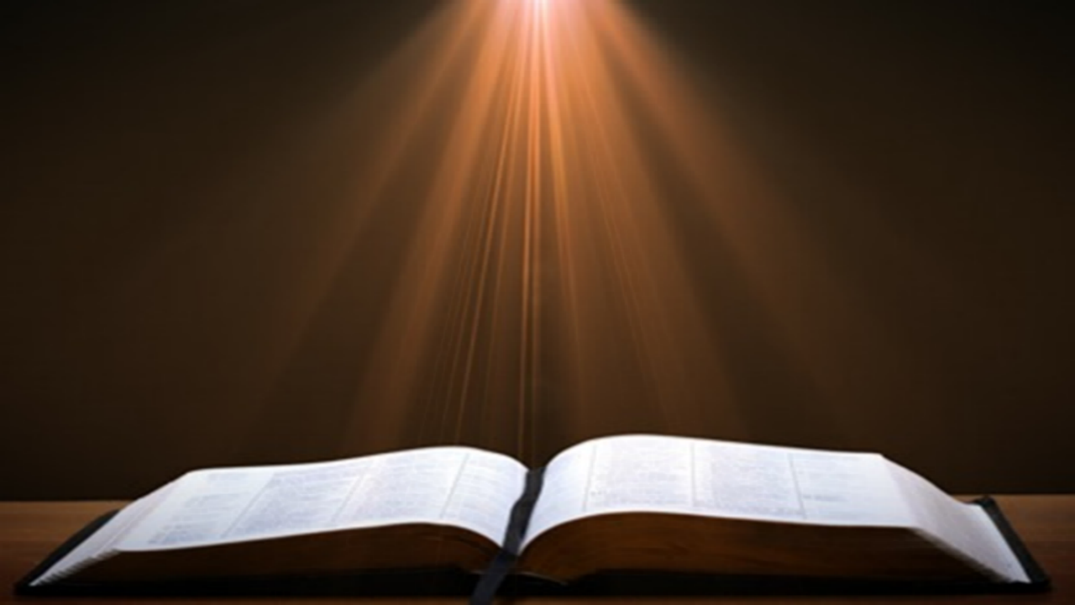
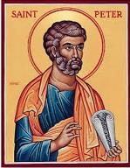
1 Peter 1:4-5
“to obtain an inheritance which is imperishable and undefiled and will not fade away, reserved in heaven for you, ⁵ who are protected by the power of God through faith for a salvation ready to be revealed in the last time.”

Slide 6
Perseverance of the Saints = Perseverance in Good Works to the End of One’s Life to Prove that He is One of the Elect
“P” stands for “Perseverance of the Saints.” This is what Calvinists say gives them the assurance of eternal security, but in actuality “the emphasis is upon the believer’s faithfulness in persevering—not upon God’s keeping power … uncertainty as to one’s ultimate salvation is, in fact, built into the very fabric of Calvinism itself.”
Bob Kirkland, Calvinism: None Dare Call It Heresy; Spotlight on the Life and Teachings of John Calvin (Eureka, MT: Lighthouse Trails, 2018), 34.

Slide 7
Perseverance of the Saints
  Calvinistic definition
  Examples
  Problems with the Calvinistic understanding

Slide 8

John Calvin
John Calvin, Calvin’s Calvinism: God’s Eternal Predestination and Secret Providence (Reformed Free Publishing Association, Kindle edition from the 2009 2nd edition), Kindle location 532.
Calvin said: “[T]hose who do not persevere unto the end belong not to the calling of God. The Fall of Adam was not by accident, nor by chance, but was ordained by the secret counsel of God.”

Slide 9
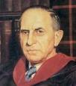
John Murray
Redemption Accomplished and Applied, pp. 152, 154-55, 165
“The crucial test of true faith is endurance to the end, abiding in Christ, and continuance in the Word…He cannot abandon himself to sin; he cannot come under the domination of sin; he cannot be guilty of certain kinds of unfaithfulness…Let us appreciate the doctrine of the perseverance of the saints and recognize that we may entertain the faith of our security in Christ only as we persevere in faith and holiness to the end...The perseverance of the saints reminds us very forcefully that only those who persevere to the end are truly saints.”
John Murray, Redemption Accomplished and Applied (Grand Rapids, MI: Eerdmans Publishing Co. 2015 edition), p. 152, 154-55, 165.

Slide 10
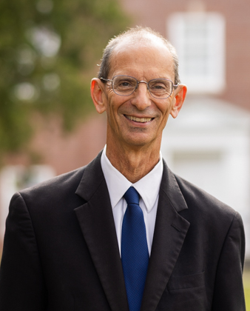
Thomas Schreiner
Thomas R. Schreiner, Faith Alone—The Doctrine of Justification (Grand Rapids: Zondervan, 2015), 191.
“The New Testament clearly teaches that bare faith cannot save and that works are necessary for final justification or final salvation.”

Slide 11
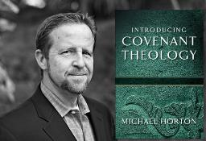
Without Personal Holiness No One Will See the Lord
“The New Testament lays before us a vast array of conditions for final salvation. Not only initial repentance and faith, but perseverance in both, demonstrated in love toward God and neighbor, are part of that holiness without which no one will see the lord (Hebrews 12:14)."
Horton, Michael. (2006). Introducing Covenant Theology (p. 182). Grand Rapids: Baker.

Slide 12
Perseverance of the Saints
  Calvinistic definition
  Examples
  Problems with the Calvinistic understanding

Slide 13
Problems with the Calvinistic Perseverance Definition
Final salvation is unbiblical
Scriptural examples of non-persevering saints
Support only found in out of context verses
Subtle form of works salvation
Preferability of immediate death following conversion?
Lessens the importance of practical sanctification
Lessens the importance of the Bema Seat warnings
Destroys the assurance of salvation

Slide 14


John 5:24
“Truly, truly, I say to you, he who hears My word, and believes Him who sent Me, has eternal life, and does not come into judgment, but has passed out of death into life.”

Slide 15

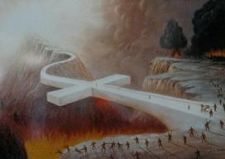
Genesis 15:6
“Then he believed in the Lord; and He reckoned [counted, to calculate, make a judgment, as in a past action] it to him as righteousness.”

Slide 16
Romans 3:28
“For we maintain that a man is justified by faith apart from works of the Law.”

Slide 17
Romans 5:1
“Therefore, having been justified by faith, we have peace with God through our Lord Jesus Christ.”

Slide 18
Theological Dictionary of the New Testament
“In Paul we first find...a legal use. The wicked are justified by faith on the basis of God’s gracious action in Christ. This justifying is a saving acquittal which takes place in the present…a present act of grace through Christ...Once-for-all justification at the cross and personal justification in faith go together. Justification is a finished work of grace...”
Gerhard Kittel and Gerhard Friedrich, eds., Theological Dictionary of the New Testament (Grand Rapids: Eerdmans, 1985), 175.

Slide 19

Henry Clarence Thiessen
“Justification is a declarative act. It is something not wrought in man, but something declared of man. It does not make upright or righteous, but declares righteous.”
Henry Clarence Thiessen, Lectures in Systematic Theology, rev. ed. (Grand Rapids: Eerdmans, 1979), 275.

Slide 20
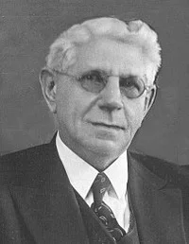
Louis Berkhof
"Justification is a judicial act of God, in which He declares, on the basis of the righteousness of Jesus Christ, that all the claims of the law are satisfied with respect to the sinner. It is unique in the application of the work of redemption in that it is a judicial act of God, a declaration respecting the sinner, and not an act or process of renewal, such as regeneration, conversion, and sanctification.”
Louis Berkhof, Systematic Theology: With a Complete Textual Index, 4th and rev. ed. (Grand Rapids: Eerdman's, 1932; reprint, Grand Rapids: Baker, 1996), 513.

Slide 21
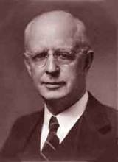
Lewis Sperry Chafer, Major Bible Themes: 52 Vital Doctrines of the Scripture Simplified and Explained, rev. ed. (Grand Rapids: Zondervan, 1974), 200.
Lewis Sperry Chafer
“God declares the one justified forever whom He sees in Christ. It is an equitable decree since the justified one is clothed in the righteousness of God. Justification is not a fiction or a state of feeling; it is rather an immutable reckoning in the mind of God.”

Slide 22
Problems with the Calvinistic Perseverance Definition
Final salvation is unbiblical
Scriptural examples of non-persevering saints
Support only found in out of context verses
Subtle form of works salvation
Preferability of immediate death following conversion?
Lessens the importance of practical sanctification
Lessens the importance of the Bema Seat warnings
Destroys the assurance of salvation

Slide 23
2 Timothy 4:7-8
“⁷ I have fought the good fight, I have finished the course, I have kept the faith; ⁸ in the future there is laid up for me the crown of righteousness, which the Lord, the righteous Judge, will award to me on that day; and not only to me, but also to all who have loved His appearing.”

Slide 24
Examples of Old Testament Non-Persevering Saints
Noah (Gen. 9:20-23; Heb. 11:7)
Lot (Gen. 13; 19; 2 Pet. 2:7-8)
Moses (Num. 20:11-12; Deut. 32:5; Matt. 17:1-3; Heb. 11:23-29; Rev. 11:6)
Exodus’ generation (Num. 13‒14; Heb. 11:29)
Samson (Judges 13‒16; Heb. 11:32)
Saul (1 Sam. 28; 31)
Solomon (1 Kgs. 11:4, 9-10)

Slide 25
Examples of Old Testament Non-Persevering Saints
Noah (Gen. 9:20-23; Heb. 11:7)
Lot (Gen. 13; 19; 2 Pet. 2:7-8)
Moses (Num. 20:11-12; Deut. 32:5; Matt. 17:1-3; Heb. 11:23-29; Rev. 11:6)
Exodus’ generation (Num. 13‒14; Heb. 11:29)
Samson (Judges 13‒16; Heb. 11:32)
Saul (1 Sam. 28; 31)
Solomon (1 Kgs. 11:4, 9-10)

Slide 26
Examples of Old Testament Non-Persevering Saints
Noah (Gen. 9:20-23; Heb. 11:7)
Lot (Gen. 13; 19; 2 Pet. 2:7-8)
Moses (Num. 20:11-12; Deut. 32:5; Matt. 17:1-3; Heb. 11:23-29; Rev. 11:6)
Exodus’ generation (Num. 13‒14; Heb. 11:29)
Samson (Judges 13‒16; Heb. 11:32)
Saul (1 Sam. 28; 31)
Solomon (1 Kgs. 11:4, 9-10)

Slide 27

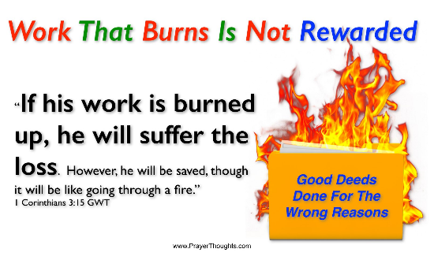
Genesis 19:22
“Hurry, escape there, for I cannot do anything until you arrive there.” Therefore the name of the town was called Zoar.”

Slide 28
2 Peter 2:7-9
“⁷ and if He rescued righteous Lot, oppressed by the sensual conduct of unprincipled men ⁸ (for by what he saw and heard that righteous man, while living among them, felt his righteous soul tormented day after day by their lawless deeds), ⁹ then the Lord knows how to rescue the godly from temptation, and to keep the unrighteous under punishment for the day of judgment.”

Slide 29
Examples of Old Testament Non-Persevering Saints
Noah (Gen. 9:20-23; Heb. 11:7)
Lot (Gen. 13; 19; 2 Pet. 2:7-8)
Moses (Num. 20:11-12; Deut. 32:5; Matt. 17:1-3; Heb. 11:23-29; Rev. 11:6)
Exodus’ generation (Num. 13‒14; Heb. 11:29)
Samson (Judges 13‒16; Heb. 11:32)
Saul (1 Sam. 28; 31)
Solomon (1 Kgs. 11:4, 9-10)

Slide 30
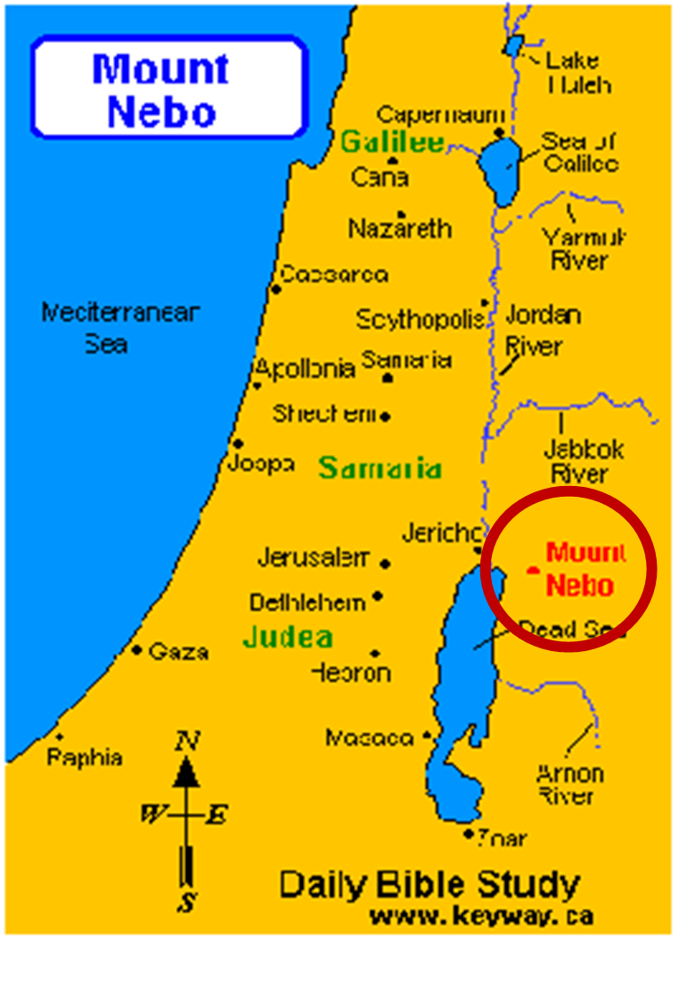

Slide 31
Examples of Old Testament Non-Persevering Saints
Noah (Gen. 9:20-23; Heb. 11:7)
Lot (Gen. 13; 19; 2 Pet. 2:7-8)
Moses (Num. 20:11-12; Deut. 32:5; Matt. 17:1-3; Heb. 11:23-29; Rev. 11:6)
Exodus’ generation (Num. 13‒14; Heb. 11:29)
Samson (Judges 13‒16; Heb. 11:32)
Saul (1 Sam. 28; 31)
Solomon (1 Kgs. 11:4, 9-10)

Slide 32
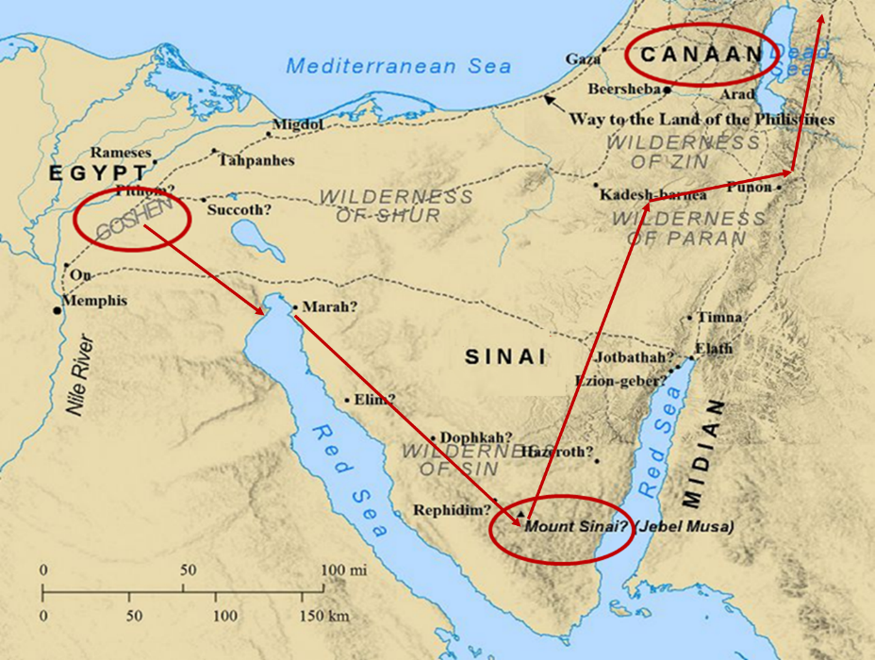

Slide 33
Examples of Old Testament Non-Persevering Saints
Noah (Gen. 9:20-23; Heb. 11:7)
Lot (Gen. 13; 19; 2 Pet. 2:7-8)
Moses (Num. 20:11-12; Deut. 32:5; Matt. 17:1-3; Heb. 11:23-29; Rev. 11:6)
Exodus’ generation (Num. 13‒14; Heb. 11:29)
Samson (Judges 13‒16; Heb. 11:32)
Saul (1 Sam. 28; 31)
Solomon (1 Kgs. 11:4, 9-10)

Slide 34
Examples of Old Testament Non-Persevering Saints
Noah (Gen. 9:20-23; Heb. 11:7)
Lot (Gen. 13; 19; 2 Pet. 2:7-8)
Moses (Num. 20:11-12; Deut. 32:5; Matt. 17:1-3; Heb. 11:23-29; Rev. 11:6)
Exodus’ generation (Num. 13‒14; Heb. 11:29)
Samson (Judges 13‒16; Heb. 11:32)
Saul (1 Sam. 28; 31)
Solomon (1 Kgs. 11:4, 9-10)

Slide 35
Examples of Old Testament Non-Persevering Saints
Noah (Gen. 9:20-23; Heb. 11:7)
Lot (Gen. 13; 19; 2 Pet. 2:7-8)
Moses (Num. 20:11-12; Deut. 32:5; Matt. 17:1-3; Heb. 11:23-29; Rev. 11:6)
Exodus’ generation (Num. 13‒14; Heb. 11:29)
Samson (Judges 13‒16; Heb. 11:32)
Saul (1 Sam. 28; 31)
Solomon (1 Kgs. 11:4, 9-10)

Slide 36
Examples of New Testament Non-Persevering Saints
Untrustworthy believers (John 2:23-25)
Non-confessing believers (John 12:42)
Ananias and Sapphira (Acts 5:1-11)
Simon the Sorcerer (Acts 8:13)
Immature believers at Corinth (1 Cor. 3:1-3)
Unrewarded believers at Corinth (1 Cor. 3:15)
Disciplined believers at Corinth (1 Cor. 11:27-32)
Demas (2 Tim. 4:10; Col. 4:14)
Immature believers in Hebrews (Heb. 5:11-14)
Seven churches in Asia Minor (Rev. 3:19)

Slide 37
Examples of New Testament Non-Persevering Saints
Untrustworthy believers (John 2:23-25)
Non-confessing believers (John 12:42)
Ananias and Sapphira (Acts 5:1-11)
Simon the Sorcerer (Acts 8:13)
Immature believers at Corinth (1 Cor. 3:1-3)
Unrewarded believers at Corinth (1 Cor. 3:15)
Disciplined believers at Corinth (1 Cor. 11:27-32)
Demas (2 Tim. 4:10; Col. 4:14)
Immature believers in Hebrews (Heb. 5:11-14)
Seven churches in Asia Minor (Rev. 3:19)

Slide 38
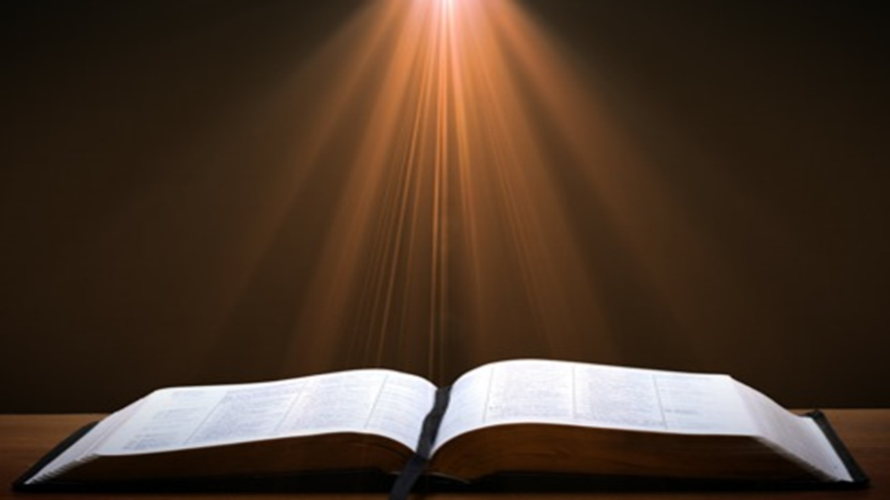
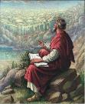
John 20:30-31
“Therefore many other signs Jesus also performed in the presence of the disciples, which are not written in this book; but these have been written so that you may believe that Jesus is the Christ, the Son of God; and that believing you may have life in His name.”

Slide 39
 | SALVATION | FRIENDSHIP
Condition | Faith | Obedience
Scripture | John 3:16 | John 15:14
Phase of Salvation | Justification | Sanctification

Slide 40
Examples of New Testament Non-Persevering Saints
Untrustworthy believers (John 2:23-25)
Non-confessing believers (John 12:42)
Ananias and Sapphira (Acts 5:1-11)
Simon the Sorcerer (Acts 8:13)
Immature believers at Corinth (1 Cor. 3:1-3)
Unrewarded believers at Corinth (1 Cor. 3:15)
Disciplined believers at Corinth (1 Cor. 11:27-32)
Demas (2 Tim. 4:10; Col. 4:14)
Immature believers in Hebrews (Heb. 5:11-14)
Seven churches in Asia Minor (Rev. 3:19)

Slide 41
John 20:30-31
“Therefore many other signs Jesus also performed in the presence of the disciples, which are not written in this book; but these have been written so that you may believe that Jesus is the Christ, the Son of God; and that believing you may have life in His name.”

Slide 42
Examples of New Testament Non-Persevering Saints
Untrustworthy believers (John 2:23-25)
Non-confessing believers (John 12:42)
Ananias and Sapphira (Acts 5:1-11)
Simon the Sorcerer (Acts 8:13)
Immature believers at Corinth (1 Cor. 3:1-3)
Unrewarded believers at Corinth (1 Cor. 3:15)
Disciplined believers at Corinth (1 Cor. 11:27-32)
Demas (2 Tim. 4:10; Col. 4:14)
Immature believers in Hebrews (Heb. 5:11-14)
Seven churches in Asia Minor (Rev. 3:19)

Slide 43
Examples of New Testament Non-Persevering Saints
Untrustworthy believers (John 2:23-25)
Non-confessing believers (John 12:42)
Ananias and Sapphira (Acts 5:1-11)
Simon the Sorcerer (Acts 8:13)
Immature believers at Corinth (1 Cor. 3:1-3)
Unrewarded believers at Corinth (1 Cor. 3:15)
Disciplined believers at Corinth (1 Cor. 11:27-32)
Demas (2 Tim. 4:10; Col. 4:14)
Immature believers in Hebrews (Heb. 5:11-14)
Seven churches in Asia Minor (Rev. 3:19)

Slide 44
Examples of New Testament Non-Persevering Saints
Untrustworthy believers (John 2:23-25)
Non-confessing believers (John 12:42)
Ananias and Sapphira (Acts 5:1-11)
Simon the Sorcerer (Acts 8:13)
Immature believers at Corinth (1 Cor. 3:1-3)
Unrewarded believers at Corinth (1 Cor. 3:15)
Disciplined believers at Corinth (1 Cor. 11:27-32)
Demas (2 Tim. 4:10; Col. 4:14)
Immature believers in Hebrews (Heb. 5:11-14)
Seven churches in Asia Minor (Rev. 3:19)

Slide 45


Slide 46
Calvin said: “[W]hat they [the Christians at Corinth] had attained so far is nothing, unless they keep steadily on; because it is not enough that they once started off on the way of the Lord, if they do not make an effort to reach the goal.”
John Calvin
John Calvin, The First Epistle of Paul the Apostle to the Corinthians (Grand Rapids, MI: Eerdmans Publishing Company, 1960), p. 197.

Slide 47
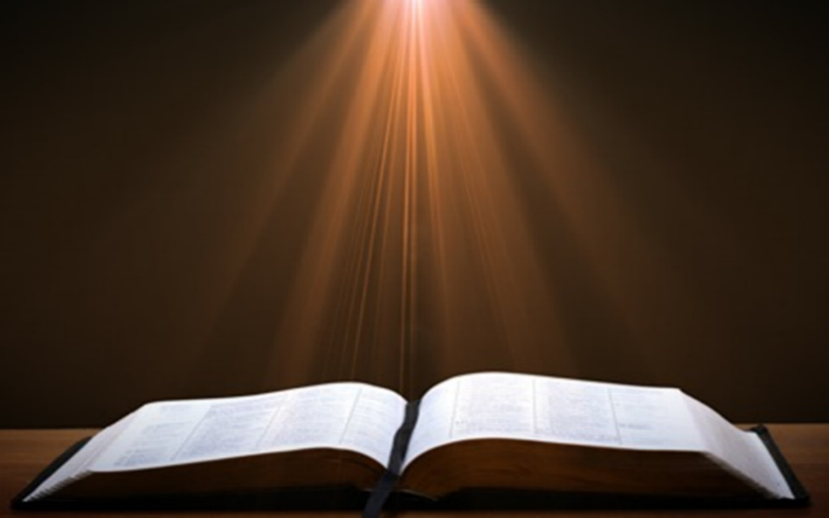
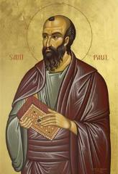
1 Corinthians 1:2
“To the church of God that is in Corinth, to those sanctified in Christ Jesus, called to be saints together with all those who in every place call upon the name of our Lord Jesus Christ, both their Lord and ours.”

Slide 48
2 Corinthians 1:1
"To the church of God that is at Corinth, with all the saints who are in the whole of Achaia."

Slide 49
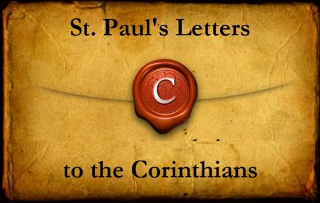
The Corinthians' Assumed Believing Status
1 Corinthians – 1:2; 3:1, 5, 6:11, 19-20
2 Corinthians – 1:1, 21-22, 24; 3:2-3; 6:14-16; 8:9; 10:15

Slide 50

1 Corinthians 3:1-3 (NKJV)
¹ And I, brethren, could not speak to you as to spiritual people but as to carnal, as to babes in Christ. ² I fed you with milk and not with solid food; for until now you were not able to receive it, and even now you are still not able; ³ for you are still carnal. For where there are envy, strife, and divisions among you, are you not carnal and behaving like mere men?

Slide 51
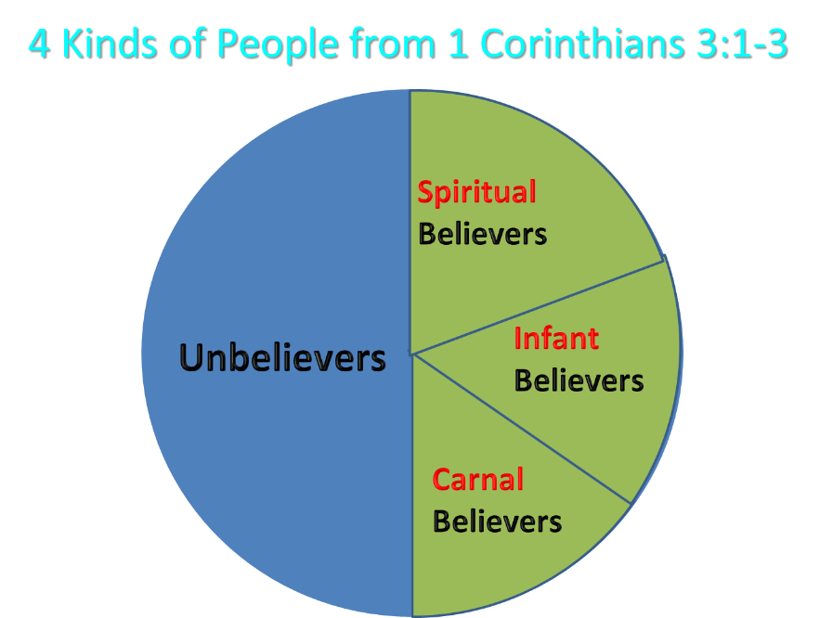
Notes:
Ray Steadman – “1st Californians”
Unbelievers vs Categories of Believers
Unbelievers – ψυχικός psuchikós; Natural, pertaining to the natural as distinguished from the spiritual
Spiritual Believers – πνευματικός pneumatikós; of persons who are spiritual, enlightened by the Holy Spirit
Infant Believers – σάρκινος sárkinos; with propensities of the flesh unto sin; νήπιος nḗpios; an infant, child, baby without any definite limitation of age. (This relates to immaturity and lack of instruction)
Carnal Believers – σαρκικός sarkikós; tendency to satisfy the flesh, implying sinfulness, sinful propensity, carnal (This relates to disobedience and open rebellion)

Slide 52
Examples of New Testament Non-Persevering Saints
Untrustworthy believers (John 2:23-25)
Non-confessing believers (John 12:42)
Ananias and Sapphira (Acts 5:1-11)
Simon the Sorcerer (Acts 8:13)
Immature believers at Corinth (1 Cor. 3:1-3)
Unrewarded believers at Corinth (1 Cor. 3:15)
Disciplined believers at Corinth (1 Cor. 11:27-32)
Demas (2 Tim. 4:10; Col. 4:14)
Immature believers in Hebrews (Heb. 5:11-14)
Seven churches in Asia Minor (Rev. 3:19)

Slide 53

1 Corinthians 3:15
UNREWARDED BELIVERS
If any man’s work is burned up, he will suffer loss; but he himself will be saved, yet so as through fire.

Slide 54
Scripture’s Four Judgments
Name | Sheep and Goat | Judgment of the Jews | Bema Seat | Great White Throne
Scripture | Matt 25:31-46 | Ezek 20:33-44 | 1 Cor 3:10-15 | Rev 20:11-15
Place | Earth, Jerusalem | Earth, wilderness | Heaven | Earth
Audience | Gentile Tribulation survivors | Jewish Tribulation survivors | Church Age believers | All unsaved
When | After Tribulation | After Tribulation | After rapture | After Millennium
Purpose | Saved Gentiles enter kingdom | Saved Jews enter kingdom | Reward believers | Degree of punishment in hell
Evaluation | Treatment of Christ’s brethren | Passing under shepherd’s rod | Works taken through fire | Not in the book; judged by books

Slide 55

Dr. Robert R. Congdon
Robert R. Congdon, How Calvinism Serves Satan's Purposes (Greer, SC: Congdon Ministries International, 2014), 29.
“Most new Calvinist do not believe that Christ will return and reign on this earth for one thousand years, nor do they understand that those of the church age will return to rule with Him following a review time before His judgment seat or bema seat when our roles and responsibilities will be determined. Most Calvinists believe the Great White Throne judgment is for everyone of all ages and it will determine whether one is truly saved or not.”

Slide 56
Examples of New Testament Non-Persevering Saints
Untrustworthy believers (John 2:23-25)
Non-confessing believers (John 12:42)
Ananias and Sapphira (Acts 5:1-11)
Simon the Sorcerer (Acts 8:13)
Immature believers at Corinth (1 Cor. 3:1-3)
Unrewarded believers at Corinth (1 Cor. 3:15)
Disciplined believers at Corinth (1 Cor. 11:27-32)
Demas (2 Tim. 4:10; Col. 4:14)
Immature believers in Hebrews (Heb. 5:11-14)
Seven churches in Asia Minor (Rev. 3:19)

Slide 57
Examples of New Testament Non-Persevering Saints
Untrustworthy believers (John 2:23-25)
Non-confessing believers (John 12:42)
Ananias and Sapphira (Acts 5:1-11)
Simon the Sorcerer (Acts 8:13)
Immature believers at Corinth (1 Cor. 3:1-3)
Unrewarded believers at Corinth (1 Cor. 3:15)
Disciplined believers at Corinth (1 Cor. 11:27-32)
Demas (2 Tim. 4:10; Col. 4:14)
Immature believers in Hebrews (Heb. 5:11-14)
Seven churches in Asia Minor (Rev. 3:19)

Slide 58
Examples of New Testament Non-Persevering Saints
Untrustworthy believers (John 2:23-25)
Non-confessing believers (John 12:42)
Ananias and Sapphira (Acts 5:1-11)
Simon the Sorcerer (Acts 8:13)
Immature believers at Corinth (1 Cor. 3:1-3)
Unrewarded believers at Corinth (1 Cor. 3:15)
Disciplined believers at Corinth (1 Cor. 11:27-32)
Demas (2 Tim. 4:10; Col. 4:14)
Immature believers in Hebrews (Heb. 5:11-14)
Seven churches in Asia Minor (Rev. 3:19)

Slide 59
Examples of New Testament Non-Persevering Saints
Untrustworthy believers (John 2:23-25)
Non-confessing believers (John 12:42)
Ananias and Sapphira (Acts 5:1-11)
Simon the Sorcerer (Acts 8:13)
Immature believers at Corinth (1 Cor. 3:1-3)
Unrewarded believers at Corinth (1 Cor. 3:15)
Disciplined believers at Corinth (1 Cor. 11:27-32)
Demas (2 Tim. 4:10; Col. 4:14)
Immature believers in Hebrews (Heb. 5:11-14)
Seven churches in Asia Minor (Rev. 3:19)

Slide 60
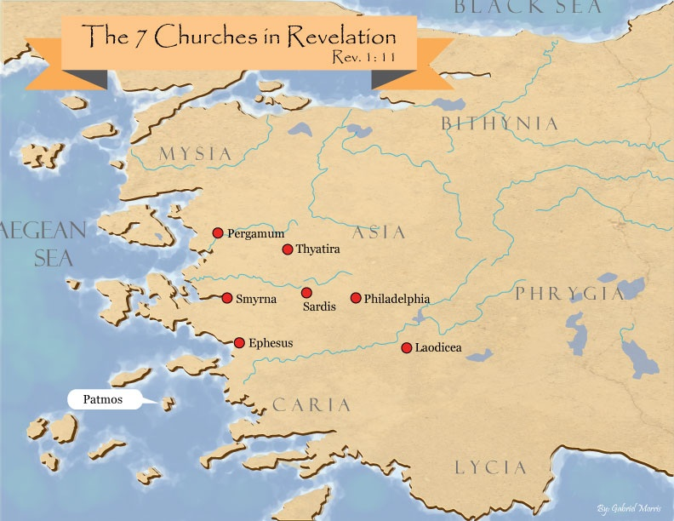
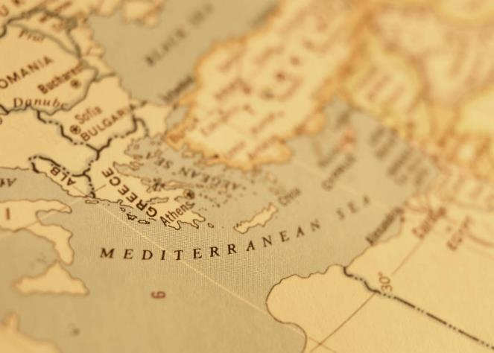

Slide 62

Revelation 3:19
“Those whom I love, I reprove and discipline; therefore be zealous and repent.”

Slide 63
Problems with the Calvinistic Perseverance Definition
Final salvation is unbiblical
Scriptural examples of non-persevering saints
Support only found in out of context verses
Subtle form of works salvation
Preferability of immediate death following conversion?
Lessens the importance of practical sanctification
Lessens the importance of the Bema Seat warnings
Destroys the assurance of salvation

Slide 64
Out of Context Verses Used to Support the Perseverance of the Saints
Matthew 24:13
John 15:5-6, 8
2 Corinthians 13:5
Ephesians 2:10
Hebrews 12:14
Revelation 13:10
Revelation 14:12

Slide 65
Out of Context Verses Used to Support the Perseverance of the Saints
Matthew 24:13
John 15:5-6, 8
2 Corinthians 13:5
Ephesians 2:10
Hebrews 12:14
Revelation 13:10
Revelation 14:12

Slide 66
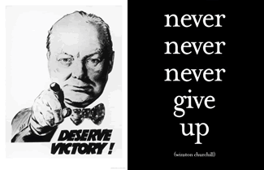
Matthew 24:13
“But the one who endures to the end, he will be saved.”

Slide 67
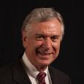
Dave Anderson
David R. Anderson, “The Soteriological Impact of Augustine’s Change from Premillennialism to Amillennialism: Part One,” Journal of the Grace Evangelical Society Volume 15, no. 28 (2002): 25.and Part Two is in no 29, Autumn, 2002.
“﻿...we chose Augustine as a case in point...Specifically, his reinterpretation of Matt 24:13 (‘he who endures to the end will be saved’) as a spiritual salvation instead of a physical salvation (to enter and populate the Millennium) caused drastic changes in his soteriology. Perseverance of the saints (faithfulness until the end of one’s physical life) became the sine qua non of his soteriology. One could believe in Christ, have the fruit of the elect, but prove he was not elect if he should not persevere in faithfulness until the end of his physical life.”

Slide 68

John MacArthur
Matthew 24‒25, The Macarthur New Testament Commentary (Chicago: Moody, 1989), 28.
"But the one who endures to the end, he shall be saved…his endurance will be a Spirit-empowered product and proof of the reality that he is saved. Neither the high cost of discipleship nor the deception of false prophets nor the enticement of sin will cause true believers to renounce Christ, because He Himself will protect them from defection. Endurance is always a mark of salvation…The perseverance of the saints in faith is a very basic element of salvation teaching in the New Testament. It states that people who are genuinely saved do not depart from the faith (see John 8: 31; 1 Cor. 15: 1-2; Col. 1: 21-23; Heb. 2: 1-3; 3: 14; 4: 14; 6: 11-12; 10: 39; 12: 14; James 1: 2-4)…Endurance…does give evidence of the spiritual life that resides in the believer...”

Slide 69

Matthew 24:15-16, 20
“¹⁵ Therefore when you see the abomination of desolation which was spoken of through Daniel the prophet, standing in the holy place (let the reader understand) ¹⁶ then those who are in Judea must flee to the mountains…²⁰ But pray that your flight will not be in the winter, or on a Sabbath.”

Slide 70
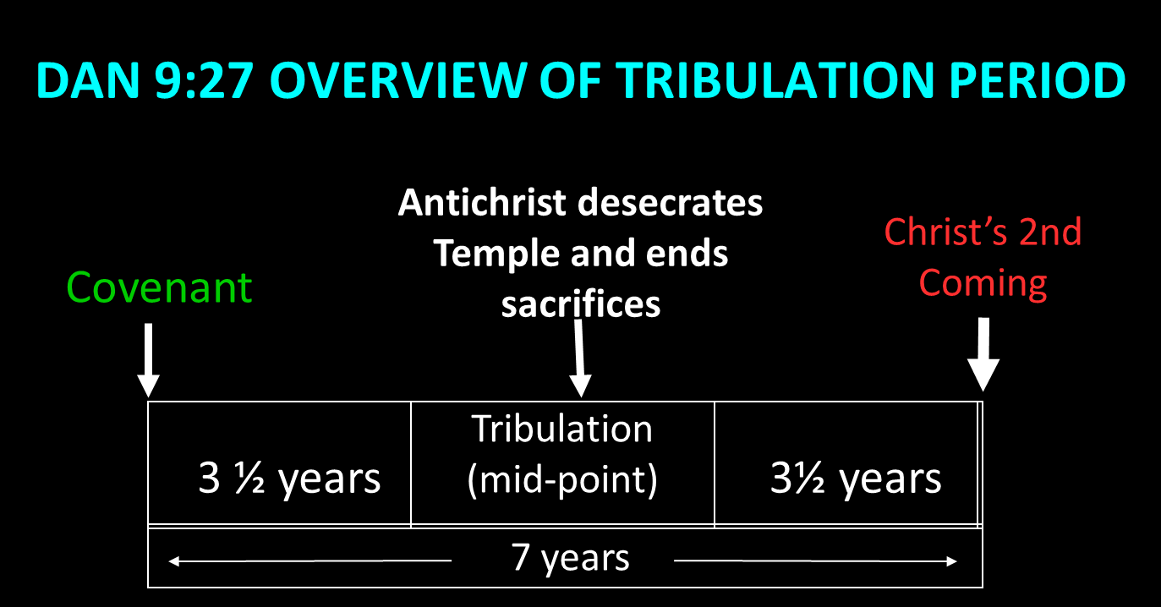

Slide 71

Daniel 9:24
Seventy weeks have been decreed for your people and your holy city, to finish the transgression, to make an end of sin, to make atonement for iniquity, to bring in everlasting righteousness, to seal up vision and prophecy and to anoint the most holy place.

Slide 72
Matthew 24:15-16, 20
“¹⁵ Therefore when you see the abomination of desolation which was spoken of through Daniel the prophet, standing in the holy place (let the reader understand) ¹⁶ then those who are in Judea must flee to the mountains…²⁰ But pray that your flight will not be in the winter, or on a Sabbath.”

Slide 73
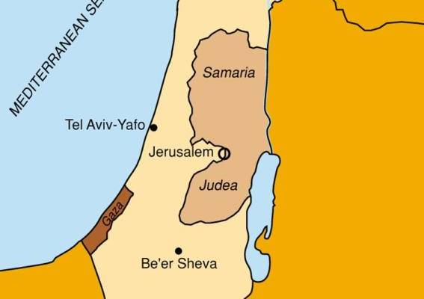

Slide 74
Matthew 24:15-16, 20
“¹⁵ Therefore when you see the abomination of desolation which was spoken of through Daniel the prophet, standing in the holy place (let the reader understand) ¹⁶ then those who are in Judea must flee to the mountains…²⁰ But pray that your flight will not be in the winter, or on a Sabbath.”

Slide 75
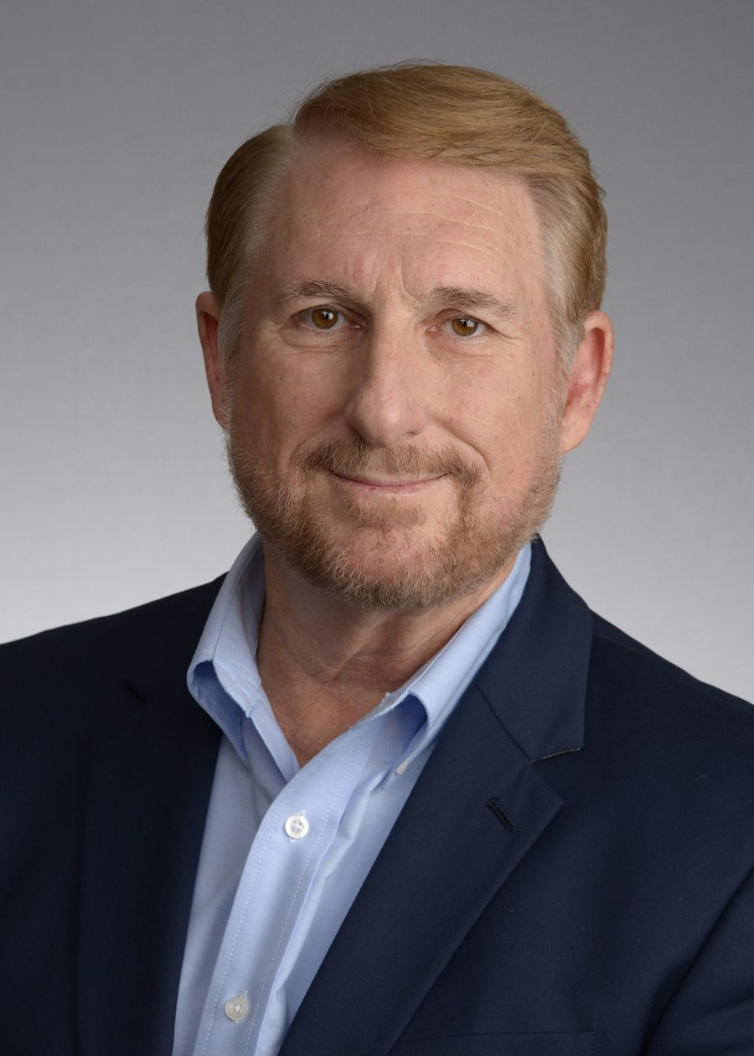
Randall Price
“Historical Problems with a First-Century Fulfillment of the Olivet Discourse,” in The End Times Controversy, ed. Tim LaHaye and Thomas Ice (Eugene, OR: Harvest, 2003), 394.
“…stormy weather comes with torrential rains that make crossing wadis in the Judean hills treacherous…concern about the possibility of travel on the Sabbath, where rabbinic law prohibited going more than a Sabbath day’s journey (i.e., beyond the immediate vicinity of the city)…”

Slide 76
Matthew 24:21-22
“²¹ For then there will be a great tribulation, such as has not occurred since the beginning of the world until now, nor ever will. ²² Unless those days had been cut short, no life would have been saved; but for the sake of the elect those days will be cut short.”

Slide 77
Isaiah 65:21-22
²¹ “They will build houses and inhabit them; They will also plant vineyards and eat their fruit.²² They will not build and another inhabit, They will not plant and another eat; For as the lifetime of a tree, so will be the days of My people, And My chosen ones will wear out the work of their hands.”

Slide 78
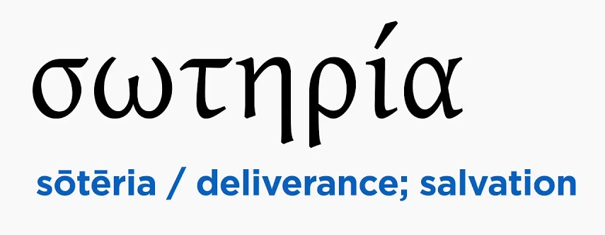
Philippians 1:19
for I know that this will turn out for my deliverance [sōtēria] through your prayers and the provision of the Spirit of Jesus Christ,

Slide 79
Hebrews 11:7
“By faith Noah, being warned by God about things not yet seen, in reverence prepared an ark for the salvation [sōtēria] of his household, by which he condemned the world, and became an heir of the righteousness which is according to faith.”

Slide 80
Out of Context Verses Used to Support the Perseverance of the Saints
Matthew 24:13
John 15:5-6, 8
2 Corinthians 13:5
Ephesians 2:10
Hebrews 12:14
Revelation 13:10
Revelation 14:12

Slide 81

John 15:6
“If anyone does not abide in Me, he is thrown away as a branch and dries up; and they gather them, and cast them into the fire and they are burned.”

Slide 82
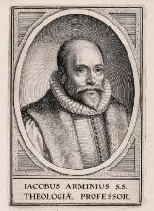
Context of John 15:5-6, 8
Context – John 15:1-8
Saved audience
  “In me” (John 15:2; 14:11)
  “Clean” (John 15:3; 13:10-11)
  Judas’ departure (John 13:29-31)
Abiding (vss. 4, 5, 7) and fruit bearing (vss. 2, 4, 5, 8, 16)
Men (not God) cast the branches into the fire (vs. 6)
“Fire” not always hell (1 Cor. 3:15; Heb. 6:8; 1 Pet. 1:6-7)
Pruning to bear more fruit (John 15:2; Heb. 12:5-11)

Slide 83
Context of John 15:5-6, 8
Context – John 15:1-8
Saved audience
  “In me” (John 15:2; 14:11)
  “Clean” (John 15:3; 13:10-11)
  Judas’ departure (John 13:29-31)
Abiding (vss. 4, 5, 7) and fruit bearing (vss. 2, 4, 5, 8, 16)
Men (not God) cast the branches into the fire (vs. 6)
“Fire” not always hell (1 Cor. 3:15; Heb. 6:8; 1 Pet. 1:6-7)
Pruning to bear more fruit (John 15:2; Heb. 12:5-11)

Slide 84
Context of John 15:5-6, 8
Context – John 15:1-8
Saved audience
  “In me” (John 15:2; 14:11)
  “Clean” (John 15:3; 13:10-11)
  Judas’ departure (John 13:29-31)
Abiding (vss. 4, 5, 7) and fruit bearing (vss. 2, 4, 5, 8, 16)
Men (not God) cast the branches into the fire (vs. 6)
“Fire” not always hell (1 Cor. 3:15; Heb. 6:8; 1 Pet. 1:6-7)
Pruning to bear more fruit (John 15:2; Heb. 12:5-11)

Slide 85
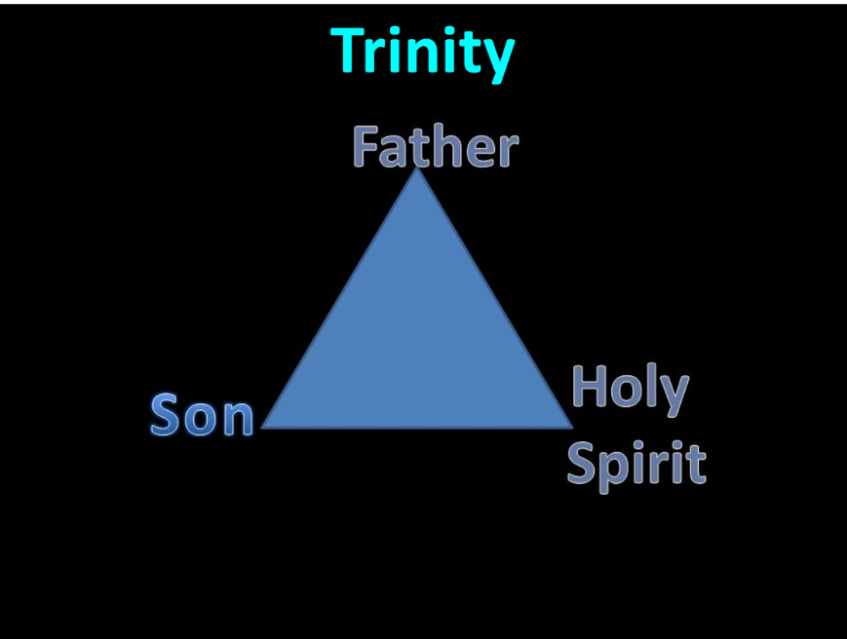

Slide 86
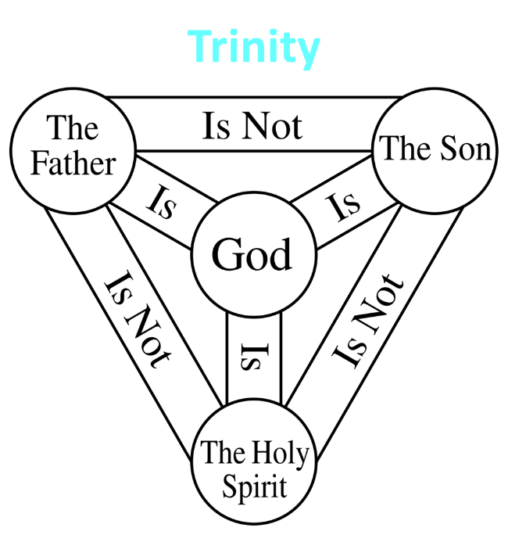

Slide 87
Context of John 15:5-6, 8
Context – John 15:1-8
Saved audience
  “In me” (John 15:2; 14:11)
  “Clean” (John 15:3; 13:10-11)
  Judas’ departure (John 13:29-31)
Abiding (vss. 4, 5, 7) and fruit bearing (vss. 2, 4, 5, 8, 16)
Men (not God) cast the branches into the fire (vs. 6)
“Fire” not always hell (1 Cor. 3:15; Heb. 6:8; 1 Pet. 1:6-7)
Pruning to bear more fruit (John 15:2; Heb. 12:5-11)

Slide 88
Context of John 15:5-6, 8
Context – John 15:1-8
Saved audience
  “In me” (John 15:2; 14:11)
  “Clean” (John 15:3; 13:10-11)
  Judas’ departure (John 13:29-31)
Abiding (vss. 4, 5, 7) and fruit bearing (vss. 2, 4, 5, 8, 16)
Men (not God) cast the branches into the fire (vs. 6)
“Fire” not always hell (1 Cor. 3:15; Heb. 6:8; 1 Pet. 1:6-7)
Pruning to bear more fruit (John 15:2; Heb. 12:5-11)

Slide 89
John 15:6
“If anyone does not abide in Me, he is thrown away as a branch and dries up; and they gather them, and cast them into the fire and they are burned.”

Slide 90
Context of John 15:5-6, 8
Context – John 15:1-8
Saved audience
  “In me” (John 15:2; 14:11)
  “Clean” (John 15:3; 13:10-11)
  Judas’ departure (John 13:29-31)
Abiding (vss. 4, 5, 7) and fruit bearing (vss. 2, 4, 5, 8, 16)
Men (not God) cast the branches into the fire (vs. 6)
“Fire” not always hell (1 Cor. 3:15; Heb. 6:8; 1 Pet. 1:6-7)
Pruning to bear more fruit (John 15:2; Heb. 12:5-11)

Slide 91
1 Corinthians 3:15
If any man’s work is burned up, he will suffer loss; but he himself will be saved, yet so as through fire.
Hebrews 6:8
but if it yields thorns and thistles, it is worthless and close to being cursed, and it ends up being burned.
1 Peter 1:6–7
⁶ …you have been distressed by various trials, ⁷ …tested by fire, may be found to result in praise and glory and honor at the revelation of Jesus Christ.

Slide 92
Context of John 15:5-6, 8
Context – John 15:1-8
Saved audience
  “In me” (John 15:2; 14:11)
  “Clean” (John 15:3; 13:10-11)
  Judas’ departure (John 13:29-31)
Abiding (vss. 4, 5, 7) and fruit bearing (vss. 2, 4, 5, 8, 16)
Men (not God) cast the branches into the fire (vs. 6)
“Fire” not always hell (1 Cor. 3:15; Heb. 6:8; 1 Pet. 1:6-7)
Pruning to bear more fruit (John 15:2; Heb. 12:5-11)

Slide 93
Out of Context Verses Used to Support the Perseverance of the Saints
Matthew 24:13
John 15:5-6, 8
2 Corinthians 13:5
Ephesians 2:10
Hebrews 12:14
Revelation 13:10
Revelation 14:12

Slide 94

2 Corinthians 13:5
“Test yourselves to see if you are in the faith; examine yourselves! Or do you not recognize this about yourselves, that Jesus Christ is in you—unless indeed you fail the test?”

Slide 95
John MacArthur
John F. MacArthur, The Gospel According to Jesus: What Does Jesus Mean When He Says, "Follow Me"? (Grand Rapids: Zondervan, 1988), 190.
“Doubts about one’s salvation are not wrong...Scripture encourages self-examination...In 2 Corinthians 13:5, Paul wrote, ‘Test yourselves to see if you are in the faith; examine yourselves! Or do you not recognize this about yourselves, that Jesus Christ is in you—unless indeed you fail the test?’ That admonition is largely ignored—and often explained away—in the contemporary church.”

Slide 96

The New Geneva Study Bible
Luder Whitlock and Bruce Waltke R.C. Sproul, Moises Silva, et al, eds., The New Geneva Study Bible: Bringing the Light of the Reformation to Scripture (Nashville, TN: Thomas Nelson, 1995), 1844.
“Paul’s words help clarify the doctrine of assurance of faith. Paul asks the Corinthians to examine their own lives for evidence of salvation. Such evidence would include trust in Christ (Heb. 3:6), obedience to God (Matt. 7:21), growth in holiness (Heb. 12:14; 1 John 3:3), the fruit of the Spirit (Gal. 5:22, 23), love for other Christians (1 John 3:14), positive influence on others (Matt. 5:16), adhering to the apostolic teaching (1 John 4:2), and the testimony of the Holy Spirit within them (Rom. 8:15, 16).”

Slide 97
1 Corinthians 1:2
“To the church of God that is in Corinth, to those sanctified in Christ Jesus, called to be saints together with all those who in every place call upon the name of our Lord Jesus Christ, both their Lord and ours.”

Slide 98
2 Corinthians 1:1
"To the church of God that is at Corinth, with all the saints who are in the whole of Achaia."

Slide 99
THE CORINTHIANS' ASSUMED BELIEVING STATUS
1 Corinthians – 1:2; 3:1, 5, 6:11, 19-20
2 Corinthians – 1:1, 21-22, 24; 3:2-3; 6:14-16; 8:9; 10:15

Slide 100
Three Tenses of Salvation
Phase | Justification | Sanctification | Glorification
Tense | Past | Present | Future
Saved from sin’s: | Penalty | Power | Presence
Scripture | Eph 2:8-9; Titus 3:5 | Philip 2:12 | Rom 5:10

Slide 101
Three Tenses of Salvation
Phase | Justification | Sanctification | Glorification
Tense | Past | Present | Future
Saved from sin’s: | Penalty | Power | Presence
Scripture | Eph 2:8-9; Titus 3:5 | Philip 2:12 | Rom 5:10

Slide 102
Three Tenses of Salvation
Phase | Justification | Sanctification | Glorification
Tense | Past | Present | Future
Saved from sin’s: | Penalty | Power | Presence
Scripture | Eph 2:8-9; Titus 3:5 | Philip 2:12 | Rom 5:10

Slide 103
1 Peter 5:8-9
⁸ ”Be of sober spirit, be on the alert. Your adversary, the devil, prowls around like a roaring lion, seeking someone to devour. ⁹ But resist him, firm in your faith, knowing that the same experiences of suffering are being accomplished by your brethren who are in the world.”

Slide 104
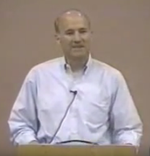
Joseph Dillow
Joseph Dillow, Final Destiny: The Future Reign of the Servant Kings (Monument, CO: Panyim, 2012), 454.
“Nowhere in the Bible is a Christian asked to examine either his faith or his life to find out if he is a Christian. He is told only to look outside of himself to Christ alone for his assurance that he is a Christian. The Christian is, however, often told to examine his walk of faith and life to see if he is walking in fellowship and in conformity to God's commands.”

Slide 105
Out of Context Verses Used to Support the Perseverance of the Saints
Matthew 24:13
John 15:5-6, 8
2 Corinthians 13:5
Ephesians 2:10
Hebrews 12:14
Revelation 13:10
Revelation 14:12

Slide 106
Ephesians 2:8-10
“⁸ For by grace you have been saved through faith; and that not of yourselves, it is the gift of God; ⁹ not as a result of works, so that no one may boast. ¹⁰ For we are His workmanship, created in Christ Jesus for good works, which God prepared beforehand so that we would walk [peripateō, subjunctive mood] in them.”

Slide 107
Out of Context Verses Used to Support the Perseverance of the Saints
Matthew 24:13
John 15:5-6, 8
2 Corinthians 13:5
Ephesians 2:10
Hebrews 12:14
Revelation 13:10
Revelation 14:12

Slide 108
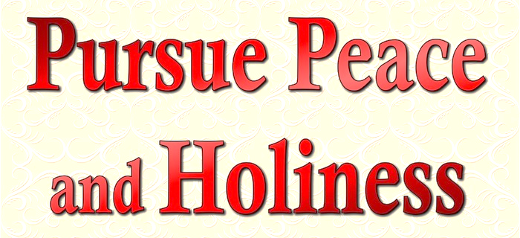
Hebrews 12:14 (NKJV)
“Pursue peace with all people, and holiness, without which no one will see the Lord.”

Slide 109
Hebrews 12:14
Holy life + faith to get to heaven
Others seeing the Lord though the believer's life and witness
Not seeing the Lord in heaven
Context = personal relationships with others (Heb. 12:14a, 15b)
Not requiring faith + holy life to get to heaven

Slide 110
Hebrews 12:14
Holy life + faith to get to heaven
Others seeing the Lord though the believer's life and witness
Not seeing the Lord in heaven
Context = personal relationships with others (Heb. 12:14a, 15b)
Not requiring faith + holy life to get to heaven

Slide 111
Without Personal Holiness No One Will See the Lord
“The New Testament lays before us a vast array of conditions for final salvation. Not only initial repentance and faith, but perseverance in both, demonstrated in love toward God and neighbor, are part of that holiness without which no one will see the lord (Hebrews 12:14)."
Horton, Michael. (2006). Introducing Covenant Theology (p. 182). Grand Rapids: Baker.

Slide 112
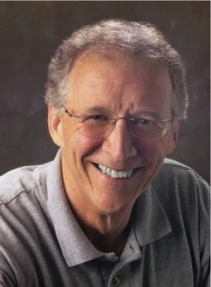
John Piper
Does God Really Save Us by Faith Alone?
https://www.desiringgod.org/articles/does-god-really-save-us-by-faith-alone
“Essential to the Christian life and necessary for final salvation is the killing of sin (Romans 8:13) and the pursuit of holiness (Hebrews 12:14).”

Slide 113
Hebrews 12:14
Holy life + faith to get to heaven
Others seeing the Lord though the believer's life and witness
Not seeing the Lord in heaven
Context = personal relationships with others (Heb. 12:14a, 15b)
Not requiring faith + holy life to get to heaven

Slide 114
Hebrews 12:14
Holy life + faith to get to heaven
Others seeing the Lord though the believer's life and witness
Not seeing the Lord in heaven
Context = personal relationships with others (Heb. 12:14a, 15b)
Not requiring faith + holy life to get to heaven

Slide 115
Hebrews 12:14
Holy life + faith to get to heaven
Others seeing the Lord though the believer's life and witness
Not seeing the Lord in heaven
Context = personal relationships with others (Heb. 12:14a, 15b)
Not requiring faith + holy life to get to heaven

Slide 116
Hebrews 12:14 (NKJV)
“Pursue peace with all people, and holiness, without which no one will see the Lord.”

Slide 117
Hebrews 12:14
Holy life + faith to get to heaven
Others seeing the Lord though the believer's life and witness
Not seeing the Lord in heaven
Context = personal relationships with others (Heb. 12:14a, 15b)
Not requiring faith + holy life to get to heaven

Slide 118
Out of Context Verses Used to Support the Perseverance of the Saints
Matthew 24:13
John 15:5-6, 8
2 Corinthians 13:5
Ephesians 2:10
Hebrews 12:14
Revelation 13:10
Revelation 14:12

Slide 119
Revelation 13:10
“If anyone is destined for captivity, to captivity he goes; if anyone kills with the sword, with the sword he must be killed. Here is the perseverance and the faith of the saints.”

Slide 120
Out of Context Verses Used to Support the Perseverance of the Saints
Matthew 24:13
John 15:5-6, 8
2 Corinthians 13:5
Ephesians 2:10
Hebrews 12:14
Revelation 13:10
Revelation 14:12

Slide 121

Revelation 14:12
“Here is the perseverance of the saints who keep the commandments of God and their faith in Jesus.”

Slide 122
Problems with the Calvinistic Perseverance Definition
Final salvation is unbiblical
Scriptural examples of non-persevering saints
Support only found in out of context verses
Subtle form of works salvation
Preferability of immediate death following conversion?
Lessens the importance of practical sanctification
Lessens the importance of the Bema Seat warnings
Destroys the assurance of salvation

Slide 123

John Piper
John Piper and Pastoral Staff, TULIP: What We Believe about the Five Points of Calvinism: Position Paper of the Pastoral Staff (Desiring God Ministries, 1997), 25, cited in Dave Hunt, What Love is This?, 379.
“No Christian can be sure that he is a true believer. Hence, there is an ongoing need to be dedicated to the Lord and to deny ourselves so that we might make it.”

Slide 124

John 5:24
“Truly, truly, I say to you, he who hears My word, and believes Him who sent Me, has eternal life, and does not come into judgment, but has passed out of death into life.”

Slide 125
Titus 2:14
“who gave Himself for us to redeem us from every lawless deed, and to purify for Himself a people for His own possession, zealous for good deeds.”

Slide 126
Problems with the Calvinistic Perseverance Definition
Final salvation is unbiblical
Scriptural examples of non-persevering saints
Support only found in out of context verses
Subtle form of works salvation
Preferability of immediate death following conversion?
Lessens the importance of practical sanctification
Lessens the importance of the Bema Seat warnings
Destroys the assurance of salvation

Slide 127
Problems with the Calvinistic Perseverance Definition
Final salvation is unbiblical
Scriptural examples of non-persevering saints
Support only found in out of context verses
Subtle form of works salvation
Preferability of immediate death following conversion?
Lessens the importance of practical sanctification
Lessens the importance of the Bema Seat warnings
Destroys the assurance of salvation

Slide 128
Problems with the Calvinistic Perseverance Definition
Final salvation is unbiblical
Scriptural examples of non-persevering saints
Support only found in out of context verses
Subtle form of works salvation
Preferability of immediate death following conversion?
Lessens the importance of practical sanctification
Lessens the importance of the Bema Seat warnings
Destroys the assurance of salvation

Slide 129
Scripture’s Five Crowns (1 Cor 3:15; 9:27; 1 John 2:28; 2 John 8; Rev 3:11)
SCRIPTURE | CROWN | PURPOSE
1 Cor. 9:24-27 | Incorruptible | Gaining mastery over the flesh
1 Thess. 2:19-20 | Rejoicing | Soul winning
Jas. 1:12; Rev. 2:10 | Life | Enduring trials
1 Pet. 5:2-4 | Glory | Shepherding God’s people
2 Tim. 4:8 | Righteousness | Longing for His appearing

Slide 130
Problems with the Calvinistic Perseverance Definition
Final salvation is unbiblical
Scriptural examples of non-persevering saints
Support only found in out of context verses
Subtle form of works salvation
Preferability of immediate death following conversion?
Lessens the importance of practical sanctification
Lessens the importance of the Bema Seat warnings
Destroys the assurance of salvation

Slide 131

Destroys the Assurance of Salvation
The Biblical View of the Assurance of Salvation
Examples of How the “Perseverance of the Saints” Destroys the Assurance of Salvation
Calvinism’s “Two Kinds of Faith” Doctrine damages the Assurance of Salvation

Slide 132
Destroys the Assurance of Salvation
The Biblical View of the Assurance of Salvation
Examples of How the “Perseverance of the Saints” Destroys the Assurance of Salvation
Calvinism’s “Two Kinds of Faith” Doctrine damages the Assurance of Salvation

Slide 133
John 5:24
“Truly, truly, I say to you, he who hears My word, and believes Him who sent Me, has eternal life, and does not come into judgment, but has passed out of death into life.”

Slide 134

1 John 5:13
“These things I have written to you who believe in the name of the Son of God, so that you may know that you have eternal life.”

Slide 135
DTS Doctrinal Statement
Article XI—Assurance
“We believe it is the privilege, not only of some, but of all by the Spirit through faith who are born again in Christ as revealed in the Scriptures, to be assured of their salvation from the very day they take Him to be their Savior and that this assurance is not founded upon any fancied discovery of their own worthiness or fitness, but wholly upon the testimony of God in His written Word, exciting within His children filial love...”

Slide 136
Lewis Sperry Chafer, Salvation: A Clear Doctrinal Analysis
(Grand Rapids: Zondervan, 1977), 60. Italics added
Lewis Sperry Chafer
“There is a normal Christian experience. There are new and blessed emotions and desires. Old things do pass away; and behold all things do become new; but all such experiences are but secondary evidences, as to the fact of salvation, in that they grow out of that positive repose of faith which is the primary evidence.”

Slide 137
Joseph Dillow
“Nowhere in the Bible is a Christian asked to examine either his faith or his life to find out if he is a Christian. He is told only to look outside of himself to Christ alone for his assurance that he is a Christian. The Christian is, however, often told to examine his walk of faith and life to see if he is walking in fellowship and in conformity to God's commands.”
Joseph Dillow, Final Destiny: The Future Reign of the Servant Kings (Monument, CO: Panyim, 2012), 454.

Slide 138
Destroys the Assurance of Salvation
The Biblical View of the Assurance of Salvation
Examples of How the “Perseverance of the Saints” Destroys the Assurance of Salvation
Calvinism’s “Two Kinds of Faith” Doctrine damages the Assurance of Salvation

Slide 139
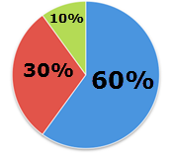
Assurance of Salvation in Calvinism?

Slide 140
Calvinism and the Assurance of Salvation
“Once fully indoctrinated into Calvinism, the Calvinist is left wondering for the rest of his life if he is one of the elect. This is not a walk of faith but of doubt, and it is totally unscriptural. Scripture says that we can walk in assurance of eternal life.”
Bob Kirkland, Calvinism: None Dare Call It Heresy; Spotlight on the Life and Teachings of John Calvin (Eureka, MT: Lighthouse Trails, 2018), 102.

Slide 141
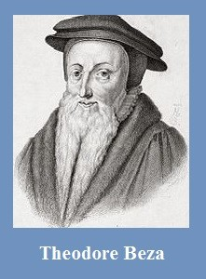
Theodore Beza
(1519‒1605)
A Little Book of Christian Questions and Responses, pp. 96-97
“Therefore, I am elect, is first perceived from sanctification begun in me, that is, by my hating of sin and my loving of righteousness.”

Slide 142
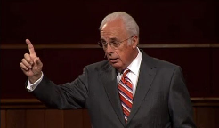
John MacArthur
The Gospel According to Jesus, p. 23
“Genuine assurance comes from seeing the Holy Spirit’s transforming work in one’s life.”

Slide 143
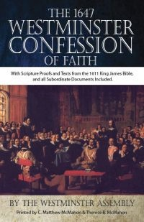
Westminster Confession Chapter XVII, Article III
– Of the Assurance of Grace and Salvation
“This infallible assurance doth not so belong to the essence of faith, but that a true believer will wait long, and conflict with many difficulties before he be a partaker of it.”

Slide 144
Even John Calvin himself did not possess assurance of salvation. Writing in his will shortly before his death in 1564, he declared: “I testify also and profess that I humbly seek from God, that He may so will me to be washed and purified by the great Redeemer’s blood, shed for the sins of the human race, that it may be permitted me to stand before His tribunal under the covert of the Redeemer Himself” (italics added).
John Calvin
Norman F. Douty, The Death of Christ (Irving, TX: Williams & Watrous Pub. Co., Revised and Enlarged Edition, 1978), p. 176, citing John Calvin from F. F. Bruce’s “Answers and Questions,” Questions 1331, in The Harvester (Exeter) January 1966.

Slide 145
John Piper
John Piper and Pastoral Staff, TULIP: What We Believe about the Five Points of Calvinism: Position Paper of the Pastoral Staff (Desiring God Ministries, 1997), 25, cited in Dave Hunt, What Love is This?, 379.
“No Christian can be sure that he is a true believer. Hence, there is an ongoing need to be dedicated to the Lord and to deny ourselves so that we might make it.”

Slide 146
John Piper
John Piper’s Interview on Family Life Radio April 14, 2020
https://www.familylife.com/podcast/familylife-today/strategies-for-standing-firm-through-coronavirus/
“What causes me to be anxious is the possibility that I may not be a Christian—that I might be fake / that everything I’ve ever done might be a farce—those are horrible, horrible thoughts; right?”

Slide 147

R.C. Sproul, Jr.
“Assurance of Salvation” (Tabletalk, Ligonier Ministries, 1989), p. 20
“A while back I had one of those moments… Suddenly the question hit me: ‘R.C. what if you are not one of the redeemed? What if your destiny is not heaven after all, but hell?’ Let me tell you that I was flooded in my body with the chill that went from my head to the bottom of my spine. I was terrified. I begin to take stock of my life, and I looked at my performance. My sins came pouring into my mind, and the more I looked at myself the worst I felt. I thought, ‘maybe it’s really true. Maybe I’m not saved after all.’...Then I remembered John 6:68. Jesus had been giving out hard teaching, and many of His former followers had left Him. When He asked Peter if he was also going to leave, Peter said, ‘where else can we go? Only you have the words of eternal life.’ In other words, Peter was also uncomfortable, but he realized that being uncomfortable with Jesus was better than any other option.”

Slide 148
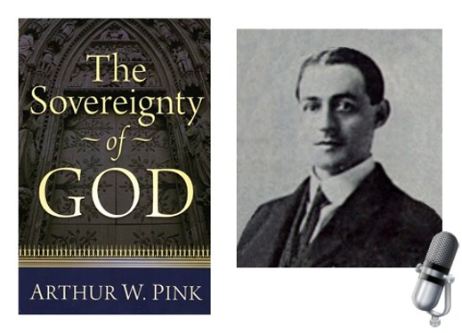
A. W. Pink
Practical Christianity, p. 16.
“Readers, if there is a reserve in your obedience, you are on your way to hell.”

Slide 149

R.T. Kendall
R. T. Kendall, Calvin and English Calvinism to 1649
(Oxford: Oxford University Press, 1979), 2.
Interestingly, it has been recorded that “nearly all of the Puritan ‘divines’ [men who were Calvinistic and taught perseverance] went through great dread and despair on their deathbeds as they realized their lives did not give perfect evidence that they were elect.”

Slide 150
R.T. Kendall
R.T. Kendall, Grace: You Don't Deserve It. You Can't Buy It. You Can't Live without It. (Lake Mary, FL: Charisma House, 2006), 3.
“I went to Oxford in 1973 to study John Owen’s doctrine of the priestly work of Christ. It turned out that my thesis took a different direction, but it plunged me deep indeed into the Puritans (p. 3).”

Slide 151
R.T. Kendall
R.T. Kendall, Grace: You Don't Deserve It. You Can't Buy It. You Can't Live without It. (Lake Mary, FL: Charisma House, 2006), 3.
“For no one could claim to be saved if they did not keep the works of the Law. Not that you could lose your salvation; it only meant you were not really converted in the first place if there was not a careful keeping of the Ten Commandments. After all, one dare not look directly to Christ for assurance—that would be presumptuous; one looked to his own faithfulness in keeping the Law first, and then—and only then—did one have the warrant to look to Christ for salvation. I kept telling myself that what these Puritans wrote surely was not what they appeared to be saying. I kept reading” (p. 3).

Slide 152
R.T. Kendall
R.T. Kendall, Grace: You Don't Deserve It. You Can't Buy It. You Can't Live without It. (Lake Mary, FL: Charisma House, 2006), 4.
“Most of the Puritans that I read can be described in this scenario: How do you know you are saved? By your sanctification. How do you know you have sanctification? By good works. How do you know what good works are? By the Ten Commandments (p. 4).”

Slide 153
R.T. Kendall
R.T. Kendall, Grace: You Don't Deserve It. You Can't Buy It. You Can't Live without It. (Lake Mary, FL: Charisma House, 2006), 4.
“It is not that they believed you are saved by good works; it was merely that you could not know you are saved unless you kept the Ten Commandments. Martin Luther’s discovery that we are justified by faith alone had sadly passed behind a cloud (p. 4).”

Slide 154
R.T. Kendall
R.T. Kendall, Grace: You Don't Deserve It. You Can't Buy It. You Can't Live without It. (Lake Mary, FL: Charisma House, 2006), 4.
“I was also surprised to learn how so many of the Puritans died. William Perkins (1558-1602), the architectural mind for what became the tradition that led to the historic Westminster Confession of Faith, died ‘in the conflict of a troubled conscience.’ His immediate successor Paul Baynes (d. 1617) ‘went out of this world, with far less comfort than many weaker Christians enjoy.’ Sadly, this kind of dying testimony was not uncommon (p. 4).”

Slide 155
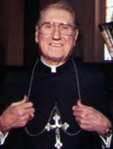
Cardinal John O’Connor of NY
quoted in Samuel Howe Verhovek, Cardinal Defends a Jailed Bishop Who Warned Cuomo on Abortion, New York Times, February 1, 1990.
“Church teaching is that I don't know, at any given moment, what my eternal future will be… I can hope, pray, do my very best – but I still don't know. Pope John II doesn't absolutely know that he will go to heaven, nor does mother Theresa of Calcutta, unless either has had a special divine revelation.”

Slide 156
Destroys the Assurance of Salvation
The Biblical View of the Assurance of Salvation
Examples of How the “Perseverance of the Saints” Destroys the Assurance of Salvation
Calvinism’s “Two Kinds of Faith” Doctrine damages the Assurance of Salvation

Slide 157

William Hendriksen
William Hendriksen, A Commentary on the Gospel of John, 3d ed. (London: Banner of Truth Trust, 1964), p. 127. (1978). Bibliotheca Sacra, 135. (1978). Bibliotheca Sacra, 135.
“Many trusted in his name; i.e., because of the manner in which his power was displayed they accepted him as a great prophet and perhaps even as the Messiah. This, however, is not the same as saying that they surrendered their hearts to him. Not all faith is saving faith...”

Slide 158
John MacArthur
The Gospel According to Jesus, p. 173
“As a divine gift, faith is neither transient nor impotent. It has an abiding quality that guarantees its endurance to the end.”
John F. MacArthur, The Gospel According to Jesus: What Does Jesus Mean When He Says, "Follow Me"? (Grand Rapids: Zondervan, 1988), 173.

Slide 159
John MacArthur
The Gospel According to Jesus, p. 173
“…The faith God gives can never evaporate.”

Slide 160
John MacArthur
Saved Without A Doubt, p. 177
“If a person fails to love and obey the Lord through the trials of life, then there is no evidence that he possesses saving faith. How many people do you know who came to church for a while, had a little trouble in their lives, and left? Although they may have made a profession of faith in Christ, they cannot be identified as those who love Him because their lives are not characterized by enduring obedience.”

Slide 161
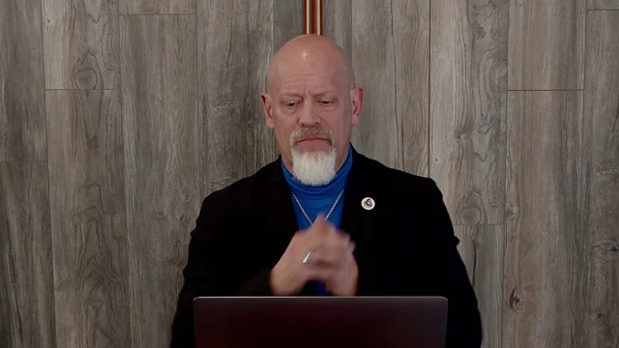
James White
James R. White, The Potter’s Freedom
(Amityville, NY: Calvary Press Publishing, 2000), 293.
“Why do some stumble and fall while others persevere? Is it that some are better, stronger, than others? No. The reason lies in the difference between having saving faith and a faith that is not divine in origin or nature. Many are those who make professions not based upon regeneration, and the ‘faith’ that is theirs will not last…These are those who have false, human faith that does not last. But those with true faith produce fruit and remain.”

Slide 162


Slide 163
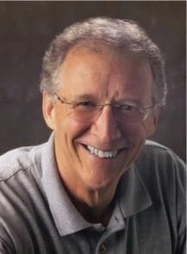
John Piper
John Piper, Desiring God (Sisters, OR: Multnomah, 1986), 65. This quote also appeared verbatim in the 1996 reprinting of Desiring God, but it was rephrased in the 2003 and 2011 editions.
“Saving faith is no simple thing. It has many dimensions. ‘Believe on the Lord Jesus’ is a massive command. It contains a hundred other things. Unless we see this, the array of conditions for salvation in the New Testament will be utterly perplexing.”

Slide 164
R.C. Sproul – Bob Wilkin as quoted in:
Bob Wilkin, “Ligonier National Conference” (The Grace Report, July 2000); http://www.gracebiblestudies.org/Resources/Web/www.duluthbible.org/g_f_j/EternalSecurity12.htm
“During the first message presented at Ligonier’s Conference in Orlando last June, Dr. R. C. Sproul indicated that Dr. James Boice, a scheduled speaker at the conference, was dying in faith that very night. Then at the end of the message he asked all 5,000 of us present to pray that Jim dies in faith. This struck me as sad. Here was a great pastor, theologian, teacher, and author. Yet Sproul was not sure that he was regenerate. (In Reformed thought, if a person fails to die in faith, he proved he was never saved in the first place.) I was reminded of R.T. Kendall’s remark that nearly to a man the Puritan divines [men who were Calvinistic and taught perseverance] died doubting whether they were saved and fearing they were going to hell. Dr. Boice died that very night, June 15th.”

Slide 165
“Believe” Defined
“pisteuō…’to believe,’ also ‘to be persuaded of,’ and hence, ‘to place confidence in, to trust,’ signifies, in this sense of the word, reliance upon, not mere credence. It is most frequent in the writings of the apostle John, especially the Gospel. He does not use the noun…Of the writers of the Gospels…uses of the verb…John ninety-nine.”
W. E. Vine, Merrill F. Unger, and William White, Vine's Complete Expository Dictionary of the Old and New Testament Words (Nashville: Nelson, 1996), 61.

Slide 166
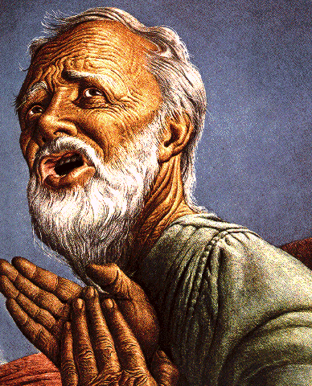
Belief – God’s One Condition for Justification
Gen 15:6
Then he believed in the LORD; and He reckoned it to him as righteousness.
John 3:16
For God so loved the world, that He gave His only begotten Son, that whoever believes in Him shall not perish, but have eternal life.
Acts 16:30-31
"Sirs, what must I do to be saved?" They said, "Believe in the Lord Jesus, and you will be saved..."

Slide 167
Passage Conditioning Salvation on
Faith Alone (Sola Fide)
Genesis 15:6
John 3:16; 5:24; 6:28-29, 47; 16:8-9; 20:30-31
Acts 16:30-31
Romans 1:16; Ephesians 2:8-9
Hebrews 11:6

Slide 168
Romans 4:5
“But to the one who does not work, but believes in Him who justifies the ungodly, his faith is credited as righteousness.”

Slide 169
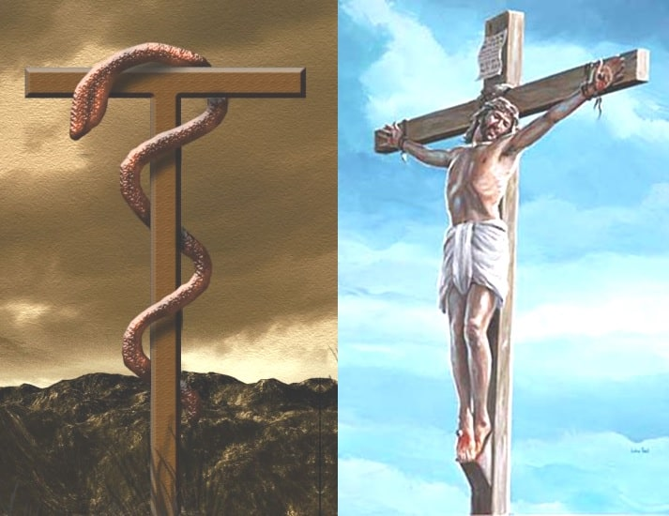
John 3:14-15
“¹⁴ As Moses lifted up the serpent in the wilderness, even so must the Son of Man be lifted up; ¹⁵ so that whoever believes will in Him have eternal life.”

Slide 170
Numbers 21:8-9
“⁸ Then the Lord said to Moses, ‘Make a fiery serpent, and set it on a standard; and it shall come about, that everyone who is bitten, when he looks at it, he will live.’ ⁹ And Moses made a bronze serpent and set it on the standard; and it came about, that if a serpent bit any man, when he looked to the bronze serpent, he lived.”

Slide 171

John 5:24
“Truly, truly, I say to you, he who hears My word, and believes Him who sent Me, has eternal life, and does not come into judgment, but has passed out of death into life.”

Slide 172
John 20:30-31
“Therefore many other signs Jesus also performed in the presence of the disciples, which are not written in this book; but these have been written so that you may believe that Jesus is the Christ, the Son of God; and that believing you may have life in His name.”

Slide 173
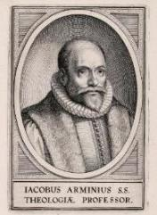
John 20:30-31?
Present tense participle “believing”-John 3:16, 18; 5:24
Abuse of the present tense
Present tense does not always require continual behavior
Mark 6:14
  John the “the one continually baptizing?”
  John already dead!
  Not describing continual baptizing
  Just describing him
How many times doe you have to MURDER before you are a MURDERER? Once! Same with a FISHERMAN & BELIEVER

Slide 174
John 20:30-31?
Does not preclude ongoing faith but does not require it
Other verb forms also used to describe belief (John 8:30-31)
It is possible for a Christian to struggle with faith
  2 Tim. 2:13 – “faithless” = unbelieving
  Jas. 1:5-8
  Peter’s sinking and three-fold denial

Slide 175
John 20:30-31?
Present tense participle “believing”-John 3:16, 18; 5:24
Abuse of the present tense
Present tense does not always require continual behavior
Mark 6:14
  John the “the one continually baptizing?”
  John already dead!
  Not describing continual baptizing
  Just describing him
How many times doe you have to MURDER before you are a MURDERER? Once! Same with a FISHERMAN & BELIEVER

Slide 176
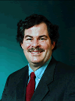
Believing Forever? – No!
Take Off Your Theological Lenses!
“The aspectual force of the present ho pisteuōn seems to be in contrast with ho pisteusas…The present was the tense of choice most likely because the NT writers by and large saw continual belief as a necessary condition of salvation. Along these lines, it seems significant that the promise of salvation is almost always given to ho pisteuōn, almost never to ho pisteusas…”
Daniel B. Wallace, Greek Grammar Beyond the Basics: An Exegetical Syntax of the New Testament with Scripture, Subject, and Greek Word Indexes (Grand Rapids: Zondervan, 1996), 621, n. 22.

Slide 177
John 20:30-31?
Present tense participle “believing”-John 3:16, 18; 5:24
Abuse of the present tense
Present tense does not always require continual behavior
Mark 6:14
  John the “the one continually baptizing?”
  John already dead!
  Not describing continual baptizing
  Just describing him
How many times doe you have to MURDER before you are a MURDERER? Once! Same with a FISHERMAN & BELIEVER

Slide 178
John 20:30-31?
Present tense participle “believing”-John 3:16, 18; 5:24
Abuse of the present tense
Present tense does not always require continual behavior
Mark 6:14
  John the “the one continually baptizing?”
  John already dead!
  Not describing continual baptizing
  Just describing him
How many times doe you have to MURDER before you are a MURDERER? Once! Same with a FISHERMAN & BELIEVER

Slide 179

Present Tense Participle Does Not Always Mean Forever
John 4:13 John 4:26 John 4:36 John 5:3 John 5:24 John 6:14 |  | John 11:26-27 Mark 6:14 Mark 14:20 Luke 16:18 Gal. 3:13
Bob Wilkin, “The One Who Believes: Is Continuous Faith Required to be Born Again?,” online: http://www.faithalone.org/magazine/y2006/06jf1.html, accessed 06 May 2015.

Slide 180
John 20:30-31?
Present tense participle “believing”-John 3:16, 18; 5:24
Abuse of the present tense
Present tense does not always require continual behavior
Mark 6:14
  John the “the one continually baptizing?”
  John already dead!
  Not describing continual baptizing
  Just describing him
How many times doe you have to MURDER before you are a MURDERER? Once! Same with a FISHERMAN & BELIEVER

Slide 181
John 20:30-31?
Present tense participle “believing”-John 3:16, 18; 5:24
Abuse of the present tense
Present tense does not always require continual behavior
Mark 6:14
  John the “the one continually baptizing?”
  John already dead!
  Not describing continual baptizing
  Just describing him
How many times doe you have to MURDER before you are a MURDERER? Once! Same with a FISHERMAN & BELIEVER

Slide 182
John 20:30-31?
Does not preclude ongoing faith but does not require it
Other verb forms also used to describe belief (John 8:30-31)
It is possible for a Christian to struggle with faith
  2 Tim. 2:13 – “faithless” = unbelieving
  Jas. 1:5-8
  Peter’s sinking and three-fold denial

Slide 183
John 20:30-31?
Does not preclude ongoing faith but does not require it
Other verb forms also used to describe belief (John 8:30-31)
It is possible for a Christian to struggle with faith
  2 Tim. 2:13 – “faithless” = unbelieving
  Jas. 1:5-8
  Peter’s sinking and three-fold denial

Slide 184
John 8:30-31
“As He spoke these things, many came to *believe in Him. So Jesus was saying to those Jews who had ⁺believed Him, “If you continue in My word, then you are truly disciples of Mine.”
* aorist active indicative
⁺ perfect active participle

Slide 185
John 20:30-31?
Does not preclude ongoing faith but does not require it
Other verb forms also used to describe belief (John 8:30-31)
It is possible for a Christian to struggle with faith
  2 Tim. 2:13 – “faithless” = unbelieving
  Jas. 1:5-8
  Peter’s sinking and three-fold denial

Slide 186
John 20:30-31?
Does not preclude ongoing faith but does not require it
Other verb forms also used to describe belief (John 8:30-31)
It is possible for a Christian to struggle with faith
  2 Tim. 2:13 – “faithless” = unbelieving
  Jas. 1:5-8
  Peter’s sinking and three-fold denial

Slide 187
2 Timothy 2:13
“If we are faithless [without faith], He remains faithful, for He cannot deny Himself.”

Slide 188
John 20:30-31?
Does not preclude ongoing faith but does not require it
Other verb forms also used to describe belief (John 8:30-31)
It is possible for a Christian to struggle with faith
  2 Tim. 2:13 – “faithless” = unbelieving
  Jas. 1:5-8
  Peter’s sinking and three-fold denial

Slide 189
James 1:5-8
“But if any of you lacks wisdom, let him ask of God, who gives to all generously and without reproach, and it will be given to him. ⁶ But he must ask in faith without any doubting, for the one who doubts is like the surf of the sea, driven and tossed by the wind. ⁷ For that man ought not to expect that he will receive anything from the Lord, ⁸ being a double-minded man, unstable in all his ways.”

Slide 190
John 20:30-31?
Does not preclude ongoing faith but does not require it
Other verb forms also used to describe belief (John 8:30-31)
It is possible for a Christian to struggle with faith
  2 Tim. 2:13 – “faithless” = unbelieving
  Jas. 1:5-8
  Peter’s sinking and three-fold denial

Slide 191
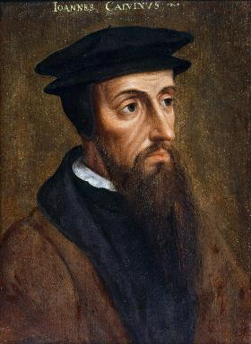
Neo-Calvinism vs. The Bible
Why Critique Calvinism?
The Source of Calvin’s Theology
Calvin’s Manner of Life
TULIP Through the Grid of Scripture
Conclusion

Slide 192
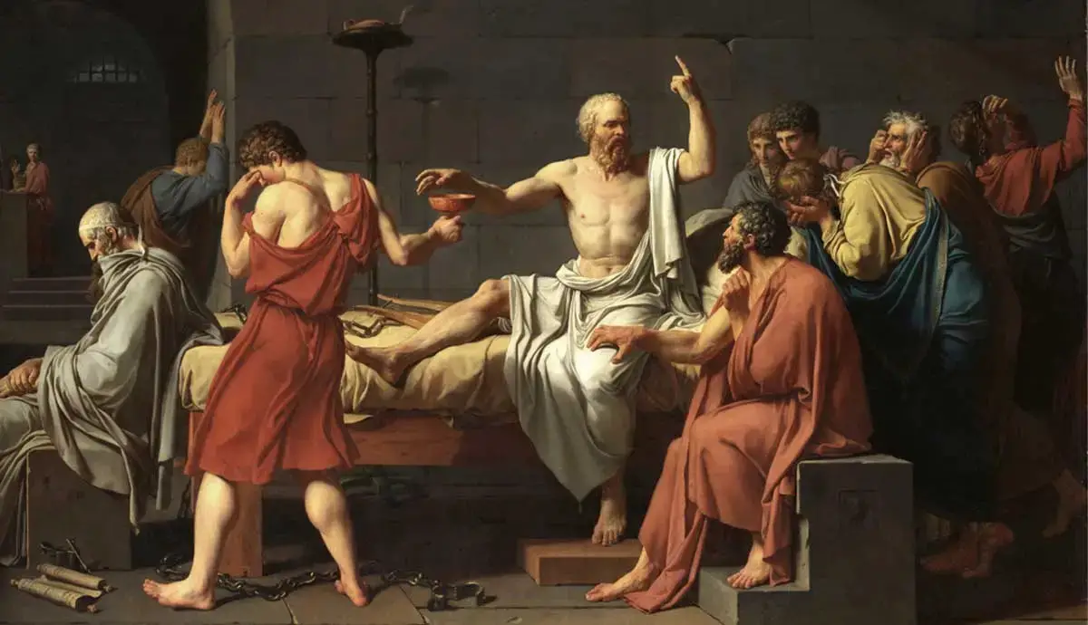
Colossians 2:8
⁸“See to it that no one takes you captive through philosophy and empty deception, according to the tradition of men, according to the elementary principles of the world, rather than according to Christ.”

Slide 193
Calvinism is an Imposed Philosophy Upon Scripture
“Likewise, John Calvin…latched onto little more than a single word (predestinate) and ran with it. Then, rather than carefully looking to the whole of Scripture to verify his precepts and conclusions, he looked to the writings of Augustine to verify his thinking. The result is that, as with Catholicism, we now have ‘another gospel’ that is not solely based on Scripture but on the confused thinking and misconstrued assumptions of a mere man. With Calvin, rather than changing his views to fit Scripture, he changed the meaning of words in Scripture to fit his now distorted view of God and salvation.”
Bob Kirkland, Calvinism: None Dare Call It Heresy; Spotlight on the Life and Teachings of John Calvin (Eureka, MT: Lighthouse Trails, 2018), 97.

