Slide 2
EXODUS STRUCTURE/OUTLINE
Redemption (1–18)
Redemption (1:1–12:30)
Liberation (12:31–15:21)
Preservation (15:22–18:27)
Mosaic Covenant (19–40)
Law (19–24)
Tabernacle instructions (25–31)
Apostasy (32–34)
Tabernacle building (35–40)

Slide 3
REDEMPTION (1:1–12:30)
Why redemption is necessary (Exod 1)
Development of the deliverer (Exod 2–4)
First confrontation with Pharaoh (Exod 5)
God reassures Moses (Exod 6:1–7:7)
Second confrontation with Pharaoh (Exod 7:18-13)
Plagues (Exod 7:14–12:30)

Slide 4
THREE PHASES OF MOSES’ 120 YEAR LIFE
LIFE PHASE | SCRIPTURE | YEARS | AGE | ACTIVITY
Natural Training | Acts 7:23 | 1526–1486 B.C. | 1-40 | Egyptian Education
Spiritual Training | Exod. 7:7 | 1486–1446 B.C. | 40-80 | Midian Shepherding
Ministry | Deut. 31:2; 34:7; Acts 7:36 | 1446–1406 B.C. | 80-120 | Exodus, Law, Wilderness Preservation, Pentateuch Authorship

Slide 5
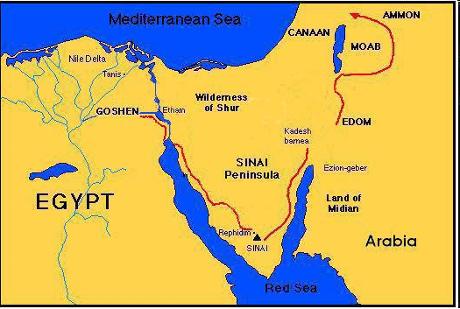

Slide 6
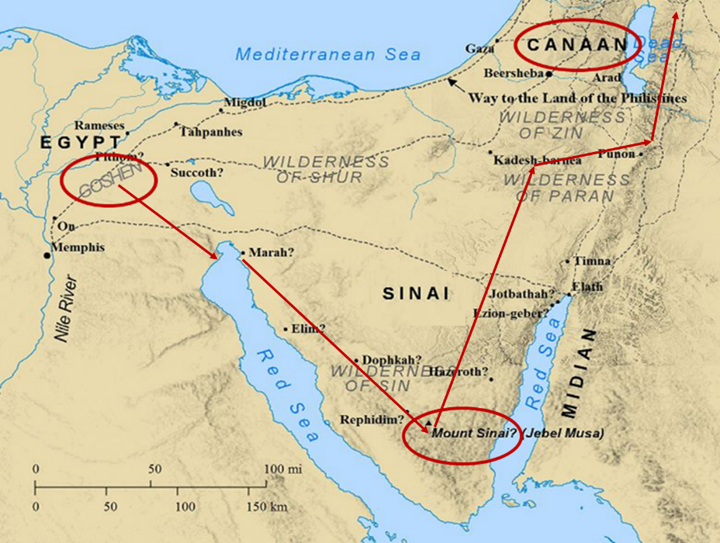

Slide 7
MOSES’ CALLING Exodus 3:1-22
Moses’ mission (1-10)
Moses’ objections (11-15)
God’s prophecies (16-22)

Slide 8
John 13:19; 14:29
“^{13:19} From now on I am telling you before it comes to pass, so that when it does occur, you may believe that I am He… ^{14:29} Now I have told you before it happens, so that when it happens, you may believe.”

Slide 9
III. Exodus 3:16-22 God’s Prophecies
Israel’s land (16-17)
Israel’ leaders (18)
Pharaoh’s opposition (19)
Egypt’s judgment (20)
Israel’s plundering (21-22)

Slide 10
III. Exodus 3:16-22 God’s Prophecies
Israel’s land (16-17)
Israel’ leaders (18)
Pharaoh’s opposition (19)
Egypt’s judgment (20)
Israel’s plundering (21-22)

Slide 11
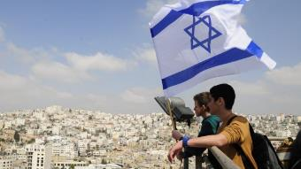
Reliability of the “Divine Regathering” Predictions
 | RETURN | PREDICTED | FULFILLED
1st | From Egypt to Canaan | Gen. 15:13-14 | Joshua 1‒12
2nd | From Babylon to Israel | Jer. 25:11; 29:10 | Ezra & Nehemiah
3rd | From the Diaspora to Israel’s restoration | Ezekiel 36:24-28 | Millennial Kingdom

Slide 13
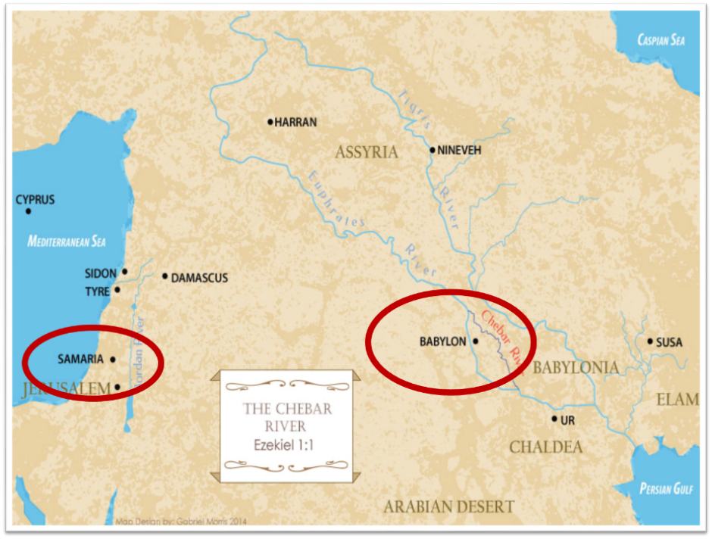

Slide 14
III. Exodus 3:16-22 God’s Prophecies
Israel’s land (16-17)
Israel’ leaders (18)
Pharaoh’s opposition (19)
Egypt’s judgment (20)
Israel’s plundering (21-22)

Slide 15
EXODUS STRUCTURE/OUTLINE
Redemption (1–18)
Redemption (1:1–12:30)
Liberation (12:31–15:21)
Preservation (15:22–18:27)
Mosaic Covenant (19–40)
Law (19–24)
Tabernacle instructions (25–31)
Apostasy (32–34)
Tabernacle building (35–40)

Slide 16
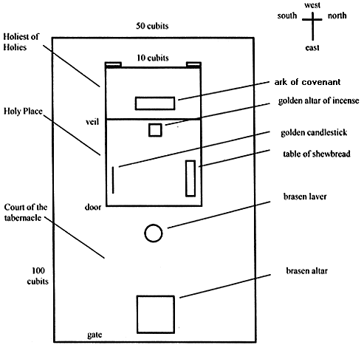
Tabernacle Diagram

Slide 17
SHAPING AND POPULATING (GEN 1:1)
Day 1: | Light | Day 4: | Luminaries
Day 2: | Water, sky | Day 5: | Sea animals, birds
Day 3: | Land, vegetation | Day 6: | Land animals, man

Slide 18
III. Exodus 3:16-22 God’s Prophecies
Israel’s land (16-17)
Israel’ leaders (18)
Pharaoh’s opposition (19)
Egypt’s judgment (20)
Israel’s plundering (21-22)

Slide 19
III. Exodus 3:16-22 God’s Prophecies
Israel’s land (16-17)
Israel’ leaders (18)
Pharaoh’s opposition (19)
Egypt’s judgment (20)
Israel’s plundering (21-22)

Slide 20
The Plagues of Egypt
NO. | DESCRIPTION | SCRIPTURE | Egyptian Deity
1. | Water to Blood | Exod. 7:14-25 | Hapi, Khnum
2. | Frogs | Exod. 8:1-15 | Heqt
3. | Gnats | Exod. 8:16-19 | Set
4. | Flies | Exod. 8:20-32 | Uatchit
5. | Disease on Cattle | Exod. 9:1-7 | Hathor, Apis
6. | Boils | Exod. 9:8-12 | Sekhmet, Serapis
7. | Hail | Exod. 9:13-35 | Seth, Nut
8. | Locusts | Exod. 10:1-20 | Seth, Nut, Osiris
9. | Darkness | Exod. 10:21-29 | Re, Horus, Atum
10. | Death of the First Born | Exod. 12:29-36 | Min, Osiris, Heqt, Isis

Slide 21
Genesis 6:1-4
“¹ Now it came about, when men began to multiply on the face of the land, and daughters were born to them, ² that the sons of God saw that the daughters of men were beautiful; and they took wives for themselves, whomever they chose. ³ Then the Lord said, ‘My Spirit shall not strive with man forever, because he also is flesh; nevertheless his days shall be one hundred and twenty years.’ ⁴ The Nephilim were on the earth in those days, and also afterward, when the sons of God came in to the daughters of men, and they bore children to them. Those were the mighty men who were of old, men of renown.”

Slide 22
III. Exodus 3:16-22 God’s Prophecies
Israel’s land (16-17)
Israel’ leaders (18)
Pharaoh’s opposition (19)
Egypt’s judgment (20)
Israel’s plundering (21-22)

Slide 23
Genesis 15:13, 16
“¹³ God said to Abram, ‘Know for certain that your descendants will be strangers in a land that is not theirs, where they will be enslaved and oppressed four hundred years… ¹⁶ Then in the fourth generation they will return here, for the wrongdoing of the Amorite is not yet complete.’”

Slide 24
EXODUS STRUCTURE/OUTLINE
Redemption (1–18)
Redemption (1:1–12:30)
Liberation (12:31–15:21)
Preservation (15:22–18:27)
Mosaic Covenant (19–40)
Law (19–24)
Tabernacle instructions (25–31)
Apostasy (32–34)
Tabernacle building (35–40)

Slide 25
Tabernacle Diagram

Slide 27
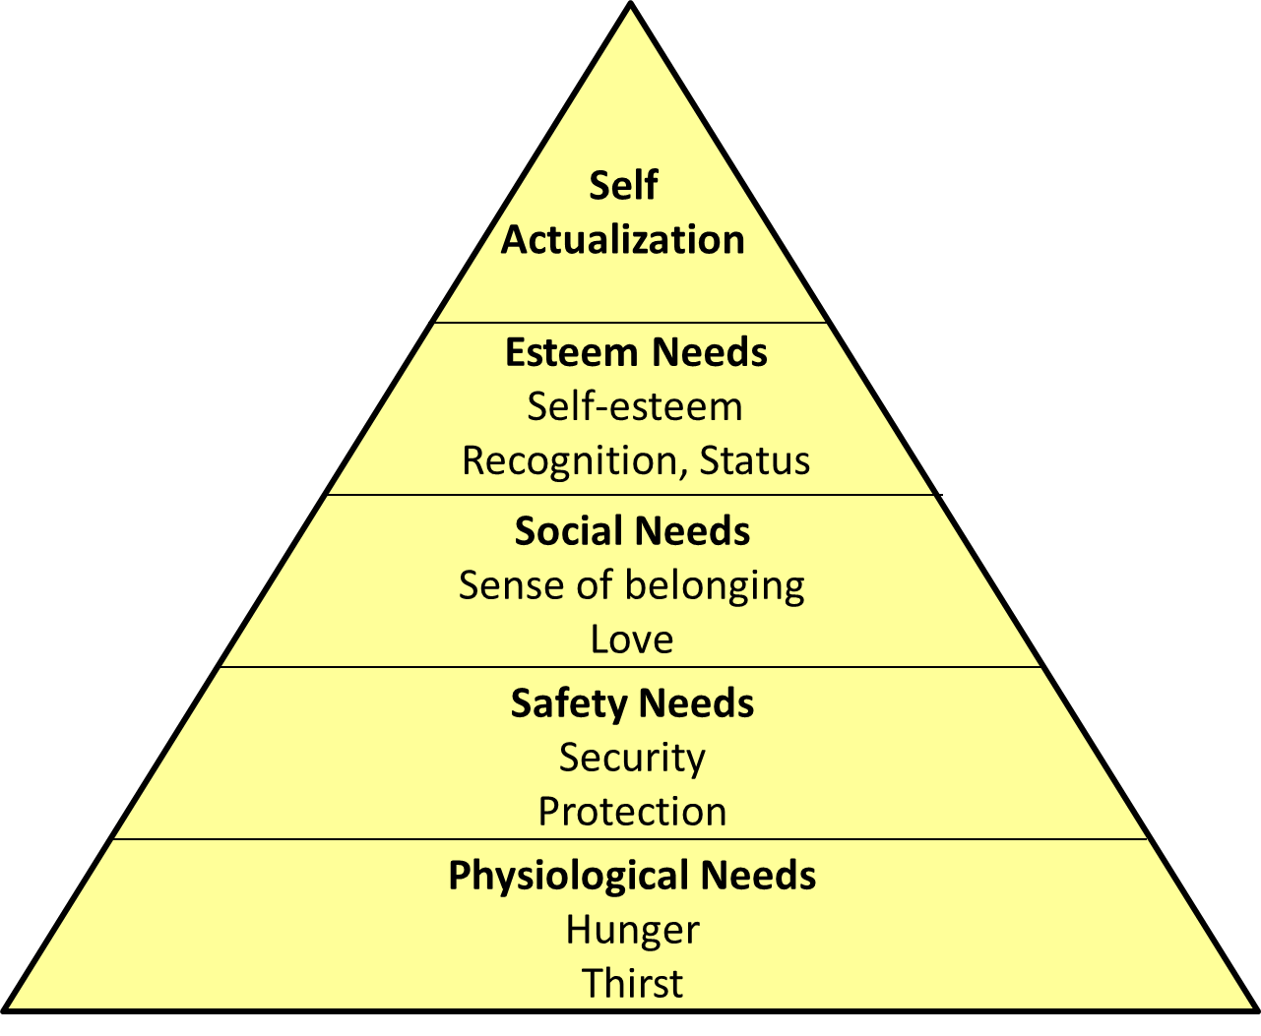
Maslow’s Hierarchy of Needs

Slide 28
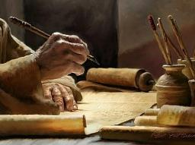
2 Timothy 3:16-17
“¹⁶ All Scripture is inspired by God [theopneustos] and profitable for teaching, for reproof, for correction, for training in righteousness; ¹⁷ so that the man of God may be adequate, equipped for every good work.”

Slide 29
2 Peter 1:3-4
“³ Seeing that His divine power has granted to us everything pertaining to life and godliness, through the true knowledge of Him who called us by His own glory and excellence. ⁴For by these He has granted to us His precious and magnificent promises, so that by them you may become partakers of the divine nature, having escaped the corruption that is in the world by lust.”

Slide 30
1 Peter 2:2
“like newborn babies, long for the pure [adolos] milk of the word, so that by it you may grow in respect to salvation, ³ if you have tasted the kindness of the Lord.”

Slide 31
Chafer Theological Seminary Distinctives:
sufficiency of the scriptures
"We believe in the complete adequacy of Scripture, for in it God has given us all things that pertain to life and godliness. We hold, therefore, that the Word of God by itself is sufficient to prepare a person for a lifetime of effective ministry.”
https://www.chafer.edu/distinctives

Slide 32
Conclusion

Slide 33
MOSES’ CALLING Exodus 3:1-22
Moses’ mission (1-10)
Moses’ objections (11-15)
God’s prophecies (16-22)

Slide 34
III. Exodus 3:16-22 God’s Prophecies
Israel’s land (16-17)
Israel’ leaders (18)
Pharaoh’s opposition (19)
Egypt’s judgment (20)
Israel’s plundering (21-22)

Slide 35
²⁴ The Lord bless you, and keep you; ²⁵ The Lord make His face shine on you, And be gracious to you; ²⁶ The Lord lift up His countenance on you, And give you peace.
Numbers 6:24–26 (NASB95)

