Slide 2
EXODUS STRUCTURE/OUTLINE
Redemption (1–18)
Redemption (1:1–12:30)
Liberation (12:31–15:21)
Preservation (15:22–18:27)
Mosaic Covenant (19–40)
Law (19–24)
Tabernacle instructions (25–31)
Apostasy (32–34)
Tabernacle building (35–40)

Slide 3
REDEMPTION (1:1–12:30)
Why redemption is necessary (Exod 1)
Development of the deliverer (Exod 2–4)
First confrontation with Pharaoh (Exod 5)
God reassures Moses (Exod 6:1–7:7)
Second confrontation with Pharaoh (Exod 7:18-13)
Plagues (Exod 7:14–12:30)

Slide 4
THREE PHASES OF MOSES’ 120 YEAR LIFE
LIFE PHASE | SCRIPTURE | YEARS | AGE | ACTIVITY
Natural Training | Acts 7:23 | 1526–1486 B.C. | 1-40 | Egyptian Education
Spiritual Training | Exod. 7:7 | 1486–1446 B.C. | 40-80 | Midian Shepherding
Ministry | Deut. 31:2; 34:7; Acts 7:36 | 1446–1406 B.C. | 80-120 | Exodus, Law, Wilderness Preservation, Pentateuch Authorship

Slide 7
MOSES’ CALLING Exodus 3:1-22
Moses’ mission (1-10)
Moses’ objections (11-15)
God’s prophecies (16-22)

Slide 8
I. Exodus 3:1-10 Moses’ Misson
God’s appearance (1-3)
God’s message (4-10)

Slide 9
Exodus 3:4-10 God’s Message
God’s calling (4)
God’s holiness (5)
God’s covenant history (6)
God’s compassionate sight (7)
God’s direction (8)
God’s compassionate hearing (9)
God’s assignment (10)

Slide 11
Names for God in Genesis
Elohim (1:1) – Power
Yahweh (2:4) – Relational
El Roi (Gen. 16:13) – Aware
El Olam (21:33) – Eternal
Jehovah Jireh (22:14) – Provision
God Isaac Feared (31:42, 53) – Reverenced
God, the God of Israel (33:20) – National

Slide 12
Exodus 3:4-10 God’s Message
God’s calling (4)
God’s holiness (5)
God’s covenant history (6)
God’s compassionate sight (7)
God’s direction (8)
God’s compassionate hearing (9)
God’s assignment (10)

Slide 13
Genesis 15:18-21
¹⁸ On that day the Lord made a covenant with Abram, saying, “To your descendants I have given this land, From the river of Egypt as far as the great river, the river Euphrates: ¹⁹ the Kenite and the Kenizzite and the Kadmonite ²⁰ and the Hittite and the Perizzite and the Rephaim ²¹ and the Amorite and the Canaanite and the Girgashite and the Jebusite.”

Slide 14
Evidence of Abrahamic Covenant’s Unconditional Nature
ANE covenant ratification ceremony (Gen 15)
Lack of stated conditions for Israel’s obedience (Gen 15)
Covenant's eternality (Gen 17:7, 13, 19; Ps. 90:2)
Covenant's immutability (Heb 6:13-18; Mal. 3:6)
Trans-generational reaffirmation despite perpetual national disobedience (Jer 31:35-37)
Walvoord, The Millennial Kingdom, 149-52

Slide 15
Land Promises Fulfilled in the Time of Joshua (Josh. 11:23; 21:43-45) or Solomon (1 Kgs. 4:21)?
Extended context (Josh 13:1-7; Judges 1:19, 21, 27, 29, 30-36)
Land gained in conquest was only a fraction of what was promised (1 Kgs. 4:25)
Jerusalem not conquered in Joshua’s day (Josh 15:63; 2 Sam 5)
Solomon’s reign extended to the border of Egypt (1 Kgs. 4:21) and not the River of Egypt (Gen. 15:18)
Solomon’s reign was tributary only (1 Kgs. 4:21)
Forever? (Gen 17:7-8, 13, 19)
Reaffirmation of land promises long after Joshua and Solomon’s time (Amos 9:11-15)
Fruchtenbaum, Israelology, 521-22, 631-32

Slide 17
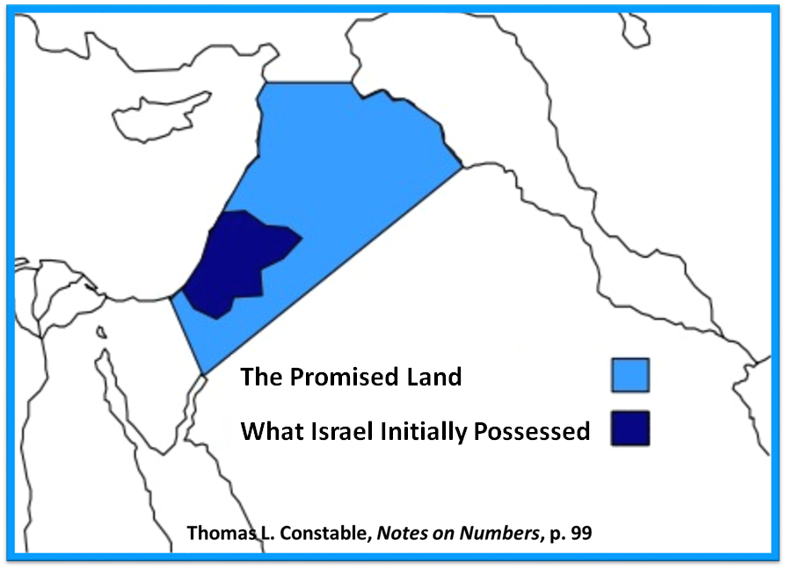

Slide 18
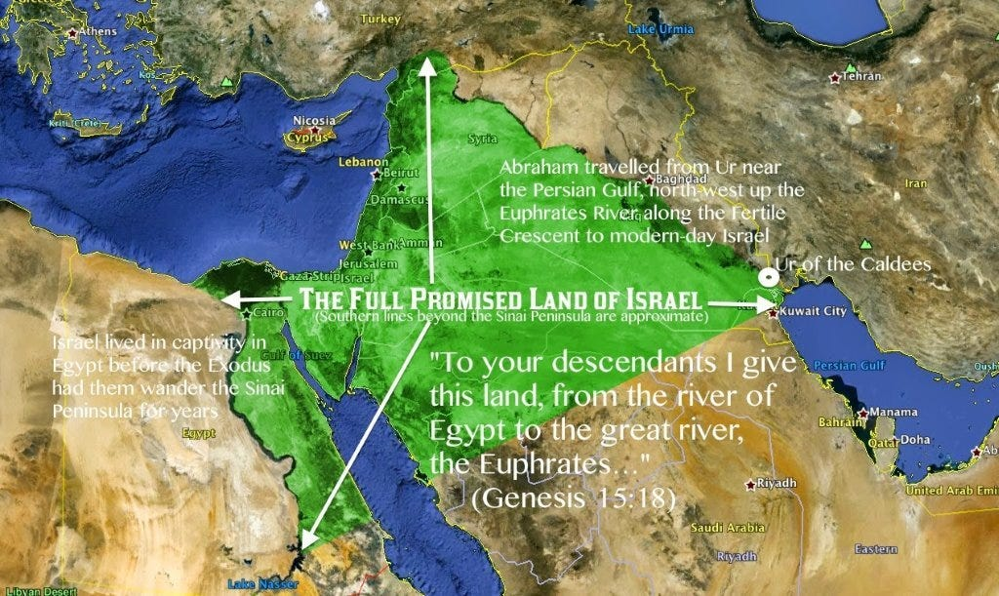

Slide 19
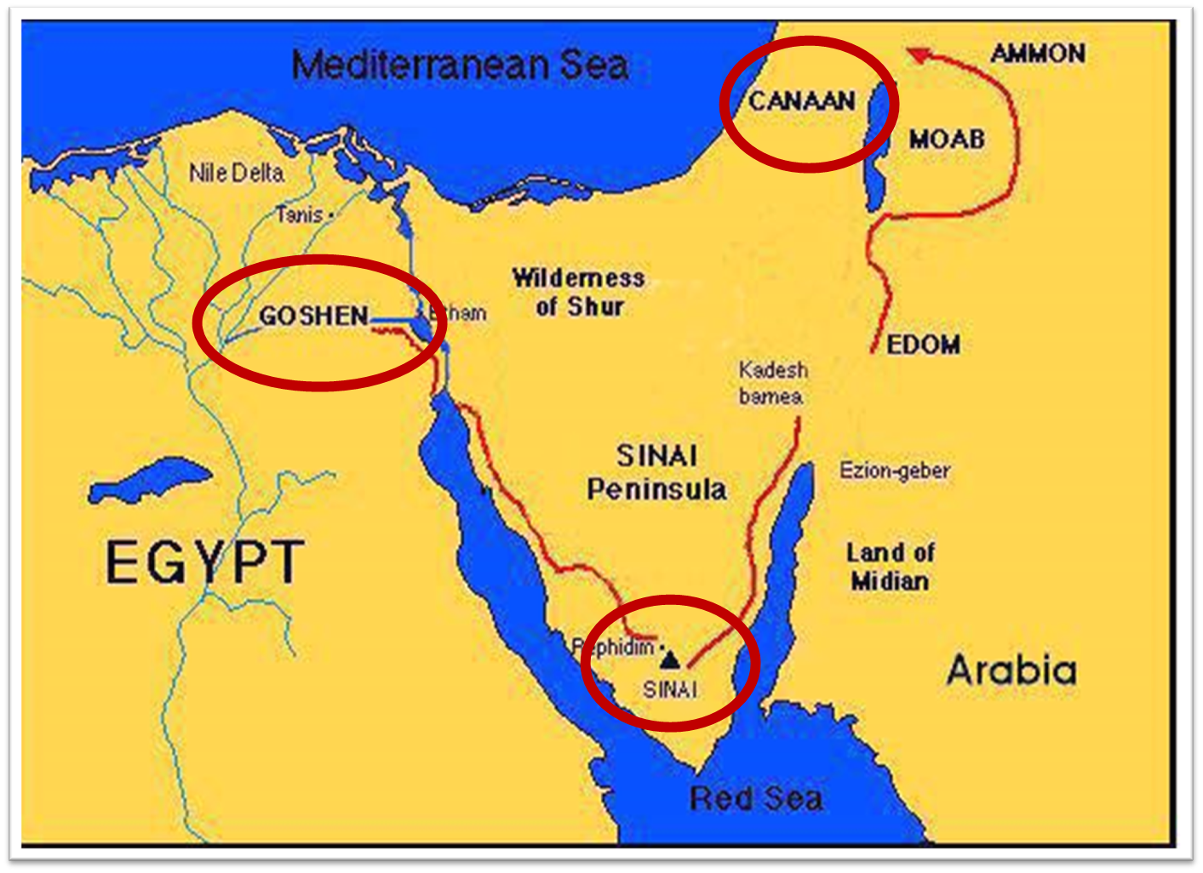

Slide 21
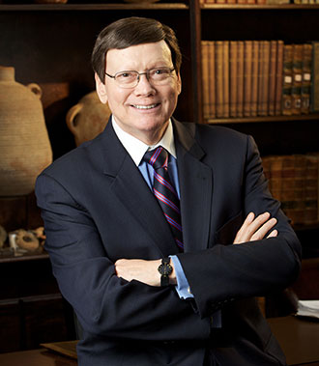
Dr. Ed Hindson
Hindson, E. E., & Mitchell, D. R., eds. (2010). King James Version Bible Commentary for Today: The Most Up-to-Date Commentary on the Time-Honored Text of the King James Version (p. 84). Thomas Nelson.
“Canaanites … Jebusites. The list of Canaanite nations inhabiting the Promised Land ranges from two names (Gen. 13:7), five names (Num. 13:29), six names (Judg. 3:5), seven names (Deut. 7:1), ten names (Gen. 15:19–21), to twelve names (see Gen. 10:15–18).”

Slide 22
Genesis 15:18-21
¹⁸ On that day the Lord made a covenant with Abram, saying, “To your descendants I have given this land, From the river of Egypt as far as the great river, the river Euphrates: ¹⁹ the Kenite and the Kenizzite and the Kadmonite ²⁰ and the Hittite and the Perizzite and the Rephaim ²¹ and the Amorite and the Canaanite and the Girgashite and the Jebusite.”

Slide 23
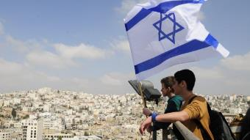
Reliability of the “Divine Regathering” Predictions
 | RETURN | PREDICTED | FULFILLED
1st | From Egypt to Canaan | Gen. 15:13-14 | Joshua 1‒12
2nd | From Babylon to Israel | Jer. 25:11; 29:10 | Ezra & Nehemiah
3rd | From the Diaspora to Israel’s restoration | Ezekiel 36:24-28 | Millennial Kingdom

Slide 24
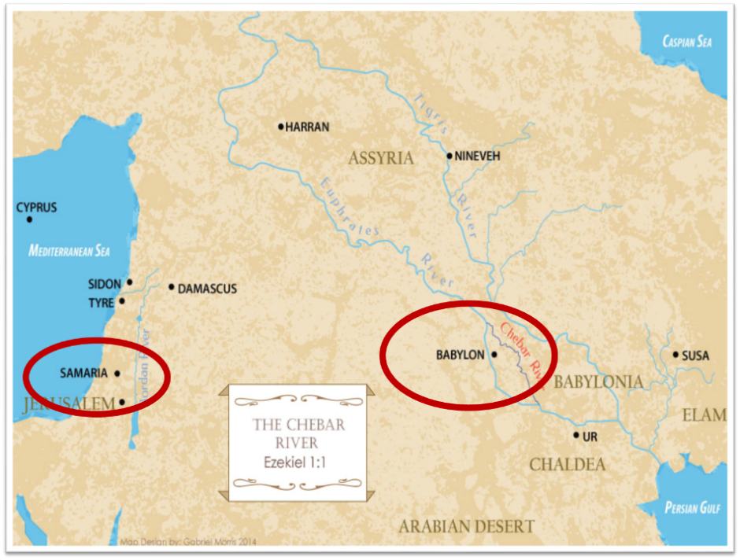

Slide 25
Exodus 3:4-10 God’s Message
God’s calling (4)
God’s holiness (5)
God’s covenant history (6)
God’s compassionate sight (7)
God’s direction (8)
God’s compassionate hearing (9)
God’s assignment (10)

Slide 26
Exodus 3:4-10 God’s Message
God’s calling (4)
God’s holiness (5)
God’s covenant history (6)
God’s compassionate sight (7)
God’s direction (8)
God’s compassionate hearing (9)
God’s assignment (10)

Slide 27
THREE PHASES OF MOSES’ 120 YEAR LIFE
LIFE PHASE | SCRIPTURE | YEARS | AGE | ACTIVITY
Natural Training | Acts 7:23 | 1526–1486 B.C. | 1-40 | Egyptian Education
Spiritual Training | Exod. 7:7 | 1486–1446 B.C. | 40-80 | Midian Shepherding
Ministry | Deut. 31:2; 34:7; Acts 7:36 | 1446–1406 B.C. | 80-120 | Exodus, Law, Wilderness Preservation, Pentateuch Authorship

Slide 28
Ephesians 2:8-10
“⁸ For by grace you have been saved through faith; and that not of yourselves, it is the gift of God; ⁹ not as a result of works, so that no one may boast. ¹⁰ For we are His workmanship, created in Christ Jesus for good works, which God prepared beforehand so that we would walk [peripateō, subjunctive mood] in them.”

Slide 30
MOSES’ CALLING Exodus 3:1-22
Moses’ mission (1-10)
Moses’ objections (11-15)
God’s prophecies (16-22)

Slide 31
II. Exodus 3:11-15 Moses’ Objections
1st objection (11-12)
2nd objection (13-15)

Slide 32
II. Exodus 3:11-15 Moses’ Objections
1st objection (11-12)
2nd objection (13-15)

Slide 33
Exodus 3:11-12 1st Objection
Inadequacy (11)
God’s presence (12)

Slide 34
Exodus 3:11-12 1st Objection
Inadequacy (11)
God’s presence (12)

Slide 35
THREE PHASES OF MOSES’ 120 YEAR LIFE
LIFE PHASE | SCRIPTURE | YEARS | AGE | ACTIVITY
Natural Training | Acts 7:23 | 1526–1486 B.C. | 1-40 | Egyptian Education
Spiritual Training | Exod. 7:7 | 1486–1446 B.C. | 40-80 | Midian Shepherding
Ministry | Deut. 31:2; 34:7; Acts 7:36 | 1446–1406 B.C. | 80-120 | Exodus, Law, Wilderness Preservation, Pentateuch Authorship

Slide 36
Exodus 3:11-12 1st Objection
Inadequacy (11)
God’s presence (12)

Slide 37
John 14:16-17
¹⁶ I will ask the Father, and He will give you another Helper, that He may be with you forever; ¹⁷ that is the Spirit of truth, whom the world cannot receive, because it does not see Him or know Him, but you know Him because He abides with you and will be in you.

Slide 40
EXODUS STRUCTURE/OUTLINE
Redemption (1–18)
Redemption (1:1–12:30)
Liberation (12:31–15:21)
Preservation (15:22–18:27)
Mosaic Covenant (19–40)
Law (19–24)
Tabernacle instructions (25–31)
Apostasy (32–34)
Tabernacle building (35–40)

Slide 41
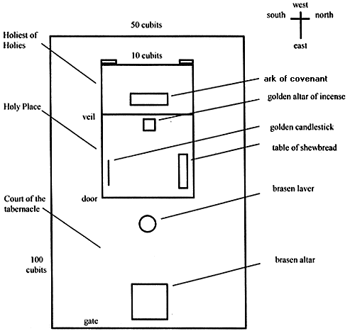
Tabernacle Diagram

Slide 42
II. Exodus 3:11-15 Moses’ Objections
1st objection (11-12)
2nd objection (13-15)

Slide 43
Exodus 3:13-15 2nd Objection
No authority (13)
God’s name (14-15)

Slide 44
Exodus 3:13-15 2nd Objection
No authority (13)
God’s name (14-15)

Slide 45
THREE PHASES OF MOSES’ 120 YEAR LIFE
LIFE PHASE | SCRIPTURE | YEARS | AGE | ACTIVITY
Natural Training | Acts 7:23 | 1526–1486 B.C. | 1-40 | Egyptian Education
Spiritual Training | Exod. 7:7 | 1486–1446 B.C. | 40-80 | Midian Shepherding
Ministry | Deut. 31:2; 34:7; Acts 7:36 | 1446–1406 B.C. | 80-120 | Exodus, Law, Wilderness Preservation, Pentateuch Authorship

Slide 46
Exodus 3:13-15 2nd Objection
No authority (13)
God’s name (14-15)

Slide 49
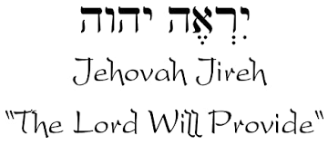

Slide 50
Names for God in Genesis
Elohim (1:1) – Power
Yahweh (2:4) – Relational
El Roi (Gen. 16:13) – Aware
El Olam (21:33) – Eternal
Jehovah Jireh (22:14) – Provision
God Isaac Feared (31:42, 53) – Reverenced
God, the God of Israel (33:20) – National

Slide 51
MOSES’ CALLING Exodus 3:1-22
Moses’ mission (1-10)
Moses’ objections (11-15)
God’s prophecies (16-22)

Slide 52
III. Exodus 3:16-22 God’s Prophecies
Israel’s land (16-17)
Israel’ leaders (18)
Pharaoh’s opposition (19)
Egypt’s judgment (20)
Israel’s plundering (21-22)

Slide 53
III. Exodus 3:16-22 God’s Prophecies
Israel’s land (16-17)
Israel’ leaders (18)
Pharaoh’s opposition (19)
Egypt’s judgment (20)
Israel’s plundering (21-22)

Slide 54
Reliability of the “Divine Regathering” Predictions
 | RETURN | PREDICTED | FULFILLED
1st | From Egypt to Canaan | Gen. 15:13-14 | Joshua 1‒12
2nd | From Babylon to Israel | Jer. 25:11; 29:10 | Ezra & Nehemiah
3rd | From the Diaspora to Israel’s restoration | Ezekiel 36:24-28 | Millennial Kingdom

Slide 56
III. Exodus 3:16-22 God’s Prophecies
Israel’s land (16-17)
Israel’ leaders (18)
Pharaoh’s opposition (19)
Egypt’s judgment (20)
Israel’s plundering (21-22)

Slide 57
EXODUS STRUCTURE/OUTLINE
Redemption (1–18)
Redemption (1:1–12:30)
Liberation (12:31–15:21)
Preservation (15:22–18:27)
Mosaic Covenant (19–40)
Law (19–24)
Tabernacle instructions (25–31)
Apostasy (32–34)
Tabernacle building (35–40)

Slide 58
Tabernacle Diagram

Slide 59
SHAPING AND POPULATING (GEN 1:1)
Day 1: | Light | Day 4: | Luminaries
Day 2: | Water, sky | Day 5: | Sea animals, birds
Day 3: | Land, vegetation | Day 6: | Land animals, man

Slide 60
III. Exodus 3:16-22 God’s Prophecies
Israel’s land (16-17)
Israel’ leaders (18)
Pharaoh’s opposition (19)
Egypt’s judgment (20)
Israel’s plundering (21-22)

Slide 61
III. Exodus 3:16-22 God’s Prophecies
Israel’s land (16-17)
Israel’ leaders (18)
Pharaoh’s opposition (19)
Egypt’s judgment (20)
Israel’s plundering (21-22)

Slide 62
The Plagues of Egypt
NO. | DESCRIPTION | SCRIPTURE | Egyptian Deity
1. | Water to Blood | Exod. 7:14-25 | Hapi, Khnum
2. | Frogs | Exod. 8:1-15 | Heqt
3. | Gnats | Exod. 8:16-19 | Set
4. | Flies | Exod. 8:20-32 | Uatchit
5. | Disease on Cattle | Exod. 9:1-7 | Hathor, Apis
6. | Boils | Exod. 9:8-12 | Sekhmet, Serapis
7. | Hail | Exod. 9:13-35 | Seth, Nut
8. | Locusts | Exod. 10:1-20 | Seth, Nut, Osiris
9. | Darkness | Exod. 10:21-29 | Re, Horus, Atum
10. | Death of the First Born | Exod. 12:29-36 | Min, Osiris, Heqt, Isis

Slide 63
III. Exodus 3:16-22 God’s Prophecies
Israel’s land (16-17)
Israel’ leaders (18)
Pharaoh’s opposition (19)
Egypt’s judgment (20)
Israel’s plundering (21-22)

Slide 64
Genesis 15:13, 16
“¹³ God said to Abram, ‘Know for certain that your descendants will be strangers in a land that is not theirs, where they will be enslaved and oppressed four hundred years… ¹⁶ Then in the fourth generation they will return here, for the wrongdoing of the Amorite is not yet complete.’”

Slide 65
EXODUS STRUCTURE/OUTLINE
Redemption (1–18)
Redemption (1:1–12:30)
Liberation (12:31–15:21)
Preservation (15:22–18:27)
Mosaic Covenant (19–40)
Law (19–24)
Tabernacle instructions (25–31)
Apostasy (32–34)
Tabernacle building (35–40)

Slide 66
Tabernacle Diagram

Slide 68
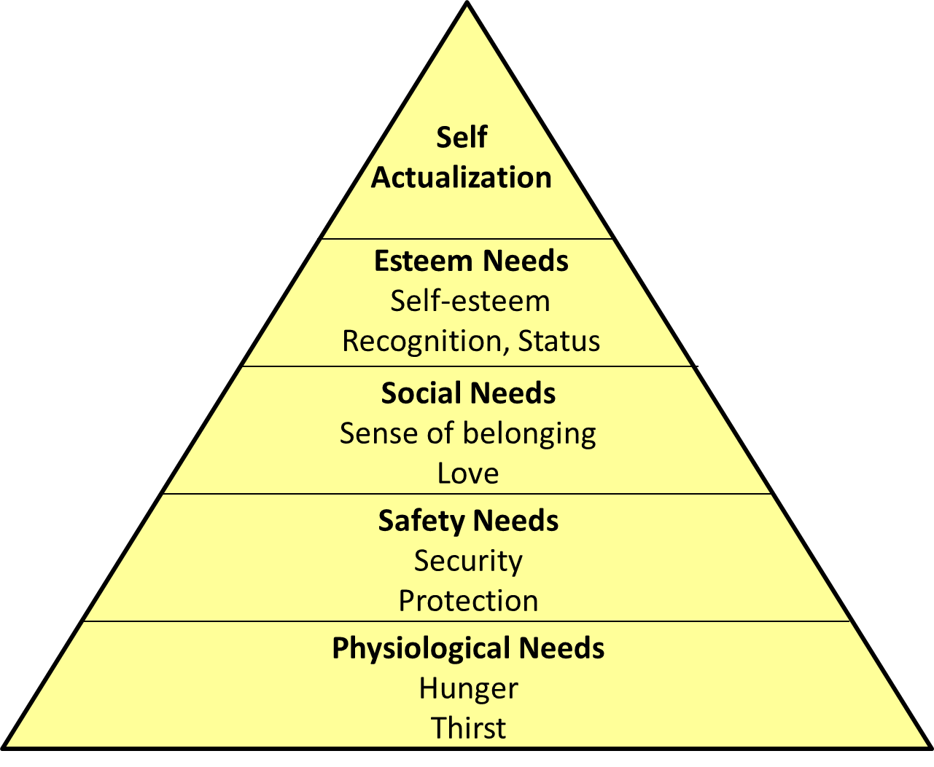
Maslow’s Hierarchy of Needs

Slide 69
2 Timothy 3:16-17
“¹⁶ All Scripture is inspired by God [theopneustos] and profitable for teaching, for reproof, for correction, for training in righteousness; ¹⁷ so that the man of God may be adequate, equipped for every good work.”

Slide 70
2 Peter 1:3-4
“³ Seeing that His divine power has granted to us everything pertaining to life and godliness, through the true knowledge of Him who called us by His own glory and excellence. ⁴For by these He has granted to us His precious and magnificent promises, so that by them you may become partakers of the divine nature, having escaped the corruption that is in the world by lust.”

Slide 71
1 Peter 2:2
“like newborn babies, long for the pure [adolos] milk of the word, so that by it you may grow in respect to salvation, ³ if you have tasted the kindness of the Lord.”

Slide 72
Chafer Theological Seminary Distinctives:
sufficiency of the scriptures
"We believe in the complete adequacy of Scripture, for in it God has given us all things that pertain to life and godliness. We hold, therefore, that the Word of God by itself is sufficient to prepare a person for a lifetime of effective ministry.”
https://www.chafer.edu/distinctives

Slide 73
Conclusion

Slide 74
MOSES’ CALLING Exodus 3:1-22
Moses’ mission (1-10)
Moses’ objections (11-15)
God’s prophecies (16-22)

Slide 75
²⁴ The Lord bless you, and keep you; ²⁵ The Lord make His face shine on you, And be gracious to you; ²⁶ The Lord lift up His countenance on you, And give you peace.
Numbers 6:24–26 (NASB95)

