Slide 2
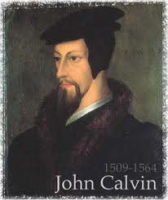
Neo-Calvinism vs. The Bible
Calvinism’s Mixed Blessing
Why Critique Calvinism?
The Source of Calvin’s Theology
Calvin’s Manner of Life
TULIP Through the Grid of Scripture
Conclusion

Slide 3
V. Running TULIP Through the Grid of Scripture
Total Depravity
Unconditional Election
Limited Atonement
Irresistible Grace
Perseverance of the Saints

Slide 4
Irresistible Grace
Calvinistic definition
Calvinistic arguments
Man can resist God’s grace
Man can resist God by disbelieving
John 6:44?

Slide 5
Irresistible Grace = ‘Regeneration Precedes Faith & Faith is a Gift’
“I” stands for “Irresistible Grace.” Faith is something “God irresistibly bestowed upon the elect without their having believed anything…By such reasoning, man…can’t even hear the gospel—much less respond to the pleadings of Christ.”
Bob Kirkland, Calvinism: None Dare Call It Heresy; Spotlight on the Life and Teachings of John Calvin (Eureka, MT: Lighthouse Trails, 2018), 34.

Slide 6
Irresistible Grace
Calvinistic definition
Calvinistic arguments
Man can resist God’s grace
Man can resist God by disbelieving
John 6:44?

Slide 7
Calvinistic Arguments
Faith is a gift
Regeneration precedes faith
Lost man cannot seek God (Rom. 3:11)

Slide 8
Irresistible Grace
Calvinistic definition
Calvinistic arguments
Man can resist God’s grace
Man can resist God by disbelieving
John 6:44?

Slide 9
Man Can Resist God’s Grace
Gen. 6:3 (1 Pet. 3:20; 2 Pet. 2:5)
Prov. 1:24-25; 29:1
Matt. 23:37
John 12:32 (Rev. 20:11-15)
Acts 7:51
Heb. 12:25

Slide 10
Irresistible Grace
Calvinistic definition
Calvinistic arguments
Man can resist God’s grace
Man can resist God by disbelieving
John 6:44?

Slide 11
Man Can Resist God By Disbelieving
John 10:25
John 12:37
Acts 9:26; 19:9; 28:24
2 Thess. 2:12

Slide 12
Man Can Resist God By Disbelieving
John 10:25
John 12:37
Acts 9:26; 19:9; 28:24
2 Thess. 2:12

Slide 13
Man Can Resist God By Disbelieving
John 10:25
John 12:37
Acts 9:26; 19:9; 28:24
2 Thess. 2:12

Slide 14
John 12:37
“But though He had performed so many signs before them, yet they were not believing in Him.”

Slide 15
OUTLINE OF JOHN
1:1-18 | HEAVENLY GENEALOGY (Explains who Jesus is)
1:19-11:57 | PUBLIC MINISTRY ( 7 signs & discourses)
12:1-50 | TRIUMPHAL ENTRY (public national rejection of Christ-12:37)
13-17 | UPPER ROOM DISCOURSE (new dispensation)
18-21 | PASSION NARRATIVES (crucifixion to resurrection)

Slide 16
Man Can Resist God By Disbelieving
John 10:25
John 12:37
Acts 9:26; 19:9; 28:24
2 Thess. 2:12

Slide 17
Man Can Resist God By Disbelieving
John 10:25
John 12:37
Acts 9:26; 19:9; 28:24
2 Thess. 2:12

Slide 18
Irresistible Grace
Calvinistic definition
Calvinistic arguments
Man can resist God’s grace
Man can resist God by disbelieving
John 6:44?

Slide 19
John 6:44
“No one can come to Me unless the Father who sent Me draws (helkyō) him; and I will raise him up on the last day.”

Slide 20
John 6:44?
Verb helkyō can mean “drag” (Acts 21:30; Jas. 2:6)
What does it mean in John’s Gospel?
John 12:32, 37-40
John 18:10; 21:6, 11 (inanimate objects)
Verb helkyō can mean “attract” or “draw” rather than coerce

Slide 21
John 6:44?
Verb helkyō can mean “drag” (Acts 21:30; Jas. 2:6)
What does it mean in John’s Gospel?
John 12:32, 37-40
John 18:10; 21:6, 11 (inanimate objects)
Verb helkyō can mean “attract” or “draw” rather than coerce

Slide 23
Illegitimate Totality Transfer
D. A. Carson, Exegetical Fallacies, 2nd ed. (Grand Rapids, MI: Baker Academic, 1996), 60-61.
“Unwarranted adoption of an expanded semantic field: The fallacy in this instance lies in the supposition that the meaning of a word in a specific context is much broader than the context itself allows and may bring with it the word’s entire semantic range. This step is sometimes called illegitimate totality transfer.”

Slide 24
John 6:44?
Verb helkyō can mean “drag” (Acts 21:30; Jas. 2:6)
What does it mean in John’s Gospel?
John 12:32, 37-40
John 18:10; 21:6, 11 (inanimate objects)
Verb helkyō can mean “attract” or “draw” rather than coerce

Slide 25
John 6:44?
Verb helkyō can mean “drag” (Acts 21:30; Jas. 2:6)
What does it mean in John’s Gospel?
John 12:32, 37-40
John 18:10; 21:6, 11 (inanimate objects)
Verb helkyō can mean “attract” or “draw” rather than coerce

Slide 26
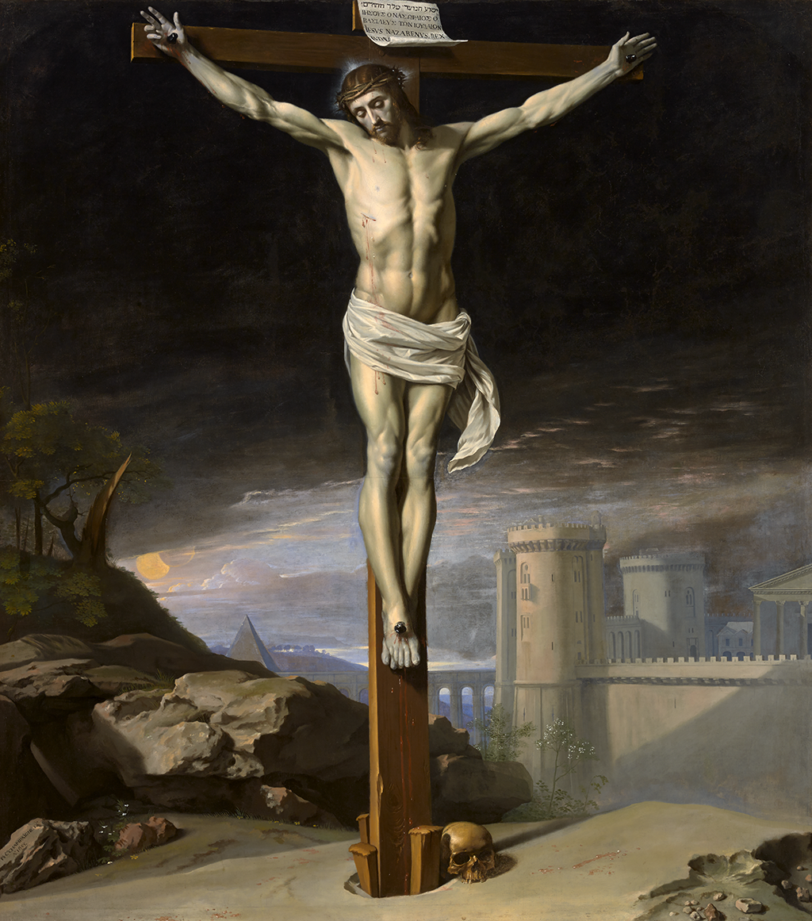
John 12:32
“And I, if I am lifted up from the earth, will draw (helkyō) all men to Myself.”

Slide 27
John 12:37
“But though He had performed so many signs before them, yet they were not believing in Him.”

Slide 28
John 6:44?
Verb helkyō can mean “drag” (Acts 21:30; Jas. 2:6)
What does it mean in John’s Gospel?
John 12:32, 37-40
John 18:10; 21:6, 11 (inanimate objects)
Verb helkyō can mean “attract” or “draw” rather than coerce

Slide 29
John 6:44?
Verb helkyō can mean “drag” (Acts 21:30; Jas. 2:6)
What does it mean in John’s Gospel?
John 12:32, 37-40
John 18:10; 21:6, 11 (inanimate objects)
Verb helkyō can mean “attract” or “draw” rather than coerce

Slide 30
Frederick L. Godet
“helkyō, to draw, does not necessarily denote an effectual drawing. This word may refer only to the preaching of the cross throughout the whole world and the action of the Holy Spirit which accompanies it. This heavenly drawing is not irresistible.”
Frederick L. Godet, Commentary on the Gospel of John, trans. Timothy Dwight [n.p.: Funk & Wagnalls, 1893; reprint, Grand Rapids: Zondervan, n.d.], 228.

Slide 31
God’s Grace to the Unsaved
Holy Spirit’s conviction (John 16:7-11)
God’s Word (Isa. 55:10-11)
Gospel (Rom. 1:16)
Creation (Ps. 19:1-4)
Conscience (Rom. 2:14-15)

Slide 32
John 1:9
“There was the true Light which, coming into the world, enlightens every man.”

Slide 33
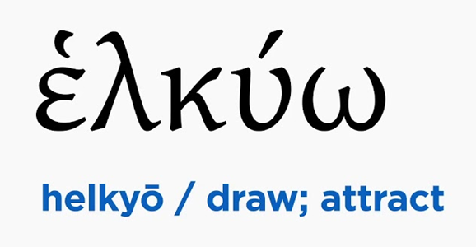
John 6:40, 44
“For this is the will of My Father, that everyone who beholds the Son and believes in Him will have eternal life, and I Myself will raise him up on the last day…No one can come to Me unless the Father who sent Me draws (helkyō) him; and I will raise him up on the last day.”

Slide 34
V. Running TULIP Through the Grid of Scripture
Total Depravity
Unconditional Election
Limited Atonement
Irresistible Grace
Perseverance of the Saints

