Slide 1
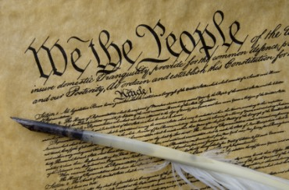

Seven Divine Institutions
Dr. Andy Woods
Senior Pastor – Sugar Land Bible Church
President – Chafer Theological Seminary

Slide 2

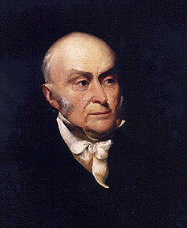
John Quincy Adams
“The birth-day of the nation is indissolubly linked with the birth-day of the Saviour [and] forms a leading event in the progress of the gospel dispensation… the Declaration of Independence first organized the social compact on the foundation of the Redeemer’s mission upon the earth [and] laid the corner stone of human government upon the first precepts of Christianity.”
John Quincy Adams, An Oration Delivered before the Inhabitants of the Town of Newburyport at Their Request on the Sixty-First Anniversary of the Declaration of Independence (Newburyport: Whipple, 1837), 5-6.

Slide 3

Mark 7:20–23
²⁰ And He was saying, “That which proceeds out of the man, that is what defiles the man. ²¹ “For from within, out of the heart of men, proceed the evil thoughts, fornications, thefts, murders, adulteries, ²² deeds of coveting and wickedness, as well as deceit, sensuality, envy, slander, pride and foolishness. ²³ “All these evil things proceed from within and defile the man.”

Slide 4

Seven Divine Institutions
Sanctity of Life (Gen. 1:27)
Labor (Gen. 2:15)
Marriage (Gen. 2:18-25)
Family (Gen. 1:26-28)
Conscience (Gen. 3:22)
Human Government (Gen. 9:6)
Nationalism (Gen. 11:6)

Slide 5
Seven Divine Institutions
Sanctity of Life (Gen. 1:27)
Labor (Gen. 2:15)
Marriage (Gen. 2:18-25)
Family (Gen. 1:26-28)
Conscience (Gen. 3:22)
Human Government (Gen. 9:6)
Nationalism (Gen. 11:6)

Slide 6
Genesis 1:27
“God created man in His own image, in the image of God He created him; male and female He created them.”

Slide 7


Genesis 9:6
“Whoever sheds man’s blood, By man his blood shall be shed, For in the image of God He made man.”

Slide 8

Genesis 1:26-28
²⁶ Then God said, “Let Us make man in Our image, according to Our likeness; and let them rule over the fish of the sea and over the birds of the sky and over the cattle and over all the earth, and over every creeping thing that creeps on the earth.” ²⁷ God created man in His own image, in the image of God He created him; male and female He created them. ²⁸ God blessed them; and God said to them, “Be fruitful and multiply, and fill the earth, and subdue it; and rule over the fish of the sea and over the birds of the sky and over every living thing that moves on the earth.”

Slide 9
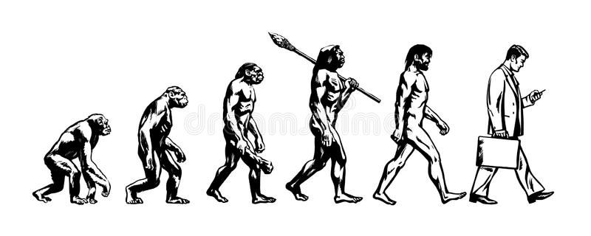

Slide 10
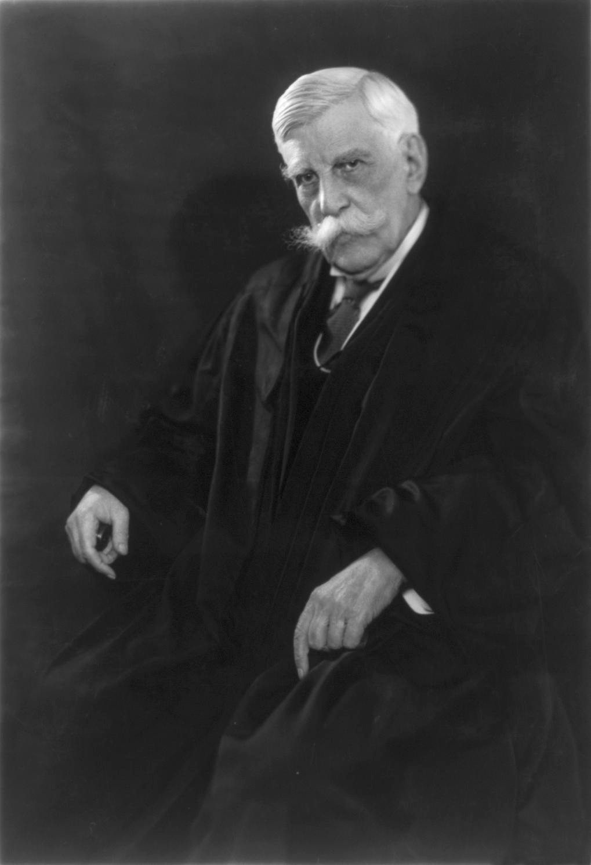
Oliver Wendell Holmes
(cited in Richard Hertz, Chance and Symbol (Chicago: University of Chicago Press, 1948), 107.)
“I see no reason for attributing to man a significance different in kind from that which belongs to a baboon or a grain of sand.”

Slide 11
Seven Divine Institutions
Sanctity of Life (Gen. 1:27)
Labor (Gen.2:15)
Marriage (Gen. 2:18-25)
Family (Gen. 1:26-28)
Conscience (Gen. 3:22)
Human Government (Gen. 9:6)
Nationalism (Gen. 11:6)

Slide 12

Genesis 3:19
“By the sweat of your face You will eat bread, Till you return to the ground, Because from it you were taken; For you are dust, And to dust you shall return.”

Slide 13
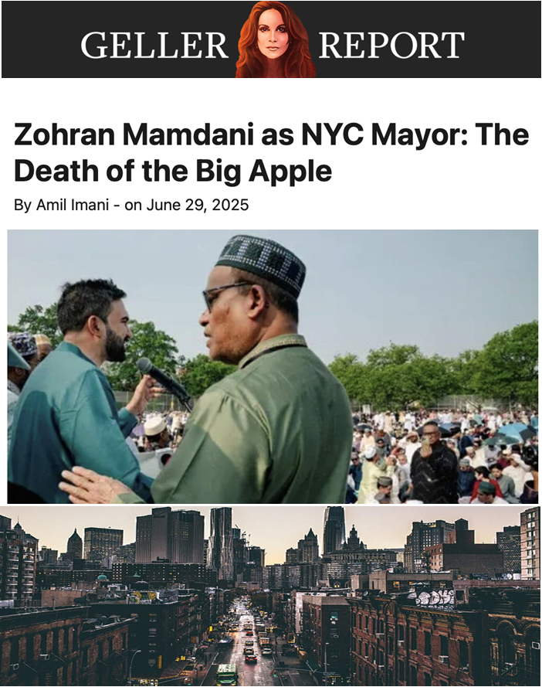

Slide 14
Genesis 3:19
“By the sweat of your face You will eat bread, Till you return to the ground, Because from it you were taken; For you are dust, And to dust you shall return.”

Slide 15
Seven Divine Institutions
Sanctity of Life (Gen. 1:27)
Labor (Gen. 2:15)
Marriage (Gen. 2:18-25)
Family (Gen. 1:26-28)
Conscience (Gen. 3:22)
Human Government (Gen. 9:6)
Nationalism (Gen. 11:6)

Slide 16

Matthew 19:3-6
³ Some Pharisees came to Jesus, testing Him and asking, “Is it lawful for a man to divorce his wife for any reason at all?” ⁴ And He answered and said, “Have you not read that He who created them from the beginning made them male and female, ⁵ and said, ‘For this reason a man shall leave his father and mother and be joined to his wife, and the two shall become one flesh’? ⁶ “So they are no longer two, but one flesh. What therefore God has joined together, let no man separate.”

Slide 17

Genesis 1:27
“God created man in His own image, in the image of God He created him; male and female He created them.”
Genesis 2:24
“For this reason a man shall leave his father and his mother, and be joined to his wife; and they shall become one flesh.”

Slide 18
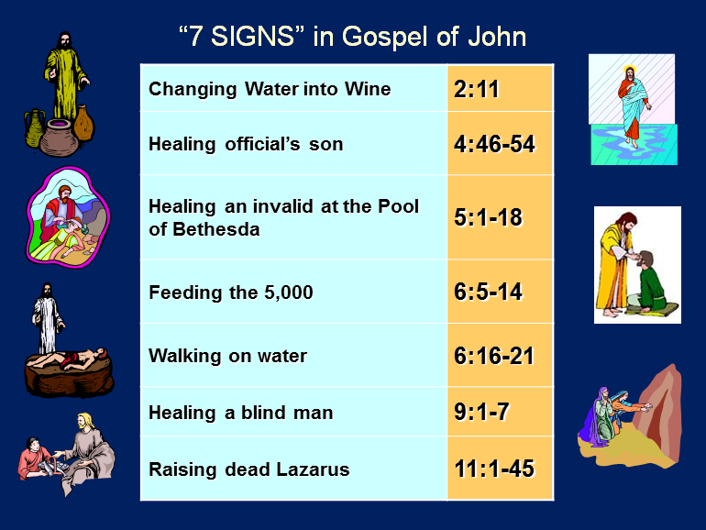

Slide 19
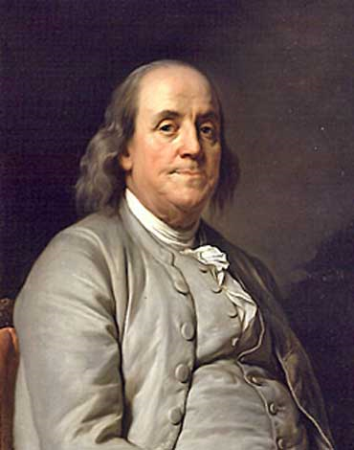
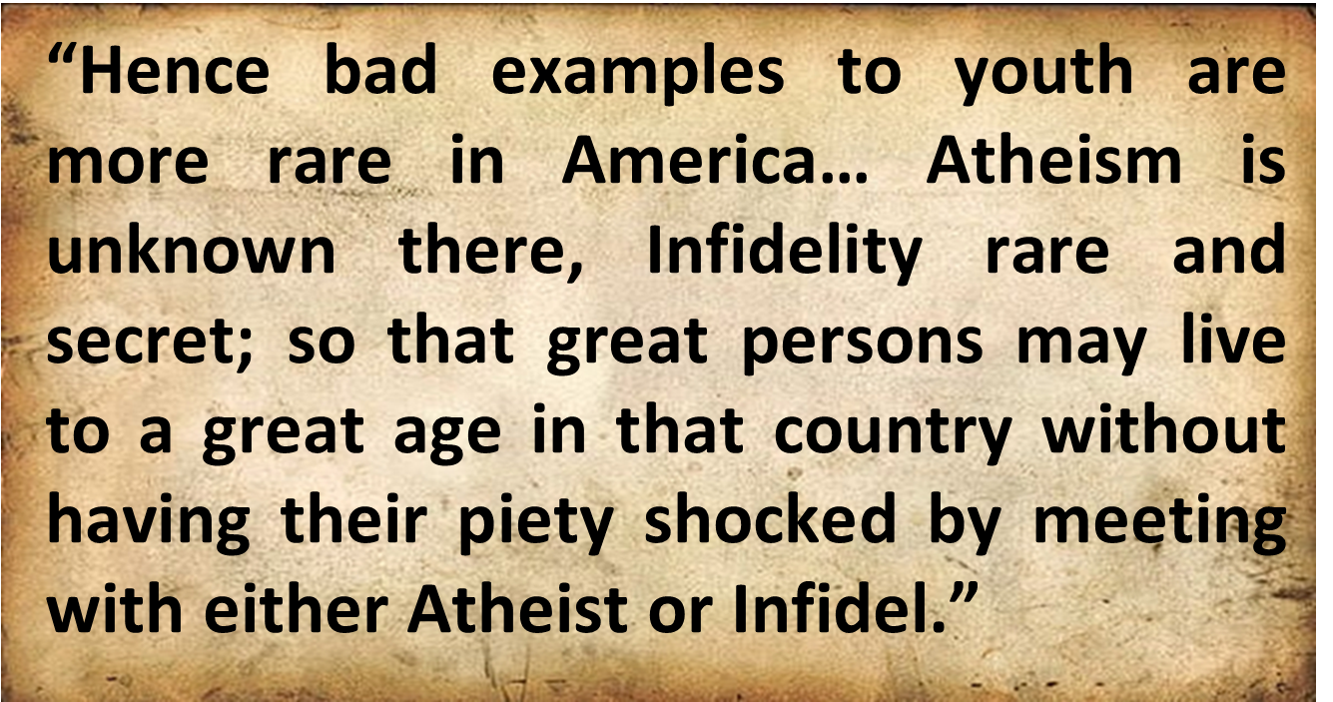
Benjamin Franklin
Benjamin Franklin, “Advice on Coming to America,” America in Person, ed. George D. Youstra, 109.

Slide 20

1 Timothy 4:1
“¹ But the Spirit explicitly says that in later times some will fall away from the faith, paying attention to deceitful spirits and doctrines of demons. ² by means of the hypocrisy of liars seared in their own conscience as with a branding iron, ³ men who forbid marriage and advocate abstaining from foods which God has created to be gratefully shared in by those who believe and know the truth.”

Slide 21

Genesis 2:24
“For this reason a man shall leave his father and his mother, and be joined to his wife; and they shall become one flesh.”

Slide 22
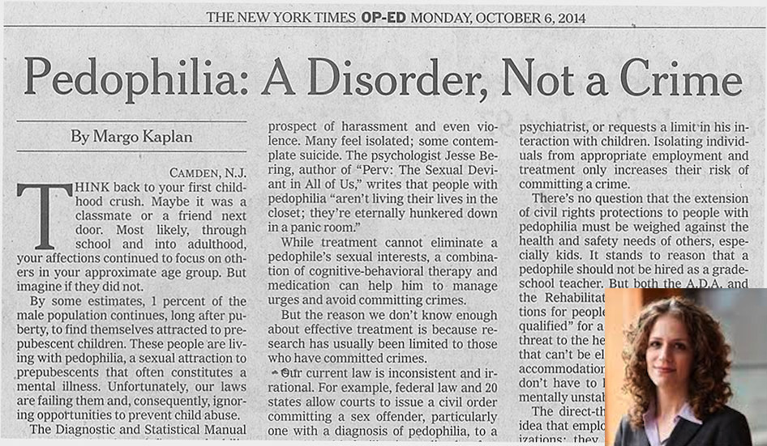

Slide 23


Slide 24
Seven Divine Institutions
Sanctity of Life (Gen. 1:27)
Labor (Gen. 2:15)
Marriage (Gen. 2:18-25)
Family (Gen. 1:26-28)
Conscience (Gen. 3:22)
Human Government (Gen. 9:6)
Nationalism (Gen. 11:6)

Slide 25
Genesis 1:26-28
²⁶ Then God said, “Let Us make man in Our image, according to Our likeness; and let them rule over the fish of the sea and over the birds of the sky and over the cattle and over all the earth, and over every creeping thing that creeps on the earth.” ²⁷ God created man in His own image, in the image of God He created him; male and female He created them. ²⁸ God blessed them; and God said to them, “Be fruitful and multiply, and fill the earth, and subdue it; and rule over the fish of the sea and over the birds of the sky and over every living thing that moves on the earth.”

Slide 26


Jeremiah 17:9
“The heart is more deceitful than all else And is desperately sick; Who can understand it?.”

Slide 27

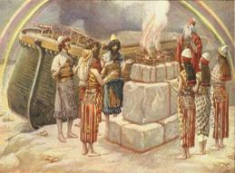
Genesis 8:21
The Lord smelled the soothing aroma; and the Lord said to Himself, “I will never again curse the ground on account of man, for the intent of man’s heart is evil from his youth; and I will never again destroy every living thing, as I have done. [emphasis mine].

Slide 28
Psalm 51:5
“Behold, I was brought forth in guilt,
And in sin my mother conceived me.”

Slide 29

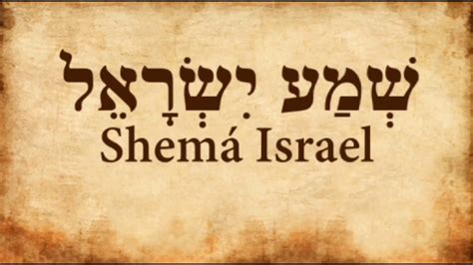
Deuteronomy 6:4-7
“⁴ Hear, Israel! The Lord is our God, the Lord is one!... ⁶ These words, which I am commanding you today, shall be on your heart. ⁷ You shall teach them diligently to your sons and shall talk of them when you sit in your house and when you walk by the way and when you lie down and when you rise up.”
29

Slide 30


Slide 31


Slide 32


Slide 33
Seven Divine Institutions
Sanctity of Life (Gen. 1:27)
Labor (Gen. 2:15)
Marriage (Gen. 2:18-25)
Family (Gen. 1:26-28)
Conscience (Gen. 3:22)
Human Government (Gen. 9:6)
Nationalism (Gen. 11:6)

Slide 34

Romans 2:14–16
¹⁴“For when Gentiles who do not have the Law do instinctively the things of the Law, these, not having the Law, are a law to themselves, ¹⁵ in that they show the work of the Law written in their hearts, their conscience bearing witness and their thoughts alternately accusing or else defending them, ¹⁶ on the day when, according to my gospel, God will judge the secrets of men through Christ Jesus.”

Slide 35
1 Timothy 4:1
“¹ But the Spirit explicitly says that in later times some will fall away from the faith, paying attention to deceitful spirits and doctrines of demons. ² by means of the hypocrisy of liars seared in their own conscience as with a branding iron, ³ men who forbid marriage and advocate abstaining from foods which God has created to be gratefully shared in by those who believe and know the truth.”

Slide 36
Seven Divine Institutions
Sanctity of Life (Gen. 1:27)
Labor (Gen. 2:15)
Marriage (Gen. 2:18-25)
Family (Gen. 1:26-28)
Conscience (Gen. 3:22)
Human Government (Gen. 9:6)
Nationalism (Gen. 11:6)

Slide 37

Genesis 6:11-13
“¹¹ Now the earth was corrupt in the sight of God, and the earth was filled with violence [חָמָס; chamas]. ¹² And God looked on the earth, and behold, it was corrupt; for humanity had corrupted its way upon the earth. ¹³ Then God said to Noah, ‘The end of humanity has come before Me; for the earth is filled with violence [חָמָס; chamas] because of people; and behold, I am about to destroy them with the earth.’”

Slide 38
Genesis 9:6
“Whoever sheds man’s blood, By man his blood shall be shed, For in the image of God He made man.”

Slide 39

Romans 13:3-5
“For rulers are not a cause of fear for good behavior, but for evil. Do you want to have no fear of authority? Do what is good and you will have praise from the same; for it [government] is a minister of God to you for good. But if you do what is evil, be afraid; for it [government] does not bear the sword for nothing; for it [government] is a minister of God, an avenger who brings wrath on the one who practices evil.”

Slide 40

1 Peter 2:13-14
“Submit yourselves for the Lord’s sake to every human institution, whether to a king as the one in authority, or to governors as sent by him for the punishment of evildoers and the praise of those who do right.”

Slide 41

Believer's Responsibilities to State
Respect (Rom. 13:7)
Taxes (Rom. 13:7)
Prayer (1 Tim. 2:1-2)
Submission (Rom. 13:1)

Slide 42

Titus 3:1
“Remind them to be subject to rulers, to authorities, to be obedient, to be ready for every good deed.”

Slide 43
Ecclesiastes 8:11
“Because the sentence against an evil deed is not executed quickly, therefore the hearts of the sons of men among them are given fully to do evil.”

Slide 44
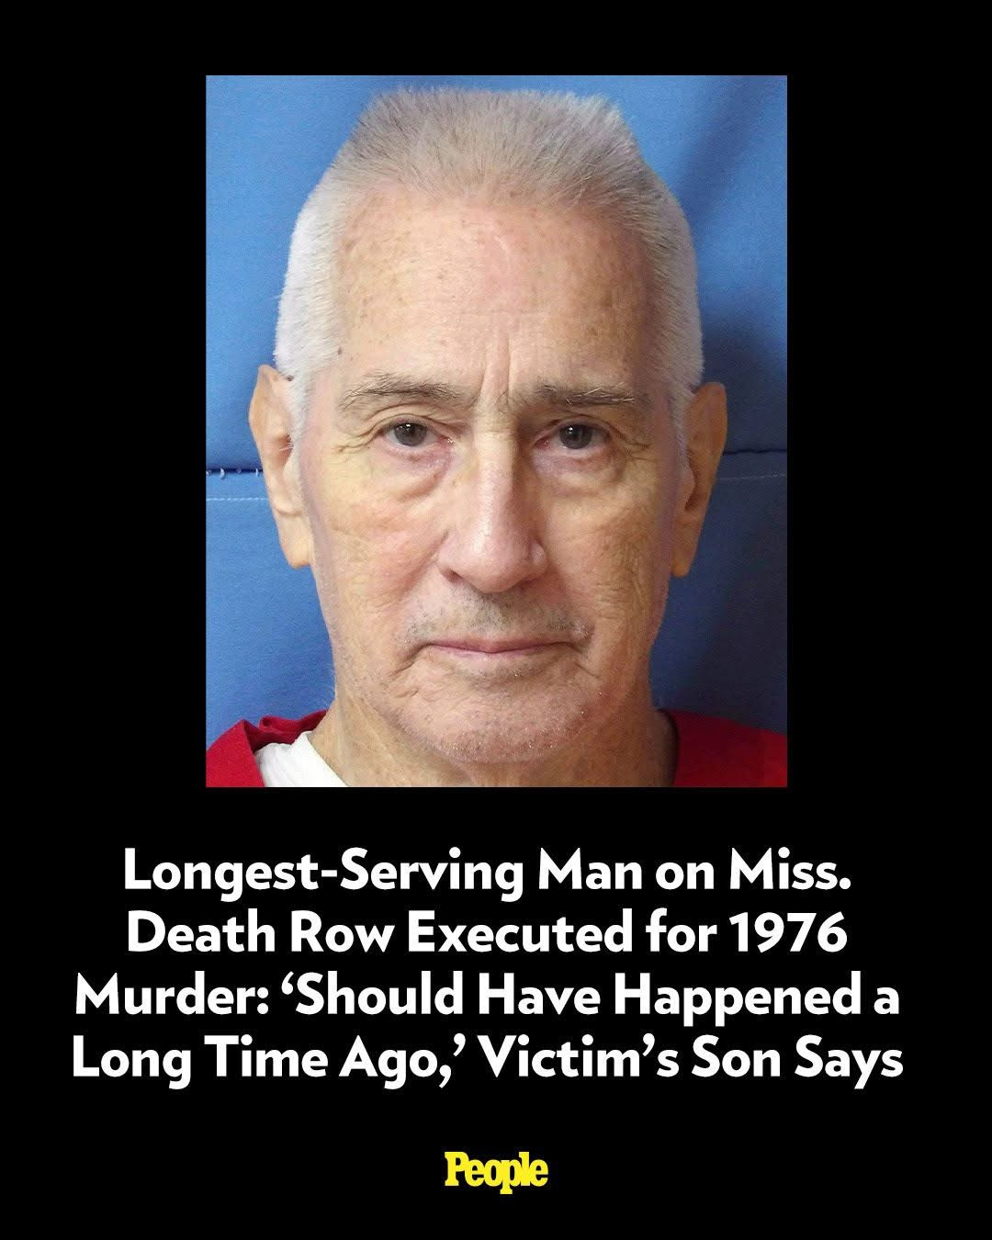

Slide 45
Seven Divine Institutions
Sanctity of Life (Gen. 1:27)
Labor (Gen. 2:15)
Marriage (Gen. 2:18-25)
Family (Gen. 1:26-28)
Conscience (Gen. 3:22)
Human Government (Gen. 9:6)
Nationalism (Gen. 11:6)

Slide 46

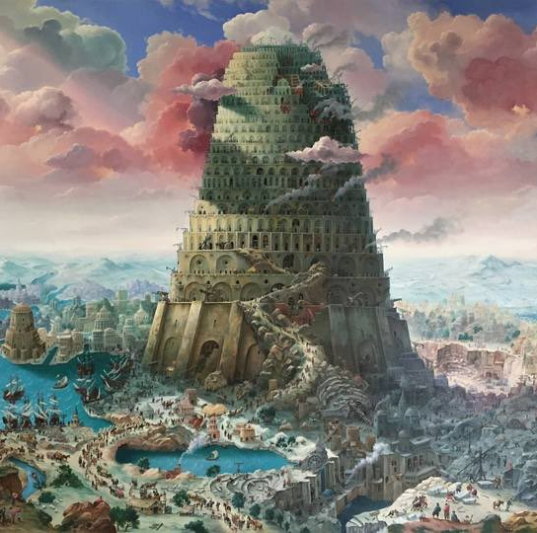
Genesis 11:6
The Lord said, “Behold, they are one people, and they all have the same language. And this is what they began to do, and now nothing which they purpose to do will be impossible for them.”

Slide 47
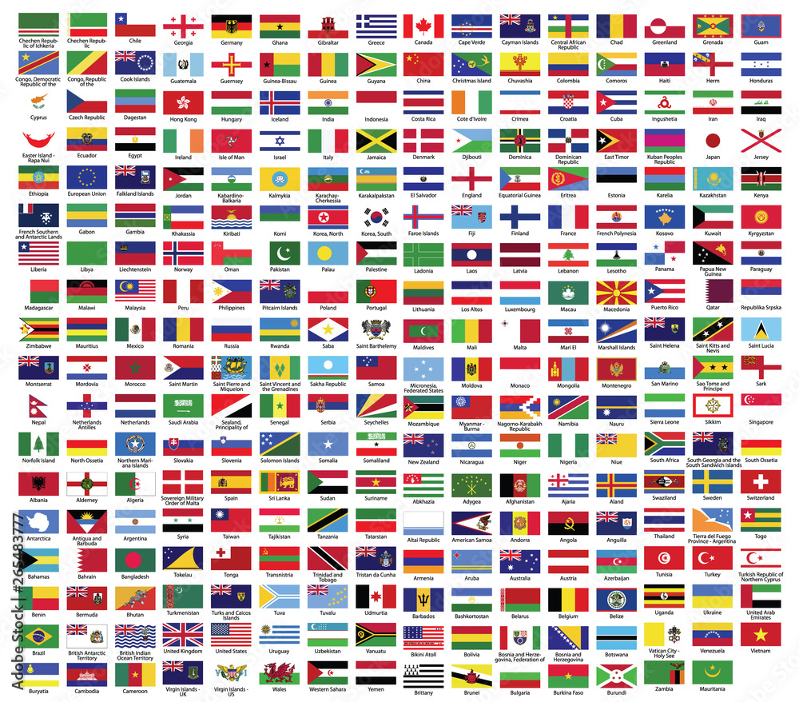
Genesis 10:32
“These are the families of the sons of Noah, according to their genealogies, by their nations; and out of these the nations were separated on the earth after the flood.”

Slide 48
God’s Doctrine of Nations
Since Babel | Deut. 32:8; Acts 17:26
Millennium | Isaiah 2:4; 66:18; Zech. 14:16-18; Rev. 12:5; 20:3
Eternal State | Rev. 21:24, 26

Slide 49

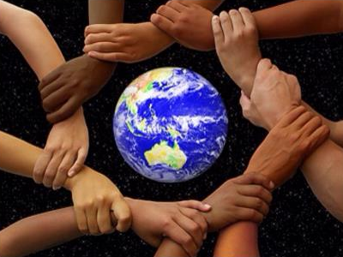
Deuteronomy 32:8
“When the Most High gave the nations their inheritance, When He separated the sons of man, He set the boundaries of the peoples According to the number of the sons of Israel.”

Slide 50

Acts 17:26
and He made from one man every nation of mankind to live on all the face of the earth, having determined their appointed times and the boundaries of their habitation, (Italics added)

Slide 51

Sine Qua Non of Nationhood
Common language
Common culture
Common currency
Enforceable national borders

Slide 52

Megan Basham
Shepherds for Sale, 50.
“Scripture does not require us to sacrifice national sovereignty. In fact, Acts 17:26 tells us that God ‘marked out [our] appointed times in history and the boundaries of [our] lands.’ The Lord is not opposed to borders; He invented them. Nor does this command require us to abandon good sense and prudence when setting limits for how many immigrants we admit and what qualifications we use for doing so.”
Megan Basham, Shepherds for Sale: How Evangelical Leaders Traded the Truth for a Leftist Agenda (NY: Broadside Books, 2024), 50.

Slide 53
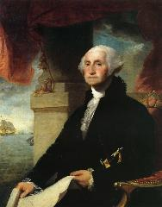
George Washington’s Farwell Address of 1790
"It is our true policy to steer clear of permanent alliances with any portion of the foreign world."
George Washington, “Washington’s Farewell Address,” online: www.wikapedia.org, accessed 7 May 2010, 1.

Slide 54


Daniel 7:23
“Thus he said: ‘The fourth beast will be a fourth kingdom on the earth, which will be different from all the other kingdoms and will devour the whole earth and tread it down and crush it.’”

Slide 55
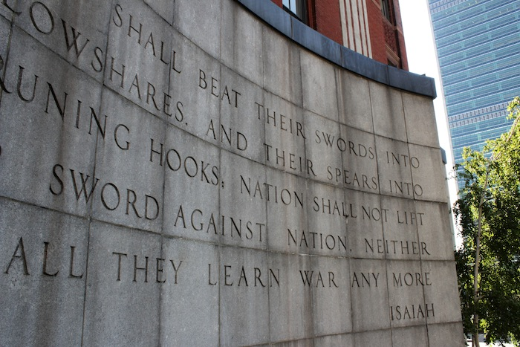

Slide 56

Humanist Manifesto II (1973)
“We deplore the division of humankind on nationalistic grounds. We have reached a turning point in human history where the best option is to transcend the limits of national sovereignty and to move toward the building of a world community… a system of world law and world order based upon transnational federal government.”

Slide 57
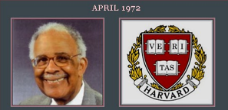
Globalist Proselytizing
“Every child in America entering school at the age of five is mentally ill because he comes to school with certain allegiances to our founding fathers, toward our elected officials, toward his parents, toward a belief in a supernatural being, and toward the sovereignty of this nation as a separate entity. It's up to you as teachers to make all these sick children well by creating the international child of the future.”
Chester M. Pierce, Harvard psychiatrist, speaking as an expert in public education at the 1973 International Education Seminar.

Slide 58

Open Borders
“In a private, paid speech to a Brazilian bank on May 16, 2013, Hillary Clinton said: ‘My dream is a hemispheric common market, with open trade and open borders, some time in the future with energy that is as green and sustainable as we can get it, powering growth and opportunity for every person in the hemisphere.’ This secret speech was released as part of the Podesta emails obtained by Wikileaks.”
http://www.breitbart.com/live/third-presidential-debate-fact-check-livewire/fact-check-yes-hillary-clinton-wants-open-borders/

Slide 59
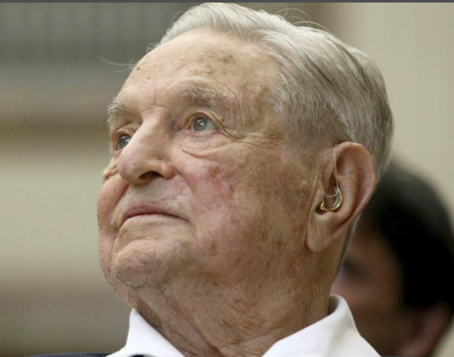
George Soros has made no secret of the fact that his aim is also to open the borders, saying in 2009 that “sovereignty is an anachronistic concept originating in bygone times.”
George Soros, “The People’s Sovereignty,” Foreign Policy, October 28, 2009, https://foreignpolicy.com/2009/10/28/the-peoples-sovereignty/

Slide 60
Conclusion

Slide 61
Seven Divine Institutions
Sanctity of Life (Gen. 1:27)
Labor (Gen. 2:15)
Marriage (Gen. 2:18-25)
Family (Gen. 1:26-28)
Conscience (Gen. 3:22)
Human Government (Gen. 9:6)
Nationalism (Gen. 11:6)

Slide 62
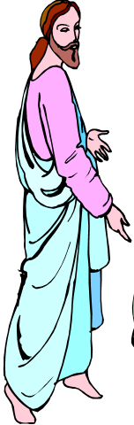
7 “I AM” statements in John
I am the Bread of Life | 6:35
I am the Light of the world | 8:12
I am the Gate for the sheep | 10:7; cf. v.9
I am the Good Shepherd | 10:11,14
I am the Resurrection and the Life | 11:25
I am the Way and the Truth and the Life | 14:6
I am the true Vine | 15:1; cf. v.5

Slide 63
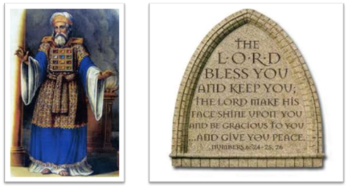
²⁴ The Lord bless you, and keep you; ²⁵ The Lord make His face shine on you, And be gracious to you; ²⁶ The Lord lift up His countenance on you, And give you peace.
Numbers 6:24–26 (NASB95)

