Slide 2
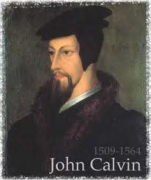
Neo-Calvinism vs. The Bible
Calvinism’s Mixed Blessing
Why Critique Calvinism?
The Source of Calvin’s Theology
Calvin’s Manner of Life
TULIP Through the Grid of Scripture
Conclusion

Slide 3
V. Running TULIP Through the Grid of Scripture
Total Depravity
Unconditional Election
Limited Atonement
Irresistible Grace
Perseverance of the Saints

Slide 4
Irresistible Grace
Calvinistic definition
Calvinistic arguments
Man can resist God’s grace
Man can resist God by disbelieving
John 6:44?

Slide 5
Irresistible Grace = ‘Regeneration Precedes Faith & Faith is a Gift’
“I” stands for “Irresistible Grace.” Faith is something “God irresistibly bestowed upon the elect without their having believed anything…By such reasoning, man…can’t even hear the gospel—much less respond to the pleadings of Christ.”
Bob Kirkland, Calvinism: None Dare Call It Heresy; Spotlight on the Life and Teachings of John Calvin (Eureka, MT: Lighthouse Trails, 2018), 34.

Slide 6
Irresistible Grace
Calvinistic definition
Calvinistic arguments
Man can resist God’s grace
Man can resist God by disbelieving
John 6:44?

Slide 7
Calvinistic Arguments
Faith is a gift
Regeneration precedes faith
Lost man cannot seek God (Rom. 3:11)

Slide 8
Romans 3:11
“There is none who understands, There is none who seeks for God.”

Slide 9
Acts 17:26-27
²⁶ and He made from one man every nation of mankind to live on all the face of the earth, having determined their appointed times and the boundaries of their habitation, ²⁷ that they would seek God, if perhaps they might grope for Him and find Him, though He is not far from each one of us (Italics added)

Slide 10
Lost Man Cannot Seek God?
No biblical verse indicates that lost man cannot believe when convicted
Lost man is held accountable for not believing (Matt. 23:37; John 3:18; 4:48; 5:40)
Lost man can believe (John 1:12; 20:31; 1 Cor. 1:21; 1 John 5:10)

Slide 11
God’s Grace to the Unsaved
Holy Spirit’s conviction
God’s Word
Gospel
Creation
Conscience
Conclusion

Slide 12
Lost Man Cannot Seek God?
No biblical verse indicates that lost man cannot believe when convicted
Lost man is held accountable for not believing (Matt. 23:37; John 3:18; 4:48; 5:40)
Lost man can believe (John 1:12; 20:31; 1 Cor. 1:21; 1 John 5:10)

Slide 13
Matthew 23:37-39
“Jerusalem, Jerusalem, who kills the prophets and stones those who are sent to her! How often I wanted to gather your children together, the way a hen gathers her chicks under her wings, and you were unwilling. ³⁸ Behold, your house is being left to you desolate! ³⁹ For I say to you, from now on you will not see Me until you say, ‘Blessed is He who comes in the name of the Lord!’”

Slide 14
Lost Man Cannot Seek God?
No biblical verse indicates that lost man cannot believe when convicted
Lost man is held accountable for not believing (Matt. 23:37; John 3:18; 4:48; 5:40)
Lost man can believe (John 1:12; 20:31; 1 Cor. 1:21; 1 John 5:10)

Slide 15
John 1:12-13
“But as many as received Him, to them He gave the right to become children of God, even to those who believe in His name, ¹³ who were born, not of blood nor of the will of the flesh nor of the will of man, but of God.”

Slide 16
John 20:30-31
“Therefore many other signs Jesus also performed in the presence of the disciples, which are not written in this book; but these have been written so that you may believe that Jesus is the Christ, the Son of God; and that believing you may have life in His name.”

Slide 17
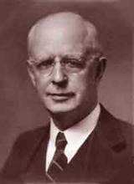
Lewis Sperry Chafer, vol. 7, Systematic Theology^{b} (Grand Rapids, MI: Kregel Publications, 1993), 265-66.
Belief-God’s One Condition for Justification
“…because upwards of 150 passages of Scripture condition salvation upon believing only (cf. John 3:16; Acts 16:31).

Slide 18
Calvinistic Arguments
Faith is a gift
Regeneration precedes faith
Lost man cannot seek God (Rom. 3:11)

Slide 19
Irresistible Grace
Calvinistic definition
Calvinistic arguments
Man can resist God’s grace
Man can resist God by disbelieving
John 6:44?

Slide 20
Man Can Resist God’s Grace
Gen. 6:3 (1 Pet. 3:20; 2 Pet. 2:5)
Prov. 1:24-25; 29:1
Matt. 23:37
John 12:32 (Rev. 20:11-15)
Acts 7:51
Heb. 12:25

Slide 21
Man Can Resist God’s Grace
Gen. 6:3 (1 Pet. 3:20; 2 Pet. 2:5)
Prov. 1:24-25; 29:1
Matt. 23:37
John 12:32 (Rev. 20:11-15)
Acts 7:51
Heb. 12:25

Slide 22
Genesis 6:1-4
“¹ Now it came about, when men began to multiply on the face of the land, and daughters were born to them, ² that the sons of God saw that the daughters of men were beautiful; and they took wives for themselves, whomever they chose. ³ Then the Lord said, ‘My Spirit shall not strive with man forever, because he also is flesh; nevertheless his days shall be one hundred and twenty years.’ ⁴ The Nephilim were on the earth in those days, and also afterward, when the sons of God came in to the daughters of men, and they bore children to them. Those were the mighty men who were of old, men of renown.”

Slide 23
Dr. Henry M. Morris
The Genesis Record, 144
“The ancient quibble about ‘Cain’s wife’ is thus seen to be quite trivial. Long before Cain died, there was a large population in the earth. By the time of the Deluge, 1,656 years after Creation by the Ussher chronology, even using the above conservative assumptions, the world population would have been at least seven billion people!”

Slide 24
Man Can Resist God’s Grace
Gen. 6:3 (1 Pet. 3:20; 2 Pet. 2:5)
Prov. 1:24-25; 29:1
Matt. 23:37
John 12:32 (Rev. 20:11-15)
Acts 7:51
Heb. 12:25

Slide 25
Man Can Resist God’s Grace
Gen. 6:3 (1 Pet. 3:20; 2 Pet. 2:5)
Prov. 1:24-25; 29:1
Matt. 23:37
John 12:32 (Rev. 20:11-15)
Acts 7:51
Heb. 12:25

Slide 26
Matthew 23:37-39
“Jerusalem, Jerusalem, who kills the prophets and stones those who are sent to her! How often I wanted to gather your children together, the way a hen gathers her chicks under her wings, and you were unwilling. ³⁸ Behold, your house is being left to you desolate! ³⁹ For I say to you, from now on you will not see Me until you say, ‘Blessed is He who comes in the name of the Lord!’”

Slide 27
Man Can Resist God’s Grace
Gen. 6:3 (1 Pet. 3:20; 2 Pet. 2:5)
Prov. 1:24-25; 29:1
Matt. 23:37
John 12:32 (Rev. 20:11-15)
Acts 7:51
Heb. 12:25

Slide 28
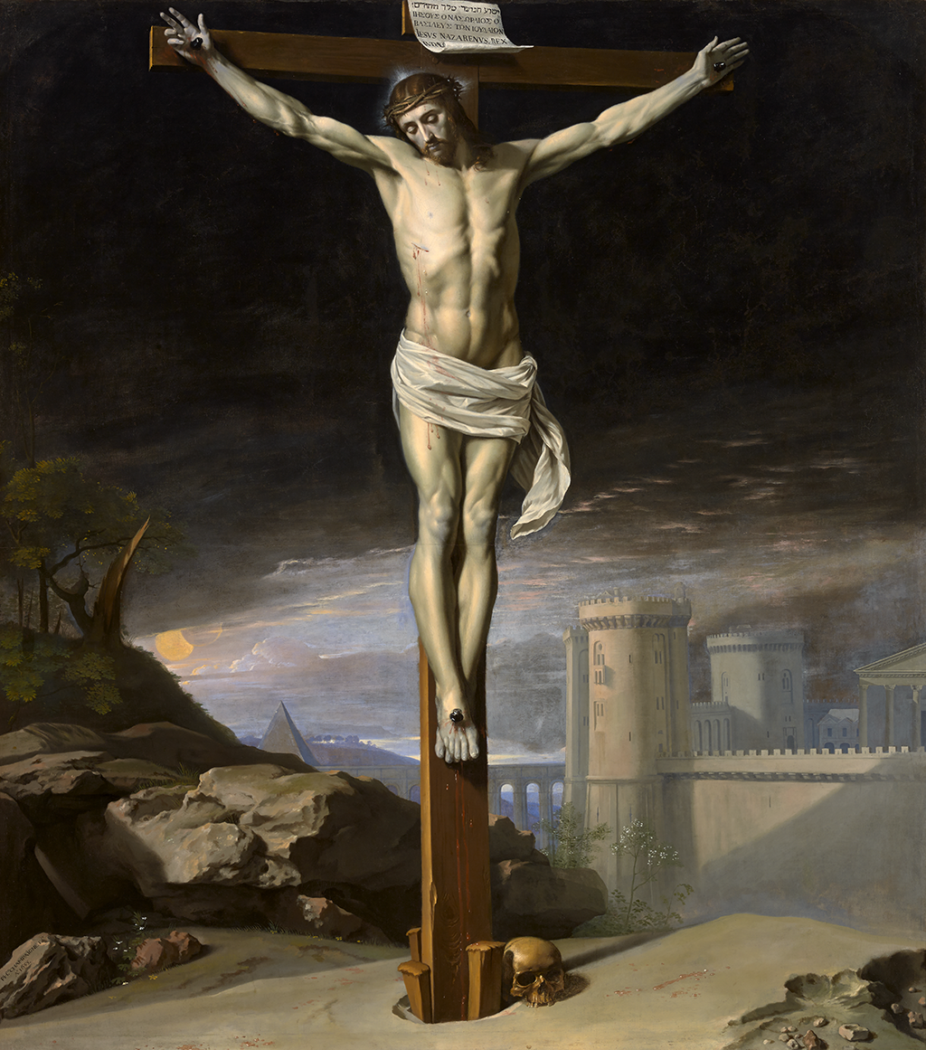
John 12:32
“And I, if I am lifted up from the earth, will draw (helkyō) all men to Myself.”

Slide 29
Scripture’s Four Judgments
NAME | SHEEP AND GOAT | JUDGMENT OF THE JEWS | BEMA SEAT | GREAT WHITE THRONE
SCRIPTURE | Matt 25:31-46 | Ezek 20:33-44 | 1 Cor 3:10-15 | Rev 20:11-15
PLACE | Earth, Jerusalem | Earth, wilderness | Heaven | Earth
AUDIENCE | Gentile Tribulation survivors | Jewish Tribulation survivors | Church Age believers | All unsaved
WHEN | After Tribulation | After Tribulation | After rapture | After Millennium
PURPOSE | Saved Gentiles enter kingdom | Saved Jews enter kingdom | Reward believers | Degree of punishment in hell
EVALUATION | Treatment of Christ’s brethren | Passing under shepherd’s rod | Works taken through fire | Not in the book; judged by books

Slide 31
Man Can Resist God’s Grace
Gen. 6:3 (1 Pet. 3:20; 2 Pet. 2:5)
Prov. 1:24-25; 29:1
Matt. 23:37
John 12:32 (Rev. 20:11-15)
Acts 7:51
Heb. 12:25

Slide 32
Man Can Resist God’s Grace
Gen. 6:3 (1 Pet. 3:20; 2 Pet. 2:5)
Prov. 1:24-25; 29:1
Matt. 23:37
John 12:32 (Rev. 20:11-15)
Acts 7:51
Heb. 12:25

Slide 33
Irresistible Grace
Calvinistic definition
Calvinistic arguments
Man can resist God’s grace
Man can resist God by disbelieving
John 6:44?

Slide 34
Man Can Resist God By Disbelieving
John 10:25
John 12:37
Acts 9:26; Acts 17:5; 19:9; 28:4
2 Thess. 2:12

Slide 35
Man Can Resist God By Disbelieving
John 10:25
John 12:37
Acts 9:26; Acts 17:5; 19:9; 28:4
2 Thess. 2:12

Slide 36
Man Can Resist God By Disbelieving
John 10:25
John 12:37
Acts 9:26; Acts 17:5; 19:9; 28:4
2 Thess. 2:12

Slide 37
John 12:37
“But though He had performed so many signs before them, yet they were not believing in Him.”

Slide 38
Man Can Resist God By Disbelieving
John 10:25
John 12:37
Acts 9:26; Acts 17:5; 19:9; 28:4
2 Thess. 2:12

Slide 39
Man Can Resist God By Disbelieving
John 10:25
John 12:37
Acts 9:26; Acts 17:5; 19:9; 28:4
2 Thess. 2:12

Slide 40
Irresistible Grace
Calvinistic definition
Calvinistic arguments
Man can resist God’s grace
Man can resist God by disbelieving
John 6:44?

Slide 41
John 6:44
“No one can come to Me unless the Father who sent Me draws (helkyō) him; and I will raise him up on the last day.”

Slide 42
John 6:44?
Verb helkyō can mean “drag” (Acts 21:30; Jas. 2:6)
What does it mean in John’s Gospel?
John 12:32, 37-40
John 18:10; 21:6, 11 (inanimate objects)
Verb helkyō can mean “attract” or “draw” rather than coerce

Slide 43
John 6:44?
Verb helkyō can mean “drag” (Acts 21:30; Jas. 2:6)
What does it mean in John’s Gospel?
John 12:32, 37-40
John 18:10; 21:6, 11 (inanimate objects)
Verb helkyō can mean “attract” or “draw” rather than coerce

Slide 44
John 6:44?
Verb helkyō can mean “drag” (Acts 21:30; Jas. 2:6)
What does it mean in John’s Gospel?
John 12:32, 37-40
John 18:10; 21:6, 11 (inanimate objects)
Verb helkyō can mean “attract” or “draw” rather than coerce

Slide 45
John 6:44?
Verb helkyō can mean “drag” (Acts 21:30; Jas. 2:6)
What does it mean in John’s Gospel?
John 12:32, 37-40
John 18:10; 21:6, 11 (inanimate objects)
Verb helkyō can mean “attract” or “draw” rather than coerce

Slide 46
John 12:32
“And I, if I am lifted up from the earth, will draw (helkyō) all men to Myself.”

Slide 47
John 12:37
“But though He had performed so many signs before them, yet they were not believing in Him.”

Slide 48
John 6:44?
Verb helkyō can mean “drag” (Acts 21:30; Jas. 2:6)
What does it mean in John’s Gospel?
John 12:32, 37-40
John 18:10; 21:6, 11 (inanimate objects)
Verb helkyō can mean “attract” or “draw” rather than coerce

Slide 49
John 6:44?
Verb helkyō can mean “drag” (Acts 21:30; Jas. 2:6)
What does it mean in John’s Gospel?
John 12:32, 37-40
John 18:10; 21:6, 11 (inanimate objects)
Verb helkyō can mean “attract” or “draw” rather than coerce

Slide 50
Frederick L. Godet
“helkyō, to draw, does not necessarily denote an effectual drawing. This word may refer only to the preaching of the cross throughout the whole world and the action of the Holy Spirit which accompanies it. This heavenly drawing is not irresistible.”
Frederick L. Godet, Commentary on the Gospel of John, trans. Timothy Dwight [n.p.: Funk & Wagnalls, 1893; reprint, Grand Rapids: Zondervan, n.d.], 228.

Slide 51
God’s Grace to the Unsaved
Holy Spirit’s conviction (John 16:7-11)
God’s Word (Isa. 55:10-11)
Gospel (Rom. 1:16)
Creation (Ps. 19:1-4)
Conscience (Rom. 2:14-15)

Slide 52
John 1:9
“There was the true Light which, coming into the world, enlightens every man.”

Slide 53
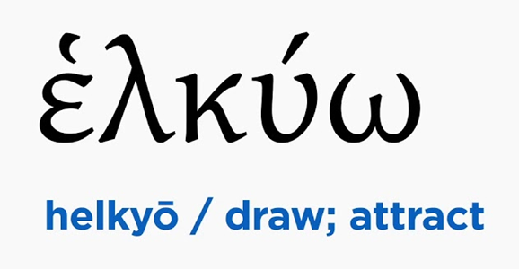
John 6:40, 44
“For this is the will of My Father, that everyone who beholds the Son and believes in Him will have eternal life, and I Myself will raise him up on the last day…No one can come to Me unless the Father who sent Me draws (helkyō) him; and I will raise him up on the last day.”

Slide 54
V. Running TULIP Through the Grid of Scripture
Total Depravity
Unconditional Election
Limited Atonement
Irresistible Grace
Perseverance of the Saints

