Slide 2
EXODUS STRUCTURE/OUTLINE
Redemption (1–18)
Redemption (1:1–12:30)
Liberation (12:31–15:21)
Preservation (15:22–18:27)
Mosaic Covenant (19–40)
Law (19–24)
Tabernacle instructions (25–31)
Apostasy (32–34)
Tabernacle building (35–40)

Slide 3
REDEMPTION (1:1–12:30)
Why redemption is necessary (Exod 1)
Development of the deliverer (Exod 2–4)
First confrontation with Pharaoh (Exod 5)
God reassures Moses (Exod 6:1–7:7)
Second confrontation with Pharaoh (Exod 7:18-13)
Plagues (Exod 7:14–12:30)

Slide 4
THREE PHASES OF MOSES’ 120 YEAR LIFE
LIFE PHASE | SCRIPTURE | YEARS | AGE | ACTIVITY
Natural Training | Acts 7:23 | 1526–1486 B.C. | 1-40 | Egyptian Education
Spiritual Training | Exod. 7:7 | 1486–1446 B.C. | 40-80 | Midian Shepherding
Ministry | Deut. 31:2; 34:7; Acts 7:36 | 1446–1406 B.C. | 80-120 | Exodus, Law, Wilderness Preservation, Pentateuch Authorship

Slide 5
MOSES’ CALLING Exodus 3:1-22
Moses’ mission (1-10)
Moses’ objections (11-15)
God’s prophecies (16-22)

Slide 6
MOSES’ CALLING Exodus 3:1-22
Moses’ mission (1-10)
Moses’ objections (11-15)
God’s prophecies (16-22)

Slide 7
I. Exodus 3:1-10 Moses’ Misson
God’s manifestation (1-3)
God’s message (4-10)

Slide 8
I. Exodus 3:1-10 Moses’ Misson
God’s manifestation (1-3)
God’s message (4-10)

Slide 9
Exodus 3:1-3 God’s Manifestation
Location (1)
Angel of the Lord (2)
Moses’ response (3)

Slide 10
Exodus 3:1-3 God’s Manifestation
Location (1)
Angel of the Lord (2)
Moses’ response (3)

Slide 14
Exodus 3:1-3 God’s Manifestation
Location (1)
Angel of the Lord (2)
Moses’ response (3)

Slide 15
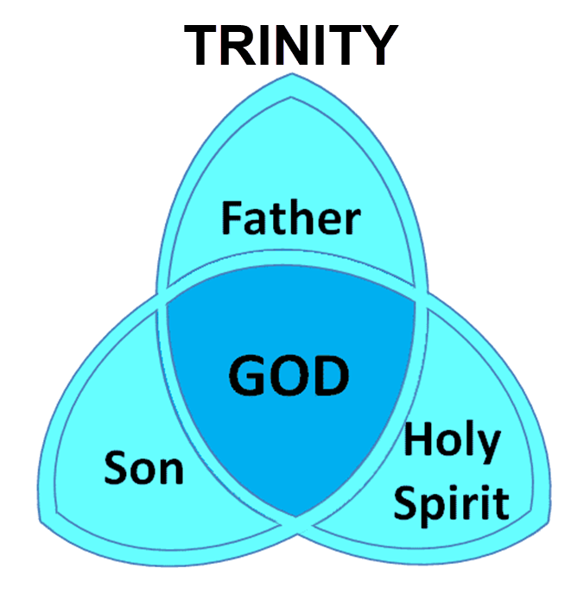

Slide 16
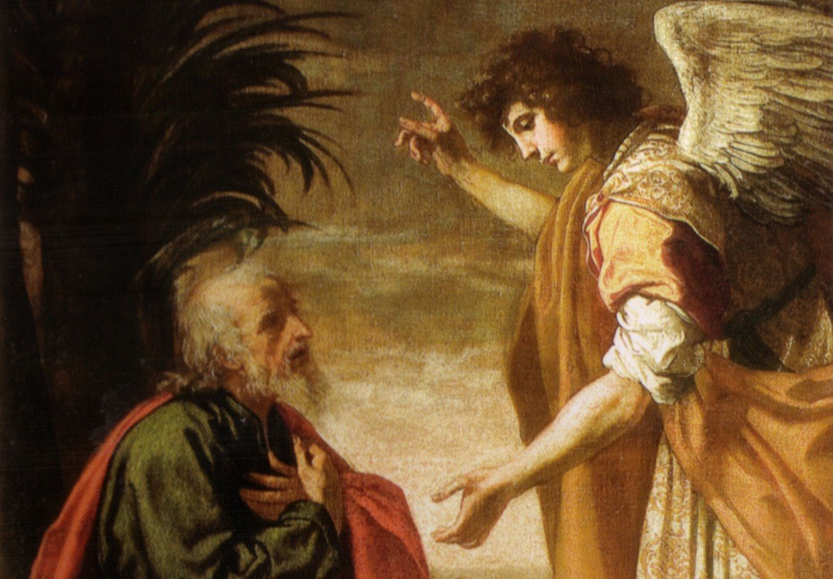
Revelation 19:10
“Then I fell at his feet to worship him. But he said to me, ‘Do not do that; I am a fellow servant of yours and your brethren who hold the testimony of Jesus; worship God. For the testimony of Jesus is the spirit of prophecy.’”

Slide 17
Exodus 3:1-3 God’s Manifestation
Location (1)
Angel of the Lord (2)
Moses’ response (3)

Slide 18
Dr. Ed Hindson
Hindson, E. E., & Mitchell, D. R., eds. (2010). King James Version Bible Commentary for Today: The Most Up-to-Date Commentary on the Time-Honored Text of the King James Version (p. 83). Thomas Nelson.
“There Moses encountered the visible manifestation of God’s presence, the Shekinah glory, in a flaming thorn bush. This is a small bush studded throughout the Sinai wilderness that, because of the intense desert heat and deficiency of rain, may sporadically and spontaneously combust. What Moses witnessed was truly unique, however, for the flame did not consume the bush. This strange sight arrested Moses’ attention, and he moved closer to investigate.”

Slide 19
I. Exodus 3:1-10 Moses’ Misson
God’s manifestation (1-3)
God’s message (4-10)

Slide 20
Exodus 3:4-10 God’s Message
God’s calling (4)
God’s holiness (5)
God’s covenant history (6)
God’s compassionate sight (7)
God’s direction (8)
God’s compassionate hearing (9)
God’s calling (10)

Slide 21
Exodus 3:4-10 God’s Message
God’s calling (4)
God’s holiness (5)
God’s covenant history (6)
God’s compassionate sight (7)
God’s direction (8)
God’s compassionate hearing (9)
God’s calling (10)

Slide 22
Dr. Ed Hindson
Hindson, E. E., & Mitchell, D. R., eds. (2010). King James Version Bible Commentary for Today: The Most Up-to-Date Commentary on the Time-Honored Text of the King James Version (p. 83). Thomas Nelson.
“When the Lord saw that He had aroused Moses’ curiosity, He called out to him from within the burning bush. Moses, Moses (v. 4). In Scripture, there is a pattern of God’s repeating a name to indicate an emphatic call for a specific commission. He does this here with Moses, and elsewhere with Abraham (Gen. 22:1), Jacob (Gen. 46:2), Samuel (1 Sam. 3:10), and Paul (Acts 9:4).”

Slide 23
Exodus 3:4-10 God’s Message
God’s calling (4)
God’s holiness (5)
God’s covenant history (6)
God’s compassionate sight (7)
God’s direction (8)
God’s compassionate hearing (9)
God’s calling (10)

Slide 24
Exodus 3:4-10 God’s Message
God’s calling (4)
God’s holiness (5)
God’s covenant history (6)
God’s compassionate sight (7)
God’s direction (8)
God’s compassionate hearing (9)
God’s calling (10)

Slide 25
Genesis 15:18-21
¹⁸ On that day the Lord made a covenant with Abram, saying, “To your descendants I have given this land, From the river of Egypt as far as the great river, the river Euphrates: ¹⁹ the Kenite and the Kenizzite and the Kadmonite ²⁰ and the Hittite and the Perizzite and the Rephaim ²¹ and the Amorite and the Canaanite and the Girgashite and the Jebusite.”

Slide 26
Evidence of Abrahamic Covenant’s Unconditional Nature
ANE covenant ratification ceremony (Gen 15)
Lack of stated conditions for Israel’s obedience (Gen 15)
Covenant's eternality (Gen 17:7, 13, 19; Ps. 90:2)
Covenant's immutability (Heb 6:13-18; Mal. 3:6)
Trans-generational reaffirmation despite perpetual national disobedience (Jer 31:35-37)
Walvoord, The Millennial Kingdom, 149-52

Slide 27
Land Promises Fulfilled in the Time of Joshua (Josh. 11:23; 21:43-45) or Solomon (1 Kgs. 4:21)?
Extended context (Josh 13:1-7; Judges 1:19, 21, 27, 29, 30-36)
Land gained in conquest was only a fraction of what was promised (1 Kgs. 4:25)
Jerusalem not conquered in Joshua’s day (Josh 15:63; 2 Sam 5)
Solomon’s reign extended to the border of Egypt (1 Kgs. 4:21) and not the River of Egypt (Gen. 15:18)
Solomon’s reign was tributary only (1 Kgs. 4:21)
Forever? (Gen 17:7-8, 13, 19)
Reaffirmation of land promises long after Joshua and Solomon’s time (Amos 9:11-15)
Fruchtenbaum, Israelology, 521-22, 631-32

Slide 29
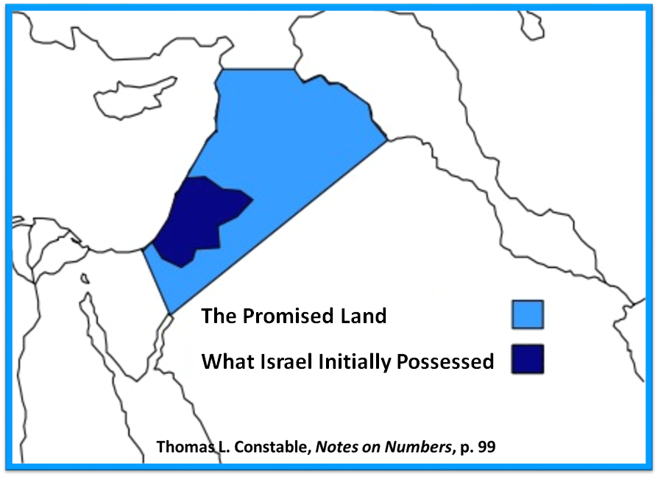

Slide 30
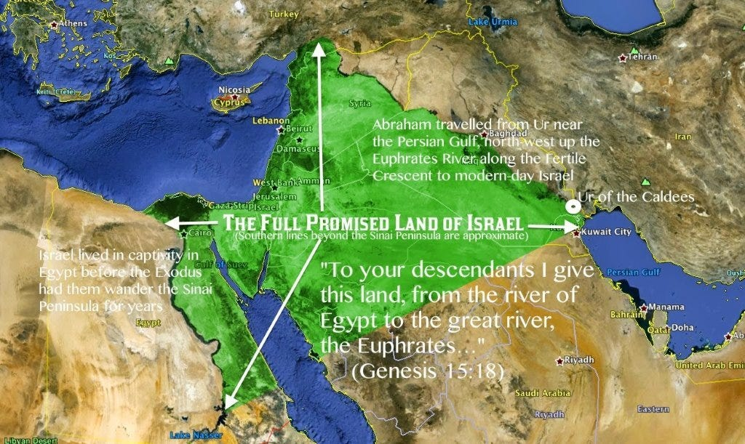

Slide 31
GENESIS STRUCTURE
Genesis 12-50 (four people)
Abraham (12:1–25:11)
Isaac (25:12–26:35)
Jacob (27–36)
Joseph (37–50)

Slide 32
Jeremiah 31:35-37
Thus says the Lord, Who gives the sun for light by day And the fixed order of the moon and the stars for light by night, Who stirs up the sea so that its waves roar; The Lord of hosts is His name:³⁶ “If this fixed order departs From before Me,” declares the Lord, “Then the offspring of Israel also will cease From being a nation before Me forever.”³⁷ Thus says the Lord, “If the heavens above can be measured And the foundations of the earth searched out below, Then I will also cast off all the offspring of Israel For all that they have done,” declares the Lord.

Slide 33
Exodus 3:4-10 God’s Message
God’s calling (4)
God’s holiness (5)
God’s covenant history (6)
God’s compassionate sight (7)
God’s direction (8)
God’s compassionate hearing (9)
God’s calling (10)

Slide 35
Names for God in Genesis
Elohim (1:1) – Power
Yahweh (2:4) – Relational
El Roi (Gen. 16:13) – Aware
El Olam (21:33) – Eternal
Jehovah Jireh (22:14) – Provision
God Isaac Feared (31:42, 53) – Reverenced
God, the God of Israel (33:20) – National

Slide 36
Exodus 3:4-10 God’s Message
God’s calling (4)
God’s holiness (5)
God’s covenant history (6)
God’s compassionate sight (7)
God’s direction (8)
God’s compassionate hearing (9)
God’s calling (10)

Slide 37
Genesis 15:18-21
¹⁸ On that day the Lord made a covenant with Abram, saying, “To your descendants I have given this land, From the river of Egypt as far as the great river, the river Euphrates: ¹⁹ the Kenite and the Kenizzite and the Kadmonite ²⁰ and the Hittite and the Perizzite and the Rephaim ²¹ and the Amorite and the Canaanite and the Girgashite and the Jebusite.”

Slide 38
Evidence of Abrahamic Covenant’s Unconditional Nature
ANE covenant ratification ceremony (Gen 15)
Lack of stated conditions for Israel’s obedience (Gen 15)
Covenant's eternality (Gen 17:7, 13, 19; Ps. 90:2)
Covenant's immutability (Heb 6:13-18; Mal. 3:6)
Trans-generational reaffirmation despite perpetual national disobedience (Jer 31:35-37)
Walvoord, The Millennial Kingdom, 149-52

Slide 39
Land Promises Fulfilled in the Time of Joshua (Josh. 11:23; 21:43-45) or Solomon (1 Kgs. 4:21)?
Extended context (Josh 13:1-7; Judges 1:19, 21, 27, 29, 30-36)
Land gained in conquest was only a fraction of what was promised (1 Kgs. 4:25)
Jerusalem not conquered in Joshua’s day (Josh 15:63; 2 Sam 5)
Solomon’s reign extended to the border of Egypt (1 Kgs. 4:21) and not the River of Egypt (Gen. 15:18)
Solomon’s reign was tributary only (1 Kgs. 4:21)
Forever? (Gen 17:7-8, 13, 19)
Reaffirmation of land promises long after Joshua and Solomon’s time (Amos 9:11-15)
Fruchtenbaum, Israelology, 521-22, 631-32

Slide 43
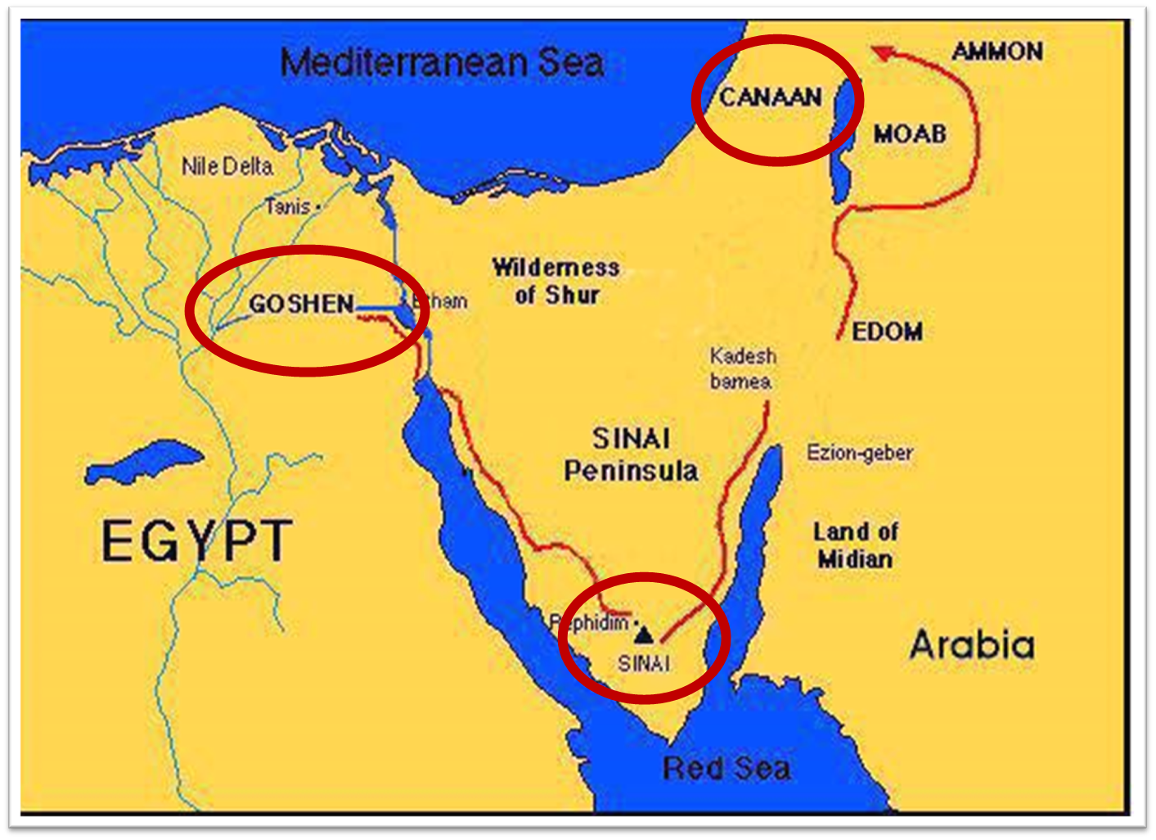

Slide 45
Dr. Ed Hindson
Hindson, E. E., & Mitchell, D. R., eds. (2010). King James Version Bible Commentary for Today: The Most Up-to-Date Commentary on the Time-Honored Text of the King James Version (p. 84). Thomas Nelson.
“Canaanites … Jebusites. The list of Canaanite nations inhabiting the Promised Land ranges from two names (Gen. 13:7), five names (Num. 13:29), six names (Judg. 3:5), seven names (Deut. 7:1), ten names (Gen. 15:19–21), to twelve names (see Gen. 10:15–18).”

Slide 46
Genesis 15:18-21
¹⁸ On that day the Lord made a covenant with Abram, saying, “To your descendants I have given this land, From the river of Egypt as far as the great river, the river Euphrates: ¹⁹ the Kenite and the Kenizzite and the Kadmonite ²⁰ and the Hittite and the Perizzite and the Rephaim ²¹ and the Amorite and the Canaanite and the Girgashite and the Jebusite.”

Slide 47
Exodus 3:4-10 God’s Message
God’s calling (4)
God’s holiness (5)
God’s covenant history (6)
God’s compassionate sight (7)
God’s direction (8)
God’s compassionate hearing (9)
God’s calling (10)

Slide 48
Exodus 3:4-10 God’s Message
God’s calling (4)
God’s holiness (5)
God’s covenant history (6)
God’s compassionate sight (7)
God’s direction (8)
God’s compassionate hearing (9)
God’s calling (10)

Slide 49
Ephesians 2:8-10
“⁸ For by grace you have been saved through faith; and that not of yourselves, it is the gift of God; ⁹ not as a result of works, so that no one may boast. ¹⁰ For we are His workmanship, created in Christ Jesus for good works, which God prepared beforehand so that we would walk [peripateō, subjunctive mood] in them.”

Slide 51
MOSES’ CALLING Exodus 3:1-22
Moses’ mission (1-10)
Moses’ objections (11-15)
God’s prophecies (16-22)

Slide 52
II. Exodus 3:11-15 Moses’ Objections
1st objection (11-12)
2nd objection (13-15)

Slide 53
II. Exodus 3:11-15 Moses’ Objections
1st objection (11-12)
2nd objection (13-15)

Slide 54
Exodus 3:11-12 1st Objection
Inadequacy (11)
God’s presence (12)

Slide 55
Exodus 3:11-12 1st Objection
Inadequacy (11)
God’s presence (12)

Slide 56
THREE PHASES OF MOSES’ 120 YEAR LIFE
LIFE PHASE | SCRIPTURE | YEARS | AGE | ACTIVITY
Natural Training | Acts 7:23 | 1526–1486 B.C. | 1-40 | Egyptian Education
Spiritual Training | Exod. 7:7 | 1486–1446 B.C. | 40-80 | Midian Shepherding
Ministry | Deut. 31:2; 34:7; Acts 7:36 | 1446–1406 B.C. | 80-120 | Exodus, Law, Wilderness Preservation, Pentateuch Authorship

Slide 57
Exodus 3:11-12 1st Objection
Inadequacy (11)
God’s presence (12)

Slide 58
John 14:16-17
¹⁶ I will ask the Father, and He will give you another Helper, that He may be with you forever; ¹⁷ that is the Spirit of truth, whom the world cannot receive, because it does not see Him or know Him, but you know Him because He abides with you and will be in you.

Slide 59
EXODUS STRUCTURE/OUTLINE
Redemption (1–18)
Redemption (1:1–12:30)
Liberation (12:31–15:21)
Preservation (15:22–18:27)
Mosaic Covenant (19–40)
Law (19–24)
Tabernacle instructions (25–31)
Apostasy (32–34)
Tabernacle building (35–40)

Slide 60
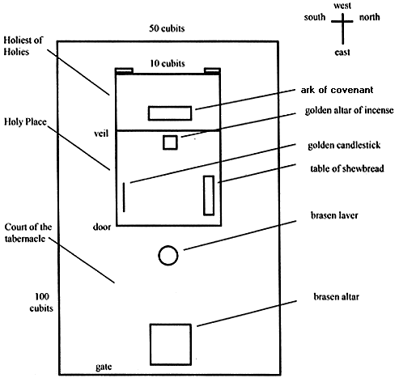
Tabernacle Diagram

Slide 61
II. Exodus 3:11-15 Moses’ Objections
1st objection (11-12)
2nd objection (13-15)

Slide 62
Exodus 3:13-15 2nd Objection
No authority (13)
God’s name (14-15)

Slide 63
Exodus 3:13-15 2nd Objection
No authority (13)
God’s name (14-15)

Slide 64
THREE PHASES OF MOSES’ 120 YEAR LIFE
LIFE PHASE | SCRIPTURE | YEARS | AGE | ACTIVITY
Natural Training | Acts 7:23 | 1526–1486 B.C. | 1-40 | Egyptian Education
Spiritual Training | Exod. 7:7 | 1486–1446 B.C. | 40-80 | Midian Shepherding
Ministry | Deut. 31:2; 34:7; Acts 7:36 | 1446–1406 B.C. | 80-120 | Exodus, Law, Wilderness Preservation, Pentateuch Authorship

Slide 65
Exodus 3:13-15 2nd Objection
No authority (13)
God’s name (14-15)

Slide 68
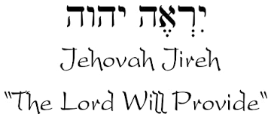

Slide 69
Names for God in Genesis
Elohim (1:1) – Power
Yahweh (2:4) – Relational
El Roi (Gen. 16:13) – Aware
El Olam (21:33) – Eternal
Jehovah Jireh (22:14) – Provision
God Isaac Feared (31:42, 53) – Reverenced
God, the God of Israel (33:20) – National

Slide 70
MOSES’ CALLING Exodus 3:1-22
Moses’ mission (1-10)
Moses’ objections (11-15)
God’s prophecies (16-22)

Slide 71
III. Exodus 3:16-22 God’s Prophecies
Israel’s land (16-17)
Israel’ leaders (18)
Pharaoh’s opposition (19)
Egypt’s judgment (20)
Israel’s plundering (21-22)

Slide 72
III. Exodus 3:16-22 God’s Prophecies
Israel’s land (16-17)
Israel’ leaders (18)
Pharaoh’s opposition (19)
Egypt’s judgment (20)
Israel’s plundering (21-22)

Slide 73
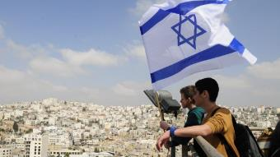
Reliability of the “Divine Regathering” Predictions
 | RETURN | PREDICTED | FULFILLED
1st | From Egypt to Canaan | Gen. 15:13-14 | Joshua 1‒12
2nd | From Babylon to Israel | Jer. 25:11; 29:10 | Ezra & Nehemiah
3rd | From the Diaspora to Israel’s restoration | Ezekiel 36:24-28 | Millennial Kingdom

Slide 74
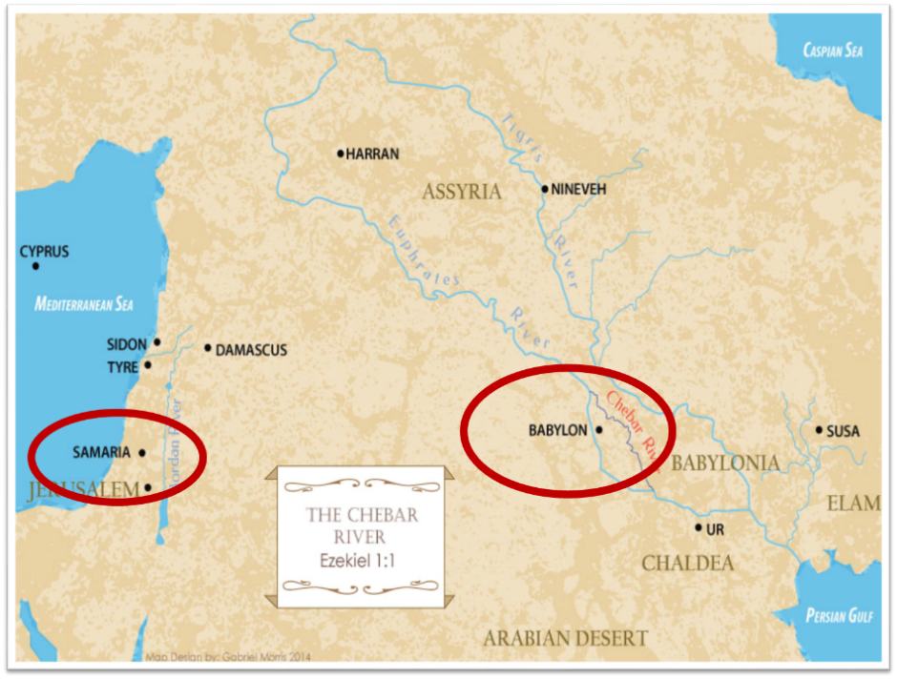

Slide 75
III. Exodus 3:16-22 God’s Prophecies
Israel’s land (16-17)
Israel’ leaders (18)
Pharaoh’s opposition (19)
Egypt’s judgment (20)
Israel’s plundering (21-22)

Slide 76
EXODUS STRUCTURE/OUTLINE
Redemption (1–18)
Redemption (1:1–12:30)
Liberation (12:31–15:21)
Preservation (15:22–18:27)
Mosaic Covenant (19–40)
Law (19–24)
Tabernacle instructions (25–31)
Apostasy (32–34)
Tabernacle building (35–40)

Slide 77
Tabernacle Diagram

Slide 78
Shaping and Populating (Gen 1:1)
Day 1: | Light | Day 4: | Luminaries
Day 2: | Water, sky | Day 5: | Sea animals, birds
Day 3: | Land, vegetation | Day 6: | Land animals, man

Slide 79
III. Exodus 3:16-22 God’s Prophecies
Israel’s land (16-17)
Israel’ leaders (18)
Pharaoh’s opposition (19)
Egypt’s judgment (20)
Israel’s plundering (21-22)

Slide 80
III. Exodus 3:16-22 God’s Prophecies
Israel’s land (16-17)
Israel’ leaders (18)
Pharaoh’s opposition (19)
Egypt’s judgment (20)
Israel’s plundering (21-22)

Slide 81
The Plagues of Egypt
NO. | DESCRIPTION | SCRIPTURE | Egyptian Deity
1. | Water to Blood | Exod. 7:14-25 | Hapi, Khnum
2. | Frogs | Exod. 8:1-15 | Heqt
3. | Gnats | Exod. 8:16-19 | Set
4. | Flies | Exod. 8:20-32 | Uatchit
5. | Disease on Cattle | Exod. 9:1-7 | Hathor, Apis
6. | Boils | Exod. 9:8-12 | Sekhmet, Serapis
7. | Hail | Exod. 9:13-35 | Seth, Nut
8. | Locusts | Exod. 10:1-20 | Seth, Nut, Osiris
9. | Darkness | Exod. 10:21-29 | Re, Horus, Atum
10. | Death of the First Born | Exod. 12:29-36 | Min, Osiris, Heqt, Isis

Slide 82
III. Exodus 3:16-22 God’s Prophecies
Israel’s land (16-17)
Israel’ leaders (18)
Pharaoh’s opposition (19)
Egypt’s judgment (20)
Israel’s plundering (21-22)

Slide 83
Genesis 15:13, 16
“¹³ God said to Abram, ‘Know for certain that your descendants will be strangers in a land that is not theirs, where they will be enslaved and oppressed four hundred years… ¹⁶ Then in the fourth generation they will return here, for the wrongdoing of the Amorite is not yet complete.’”

Slide 84
EXODUS STRUCTURE/OUTLINE
Redemption (1–18)
Redemption (1:1–12:30)
Liberation (12:31–15:21)
Preservation (15:22–18:27)
Mosaic Covenant (19–40)
Law (19–24)
Tabernacle instructions (25–31)
Apostasy (32–34)
Tabernacle building (35–40)

Slide 85
Tabernacle Diagram

Slide 87
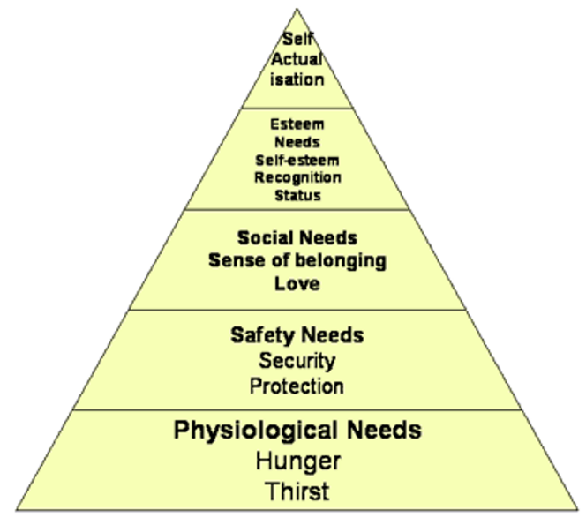
Maslow’s Hierarchy of Needs

Slide 88
2 Timothy 3:16-17
“¹⁶ All Scripture is inspired by God [theopneustos] and profitable for teaching, for reproof, for correction, for training in righteousness; ¹⁷ so that the man of God may be adequate, equipped for every good work.”

Slide 89
2 Peter 1:3-4
“³ Seeing that His divine power has granted to us everything pertaining to life and godliness, through the true knowledge of Him who called us by His own glory and excellence. ⁴For by these He has granted to us His precious and magnificent promises, so that by them you may become partakers of the divine nature, having escaped the corruption that is in the world by lust.”

Slide 90
1 Peter 2:2
“like newborn babies, long for the pure [adolos] milk of the word, so that by it you may grow in respect to salvation, ³ if you have tasted the kindness of the Lord.”

Slide 91
Chafer Theological Seminary Distinctives:
sufficiency of the scriptures
"We believe in the complete adequacy of Scripture, for in it God has given us all things that pertain to life and godliness. We hold, therefore, that the Word of God by itself is sufficient to prepare a person for a lifetime of effective ministry.”
https://www.chafer.edu/distinctives

Slide 92
Conclusion

Slide 93
MOSES’ CALLING Exodus 3:1-22
Moses’ mission (1-10)
Moses’ objections (11-15)
God’s prophecies (16-22)

Slide 94
²⁴ The Lord bless you, and keep you; ²⁵ The Lord make His face shine on you, And be gracious to you; ²⁶ The Lord lift up His countenance on you, And give you peace.
Numbers 6:24–26 (NASB95)

