Slide 2
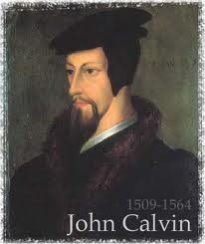
Neo-Calvinism vs. The Bible
Calvinism’s Mixed Blessing
Why Critique Calvinism?
The Source of Calvin’s Theology
Calvin’s Manner of Life
TULIP Through the Grid of Scripture
Conclusion

Slide 3
V. Running TULIP Through the Grid of Scripture
Total Depravity
Unconditional Election
Limited Atonement
Irresistible Grace
Perseverance of the Saints

Slide 4
Irresistible Grace
Calvinistic definition
Calvinistic arguments
Man can resist God’s grace
Man can resist God by disbelieving
John 6:44?

Slide 5
Irresistible Grace = ‘Regeneration Precedes Faith & Faith is a Gift’
“I” stands for “Irresistible Grace.” Faith is something “God irresistibly bestowed upon the elect without their having believed anything…By such reasoning, man…can’t even hear the gospel—much less respond to the pleadings of Christ.”
Bob Kirkland, Calvinism: None Dare Call It Heresy; Spotlight on the Life and Teachings of John Calvin (Eureka, MT: Lighthouse Trails, 2018), 34.

Slide 6
Irresistible Grace
Calvinistic definition
Calvinistic arguments
Man can resist God’s grace
Man can resist God by disbelieving
John 6:44?

Slide 7
Calvinistic Arguments
Faith is a gift
Regeneration precedes faith
Lost man cannot seek God (Rom. 3:11)

Slide 8
Romans 3:11
“There is none who understands, There is none who seeks for God.”

Slide 9
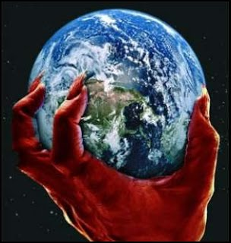
2 Corinthians 4:4
“in whose case the god of this world has blinded the minds of the unbelieving so that they might not see the light of the gospel of the glory of Christ, who is the image of God.”

Slide 10
Acts 17:26-27
²⁶ and He made from one man every nation of mankind to live on all the face of the earth, having determined their appointed times and the boundaries of their habitation, ²⁷ that they would seek God, if perhaps they might grope for Him and find Him, though He is not far from each one of us (Italics added)

Slide 11
Lost Man Cannot Seek God?
No biblical verse indicates that lost man cannot believe when convicted
Lost man is held accountable for not believing (Matt. 23:37; John 3:18; 4:48; 5:40)
Lost man can believe (John 1:12; 20:31; 1 Cor. 1:21; 1 John 5:10)

Slide 12
Lost Man Cannot Seek God?
No biblical verse indicates that lost man cannot believe when convicted
Lost man is held accountable for not believing (Matt. 23:37; John 3:18; 4:48; 5:40)
Lost man can believe (John 1:12; 20:31; 1 Cor. 1:21; 1 John 5:10)

Slide 13
God’s Grace to the Unsaved
Holy Spirit’s conviction
God’s Word
Gospel
Creation
Conscience
Conclusion

Slide 14
God’s Grace to the Unsaved
Holy Spirit’s conviction
God’s Word
Gospel
Creation
Conscience
Conclusion

Slide 15
John 16:7-11
“⁷ But I tell you the truth, it is to your advantage that I go away; for if I do not go away, the Helper will not come to you; but if I go, I will send Him to you. ⁸ And He, when He comes, will convict the world concerning sin (hamartia, singular noun) and righteousness and judgment; ⁹ concerning sin, because they do not believe in Me; ¹⁰ and concerning righteousness, because I go to the Father and you no longer see Me; ¹¹ and concerning judgment, because the ruler of this world has been judged.”

Slide 16
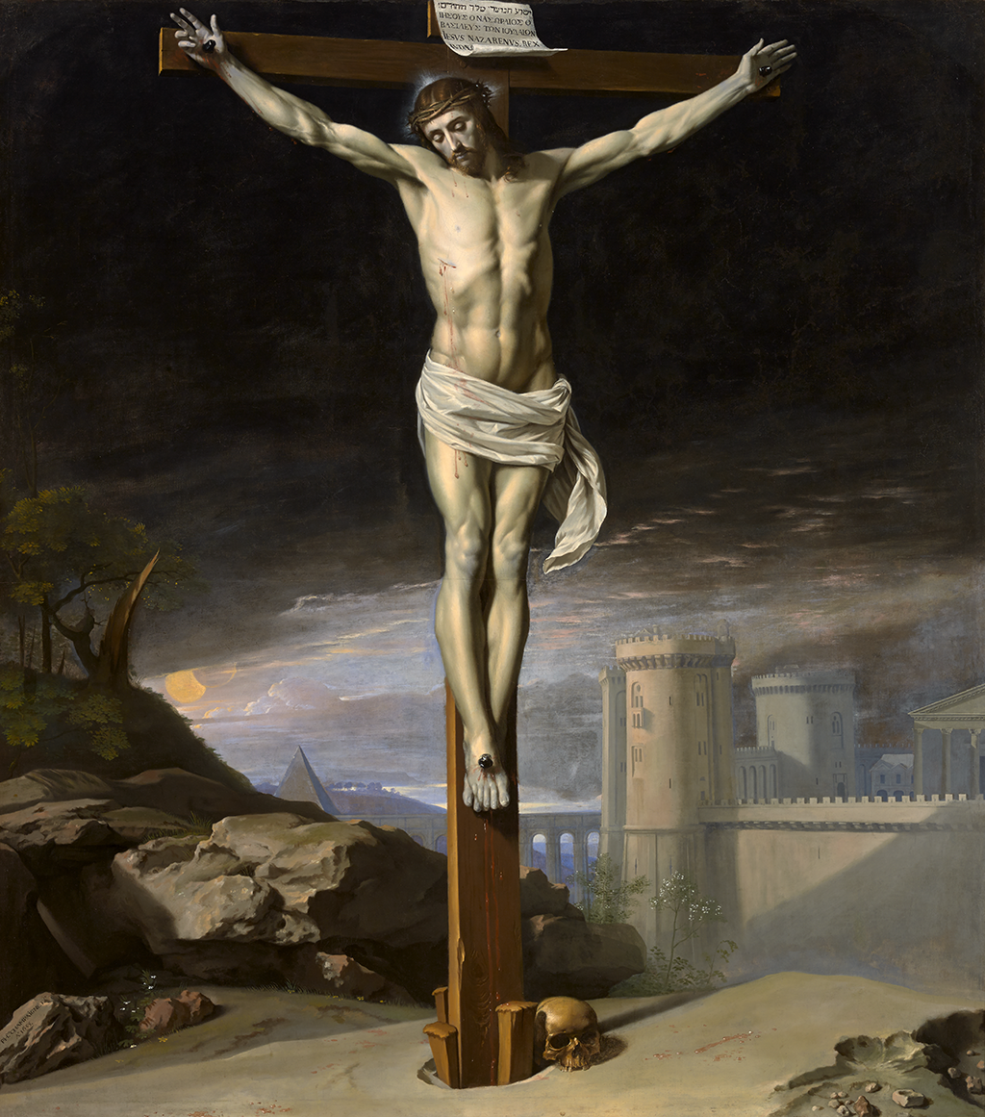
John 12:32
“And I, if I am lifted up from the earth, will draw (helkyō) all men to Myself.”

Slide 17
Genesis 6:1-4
“¹ Now it came about, when men began to multiply on the face of the land, and daughters were born to them, ² that the sons of God saw that the daughters of men were beautiful; and they took wives for themselves, whomever they chose. ³ Then the Lord said, ‘My Spirit shall not strive with man forever, because he also is flesh; nevertheless his days shall be one hundred and twenty years.’ ⁴ The Nephilim were on the earth in those days, and also afterward, when the sons of God came in to the daughters of men, and they bore children to them. Those were the mighty men who were of old, men of renown.”

Slide 18
God’s Grace to the Unsaved
Holy Spirit’s conviction
God’s Word
Gospel
Creation
Conscience
Conclusion

Slide 19
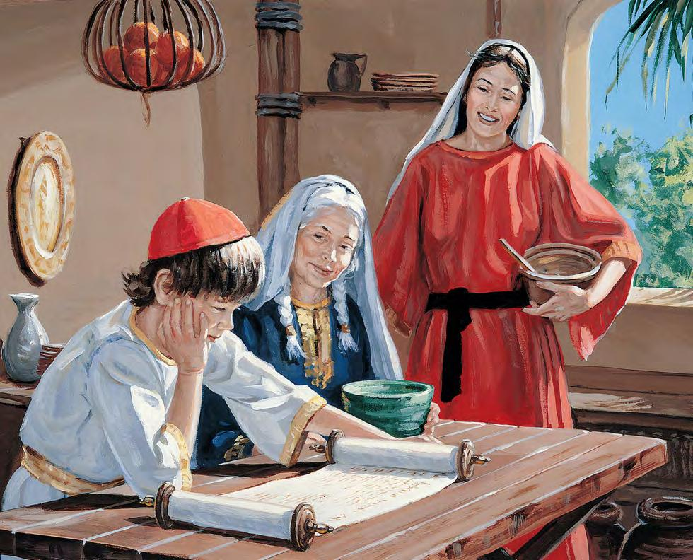
2 Timothy 3:15
“and that from childhood you have known the sacred writings which are able to give you the wisdom that leads to salvation through faith which is in Christ Jesus.”

Slide 20
2 Timothy 3:16-17
“All Scripture is inspired by God [theopneustos] and profitable for teaching, for reproof, for correction, for training in righteousness; so that the man of God may be adequate, equipped for every good work.”

Slide 21
Isaiah 55:10-11
¹⁰ “For as the rain and the snow come down from heaven, And do not return there without watering the earth And making it bear and sprout, And furnishing seed to the sower and bread to the eater; ¹¹ So will My word be which goes forth from My mouth; It will not return to Me empty, Without accomplishing what I desire, And without succeeding in the matter for which I sent it.”

Slide 22
Romans 10:17
“So faith comes from hearing, and hearing by the word of Christ.”

Slide 23
God’s Grace to the Unsaved
Holy Spirit’s conviction
God’s Word
Gospel
Creation
Conscience
Conclusion

Slide 24
Romans 1:16
“For I am not ashamed of the gospel, for it is the power [dynamis] of God for salvation to everyone who believes, to the Jew first and also to the Greek.”

Slide 25
God’s Grace to the Unsaved
Holy Spirit’s conviction
God’s Word
Gospel
Creation
Conscience
Conclusion

Slide 26
Psalm 19:1-4
“¹ The heavens are telling of the glory of God; And their expanse is declaring the work of His hands. ² Day to day pours forth speech, And night to night reveals knowledge. ³ There is no speech, nor are there words; Their voice is not heard. ⁴ Their line has gone out through all the earth, And their utterances to the end of the world. In them He has placed a tent for the sun.”

Slide 27
Romans 1:18-20
“¹⁸ For the wrath of God is revealed from heaven against all ungodliness and unrighteousness of men who suppress the truth in unrighteousness, ¹⁹ because that which is known about God is evident within them; for God made it evident to them. ²⁰ For since the creation of the world His invisible attributes, His eternal power and divine nature, have been clearly seen, being understood through what has been made, so that they are without excuse.”

Slide 28
God’s Grace to the Unsaved
Holy Spirit’s conviction
God’s Word
Gospel
Creation
Conscience
Conclusion

Slide 29
Romans 2:14–16
¹⁴“For when Gentiles who do not have the Law do instinctively the things of the Law, these, not having the Law, are a law to themselves, ¹⁵ in that they show the work of the Law written in their hearts, their conscience bearing witness and their thoughts alternately accusing or else defending them, ¹⁶ on the day when, according to my gospel, God will judge the secrets of men through Christ Jesus.”

Slide 30
God’s Grace to the Unsaved
Holy Spirit’s conviction
God’s Word
Gospel
Creation
Conscience
Conclusion

Slide 31
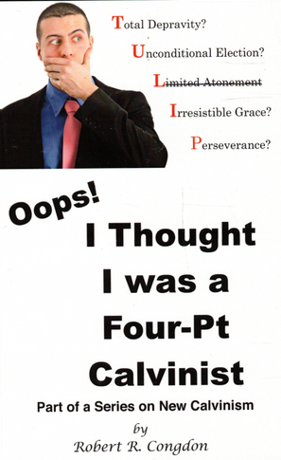
Dr. Robert R. Congdon
Oops! I Thought I Was a Four - Pt Calvinist (Greer, SC: Congdon Ministries International, 2014), 48, 69-70.
“While I do agree that salvation comes through the workings of the Holy Spirit and the Word of God, I disagree with the idea that God must first predispose some to believe and receive it, for the Word of God and the Holy Spirit are sufficient in and of themselves in bringing about the new birth. Instead of forcing individuals to be saved through the irresistible prompting of the Holy Spirit, God uses His Word and the convicting work of the Holy Spirit to confirm its truth in order to bring individuals to the point of decision. It is certainly God’s grace that offers it, but at this point they are free to accept or reject salvation.…their [Calvinism’s] definition of total depravity negates the sufficiency of the power of the Word of God and the Holy Spirit to give life...”

Slide 32
Lost Man Cannot Seek God?
No biblical verse indicates that lost man cannot believe when convicted
Lost man is held accountable for not believing (Matt. 23:37; John 3:18; 4:48; 5:40)
Lost man can believe (John 1:12; 20:31; 1 Cor. 1:21; 1 John 5:10)

Slide 33
Matthew 23:37-39
“Jerusalem, Jerusalem, who kills the prophets and stones those who are sent to her! How often I wanted to gather your children together, the way a hen gathers her chicks under her wings, and you were unwilling. ³⁸ Behold, your house is being left to you desolate! ³⁹ For I say to you, from now on you will not see Me until you say, ‘Blessed is He who comes in the name of the Lord!’”

Slide 34
Lost Man Cannot Seek God?
No biblical verse indicates that lost man cannot believe when convicted
Lost man is held accountable for not believing (Matt. 23:37; John 3:18; 4:48; 5:40)
Lost man can believe (John 1:12; 20:31; 1 Cor. 1:21; 1 John 5:10)

Slide 35
John 1:12-13
“But as many as received Him, to them He gave the right to become children of God, even to those who believe in His name, ¹³ who were born, not of blood nor of the will of the flesh nor of the will of man, but of God.”

Slide 36
John 20:30-31
“Therefore many other signs Jesus also performed in the presence of the disciples, which are not written in this book; but these have been written so that you may believe that Jesus is the Christ, the Son of God; and that believing you may have life in His name.”

Slide 37
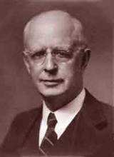
Lewis Sperry Chafer, vol. 7, Systematic Theology^{b} (Grand Rapids, MI: Kregel Publications, 1993), 265-66.
Belief-God’s One Condition for Justification
“…because upwards of 150 passages of Scripture condition salvation upon believing only (cf. John 3:16; Acts 16:31).

Slide 38
Irresistible Grace
Calvinistic definition
Calvinistic arguments
Man can resist God’s grace
Man can resist God by disbelieving
John 6:44?

Slide 39
Man Can Resist God’s Grace
Gen. 6:3 (1 Pet. 3:20; 2 Pet. 2:5)
Prov. 1:24-25; 29:1
Matt. 23:37
John 12:32 (Rev. 20:11-15)
Acts 7:51
Heb. 12:25

Slide 40
Man Can Resist God’s Grace
Gen. 6:3 (1 Pet. 3:20; 2 Pet. 2:5)
Prov. 1:24-25; 29:1
Matt. 23:37
John 12:32 (Rev. 20:11-15)
Acts 7:51
Heb. 12:25

Slide 41
Genesis 6:1-4
“¹ Now it came about, when men began to multiply on the face of the land, and daughters were born to them, ² that the sons of God saw that the daughters of men were beautiful; and they took wives for themselves, whomever they chose. ³ Then the Lord said, ‘My Spirit shall not strive with man forever, because he also is flesh; nevertheless his days shall be one hundred and twenty years.’ ⁴ The Nephilim were on the earth in those days, and also afterward, when the sons of God came in to the daughters of men, and they bore children to them. Those were the mighty men who were of old, men of renown.”

Slide 42
Dr. Henry M. Morris
The Genesis Record, 144
“The ancient quibble about ‘Cain’s wife’ is thus seen to be quite trivial. Long before Cain died, there was a large population in the earth. By the time of the Deluge, 1,656 years after Creation by the Ussher chronology, even using the above conservative assumptions, the world population would have been at least seven billion people!”

Slide 43
Man Can Resist God’s Grace
Gen. 6:3 (1 Pet. 3:20; 2 Pet. 2:5)
Prov. 1:24-25; 29:1
Matt. 23:37
John 12:32 (Rev. 20:11-15)
Acts 7:51
Heb. 12:25

Slide 44
Man Can Resist God’s Grace
Gen. 6:3 (1 Pet. 3:20; 2 Pet. 2:5)
Prov. 1:24-25; 29:1
Matt. 23:37
John 12:32 (Rev. 20:11-15)
Acts 7:51
Heb. 12:25

Slide 45
Matthew 23:37-39
“Jerusalem, Jerusalem, who kills the prophets and stones those who are sent to her! How often I wanted to gather your children together, the way a hen gathers her chicks under her wings, and you were unwilling. ³⁸ Behold, your house is being left to you desolate! ³⁹ For I say to you, from now on you will not see Me until you say, ‘Blessed is He who comes in the name of the Lord!’”

Slide 46
Man Can Resist God’s Grace
Gen. 6:3 (1 Pet. 3:20; 2 Pet. 2:5)
Prov. 1:24-25; 29:1
Matt. 23:37
John 12:32 (Rev. 20:11-15)
Acts 7:51
Heb. 12:25

Slide 47
John 12:32
“And I, if I am lifted up from the earth, will draw (helkyō) all men to Myself.”

Slide 49
Man Can Resist God’s Grace
Gen. 6:3 (1 Pet. 3:20; 2 Pet. 2:5)
Prov. 1:24-25; 29:1
Matt. 23:37
John 12:32 (Rev. 20:11-15)
Acts 7:51
Heb. 12:25

Slide 50
Man Can Resist God’s Grace
Gen. 6:3 (1 Pet. 3:20; 2 Pet. 2:5)
Prov. 1:24-25; 29:1
Matt. 23:37
John 12:32 (Rev. 20:11-15)
Acts 7:51
Heb. 12:25

Slide 51
Irresistible Grace
Calvinistic definition
Calvinistic arguments
Man can resist God’s grace
Man can resist God by disbelieving
John 6:44?

Slide 52
Man Can Resist God By Disbelieving
John 10:25
John 12:37
Acts 9:26; Acts 17:5; 19:9; 28:4
2 Thess. 2:12

Slide 53
Man Can Resist God By Disbelieving
John 10:25
John 12:37
Acts 9:26; Acts 17:5; 19:9; 28:4
2 Thess. 2:12

Slide 54
Man Can Resist God By Disbelieving
John 10:25
John 12:37
Acts 9:26; Acts 17:5; 19:9; 28:4
2 Thess. 2:12

Slide 55
Man Can Resist God By Disbelieving
John 10:25
John 12:37
Acts 9:26; Acts 17:5; 19:9; 28:4
2 Thess. 2:12

Slide 56
Man Can Resist God By Disbelieving
John 10:25
John 12:37
Acts 9:26; Acts 17:5; 19:9; 28:4
2 Thess. 2:12

Slide 57
Irresistible Grace
Calvinistic definition
Calvinistic arguments
Man can resist God’s grace
Man can resist God by disbelieving
John 6:44?

