Slide 2
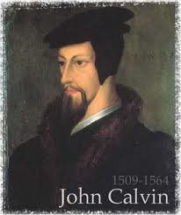
Neo-Calvinism vs. The Bible
Calvinism’s Mixed Blessing
Why Critique Calvinism?
The Source of Calvin’s Theology
Calvin’s Manner of Life
TULIP Through the Grid of Scripture
Conclusion

Slide 3
V. Running TULIP Through the Grid of Scripture
Total Depravity
Unconditional Election
Limited Atonement
Irresistible Grace
Perseverance of the Saints

Slide 4
Irresistible Grace
Calvinistic definition
Calvinistic arguments
Man can resist God’s grace
Man can resist God by disbelieving
John 6:44?

Slide 5
Irresistible Grace = ‘Regeneration Precedes Faith & Faith is a Gift’
“I” stands for “Irresistible Grace.” Faith is something “God irresistibly bestowed upon the elect without their having believed anything…By such reasoning, man…can’t even hear the gospel—much less respond to the pleadings of Christ.”
Bob Kirkland, Calvinism: None Dare Call It Heresy; Spotlight on the Life and Teachings of John Calvin (Eureka, MT: Lighthouse Trails, 2018), 34.

Slide 6
Irresistible Grace
Calvinistic definition
Calvinistic arguments
Man can resist God’s grace
Man can resist God by disbelieving
John 6:44?

Slide 7
Calvinistic Arguments
Faith is a gift
Regeneration precedes faith
Lost man cannot seek God (Rom. 3:11)

Slide 8
Regeneration Precedes Faith?
Definition
Calvinistic examples
Calvinist Proof texts
Biblical order
Ordo-Salutis
An eschatological parallel
Why believe?

Slide 9
Titus 3:5
“He saved us, not on the basis of deeds which we have done in righteousness, but according to His mercy, by the washing of regeneration [palingenesia] and renewing by the Holy Spirit.”

Slide 10
Regeneration Precedes Faith?
Definition
Calvinistic examples
Calvinist Proof texts
Biblical order
Ordo-Salutis
An eschatological parallel
Why believe?

Slide 11
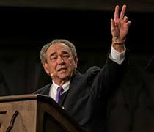
R.C. Sproul
Sproul explains that according to the “Reformed view of predestination before a person can choose Christ he must be born again.”
R. C. Sproul, Chosen by God (Carol Stream, IL: Tyndale House Publishers, Inc., 1986), 72.

Slide 12
Regeneration Precedes Faith?
Definition
Calvinistic examples
Calvinist Proof texts
Biblical order
Ordo-Salutis
An eschatological parallel
Why believe?

Slide 13
Ephesians 2:1-5
¹ “And you were dead in your trespasses and sins, ² in which you formerly walked according to the course of this world, according to the prince of the power of the air, of the spirit that is now working in the sons of disobedience. ³ Among them we too all formerly lived in the lusts of our flesh, indulging the desires of the flesh and of the mind, and were by nature children of wrath, even as the rest. ⁴ But God, being rich in mercy, because of His great love with which He loved us, ⁵ even when we were dead in our transgressions, made us alive together with Christ (by grace you have been saved)”

Slide 14
Regeneration Precedes Faith?
Definition
Calvinistic examples
Calvinist Proof texts
Biblical order
Ordo-Salutis
An eschatological parallel
Why believe?

Slide 15
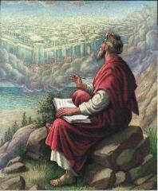
John 3:16
“For God so loved the world, that He gave His only begotten Son, that whoever believes in Him shall not perish, but have eternal life.”

Slide 16
Regeneration Precedes Faith?
Definition
Calvinistic examples
Calvinist Proof texts
Biblical order
Ordo-Salutis
An eschatological parallel
Why believe?

Slide 17
John 16:7-11
“⁷ But I tell you the truth, it is to your advantage that I go away; for if I do not go away, the Helper will not come to you; but if I go, I will send Him to you. ⁸ And He, when He comes, will convict the world concerning sin (hamartia, singular noun) and righteousness and judgment; ⁹ concerning sin, because they do not believe in Me; ¹⁰ and concerning righteousness, because I go to the Father and you no longer see Me; ¹¹ and concerning judgment, because the ruler of this world has been judged.”

Slide 18
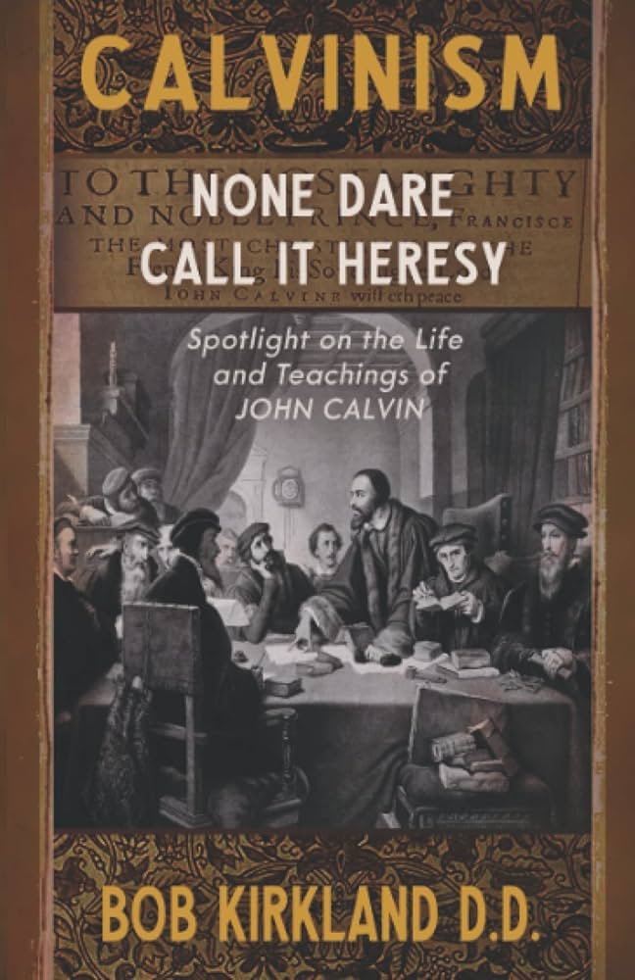
Divine Drawing vs. Divine Coercion
“We see then that while it is the Holy Spirit’s work to draw men to the Savior, it is incumbent on each individual to respond of his own free will prior to conversion.”
Bob Kirkland, Calvinism: None Dare Call It Heresy; Spotlight on the Life and Teachings of John Calvin (Eureka, MT: Lighthouse Trails, 2018), 40.

Slide 19
René A. Lopez
“In His convicting work the Holy Spirit draws sinners to Himself and waits for their simple response of faith. God then imparts eternal life to them the moment they believe. As Paul and Silas told the Philippian jailer, ‘Believe on the Lord Jesus Christ, and you will be saved (Acts 16:31).’”
“Is Faith a Gift From God or a Human Exercise?,” Bibliotheca Sacra 164 (July–September 2007): 276.

Slide 20
Regeneration Precedes Faith?
Definition
Calvinistic examples
Calvinist Proof texts
Biblical order
Ordo-Salutis
An eschatological parallel
Why believe?

Slide 21
Titus 3:5
“He saved us, not on the basis of deeds which we have done in righteousness, but according to His mercy, by the washing of regeneration [palingenesia] and renewing by the Holy Spirit.”

Slide 22
Matthew 19:28
“And Jesus said to them, ’Truly I say to you, that you who have followed Me, in the regeneration [palingenesia] when the Son of Man will sit on His glorious throne, you also shall sit upon twelve thrones, judging the twelve tribes of Israel.’”

Slide 24
Regeneration Precedes Faith?
Definition
Calvinistic examples
Calvinist Proof texts
Biblical order
Ordo-Salutis
An eschatological parallel
Why believe?

Slide 25
Charles Ryrie
“In the Reformed statement of the ordo salutis, regeneration precedes faith, for, it is argued, a sinner must be given new life in order to be able to believe. While this is admittedly stated only as a logical order, it is not wise to insist even on that; for it may as well be argued that if a sinner has new life through regeneration, why does he need to believe?”
Charles C. Ryrie, Basic Theology (Wheaton, IL: Victor, 1986; reprint, Chicago: Moody, 1999), 326.

Slide 26
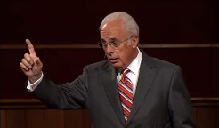
John MacArthur
“Furthermore, because of human depravity, there is nothing in a fallen, reprobate sinner that desires God or is capable of responding in faith...From the viewpoint of reason, regeneration logically must initiate faith and repentance.”
John F. MacArthur, Faith Works: The Gospel According to the Apostles (Dallas, TX: Word, 1993), 62 & n. 8.

Slide 27
Does Regeneration Precede Faith?
"If I am to preach the faith in Christ to a man who is regenerated, then the man, being regenerated, is saved already, and it is an unnecessary and ridiculous thing for me to preach Christ to him, and bid him to believe in order to be saved when he is saved already, being regenerate. Am I only to preach faith to those who have it? Absurd, indeed! Is not this waiting till the man is cured and then bringing him the medicine? This is preaching Christ to the righteous and not to sinners."
[Spurgeon - Sermon entitled, The Warrant of Faith].

Slide 28
Calvinistic Arguments
Faith is a gift
Regeneration precedes faith
Lost man cannot seek God (Rom. 3:11)

Slide 29
Romans 3:11
“There is none who understands, There is none who seeks for God.”

Slide 30
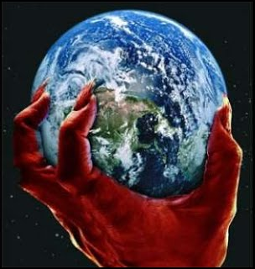
2 Corinthians 4:4
“in whose case the god of this world has blinded the minds of the unbelieving so that they might not see the light of the gospel of the glory of Christ, who is the image of God.”

Slide 31
Acts 17:26-27
²⁶ and He made from one man every nation of mankind to live on all the face of the earth, having determined their appointed times and the boundaries of their habitation, ²⁷ that they would seek God, if perhaps they might grope for Him and find Him, though He is not far from each one of us (Italics added)

Slide 32
Lost Man Cannot Seek God?
No biblical verse indicates that lost man cannot believe when convicted
Lost man is held accountable for not believing (Matt. 23:37; John 3:18; 4:48; 5:40)
Lost man can believe (John 1:12; 20:31; 1 Cor. 1:21; 1 John 5:10)

Slide 33
Lost Man Cannot Seek God?
No biblical verse indicates that lost man cannot believe when convicted
Lost man is held accountable for not believing (Matt. 23:37; John 3:18; 4:48; 5:40)
Lost man can believe (John 1:12; 20:31; 1 Cor. 1:21; 1 John 5:10)

Slide 34
John 16:7-11
“⁷ But I tell you the truth, it is to your advantage that I go away; for if I do not go away, the Helper will not come to you; but if I go, I will send Him to you. ⁸ And He, when He comes, will convict the world concerning sin (hamartia, singular noun) and righteousness and judgment; ⁹ concerning sin, because they do not believe in Me; ¹⁰ and concerning righteousness, because I go to the Father and you no longer see Me; ¹¹ and concerning judgment, because the ruler of this world has been judged.”

Slide 35
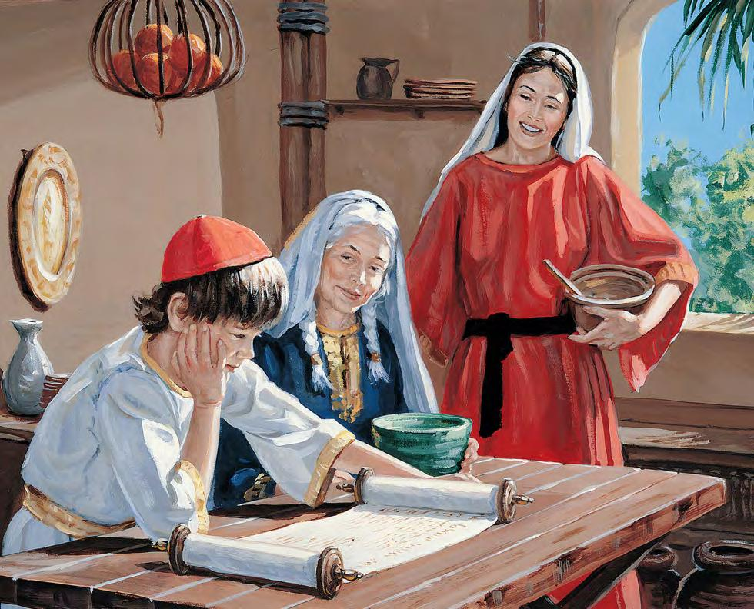
2 Timothy 3:15
“and that from childhood you have known the sacred writings which are able to give you the wisdom that leads to salvation through faith which is in Christ Jesus.”

Slide 36
2 Timothy 3:16-17
“All Scripture is inspired by God [theopneustos] and profitable for teaching, for reproof, for correction, for training in righteousness; so that the man of God may be adequate, equipped for every good work.”

Slide 37
Isaiah 55:10-11
¹⁰ “For as the rain and the snow come down from heaven, And do not return there without watering the earth And making it bear and sprout, And furnishing seed to the sower and bread to the eater; ¹¹ So will My word be which goes forth from My mouth; It will not return to Me empty, Without accomplishing what I desire, And without succeeding in the matter for which I sent it.”

Slide 38
Romans 10:17
“So faith comes from hearing, and hearing by the word of Christ.”

Slide 39
Romans 1:16
“For I am not ashamed of the gospel, for it is the power of God for salvation to everyone who believes, to the Jew first and also to the Greek.”

Slide 40
Psalm 19:1-4
“¹ The heavens are telling of the glory of God; And their expanse is declaring the work of His hands. ² Day to day pours forth speech, And night to night reveals knowledge. ³ There is no speech, nor are there words; Their voice is not heard. ⁴ Their line has gone out through all the earth, And their utterances to the end of the world. In them He has placed a tent for the sun.”

Slide 41
Romans 1:18-20
“¹⁸ For the wrath of God is revealed from heaven against all ungodliness and unrighteousness of men who suppress the truth in unrighteousness, ¹⁹ because that which is known about God is evident within them; for God made it evident to them. ²⁰ For since the creation of the world His invisible attributes, His eternal power and divine nature, have been clearly seen, being understood through what has been made, so that they are without excuse.”

Slide 42
Romans 2:14–16
¹⁴“For when Gentiles who do not have the Law do instinctively the things of the Law, these, not having the Law, are a law to themselves, ¹⁵ in that they show the work of the Law written in their hearts, their conscience bearing witness and their thoughts alternately accusing or else defending them, ¹⁶ on the day when, according to my gospel, God will judge the secrets of men through Christ Jesus.”

Slide 43
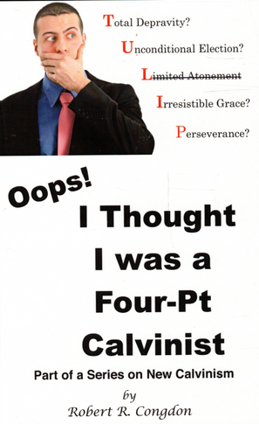
Dr. Robert R. Congdon
Oops! I Thought I Was a Four - Pt Calvinist (Greer, SC: Congdon Ministries International, 2014), 48, 69-70.
“While I do agree that salvation comes through the workings of the Holy Spirit and the Word of God, I disagree with the idea that God must first predispose some to believe and receive it, for the Word of God and the Holy Spirit are sufficient in and of themselves in bringing about the new birth. Instead of forcing individuals to be saved through the irresistible prompting of the Holy Spirit, God uses His Word and the convicting work of the Holy Spirit to confirm its truth in order to bring individuals to the point of decision. It is certainly God’s grace that offers it, but at this point they are free to accept or reject salvation.…their [Calvinism’s] definition of total depravity negates the sufficiency of the power of the Word of God and the Holy Spirit to give life...”

Slide 44
Lost Man Cannot Seek God?
No biblical verse indicates that lost man cannot believe when convicted
Lost man is held accountable for not believing (Matt. 23:37; John 3:18; 4:48; 5:40)
Lost man can believe (John 1:12; 20:31; 1 Cor. 1:21; 1 John 5:10)

Slide 45
Matthew 23:37-39
“Jerusalem, Jerusalem, who kills the prophets and stones those who are sent to her! How often I wanted to gather your children together, the way a hen gathers her chicks under her wings, and you were unwilling. ³⁸ Behold, your house is being left to you desolate! ³⁹ For I say to you, from now on you will not see Me until you say, ‘Blessed is He who comes in the name of the Lord!’”

Slide 46
Lost Man Cannot Seek God?
No biblical verse indicates that lost man cannot believe when convicted
Lost man is held accountable for not believing (Matt. 23:37; John 3:18; 4:48; 5:40)
Lost man can believe (John 1:12; 20:31; 1 Cor. 1:21; 1 John 5:10)

Slide 47
John 1:12-13
“But as many as received Him, to them He gave the right to become children of God, even to those who believe in His name, ¹³ who were born, not of blood nor of the will of the flesh nor of the will of man, but of God.”

Slide 48
John 20:30-31
“Therefore many other signs Jesus also performed in the presence of the disciples, which are not written in this book; but these have been written so that you may believe that Jesus is the Christ, the Son of God; and that believing you may have life in His name.”

Slide 49
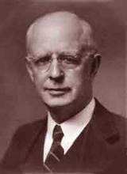
Lewis Sperry Chafer, vol. 7, Systematic Theology^{b} (Grand Rapids, MI: Kregel Publications, 1993), 265-66.
Belief-God’s One Condition for Justification
“…because upwards of 150 passages of Scripture condition salvation upon believing only (cf. John 3:16; Acts 16:31).

Slide 50
Irresistible Grace
Calvinistic definition
Calvinistic arguments
Man can resist God’s grace
Man can resist God by disbelieving
John 6:44?

