Slide 1



Slide 2

Ezekiel 37:7-11
⁷ So I prophesied as I was commanded; and as I prophesied, there was a noise, and behold, a rattling; and the bones came together, bone to its bone. ⁸ And I looked, and behold, sinews were on them, and flesh grew and skin covered them; but there was no breath in them. ⁹ Then He said to me, “Prophesy to the breath, prophesy, son of man, and say to the breath, ‘Thus says the Lord God, “Come from the four winds, O breath, and breathe on these slain, that they come to life.”’” ¹⁰ So I prophesied as . . .

Slide 3
Ezekiel 37:7-11
. . . He commanded me, and the breath came into them, and they came to life and stood on their feet, an exceedingly great army. ¹¹ Then He said to me, “Son of man, these bones are the whole house of Israel; behold, they say, ‘Our bones are dried up and our hope has perished. We are completely cut off’.”

Slide 4
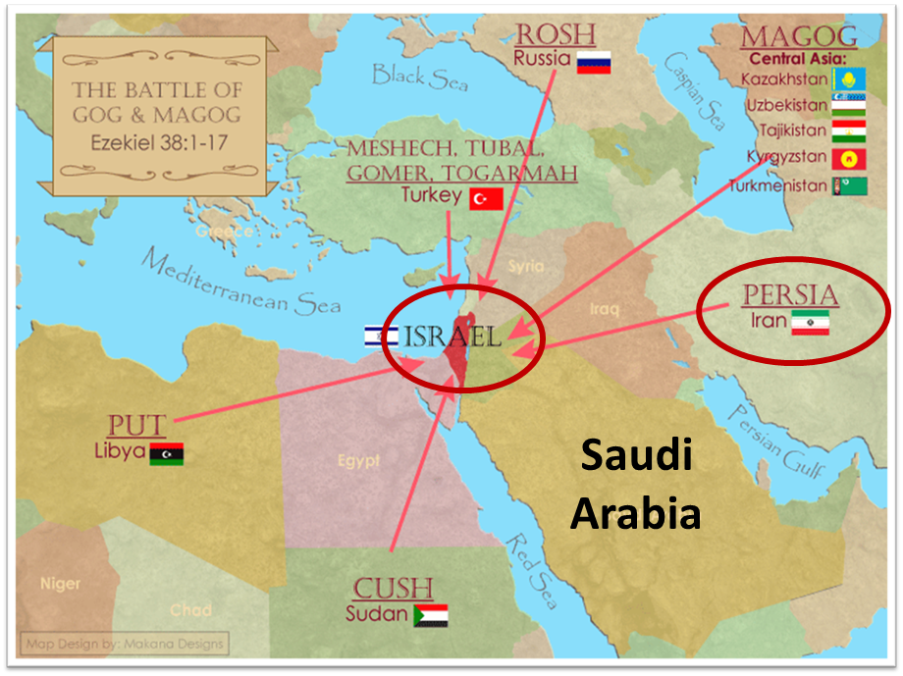

Slide 5

EXODUS STRUCTURE/OUTLINE
Redemption (1–18)
  Redemption (1:1–12:30)
  Liberation (12:31–15:21)
  Preservation (15:22–18:27)
Mosaic Covenant (19–40)
  Law (19–24)
  Tabernacle instructions (25–31)
  Apostasy (32–34)
  Tabernacle building (35–40)

Slide 6
REDEMPTION
(1:1–12:30)
Why redemption is necessary (Exod 1)
Development of the deliverer (Exod 2–4)
First confrontation with Pharaoh (Exod 5)
God reassures Moses (Exod 6:1–7:7)
Second confrontation with Pharaoh (Exod 7:18-13)
Plagues (Exod 7:14–12:30)

Slide 7
MOSES’ BIRTH, REARING, MARRIAGE, & TRAINING
Exodus 2:1-25
  Moses’ birth (1-4)
  Moses’ rearing (5-10)
  Moses’ flight (11-15)
  Moses’ marriage (16-22)
  God’s observation (23-25)

Slide 8
III. Exodus 2:11-15
Moses’ Flight
    Moses’ murder (11-12)
    Moses’ fear (13-15)

Slide 9
THREE PHASES OF MOSES’ 120 YEAR LIFE
LIFE PHASE | SCRIPTURE | YEARS | AGE | ACTIVITY
Natural Training | Acts 7:23 | 1526–1486 B.C. | 1-40 | Egyptian Education
Spiritual Training | Exod. 7:7 | 1486–1446 B.C. | 40-80 | Midian Shepherding
Ministry | Deut. 31:2; 34:7; Acts 7:36 | 1446–1406 B.C. | 80-120 | Exodus, Law, Wilderness Preservation, Pentateuch Authorship

Slide 10
III. Exodus 2:11-15
Moses’ Flight
    Moses’ murder (11-12)
    Moses’ fear (13-15)

Slide 11

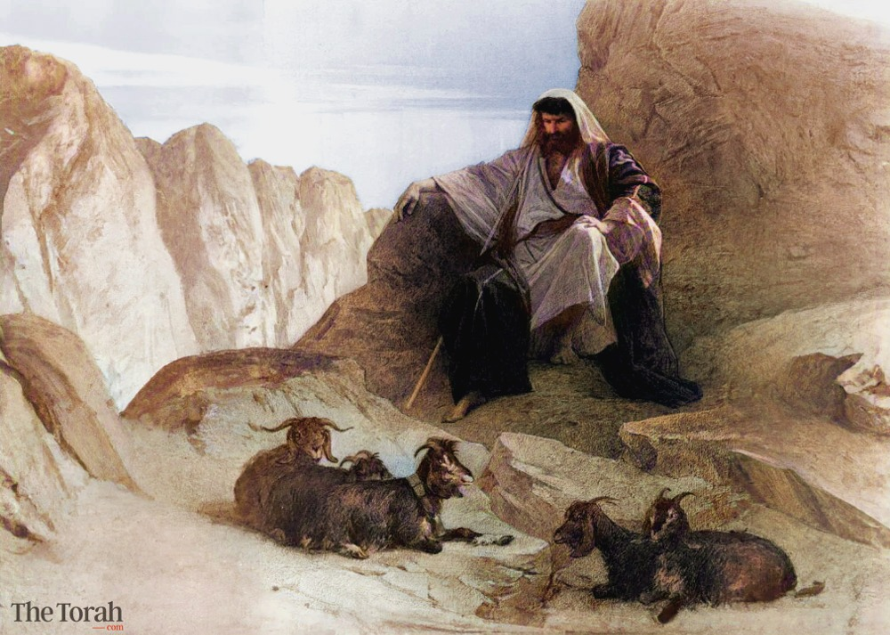
Charles Ryrie
Ryrie Study Bible, page 93
Exodus 2:15 - “the land of Midian. An area E of the Gulf of Aqaba or on the Sinai Peninsula, inhabited by the nomadic sons of Abraham by Keturah (cf. Gen. 25:2). Moses must have learned about surviving in the desert during these years.”﻿

Slide 12
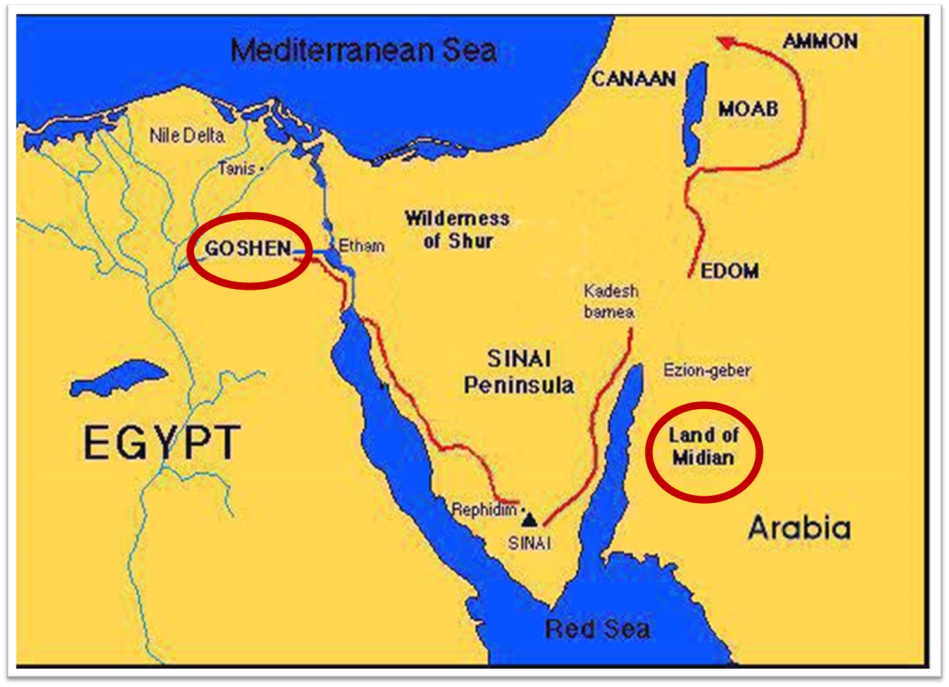

Slide 13
MOSES’ BIRTH, REARING, MARRIAGE, & TRAINING
Exodus 2:1-25
  Moses’ birth (1-4)
  Moses’ rearing (5-10)
  Moses’ flight (11-15)
  Moses’ marriage (16-22)
  God’s observation (23-25)

Slide 14
IV. Exodus 2:16-22
Moses’ Marriage
    Moses assists Midianite girls (16-20)
    Moses marries a Midianite girl (21-22)

Slide 15
IV. Exodus 2:16-22
Moses’ Marriage
    Moses assists Midianite girls (16-20)
    Moses marries a Midianite girl (21-22)

Slide 16
Exodus 2:16-20
Moses Assists a Midianite Girl
      Moses’ actions (16-17)
      Family report (18-20)

Slide 17
Exodus 2:16-20
Moses Assists a Midianite Girl
      Moses’ actions (16-17)
      Family report (18-20)

Slide 18
Exodus 2:16-20
Moses Assists a Midianite Girl
      Moses’ actions (16-17)
      Family report (18-20)

Slide 19
IV. Exodus 2:16-22
Moses’ Marriage
    Moses assists Midianite girls (16-20)
    Moses marries a Midianite girl (21-22)

Slide 20
Exodus 2:21-22
Moses Marries a Midianite Girl
      Moses’ wife (21)
      Moses’ son (22)

Slide 21
Exodus 2:21-22
Moses Marries a Midianite Girl
      Moses’ wife (21)
      Moses’ son (22)

Slide 22
The Divine Institutions
Conscience (Gen. 3:22)
Marriage and family (Gen. 1:26-28; 2:18-25)
Labor (Gen. 2:15; 3:19)
Government (Gen. 9:6)
Nationalism (Gen. 11:1-9)

Slide 23

John 16:7-11
“⁷ But I tell you the truth, it is to your advantage that I go away; for if I do not go away, the Helper will not come to you; but if I go, I will send Him to you. ⁸ And He, when He comes, will convict the world concerning sin (hamartia, singular noun) and righteousness and judgment; ⁹ concerning sin, because they do not believe in Me; ¹⁰ and concerning righteousness, because I go to the Father and you no longer see Me; ¹¹ and concerning judgment, because the ruler of this world has been judged.”

Slide 24
Exodus 2:21-22
Moses Marries a Midianite Girl
      Moses’ wife (21)
      Moses’ son (22)

Slide 26
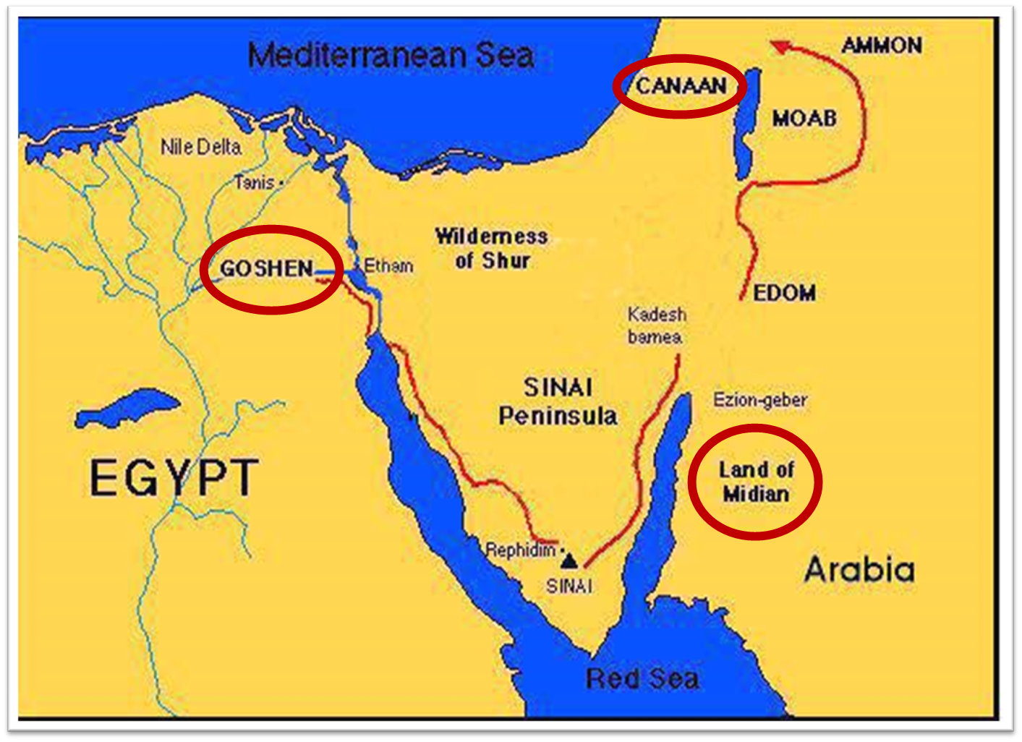

Slide 27
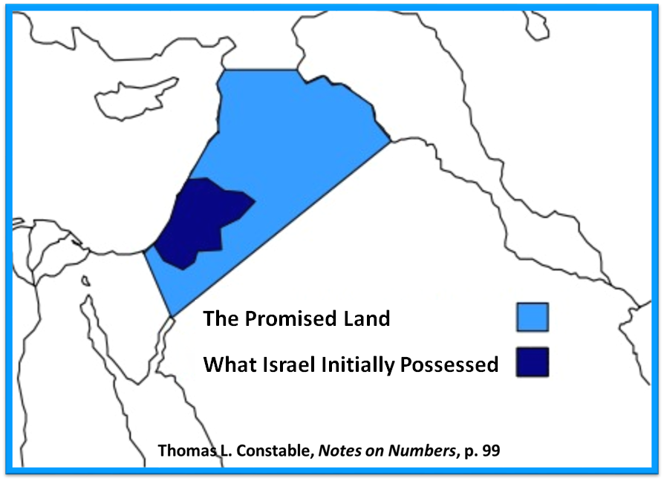

Slide 28
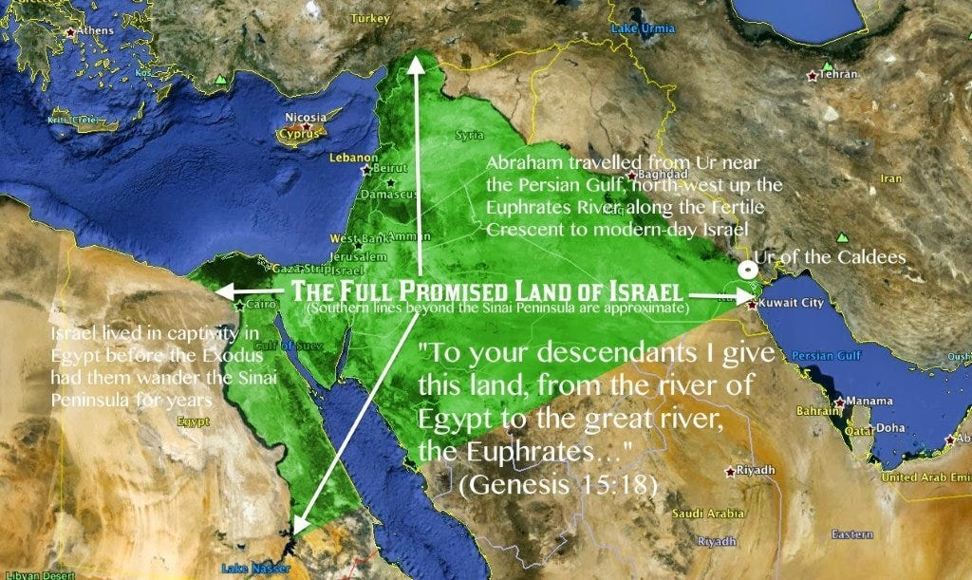

Slide 29
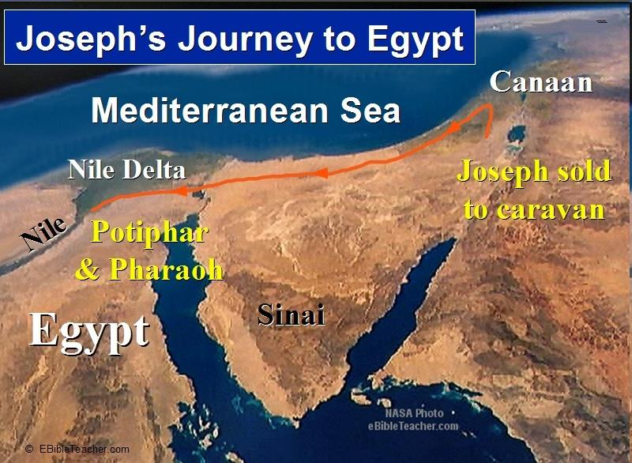

Slide 30
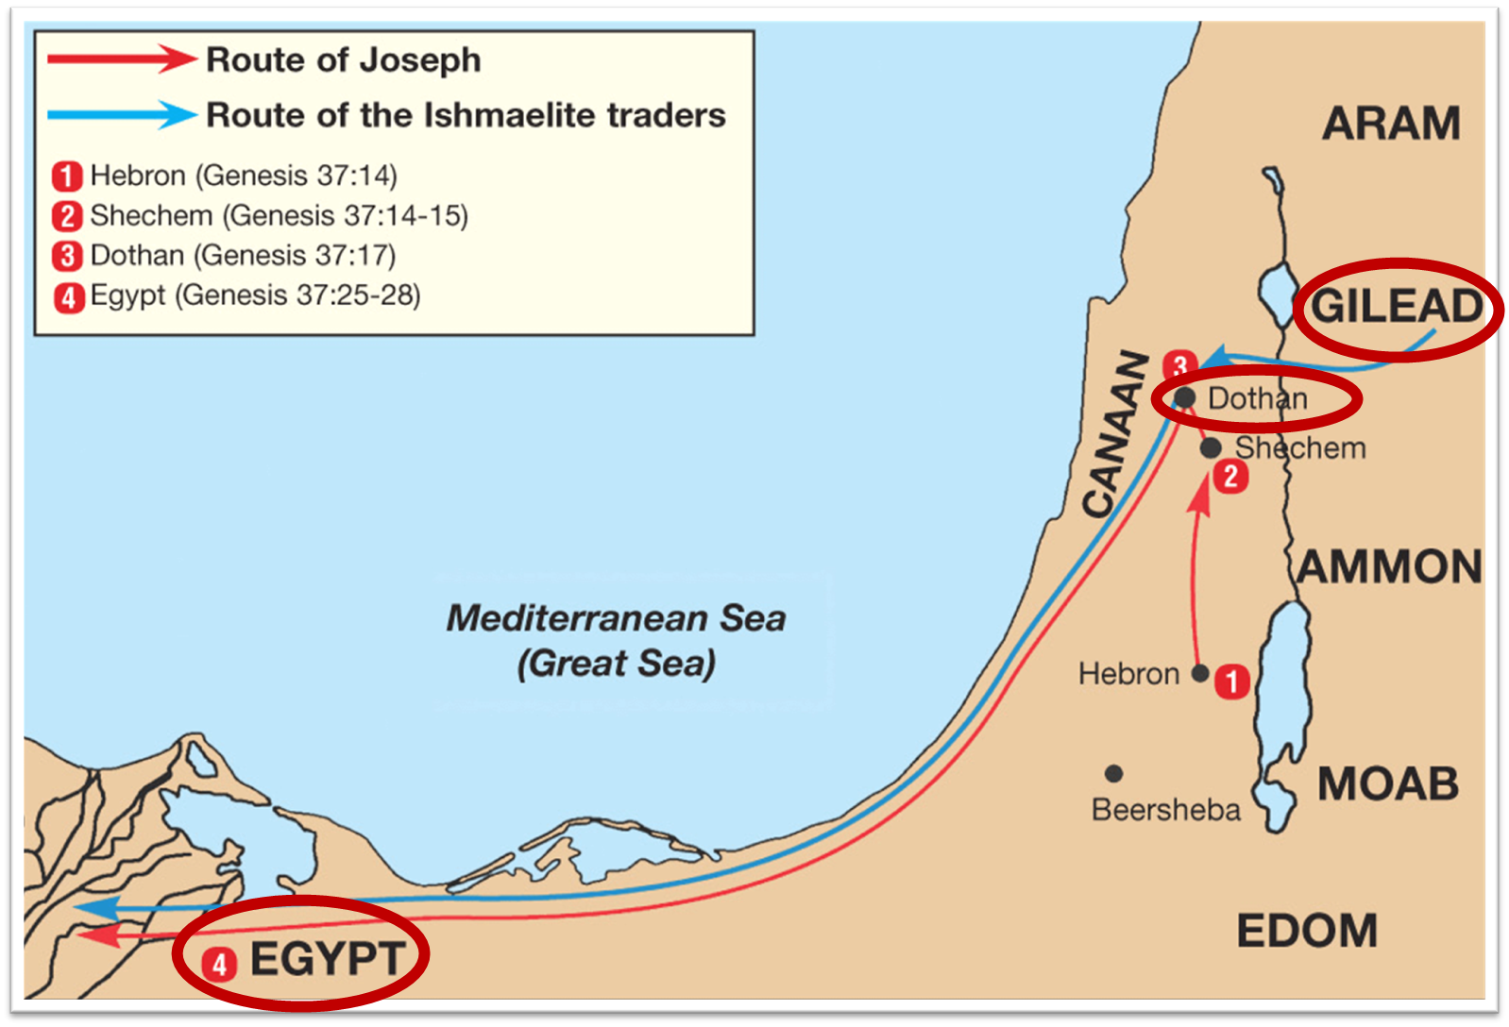

Slide 31

Names & Titles Demonstrating Satan’s
Post-Fall, Earthly Authority
(Job 1:7; 2:2; Luke 4:5-8; Rom. 8:19-22)
Prince of this world (John 12:31; 14:30; 16:11)
God of this age (2 Cor. 4:4)
Prince and power of the air (Eph. 2:2)
Who the believer wrestles with (Eph. 6:12)
Roaring lion (1 Pet. 5:8)
Whole world lies in his power (1 John 5:19)

Slide 32
MOSES’ BIRTH, REARING, MARRIAGE, & TRAINING
Exodus 2:1-25
  Moses’ birth (1-4)
  Moses’ rearing (5-10)
  Moses’ flight (11-15)
  Moses’ marriage (16-22)
  God’s observation (23-25)

Slide 33
V. Exodus 2:23-25
God’s Observation
    Pharaoh’s death (23a)
    Israel’s bondage (23b)
    Israel’s prayer (23c)
    Israel’s covenant (24-25)

Slide 34
V. Exodus 2:23-25
God’s Observation
    Pharaoh’s death (23a)
    Israel’s bondage (23b)
    Israel’s prayer (23c)
    Israel’s covenant (24-25)

Slide 35
THREE PHASES OF MOSES’ 120 YEAR LIFE
LIFE PHASE | SCRIPTURE | YEARS | AGE | ACTIVITY
Natural Training | Acts 7:23 | 1526–1486 B.C. | 1-40 | Egyptian Education
Spiritual Training | Exod. 7:7 | 1486–1446 B.C. | 40-80 | Midian Shepherding
Ministry | Deut. 31:2; 34:7; Acts 7:36 | 1446–1406 B.C. | 80-120 | Exodus, Law, Wilderness Preservation, Pentateuch Authorship

Slide 36
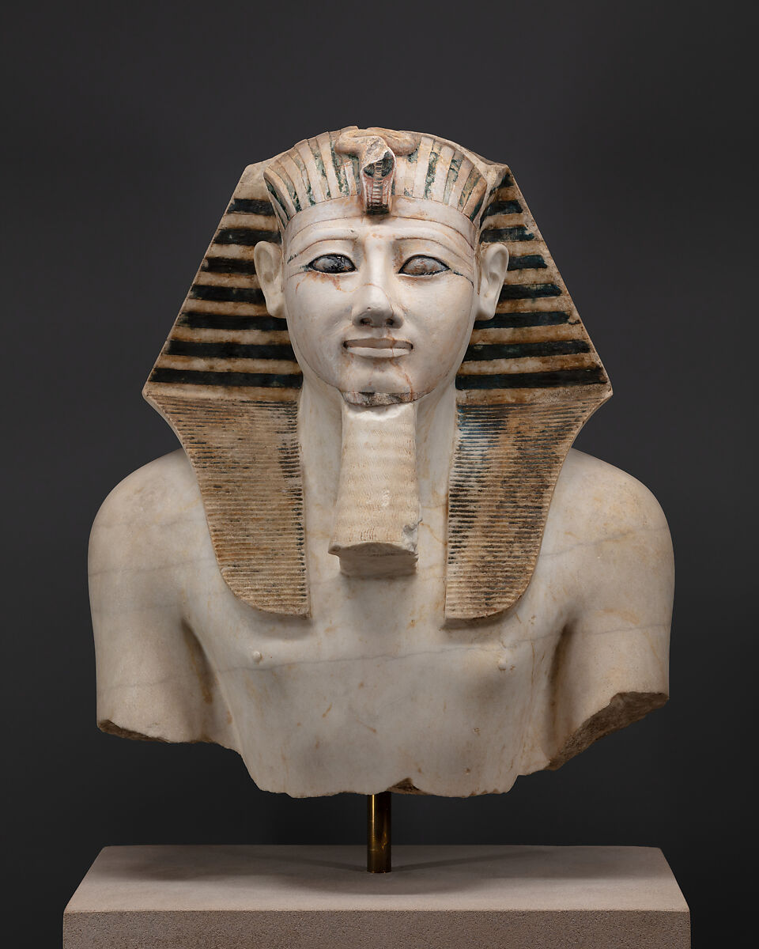
Charles Ryrie
Ryrie Study Bible, page 93
Exodus 2:23 - “The king would be Thutmose III (1482–1450), the predecessor to the pharaoh of the Exodus, Amenhotep II.”﻿

Slide 37
DATE OF THE EXODUS
1446 b.c.
  Literal numbers
  Oppression – Thutmose III
  Exodus – Amenhotep II

Slide 38
V. Exodus 2:23-25
God’s Observation
    Pharaoh’s death (23a)
    Israel’s bondage (23b)
    Israel’s prayer (23c)
    Israel’s covenant (24-25)

Slide 39

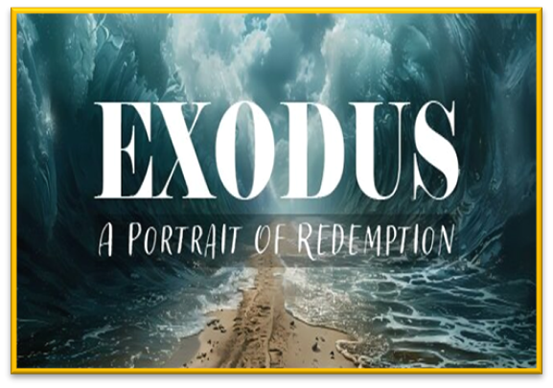
Romans 6:23
“For the wages of sin is death, but the free gift of God is eternal life in Christ Jesus our Lord.”

Slide 40
V. Exodus 2:23-25
God’s Observation
    Pharaoh’s death (23a)
    Israel’s bondage (23b)
    Israel’s prayer (23c)
    Israel’s covenant (24-25)

Slide 41


Revelation 1:3
“Blessed [makarios] is he who reads and those who hear the words of the prophecy, and heed the things which are written in it; for the time is near.”

Slide 42
V. Exodus 2:23-25
God’s Observation
    Pharaoh’s death (23a)
    Israel’s bondage (23b)
    Israel’s prayer (23c)
    Israel’s covenant (24-25)

Slide 43

Exodus 2:24
“So God heard their groaning; and God remembered His covenant with Abraham, Isaac, and Jacob.”

Slide 44

Genesis 15:18-21
¹⁸ On that day the Lord made a covenant with Abram, saying, “To your descendants I have given this land, From the river of Egypt as far as the great river, the river Euphrates: ¹⁹ the Kenite and the Kenizzite and the Kadmonite ²⁰ and the Hittite and the Perizzite and the Rephaim ²¹ and the Amorite and the Canaanite and the Girgashite and the Jebusite.”

Slide 45

Genesis 15:13, 16
“¹³ God said to Abram, ‘Know for certain that your descendants will be strangers in a land that is not theirs, where they will be enslaved and oppressed four hundred years… ¹⁶ Then in the fourth generation they will return here, for the wrongdoing of the Amorite is not yet complete.’”

Slide 46
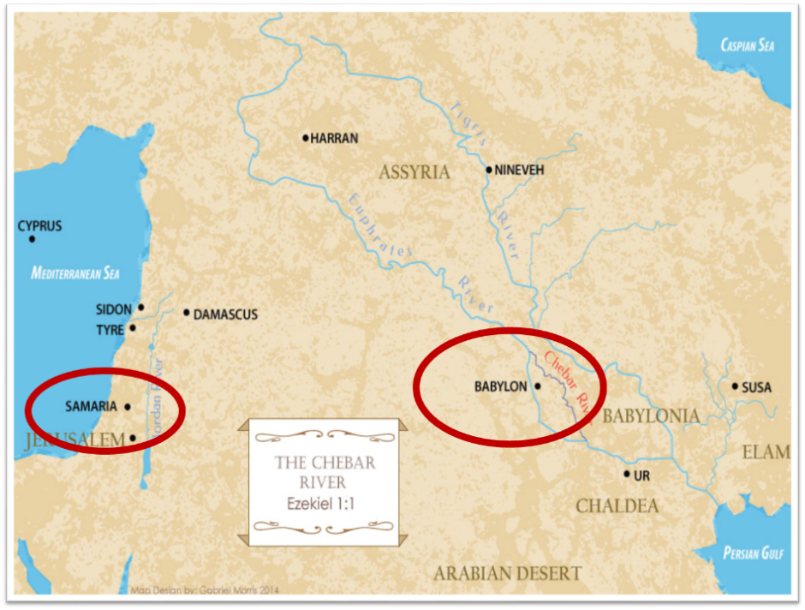

Slide 47
Ezekiel 36:22
“Therefore, say to the house of Israel, ‘This is what the Lord God says: “It is not for your sake, house of Israel, that I am about to act, but for My holy name, which you have profaned among the nations where you went.”

Slide 48
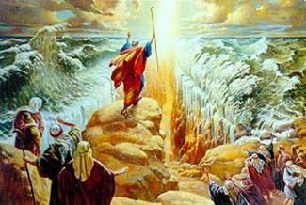
IMPORTANCE
God’s promises & covenant to Israel remain literal, reliable, unconditional, and unfulfilled (Gen. 23)
Basis of God’s intervention in history (Gen. 15:14-16; Exod. 2:24)
God must once again move His hand in history to fulfill His Word (Ezek. 36:22)
Forms the expectation of a future earthly kingdom

Slide 49

Evidence of Abrahamic Covenant’s Unconditional Nature
ANE covenant ratification ceremony (Gen 15)
Lack of stated conditions for Israel’s obedience (Gen 15)
Covenant's eternality (Gen 17:7, 13, 19; Ps. 90:2)
Covenant's immutability (Heb 6:13-18; Mal. 3:6)
Trans-generational reaffirmation despite perpetual national disobedience (Jer 31:35-37)
Walvoord, The Millennial Kingdom, 149-52

Slide 50

Land Promises Fulfilled in the Time of Joshua (Josh. 11:23; 21:43-45) or Solomon (1 Kgs. 4:21)?
Extended context (Josh 13:1-7; Judges 1:19, 21, 27, 29, 30-36)
Land gained in conquest was only a fraction of what was promised (1 Kgs. 4:25)
Jerusalem not conquered in Joshua’s day (Josh 15:63; 2 Sam 5)
Solomon’s reign extended to the border of Egypt (1 Kgs. 4:21) and not the River of Egypt (Gen. 15:18)
Solomon’s reign was tributary only (1 Kgs. 4:21)
Forever? (Gen 17:7-8, 13, 19)
Reaffirmation of land promises long after Joshua and Solomon’s time (Amos 9:11-15)
Fruchtenbaum, Israelology, 521-22, 631-32

Slide 51
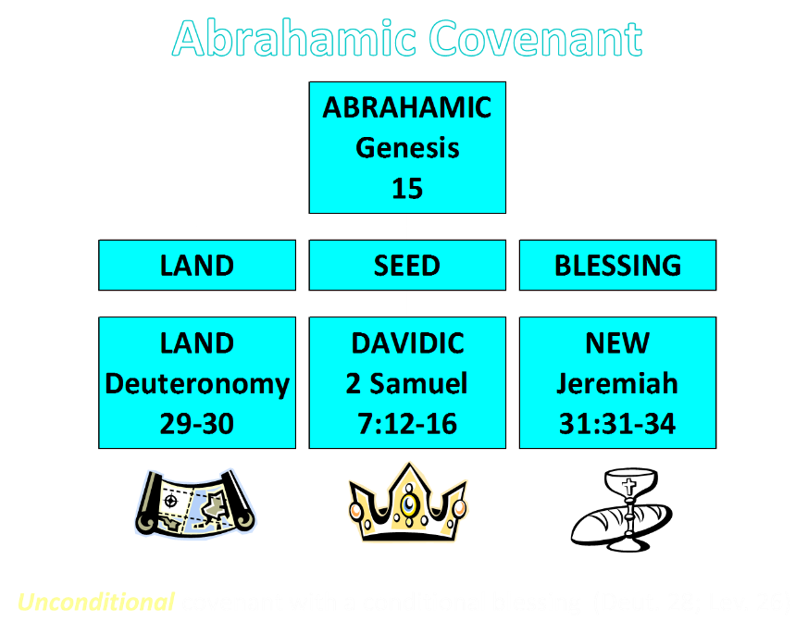

Slide 52
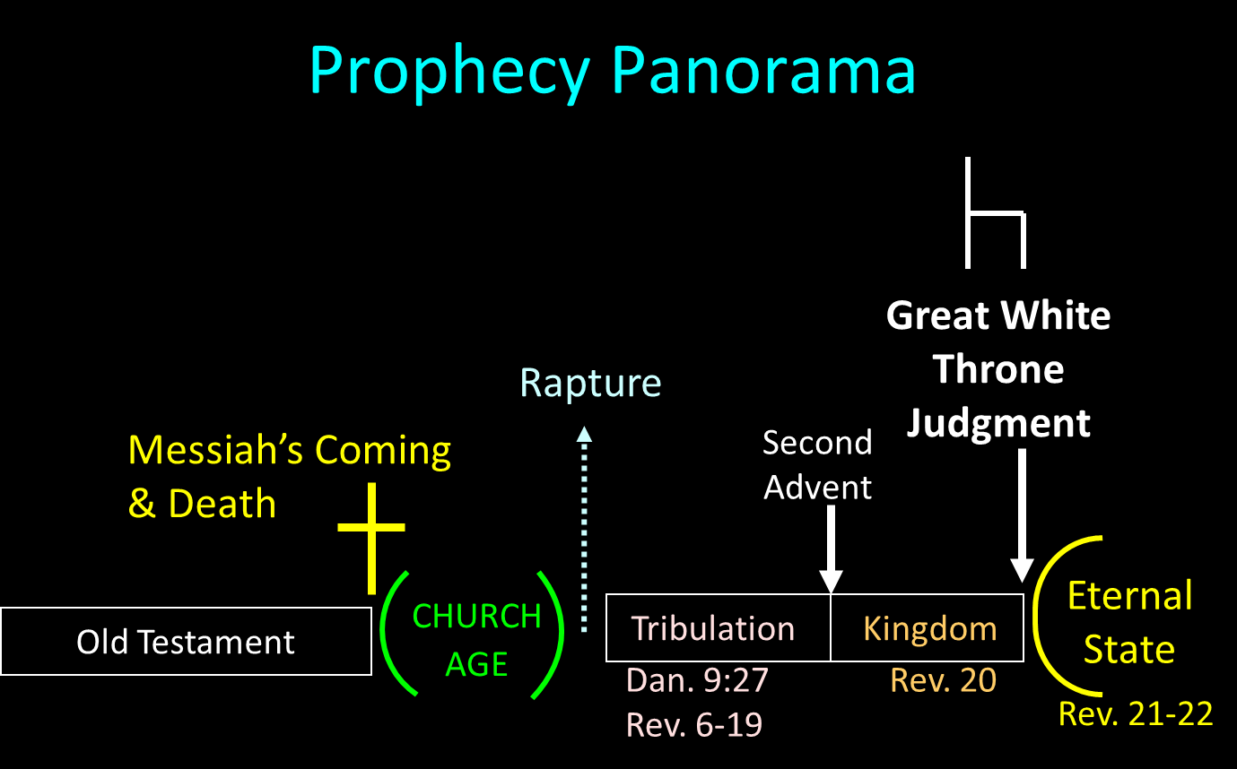

Slide 53
Conclusion

Slide 54
MOSES’ BIRTH, REARING, MARRIAGE, & TRAINING
Exodus 2:1-25
  Moses’ birth (1-4)
  Moses’ rearing (5-10)
  Moses’ flight (11-15)
  Moses’ marriage (16-22)
  God’s observation (23-25)

Slide 55
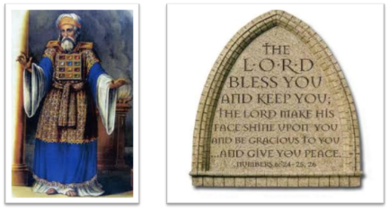
²⁴ The Lord bless you, and keep you; ²⁵ The Lord make His face shine on you, And be gracious to you; ²⁶ The Lord lift up His countenance on you, And give you peace.
Numbers 6:24–26 (NASB95)

