Slide 2
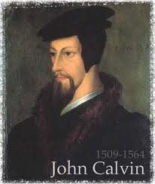
Neo-Calvinism vs. The Bible
Calvinism’s Mixed Blessing
Why Critique Calvinism?
The Source of Calvin’s Theology
Calvin’s Manner of Life
TULIP Through the Grid of Scripture
Conclusion

Slide 3
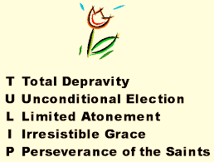
V. Running TULIP Through the Grid of Scripture
Total Depravity
Unconditional Election
Limited Atonement
Irresistible Grace
Perseverance of the Saints

Slide 4
Irresistible Grace
Calvinistic definition
Calvinistic arguments
Man can resist God’s grace
Man can resist God by disbelieving
John 6:44?

Slide 5
Irresistible Grace = ‘Regeneration Precedes Faith & Faith is a Gift’
“I” stands for “Irresistible Grace.” Faith is something “God irresistibly bestowed upon the elect without their having believed anything…By such reasoning, man…can’t even hear the gospel—much less respond to the pleadings of Christ.”
Bob Kirkland, Calvinism: None Dare Call It Heresy; Spotlight on the Life and Teachings of John Calvin (Eureka, MT: Lighthouse Trails, 2018), 34.

Slide 6
Irresistible Grace
Calvinistic definition
Calvinistic arguments
Man can resist God’s grace
Man can resist God by disbelieving
John 6:44?

Slide 7
Calvinistic Arguments
Faith is a gift
Regeneration precedes faith
Lost man cannot seek God (Rom. 3:11)

Slide 8
Regeneration Precedes Faith?
Definition
Calvinistic examples
Calvinist Proof texts
Biblical order
Ordo-Salutis
An eschatological parallel
Why believe?

Slide 9
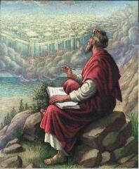
Titus 3:5
“He saved us, not on the basis of deeds which we have done in righteousness, but according to His mercy, by the washing of regeneration [palingenesia] and renewing by the Holy Spirit.”

Slide 10
Regeneration
Definition – impartation of divine life
Palingenesia (Titus 3:5)
Needed because of spiritual death – Gen. 2:16-17; Eph. 2:1
New birth – John 3:5
Accomplished through exposure to God’s Word (Jas. 1:18; 1 Pet. 1:23; Rom. 10:17; 2 Tim. 3:15)
If you are born once you will die twice; if you are born twice you will die once

Slide 11
Regeneration Precedes Faith?
Definition
Calvinistic examples
Calvinist Proof texts
Biblical order
Ordo-Salutis
An eschatological parallel
Why believe?

Slide 12
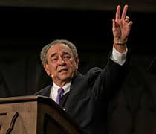
R.C. Sproul
Sproul explains that according to the “Reformed view of predestination before a person can choose Christ he must be born again.”
R. C. Sproul, Chosen by God (Carol Stream, IL: Tyndale House Publishers, Inc., 1986), 72.

Slide 13
David N. Steele & Curtis C. Thomas
“Because of the fall, man is an unable of himself to savingly believe the gospel. The sinner is dead, blind, and deaf to the things of God; his heart is deceitful and desperately corrupt. His will is not free, it is in bondage to his evil nature, therefore, he will not – indeed he cannot – choose good over evil in the spiritual realm. Consequently, it takes much more than the Spirit’s assistance to bring a sinner to Christ – it takes regeneration by which He makes the sinner alive and gives him a new nature. Faith is not something man contributes to salvation, but is itself a part of God‘s gift of salvation – it is God’s gift to the sinner, not the sinner’s gift to God.”
David N. Steele, Curtis C. Thomas, and S. Lance Quinn, The Five Points of Calvinism, 2nd ed. (Phillipsburg, NJ: Presbyterian and Reformed Publishing, 1963), 5-6.

Slide 14
Regeneration Precedes Faith?
Definition
Calvinistic examples
Calvinist Proof texts
Biblical order
Ordo-Salutis
An eschatological parallel
Why believe?

Slide 15
John 3:8
“The wind blows where it wishes and you hear the sound of it, but do not know where it comes from and where it is going; so is everyone who is born of the Spirit.”

Slide 16
John 3:16
“For God so loved the world, that He gave His only begotten Son, that whoever believes in Him shall not perish, but have eternal life.”

Slide 17
Ephesians 2:1-5
¹ “And you were dead in your trespasses and sins, ² in which you formerly walked according to the course of this world, according to the prince of the power of the air, of the spirit that is now working in the sons of disobedience. ³ Among them we too all formerly lived in the lusts of our flesh, indulging the desires of the flesh and of the mind, and were by nature children of wrath, even as the rest. ⁴ But God, being rich in mercy, because of His great love with which He loved us, ⁵ even when we were dead in our transgressions, made us alive together with Christ (by grace you have been saved)”

Slide 18
Regeneration Precedes Faith?
Definition
Calvinistic examples
Calvinist Proof texts
Biblical order
Ordo-Salutis
An eschatological parallel
Why believe?

Slide 19
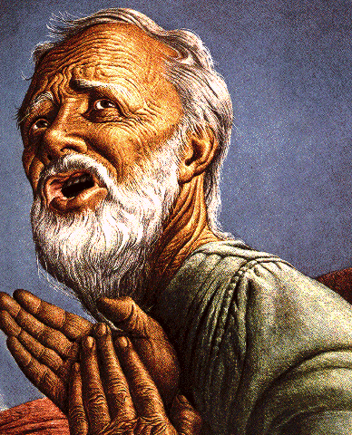
Belief – God’s One Condition for Justification
Gen 15:6
Then he believed in the LORD; and He reckoned it to him as righteousness.
John 3:16
For God so loved the world, that He gave His only begotten Son, that whoever believes in Him shall not perish, but have eternal life.
Acts 16:30-31
"Sirs, what must I do to be saved?" They said, "Believe in the Lord Jesus, and you will be saved..."

Slide 20
John 3:16
“For God so loved the world, that He gave His only begotten Son, that whoever believes in Him shall not perish, but have eternal life.”

Slide 21
John 5:24
“Truly, truly, I say to you, he who hears My word, and believes Him who sent Me, has eternal life, and does not come into judgment, but has passed out of death into life.”

Slide 22
John 6:40
“For this is the will of My Father, that everyone who beholds the Son and believes in Him will have eternal life, and I Myself will raise him up on the last day.”

Slide 23
John 6:47
“Truly, truly, I say to you, he who believes has eternal life.”

Slide 24
John 20:30-31
“Therefore many other signs Jesus also performed in the presence of the disciples, which are not written in this book; but these have been written so that you may believe that Jesus is the Christ, the Son of God; and that believing you may have life in His name.”

Slide 25
2 Corinthians 5:17
“Therefore if anyone is in Christ, he is a new creature; the old things passed away; behold, new things have come.”

Slide 26
Regeneration Precedes Faith?
Definition
Calvinistic examples
Calvinist Proof texts
Biblical order
Ordo-Salutis
An eschatological parallel
Why believe?

Slide 27
John 16:7-11
“⁷ But I tell you the truth, it is to your advantage that I go away; for if I do not go away, the Helper will not come to you; but if I go, I will send Him to you. ⁸ And He, when He comes, will convict the world concerning sin (hamartia, singular noun) and righteousness and judgment; ⁹ concerning sin, because they do not believe in Me; ¹⁰ and concerning righteousness, because I go to the Father and you no longer see Me; ¹¹ and concerning judgment, because the ruler of this world has been judged.”

Slide 28
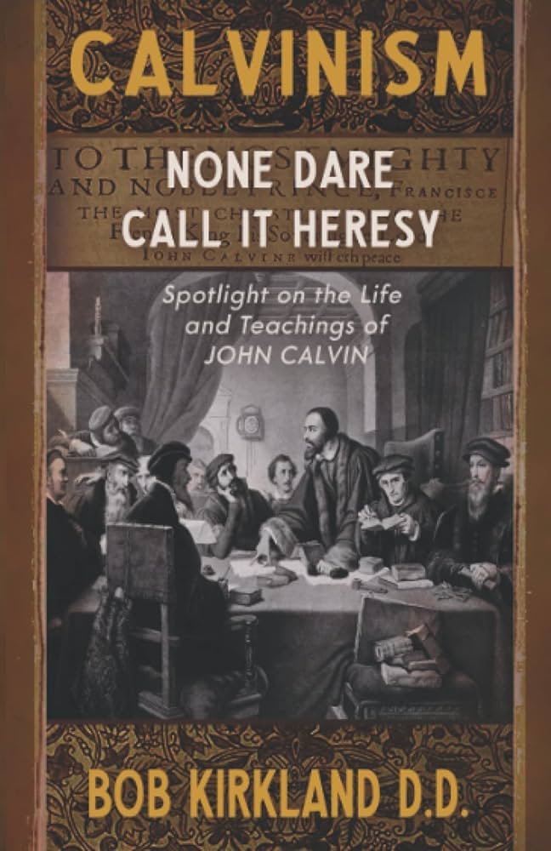
Divine Drawing vs. Divine Coercion
“We see then that while it is the Holy Spirit’s work to draw men to the Savior, it is incumbent on each individual to respond of his own free will prior to conversion.”
Bob Kirkland, Calvinism: None Dare Call It Heresy; Spotlight on the Life and Teachings of John Calvin (Eureka, MT: Lighthouse Trails, 2018), 40.

Slide 29
René A. Lopez
“In His convicting work the Holy Spirit draws sinners to Himself and waits for their simple response of faith. God then imparts eternal life to them the moment they believe. As Paul and Silas told the Philippian jailer, ‘Believe on the Lord Jesus Christ, and you will be saved (Acts 16:31).’”
“Is Faith a Gift From God or a Human Exercise?,” Bibliotheca Sacra 164 (July–September 2007): 276.

Slide 30
Regeneration Precedes Faith?
Definition
Calvinistic examples
Calvinist Proof texts
Biblical order
Ordo-Salutis
An eschatological parallel
Why believe?

Slide 31
Titus 3:5
“He saved us, not on the basis of deeds which we have done in righteousness, but according to His mercy, by the washing of regeneration [palingenesia] and renewing by the Holy Spirit.”

Slide 32
Matthew 19:28
“And Jesus said to them, ’Truly I say to you, that you who have followed Me, in the regeneration [palingenesia] when the Son of Man will sit on His glorious throne, you also shall sit upon twelve thrones, judging the twelve tribes of Israel.’”

Slide 34
Regeneration Precedes Faith?
Definition
Calvinistic examples
Calvinist Proof texts
Biblical order
Ordo-Salutis
An eschatological parallel
Why believe?

Slide 35
Charles Ryrie
“In the Reformed statement of the ordo salutis, regeneration precedes faith, for, it is argued, a sinner must be given new life in order to be able to believe. While this is admittedly stated only as a logical order, it is not wise to insist even on that; for it may as well be argued that if a sinner has new life through regeneration, why does he need to believe?”
Charles C. Ryrie, Basic Theology (Wheaton, IL: Victor, 1986; reprint, Chicago: Moody, 1999), 326.

Slide 36
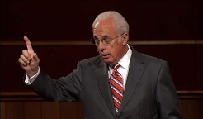
John MacArthur
“Furthermore, because of human depravity, there is nothing in a fallen, reprobate sinner that desires God or is capable of responding in faith...From the viewpoint of reason, regeneration logically must initiate faith and repentance.”
John F. MacArthur, Faith Works: The Gospel According to the Apostles (Dallas, TX: Word, 1993), 62 & n. 8.

Slide 37
Does Regeneration Precede Faith?
"If I am to preach the faith in Christ to a man who is regenerated, then the man, being regenerated, is saved already, and it is an unnecessary and ridiculous thing for me to preach Christ to him, and bid him to believe in order to be saved when he is saved already, being regenerate. Am I only to preach faith to those who have it? Absurd, indeed! Is not this waiting till the man is cured and then bringing him the medicine? This is preaching Christ to the righteous and not to sinners."
[Spurgeon - Sermon entitled, The Warrant of Faith].

Slide 38
Calvinistic Arguments
Faith is a gift
Regeneration precedes faith
Lost man cannot seek God (Rom. 3:11)

