Slide 2
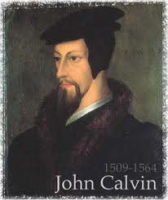
Neo-Calvinism vs. The Bible
Calvinism’s Mixed Blessing
Why Critique Calvinism?
The Source of Calvin’s Theology
Calvin’s Manner of Life
TULIP Through the Grid of Scripture
Conclusion

Slide 3
V. Running TULIP Through the Grid of Scripture
Total Depravity
Unconditional Election
Limited Atonement
Irresistible Grace
Perseverance of the Saints

Slide 4
Irresistible Grace
Calvinistic definition
Calvinistic arguments
Man can resist God’s grace
Man can resist God by disbelieving
John 6:44?

Slide 5
Irresistible Grace = Regeneration Precedes Faith & Faith is a Gift
“I” stands for “Irresistible Grace.” Faith is something “God irresistibly bestowed upon the elect without their having believed anything…By such reasoning, man…can’t even hear the gospel—much less respond to the pleadings of Christ.”
Bob Kirkland, Calvinism: None Dare Call It Heresy; Spotlight on the Life and Teachings of John Calvin (Eureka, MT: Lighthouse Trails, 2018), 34.

Slide 6
Irresistible Grace
Calvinistic definition
Calvinistic arguments
Man can resist God’s grace
Man can resist God by disbelieving
John 6:44?

Slide 7
Calvinistic Arguments
Faith is a gift
Regeneration precedes faith
Lost man cannot seek God (Rom. 3:11)

Slide 8
Faith is a Gift?
Calvinist Examples
Faith is a work?
Calvinist Proof texts
Miscellaneous problems

Slide 9
iv. Miscellaneous Problems
Degree of faith mentioned? (Matt. 8:5-13)
Responsibility to believe?
Responsibility for not believing (John 3:18; 5:40)
Confuses the instrument with the agent
Reverses the subject (man)‒object (God) relationship
Romans 10:17
Confuses how the Gospel is shared
A lively corpse indeed?
Roman Catholic roots

Slide 10
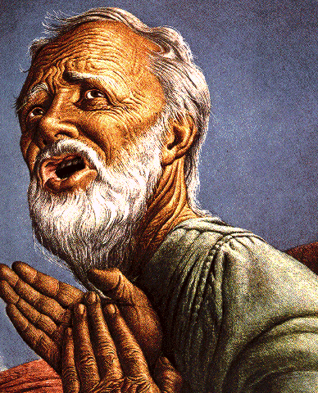
Passages Conditioning Salvation on Faith Alone (Sola Fide)
Genesis 15:6
John 3:16; 5:24; 6:28-29, 47; 16:8-9; 20:30-31
Acts 16:30-31
Romans 1:16; Ephesians 2:8-9
Hebrews 11:6

Slide 11
Belief – God’s One Condition for Justification
Gen 15:6
Then he believed in the LORD; and He reckoned it to him as righteousness.
John 3:16
For God so loved the world, that He gave His only begotten Son, that whoever believes in Him shall not perish, but have eternal life.
Acts 16:30-31
"Sirs, what must I do to be saved?" They said, "Believe in the Lord Jesus, and you will be saved..."

Slide 12
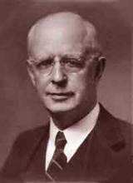
Lewis Sperry Chafer, vol. 7, Systematic Theology^{b} (Grand Rapids, MI: Kregel Publications, 1993), 265-66.
Belief-God’s One Condition for Justification
“…because upwards of 150 passages of Scripture condition salvation upon believing only (cf. John 3:16; Acts 16:31).

Slide 13
John MacArthur, Jr.
Tape GC 90-21 on Lordship salvation, last part of tape, comments made during the closing invitation.
“If faith is a gift of God, THEN HOW DO I GET IT? Do I do nothing and hope that God will sovereignly bestow it upon me? Or, do I cry out to God and pray that He will give me the gift of saving faith? Dr. MacArthur apparently holds to this second option. At the end of one of his messages he gave a salvation appeal and said the following: "Faith is a gift from God...it is permanent...the faith that God gives begets obedience...God gave it to you and He sustains it...May God grant you a true saving faith, a permanent gift that begins in humility and brokenness over sin and ends up in obedience unto righteousness. That's true faith and it's a gift that only God can give, and if you desire it pray and ask that He would grant it to you.”

Slide 14
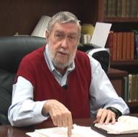
Jay Adams
Competent to Counsel, 70.
“But counselors, as Christians, are obligated to present the claims of Christ. They must present the good news that Christ Jesus died on the cross in the place of His own, that He bore the guilt and suffered the penalty for their sins. He died that all whom the Father had given to Him might come unto Him and have life everlasting. As a reformed Christian, the writer believes that counselors must not tell any unsaved counselee that Christ died for him, FOR THEY CANNOT SAY THAT. No man knows except Christ Himself who are His elect for whom He died." [emphasis mine]

Slide 15
iv. Miscellaneous Problems
Degree of faith mentioned? (Matt. 8:5-13)
Responsibility to believe?
Responsibility for not believing (John 3:18; 5:40)
Confuses the instrument with the agent
Reverses the subject (man)‒object (God) relationship
Romans 10:17
Confuses how the Gospel is shared
A lively corpse indeed?
Roman Catholic roots

Slide 16
John MacArthur, Jr.
Tape GC 90-21 on Lordship salvation, last part of tape, comments made during the closing invitation.
“If faith is a gift of God, THEN HOW DO I GET IT? Do I do nothing and hope that God will sovereignly bestow it upon me? Or, do I cry out to God and pray that He will give me the gift of saving faith? Dr. MacArthur apparently holds to this second option. At the end of one of his messages he gave a salvation appeal and said the following: "Faith is a gift from God...it is permanent...the faith that God gives begets obedience...God gave it to you and He sustains it...May God grant you a true saving faith, a permanent gift that begins in humility and brokenness over sin and ends up in obedience unto righteousness. That's true faith and it's a gift that only God can give, and if you desire it pray and ask that He would grant it to you.”

Slide 17
Roy L. Aldrich
“Thus an unscriptural doctrine of total depravity leads to an unscriptural and inconsistent plan of salvation. Doubtless the sinner is ‘dead in trespasses and sins’ (Eph. 2:1b). If this means that regeneration must precede faith, then it must also mean that regeneration must precede all three of the pious duties Shedd outlines for the lost [as seen in the following sentence]. A doctrine of total depravity that excludes the possibility of faith must also exclude the possibilities of ‘hearing the word,’ ‘giving serious application to divine truth,’ and ‘praying for the Holy Spirit for conviction and regeneration.’ The extreme Calvinist deals with a rather lively spiritual corpse after all. If the corpse has enough vitality to read the Word, and heed the message, and pray for conviction, perhaps it can also believe.”
Roy L. Aldrich, “The Gift of God,” Bibliotheca Sacra 122 (July–September 1965): 249.

Slide 18
iv. Miscellaneous Problems
Degree of faith mentioned? (Matt. 8:5-13)
Responsibility to believe?
Responsibility for not believing (John 3:18; 5:40)
Confuses the instrument with the agent
Reverses the subject (man)‒object (God) relationship
Romans 10:17
Confuses how the Gospel is shared
A lively corpse indeed?
Roman Catholic roots

Slide 19
Gary L. Nebeker
“the concept of infused faith for salvation bears a marked resemblance to the sacramentalism of the Roman Catholic Church. That is to say, faith becomes a transmitted and efficacious element which God gives to men for salvation.”
Gary L. Nebeker, “Is Faith a Gift of God? Ephesians 2:8 Reconsidered,” Grace Evangelical Society News, July 1989, 1.

Slide 20
Dave Hunt
“Most of those today, including evangelical leaders who hold Calvin in great esteem, are not aware that they have been captivated by the writings of a devout Roman Catholic, newly converted to Luther’s Protestantism, who had broken with Rome only a year before. Oddly, Calvin kept himself on the payroll of the Roman Catholic Church for nearly a year after he claimed to have been miraculously delivered from the ‘deep slough’ of ‘obstinate addiction to the superstitions of the papacy.’”
Dave Hunt, What Love Is This? Calvinism's Misrepresentation of God, 4th ed. (Bend, OR: Berean Call, 2013), 42.

Slide 21
Calvinistic Arguments
Faith is a gift
Regeneration precedes faith
Lost man cannot seek God (Rom. 3:11)

Slide 22
Regeneration Precedes Faith?
Definition
Calvinistic examples
Calvinist Proof texts
Biblical order
Ordo-Salutis
An eschatological parallel
Why believe?

Slide 23
Regeneration Precedes Faith?
Definition
Calvinistic examples
Calvinist Proof texts
Biblical order
Ordo-Salutis
An eschatological parallel
Why believe?

Slide 24
Regeneration
Definition – impartation of divine life
Palingenesia (Titus 3:5)
Needed because of spiritual death – Gen. 2:16-17; Eph. 2:1
New birth – John 3:5
Accomplished through exposure to God’s Word (Jas. 1:18; 1 Pet. 1:23; Rom. 10:17; 2 Tim. 3:15)
If you are born once you will die twice; if you are born twice you will die once

Slide 25
Regeneration Precedes Faith?
Definition
Calvinistic examples
Calvinist Proof texts
Biblical order
Ordo-Salutis
An eschatological parallel
Why believe?

Slide 26
David N. Steele & Curtis C. Thomas
“Thus, the once dead sinner is drawn to Christ by the inward, supernatural call of the Spirit, who through regeneration makes him alive and creates faith and repentance within him.”
David N. Steele, Curtis C. Thomas, and S. Lance Quinn, The Five Points of Calvinism, 2nd ed. (Phillipsburg, NJ: Presbyterian and Reformed Publishing, 1963), 53.

Slide 27
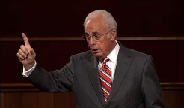
John MacArthur
“Furthermore, because of human depravity, there is nothing in a fallen, reprobate sinner that desires God or is capable of responding in faith...From the viewpoint of reason, regeneration logically must initiate faith and repentance.”
John F. MacArthur, Faith Works: The Gospel According to the Apostles (Dallas, TX: Word, 1993), 62 & n. 8.

Slide 28
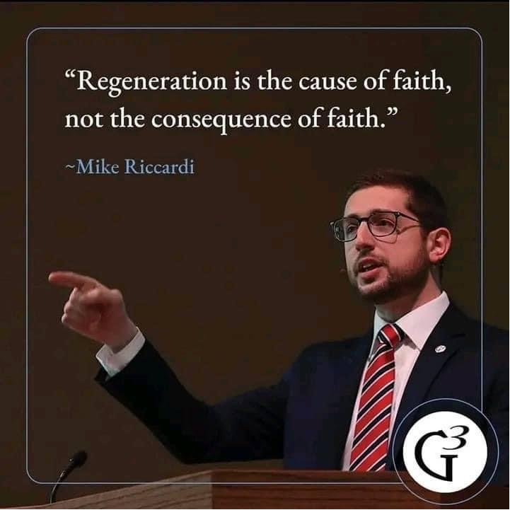

Slide 29
Tom Wells
“I am afraid we have come to think of faith and the new birth in just the opposite way. . . . If a man must repent and have faith in order to be born again—if he must make some such decision about it—then he is the cause, in part at least, of his own birth. No, the Biblical view is quite the opposite. Put simply, it is this. A man must be born again in order to exercise faith.”
Tom Wells, Faith: The Gift of God (Carlisle, PA: Banner of Truth Trust, 1983), 58.

Slide 31
R.C. Sproul
Sproul explains that according to the “Reformed view of predestination before a person can choose Christ he must be born again.”
R. C. Sproul, Chosen by God (Carol Stream, IL: Tyndale House Publishers, Inc., 1986), 72.

Slide 32
James White
White writes, “The Reformed assertion is that man cannot understand and embrace the gospel nor respond in faith and repentance toward Christ without God first freeing him from sin and giving him spiritual life (regeneration).”
James R. White, The Potter’s Freedom (Amityville, NY: Calvary Press Publishing, 2000), 101.

Slide 33
James White
White writes, “‘Irresistible grace’ is a reference to God’s sovereign regeneration of His elect: any other use of this phrase is in error.”
James R. White, The Potter’s Freedom (Amityville, NY: Calvary Press Publishing, 2000), 137.

Slide 34
J. I. Packer
“Without [regeneration] there is no faith in the redeemer, and therefore no benefit from His death…we are impotent to turn to Christ in repentance and faith; part of the effect of regeneration, however, is that faith dawns in our hearts.”
J. I. Packer, Great Grace (Ann Arbor, MI: Vine Books, 1997), 67.

Slide 35
David N. Steele & Curtis C. Thomas
“Because of the fall, man is an unable of himself to savingly believe the gospel. The sinner is dead, blind, and deaf to the things of God; his heart is deceitful and desperately corrupt. His will is not free, it is in bondage to his evil nature, therefore, he will not – indeed he cannot – choose good over evil in the spiritual realm. Consequently, it takes much more than the Spirit’s assistance to bring a sinner to Christ – it takes regeneration by which He makes the sinner alive and gives him a new nature. Faith is not something man contributes to salvation, but is itself a part of God‘s gift of salvation – it is God’s gift to the sinner, not the sinner’s gift to God.”
David N. Steele, Curtis C. Thomas, and S. Lance Quinn, The Five Points of Calvinism, 2nd ed. (Phillipsburg, NJ: Presbyterian and Reformed Publishing, 1963), 5-6.

Slide 36
Regeneration Precedes Faith?
Definition
Calvinistic examples
Calvinist Proof texts
Biblical order
Ordo-Salutis
An eschatological parallel
Why believe?

Slide 37
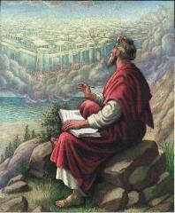
John 1:13
“who were born, not of blood nor of the will of the flesh nor of the will of man, but of God.”

Slide 38
John 1:12-13
“But as many as received Him, to them He gave the right to become children of God, even to those who believe in His name, ¹³ who were born, not of blood nor of the will of the flesh nor of the will of man, but of God.”

Slide 39
Ezekiel 36:24-28
“For I will take you from the nations, gather you from all the lands and bring you into your own land. ²⁵ Then I will sprinkle clean water on you, and you will be clean; I will cleanse you from all your filthiness and from all your idols. ²⁶ Moreover, I will give you a new heart and put a new spirit within you; and I will remove the heart of stone from your flesh and give you a heart of flesh. ²⁷ I will put My Spirit within you and cause you to walk in My statutes, and you will be careful to observe My ordinances. ²⁸ You will live in the land that I gave to your forefathers; so you will be My people, and I will be your God.”

Slide 40
Matthew 23:37-39
“Jerusalem, Jerusalem, who kills the prophets and stones those who are sent to her! How often I wanted to gather your children together, the way a hen gathers her chicks under her wings, and you were unwilling. ³⁸ Behold, your house is being left to you desolate! ³⁹ For I say to you, from now on you will not see Me until you say, ‘Blessed is He who comes in the name of the Lord!’”

Slide 41
Regeneration Precedes Faith?
Definition
Calvinistic examples
Calvinist Proof texts
Biblical order
Ordo-Salutis
An eschatological parallel
Why believe?

Slide 42
Belief – God’s One Condition for Justification
Gen 15:6
Then he believed in the LORD; and He reckoned it to him as righteousness.
John 3:16
For God so loved the world, that He gave His only begotten Son, that whoever believes in Him shall not perish, but have eternal life.
Acts 16:30-31
"Sirs, what must I do to be saved?" They said, "Believe in the Lord Jesus, and you will be saved..."

Slide 43
John 3:16
“For God so loved the world, that He gave His only begotten Son, that whoever believes in Him shall not perish, but have eternal life.”

Slide 44
John 5:24
“Truly, truly, I say to you, he who hears My word, and believes Him who sent Me, has eternal life, and does not come into judgment, but has passed out of death into life.”

Slide 45
John 6:40
“For this is the will of My Father, that everyone who beholds the Son and believes in Him will have eternal life, and I Myself will raise him up on the last day.”

Slide 46
John 6:47
“Truly, truly, I say to you, he who believes has eternal life.”

Slide 47
John 20:30-31
“Therefore many other signs Jesus also performed in the presence of the disciples, which are not written in this book; but these have been written so that you may believe that Jesus is the Christ, the Son of God; and that believing you may have life in His name.”

Slide 48
Regeneration Precedes Faith?
Definition
Calvinistic examples
Calvinist Proof texts
Biblical order
Ordo-Salutis
An eschatological parallel
Why believe?

Slide 49
John 16:7-11
“⁷ But I tell you the truth, it is to your advantage that I go away; for if I do not go away, the Helper will not come to you; but if I go, I will send Him to you. ⁸ And He, when He comes, will convict the world concerning sin (hamartia, singular noun) and righteousness and judgment; ⁹ concerning sin, because they do not believe in Me; ¹⁰ and concerning righteousness, because I go to the Father and you no longer see Me; ¹¹ and concerning judgment, because the ruler of this world has been judged.”

Slide 50
Divine Drawing vs. Divine Coercion
“We see then that while it is the Holy Spirit’s work to draw men to the Savior, it is incumbent on each individual to respond of his own free will prior to conversion.”
Bob Kirkland, Calvinism: None Dare Call It Heresy; Spotlight on the Life and Teachings of John Calvin (Eureka, MT: Lighthouse Trails, 2018), 40.

Slide 51
René A. Lopez
“In His convicting work the Holy Spirit draws sinners to Himself and waits for their simple response of faith. God then imparts eternal life to them the moment they believe. As Paul and Silas told the Philippian jailer, ‘Believe on the Lord Jesus Christ, and you will be saved (Acts 16:31).’”
“Is Faith a Gift From God or a Human Exercise?,” Bibliotheca Sacra 164 (July–September 2007): 276.

Slide 52
Regeneration Precedes Faith?
Definition
Calvinistic examples
Calvinist Proof texts
Biblical order
Ordo-Salutis
An eschatological parallel
Why believe?

Slide 53
Matthew 19:28
“And Jesus said to them, ’Truly I say to you, that you who have followed Me, in the regeneration [palingenesia] when the Son of Man will sit on His glorious throne, you also shall sit upon twelve thrones, judging the twelve tribes of Israel.’”

Slide 55
Regeneration Precedes Faith?
Definition
Calvinistic examples
Calvinist Proof texts
Biblical order
Ordo-Salutis
An eschatological parallel
Why believe?

Slide 56
Charles Ryrie
“In the Reformed statement of the ordo salutis, regeneration precedes faith, for, it is argued, a sinner must be given new life in order to be able to believe. While this is admittedly stated only as a logical order, it is not wise to insist even on that; for it may as well be argued that if a sinner has new life through regeneration, why does he need to believe?”
Charles C. Ryrie, Basic Theology (Wheaton, IL: Victor, 1986; reprint, Chicago: Moody, 1999), 326.

Slide 57
Does Regeneration Precede Faith?
"If I am to preach the faith in Christ to a man who is regenerated, then the man, being regenerated, is saved already, and it is an unnecessary and ridiculous thing for me to preach Christ to him, and bid him to believe in order to be saved when he is saved already, being regenerate. Am I only to preach faith to those who have it? Absurd, indeed! Is not this waiting till the man is cured and then bringing him the medicine? This is preaching Christ to the righteous and not to sinners."
[Spurgeon - Sermon entitled, The Warrant of Faith].

