Slide 2
EXODUS STRUCTURE/OUTLINE
Redemption (1–18)
Redemption (1:1–12:30)
Liberation (12:31–15:21)
Preservation (15:22–18:27)
Mosaic Covenant (19–40)
Law (19–24)
Tabernacle instructions (25–31)
Apostasy (32–34)
Tabernacle building (35–40)

Slide 3
REDEMPTION (1:1–12:30)
Why redemption is necessary (Exod 1)
Development of the deliverer (Exod 2–4)
First confrontation with Pharaoh (Exod 5)
God reassures Moses (Exod 6:1–7:7)
Second confrontation with Pharaoh (Exod 7:18-13)
Plagues (Exod 7:14–12:30)

Slide 4
REASON AND RESULTS OF THE OPPRESSION Exodus 1:1-22
Reason for the Oppression (1-10)
Results of the Oppression (11-22)
Willmington, Outline Bible, 25

Slide 5
II. Exodus 1:11-22 Results of the Oppression
Pharaoh’s building decree (11-14)
Pharaoh’s bloody decree (15-22)
Willmington, Outline Bible, 25

Slide 6
Exodus 1:15-22 Pharaoh’s Bloody Decree
His order to the midwives (15-21)
His order to the masses (22)
Willmington, Outline Bible, 25

Slide 7
Exodus 1:15-22 Pharaoh’s Bloody Decree
His order to the midwives (15-21)
His order to the masses (22)
Willmington, Outline Bible, 25

Slide 8
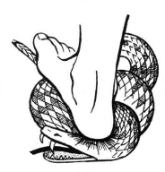
Genesis 3:15
“And I will put enmity Between you and the woman, And between your seed and her seed; He shall bruise you on the head, And you shall bruise him on the heel.”

Slide 9
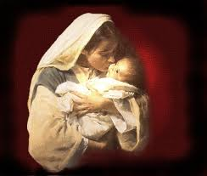
Satanic Attempts to Stop Messiah’s Birth
Cain & Abel (Gen. 4)
Sons of God (Gen. 6)
Pharaoh persecutes Israel (Exod. 1)
Joash protected from Athaliah (2 Chron. 22‒23)
Haman persecutes Israel (Esther)
Antiochus Epiphanés (Dan. 11:31)
Herod persecutes Christ (Matt 2; Rev 12:4)

Slide 10
Satanic Attempts to Stop Messiah’s Birth
Cain & Abel (Gen. 4)
Sons of God (Gen. 6)
Pharaoh persecutes Israel (Exod. 1)
Joash protected from Athaliah (2 Chron. 22‒23)
Haman persecutes Israel (Esther)
Antiochus Epiphanés (Dan. 11:31)
Herod persecutes Christ (Matt 2; Rev 12:4)

Slide 11
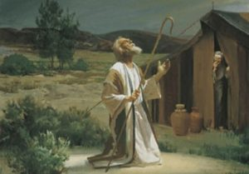
Genesis 12:3
“And I will bless those who bless you, And the one who curses you I will curse. And in you all the families of the earth will be blessed.”

Slide 12
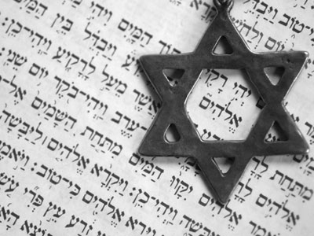
Israel’s Three Blessings to the World (Gen 12:3b)
Scripture (Rom 3:2)
Savior (John 4:22)
Kingdom (Isa 2:2-3)

Slide 14
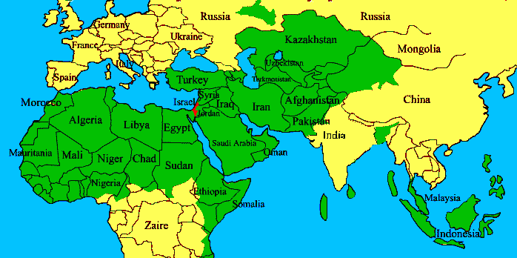
ISRAEL

Slide 15
Romans 13:1-5
“¹ Every person is to be in subjection to the governing authorities. For there is no authority except from God, and those which exist are established by God. ² Therefore whoever resists authority has opposed the ordinance of God; and they who have opposed will receive condemnation upon themselves. ³ For rulers are not a cause of fear for good behavior, but for evil. Do you want to have no fear of authority? Do what is good and you will have praise from the same.”

Slide 16
Romans 13:1-5
“⁴ for it is a minister of God to you for good. But if you do what is evil, be afraid; for it does not bear the sword for nothing; for it is a minister of God, an avenger who brings wrath on the one who practices evil. ⁵ Therefore, it is necessary to be in subjection, not only because of wrath, but also for conscience’ sake.”

Slide 17
Titus 3:1
“Remind them to be subject to rulers, to authorities, to be obedient, to be ready for every good deed.”

Slide 18
1 Peter 2:13-14
“Submit yourselves for the Lord’s sake to every human institution, whether to a king as the one in authority, or to governors as sent by him for the punishment of evildoers and the praise of those who do right.”

Slide 19
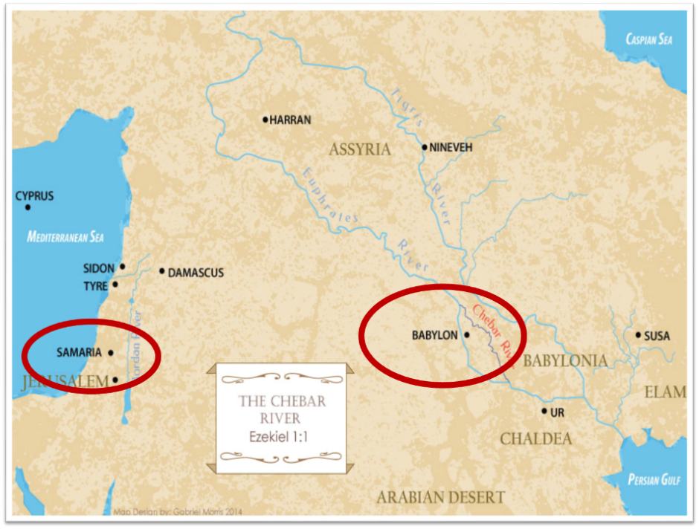

Slide 20
Synthetic Outline
Chiasm in “Aramaic” ( Dan. 2-7)
1. Gentile History (2)
2. Protection (3)
3. Revelation to a gentile king (4)
3'. Revelation to a gentile king (5)
2. Protection (6)
1. Gentile history (7)

Slide 21
Synthetic Outline
Chiasm in “Aramaic” ( Dan. 2-7)
1. Gentile History (2)
2. Protection (3)
3. Revelation to a gentile king (4)
3'. Revelation to a gentile king (5)
2. Protection (6)
1. Gentile history (7)

Slide 22
PRINCIPLES OF CIVIL DISOBEDIENCE
“Crystal” clear conflict between the laws of man and God
Exhaustion of all creative legal remedies
A willingness to “pay the consequences”
Maintaining of respect for civil authorities

Slide 23
Charles Ryrie Ryrie Study Bible, page 69
Exodus 1:7 - “The census at Sinai (Num. 1) showed 603,000 males 20 years and older. If they represented about 1/4 of the total population, then the Israelites numbered some 2,000,000 people. An annual growth rate of 5 percent would increase the population from 100 to 2,000,000 in only 215 years (see Gen. 46:27; Ex. 12:41).”﻿

Slide 24
8 New Promises Genesis 12:1-3
Land (Gen. 12:1b)
Great nation (Gen. 12:2a)
Personal blessing (Gen. 12:2b)
Great name (Gen. 12:2c)
Blessing to others (Gen. 12:2d)
Blessing to blessers (Gen. 12:3a)
Cursing to cursers (Gen. 12:3b)
Blessing to the world (Gen. 12:3c)

Slide 25
Genesis 12:3
“And I will bless those who bless you, And the one who curses you I will curse. And in you all the families of the earth will be blessed.”

Slide 26
Exodus 1:15-22 Pharaoh’s Bloody Decree
His order to the midwives (15-21)
His order to the masses (22)
Willmington, Outline Bible, 25

Slide 27
Satanic Attempts to Stop Messiah’s Birth
Cain & Abel (Gen. 4)
Sons of God (Gen. 6)
Pharaoh persecutes Israel (Exod. 1)
Joash protected from Athaliah (2 Chron. 22‒23)
Haman persecutes Israel (Esther)
Antiochus Epiphanés (Dan. 11:31)
Herod persecutes Christ (Matt 2; Rev 12:4)

Slide 28
8 New Promises Genesis 12:1-3
Land (Gen. 12:1b)
Great nation (Gen. 12:2a)
Personal blessing (Gen. 12:2b)
Great name (Gen. 12:2c)
Blessing to others (Gen. 12:2d)
Blessing to blessers (Gen. 12:3a)
Cursing to cursers (Gen. 12:3b)
Blessing to the world (Gen. 12:3c)

Slide 29
Genesis 12:3
“And I will bless those who bless you, And the one who curses you I will curse. And in you all the families of the earth will be blessed.”

Slide 30
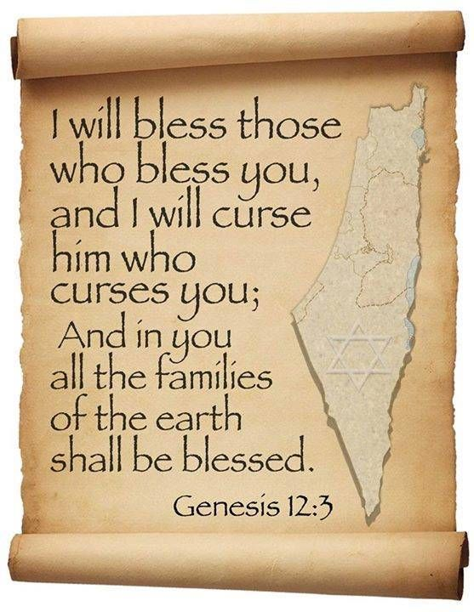
Genesis 12:3
“And I will bless those who bless you, And the one who curses [kalal] you I will curse [aor]. And in you all the families of the earth will be blessed.”

Slide 31
Dr. Arnold G. Fruchtenbaum
The Book of Genesis, 242
“The first word for curse is kalal, which means ‘to treat lightly,’ ‘to hold in contempt,’ or ‘to curse.’ To merely treat Abram and the Jews lightly is to incur the curse of God. The second word for curse used in this phrase (him that curses you will I curse) is aor, from the Hebrew root arah, which means ‘to impose a barrier,’ ‘to ban.’ This is a much stronger word for curse than the first one in the phrase…Therefore, even a light curse against Abram or against the Jews will bring a heavier curse from God.”

Slide 34
The Plagues of Egypt
NO. | DESCRIPTION | SCRIPTURE | Egyptian Deity
1. | Water to Blood | Exod. 7:14-25 | Hapi, Khnum
2. | Frogs | Exod. 8:1-15 | Heqt
3. | Gnats | Exod. 8:16-19 | Set
4. | Flies | Exod. 8:20-32 | Uatchit
5. | Disease on Cattle | Exod. 9:1-7 | Hathor, Apis
6. | Boils | Exod. 9:8-12 | Sekhmet, Serapis
7. | Hail | Exod. 9:13-35 | Seth, Nut
8. | Locusts | Exod. 10:1-20 | Seth, Nut, Osiris
9. | Darkness | Exod. 10:21-29 | Re, Horus, Atum
10. | Death of the First Born | Exod. 12:29-36 | Min, Osiris, Heqt, Isis

Slide 35
Conclusion

Slide 36
REASON AND RESULTS OF THE OPPRESSION Exodus 1:1-22
Reason for the Oppression (1-10)
Results of the Oppression (11-22)
Willmington, Outline Bible, 25

Slide 37
II. Exodus 1:11-22 Results of the Oppression
Pharaoh’s building decree (11-14)
Pharaoh’s bloody decree (15-22)
Willmington, Outline Bible, 25

Slide 38
Exodus 1:15-22 Pharaoh’s Bloody Decree
His order to the midwives (15-21)
His order to the masses (22)
Willmington, Outline Bible, 25

Slide 39
REDEMPTION (1:1–12:30)
Why redemption is necessary (Exod 1)
Development of the deliverer (Exod 2–4)
First confrontation with Pharaoh (Exod 5)
God reassures Moses (Exod 6:1–7:7)
Second confrontation with Pharaoh (Exod 7:18-13)
Plagues (Exod 7:14–12:30)

Slide 40
²⁴ The Lord bless you, and keep you; ²⁵ The Lord make His face shine on you, And be gracious to you; ²⁶ The Lord lift up His countenance on you, And give you peace.
Numbers 6:24–26 (NASB95)

