Slide 2
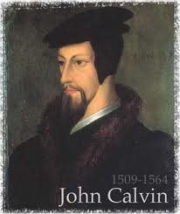
Neo-Calvinism vs. The Bible
Calvinism’s Mixed Blessing
Why Critique Calvinism?
The Source of Calvin’s Theology
Calvin’s Manner of Life
TULIP Through the Grid of Scripture
Conclusion

Slide 3
V. Running TULIP Through the Grid of Scripture
Total Depravity
Unconditional Election
Limited Atonement
Irresistible Grace
Perseverance of the Saints

Slide 4
Irresistible Grace
Calvinistic definition
Calvinistic arguments
Man can resist God’s grace
Man can resist God by disbelieving
John 6:44?

Slide 5
Irresistible Grace = Regeneration Precedes Faith & Faith is a Gift
“I” stands for “Irresistible Grace.” Faith is something “God irresistibly bestowed upon the elect without their having believed anything…By such reasoning, man…can’t even hear the gospel—much less respond to the pleadings of Christ.”
Bob Kirkland, Calvinism: None Dare Call It Heresy; Spotlight on the Life and Teachings of John Calvin (Eureka, MT: Lighthouse Trails, 2018), 34.

Slide 6
Irresistible Grace
Calvinistic definition
Calvinistic arguments
Man can resist God’s grace
Man can resist God by disbelieving
John 6:44?

Slide 7
Calvinistic Arguments
Faith is a gift
Regeneration precedes faith
Lost man cannot seek God (Rom. 3:11)

Slide 8
Faith is a Gift?
Calvinist Examples
Faith is a work?
Calvinist Proof texts
Miscellaneous problems

Slide 9
Calvinist Proof-Texts
John 6:27-29 John 6:44-45 Acts 3:16 Acts 11:18 Acts 16:14 |  | (f) 1 Cor. 12:9 (g) Rom. 12:3 (h) Eph. 2:8-9 (i) Philip. 1:29 (j) 2 Pet. 1:1

Slide 10
Philippians 1:29
“For to you it has been granted for Christ’s sake, not only to believe in Him, but also to suffer for His sake.”

Slide 11
René A. Lopez
“However, the gift of faith is not the topic of the verse. In fact the word ‘granted’ (…‘give graciously’) should be understood here as conveying a privilege. It is a graciously granted privilege that God allows a person to believe in Christ and to suffer for Him. Since ‘to believe’ and ‘to suffer’ are parallel, it follows that if faith is a gift then so is suffering. But the Bible nowhere speaks of suffering as a divine gift. Furthermore, ‘it is not God who suffers but man. Likewise, it is not God who believes but man. Both believing and suffering are actions of people.’”
“Is Faith a Gift From God or a Human Exercise?,” Bibliotheca Sacra 164 (July–September 2007): 269-70.

Slide 12
John 16:7-11
“⁷ But I tell you the truth, it is to your advantage that I go away; for if I do not go away, the Helper will not come to you; but if I go, I will send Him to you. ⁸ And He, when He comes, will convict the world concerning sin and righteousness and judgment; ⁹ concerning sin, because they do not believe in Me; ¹⁰ and concerning righteousness, because I go to the Father and you no longer see Me; ¹¹ and concerning judgment, because the ruler of this world has been judged.”

Slide 13
Philippians 1:29
“For to you it has been granted for Christ’s sake, not only to believe in Him, but also to suffer for His sake.”

Slide 14
Calvinist Proof-Texts
John 6:27-29 John 6:44-45 Acts 3:16 Acts 11:18 Acts 16:14 |  | (f) 1 Cor. 12:9 (g) Rom. 12:3 (h) Eph. 2:8-9 (i) Philip. 1:29 (j) 2 Pet. 1:1

Slide 15
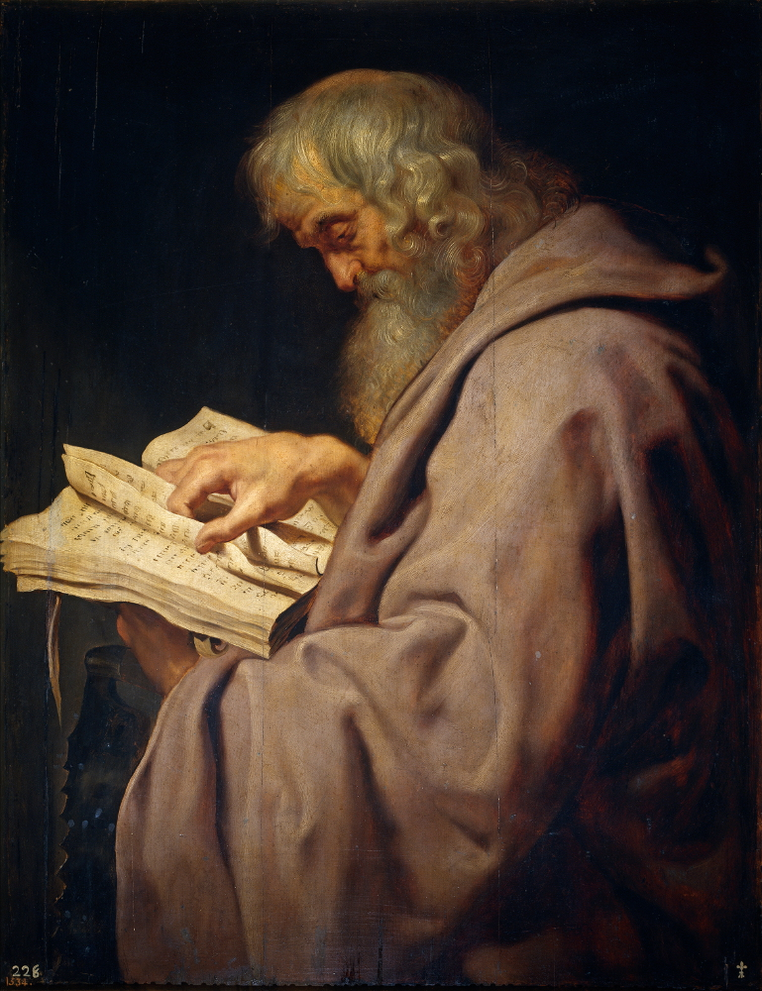
2 Peter 1:1
“Simon Peter, a bond-servant and apostle of Jesus Christ, To those who have received a faith of the same kind as ours, by the righteousness of our God and Savior, Jesus Christ.”

Slide 16
Faith is a Gift?
Calvinist Examples
Faith is a work?
Calvinist Proof texts
Miscellaneous problems

Slide 17
iv. Miscellaneous Problems
Degree of faith mentioned? (Matt. 8:5-13)
Responsibility to believe?
Responsibility for not believing (John 3:18; 5:40)
Confuses the instrument with the agent
Reverses the subject (man)‒object (God) relationship
Romans 10:17
Confuses how the Gospel is shared
A lively corpse indeed?
Roman Catholic roots

Slide 18
iv. Miscellaneous Problems
Degree of faith mentioned? (Matt. 8:5-13)
Responsibility to believe?
Responsibility for not believing (John 3:18; 5:40)
Confuses the instrument with the agent
Reverses the subject (man)‒object (God) relationship
Romans 10:17
Confuses how the Gospel is shared
A lively corpse indeed?
Roman Catholic roots

Slide 19
René A. Lopez
“A Roman centurion is another example of a person who exercised faith (Matt. 8:5–13). Marveling at his faith, Jesus said, ‘Truly I say to you, I have not found such great faith with anyone in Israel’ (v. 10). Jesus’ reference to the centurion’s ‘great faith’ makes sense only if that faith came from the centurion and not God. For why would Christ emphasize the centurion‘s degree of faith if it came from God?”
“Is Faith a Gift From God or a Human Exercise?,” Bibliotheca Sacra 164 (July–September 2007): 264.

Slide 20
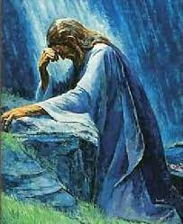
Luke 22:32
“but I have prayed for you, that your faith may not fail; and you, when once you have turned again, strengthen your brothers.”

Slide 21
iv. Miscellaneous Problems
Degree of faith mentioned? (Matt. 8:5-13)
Responsibility to believe?
Responsibility for not believing (John 3:18; 5:40)
Confuses the instrument with the agent
Reverses the subject (man)‒object (God) relationship
Romans 10:17
Confuses how the Gospel is shared
A lively corpse indeed?
Roman Catholic roots

Slide 22
The Responsibility to Believe
John 1:12-13 John 3:16 John 3:36 John 5:24 John 6:47 |  | Acts 16:31 Rom. 3:21-22 Rom. 3:25-26 Rom. 4:3-6 Eph. 2:8

Slide 23
iv. Miscellaneous Problems
Degree of faith mentioned? (Matt. 8:5-13)
Responsibility to believe?
Responsibility for not believing (John 3:18; 5:40)
Confuses the instrument with the agent
Reverses the subject (man)‒object (God) relationship
Romans 10:17
Confuses how the Gospel is shared
A lively corpse indeed?
Roman Catholic roots

Slide 24
Dr. Robert R. Congdon
Oops! I Thought I Was a Four - Pt Calvinist (Greer, SC: Congdon Ministries International, 2014), 51.
“Furthermore, why would God admonish and warn unbelievers for being spiritually blind and deaf if it were not in their power to respond?…Is this not a mockery? It would be like chiding a legless man for being unable to walk.”

Slide 25
iv. Miscellaneous Problems
Degree of faith mentioned? (Matt. 8:5-13)
Responsibility to believe?
Responsibility for not believing (John 3:18; 5:40)
Confuses the instrument with the agent
Reverses the subject (man)‒object (God) relationship
Romans 10:17
Confuses how the Gospel is shared
A lively corpse indeed?
Roman Catholic roots

Slide 26
Charlie Bing
“When faith is called a dynamic (the same as calling it a power), it is confused with the Holy Spirit. The Spirit is the agent of salvation and the Power that effects a changed life. Faith is the instrument of salvation which, when exercised as a response to God‘s grace, secures the Spirit’s salvation.”
Charles C. Bing, “Lordship Salvation: A Biblical Evaluation and Response” (Th.D. diss., Dallas Theological Seminary, 1991), 53.

Slide 27
iv. Miscellaneous Problems
Degree of faith mentioned? (Matt. 8:5-13)
Responsibility to believe?
Responsibility for not believing (John 3:18; 5:40)
Confuses the instrument with the agent
Reverses the subject (man)‒object (God) relationship
Romans 10:17
Confuses how the Gospel is shared
A lively corpse indeed?
Roman Catholic roots

Slide 28
Carmen Bryant
“It is not God who believes but man, even though a work of God may have occurred previously to enable man to believe. It is man who performs the action. Linguistically, man is the subject, God the object. Saying that faith is a ‘gift of God’ reverses the subject-object relationship.”
Carmen J. Bryant, “Salvific Faith: Gift from God or Action of Man? A Linguistic Approach” (Th.M. thesis, Western Conservative Baptist Seminary, 1992), 51-53.

Slide 29
iv. Miscellaneous Problems
Degree of faith mentioned? (Matt. 8:5-13)
Responsibility to believe?
Responsibility for not believing (John 3:18; 5:40)
Confuses the instrument with the agent
Reverses the subject (man)‒object (God) relationship
Romans 10:17
Confuses how the Gospel is shared
A lively corpse indeed?
Roman Catholic roots

Slide 30
Romans 10:17
“So faith comes from hearing, and hearing by the word of Christ.”

Slide 31
iv. Miscellaneous Problems
Degree of faith mentioned? (Matt. 8:5-13)
Responsibility to believe?
Responsibility for not believing (John 3:18; 5:40)
Confuses the instrument with the agent
Reverses the subject (man)‒object (God) relationship
Romans 10:17
Confuses how the Gospel is shared
A lively corpse indeed?
Roman Catholic roots

Slide 32
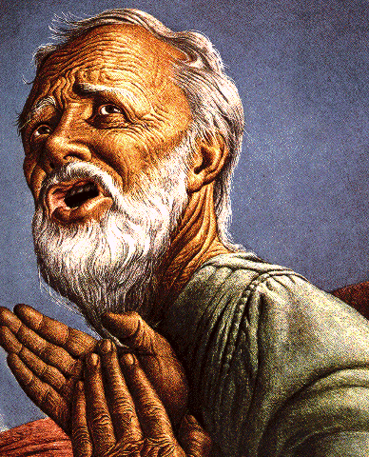
Passages Conditioning Salvation on Faith Alone (Sola Fide)
Genesis 15:6
John 3:16; 5:24; 6:28-29, 47; 16:8-9; 20:30-31
Acts 16:30-31
Romans 1:16; Ephesians 2:8-9
Hebrews 11:6

Slide 33
Belief – God’s One Condition for Justification
Gen 15:6
Then he believed in the LORD; and He reckoned it to him as righteousness.
John 3:16
For God so loved the world, that He gave His only begotten Son, that whoever believes in Him shall not perish, but have eternal life.
Acts 16:30-31
"Sirs, what must I do to be saved?" They said, "Believe in the Lord Jesus, and you will be saved..."

Slide 34
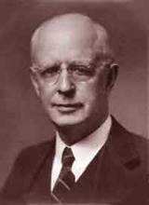
Lewis Sperry Chafer, vol. 7, Systematic Theology^{b} (Grand Rapids, MI: Kregel Publications, 1993), 265-66.
Belief-God’s One Condition for Justification
“…because upwards of 150 passages of Scripture condition salvation upon believing only (cf. John 3:16; Acts 16:31).

Slide 35
John MacArthur, Jr.
Tape GC 90-21 on Lordship salvation, last part of tape, comments made during the closing invitation.
“If faith is a gift of God, THEN HOW DO I GET IT? Do I do nothing and hope that God will sovereignly bestow it upon me? Or, do I cry out to God and pray that He will give me the gift of saving faith? Dr. MacArthur apparently holds to this second option. At the end of one of his messages he gave a salvation appeal and said the following: "Faith is a gift from God...it is permanent...the faith that God gives begets obedience...God gave it to you and He sustains it...May God grant you a true saving faith, a permanent gift that begins in humility and brokenness over sin and ends up in obedience unto righteousness. That's true faith and it's a gift that only God can give, and if you desire it pray and ask that He would grant it to you.”

Slide 36
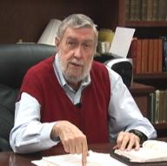
Jay Adams
Competent to Counsel, 70.
“But counselors, as Christians, are obligated to present the claims of Christ. They must present the good news that Christ Jesus died on the cross in the place of His own, that He bore the guilt and suffered the penalty for their sins. He died that all whom the Father had given to Him might come unto Him and have life everlasting. As a reformed Christian, the writer believes that counselors must not tell any unsaved counselee that Christ died for him, FOR THEY CANNOT SAY THAT. No man knows except Christ Himself who are His elect for whom He died." [emphasis mine]

Slide 37
iv. Miscellaneous Problems
Degree of faith mentioned? (Matt. 8:5-13)
Responsibility to believe?
Responsibility for not believing (John 3:18; 5:40)
Confuses the instrument with the agent
Reverses the subject (man)‒object (God) relationship
Romans 10:17
Confuses how the Gospel is shared
A lively corpse indeed?
Roman Catholic roots

Slide 38
John MacArthur, Jr.
Tape GC 90-21 on Lordship salvation, last part of tape, comments made during the closing invitation.
“If faith is a gift of God, THEN HOW DO I GET IT? Do I do nothing and hope that God will sovereignly bestow it upon me? Or, do I cry out to God and pray that He will give me the gift of saving faith? Dr. MacArthur apparently holds to this second option. At the end of one of his messages he gave a salvation appeal and said the following: "Faith is a gift from God...it is permanent...the faith that God gives begets obedience...God gave it to you and He sustains it...May God grant you a true saving faith, a permanent gift that begins in humility and brokenness over sin and ends up in obedience unto righteousness. That's true faith and it's a gift that only God can give, and if you desire it pray and ask that He would grant it to you.”

Slide 39
Roy L. Aldrich
“Thus an unscriptural doctrine of total depravity leads to an unscriptural and inconsistent plan of salvation. Doubtless the sinner is ‘dead in trespasses and sins’ (Eph. 2:1b). If this means that regeneration must precede faith, then it must also mean that regeneration must precede all three of the pious duties Shedd outlines for the lost [as seen in the following sentence]. A doctrine of total depravity that excludes the possibility of faith must also exclude the possibilities of ‘hearing the word,’ ‘giving serious application to divine truth,’ and ‘praying for the Holy Spirit for conviction and regeneration.’ The extreme Calvinist deals with a rather lively spiritual corpse after all. If the corpse has enough vitality to read the Word, and heed the message, and pray for conviction, perhaps it can also believe.”
Roy L. Aldrich, “The Gift of God,” Bibliotheca Sacra 122 (July–September 1965): 249.

Slide 40
iv. Miscellaneous Problems
Degree of faith mentioned? (Matt. 8:5-13)
Responsibility to believe?
Responsibility for not believing (John 3:18; 5:40)
Confuses the instrument with the agent
Reverses the subject (man)‒object (God) relationship
Romans 10:17
Confuses how the Gospel is shared
A lively corpse indeed?
Roman Catholic roots

Slide 41
Gary L. Nebeker
“the concept of infused faith for salvation bears a marked resemblance to the sacramentalism of the Roman Catholic Church. That is to say, faith becomes a transmitted and efficacious element which God gives to men for salvation.”
Gary L. Nebeker, “Is Faith a Gift of God? Ephesians 2:8 Reconsidered,” Grace Evangelical Society News, July 1989, 1.

Slide 42
Dave Hunt
“Most of those today, including evangelical leaders who hold Calvin in great esteem, are not aware that they have been captivated by the writings of a devout Roman Catholic, newly converted to Luther’s Protestantism, who had broken with Rome only a year before. Oddly, Calvin kept himself on the payroll of the Roman Catholic Church for nearly a year after he claimed to have been miraculously delivered from the ‘deep slough’ of ‘obstinate addiction to the superstitions of the papacy.’”
Dave Hunt, What Love Is This? Calvinism's Misrepresentation of God, 4th ed. (Bend, OR: Berean Call, 2013), 42.

