Slide 2
INTRODUCTORY MATTERS
Title |  | Structure
Authorship |  | Message
Date |  | Purpose
Audience |  | Unique characteristics
Scope |  | Christ in Exodus

Slide 3
EXODUS STRUCTURE/OUTLINE
Redemption (1–18)
Redemption (1:1–12:30)
Liberation (12:31–15:21)
Preservation (15:22–18:27)
Mosaic Covenant (19–40)
Law (19–24)
Tabernacle instructions (25–31)
Apostasy (32–34)
Tabernacle building (35–40)

Slide 4
EXODUS STRUCTURE/OUTLINE
Redemption (1–18)
Redemption (1:1–12:30)
Liberation (12:31–15:21)
Preservation (15:22–18:27)
Mosaic Covenant (19–40)
Law (19–24)
Tabernacle instructions (25–31)
Apostasy (32–34)
Tabernacle building (35–40)

Slide 5
EXODUS STRUCTURE/OUTLINE
Redemption (1–18)
Redemption (1:1–12:30)
Liberation (12:31–15:21)
Preservation (15:22–18:27)
Mosaic Covenant (19–40)
Law (19–24)
Tabernacle instructions (25–31)
Apostasy (32–34)
Tabernacle building (35–40)

Slide 6
REDEMPTION (1:1–12:30)
Why redemption is necessary (Exod 1)
Development of the deliverer (Exod 2–4)
First confrontation with Pharaoh (Exod 5)
God reassures Moses (Exod 6:1–7:7)
Second confrontation with Pharaoh (Exod 7:18-13)
Plagues (Exod 7:14–12:30)

Slide 7
REDEMPTION (1:1–12:30)
Why redemption is necessary (Exod 1)
Development of the deliverer (Exod 2–4)
First confrontation with Pharaoh (Exod 5)
God reassures Moses (Exod 6:1–7:7)
Second confrontation with Pharaoh (Exod 7:18-13)
Plagues (Exod 7:14–12:30)

Slide 8
REASON AND RESULTS OF THE OPPRESSION Exodus 1:1-22
Reason for the Oppression (1-10)
Results of the Oppression (11-22)
Willmington, Outline Bible, 25

Slide 9
REASON AND RESULTS OF THE OPPRESSION Exodus 1:1-22
Reason for the Oppression (1-10)
Results of the Oppression (11-22)
Willmington, Outline Bible, 25

Slide 10
EXODUS 1:1-10 Reason for the Oppression
Fruitfulness (1-7)
Fear (8-10)
Willmington, Outline Bible, 25

Slide 11
EXODUS 1:1-10 Reason for the Oppression
Fruitfulness (1-7)
Fear (8-10)
Willmington, Outline Bible, 25

Slide 14
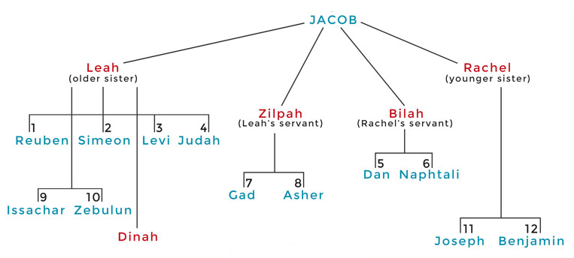

Slide 15
GENESIS 46:26-27 Grand Total of Jacob’s Family
Total: 66 (26)
Total: 70 (27)

Slide 16
GENESIS 46:26-27 Grand Total of Jacob’s Family
Total: 66 (26)
Total: 70 (27)

Slide 17
Dr. Arnold G. Fruchtenbaum
The Book of Genesis, 610
“Verse 26 gives the figure sixty-six (66): All the souls that came with Jacob into Egypt, that came out of his loins, meaning counting only those who were direct descendants of Jacob, with the exception besides Jacob’s sons’ wives, in other words, not counting the wives of his sons: all the souls were three score and six [66]. This figure counts only the children outside Egypt and excludes Jacob, Joseph, and the two sons of Joseph.”

Slide 18
GENESIS 46:26-27 Grand Total of Jacob’s Family
Total: 66 (26)
Total: 70 (27)

Slide 19
Dr. Arnold G. Fruchtenbaum
The Book of Genesis, 610-611
“Therefore, the figure seventy includes only Jacob and his immediate descendants: Jacob, twelve sons, fifty-one grandsons, two great grandsons, one daughter, one granddaughter, one unnamed daughter of Leah, and one unnamed granddaughter. If one begins to add the servants and wives plus the women and children absorbed from Shechem (34:29), probably the entire figure would be about three hundred or more. In Acts 7:14, Stephen gave a total figure of seventy-five (75), a figure taken from the Septuagint section of Genesis 46:27 and Exodus 1:5, a…

Slide 20
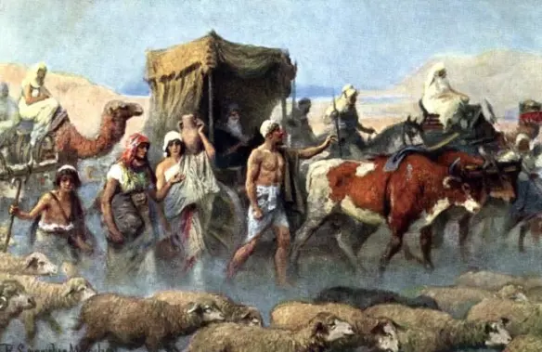
Dr. Arnold G. Fruchtenbaum
The Book of Genesis, 610-611
. . .figure also supported by the Dead Sea Scrolls. These add to the figure of seventy the five grandsons of Joseph: the son and grandson of Manasseh and the two sons of Ephraim (Num. 26:28–37, I Chron. 7:14–27).”

Slide 21
Charles Ryrie Ryrie Study Bible, page 69
Exodus 1:7 - “The census at Sinai (Num. 1) showed 603,000 males 20 years and older. If they represented about 1/4 of the total population, then the Israelites numbered some 2,000,000 people. An annual growth rate of 5 percent would increase the population from 100 to 2,000,000 in only 215 years (see Gen. 46:27; Ex. 12:41).”﻿

Slide 22
EXODUS 1:1-10 Reason for the Oppression
Fruitfulness (1-7)
Fear (8-10)
Willmington, Outline Bible, 25

Slide 23
Charles Ryrie Ryrie Study Bible, page 69
Exodus 1:8 - “1:8 The new king was possibly Ahmose I (ca. 1570–1546), who expelled the Hyksos rulers from Egypt, or more likely Amenhotep I (ca. 1546–1525) or Thutmose I (ca. 1525–1512).”﻿

Slide 24
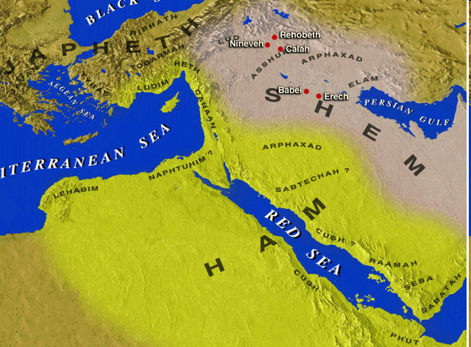

Slide 25
Dr. Arnold G. Fruchtenbaum
The Book of Genesis, 570
“The Hyksos Period, during which Joseph’s story unfolds, was the two-hundred-year period from 1750 until 1550 B.C. The Hyksos were Semitic rulers that conquered Egypt and ruled during the sixteenth and seventeenth dynasties. Thus, the Pharaoh at the time of Joseph was Semitic. This explains how a Semite such as Joseph could rise to the second highest position in Egypt, which had a Hamitic population.”

Slide 26
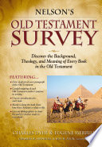
Eugene Merrill Nelson’s Old Testament Survey, page 43-44
“On the collapse of the Twelfth Dynasty, Egypt entered the chaotic era of the Semitic Hyksos rule, especially in the delta region of Israel’s habitation, until new native Egyptian rebels rose up to overthrow the Hyksos and expel them from the land...The ‘new king’ who did not know Joseph (that is, whose sympathies were no longer with the Hebrew people) was probably Ahmose, founder of the New Kingdom (around 1570 B.C.). Having just expelled the Hyksos, he put the Hebrews into slave labor because he viewed them as pro-Hyksos agents who could do harm to his government. Other pharaohs followed this policy and even intensified the persecution, going so far as to institute infanticide against all Hebrew male children.”﻿

Slide 27
From Peter to Paul
PETER | PAUL
Heals a man lame from birth (3:1-11) | Heals a man lame from birth (14:8-18)
Heals by shadow (5:15-16) | Heals by handkerchief (19:11-12)
Success is a cause of jealousy (5:17) | Success is a cause of jealousy (13:45)
Confronts a sorcerer (8:9-24) | Confronts a sorcerer (13:6-11)
Raises Dorcas (9:36-41) | Raises Eutychus (20:9-12)
Jailed and miraculously freed (12:3-19) | Jailed and miraculously freed (16:25-34)

Slide 28
REASON AND RESULTS OF THE OPPRESSION Exodus 1:1-22
Reason for the Oppression (1-10)
Results of the Oppression (11-22)
Willmington, Outline Bible, 25

Slide 29
II. Exodus 1:11-22 Results of the Oppression
Pharaoh’s building decree (11-14)
Pharaoh’s bloody decree (15-22)
Willmington, Outline Bible, 25

Slide 30
II. Exodus 1:11-22 Results of the Oppression
Pharaoh’s building decree (11-14)
Pharaoh’s bloody decree (15-22)
Willmington, Outline Bible, 25

Slide 31
Genesis 15:13, 16
“¹³ God said to Abram, ‘Know for certain that your descendants will be strangers in a land that is not theirs, where they will be enslaved and oppressed four hundred years… ¹⁶ Then in the fourth generation they will return here, for the wrongdoing of the Amorite is not yet complete.’”

Slide 32
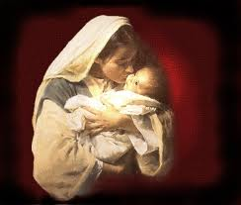
Satanic Attempts to Stop Messiah’s Birth
Cain & Abel (Gen. 4)
Sons of God (Gen. 6)
Pharaoh persecutes Israel (Exod. 1)
Joash protected from Athaliah (2 Chron. 22‒23)
Haman persecutes Israel (Esther)
Antiochus Epiphanés (Dan. 11:31)
Herod persecutes Christ (Matt 2; Rev 12:4)

Slide 33
Satanic Attempts to Stop Messiah’s Birth
Cain & Abel (Gen. 4)
Sons of God (Gen. 6)
Pharaoh persecutes Israel (Exod. 1)
Joash protected from Athaliah (2 Chron. 22‒23)
Haman persecutes Israel (Esther)
Antiochus Epiphanés (Dan. 11:31)
Herod persecutes Christ (Matt 2; Rev 12:4)

Slide 34
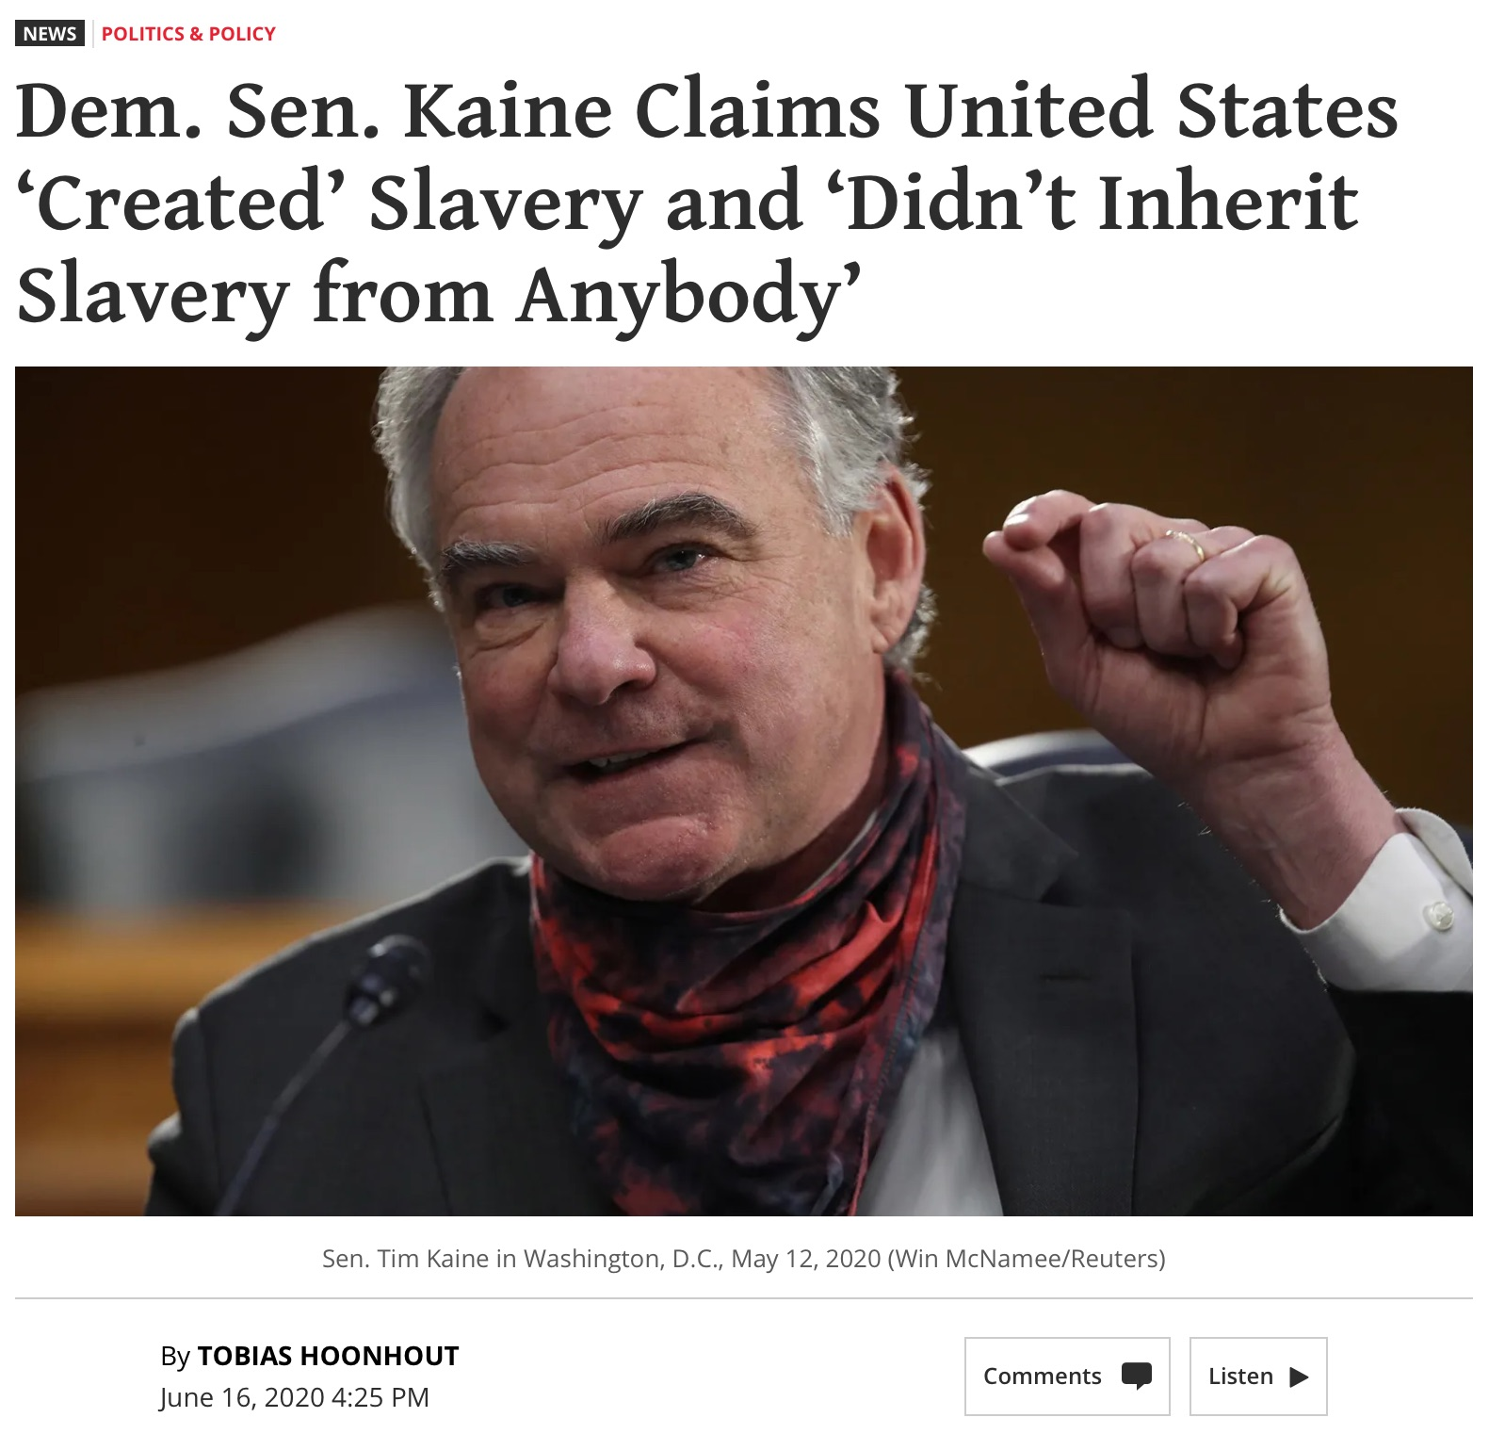

Slide 35
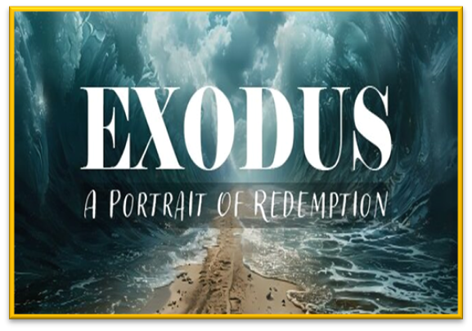
Romans 6:23
“For the wages of sin is death, but the free gift of God is eternal life in Christ Jesus our Lord.”

Slide 36
II. Exodus 1:11-22 Results of the Oppression
Pharaoh’s building decree (11-14)
Pharaoh’s bloody decree (15-22)
Willmington, Outline Bible, 25

Slide 37
Exodus 1:15-22 Pharaoh’s Bloody Decree
His order to the midwives (15-21)
His order to the masses (22)
Willmington, Outline Bible, 25

Slide 38
Exodus 1:15-22 Pharaoh’s Bloody Decree
His order to the midwives (15-21)
His order to the masses (22)
Willmington, Outline Bible, 25

Slide 39
Satanic Attempts to Stop Messiah’s Birth
Cain & Abel (Gen. 4)
Sons of God (Gen. 6)
Pharaoh persecutes Israel (Exod. 1)
Joash protected from Athaliah (2 Chron. 22‒23)
Haman persecutes Israel (Esther)
Antiochus Epiphanés (Dan. 11:31)
Herod persecutes Christ (Matt 2; Rev 12:4)

Slide 40
Romans 13:1-5
“¹ Every person is to be in subjection to the governing authorities. For there is no authority except from God, and those which exist are established by God. ² Therefore whoever resists authority has opposed the ordinance of God; and they who have opposed will receive condemnation upon themselves. ³ For rulers are not a cause of fear for good behavior, but for evil. Do you want to have no fear of authority? Do what is good and you will have praise from the same.”

Slide 41
Romans 13:1-5
“⁴ for it is a minister of God to you for good. But if you do what is evil, be afraid; for it does not bear the sword for nothing; for it is a minister of God, an avenger who brings wrath on the one who practices evil. ⁵ Therefore, it is necessary to be in subjection, not only because of wrath, but also for conscience’ sake.”

Slide 42
Titus 3:1
“Remind them to be subject to rulers, to authorities, to be obedient, to be ready for every good deed.”

Slide 43
1 Peter 2:13-14
“Submit yourselves for the Lord’s sake to every human institution, whether to a king as the one in authority, or to governors as sent by him for the punishment of evildoers and the praise of those who do right.”

Slide 44
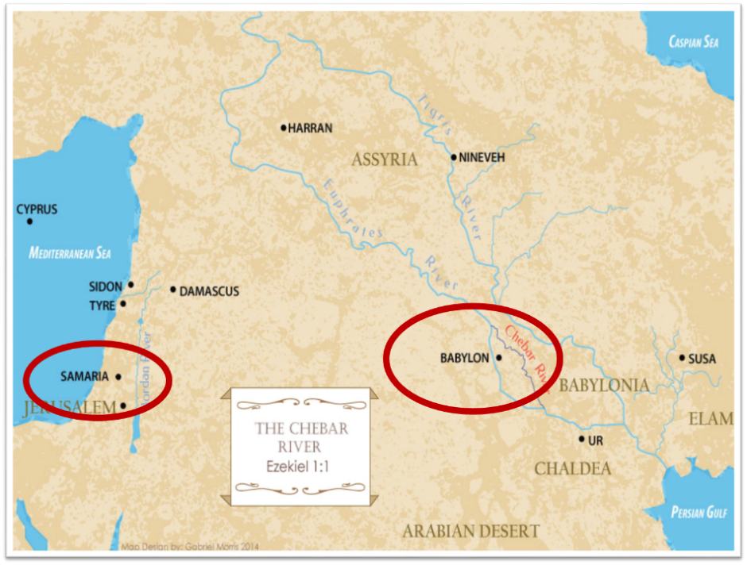

Slide 45
Synthetic Outline
Chiasm in “Aramaic” ( Dan. 2-7)
1. Gentile History (2)
2. Protection (3)
3. Revelation to a gentile king (4)
3'. Revelation to a gentile king (5)
2. Protection (6)
1. Gentile history (7)

Slide 46
PRINCIPLES OF CIVIL DISOBEDIENCE
“Crystal” clear conflict between the laws of man and God
Exhaustion of all creative legal remedies
A willingness to “pay the consequences”
Maintaining of respect for civil authorities

Slide 47
Charles Ryrie Ryrie Study Bible, page 69
Exodus 1:7 - “The census at Sinai (Num. 1) showed 603,000 males 20 years and older. If they represented about 1/4 of the total population, then the Israelites numbered some 2,000,000 people. An annual growth rate of 5 percent would increase the population from 100 to 2,000,000 in only 215 years (see Gen. 46:27; Ex. 12:41).”﻿

Slide 48
8 New Promises Genesis 12:1-3
Land (Gen. 12:1b)
Great nation (Gen. 12:2a)
Personal blessing (Gen. 12:2b)
Great name (Gen. 12:2c)
Blessing to others (Gen. 12:2d)
Blessing to blessers (Gen. 12:3a)
Cursing to cursers (Gen. 12:3b)
Blessing to the world (Gen. 12:3c)

Slide 49
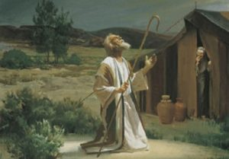
Genesis 12:3
“And I will bless those who bless you, And the one who curses you I will curse. And in you all the families of the earth will be blessed.”

Slide 50
Exodus 1:15-22 Pharaoh’s Bloody Decree
His order to the midwives (15-21)
His order to the masses (22)
Willmington, Outline Bible, 25

Slide 51
Satanic Attempts to Stop Messiah’s Birth
Cain & Abel (Gen. 4)
Sons of God (Gen. 6)
Pharaoh persecutes Israel (Exod. 1)
Joash protected from Athaliah (2 Chron. 22‒23)
Haman persecutes Israel (Esther)
Antiochus Epiphanés (Dan. 11:31)
Herod persecutes Christ (Matt 2; Rev 12:4)

Slide 52
8 New Promises Genesis 12:1-3
Land (Gen. 12:1b)
Great nation (Gen. 12:2a)
Personal blessing (Gen. 12:2b)
Great name (Gen. 12:2c)
Blessing to others (Gen. 12:2d)
Blessing to blessers (Gen. 12:3a)
Cursing to cursers (Gen. 12:3b)
Blessing to the world (Gen. 12:3c)

Slide 53
Genesis 12:3
“And I will bless those who bless you, And the one who curses you I will curse. And in you all the families of the earth will be blessed.”

Slide 54
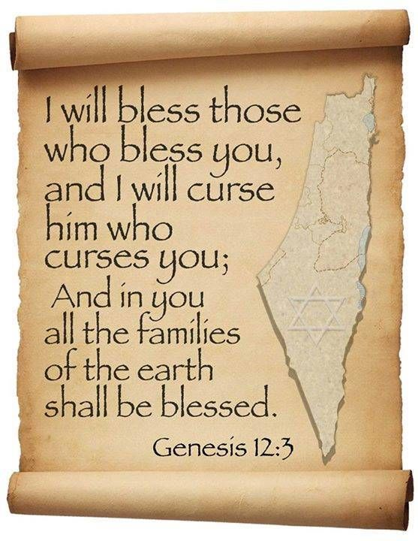
Genesis 12:3
“And I will bless those who bless you, And the one who curses [kalal] you I will curse [aor]. And in you all the families of the earth will be blessed.”

Slide 55
Dr. Arnold G. Fruchtenbaum
The Book of Genesis, 242
“The first word for curse is kalal, which means ‘to treat lightly,’ ‘to hold in contempt,’ or ‘to curse.’ To merely treat Abram and the Jews lightly is to incur the curse of God. The second word for curse used in this phrase (him that curses you will I curse) is aor, from the Hebrew root arah, which means ‘to impose a barrier,’ ‘to ban.’ This is a much stronger word for curse than the first one in the phrase…Therefore, even a light curse against Abram or against the Jews will bring a heavier curse from God.”

Slide 58
The Plagues of Egypt
NO. | DESCRIPTION | SCRIPTURE | Egyptian Deity
1. | Water to Blood | Exod. 7:14-25 | Hapi, Khnum
2. | Frogs | Exod. 8:1-15 | Heqt
3. | Gnats | Exod. 8:16-19 | Set
4. | Flies | Exod. 8:20-32 | Uatchit
5. | Disease on Cattle | Exod. 9:1-7 | Hathor, Apis
6. | Boils | Exod. 9:8-12 | Sekhmet, Serapis
7. | Hail | Exod. 9:13-35 | Seth, Nut
8. | Locusts | Exod. 10:1-20 | Seth, Nut, Osiris
9. | Darkness | Exod. 10:21-29 | Re, Horus, Atum
10. | Death of the First Born | Exod. 12:29-36 | Min, Osiris, Heqt, Isis

Slide 59
Conclusion

Slide 60
REASON AND RESULTS OF THE OPPRESSION Exodus 1:1-22
Reason for the Oppression (1-10)
Results of the Oppression (11-22)
Willmington, Outline Bible, 25

Slide 61
²⁴ The Lord bless you, and keep you; ²⁵ The Lord make His face shine on you, And be gracious to you; ²⁶ The Lord lift up His countenance on you, And give you peace.
Numbers 6:24–26 (NASB95)

