Slide 2
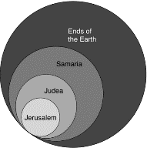
Acts 1:8
“but you will receive power when the Holy Spirit has come upon you; and you shall be My witnesses both in Jerusalem, and in all Judea and Samaria, and even to the remotest part of the earth.”

Slide 3
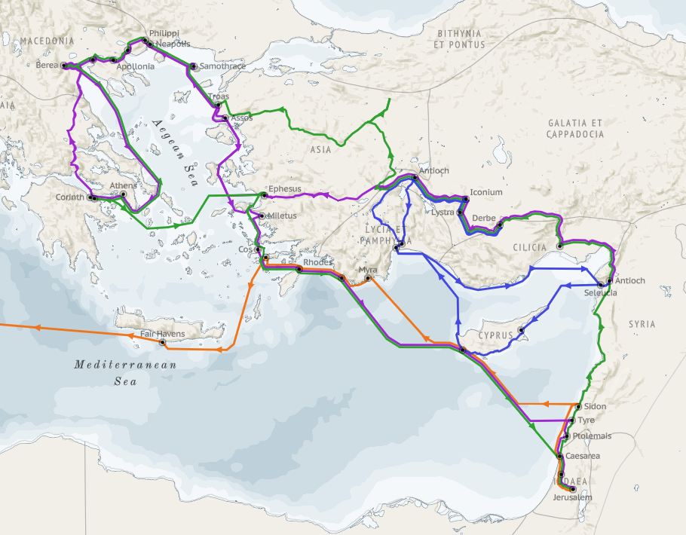
Structure (Acts 1:8)
Jerusalem (Acts 1–7)
Judea and Samaria (Acts 8–12)
Remotest part of the earth (Acts 13–28)
1st missionary journey (Acts 13–14)
Jerusalem council (Acts 15:1-35)
2nd missionary journey (Acts 15:36 –18:22)
3rd missionary journey (Acts 18:23–21:17)
Trip to Rome (Acts 21:18–28:31)

Slide 4
Acts 13‒14 1st Missionary Journey
Paul & Barnabas’ appointment (13:1-3)
Cyprus ministry (13:4-12)
Pisidian Antioch ministry (13:13-52)
Iconium ministry (14:1-7)
Lystra ministry (14:8-20a)
Derbe ministry (14:20b-21a)
Return to Antioch (14:21b-28)

Slide 5
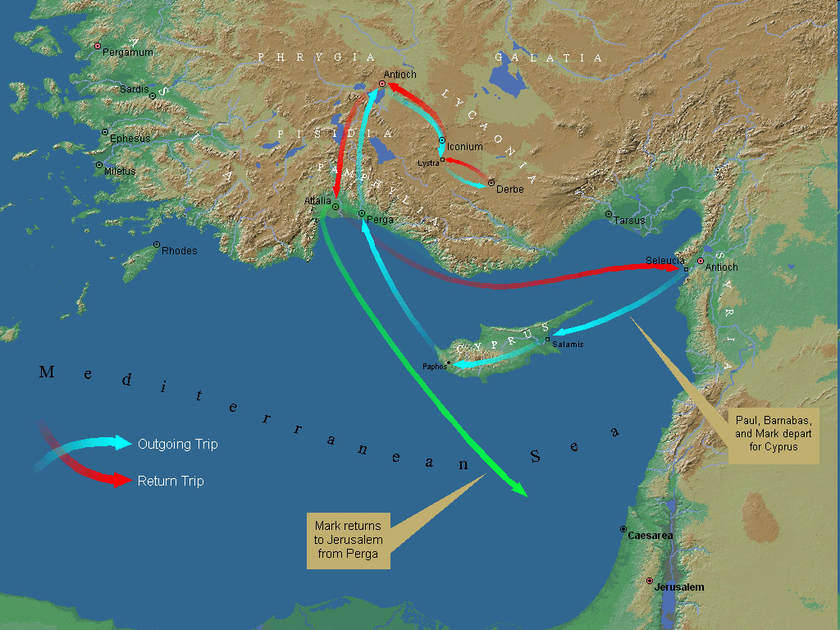
First Missionary Journey

Slide 6
III. Pisidia Antioch Ministry Acts 13:13-52
Journey to Pisidian Antioch (13-15)
Paul’s message (16-41)
Results of Paul’s message (42-52)

Slide 7
Acts 13:16-41 Paul’s Message
Introduction (16)
Historical background (17-22)
Messiah (23-25)
Gospel (26-29)
Resurrection (30-37)
Application to Paul’s audience (38-39)
Warning (40-41)

Slide 8
III. Pisidia Antioch Ministry Acts 13:13-52
Journey to Pisidian Antioch (13-15)
Paul’s message (16-41)
Results of Paul’s message (42-52)

Slide 9
Acts 13:42-53 Results of Paul’s Message
Immediate results (42-43)
Subsequent results (44-49)
Results for the Apostles (50-52)

Slide 10
Acts 13:44-49 Subsequent Results
Citizens (44)
Unbelieving religious leaders (45)
Apostles’ decision (46-47)
Results of the Apostles’ decision (48-49)

Slide 11
Acts 13:44-49 Subsequent Results
Citizens (44)
Unbelieving religious leaders (45)
Apostles’ decision (46-47)
Results of the Apostles’ decision (48-49)

Slide 12
Acts 13:44-49 Subsequent Results
Citizens (44)
Unbelieving religious leaders (45)
Apostles’ decision (46-47)
Results of the Apostles’ decision (48-49)

Slide 13
From Peter to Paul
Reference | Center | Person | Place | Outreach
Acts 1–12 | Jerusalem | Peter | Jerusalem, Judea, Samaria | Jewish
Acts 13–28 | Antioch | Paul | Uttermost parts | Gentiles

Slide 14
From Peter to Paul
Peter | Paul
Heals a man lame from birth (3:1-11) | Heals a man lame from birth (14:8-18)
Heals by shadow (5:15-16) | Heals by handkerchief (19:11-12)
Success is a cause of jealousy (5:17) | Success is a cause of jealousy (13:45)
Confronts a sorcerer (8:9-24) | Confronts a sorcerer (13:6-11)
Raises Dorcas (9:36-41) | Raises Eutychus (20:9-12)
Jailed and miraculously freed (12:3-19) | Jailed and miraculously freed (16:25-34)

Slide 15
Acts 13:44-49 Subsequent Results
Citizens (44)
Unbelieving religious leaders (45)
Apostles’ decision (46-47)
Results of the Apostles’ decision (48-49)

Slide 16
Dr. Arnold G. Fruchtenbaum
The Book of Acts, 301
“Chapter 13 shows the pattern of evangelizing activity. The apostles proclaimed the gospel to the Jews first, and when that proclamation was rejected, only then did they turn to the Gentiles. This is not a once-and-for-all turning to the Gentiles in general, as some seem to think. As the book of Acts continues and as the apostles entered the next city, they again went to the Jews first. So, the turning away from the Jews in Antioch Pisidia was only a local, regional situation. The Jewish people there rejected the gospel, so Paul and Barnabas turned to the Gentiles. In a new locality, they would once again adopt the same procedure of going to the Jews first, because that mandate was never rescinded.”

Slide 17
Acts 1:8
“but you will receive power when the Holy Spirit has come upon you; and you shall be My witnesses both in Jerusalem, and in all Judea and Samaria, and even to the remotest part of the earth.”

Slide 18
8 New Promises Genesis 12:1-3
Land (Gen. 12:1b)
Great nation (Gen. 12:2a)
Personal blessing (Gen. 12:2b)
Great name (Gen. 12:2c)
Blessing to others (Gen. 12:2d)
Blessing to blessers (Gen. 12:3a)
Cursing to cursers (Gen. 12:3b)
Blessing to the world (Gen. 12:3c)

Slide 19
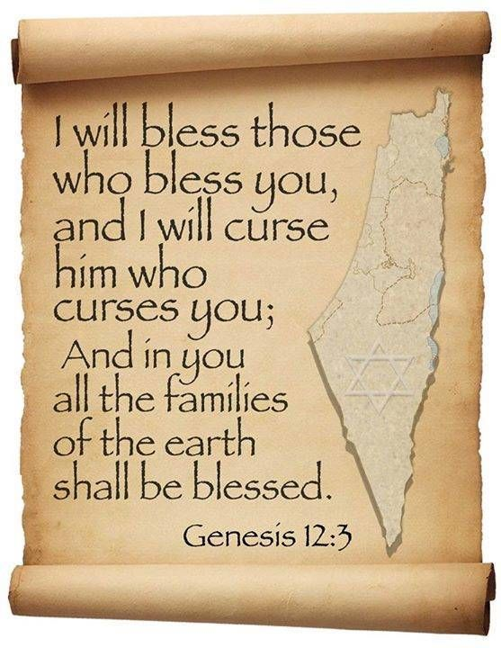
Genesis 12:3
“And I will bless those who bless you, And the one who curses you I will curse. And in you all the families of the earth will be blessed.”

Slide 20
Acts 13:44-49 Subsequent Results
Citizens (44)
Unbelieving religious leaders (45)
Apostles’ decision (46-47)
Results of the Apostles’ decision (48-49)

Slide 21
Acts 13:48-49 Results of the Apostles’ Decision
Salvation to the Gentiles (48)
Spread of the Gospel (49)

Slide 22
Acts 13:48-49 Results of the Apostles’ Decision
Salvation to the Gentiles (48)
Spread of the Gospel (49)

Slide 23
Acts 13:48
“When the Gentiles heard this, they began rejoicing and glorifying the word of the Lord; and as many as had been appointed [tassō] to eternal life believed.”

Slide 24
Dr. Arnold G. Fruchtenbaum
The Book of Acts, 300
“Verses 48-49 record that the decision to turn to the Gentiles produced two results. The first result was the salvation of the Gentiles (v. 48). Luke wrote: As many as were ordained to eternal life believed. According to The Bible Knowledge Commentary, the Greek term for ‘ordained,’ tetagmenoi, “comes from the verb tassó, a military word meaning ‘to arrange’ or ‘to assign.’ Luke used it here to show that God’s elective decree included Gentiles.” Those who were appointed to eternal life believed. This is a clear statement of God’s sovereignty and the doctrine of election and predestination: Those whom God ordained to eternal life were the ones who believed; those who believed were the ones who were appointed to believe; only those who were appointed believed. As a result, many of the Gentiles were saved.

Slide 25
Laurence M. Vance
“Every Calvinist, no matter what else he believes, uses this verse [Acts 13:48] to prove Unconditional Election. Every Calvinist claims that on the basis of this verse, every person who has ever been saved (Old or New Testament) or ever will be saved (Church age or Tribulation or Millennium) was ‘ordained to life’ before the foundation of the world by a sovereign, eternal decree.”
Laurence M. Vance, The Other Side of Calvinism, rev. ed. (Pensacola, FL: Vance Publications, 1999); citing Calvin, Institutes, 345..

Slide 26
Acts 13:48?
One verse cannot be used to undo hundreds of others (1 Tim. 2:4; 2 Pet. 3:9)
Sometimes the Greek word for “appointed”(NASB) or “ordained” (KJV) is translated “wanted” (LB) or “disposed” (REB) in other English translations
Tassō is used (rather than proorizō), which never refers to predestination unto Salvation in any of its other New Testament uses (Matt. 28:16; Luke 7:38; Acts 15:2; 22:10; 28:23; Rom. 13:1; 1 Cor. 16:15)

Slide 27
Acts 13:48?
One verse cannot be used to undo hundreds of others (1 Tim. 2:4; 2 Pet. 3:9)
Sometimes the Greek word for “appointed”(NASB) or “ordained” (KJV) is translated “wanted” (LB) or “disposed” (REB) in other English translations
Tassō is used (rather than proorizō), which never refers to predestination unto Salvation in any of its other New Testament uses (Matt. 28:16; Luke 7:38; Acts 15:2; 22:10; 28:23; Rom. 13:1; 1 Cor. 16:15)

Slide 28
1 Timothy 2:3-4
“³ This is good and acceptable in the sight of God our Savior, ⁴ who desires all men to be saved and to come to the knowledge of the truth.”

Slide 29
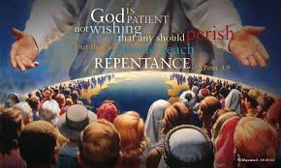
2 Peter 3:9
“The Lord is not slow about His promise, as some count slowness, but is patient toward you, not wishing for any to perish but for all to come to repentance.”

Slide 30
Acts 13:48?
One verse cannot be used to undo hundreds of others (1 Tim. 2:4; 2 Pet. 3:9)
Sometimes the Greek word for “appointed”(NASB) or “ordained” (KJV) is translated “wanted” (LB) or “disposed” (REB) in other English translations
Tassō is used (rather than proorizō), which never refers to predestination unto Salvation in any of its other New Testament uses (Matt. 28:16; Luke 7:38; Acts 15:2; 22:10; 28:23; Rom. 13:1; 1 Cor. 16:15)

Slide 31
Acts 13:48?
The corrupted, Roman Catholic Latin Vulgate mistranslates tassō as “preordained.”
The context of the book of Acts pertains to the predisposition of the Gentiles (rather than the Jews) toward the Gospel (Acts 13:44-47; 28:26-28)
There is no textual or exegetical evidence that the divine appointing (tassō) caused the believing (pisteuō).

Slide 32
Acts 13:48?
The corrupted, Roman Catholic Latin Vulgate mistranslates tassō as “preordained.”
The context of the book of Acts pertains to the predisposition of the Gentiles (rather than the Jews) toward the Gospel (Acts 13:44-47; 28:26-28)
There is no textual or exegetical evidence that the divine appointing (tassō) caused the believing (pisteuō).

Slide 33
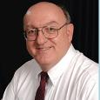
Dennis Rokser
“[It is incorrect to say that]…the Greek verb for ‘believe’ (episteusan) is the result of the perfect passive participle ‘appointed’ (tetagmenoi). Grammatically, all that the aorist tense verb of ‘believe’ shows when it is combined with the periphrastic construction of ‘had been appointed’ is that the appointing on God's part preceded the believing on man's part. NOTE: the grammar does not prove that one is the result of the other! In order to show that the act of believing was the result of or caused by God's prior appointing, there would need to be a causal conjunction in the Greek text after ‘believed’ (episteusan), so that the verse would say: ‘and believed [episteusan], because [hoti, hina, hos, hoste] they had been appointed to life eternal.’”
Personal email correspondence from Dennis Rokser

Slide 34
Dennis Rokser
“The conjunctions hoti, hina, hos, hoste are all used at times in Greek (most often hoti) to show purpose, result, or cause. But Acts 13:48 contains none of these! Calvinists assume that God foreordains certain people (those unconditionally elected to eternal salvation) to receive the gift of faith. If that were the case, then this verse should say ‘and as many as were appointed to believe received life eternal.’”
Personal email correspondence from Dennis Rokser

Slide 35
Acts 13:48
“When the Gentiles heard this, they began rejoicing and glorifying the word of the Lord; and as many as had been appointed [tassō] to eternal life believed.”

Slide 36
Dennis Rokser
“There are no verses in the Bible that say we were preordained to believe. Acts 13:48 simply doesn't say WHY the Galatians were appointed to eternal life. However, since the context of the passage involves human responsibility (v. 46), and it is consistent with Scripture elsewhere, we should interpret v. 48 to mean that God's ordaining must have factored in their faith which He foresaw.”
Personal email correspondence from Dennis Rokser

Slide 37
Acts 13:48?
Contrary too many English translations, the word order of Acts 13:48 in the Greek text places the verb “believed” before the Greek verb pre-ordained “appointed.”
In Acts 13:48, “believed” is in the active voice.

Slide 38
Acts 13:48?
Contrary too many English translations, the word order of Acts 13:48 in the Greek text places the verb “believed” before the Greek verb pre-ordained “appointed.”
In Acts 13:48, “believed” is in the active voice.

Slide 39
Acts 13:48
“When the Gentiles heard this, they began rejoicing and glorifying the word of the Lord; and as many as had been appointed [tassō] to eternal life believed.”
Acts 13:48 (NA26)
⁴⁸ Ἀκούοντα δὲ τὰ ἔθνη ἔχαιρον καὶ ἐδόξαζον τὸν λόγον τοῦ κυρίου καὶ ἐπίστευσαν ὅσοι ἦσαν τεταγμένοι εἰς ζωὴν αἰώνιον·

Slide 40
Ron Merryman
“The verb “believed” (aorist tense, active voice, indicative mode) stands first in word order in the Greek text, thus it is emphasized. The statement literally is, ‘And they believed, as many as were ordained unto eternal life’ (a perfect tense periphrastic in Greek). They did not believe because they were ordained unto eternal life.”
Ron Merryman, “Election & Acts 13:48,” Grace Family Journal, September-October 2000.

Slide 41
Acts 13:48?
Contrary too many English translations, the word order of Acts 13:48 in the Greek text places the verb “believed” before the Greek verb pre-ordained “appointed.”
In Acts 13:48, “believed” is in the active voice.

Slide 42
Ron Merryman
“Simply, they believed; that is, they actively (active voice) expressed positive volition toward the Gospel…‘Believed’ or ‘believe’ is consistently active in voice in its over 100 uses in the N.T. relative to trust in Christ and Him alone. That means the person who believes is actively, not passively, trusting in the Gospel. They are exercising their faith, not someone else's and not a faith given to them… Contrasted to the ones that believed in the context are those that did not. We are told that ‘they spake against the things that were spoken by Paul, contradicting and blaspheming’ (v.45). Again, the verbal voice is active. . . .
Ron Merryman, “Election & Acts 13:48,” Grace Family Journal, September-October 2000.

Slide 43
Ron Merryman
“…They were actively expressing their negative volition to the Gospel, so that Paul follows their blasphemies with the statement ‘... you put it (the word of God expressed in the Gospel he had just spoken) from you and you judge yourselves unworthy of eternal life’ (v. 46). These verbs also are active voice. They could not blame their negativeness on Satan or any other. Paul did not say that God declared these unbelieving Jews unworthy of eternal life: he says that they declared themselves unworthy of it!”
Ron Merryman, “Election & Acts 13:48,” Grace Family Journal, September-October 2000.

Slide 44
Romans 8:29–30
²⁹ For those whom He foreknew [proginōskō], He also predestined to become conformed to the image of His Son, so that He would be the firstborn among many brethren; ³⁰ and these whom He predestined, He also called; and these whom He called, He also justified; and these whom He justified, He also glorified.

Slide 45
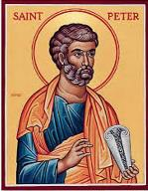
2 Peter 3:17
“You therefore, beloved, knowing this beforehand [proginōskō], be on your guard so that you are not carried away by the error of unprincipled men and fall from your own steadfastness.”

Slide 46
Acts 13:48-49 Results of the Apostles’ Decision
Salvation to the Gentiles (48)
Spread of the Gospel (49)

Slide 47
Purpose
To present Theophilus with an orderly account of the birth and growth of the church so as to affirm him in what he has believed.

Slide 48
Message
Birth and growth of the church numerically, geographically, ethnically.
Components
Numerically (progress reports)
Geographically (From Jerusalem to Rome)
Ethnically (From Judaism to Gentile domination)

Slide 49
Progress Reports
Clearest: Acts 2:47; 6:7; 9:31; 12:24; 16:5; 19:20; 28:30-31
Less clear: Acts 1:13, 15; 2:41, 47; 4:4, 31; 5:14, 42; 8:25, 40; 11:21; 13:49; 17:6

Slide 50
Dr. Arnold G. Fruchtenbaum
The Book of Acts, 300
“In verse 49, the second result was the advancement of the gospel. The Greek word for ‘was spread,’ diephereto, means ‘to carry in different directions.’ The strategic location of Antioch of Pisidia would help the spread of the gospel throughout all the region. The ministry grew in spite of determined opposition.”

Slide 51
Acts 13:42-53 Results of Paul’s Message
Immediate results (42-43)
Subsequent results (44-49)
Results for the Apostles (50-52)

Slide 52
Acts 13:50-52 Results for the Apostles
Jewish opposition to the Gospel (50)
Apostles’ response (51)
Impact on the Pisidian Antioch Church (52)

Slide 53
Acts 13:50-52 Results for the Apostles
Jewish opposition to the Gospel (50)
Apostles’ response (51)
Impact on the Pisidian Antioch Church (52)

Slide 54
Acts 13:50-52 Results for the Apostles
Jewish opposition to the Gospel (50)
Apostles’ response (51)
Impact on the Pisidian Antioch Church (52)

Slide 55
Biblical Basis for Separation?
2 Thess. 3:6, 14
1 Cor. 5:11
2 Cor. 6:14-18
Rom. 16:17
Eph. 5:11
Titus 3:9-11
2 John 9-11

Slide 56
2 John 7-11
“⁷ For many deceivers have gone out into the world, those who do not acknowledge Jesus Christ as coming in the flesh. This is the deceiver and the antichrist. ⁸ Watch yourselves, that you do not lose what we have accomplished, but that you may receive a full reward. ⁹ Anyone who goes too far and does not abide in the teaching of Christ, does not have God; the one who abides in the teaching, he has both the Father and the Son. ¹⁰ If anyone comes to you and does not bring this teaching, do not receive him into your house, and do not give him a greeting; ¹¹ for the one who gives him a greeting participates in his evil deeds.”

Slide 57
What to Separate From?
False doctrine – 1 Tim. 4:16; Titus 1:9
Divisive persons – Rom. 16:17; Titus 3:9-11
Immorality – 1 Cor. 5:9-11; Eph. 5:11
General disobedience to Scripture –2 Thess. 3:6, 14

Slide 58
Dr. Arnold G. Fruchtenbaum
The Book of Acts, 301
“The apostolic response is given in verse 51: But they shook off the dust of their feet against them. This action was a visible, physical, symbolic measure marking a complete break of fellowship and renunciation with a person or community. It was also what Yeshua had commanded His disciples to do (Mt. 10:14; Mk. 6:11; Lk. 9:5). The procedure was to take the sandals off the feet, and the dust was shaken toward the group or place being renounced as a symbolic token. Then the apostles went to Iconium, the next city to be evangelized.”

Slide 59
First Missionary Journey

Slide 60
Acts 13:50-52 Results for the Apostles
Jewish opposition to the Gospel (50)
Apostles’ response (51)
Impact on the Pisidian Antioch Church (52)

Slide 61
c) Acts 13:52 Impact on the Pisidian Antioch Church
Joy (52a)
Holy Spirit (52b)

Slide 62
c) Acts 13:52 Impact on the Pisidian Antioch Church
Joy (52a)
Holy Spirit (52b)

Slide 63
c) Acts 13:52 Impact on the Pisidian Antioch Church
Joy (52a)
Holy Spirit (52b)

Slide 64
John 14:16-17
¹⁶ I will ask the Father, and He will give you another Helper, that He may be with you forever; ¹⁷ that is the Spirit of truth, whom the world cannot receive, because it does not see Him or know Him, but you know Him because He abides with you and will be in you.

Slide 65
Acts 13‒14 1st Missionary Journey
Paul & Barnabas’ appointment (13:1-3)
Cyprus ministry (13:4-12)
Pisidian Antioch ministry (13:13-52)
Iconium ministry (14:1-7)
Lystra ministry (14:8-20a)
Derbe ministry (14:20b-21a)
Return to Antioch (14:21b-28)

Slide 66
Acts 13‒14 1st Missionary Journey
Paul & Barnabas’ appointment (13:1-3)
Cyprus ministry (13:4-12)
Pisidian Antioch ministry (13:13-52)
Iconium ministry (14:1-7)
Lystra ministry (14:8-20a)
Derbe ministry (14:20b-21a)
Return to Antioch (14:21b-28)

Slide 67
Acts 13‒14 1st Missionary Journey
Paul & Barnabas’ appointment (13:1-3)
Cyprus ministry (13:4-12)
Pisidian Antioch ministry (13:13-52)
Iconium ministry (14:1-7)
Lystra ministry (14:8-20a)
Derbe ministry (14:20b-21a)
Return to Antioch (14:21b-28)

Slide 68
Acts 13‒14 1st Missionary Journey
Paul & Barnabas’ appointment (13:1-3)
Cyprus ministry (13:4-12)
Pisidian Antioch ministry (13:13-52)
Iconium ministry (14:1-7)
Lystra ministry (14:8-20a)
Derbe ministry (14:20b-21a)
Return to Antioch (14:21b-28)

Slide 69
Conclusion

Slide 70
Acts 13‒14 1st Missionary Journey
Paul & Barnabas’ appointment (13:1-3)
Cyprus ministry (13:4-12)
Pisidian Antioch ministry (13:13-52)
Iconium ministry (14:1-7)
Lystra ministry (14:8-20a)
Derbe ministry (14:20b-21a)
Return to Antioch (14:21b-28)

