Slide 2
INTRODUCTORY MATTERS
Title |  | Structure
Authorship |  | Message
Date |  | Purpose
Audience |  | Unique characteristics
Scope |  | Christ in Exodus

Slide 3
INTRODUCTORY MATTERS
Title |  | Structure
Authorship |  | Message
Date |  | Purpose
Audience |  | Unique characteristics
Scope |  | Christ in Exodus

Slide 4
TITLE
Hebrew: “And these are the names of”
LXX: Exodos (Exod 19:1)
Vulgate: Liber Exodus
English: Book of Exodus

Slide 5
INTRODUCTORY MATTERS
Title |  | Structure
Authorship |  | Message
Date |  | Purpose
Audience |  | Unique characteristics
Scope |  | Christ in Exodus

Slide 6
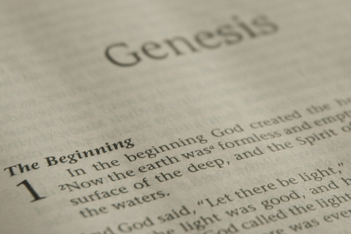
DOCUMENTARY HYPOTHESIS
J – Yahwist (850 B.C.)
E – Elohist (750 B.C.)
D – Deuteronomist (621 B.C.)
P – Priestly code (525 B.C.)

Slide 7
AUTHORSHIP
Charles Darwin
Karl Marx
Julius Wellhausen
John Dewey
Sigmund Freud
John Maynard Keynes
Soren Kierkegaard

Slide 8
MOSAIC AUTHORSHIP
Picks up where Genesis left off
Book itself-Exod 17:14
OT-Josh 8:31
NT-John 1:45

Slide 9
MOSAIC AUTHORSHIP
Picks up where Genesis left off
Book itself-Exod 17:14
OT-Josh 8:31
NT-John 1:45

Slide 11
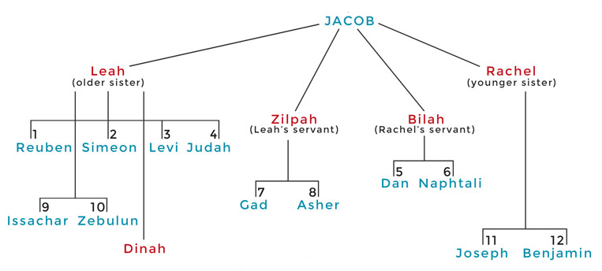

Slide 12
MOSAIC AUTHORSHIP
Picks up where Genesis left off
Book itself-Exod 17:14
OT-Josh 8:31
NT-John 1:45

Slide 13
INTRODUCTORY MATTERS
Title |  | Structure
Authorship |  | Message
Date |  | Purpose
Audience |  | Unique characteristics
Scope |  | Christ in Exodus

Slide 14
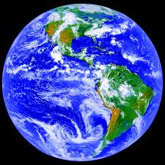
AGE OF THE EARTH?
971-931 BC=Solomonic reign
966=Solomon rebuilds temple (1 Kgs 6:1b)
- 480 years for the Exodus’ date (1 Kgs 6:1a)
= 1446 BC for Exodus’ date
- 430 years for Jacob’s migration to Egypt (Exod 12:40)
= 1876 BC for Jacob’s migration to Egypt (Gen 46)
Genealogies of Gen 5; 11
= 4000 BC for the earth’s age

Slide 15
AGE OF THE EARTH?
971-931 BC=Solomonic reign
966=Solomon rebuilds temple (1 Kgs 6:1b)
- 480 years for the Exodus’ date (1 Kgs 6:1a)
= 1446 BC for Exodus’ date
- 430 years for Jacob’s migration to Egypt (Exod 12:40)
= 1876 BC for Jacob’s migration to Egypt (Gen 46)
Genealogies of Gen 5; 11
= 4000 BC for the earth’s age

Slide 16
AGE OF THE EARTH?
971-931 BC=Solomonic reign
966=Solomon rebuilds temple (1 Kgs 6:1b)
- 480 years for the Exodus’ date (1 Kgs 6:1a)
= 1446 BC for Exodus’ date
- 430 years for Jacob’s migration to Egypt (Exod 12:40)
= 1876 BC for Jacob’s migration to Egypt (Gen 46)
Genealogies of Gen 5; 11
= 4000 BC for the earth’s age

Slide 17
1 Kings 6:1
“Now it came about in the four hundred and eightieth year after the sons of Israel came out of the land of Egypt, in the fourth year of Solomon’s reign over Israel, in the month of Ziv which is the second month, that he began to build the house of the Lord.”

Slide 18
AGE OF THE EARTH?
971-931 BC=Solomonic reign
966=Solomon rebuilds temple (1 Kgs 6:1b)
- 480 years for the Exodus’ date (1 Kgs 6:1a)
= 1446 BC for Exodus’ date
- 430 years for Jacob’s migration to Egypt (Exod 12:40)
= 1876 BC for Jacob’s migration to Egypt (Gen 46)
Genealogies of Gen 5; 11
= 4000 BC for the earth’s age

Slide 19
1 Kings 6:1
“Now it came about in the four hundred and eightieth year after the sons of Israel came out of the land of Egypt, in the fourth year of Solomon’s reign over Israel, in the month of Ziv which is the second month, that he began to build the house of the Lord.”

Slide 20
AGE OF THE EARTH?
971-931 BC=Solomonic reign
966=Solomon rebuilds temple (1 Kgs 6:1b)
- 480 years for the Exodus’ date (1 Kgs 6:1a)
= 1446 BC for Exodus’ date
- 430 years for Jacob’s migration to Egypt (Exod 12:40)
= 1876 BC for Jacob’s migration to Egypt (Gen 46)
Genealogies of Gen 5; 11
= 4000 BC for the earth’s age

Slide 21
DATE OF THE EXODUS
1446
Literal numbers
Oppression-Thutmose III
Exodus-Amenhotep II

Slide 22
THREE PHASES OF MOSES’ 120 YEAR LIFE
LIFE PHASE | SCRIPTURE | YEARS | AGE | ACTIVITY
Natural Training | Acts 7:23 | 1526–1486 B.C. | 1-40 | Egyptian Education
Spiritual Training | Exod. 7:7 | 1486–1446 B.C. | 40-80 | Midian Shepherding
Ministry | Deut. 31:2; 34:7; Acts 7:36 | 1446–1406 B.C. | 80-120 | Exodus, Law, Wilderness Preservation, Pentateuch Authorship

Slide 23
1444 B.C.
Final third of Moses’ life (1526–1406)
1526 – 1486-birth to rearing in Egypt (Acts 7:23)
1486 – 1446-Midian to sojourn to Exodus (Exod. 7:7)
1446 – 1406-Wilderness wanderings to death (Acts 7:36; Deut. 34:7)
Exodus does not mention an event after the giving of the Mosaic Covenant
Important information recorded in Exodus
Exodus written toward the beginning of the final third of Moses’ life

Slide 24
INTRODUCTORY MATTERS
Title |  | Structure
Authorship |  | Message
Date |  | Purpose
Audience |  | Unique characteristics
Scope |  | Christ in Exodus

Slide 26
AUDIENCE
First generation that came out of Egypt
Generation that had experienced the Exodus
Generation that had received the Mosaic Covenant at Sinai
Sinai references – Exod. 17:14; 24:4; 34:27-28

Slide 27
INTRODUCTORY MATTERS
Title |  | Structure
Authorship |  | Message
Date |  | Purpose
Audience |  | Unique characteristics
Scope |  | Christ in Exodus

Slide 28
AGE OF THE EARTH?
971-931 BC=Solomonic reign
966=Solomon rebuilds temple (1 Kgs 6:1b)
- 480 years for the Exodus’ date (1 Kgs 6:1a)
= 1446 BC for Exodus’ date
- 430 years for Jacob’s migration to Egypt (Exod 12:40)
= 1876 BC for Jacob’s migration to Egypt (Gen 46)
Genealogies of Gen 5; 11
= 4000 BC for the earth’s age

Slide 29
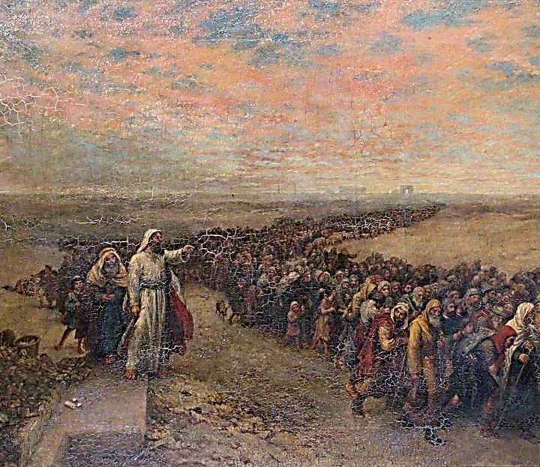
Exodus 12:40-41
“⁴⁰ Now the time that the sons of Israel lived in Egypt was four hundred and thirty years. ⁴¹ And at the end of four hundred and thirty years, to the very day, all the hosts of the Lord went out from the land of Egypt.”

Slide 30
AGE OF THE EARTH?
971-931 BC=Solomonic reign
966=Solomon rebuilds temple (1 Kgs 6:1b)
- 480 years for the Exodus’ date (1 Kgs 6:1a)
= 1446 BC for Exodus’ date
- 430 years for Jacob’s migration to Egypt (Exod 12:40)
= 1876 BC for Jacob’s migration to Egypt (Gen 46)
Genealogies of Gen 5; 11
= 4000 BC for the earth’s age

Slide 32
THREE PHASES OF MOSES’ 120 YEAR LIFE
LIFE PHASE | SCRIPTURE | YEARS | AGE | ACTIVITY
Natural Training | Acts 7:23 | 1526–1486 B.C. | 1-40 | Egyptian Education
Spiritual Training | Exod. 7:7 | 1486–1446 B.C. | 40-80 | Midian Shepherding
Ministry | Deut. 31:2; 34:7; Acts 7:36 | 1446–1406 B.C. | 80-120 | Exodus, Law, Wilderness Preservation, Pentateuch Authorship

Slide 33
SCOPE
1876 – 1444 – Events of Gen. 46 to the Exodus
1526 – 1444-Moses’ birth to the Exodus
Exodus covers the first 80 years of Moses’ 120 year life (Deut. 34:7)

Slide 34
SCOPE
Exod. 1:1–13:16 = 430 years or 80 years
Exod. 13:17–18:27 = 2 months (Exod. 19:1)
Exod. 19:1–40:38 = 10 months (Exod. 12:51; 40:2, 17)

Slide 35
INTRODUCTORY MATTERS
Title |  | Structure
Authorship |  | Message
Date |  | Purpose
Audience |  | Unique characteristics
Scope |  | Christ in Exodus

Slide 36
EXODUS STRUCTURE/OUTLINE
Redemption (1–18)
Redemption (1:1–12:30)
Liberation (12:31–15:21)
Preservation (15:22–18:27)
Mosaic Covenant (19–40)
Law (19–24)
Tabernacle instructions (25–31)
Apostasy (32–34)
Tabernacle building (35–40)

Slide 37
EXODUS STRUCTURE/OUTLINE
Redemption (1–18)
Redemption (1:1–12:30)
Liberation (12:31–15:21)
Preservation (15:22–18:27)
Mosaic Covenant (19–40)
Law (19–24)
Tabernacle instructions (25–31)
Apostasy (32–34)
Tabernacle building (35–40)

Slide 39
EXODUS STRUCTURE/OUTLINE
Redemption (1–18)
Redemption (1:1–12:30)
Liberation (12:31–15:21)
Preservation (15:22–18:27)
Mosaic Covenant (19–40)
Law (19–24)
Tabernacle instructions (25–31)
Apostasy (32–34)
Tabernacle building (35–40)

Slide 40
Exodus 19:5-6
“Now then, if you will indeed obey My voice and keep My covenant, then you shall be My own possession among all the peoples, for all the earth is Mine; and you shall be to Me a kingdom of priests and a holy nation.’ These are the words that you shall speak to the sons of Israel.”

Slide 41
EXODUS STRUCTURE/OUTLINE
Redemption (1–18)
Redemption (1:1–12:30)
Liberation (12:31–15:21)
Preservation (15:22–18:27)
Mosaic Covenant (19–40)
Law (19–24)
Tabernacle instructions (25–31)
Apostasy (32–34)
Tabernacle building (35–40)

Slide 42
EXODUS STRUCTURE/OUTLINE
Redemption (1–18)
Redemption (1:1–12:30)
Liberation (12:31–15:21)
Preservation (15:22–18:27)
Mosaic Covenant (19–40)
Law (19–24)
Tabernacle instructions (25–31)
Apostasy (32–34)
Tabernacle building (35–40)

Slide 43
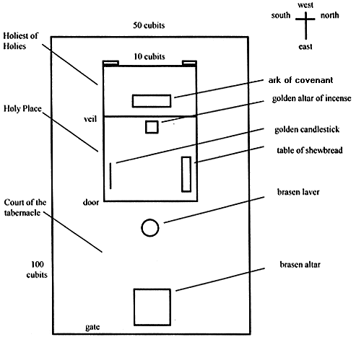
Tabernacle Diagram

Slide 44
EXODUS STRUCTURE/OUTLINE
Redemption (1–18)
Redemption (1:1–12:30)
Liberation (12:31–15:21)
Preservation (15:22–18:27)
Mosaic Covenant (19–40)
Law (19–24)
Tabernacle instructions (25–31)
Apostasy (32–34)
Tabernacle building (35–40)

Slide 45
INTRODUCTORY MATTERS
Title |  | Structure
Authorship |  | Message
Date |  | Purpose
Audience |  | Unique characteristics
Scope |  | Christ in Exodus

Slide 46
MESSAGE
God’s complete salvation of Israel is communicated through God’s redemption of His elect nation from Egypt (1–18) and His giving them the Mosaic Covenant to teach them how to order their lives under God (19–40)

Slide 47
INTRODUCTORY MATTERS
Title |  | Structure
Authorship |  | Message
Date |  | Purpose
Audience |  | Unique characteristics
Scope |  | Christ in Exodus

Slide 48
PURPOSE
Moses wrote in order to encourage the Jews to act consistent with their calling as a kingdom of priests in their journey toward the conquest and beyond.

Slide 49
Exodus 19:5-6
“Now then, if you will indeed obey My voice and keep My covenant, then you shall be My own possession among all the peoples, for all the earth is Mine; and you shall be to Me a kingdom of priests and a holy nation.’ These are the words that you shall speak to the sons of Israel.”

Slide 50
INTRODUCTORY MATTERS
Title |  | Structure
Authorship |  | Message
Date |  | Purpose
Audience |  | Unique characteristics
Scope |  | Christ in Exodus

Slide 51
UNIQUE CHARACTERISTICS
Volume of citation in the rest of the canon
OT – Cited more than any other book
NT – Only Psalms (liturgical) and Isaiah (messianic) are cited more

Slide 52
INTRODUCTORY MATTERS
Title |  | Structure
Authorship |  | Message
Date |  | Purpose
Audience |  | Unique characteristics
Scope |  | Christ in Exodus

Slide 53
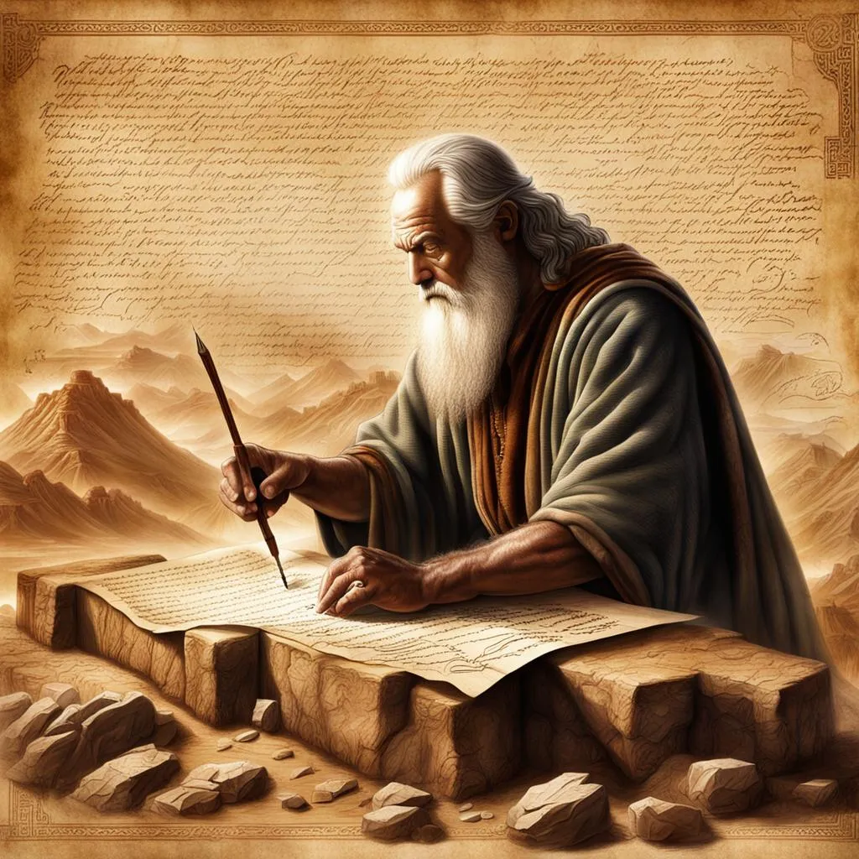
John 5:39, 46
“³⁹ You search the Scriptures because you think that in them you have eternal life; it is these that testify about Me…⁴⁶ For if you believed Moses, you would believe Me, for he wrote about Me.”

Slide 54
Luke 24:27, 44
“²⁷ Then beginning with Moses and with all the prophets, He explained to them the things concerning Himself in all the Scriptures…⁴⁴ Now He said to them, ‘These are My words which I spoke to you while I was still with you, that all things which are written about Me in the Law of Moses and the Prophets and the Psalms must be fulfilled.’”

Slide 55
Acts 17:1-3
“¹ Now when they had traveled through Amphipolis and Apollonia, they came to Thessalonica, where there was a synagogue of the Jews. ² And according to Paul’s custom, he visited them, and for three Sabbaths reasoned with them from the Scriptures, ³ explaining and giving evidence that the Christ had to suffer and rise from the dead, and saying, “This Jesus whom I am proclaiming to you is the Christ.”

Slide 56
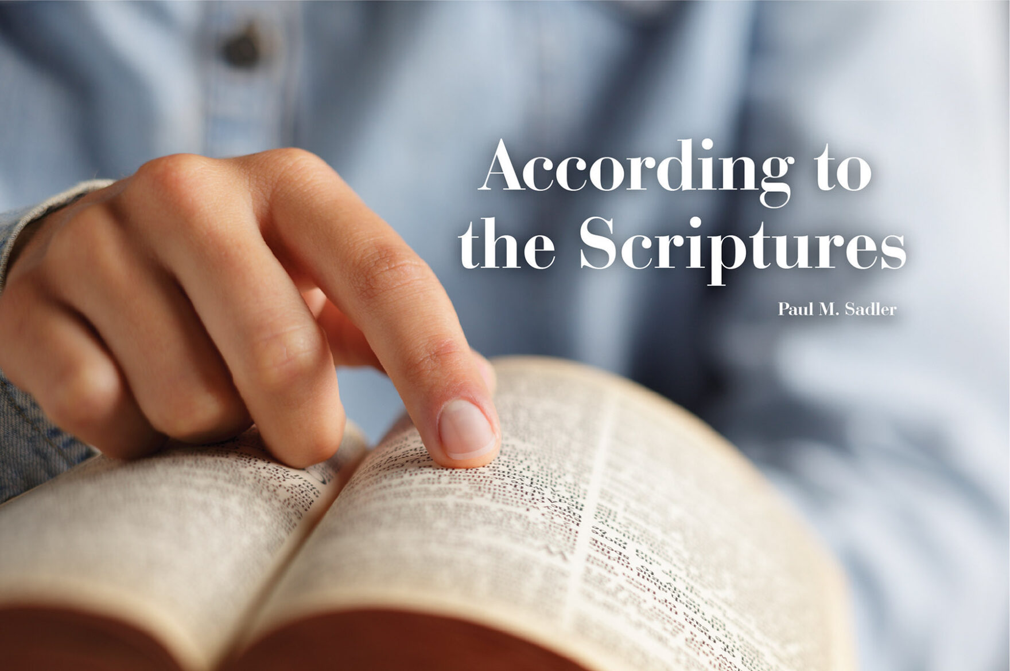
1 Corinthians 15:3-4
“³ For I handed down to you as of first importance what I also received, that Christ died for our sins according to the Scriptures, ⁴ and that He was buried, and that He was raised on the third day according to the Scriptures.”

Slide 57
CHRIST IN EXODUS (Luke 24:27, 44)
Passover Lamb
Lamb (John 1:29; 1 Cor 5:7)
Unblemished (Exod 12:5; 1 John 2:1)
No broken bones (Exod 12:46; John 19:36)
Typology
Tabernacle (John 1:14, skēnoō)
Water from the rock (1 Cor 10:3-4)
Manna from heaven (John 6:31-35)
Tabernacle priest (Heb 4:14-16)

Slide 58
CHRIST IN EXODUS (Luke 24:27, 44)
Passover Lamb
Lamb (John 1:29; 1 Cor 5:7)
Unblemished (Exod 12:5; 1 John 2:1)
No broken bones (Exod 12:46; John 19:36)
Typology
Tabernacle (John 1:14, skēnoō)
Water from the rock (1 Cor 10:3-4)
Manna from heaven (John 6:31-35)
Tabernacle priest (Heb 4:14-16)

Slide 59
John 1:29
“The next day he saw Jesus coming to him, and said, ‘Behold, the Lamb of God who takes away the sin of the world!’”

Slide 60
CHRIST IN EXODUS (Luke 24:27, 44)
Passover Lamb
Lamb (John 1:29; 1 Cor 5:7)
Unblemished (Exod 12:5; 1 John 2:1)
No broken bones (Exod 12:46; John 19:36)
Typology
Tabernacle (John 1:14, skēnoō)
Water from the rock (1 Cor 10:3-4)
Manna from heaven (John 6:31-35)
Tabernacle priest (Heb 4:14-16)

Slide 61
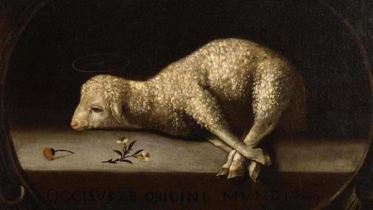
Exodus 12:5
“Your lamb shall be an unblemished male a year old; you may take it from the sheep or from the goats.”

Slide 62
CHRIST IN EXODUS (Luke 24:27, 44)
Passover Lamb
Lamb (John 1:29; 1 Cor 5:7)
Unblemished (Exod 12:5; 1 John 2:1)
No broken bones (Exod 12:46; John 19:36)
Typology
Tabernacle (John 1:14, skēnoō)
Water from the rock (1 Cor 10:3-4)
Manna from heaven (John 6:31-35)
Tabernacle priest (Heb 4:14-16)

Slide 63
CHRIST IN EXODUS (Luke 24:27, 44)
Passover Lamb
Lamb (John 1:29; 1 Cor 5:7)
Unblemished (Exod 12:5; 1 John 2:1)
No broken bones (Exod 12:46; John 19:36)
Typology
Tabernacle (John 1:14, skēnoō)
Water from the rock (1 Cor 10:3-4)
Manna from heaven (John 6:31-35)
Tabernacle priest (Heb 4:14-16)

Slide 64
Tabernacle Diagram

Slide 65
John 1:14
“And the Word became flesh, and dwelt [skēnoō] among us, and we saw His glory, glory as of the only begotten [monogenēs] from the Father, full of grace and truth.”

Slide 66
CHRIST IN EXODUS (Luke 24:27, 44)
Passover Lamb
Lamb (John 1:29; 1 Cor 5:7)
Unblemished (Exod 12:5; 1 John 2:1)
No broken bones (Exod 12:46; John 19:36)
Typology
Tabernacle (John 1:14, skēnoō)
Water from the rock (1 Cor 10:3-4)
Manna from heaven (John 6:31-35)
Tabernacle priest (Heb 4:14-16)

Slide 67
CHRIST IN EXODUS (Luke 24:27, 44)
Passover Lamb
Lamb (John 1:29; 1 Cor 5:7)
Unblemished (Exod 12:5; 1 John 2:1)
No broken bones (Exod 12:46; John 19:36)
Typology
Tabernacle (John 1:14, skēnoō)
Water from the rock (1 Cor 10:3-4)
Manna from heaven (John 6:31-35)
Tabernacle priest (Heb 4:14-16)

Slide 68
Tabernacle Diagram

Slide 69
3 REASONS WHY CHRIST IS SUPERIOR TO AARON (Hebrews 4:14-16)
Heavenly position (4:14)
Tested in all ways (4:15)
Allows entrance into God’s throne room (4:16)

Slide 70
Conclusion

Slide 71
INTRODUCTORY MATTERS
Title |  | Structure
Authorship |  | Message
Date |  | Purpose
Audience |  | Unique characteristics
Scope |  | Christ in Exodus

Slide 72
²⁴ The Lord bless you, and keep you; ²⁵ The Lord make His face shine on you, And be gracious to you; ²⁶ The Lord lift up His countenance on you, And give you peace.
Numbers 6:24–26 (NASB95)

