Slide 2
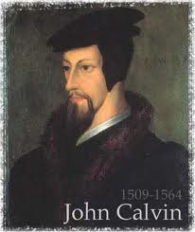
Neo-Calvinism vs. The Bible
Calvinism’s Mixed Blessing
Why Critique Calvinism?
The Source of Calvin’s Theology
Calvin’s Manner of Life
TULIP Through the Grid of Scripture
Conclusion

Slide 3
V. Running TULIP Through the Grid of Scripture
Total Depravity
Unconditional Election
Limited Atonement
Irresistible Grace
Perseverance of the Saints

Slide 4
Irresistible Grace
Calvinistic definition
Calvinistic arguments
Man can resist God’s grace
Man can resist God by disbelieving
John 6:44?

Slide 5
Irresistible Grace = Regeneration Precedes Faith & Faith is a Gift
“I” stands for “Irresistible Grace.” Faith is something “God irresistibly bestowed upon the elect without their having believed anything…By such reasoning, man…can’t even hear the gospel—much less respond to the pleadings of Christ.”
Bob Kirkland, Calvinism: None Dare Call It Heresy; Spotlight on the Life and Teachings of John Calvin (Eureka, MT: Lighthouse Trails, 2018), 34.

Slide 6
David N. Steele & Curtis C. Thomas
“Because of the fall, man is an unable of himself to savingly believe the gospel. The sinner is dead, blind, and deaf to the things of God; his heart is deceitful and desperately corrupt. His will is not free, it is in bondage to his evil nature, therefore, he will not – indeed he cannot – choose good over evil in the spiritual realm. Consequently, it takes much more than the Spirit’s assistance to bring a sinner to Christ – it takes regeneration by which He makes the sinner alive and gives him a new nature. Faith is not something man contributes to salvation, but is itself a part of God‘s gift of salvation – it is God’s gift to the sinner, not the sinner’s gift to God.”
David N. Steele, Curtis C. Thomas, and S. Lance Quinn, The Five Points of Calvinism, 2nd ed. (Phillipsburg, NJ: Presbyterian and Reformed Publishing, 1963), 5-6.

Slide 7
John 16:7-11
“⁷ But I tell you the truth, it is to your advantage that I go away; for if I do not go away, the Helper will not come to you; but if I go, I will send Him to you. ⁸ And He, when He comes, will convict the world concerning sin and righteousness and judgment; ⁹ concerning sin, because they do not believe in Me; ¹⁰ and concerning righteousness, because I go to the Father and you no longer see Me; ¹¹ and concerning judgment, because the ruler of this world has been judged.”

Slide 8
Irresistible Grace
Calvinistic definition
Calvinistic arguments
Man can resist God’s grace
Man can resist God by disbelieving
John 6:44?

Slide 9
Calvinistic Arguments
Faith is a gift
Regeneration precedes faith
Lost man cannot seek God (Rom. 3:11)

Slide 10
Faith is a Gift?
Calvinist Examples
Faith is a work?
Calvinist Proof texts
Miscellaneous problems

Slide 11
Tom Wells
Wells compares spiritual deadness to “an old dry [Christmas] tree with ―no fruit or ornaments of his own [his faith]. Then God comes along and hangs the bright jewel of faith on him. . . . There is no real connection between what he is and this gift of faith from God.”
Tom Wells, Faith: The Gift of God (Carlisle, PA: Banner of Truth Trust, 1983), 56–57

Slide 12
Calvin said: “Had he [Paul] said men are not willing to be wise, that indeed would have been true, but he states further that they are not able. Hence we infer, that faith is not in one‘s own power, but is divinely conferred.”
John Calvin
John Calvin, Commentary on the Epistles of Paul the Apostle to the Corinthians, trans. William Pringle [Edinburgh: Calvin Translation Society, n.d.; re- print, Grand Rapids: Baker, 2003], 116–17.

Slide 14
Faith is a Gift?
Calvinist Examples
Faith is a work?
Calvinist Proof texts
Miscellaneous problems

Slide 15
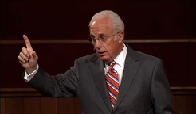
John MacArthur
The Gospel According to Jesus, p. 33
“Faith and works are not incompatible. There is a sense in which Jesus calls even the act of believing a work (John 6:29)—not merely a human work, but a gracious work of God in us. He brings us to faith, then enables and empowers us to believe unto obedience (cf. Romans 16:26).”

Slide 16
Sam Storms
“..even if what he or she does is simply to repent and believe the gospel, God’s grace is seriously, albeit unwittingly, compromised.”
Sam Storms, Chosen for Life: The Case for Divine Election (Wheaton, IL: Crossway Books, a ministry of Good News Publishers, revised and expanded edition, 2007), p. 77.

Slide 17
James White
White argues that because the Bible says Christ saves sinners, we can’t change it to say that he “saves synergistically with the assistance of the sinner himself.”
James R. White, The Potter’s Freedom (Amityville, NY: Calvary Press Publishing, 2000), 247.

Slide 18
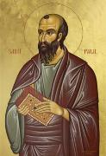
Romans 4:4-5
⁴ “Now to the one who works, his wage is not credited as a favor, but as what is due. ⁵ But to the one who does not work, but believes in Him who justifies the ungodly, his faith is credited as righteousness.”

Slide 19
Ephesians 2:8-10
“⁸ For by grace you have been saved through faith; and that not of yourselves, it is the gift of God; ⁹ not as a result of works, so that no one may boast. ¹⁰ For we are His workmanship, created in Christ Jesus for good works, which God prepared beforehand so that we would walk in them.”

Slide 20
Alfred J. Martin
“Faith is never presented in the Scripture as a meritorious act, but only as a channel of salvation.”
Alfred J. Martin, “The Sovereignty of Grace as Seen in Romans 8:28–30,” Bibliotheca Sacra 99 (October–December 1942): 460.

Slide 21
René A. Lopez
“Scripture never considers faith a work. Instead faith is always juxtaposed to works, as Paul stated in Romans 4:3–5. Human faith is but a passive response that receives God‘s free gift of eternal life. Who would accuse a beggar of working by holding out his hand to receive a dollar bill? No one!”
Rene A. Lopez, “Is Faith a Gift From God or a Human Exercise?,” Bibliotheca Sacra 164 (July–September 2007): 266.

Slide 22
Faith is a Gift?
Calvinist Examples
Faith is a work?
Calvinist Proof texts
Miscellaneous problems

Slide 23
Calvinist Proof-Texts
John 6:27-29 John 6:44-45 Acts 3:16 Acts 11:18 Acts 16:14 |  | (f) 1 Cor. 12:9 (g) Rom. 12:3 (h) Eph. 2:8-9 (i) Philip. 1:29 (j) 2 Pet. 1:1

Slide 24
Calvinist Proof-Texts
John 6:27-29 John 6:44-45 Acts 3:16 Acts 11:18 Acts 16:14 |  | (f) 1 Cor. 12:9 (g) Rom. 12:3 (h) Eph. 2:8-9 (i) Philip. 1:29 (j) 2 Pet. 1:1

Slide 25
John 6:27-29
“²⁷ Do not work for the food which perishes, but for the food which endures to eternal life, which the Son of Man will give to you, for on Him the Father, God, has set His seal.” ²⁸ Therefore they said to Him, “What shall we do, so that we may work the works of God?” ²⁹ Jesus answered and said to them, “This is the work of God, that you believe in Him whom He has sent.”

Slide 26
John 6:27-29
“²⁷ Do not work for the food which perishes, but for the food which endures to eternal life, which the Son of Man will give to you, for on Him the Father, God, has set His seal.” ²⁸ Therefore they said to Him, “What shall we do, so that we may work the works of God?” ²⁹ Jesus answered and said to them, “This is the work of God, that you believe in Him whom He has sent.”

Slide 27
John 6:27-29
“²⁷ Do not work for the food which perishes, but for the food which endures to eternal life, which the Son of Man will give to you, for on Him the Father, God, has set His seal.” ²⁸ Therefore they said to Him, “What shall we do, so that we may work the works of God?” ²⁹ Jesus answered and said to them, “This is the work of God, that you believe in Him whom He has sent.”

Slide 28
John 6:27-29
“²⁷ Do not work for the food which perishes, but for the food which endures to eternal life, which the Son of Man will give to you, for on Him the Father, God, has set His seal.” ²⁸ Therefore they said to Him, “What shall we do, so that we may work the works of God?” ²⁹ Jesus answered and said to them, “This is the work of God, that you believe in Him whom He has sent.”

Slide 29
John 6:27-29
“²⁷ Do not work for the food which perishes, but for the food which endures to eternal life, which the Son of Man will give to you, for on Him the Father, God, has set His seal.” ²⁸ Therefore they said to Him, “What shall we do, so that we may work the works of God?” ²⁹ Jesus answered and said to them, “This is the work of God, that you believe in Him whom He has sent.”

Slide 30
John 6:27-29
“²⁷ Do not work for the food which perishes, but for the food which endures to eternal life, which the Son of Man will give to you, for on Him the Father, God, has set His seal.” ²⁸ Therefore they said to Him, “What shall we do, so that we may work the works of God?” ²⁹ Jesus answered and said to them, “This is the work of God, that you believe in Him whom He has sent.”

Slide 31
Calvinist Proof-Texts
John 6:27-29 John 6:44-45 Acts 3:16 Acts 11:18 Acts 16:14 |  | (f) 1 Cor. 12:9 (g) Rom. 12:3 (h) Eph. 2:8-9 (i) Philip. 1:29 (j) 2 Pet. 1:1

Slide 32
John 6:44-45
“⁴⁴ No one can come to Me unless the Father who sent Me draws him; and I will raise him up on the last day. ⁴⁵ It is written in the prophets, ‘And they shall all be taught of God.’ Everyone who has heard and learned from the Father, comes to Me.”

Slide 33
John 6:44-45
“⁴⁴ No one can come to Me unless the Father who sent Me draws him; and I will raise him up on the last day. ⁴⁵ It is written in the prophets, ‘And they shall all be taught of God.’ Everyone who has heard and learned from the Father, comes to Me.”

Slide 34
John 6:44-45
“⁴⁴ No one can come to Me unless the Father who sent Me draws him; and I will raise him up on the last day. ⁴⁵ It is written in the prophets, ‘And they shall all be taught of God.’ Everyone who has heard and learned from the Father, comes to Me.”

Slide 35
John 6:44-45
“⁴⁴ No one can come to Me unless the Father who sent Me draws him; and I will raise him up on the last day. ⁴⁵ It is written in the prophets, ‘And they shall all be taught of God.’ Everyone who has heard and learned from the Father, comes to Me.”

Slide 36
Calvinist Proof-Texts
John 6:27-29 John 6:44-45 Acts 3:16 Acts 11:18 Acts 16:14 |  | (f) 1 Cor. 12:9 (g) Rom. 12:3 (h) Eph. 2:8-9 (i) Philip. 1:29 (j) 2 Pet. 1:1

Slide 37
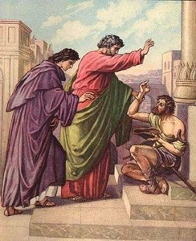
Acts 3:16
“And on the basis of faith in His name, it is the name of Jesus which has strengthened this man whom you see and know; and the faith which comes through Him has given him this perfect health in the presence of you all.”

Slide 38
Acts 3:16
“And on the basis of faith in His name, it is the name of Jesus which has strengthened this man whom you see and know; and the faith which comes through Him has given him this perfect health in the presence of you all.”

Slide 39
John MacArthur
The Gospel According to Jesus, p. 69
“Either way, the meaning is inescapable: Faith is God’s gracious gift. Jesus explicitly affirmed this truth: ‘No one can come to Me, unless it has been granted him from the Father’ (John 6:65). Faith is also spoken of as a divine gift in Acts 3:16 (‘The faith which comes through Him has given him this perfect health in the presence of you all’), Philippians 1:29 (‘To you it has been granted for Christ’s sake, not only to believe in Him, but also to suffer for His sake’), and 2 Peter 1:1 (‘Simon Peter, a bond-servant and apostle of Jesus Christ, to those who have received a faith of the same kind as ours’).”

Slide 40
René A. Lopez
“MacArthur says that the phrase ‘faith which comes through Him’ means that faith is a divine gift. However, in the first part of this verse faith is the means by which the healing took place, and ‘in His name’ stresses the object (God) of that faith. The latter half of the passage is repetitious in order to rule out anything magical about the source of the healing. The man’s faith in Peter’s words resulted in healing through Jesus. ‘Such faith was possible through Jesus: the proclamation of his power made it possible for people to believe.’ Therefore, nothing in Acts 3:16 supports the gift-of-faith view.”
“Is Faith a Gift From God or a Human Exercise?,” Bibliotheca Sacra 164 (July–September 2007): 268-69.

Slide 41
Acts 3:16
“And on the basis of faith in His name, it is the name of Jesus which has strengthened this man whom you see and know; and the faith which comes through Him has given him this perfect health in the presence of you all.”

Slide 42
Acts 3:16
“And on the basis of faith in His name, it is the name of Jesus which has strengthened this man whom you see and know; and the faith which comes through Him has given him this perfect health in the presence of you all.”

Slide 43
Acts 3:6, 12
“⁶ But Peter said, “I do not possess silver and gold, but what I do have I give to you: In the name of Jesus Christ the Nazarene—walk!”…¹² But when Peter saw this, he replied to the people, ‘Men of Israel, why are you amazed at this, or why do you gaze at us, as if by our own power or piety we had made him walk?’”

Slide 44
Calvinist Proof-Texts
John 6:27-29 John 6:44-45 Acts 3:16 Acts 11:18 Acts 16:14 |  | (f) 1 Cor. 12:9 (g) Rom. 12:3 (h) Eph. 2:8-9 (i) Philip. 1:29 (j) 2 Pet. 1:1

Slide 45
Acts 11:18
“When they heard this, they quieted down and glorified God, saying, ‘Well then, God has granted to the Gentiles also the repentance that leads to life.’”

Slide 46
John 16:7-11
“⁷ But I tell you the truth, it is to your advantage that I go away; for if I do not go away, the Helper will not come to you; but if I go, I will send Him to you. ⁸ And He, when He comes, will convict the world concerning sin and righteousness and judgment; ⁹ concerning sin, because they do not believe in Me; ¹⁰ and concerning righteousness, because I go to the Father and you no longer see Me; ¹¹ and concerning judgment, because the ruler of this world has been judged.”

Slide 47
Calvinist Proof-Texts
John 6:27-29 John 6:44-45 Acts 3:16 Acts 11:18 Acts 16:14 |  | (f) 1 Cor. 12:9 (g) Rom. 12:3 (h) Eph. 2:8-9 (i) Philip. 1:29 (j) 2 Pet. 1:1

Slide 48
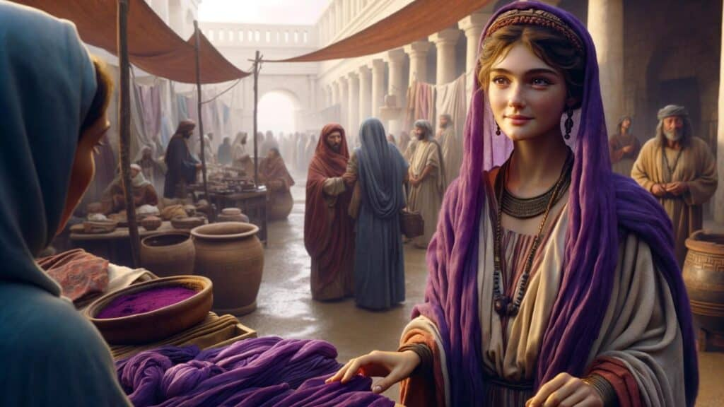
Acts 16:14
“A woman named Lydia, from the city of Thyatira, a seller of purple fabrics, a worshiper of God, was listening; and the Lord opened her heart to respond to the things spoken by Paul.”

Slide 49
John 16:7-11
“⁷ But I tell you the truth, it is to your advantage that I go away; for if I do not go away, the Helper will not come to you; but if I go, I will send Him to you. ⁸ And He, when He comes, will convict the world concerning sin and righteousness and judgment; ⁹ concerning sin, because they do not believe in Me; ¹⁰ and concerning righteousness, because I go to the Father and you no longer see Me; ¹¹ and concerning judgment, because the ruler of this world has been judged.”

Slide 50
René A. Lopez
“The Greek…(‘opened’) refers to ‘opening of the eyes to make understanding possible and enable perception.’ Many of the New Testament occurrences of…(‘heart’) refer to the mind, as it does here; God opened Lydia’s ‘eyes of the heart,’ as if removing a mental veil (2 Cor. 4:3–4), so that she would understand and respond. God enabled her to understand Paul’s message so that she could believe and be saved. But opening her heart (or understanding) is not the same as giving her faith. Acts 16 does not say God gave her faith. Instead He enabled her to understand so that she could exercise faith…Paul wrote in Romans 3:11, ‘There is none who understands, there is none who seeks for God.’ However, God was drawing (cf. John 6:44–45) Lydia to Himself before Paul arrived. Nevertheless giving a person the ability to understand differs from giving him or her faith to believe. God enlightened (a type of drawing) Lydia so that she could believe, but it was still her faith, not God’s gift of faith.”
“Is Faith a Gift From God or a Human Exercise?,” Bibliotheca Sacra 164 (July–September 2007): 264 and n. 20.

Slide 51
Calvinist Proof-Texts
John 6:27-29 John 6:44-45 Acts 3:16 Acts 11:18 Acts 16:14 |  | (f) 1 Cor. 12:9 (g) Rom. 12:3 (h) Eph. 2:8-9 (i) Philip. 1:29 (j) 2 Pet. 1:1

Slide 52
1 Corinthians 12:9
“to another faith by the same Spirit, and to another gifts of healing by the one Spirit.”

Slide 53
Calvinist Proof-Texts
John 6:27-29 John 6:44-45 Acts 3:16 Acts 11:18 Acts 16:14 |  | (f) 1 Cor. 12:9 (g) Rom. 12:3 (h) Eph. 2:8-9 (i) Philip. 1:29 (j) 2 Pet. 1:1

Slide 54
Romans 12:3
“For through the grace given to me I say to everyone among you not to think more highly of himself than he ought to think; but to think so as to have sound judgment, as God has allotted to each a measure of faith.”

Slide 55
Calvinist Proof-Texts
John 6:27-29 John 6:44-45 Acts 3:16 Acts 11:18 Acts 16:14 |  | (f) 1 Cor. 12:9 (g) Rom. 12:3 (h) Eph. 2:8-9 (i) Philip. 1:29 (j) 2 Pet. 1:1

Slide 56
Ephesians 2:8-10
“⁸ For by grace you have been saved through faith; and that not of yourselves, it is the gift of God; ⁹ not as a result of works, so that no one may boast. ¹⁰ For we are His workmanship, created in Christ Jesus for good works, which God prepared beforehand so that we would walk in them.”

Slide 57
Gordon H. Clark
“A dead man cannot…exercise faith in Jesus Christ. Faith is an activity of spiritual life, and without the life there can be no activity. Furthermore, faith… does not come by any independent decision. The Scripture is explicit, plain, and unmistakable: ‘for by grace are you saved through faith, and that is not of yourselves, it is the gift of God’ (Ephesians 2:8). Look at the words again, ‘it is the gift of God.’ If God does not give a man faith no amount of willpower and decision can manufacture it for him.”
Gordon H. Clark, Predestination (Phillipsburg, NJ: Presbyterian and Reformed Publishing, 1987), 102.

Slide 58
Ephesians 2:8-9
“⁸ For by grace you have been saved through faith [pistis, feminine noun]; and that [touto, neuter demonstrative pronoun] not of yourselves, it is the gift [dōron, neuter noun] of God; ⁹ not as a result of works, so that no one may boast. ”

Slide 59
Harold Hoehner
“The real problem is with the demonstrative pronoun τοῦτο, ‘this.’ Barth states, “The neuter pronoun ‘this’ may refer to…the noun ‘faith.’” Some commentators think that it refers to πίστεως, the nearest preceding noun. A serious objection to this is that the feminine noun does not match the neuter gender of the pronoun…Furthermore, to refer back to any one of these words seems to be redundant.”
Harold W. Hoehner, Ephesians: An Exegetical Commentary (Grand Rapids: Baker, 2002), 342-43.

Slide 60
Harold Hoehner
“Rather than any particular word it is best to conclude that τοῦτο refers back to the preceding section. This is common and there are numerous illustrations of such in Ephesians. For example, in 1:15 τοῦτο refers back to the contents of 1:3–14, in 3:1 it refers back to 2:11–22, and in 3:14 it refers back to 3:1–13. Therefore, in the present context, τοῦτο refers back to 2:4–8a and more specifically 2:8a, the concept of salvation by grace through faith.”
Harold W. Hoehner, Ephesians: An Exegetical Commentary (Grand Rapids: Baker, 2002), 342-43.

Slide 61
Ephesians 2:8-10
“⁸ For by grace you have been saved through faith; and that not of yourselves, it is the gift of God; ⁹ not as a result of works, so that no one may boast. ¹⁰ For we are His workmanship, created in Christ Jesus for good works, which God prepared beforehand so that we would walk in them.”

Slide 62
What “Gift” and “Not by Works” Do Refer To
“Gift” (dōron) never refers to “faith” (pistis) but…
Everlasting life (John 4:10)
Eternal life (Rom. 6:23)
Holy Spirit (Acts 2:38; 8:20; 10:45; 11:17)
Justification (Rom. 5:15, 17)
Jesus Christ (2 Cor. 9:15)
George Zeller, “What Is The Gift of God? A Study of Ephesians 2:8-9,” online: http://www.middletownbiblechurch.org/reformed/godgift.htm, accessed 04 November 2019.

Slide 63
Ephesians 2:8-10
“⁸ For by grace you have been saved through faith; and that not of yourselves, it is the gift of God; ⁹ not as a result of works, so that no one may boast. ¹⁰ For we are His workmanship, created in Christ Jesus for good works, which God prepared beforehand so that we would walk in them.”

Slide 64
What “Gift” and “Not by Works” Do Refer To
“Not by works” never refers to “faith” (pistis) but…
Justification (Rom. 3:20, 27, 28; 4:2, 6; Gal. 2:16)
Election (Rom. 9:11; 11:6)
Righteousness (Rom. 9:32)
Salvation (Titus 3:5; 2 Tim. 1:9)
Calling (2 Tim. 1:9)
George Zeller, “What Is The Gift of God? A Study of Ephesians 2:8-9,” online: http://www.middletownbiblechurch.org/reformed/godgift.htm, accessed 04 November 2019.

Slide 65
Harold Hoehner
“The genitive could be possessive, ‘God’s gift,’ or more likely a genitive of origin, ‘gift from God.’ In the present passage, the gift of God does not refer to ‘faith’ but rather it refers to whole concept of salvation. The contrast is stark not only in the words themselves but also in their position in the sentence. The words καὶ τοῦτο οὐκ ἐξ ὑμῶν, θεοῦ τὸ δῶρον are literally ‘and this is not of yourselves, of God is the gift.’ In conclusion, the ‘gift’ is that which is outside of ourselves and is to be received. Therefore, the gift of salvation has its origin in God, its basis is grace, and it is received by means of faith.”
Harold W. Hoehner, Ephesians: An Exegetical Commentary (Grand Rapids: Baker, 2002), 343-44.

Slide 66
Calvinist Proof-Texts
John 6:27-29 John 6:44-45 Acts 3:16 Acts 11:18 Acts 16:14 |  | (f) 1 Cor. 12:9 (g) Rom. 12:3 (h) Eph. 2:8-9 (i) Philip. 1:29 (j) 2 Pet. 1:1

Slide 67
Philippians 1:29
“For to you it has been granted for Christ’s sake, not only to believe in Him, but also to suffer for His sake.”

Slide 68
René A. Lopez
“However, the gift of faith is not the topic of the verse. In fact the word ‘granted’ (…‘give graciously’) should be understood here as conveying a privilege. It is a graciously granted privilege that God allows a person to believe in Christ and to suffer for Him. Since ‘to believe’ and ‘to suffer’ are parallel, it follows that if faith is a gift then so is suffering. But the Bible nowhere speaks of suffering as a divine gift. Furthermore, ‘it is not God who suffers but man. Likewise, it is not God who believes but man. Both believing and suffering are actions of people.’”
“Is Faith a Gift From God or a Human Exercise?,” Bibliotheca Sacra 164 (July–September 2007): 269-70.

Slide 69
John 16:7-11
“⁷ But I tell you the truth, it is to your advantage that I go away; for if I do not go away, the Helper will not come to you; but if I go, I will send Him to you. ⁸ And He, when He comes, will convict the world concerning sin and righteousness and judgment; ⁹ concerning sin, because they do not believe in Me; ¹⁰ and concerning righteousness, because I go to the Father and you no longer see Me; ¹¹ and concerning judgment, because the ruler of this world has been judged.”

Slide 70
Philippians 1:29
“For to you it has been granted for Christ’s sake, not only to believe in Him, but also to suffer for His sake.”

Slide 71
Calvinist Proof-Texts
John 6:27-29 John 6:44-45 Acts 3:16 Acts 11:18 Acts 16:14 |  | (f) 1 Cor. 12:9 (g) Rom. 12:3 (h) Eph. 2:8-9 (i) Philip. 1:29 (j) 2 Pet. 1:1

Slide 72
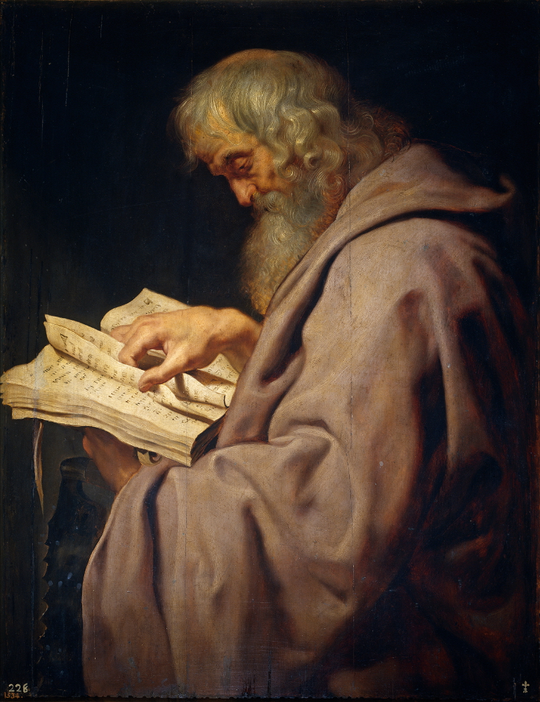
2 Peter 1:1
“Simon Peter, a bond-servant and apostle of Jesus Christ, To those who have received a faith of the same kind as ours, by the righteousness of our God and Savior, Jesus Christ.”

Slide 73
Faith is a Gift?
Calvinist Examples
Faith is a work?
Calvinist Proof texts
Miscellaneous problems

Slide 74
iv. Miscellaneous Problems
Degree of faith mentioned? (Matt. 8:5-13)
Responsibility to believe?
Responsibility for not believing (John 3:18; 5:40)
Confuses the instrument with the agent
Reverses the subject (man)‒object (God) relationship
Romans 10:17
Confuses how the Gospel is shared
A lively corpse indeed?
Roman Catholic roots

Slide 75
iv. Miscellaneous Problems
Degree of faith mentioned? (Matt. 8:5-13)
Responsibility to believe?
Responsibility for not believing (John 3:18; 5:40)
Confuses the instrument with the agent
Reverses the subject (man)‒object (God) relationship
Romans 10:17
Confuses how the Gospel is shared
A lively corpse indeed?
Roman Catholic roots

Slide 76
René A. Lopez
“A Roman centurion is another example of a person who exercised faith (Matt. 8:5–13). Marveling at his faith, Jesus said, ‘Truly I say to you, I have not found such great faith with anyone in Israel’ (v. 10). Jesus’ reference to the centurion’s ‘great faith’ makes sense only if that faith came from the centurion and not God. For why would Christ emphasize the centurion‘s degree of faith if it came from God?”
“Is Faith a Gift From God or a Human Exercise?,” Bibliotheca Sacra 164 (July–September 2007): 264.

Slide 77
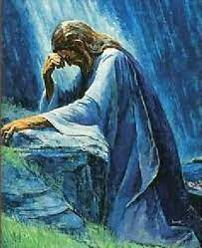
Luke 22:32
“but I have prayed for you, that your faith may not fail; and you, when once you have turned again, strengthen your brothers.”

Slide 78
iv. Miscellaneous Problems
Degree of faith mentioned? (Matt. 8:5-13)
Responsibility to believe?
Responsibility for not believing (John 3:18; 5:40)
Confuses the instrument with the agent
Reverses the subject (man)‒object (God) relationship
Romans 10:17
Confuses how the Gospel is shared
A lively corpse indeed?
Roman Catholic roots

Slide 79
The Responsibility to Believe
John 1:12-13 John 3:16 John 3:36 John 5:24 John 6:47 |  | Acts 16:31 Rom. 3:21-22 Rom. 3:25-26 Rom. 4:3-6 Eph. 2:8

Slide 80
iv. Miscellaneous Problems
Degree of faith mentioned? (Matt. 8:5-13)
Responsibility to believe?
Responsibility for not believing (John 3:18; 5:40)
Confuses the instrument with the agent
Reverses the subject (man)‒object (God) relationship
Romans 10:17
Confuses how the Gospel is shared
A lively corpse indeed?
Roman Catholic roots

Slide 81
Dr. Robert R. Congdon
Oops! I Thought I Was a Four - Pt Calvinist (Greer, SC: Congdon Ministries International, 2014), 51.
“Furthermore, why would God admonish and warn unbelievers for being spiritually blind and deaf if it were not in their power to respond?…Is this not a mockery? It would be like chiding a legless man for being unable to walk.”

Slide 82
iv. Miscellaneous Problems
Degree of faith mentioned? (Matt. 8:5-13)
Responsibility to believe?
Responsibility for not believing (John 3:18; 5:40)
Confuses the instrument with the agent
Reverses the subject (man)‒object (God) relationship
Romans 10:17
Confuses how the Gospel is shared
A lively corpse indeed?
Roman Catholic roots

Slide 83
Charlie Bing
“When faith is called a dynamic (the same as calling it a power), it is confused with the Holy Spirit. The Spirit is the agent of salvation and the Power that effects a changed life. Faith is the instrument of salvation which, when exercised as a response to God‘s grace, secures the Spirit’s salvation.”
Charles C. Bing, “Lordship Salvation: A Biblical Evaluation and Response” (Th.D. diss., Dallas Theological Seminary, 1991), 53.

Slide 84
iv. Miscellaneous Problems
Degree of faith mentioned? (Matt. 8:5-13)
Responsibility to believe?
Responsibility for not believing (John 3:18; 5:40)
Confuses the instrument with the agent
Reverses the subject (man)‒object (God) relationship
Romans 10:17
Confuses how the Gospel is shared
A lively corpse indeed?
Roman Catholic roots

Slide 85
Carmen Bryant
“It is not God who believes but man, even though a work of God may have occurred previously to enable man to believe. It is man who performs the action. Linguistically, man is the subject, God the object. Saying that faith is a ‘gift of God’ reverses the subject-object relationship.”
Carmen J. Bryant, “Salvific Faith: Gift from God or Action of Man? A Linguistic Approach” (Th.M. thesis, Western Conservative Baptist Seminary, 1992), 51-53.

Slide 86
iv. Miscellaneous Problems
Degree of faith mentioned? (Matt. 8:5-13)
Responsibility to believe?
Responsibility for not believing (John 3:18; 5:40)
Confuses the instrument with the agent
Reverses the subject (man)‒object (God) relationship
Romans 10:17
Confuses how the Gospel is shared
A lively corpse indeed?
Roman Catholic roots

Slide 87
Romans 10:17
“So faith comes from hearing, and hearing by the word of Christ.”

Slide 88
iv. Miscellaneous Problems
Degree of faith mentioned? (Matt. 8:5-13)
Responsibility to believe?
Responsibility for not believing (John 3:18; 5:40)
Confuses the instrument with the agent
Reverses the subject (man)‒object (God) relationship
Romans 10:17
Confuses how the Gospel is shared
A lively corpse indeed?
Roman Catholic roots

Slide 89
Passages Conditioning Salvation on Faith Alone (Sola Fide)
Genesis 15:6
John 3:16; 5:24; 6:28-29, 47; 16:8-9; 20:30-31
Acts 16:30-31
Romans 1:16; Ephesians 2:8-9
Hebrews 11:6

Slide 90
Belief – God’s One Condition for Justification
Gen 15:6
Then he believed in the LORD; and He reckoned it to him as righteousness.
John 3:16
For God so loved the world, that He gave His only begotten Son, that whoever believes in Him shall not perish, but have eternal life.
Acts 16:30-31
"Sirs, what must I do to be saved?" They said, "Believe in the Lord Jesus, and you will be saved..."

Slide 91
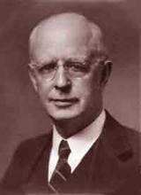
Lewis Sperry Chafer, vol. 7, Systematic Theology^{b} (Grand Rapids, MI: Kregel Publications, 1993), 265-66.
Belief-God’s One Condition for Justification
“…because upwards of 150 passages of Scripture condition salvation upon believing only (cf. John 3:16; Acts 16:31).

Slide 92
John MacArthur, Jr.
Tape GC 90-21 on Lordship salvation, last part of tape, comments made during the closing invitation.
“If faith is a gift of God, THEN HOW DO I GET IT? Do I do nothing and hope that God will sovereignly bestow it upon me? Or, do I cry out to God and pray that He will give me the gift of saving faith? Dr. MacArthur apparently holds to this second option. At the end of one of his messages he gave a salvation appeal and said the following: "Faith is a gift from God...it is permanent...the faith that God gives begets obedience...God gave it to you and He sustains it...May God grant you a true saving faith, a permanent gift that begins in humility and brokenness over sin and ends up in obedience unto righteousness. That's true faith and it's a gift that only God can give, and if you desire it pray and ask that He would grant it to you.”

Slide 93
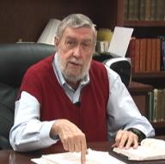
Jay Adams
Competent to Counsel, 70.
“But counselors, as Christians, are obligated to present the claims of Christ. They must present the good news that Christ Jesus died on the cross in the place of His own, that He bore the guilt and suffered the penalty for their sins. He died that all whom the Father had given to Him might come unto Him and have life everlasting. As a reformed Christian, the writer believes that counselors must not tell any unsaved counselee that Christ died for him, FOR THEY CANNOT SAY THAT. No man knows except Christ Himself who are His elect for whom He died." [emphasis mine]

Slide 94
iv. Miscellaneous Problems
Degree of faith mentioned? (Matt. 8:5-13)
Responsibility to believe?
Responsibility for not believing (John 3:18; 5:40)
Confuses the instrument with the agent
Reverses the subject (man)‒object (God) relationship
Romans 10:17
Confuses how the Gospel is shared
A lively corpse indeed?
Roman Catholic roots

Slide 95
John MacArthur, Jr.
Tape GC 90-21 on Lordship salvation, last part of tape, comments made during the closing invitation.
“If faith is a gift of God, THEN HOW DO I GET IT? Do I do nothing and hope that God will sovereignly bestow it upon me? Or, do I cry out to God and pray that He will give me the gift of saving faith? Dr. MacArthur apparently holds to this second option. At the end of one of his messages he gave a salvation appeal and said the following: "Faith is a gift from God...it is permanent...the faith that God gives begets obedience...God gave it to you and He sustains it...May God grant you a true saving faith, a permanent gift that begins in humility and brokenness over sin and ends up in obedience unto righteousness. That's true faith and it's a gift that only God can give, and if you desire it pray and ask that He would grant it to you.”

Slide 96
Roy L. Aldrich
“Thus an unscriptural doctrine of total depravity leads to an unscriptural and inconsistent plan of salvation. Doubtless the sinner is ‘dead in trespasses and sins’ (Eph. 2:1b). If this means that regeneration must precede faith, then it must also mean that regeneration must precede all three of the pious duties Shedd outlines for the lost [as seen in the following sentence]. A doctrine of total depravity that excludes the possibility of faith must also exclude the possibilities of ‘hearing the word,’ ‘giving serious application to divine truth,’ and ‘praying for the Holy Spirit for conviction and regeneration.’ The extreme Calvinist deals with a rather lively spiritual corpse after all. If the corpse has enough vitality to read the Word, and heed the message, and pray for conviction, perhaps it can also believe.”
Roy L. Aldrich, “The Gift of God,” Bibliotheca Sacra 122 (July–September 1965): 249.

Slide 97
iv. Miscellaneous Problems
Degree of faith mentioned? (Matt. 8:5-13)
Responsibility to believe?
Responsibility for not believing (John 3:18; 5:40)
Confuses the instrument with the agent
Reverses the subject (man)‒object (God) relationship
Romans 10:17
Confuses how the Gospel is shared
A lively corpse indeed?
Roman Catholic roots

Slide 98
Gary L. Nebeker
“the concept of infused faith for salvation bears a marked resemblance to the sacramentalism of the Roman Catholic Church. That is to say, faith becomes a transmitted and efficacious element which God gives to men for salvation.”
Gary L. Nebeker, “Is Faith a Gift of God? Ephesians 2:8 Reconsidered,” Grace Evangelical Society News, July 1989, 1.

Slide 99
Dave Hunt
“Most of those today, including evangelical leaders who hold Calvin in great esteem, are not aware that they have been captivated by the writings of a devout Roman Catholic, newly converted to Luther’s Protestantism, who had broken with Rome only a year before. Oddly, Calvin kept himself on the payroll of the Roman Catholic Church for nearly a year after he claimed to have been miraculously delivered from the ‘deep slough’ of ‘obstinate addiction to the superstitions of the papacy.’”
Dave Hunt, What Love Is This? Calvinism's Misrepresentation of God, 4th ed. (Bend, OR: Berean Call, 2013), 42.

