Slide 1
Genesis 12‒50
Israel’s Birth & Preservation

Slide 2
GENESIS STRUCTURE
Genesis 12-50 (four people)
Abraham (12:1–25:11)
Isaac (25:12–26:35)
Jacob (27–36)
Joseph (37–50)

Slide 3
Genesis 37‒50 Joseph
Joseph sold unto Egypt (37)
Canaan’s corruption (38)
Joseph falsely accused (39)
Joseph’s short-term predictions (40)
Joseph’s elevation (41)
Joseph’s first reunion with his brothers (42)
Joseph’s second reunion with his brothers (43‒45)
Joseph’s second reunion with his brothers (43‒45)
Sojourn to Egypt (46:1‒47:12)
Famine’s course (47:13-26)
Jacob in Egypt (47:27-31)
Jacob blesses Joseph’s sons (48)
Jacob blesses his sons (49)
Jacob’s burial & Joseph’s death (50)

Slide 4
Genesis 50:1-26 Death & Burial of Jacob & Joseph
Events following Jacob’s death (1-3)
Jacob’s burial (4-14)
Brothers’ fear & Joseph’s reassurance (15-21)
Joseph’s death (22-26)

Slide 5
IV. Genesis 50:22-26 Joseph’s Death
Joseph’s lifespan (22)
Joseph’s seed (23)
Joseph’s charge (24-25)
Joseph’s death (26)

Slide 6
IV. Genesis 50:22-26 Joseph’s Death
Joseph’s lifespan (22)
Joseph’s seed (23)
Joseph’s charge (24-25)
Joseph’s death (26)

Slide 7
Genesis 50:22 Joseph’s Lifespan
Place (22a)
Years (22b)

Slide 8
Genesis 50:22 Joseph’s Lifespan
Place (22a)
Years (22b)

Slide 9
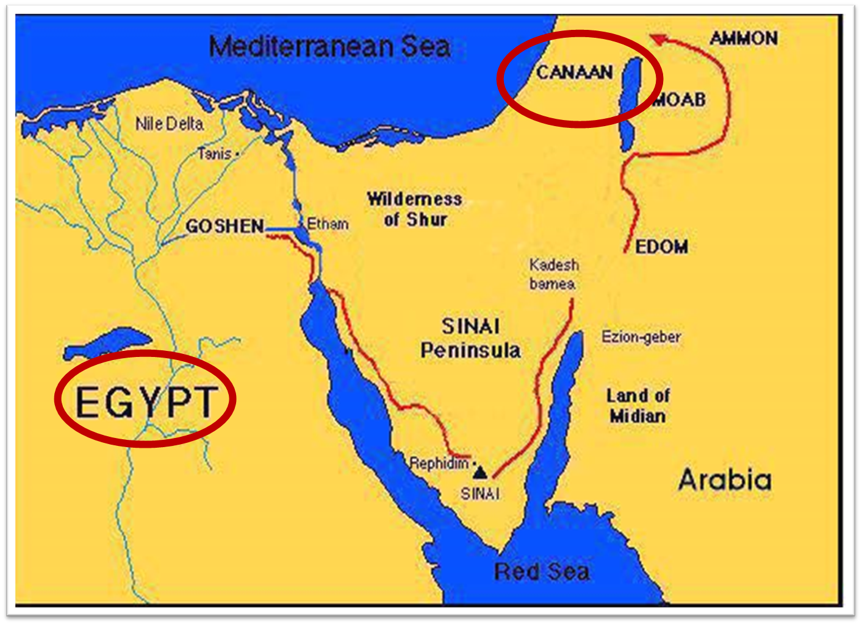

Slide 11
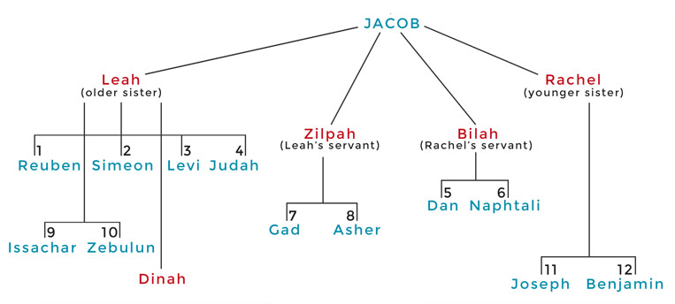

Slide 12
Genesis 50:22 Joseph’s Lifespan
Place (22a)
Years (22b)

Slide 13
Dr. Arnold G. Fruchtenbaum
The Book of Genesis, 660-61
“Moreover, living up to 110 was considered a very ideal age for an Egyptian, in fact, so ideal that in Ancient Egyptian Texts there are twenty-seven references to this age. For example, in the Inscriptions of Vizier Ptah Hotep, who held the same position that Joseph did, states: ‘What I have done on earth is not inconsiderable. I attained 110 years of life which the king gave me, with favor foremost among the ancestors through doing right for the King up to the point of veneration.’”

Slide 14
IV. Genesis 50:22-26 Joseph’s Death
Joseph’s lifespan (22)
Joseph’s seed (23)
Joseph’s charge (24-25)
Joseph’s death (26)

Slide 15
Genesis 50:23 Joseph’s Seed
Ephraim (23a)
Manasseh (23b)

Slide 16
Genesis 50:23 Joseph’s Seed
Ephraim (23a)
Manasseh (23b)

Slide 17
Genesis 50:23 Joseph’s Seed
Ephraim (23a)
Manasseh (23b)

Slide 18
IV. Genesis 50:22-26 Joseph’s Death
Joseph’s lifespan (22)
Joseph’s seed (23)
Joseph’s charge (24-25)
Joseph’s death (26)

Slide 19
Genesis 50:24-25 Joseph’s Charge
Prediction of his death (24a)
Prediction of return to Canaan (24b)
Oath (25)

Slide 20
Genesis 50:24-25 Joseph’s Charge
Prediction of his death (24a)
Prediction of return to Canaan (24b)
Oath (25)

Slide 21
Genesis 50:24-25 Joseph’s Charge
Prediction of his death (24a)
Prediction of return to Canaan (24b)
Oath (25)

Slide 22
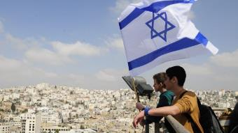
Reliability of the “Divine Regathering” Predictions
 | RETURN | PREDICTED | FULFILLED
1st | From Egypt to Canaan | Gen. 15:13-14 | Joshua 1‒12
2nd | From Babylon to Israel | Jer. 25:11; 29:10 | Ezra & Nehemiah
3rd | From the Diaspora to Israel’s restoration | Ezekiel 36:24-28 | Millennial Kingdom

Slide 25
Genesis 15:18-21
¹⁸ On that day the Lord made a covenant with Abram, saying, “To your descendants I have given this land, From the river of Egypt as far as the great river, the river Euphrates: ¹⁹ the Kenite and the Kenizzite and the Kadmonite ²⁰ and the Hittite and the Perizzite and the Rephaim ²¹ and the Amorite and the Canaanite and the Girgashite and the Jebusite.”

Slide 26
Evidence of Abrahamic Covenant’s Unconditional Nature
ANE covenant ratification ceremony (Gen 15)
Lack of stated conditions for Israel’s obedience (Gen 15)
Covenant's eternality (Gen 17:7, 13, 19; Ps. 90:2)
Covenant's immutability (Heb 6:13-18; Mal. 3:6)
Trans-generational reaffirmation despite perpetual national disobedience (Jer 31:35-37)
Walvoord, The Millennial Kingdom, 149-52

Slide 27
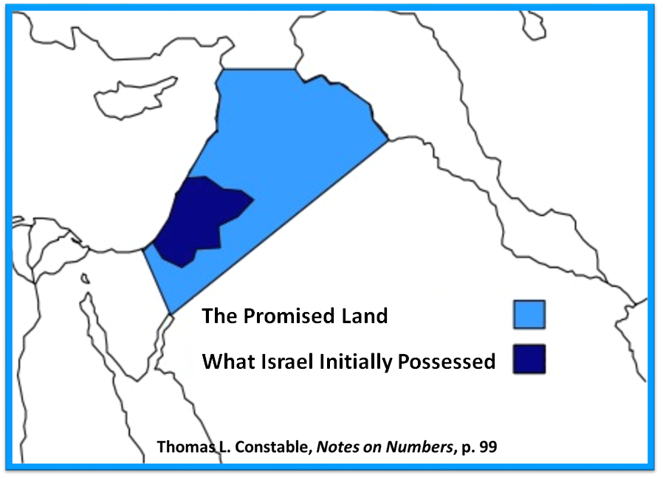

Slide 28
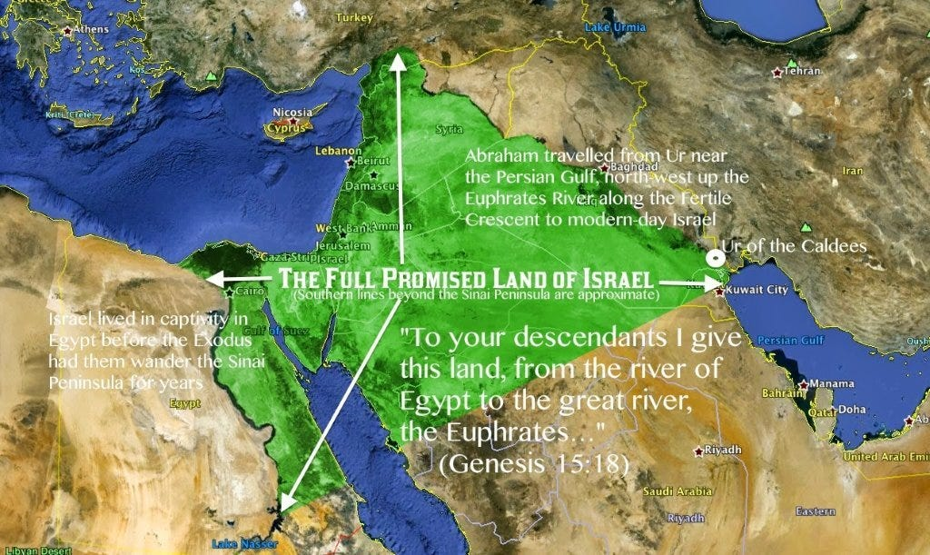

Slide 29
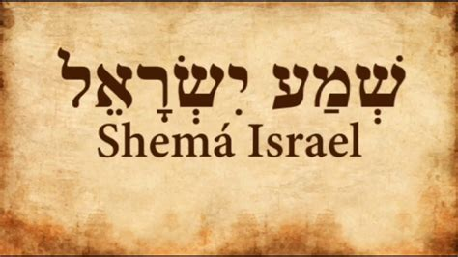
Deuteronomy 6:4-7
“⁴ Hear, Israel! The Lord is our God, the Lord is one!... ⁶ These words, which I am commanding you today, shall be on your heart. ⁷ You shall teach them diligently to your sons and shall talk of them when you sit in your house and when you walk by the way and when you lie down and when you rise up.”

Slide 30
Genesis 50:24-25 Joseph’s Charge
Prediction of his death (24a)
Prediction of return to Canaan (24b)
Oath (25)

Slide 33
IV. Genesis 50:22-26 Joseph’s Death
Joseph’s lifespan (22)
Joseph’s seed (23)
Joseph’s charge (24-25)
Joseph’s death (26)

Slide 34
Genesis 50:26 Joseph’s Death
Age (26a)
Burial (26b)

Slide 35
Genesis 50:26 Joseph’s Death
Age (26a)
Burial (26b)

Slide 36
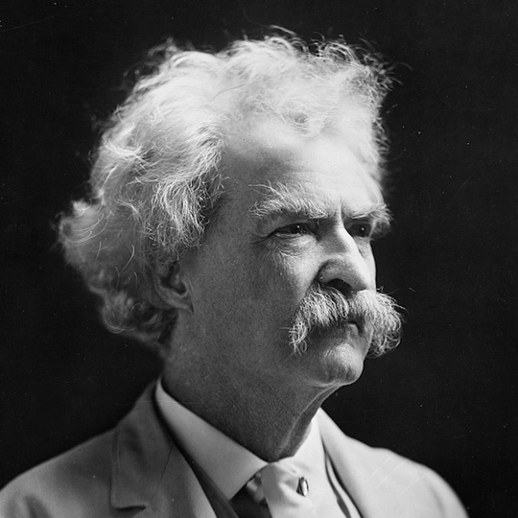
Mark Twain Autobiography, 2:37
“A myriad of men are born; they labor and sweat and struggle for bread; they squabble and scold and fight; they scramble for little mean advantages over each other. Age creeps upon them and infirmities follow; shames and humiliations bring down their prides and their vanities. Those they love are taken from them, and the joy of life is turned to aching grief. The burden of pain, care, and misery grows heavier year by year. At length ambition is dead, pride is dead, vanity is dead; longing for release is in their place. It comes at last-the only un-poisoned gift earth ever had for them-and they vanish from a world where they were of no consequence; where they achieved nothing, where they were a mistake and a failure and a foolishness; where they left no sign that they have existed – a world that will lament them a day and forget them forever.”

Slide 37
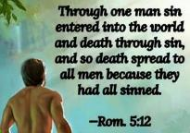
Genesis 2:16-17
“¹⁶ The Lord God commanded the man, saying, ‘From any tree of the garden you may eat freely; ¹⁷ but from the tree of the knowledge of good and evil you shall not eat, for in the day that you eat from it you will surely die (muwth).’”

Slide 38
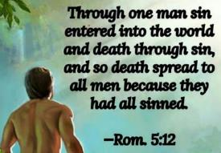
Genesis 3:19
“By the sweat of your face You will eat bread, Till you return to the ground, Because from it you were taken; For you are dust, And to dust you shall return.”

Slide 39
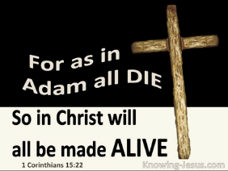
1 Corinthians 15:21-22
“²¹ For since by a man came death, by a man also came the resurrection of the dead. ²² For as in Adam all die, so also in Christ all will be made alive.”

Slide 40
Romans 5:12
“Therefore, just as through one man sin entered into the world, and death through sin, and so death spread to all men, because all sinned—.”

Slide 41
Romans 6:23
“For the wages of sin is death, but the free gift of God is eternal life in Christ Jesus our Lord.”

Slide 42
Hebrews 9:27
“And inasmuch as it is appointed for men to die once and after this comes judgment.”

Slide 43
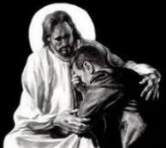
Revelation 21:4
“and He will wipe away every tear from their eyes; and there will no longer be any death; there will no longer be any mourning, or crying, or pain; the first things have passed away.”

Slide 45
Genesis 50:26 Joseph’s Death
Age (26a)
Burial (26b)

Slide 46
Conclusion

Slide 47
IV. Genesis 50:22-26 Joseph’s Death
Joseph’s lifespan (22)
Joseph’s seed (23)
Joseph’s charge (24-25)
Joseph’s death (26)

Slide 48
²⁴ The Lord bless you, and keep you; ²⁵ The Lord make His face shine on you, And be gracious to you; ²⁶ The Lord lift up His countenance on you, And give you peace.
Numbers 6:24–26 (NASB95)

